Slide 1
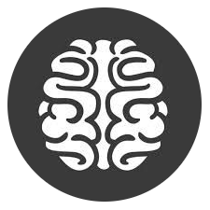
Phoenix AI & ML

Slide 2
Grow Neural Networks
(like Nature intended)

Slide 3

“There’s a whole ocean of data!!”
(Don’t be a megalomaniac)
A psychopathological condition characterized by delusional fantasies of wealth, power, or omnipotence originating from the utilization of Deep Learning

Slide 4
Neuroevolution IRL
Controlling Robots (RL)
Controlling Video Game Agents (RL)
Evolving Visual Artwork
Evolving Music
Generating new content in Video Games
Most accurate mass estimate of the top quark, in the Tevatron particle accelerator
Resilient to continual and dynamic fluctuations

Slide 5
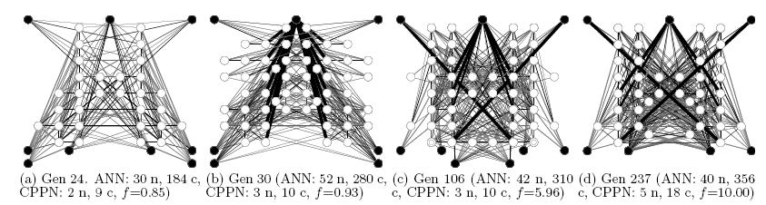
NEAT Evolved Networks
No backprop!

Slide 6
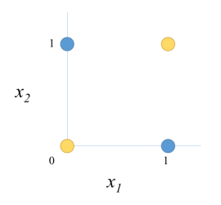
XOR Example
0 xor 0 = 0
0 xor 1 = 1
1 xor 0 = 1
1 xor 1 = 0

Slide 7
Brief Structure
Data
Encoding
Algorithm
Fitness!

Slide 8
Neuroevolution of
Augmenting Topologies
(NEAT)
Genome Encoding
Phenome Instantiation
Fitness Measurement
Crossover (Sex)
Speciation + Death
Mutation

Slide 9
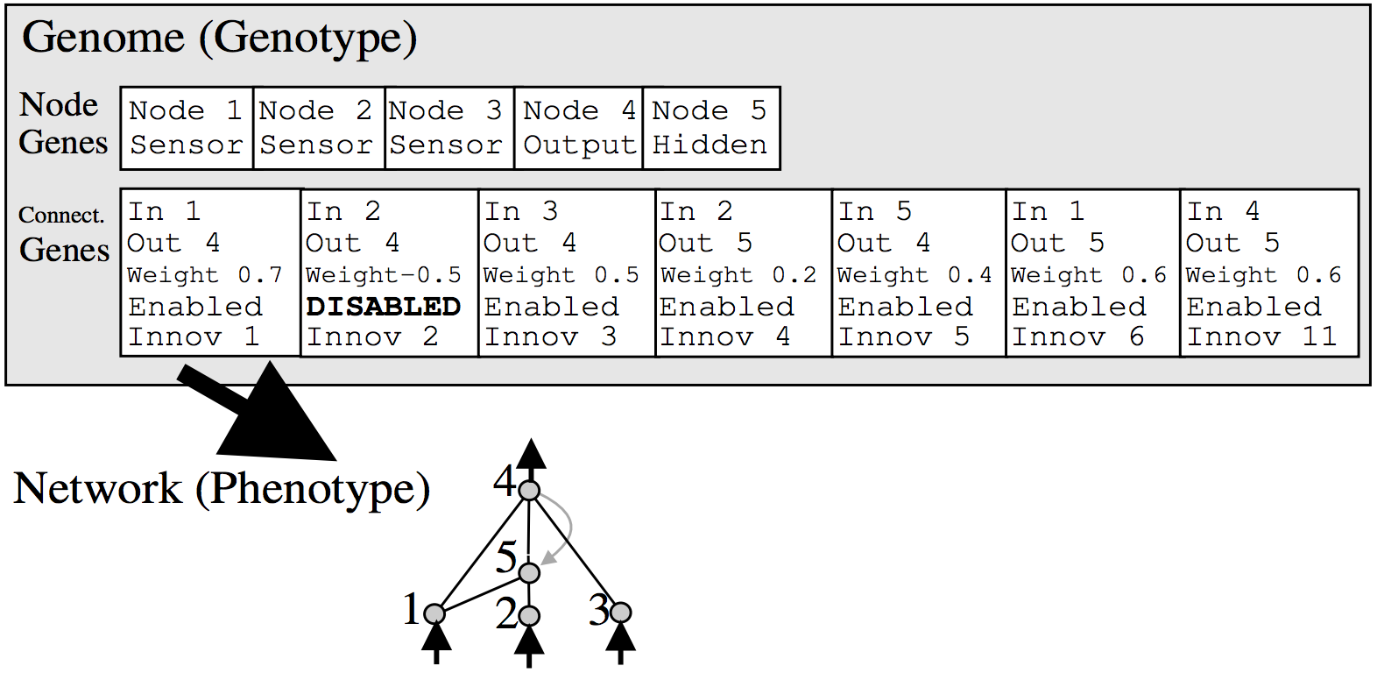
Genome Encoding
(Genetic Programming)

Slide 10
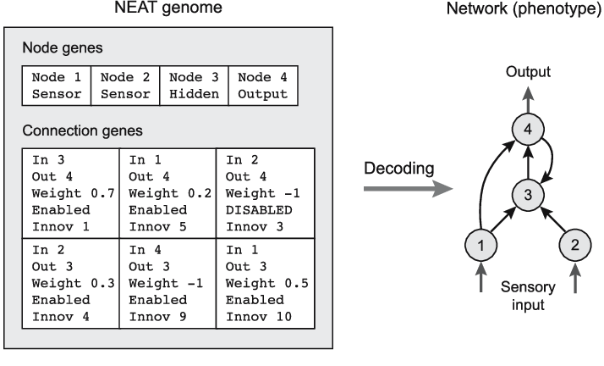
Phenome Instantiation
Neural Network

Slide 11
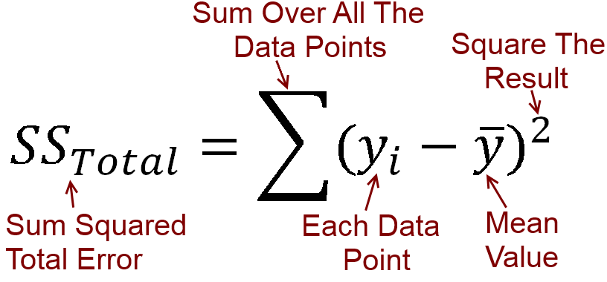
Fitness
(SSE works nicely)
The ultimate goal of your NEAT Networks:
Maximize Fitness!

Slide 12
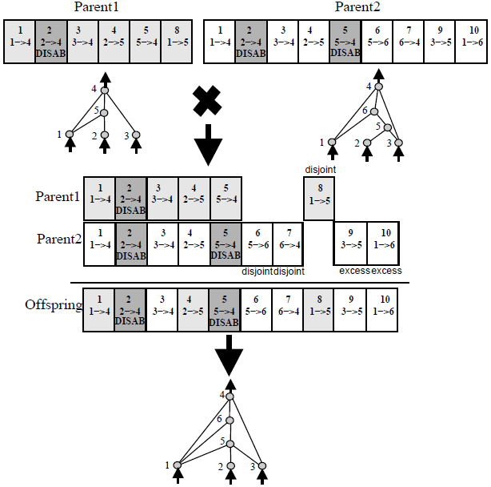
Crossover
(Sex)

Slide 13
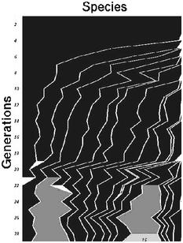

Speciation
Split Genomes into different species
Match genes by innovation #
Linear combination:
Disjoint and Excess Genes
Gene similarity
δ = Compatibility Threshold
N = # of Genes in matching Genome
W = Matching Genes including disabled
E = Excess Genes D = Disjoint Genes
C1,C2,C3 = Controllable Weights

Slide 14
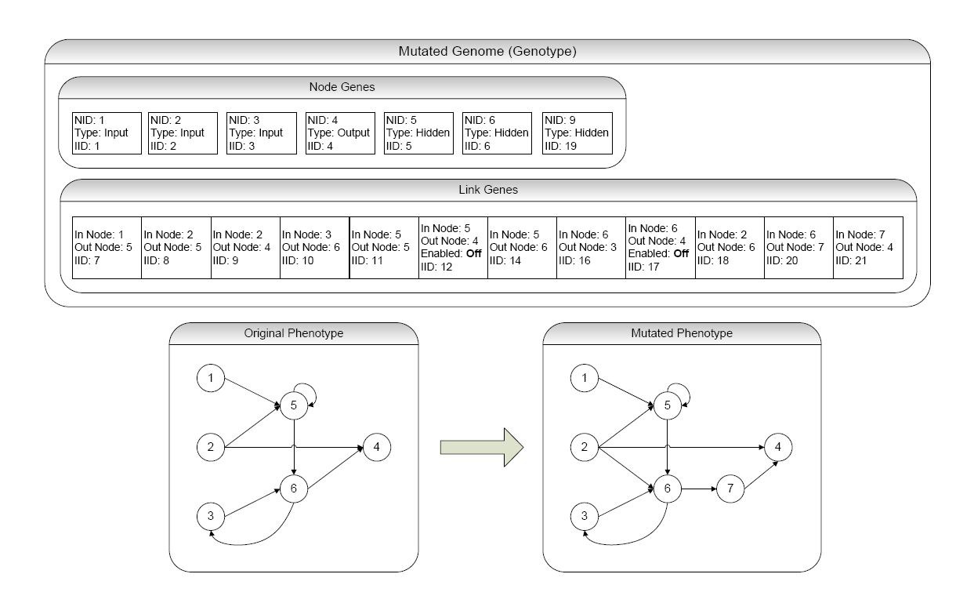
Mutation
(Complexification)

Slide 15
NEAT Lifecycle
Genome
Phenome
Mutation
Fitness
Speciation
Crossover

Slide 16
The grand aim of science
is to cover the greatest number of experimental facts
by logical deduction
from the smallest number of hypotheses or axioms.
- Albert Einstein

