Slide 1

Phoenix AI & ML

Slide 2
Workshop
Neural Network Fundamentals

Slide 3
What is a Neural Network?
Linear vs Non-Linear
Simple Neural Network
The Phase Transition
Universality of a Neural Net

Slide 4
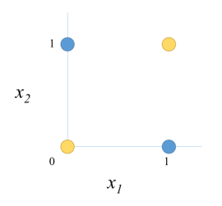
Linear vs Non-Linear
0 xor 0 = 0
0 xor 1 = 1
1 xor 0 = 1
1 xor 1 = 0

Slide 5
Simple Neural Network
[DEMO]

Slide 6
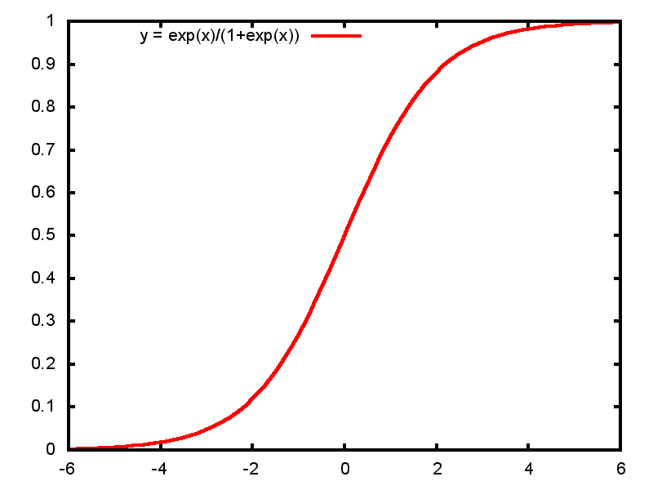
The Phase Transition

Slide 7
The universe is a vast
symphony of phase transitions:
Nothing can grow without limit!

Slide 8
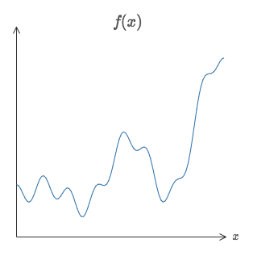
The Universality of a Neural Network
Approximate any bound continuous function!
f(x) = 0.2 + 0.4x^2 + 0.3xsin(15x) + 0.05cos(50x)

