Slide 1

What is HTML?
Rick : HTML is the content and structure of a webpage Morty.
Summer : It’s like the only thing that really matters

Slide 2
Your first webpage
Morty: Ah Geez Rick. What does HTML look like?
Rick: Burrrp. Let me show you.. Let me show you
<html>
<body>
<h1>Hello Infinite Timelines</h1>
</body>
</html>

Slide 3

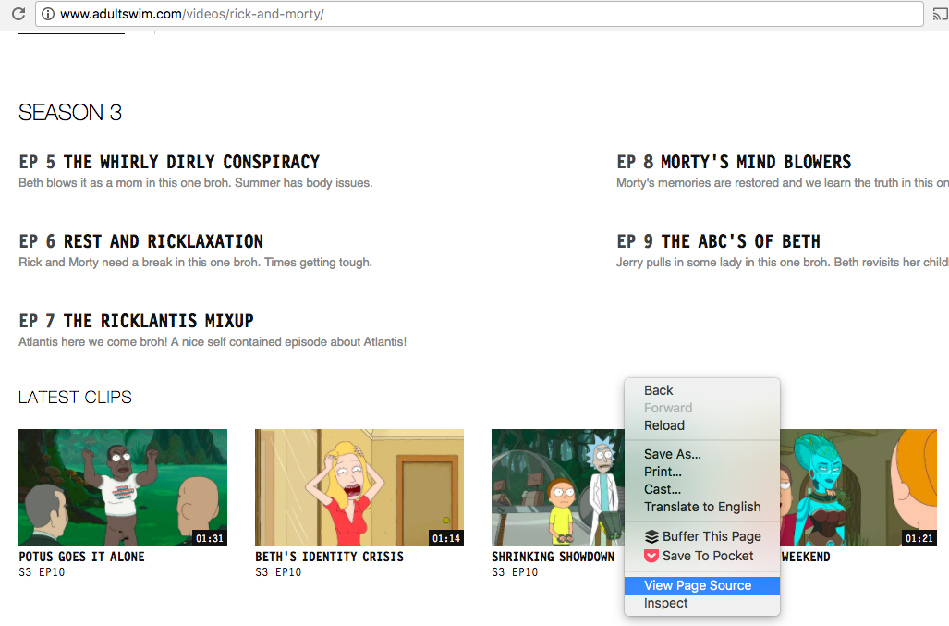
Check out the code behind Adult Swim’s website?

Slide 4
Down the HTML rabbit hole?
Rick: Pay attention Morty! I don’t have time to do this myself and school is wasting your time. Burrrp.
What we are covering:
Tags
Elements Attributes

Slide 5
Let’s Get Schwifty with Tags
Rick: I like to think of tags as Jerry next to me. Every tag starts with a “less than” sign and ends with a “greater than” sign. I can prove it mathematically!
<html> <! - - HTML tag - ->
<body> <! - - body tag - ->
<h1>Hello Infinite Timelines!</h1> <! - - H1 tags, one opening and one closing - ->
</body>
</html>

Slide 6
HTML tags are more simple than your dad’s brain
Rick: Listen here Morty. There are opening tags and closing tags. Closing tags have a backslash before the tag name. You got it? This is very important it might save your life someday or even get you a date with Jessica
Morty: Really?
Rick: Of course not Morty. Geez. You can build a better Jessica with this.

Slide 7
HTML elements are more valuable than a cloud that farts gold
Rick: HTML elements are made up by the opening and closing tags. Kind of like that stupid ant idiot from Vindicators has the super power of being left out crumbs
<html>
<body>
<h1>Hello Infinite Timelines</h1>
</body>
</html>
Some consist of just a self-closing tag
<img src=“http://Vindicators4.jpg">

Slide 8
Basic HTML elements
Rick: These HTML elements are basic like multiverse cable
<html> defines an HTML document
<head> defines info about the document
<title> defines a title for the document
<body> defines the document body
<h1> to <h6> defines HTML headings
<p> defines a paragraph
<br> inserts a line break

Slide 9
Other important HTML elements
<img> defines an image
<section> defines a section in a document
<div> another way to define a section in a document
<a> defines a hyperlink
<ul> <li> / <ol><li> defines unordered or ordered list
<button> defines a button
<table> defines a table
<video> defines a video

Slide 10
HTML attributes and fractal dust
Rick: Morty did you touch my fractal dust?! Anyway. HTML attributes set properties on an element. Put them in the opening tag Morty so I don’t have to clean up .
<a href=“https://blitzandchips.com">Party Roy</a> href is an attribute for setting the destination of a link
<h1 class=“ricksanchez”>The most Rick of Ricks</h1>
class won’t show up in the rendered webpage, but will be important when we start talking about CSS
<h1 id=“evilmorty”>The only risk to Rick C-137</h1>
id also won’t show up in the rendered webpage, but will be important when we start talking about CSS

Slide 11
Let’s Get Riggity Wrecked with CSS?
Jerry: Beth? Where are all the pretty colors on this website?
Beth: Jerry it obviously is missing CSS. Cascading Style Sheets? What makes a webpage not look like just text??? Don’t you ever listen?

Slide 12
What the hell is CSS?
Rick: Why are you in bed Morty?!
Key concepts:
Selectors
Property
Value
Declaration / Declaration block

Slide 13
Schwifty Example
h3 {
color: red;
background-color: #FFDF00 /* Cromulon Yellow */
font-size: 36px;
font-family: futura
}

Slide 14
CSS selectors are like portal destinations
Rick: CSS selectors are kind of like when we set a destination on the portal gun. Except HTML elements are the target instead of the lame planets you like to go to:
p selects all paragraph tags
.header selects HTML elements with the header class
#portalnav selects HTML elements with the portalnav ID
p.header selects paragraph tags with the header class
Selectors can be combined.

Slide 15
Show Me What You Got! CSS Properties
Rick: CSS properties are the shiz! They determine what appearance you set…
color determines the font color
font-family sets the type style
background-image sets a background image for an element
animation shorthand for all animation props
margin shorthand for all margin properties

Slide 16
Get Schwifty with CSS Values
Rick: Each property has a set of values Morty. It’s like the greatest choose your own adventure novel!
color: pink, light blue, #CCCCCC acceptable color values
font-family: helvetica, arial, sans-serif acceptable font-family values
background-image: url("imageFile.jpg") URL value points to a file location
height: 10px 75% acceptable height values can be a percentage or length

Slide 17
Wicked CSS example
.jessica {
height: 95%;
background-image: url(“dreamgirl.jpeg”);
color: tan;
text-decoration: underline;
}

