Slide 1

What is HTML?
Rick : HTML is the content and structure of a webpage Morty.
Summer : It’s like the only thing that really matters

Slide 2
Your first webpage
Morty: Ah Geez Rick. What does HTML look like?
Rick: Burrrp. Let me show you.. Let me show you
<html>
<body>
<h1>Hello Infinite Timelines</h1>
</body>
</html>

Slide 3

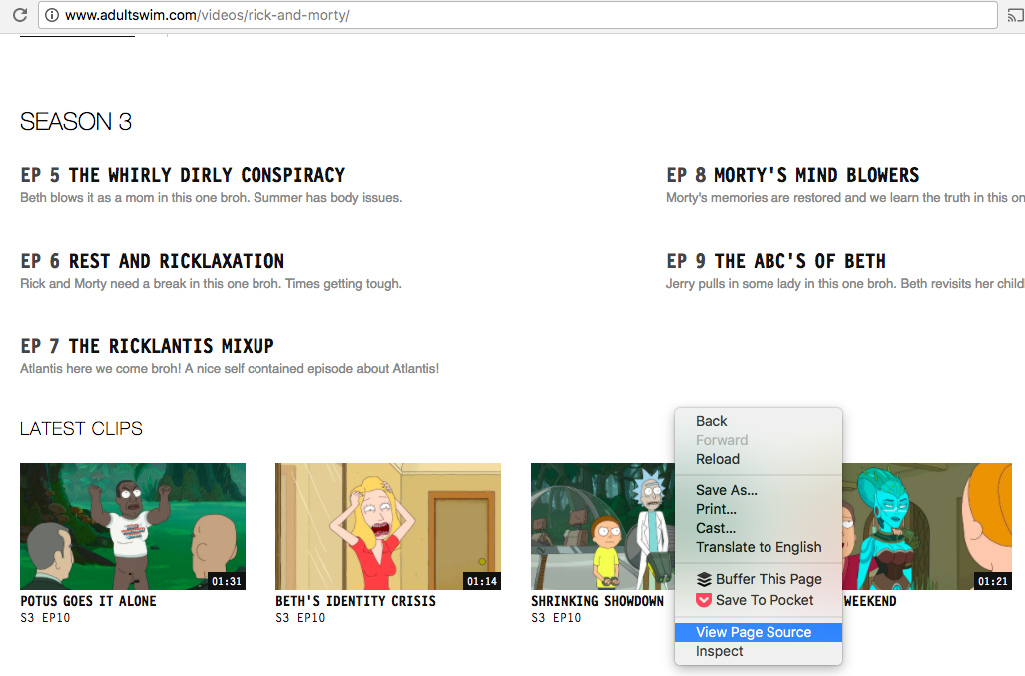
Check out the code behind Adult Swim’s website?

Slide 4
Down the HTML rabbit hole?
Rick: Pay attention Morty! I don’t have time to do this myself and school is wasting your time. Burrrp.
What we are covering:
Tags
Elements Attributes

Slide 5
Let’s Get Schwifty with Tags
Rick: I like to think of tags as Jerry next to me. Every tag starts with a “less than” sign and ends with a “greater than” sign. I can prove it mathematically!
<html> <! - - HTML tag - ->
<body> <! - - body tag - ->
<h1>Hello Infinite Timelines!</h1> <! - - H1 tags, one opening and one closing - ->
</body>
</html>

Slide 6
HTML tags are more simple than your dad’s brain
Rick: Listen here Morty. There are opening tags and closing tags. Closing tags have a backslash before the tag name. You got it? This is very important it might save your life someday or even get you a date with Jessica
Morty: Really?
Rick: Of course not Morty. Geez. You can build a better Jessica with this.

Slide 7
HTML elements are more valuable than a cloud that farts gold
Rick: HTML elements are made up by the opening and closing tags. Kind of like that stupid ant idiot from Vindicators has the super power of being left out crumbs
<html>
<body>
<h1>Hello Infinite Timelines</h1>
</body>
</html>
Some consist of just a self-closing tag
<img src=“http://Vindicators4.jpg">

Slide 8
Basic HTML elements
Rick: These HTML elements are basic like multiverse cable
<html> defines an HTML document
<head> defines info about the document
<title> defines a title for the document
<body> defines the document body
<h1> to <h6> defines HTML headings
<p> defines a paragraph
<br> inserts a line break

Slide 9
Other important HTML elements
<img> defines an image
<section> defines a section in a document
<div> another way to define a section in a document
<a> defines a hyperlink
<ul> <li> / <ol><li> defines unordered or ordered list
<button> defines a button
<table> defines a table
<video> defines a video

Slide 10
HTML attributes and fractal dust
Rick: Morty did you touch my fractal dust?! Anyway. HTML attributes set properties on an element. Put them in the opening tag Morty so I don’t have to clean up .
<a href=“https://blitzandchips.com">Party Roy</a> href is an attribute for setting the destination of a link
<h1 class=“ricksanchez”>The most Rick of Ricks</h1>
class won’t show up in the rendered webpage, but will be important when we start talking about CSS
<h1 id=“evilmorty”>The only risk to Rick C-137</h1>
id also won’t show up in the rendered webpage, but will be important when we start talking about CSS

Slide 11
Let’s Get Riggity Wrecked with CSS?
Jerry: Beth? Where are all the pretty colors on this website?
Beth: Jerry it obviously is missing CSS. Cascading Style Sheets? What makes a webpage not look like just text??? Don’t you ever listen?

Slide 12
What is CSS?
Key concepts: Selectors Property Value
Declaration / Declaration block
Two problems we solve with CSS: Presentation of specific elements Layout

Slide 13
CSS Example
h1 {
color: red;
font-size: 36px;
}

Slide 14
CSS Selectors
CSS selectors determine which HTML elements are targeted for specific styles:
p This selects all paragraph tags
.header This selects HTML elements with the class “header”
#navigation This selects HTML elements with the ID navigation
p.header This selects paragraph tags with the header class
Selectors can be combined.

Slide 15
CSS Properties
CSS properties determine what about the appearance you’re setting:
color This determines the font color
font-family This lets you set the typeface as well as backup typefaces
background-image This lets you set a background image for an element
height This lets you set the height of an element

Slide 16
CSS Properties
Each property has a default value for a given element. When you write CSS, you over-ride that default value with a new value.

Slide 17

CSS Values
Each property has a set of acceptable values that you can set:
color: red, blue, green, #CCCCCC These are all acceptable values for the color property
font-family: helvetica, arial, sans-serif These are all acceptable values for the font-family property
background-image: url("imageFile.jpg") This property looks for a URL value that points to a specific image file
height: 40px 50% Height can be set as an explicit width or as a percentage of the containing box

Slide 18

CSS Example
This is a declaration block, containing two declarations:
h1 {
color: red;
font-size: 36px;
}

Slide 19
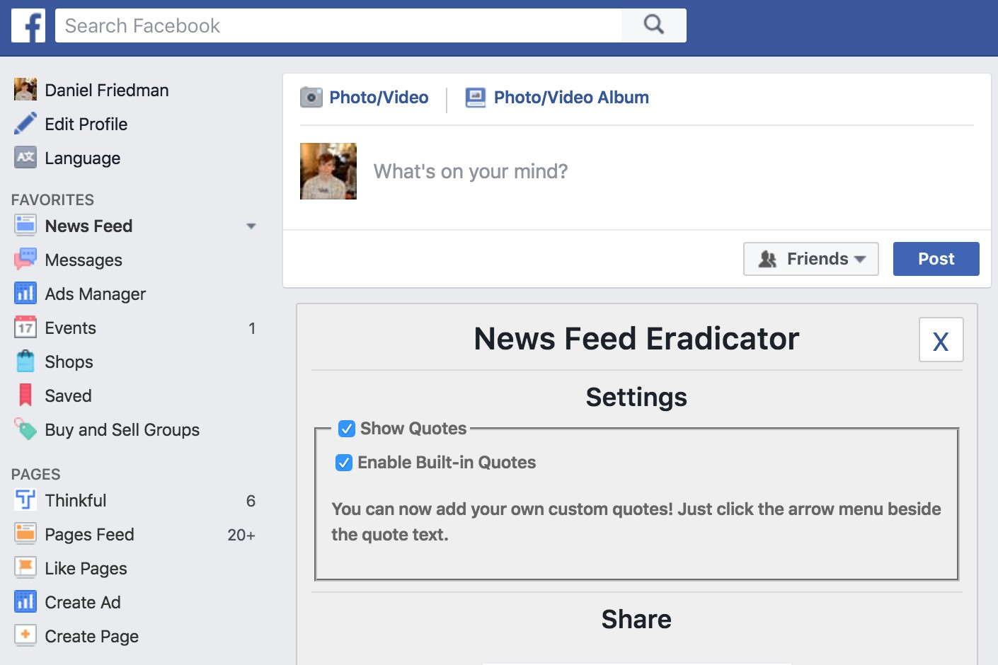
CSS Layout
CSS layout determines how elements are arranged around each other. For example, Facebook wrote styles to make the nav bar stick to the top, have the pages and favorites section on the left and the news feed run in the center:

