Slide 1
search experiments
Christopher Irvine (100036248)

Slide 2
Overview
Indexing System
Stemming
Retrieval System
TF*IDF
Weighting
Evaluation
Improvements

Slide 3
Indexing System
Overview
Stemming
Cleaned scraped text
Separated Titles and Headers
Saved first 30 tokens
Stemmed Tokens
Generated Vocabulary
Created Postings Table
Saves every 100 documents
4 possible stemmers
Indexed first 500 pages
Compared vocabularies
Lemmatizer was most accurate
BUT did least stemming

Slide 4
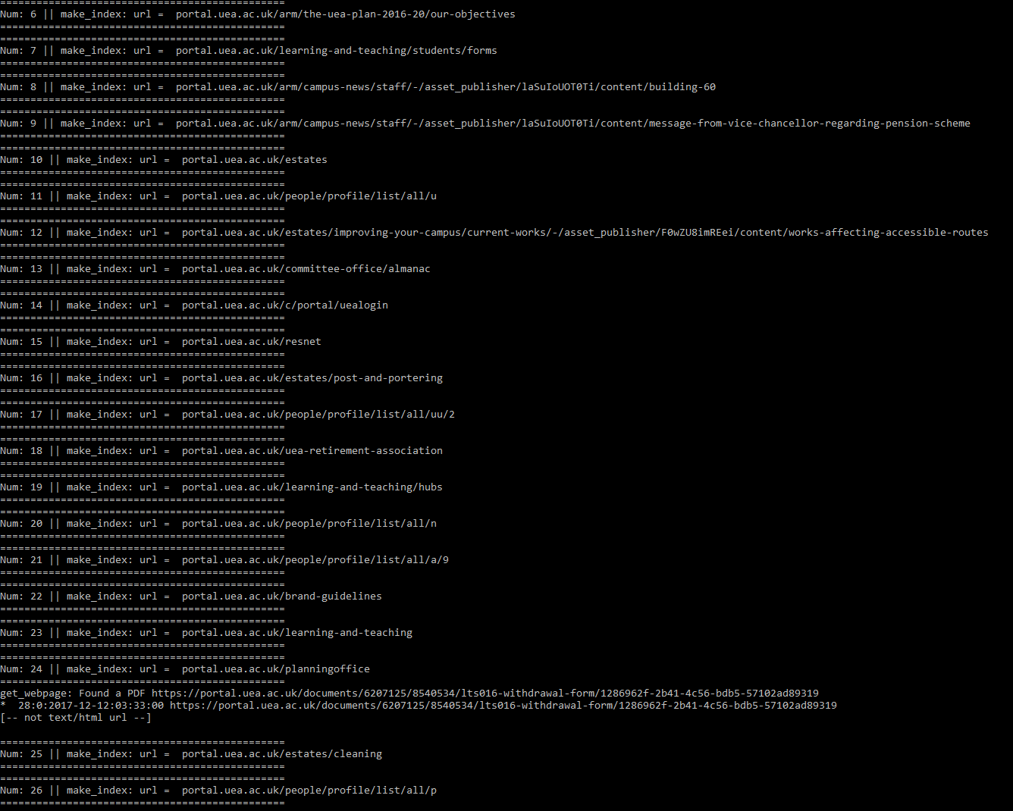
Indexing output:

Slide 5
Retrieval System
TF*IDF
Weighting
Query cleaned using same method
Inverse Document Frequency for each term
Retrieve TF from postings
Calculate total score for each document
Results sorted so highest first and presented
Title == x2.5
Header == x1.5
First 30 == x.175
Meta was not consistently used

Slide 6
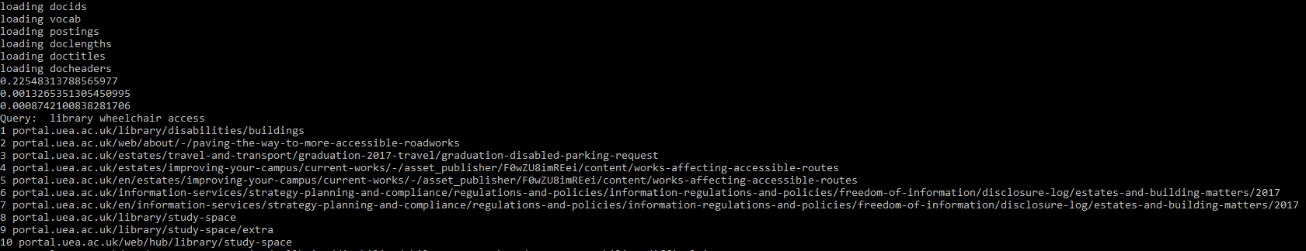
Retrieval Output:
Loads in documents
Gives the relevance of each of the terms
Prints results
Snippets excluded from command line print out for simplicity

Slide 7
Evaluation
Initial Improvements
Stemming
Weighting
Overall System Performance
Further improvements
Methodology inspiration from “Stemming algorithms: A case study for detailed evaluation” by David A Hull

Slide 8
Evaluation Methodology
Comparing Systems
Investigating Queries
Generated base corpus
Same Search Query for all systems
Multifaith centre opening times
Generated graphs to compare system performance
Priority of returning relevant documents
Only examined top 10 documents
Test set of top 100 documents
Deeper investigation
Looked into
Stemming Issues
Named Entity Issues
Consistency

Slide 9
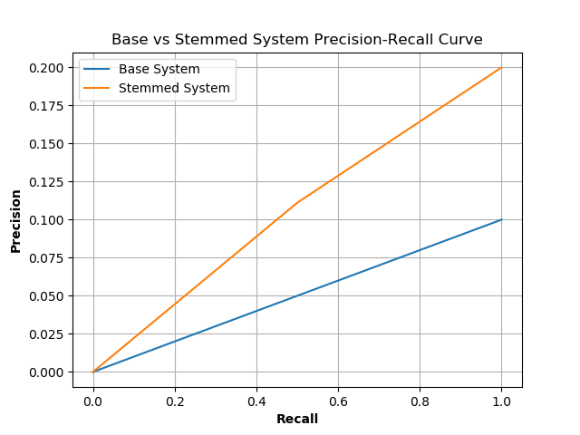
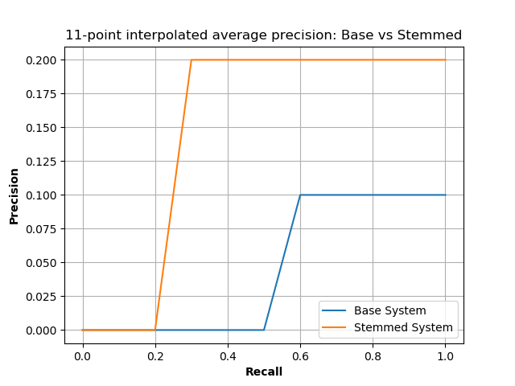
Stemming vs Base System
Stemming improved accuracy, but only marginally
Brought relevant documents towards top of list

Slide 10
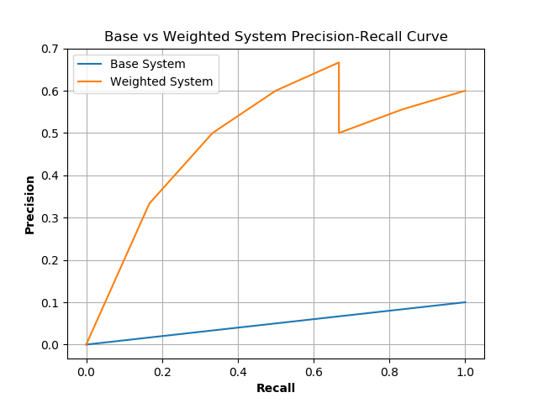
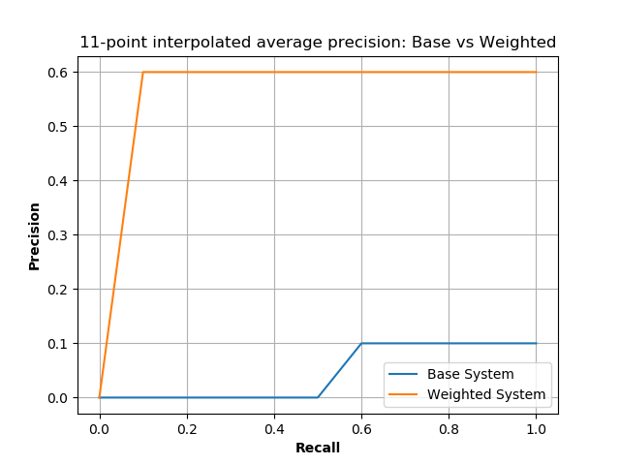
Weighting vs Base System
Weighting yielded significant improvement
Slight drop in accuracy, but acceptable
Brought relevant documents to top

Slide 11
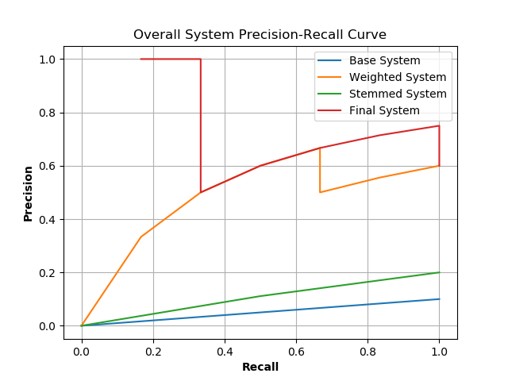
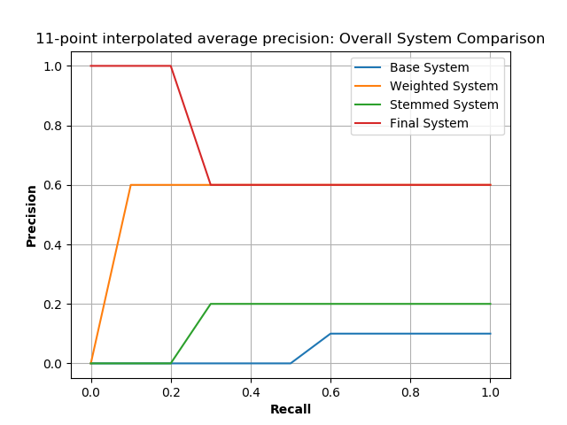
Overall System Comparison
Final System incorporates Weighting and Stemming
Significantly better at start
Fell and plateaued at Weighted level

Slide 12
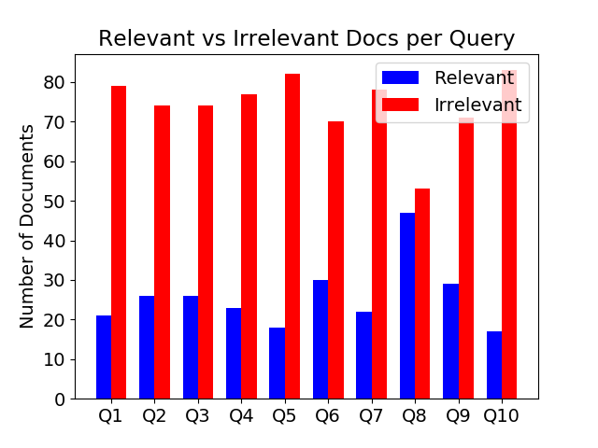
Overall System Performance
 | Q1 | Q2 | Q3 | Q4 | Q5 | Q6 | Q7 | Q8 | Q9 | Q10 | Average
Average Precision Value (3 sf) | 0.321 | 0.692 | 0.598 | 0.494 | 0.691 | 0.935 | 0.945 | 0.929 | 0.206 | 0.148 | 0.638
Table 1: Average Precision Value for each Query and for entire system
Average system accuracy is good
Worst Queries: Q1, Q5 Q10
Inaccurate Queries: Q5, Q6
Best Queries: Q2, Q3, Q7, Q8

Slide 13
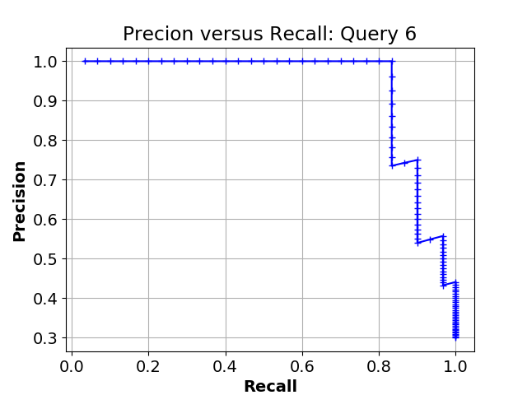
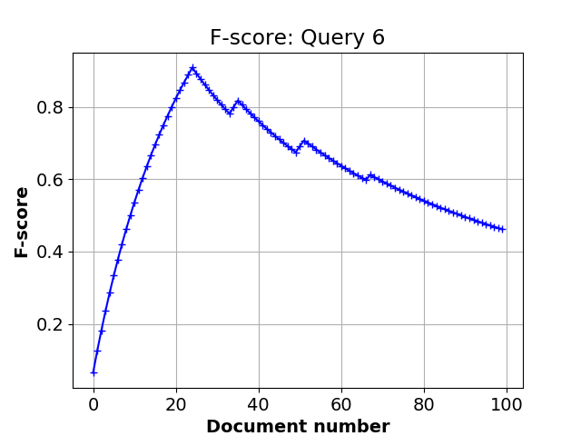
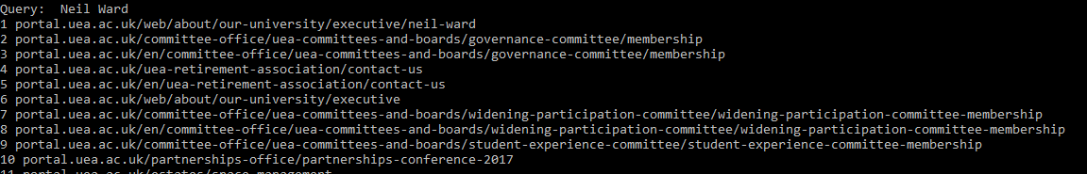
What happened to Q5? (1) Search Term: Neil Ward
Search Term was “Neil Ward”
Graphs are as expected
But looking into retrieved documents…

Slide 14
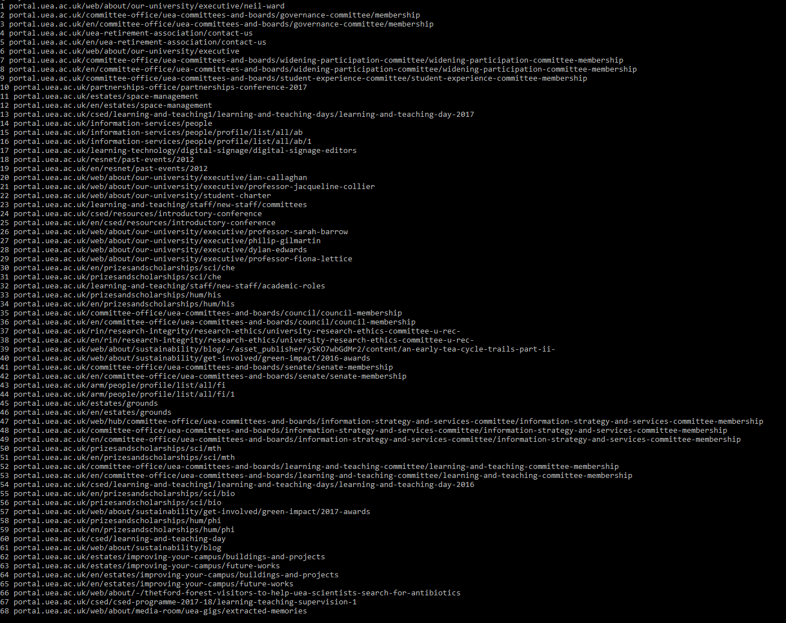
What happened to Q5? (2) Search Term: Neil Ward
Every arrow = another Neil
System believed it was accurate
But first 6 are accurate
For a user that is enough

Slide 15
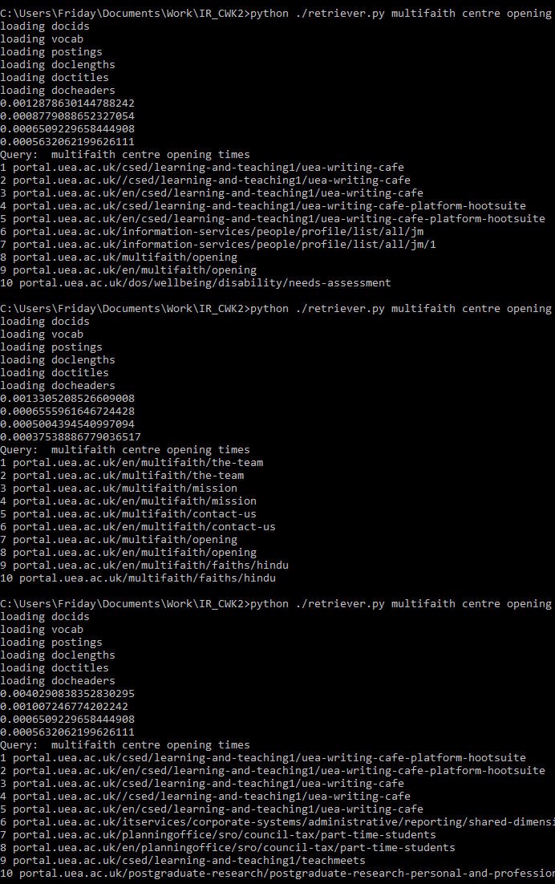
Future Improvements
Q5 Investigation suggested that:
Named Entity Recognition can benefit the system
Relevance and User Feedback can also be implemented
A Graphical User Interface (GUI) to assist the User:
Identify relevant documents
Snippets
Rate the quality of the search
Report Issues
Consistency is an outstanding issue…

Slide 16
Conclusions
The Developed System
Indexing with Stemming and Weighting (preparation)
Retrieval with Weighting and TF*IDF
Benefits of Stemming and Weighting to System
Proved work well in combination
Investigated why Q5 results were poor quality
Named Entity Recognition
Future Improvements to Developed System

Slide 17
References
Hull, DAH, 1996. Stemming algorithms: A case study for detailed evaluation. Journal of the American Society for Information Science (JASIS), 47, 70-84.

Slide 18
Thank you for listening
Do you have any questions?

