Slide 1
Much ado about everything
The configuration management story
Christopher A Irvine
100036248

Slide 2
Contents
What is Configuration Management
Definition
History
The 5 Functions of Configuration Management
Using Configuration Management
In the Office & at Home
Cost-Benefit Analysis

Slide 3
What is configuration management?
Definition
History

Slide 4
Defining Configuration management
Collection of…
Principles
Techniques
Characteristics
Control the execution of a project
Consistency throughout all tasks
Executed by the Project Management
“Configuration Management encompasses the administrative activities concerned with the creation, maintenance, controlled change and quality control of the scope of work”
- Association for Project Management¹

Slide 5
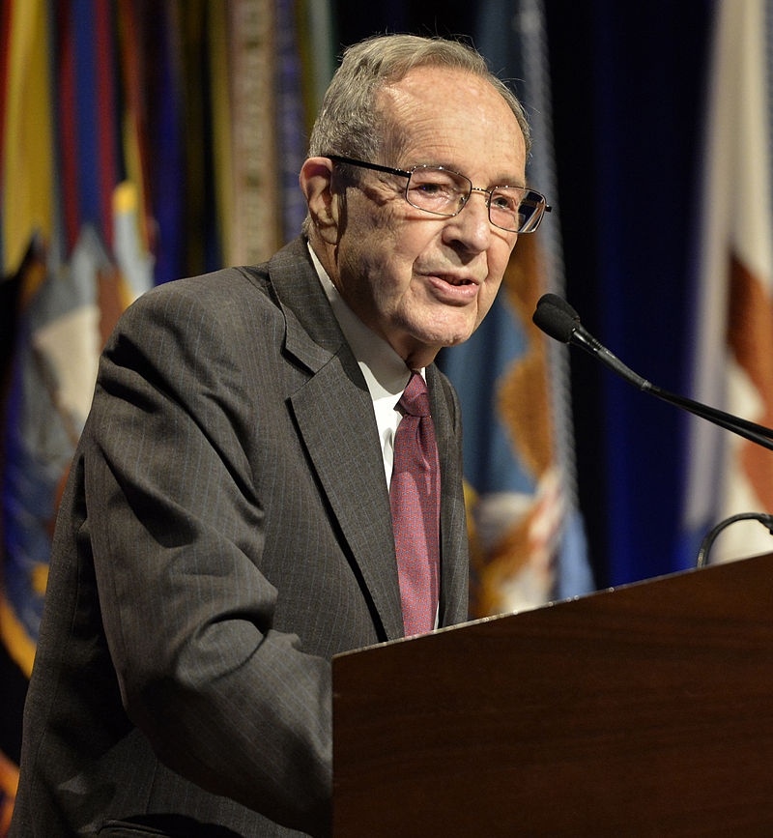
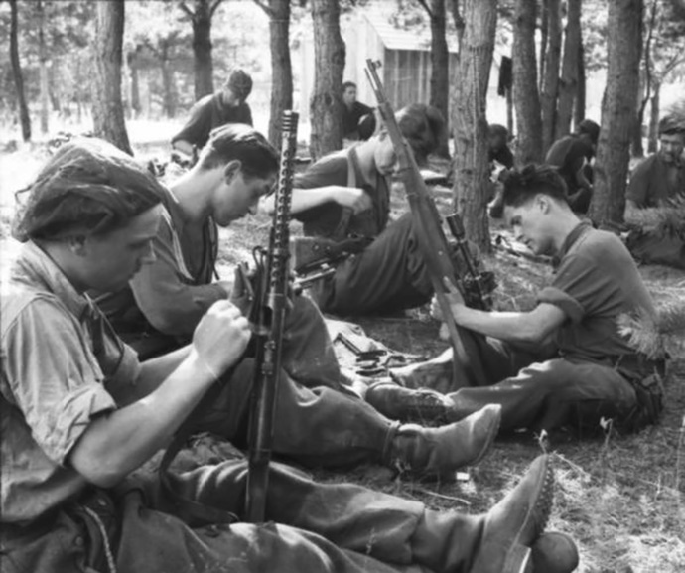
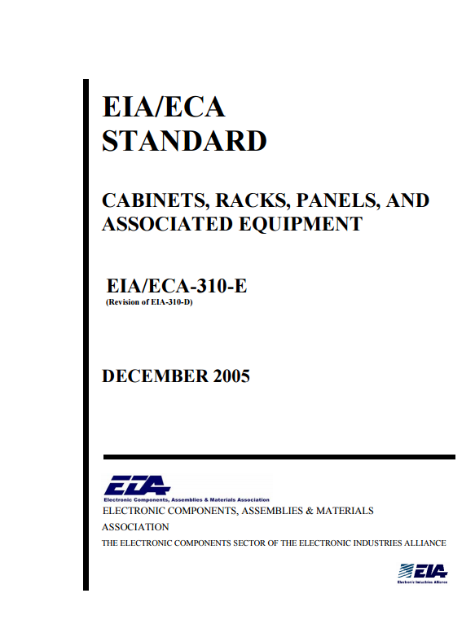


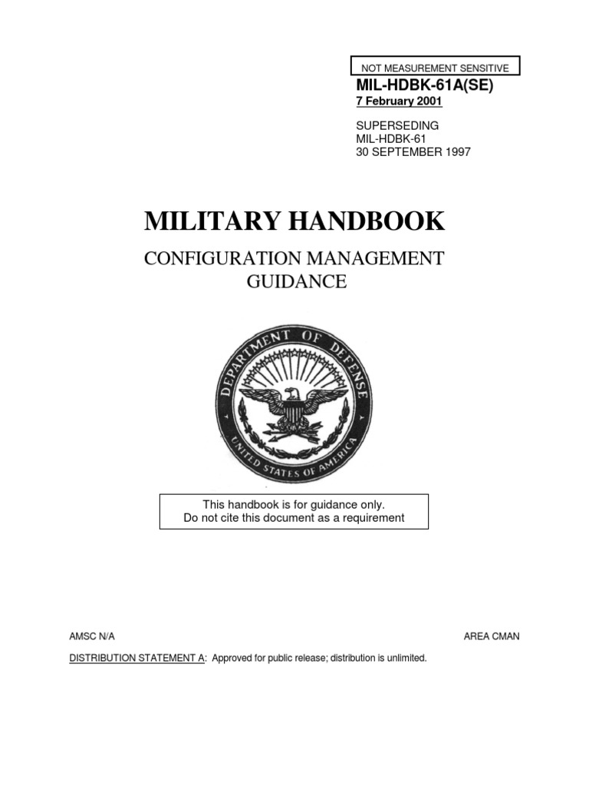
History of configuration management
3
2
5
7
6
4
1940s-50s
Late 90s
Today
1980s-90s

Slide 6
References
Association for Project Management (2017). Configuration Management
Dickson, S. (2015). 10 Important Guns of WWII. The Vintage News
Fawcett, Glenn (2015). U.S. Department of Defence

