Slide 1
Much ado about everything
The configuration management story
Christopher A Irvine
100036248

Slide 2
Contents
What is Configuration Management
Definition
History
The 5 Functions of Configuration Management
CM Planning and Management
Using Configuration Management
In the Office & at Home
Cost-Benefit Analysis

Slide 3
What is configuration management?
Definition
History
Functions
Software configuration management

Slide 4
Defining Configuration management
Collection of…
Principles
Techniques
Characteristics
Control the execution of a project
Consistency throughout all tasks
Executed by the Project Management
“Configuration Management encompasses the administrative activities concerned with the creation, maintenance, controlled change and quality control of the scope of work”
- Association for Project Management¹

Slide 5


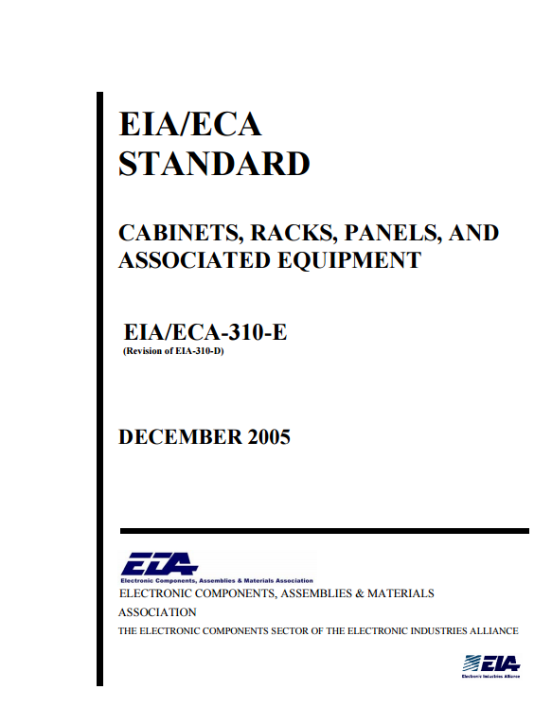
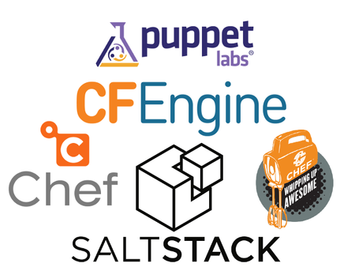

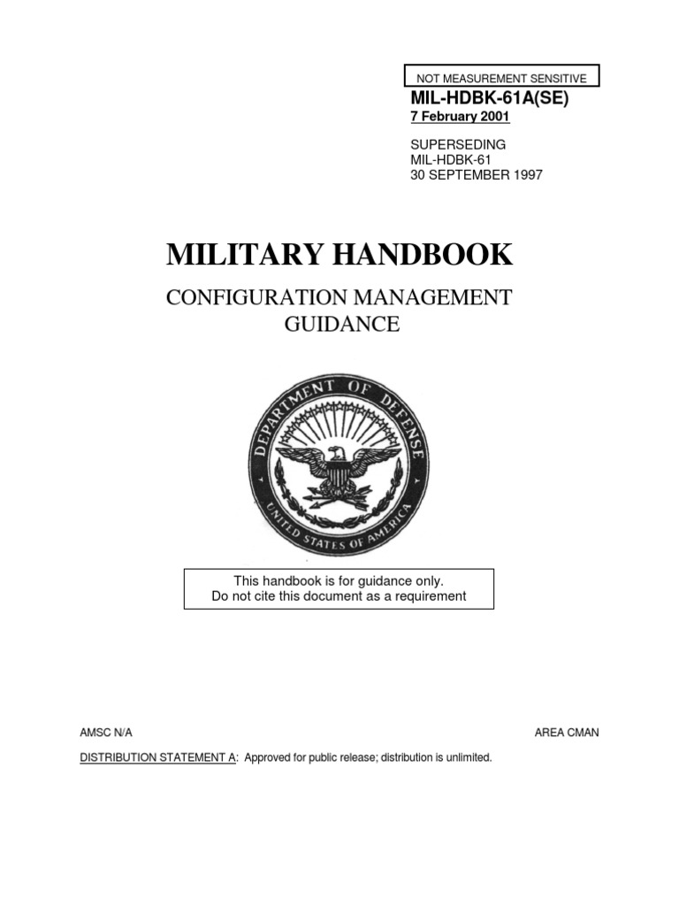
History of configuration management
3
2
5
7
6
4
1940s-50s
Late 90s
Today
1980s-90s

Slide 6
The 5 functions of configuration management
CM Planning and Management
Configuration Identification
Configuration Control
Change Status and Accounting
Configuration Verification & Audit

Slide 7
CM Planning and Management
Formal document outlining processes required for the project:
Personnel
Responsibilities & Resources
Training
Administrative meeting guidelines
Baselining resources
Configuration Control & Status Accounting
Naming Conventions
Audits & reviews
Subcontractor/Vendor CM Requirements

Slide 8
Software configuration management (SCM)
Adapted from traditional CM
Greater emphasis on tracking changes
Design Document largely replaces CM Planning and Management function
Configuration Identification
Configuration Change Control
Configuration Status Accounting
Configuration Audits

Slide 9
Using configuration management
In the office
(S)CM tools
At home

Slide 10
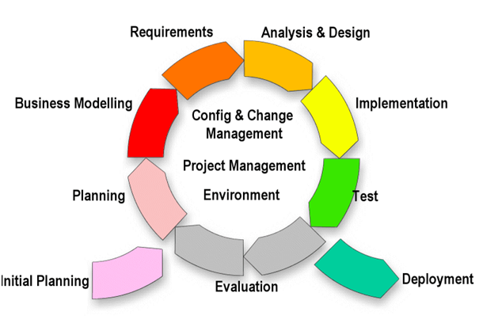
in the office
8
Each function of CM produces a formal document
Change reports, functionality audits, configuration accounts
Reports ensure that CM is carried out
CM follows iterative development life cycles
For example: in software projects think:
Change reports = GitHub commit and pull request comments
Audits = Trello and CodeShip reports

Slide 11
(S)CM Tools
Many options for Tools and Services to manage CM
Automated
Artificial Intelligence & Machine Learning
Removes the need for dedicated Configuration Manager
9

Slide 12
At home
Many CM techniques are used in home life
Lists
Filing Conventions
Can we increase the use of CM at home?
Some may consider further use as “overkill”
But CM in the home increases efficiency
Down to the individual homemakers

Slide 13
Costs & Benefits of Configuration Management

Slide 14
Benefits of (S)CM
Increases
Efficiency
Team Communication (internal and external)
Decreases tasks complexity
Ability to track changes and issues from start to finish

Slide 15
Costs of (S)CM
Financial & Time costs:
Configuration, Project, Resource Managers salaries
Licenses for tools
Time needed to complete CM reports
Checking work done by CM tools
Risks
Increased complexity
Confusing paper trails
Arguments

Slide 16
Summary
CM is a series of processes that help manage a project
(S)CM produces a paper trail giving the ability to track project accurately
CM is used both in the Office and at Home
We can (and should) increase the use of CM in our homes
Many tools are available to manage CM for you
But all CM requires time and money, and when done incorrectly it can harm a project

Slide 17
References
Association for Project Management (2017). Configuration Management
Dickson, S. (2015). 10 Important Guns of WWII. The Vintage News
Fawcett, Glenn (2015). U.S. Department of Defence
MIL-HDBK-61A(SE) Configuration Management Guidance (2001). U.S. Department of Defence
EIA/ECA-310 Cabinets, Racks, Panels and Associated Equipment (2005). EIA
INTIS Logo (2018). International Committee for Information Technology Standards
A Guide to Open Source Cloud Computing Software (2014). Bryant, Christian
Configuration Management Life-Cycle Diagram (2014), BusinessProDesigns

