Slide 1
MAI 5100: Fundamentals of AI
Week 2: Problem Solving by Searching
Dr. Christopher Clarke · University of Guyana · 31 October 2026

Slide 2
Announcements
Homework 0 (Search) is released today on GitHub: hw/hw0
  Due Saturday, 21 November, 11:59 PM Guyana time
  Pac-Man Q1–Q3 (DFS, BFS, UCS) use today’s material; A* and heuristics follow on 14 November
No class next Saturday (7 November)
Next lecture (14 November): informed search, heuristics, and A*
Reading: Russell & Norvig, Chapter 3.1–3.4

Slide 3
Recap: Week 1
AI as designing rational agents: act to maximize expected utility
An agent perceives its environment through sensors and acts through actuators
Properties of the environment (observable? deterministic? static? discrete?) determine which techniques fit
Today’s setting: fully observable, deterministic, static, discrete, single agent
  In this setting, an agent can find a whole plan by searching before it acts

Slide 4
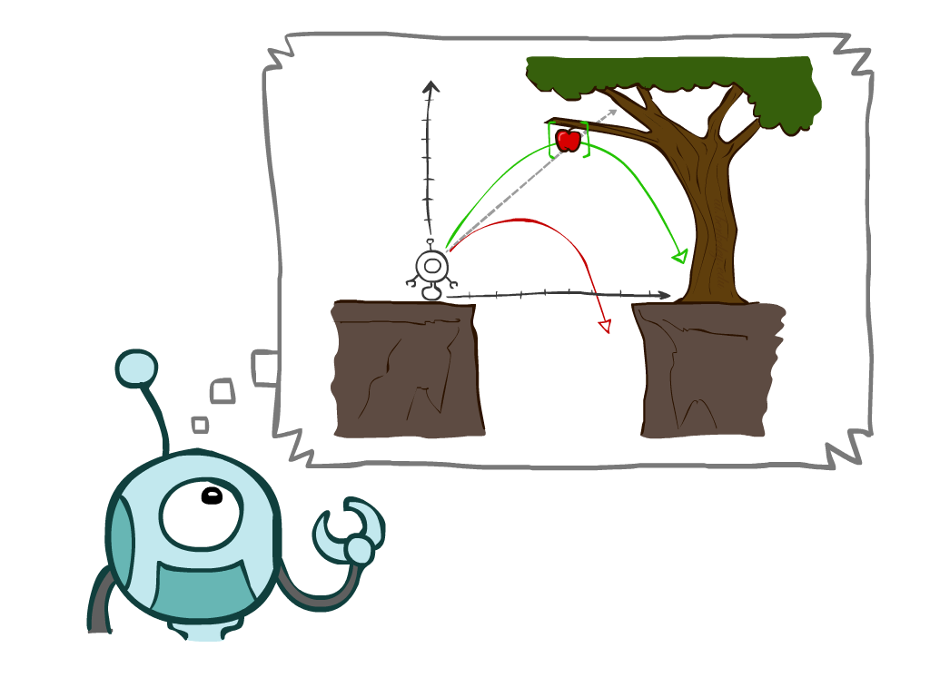
Today
Intelligent agents: rationality, PEAS, environments, agent types
Agents that plan ahead
Search problems (worked example: water jugs)
Uninformed search methods, each with a step-by-step worked example
  Depth-first search
  Breadth-first search
  Iterative deepening
  Uniform-cost search
Practice problem and Homework 0
Notes:
General theme in the class:
A goal we have in mind.
A mathematical abstraction to formalize this
Algorithms that operate on these abstractions

Slide 5
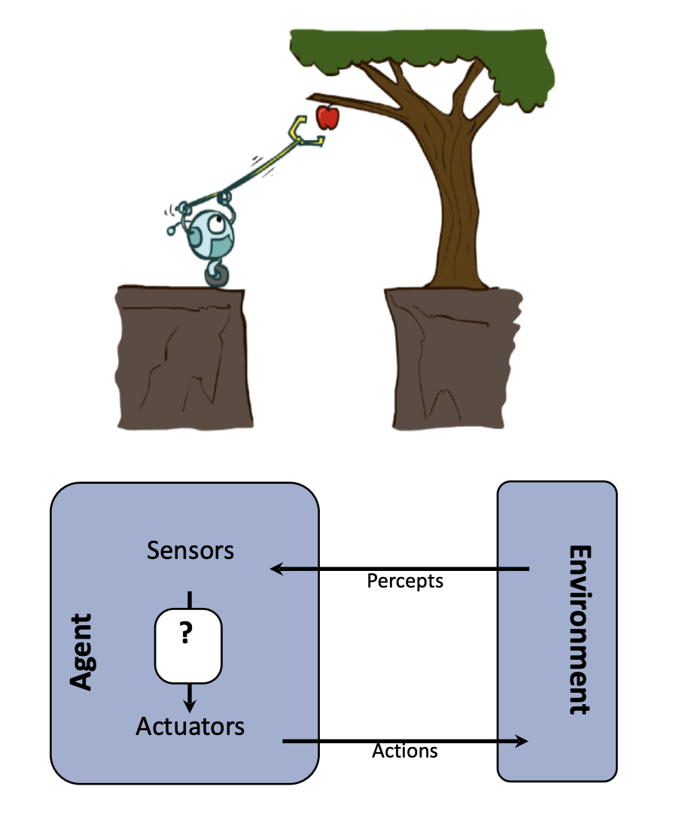
Intelligent Agents
An agent is anything that perceives its environment through sensors and acts on it through actuators
  Physical: robots, self-driving cars, drones
  Software: chatbots, recommender systems, game AI, trading bots
The agent function maps the percept history to an action
The agent program implements that function on a real machine
Designing an agent means understanding the task, the environment, and the actions available

Slide 6
Good Behavior: The Concept of Rationality
A rational agent chooses the action that is expected to maximize its performance measure, given:
  what it has perceived so far (the percept sequence)
  what it knows about the environment
  the actions it can perform
Rational ≠ omniscient: it maximizes expected performance, not actual outcome
Rational ≠ perfect: agents should gather information and learn when they can
The performance measure defines success. Choose it carefully: reward what you want achieved, not how you think the agent should behave

Slide 7
Specifying the Task Environment: PEAS
Before designing an agent, describe its task environment.
Example: an automated taxi
P
Performance measure
How do we judge success?
Safe, fast, legal, comfortable trip; maximize profit
E
Environment
Where does the agent operate?
Roads, traffic, pedestrians, weather, passengers
A
Actuators
How does it act?
Steering, accelerator, brake, signals, horn, display
S
Sensors
How does it perceive?
Cameras, lidar, radar, GPS, speedometer, odometer

Slide 8
PEAS Examples
Agent | Performance | Environment | Actuators | Sensors
Medical diagnosis system | Healthy patient, lower costs | Patient, hospital, staff | Display of questions, tests, diagnoses, treatments | Touchscreen or voice entry of symptoms and findings
Crop-monitoring drone | Early pest detection, area covered, battery use | Farms, weather, crops, livestock | Rotors, camera gimbal, alerts to farmers | Cameras, multispectral sensor, GPS, altimeter
Pac-Man agent | Score: eat food, avoid ghosts, finish fast | Maze, food pellets, ghosts | Move N, S, E, W, or Stop | Game state: positions of walls, food, ghosts
Customer-support chatbot | Issues resolved, customer satisfaction, cost | Customers, product data, ticket system | Text replies, ticket updates, hand-off to a human | Customer messages, account records
Quick exercise: write the PEAS description for a GPS navigation app used in Georgetown traffic.

Slide 9
Properties of Task Environments
Property | Question to ask | Example
Fully vs. partially observable | Can the sensors see the complete relevant state? | Chess vs. poker
Deterministic vs. stochastic | Is the next state completely determined by the current state and action? | Chess vs. weather forecasting
Episodic vs. sequential | Does the current decision affect future decisions? | Spam filter vs. chess
Static vs. dynamic | Can the world change while the agent is deliberating? | Crossword vs. stock market
Discrete vs. continuous | Are states, time, and actions countable? | Chess vs. robot navigation
Single vs. multi-agent | Are other agents acting in the environment? | Crossword vs. soccer
The hardest case: partially observable, stochastic, sequential, dynamic, continuous, multi-agent (e.g. driving a taxi).

Slide 10
Classify These Environments
Task | Observable | Deterministic | Episodic | Static | Discrete | Agents
Chess
Poker
Stock market
Robot navigation
Email spam filter
Soccer
8-puzzle
Work with a neighbour for 5 minutes, then we fill it in together.

Slide 11
Classify These Environments: Answers
Task | Observable | Deterministic | Episodic | Static | Discrete | Agents
Chess | Fully | Deterministic | Sequential | Static | Discrete | Multi
Poker | Partially | Stochastic | Sequential | Static | Discrete | Multi
Stock market | Partially | Stochastic | Sequential | Dynamic | Continuous | Multi
Robot navigation | Partially | Stochastic | Sequential | Dynamic | Continuous | Single
Email spam filter | Partially | Stochastic | Episodic | Static | Discrete | Single
Soccer | Partially | Stochastic | Sequential | Dynamic | Continuous | Multi
8-puzzle | Fully | Deterministic | Sequential | Static | Discrete | Single
Several answers are debatable: what matters is the reasoning. The 8-puzzle row is the setting for today’s search algorithms.

Slide 12
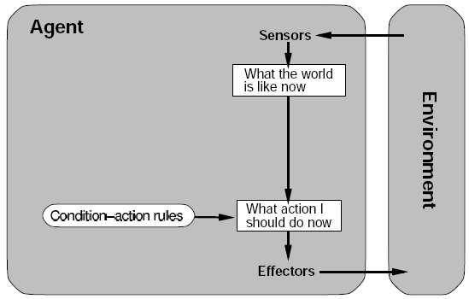
Types of Agents: Simple Reflex
Choose an action using only the current percept and condition–action rules
  “If the car in front is braking, then brake”
Simple and fast, but only works if the environment is fully observable
Example: a thermostat; a spam filter keyed on a list of banned words

Slide 13
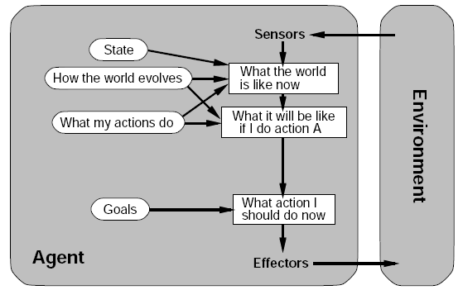
Model-Based and Goal-Based Agents
Model-based reflex: keep an internal state that tracks the parts of the world it cannot currently see
  Needs a model of how the world evolves and what its actions do
Goal-based: ask “what will happen if I do action A?” and pick actions that reach a goal
  This is where search and planning come in: today’s topic
Example: a navigation app planning a route to your destination

Slide 14
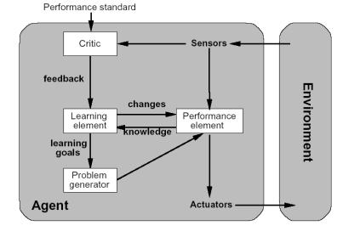
Utility-Based and Learning Agents
Utility-based: goals are not enough when there are trade-offs. A utility function scores how good each outcome is
  A self-driving car balancing safety, speed, and comfort
Learning agents improve with experience:
  Critic gives feedback against a performance standard
  Learning element updates the agent; problem generator suggests exploration
Course roadmap: goal-based (search) → utility-based (MDPs) → learning (RL, ML)

Slide 15
Problem-Solving Agents
When the right action is not obvious, a goal-based agent must plan ahead: consider a sequence of actions that leads to a goal
Such an agent is a problem-solving agent; the computation it does is search
We assume the environment is fully observable, deterministic, static, discrete, and known
  Then a solution is simply a fixed sequence of actions
Four steps: formulate the goal → formulate the problem → search for a solution → execute it

Slide 16
Agents that Plan

Slide 17
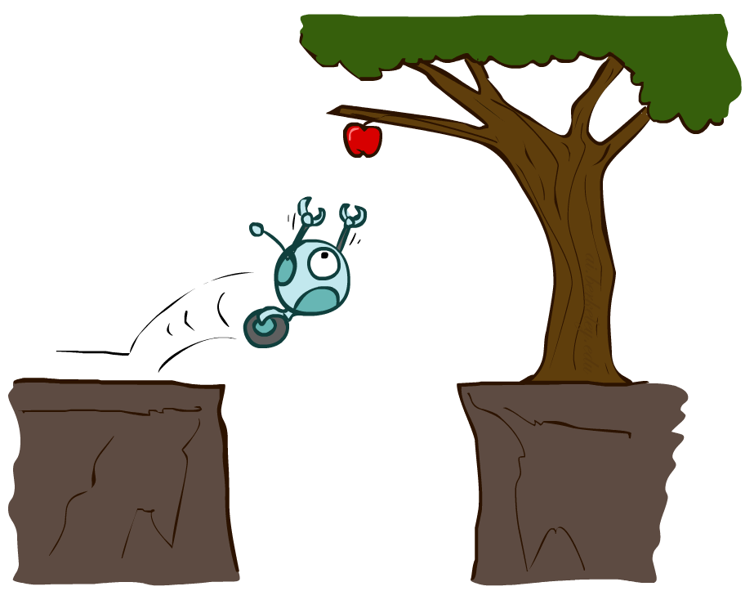
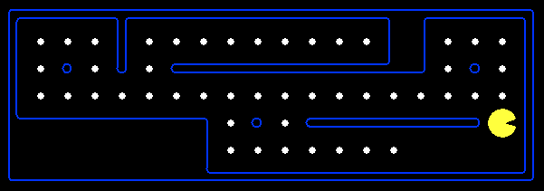
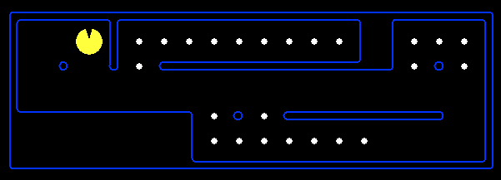
Reflex Agents
Reflex agents:
  Choose action based on current percept (and maybe memory)
  May have memory or a model of the world’s current state
  Do not consider the future consequences of their actions
  Consider how the world IS
Can a reflex agent be rational?
[Demo: reflex optimal (L2D1)]
[Demo: reflex optimal (L2D2)]
Notes:
Examples: blinking your eye (not using your entire thinking capabilities), vacuum cleaner moving towards nearest dirt

Slide 18
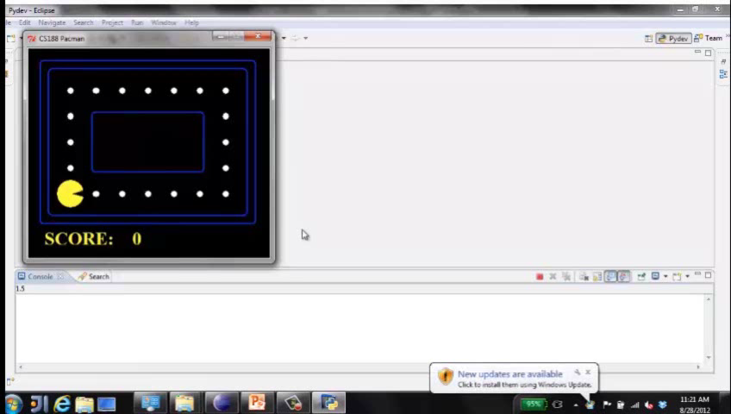
Video of Demo Reflex Optimal

Slide 19
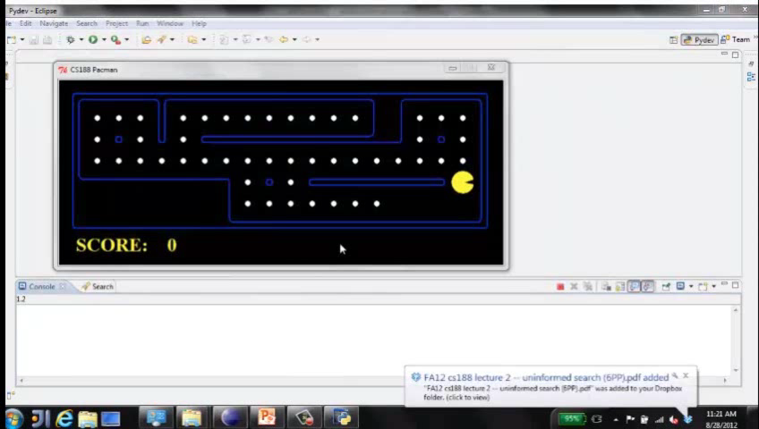
Video of Demo Reflex Odd

Slide 20
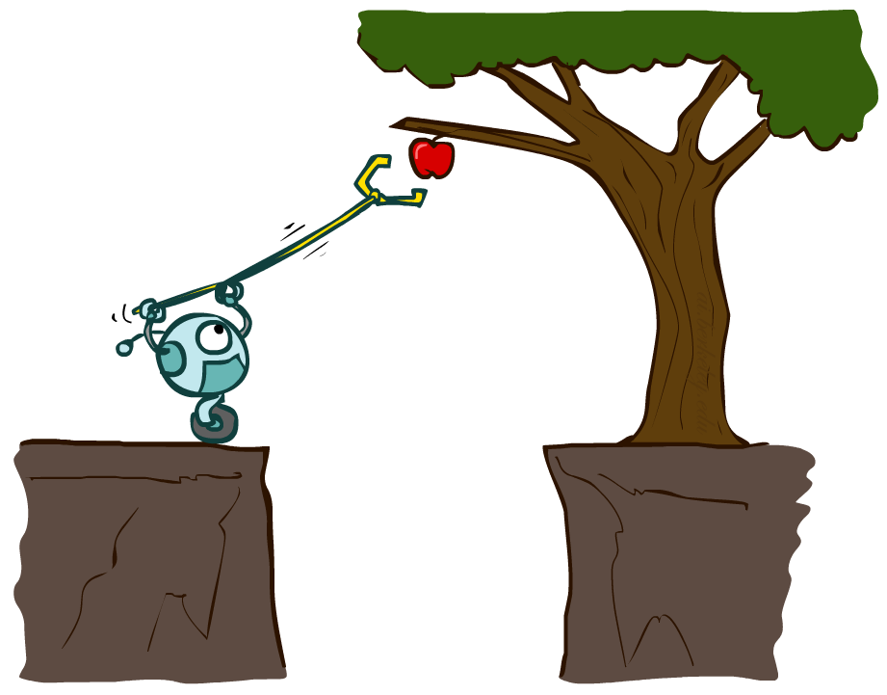
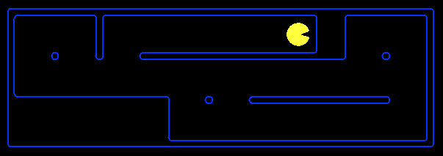
Planning Agents
Planning agents:
  Ask “what if”
  Decisions based on (hypothesized) consequences of actions
  Must have a model of how the world evolves in response to actions
  Must formulate a goal (test)
  Consider how the world WOULD BE
Optimal vs. complete planning
Planning vs. replanning
[Demo: replanning (L2D3)]
[Demo: mastermind (L2D4)]

Slide 21
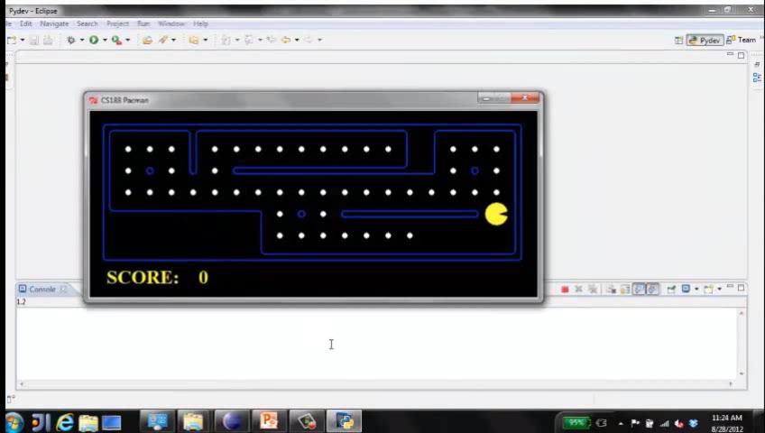
Video of Demo Replanning

Slide 22
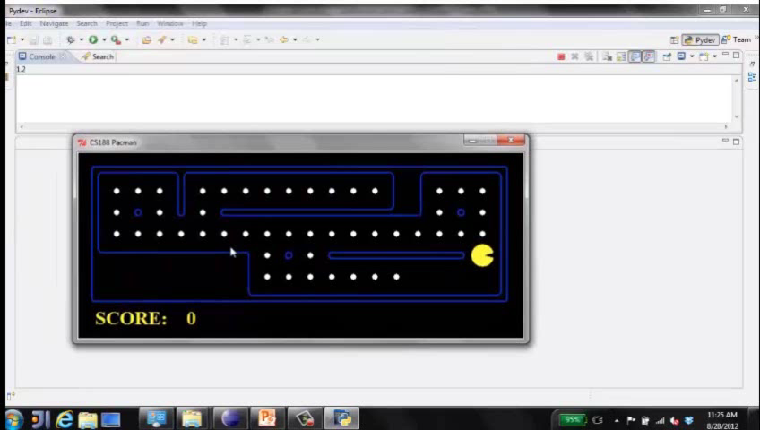
Video of Demo Mastermind

Slide 23
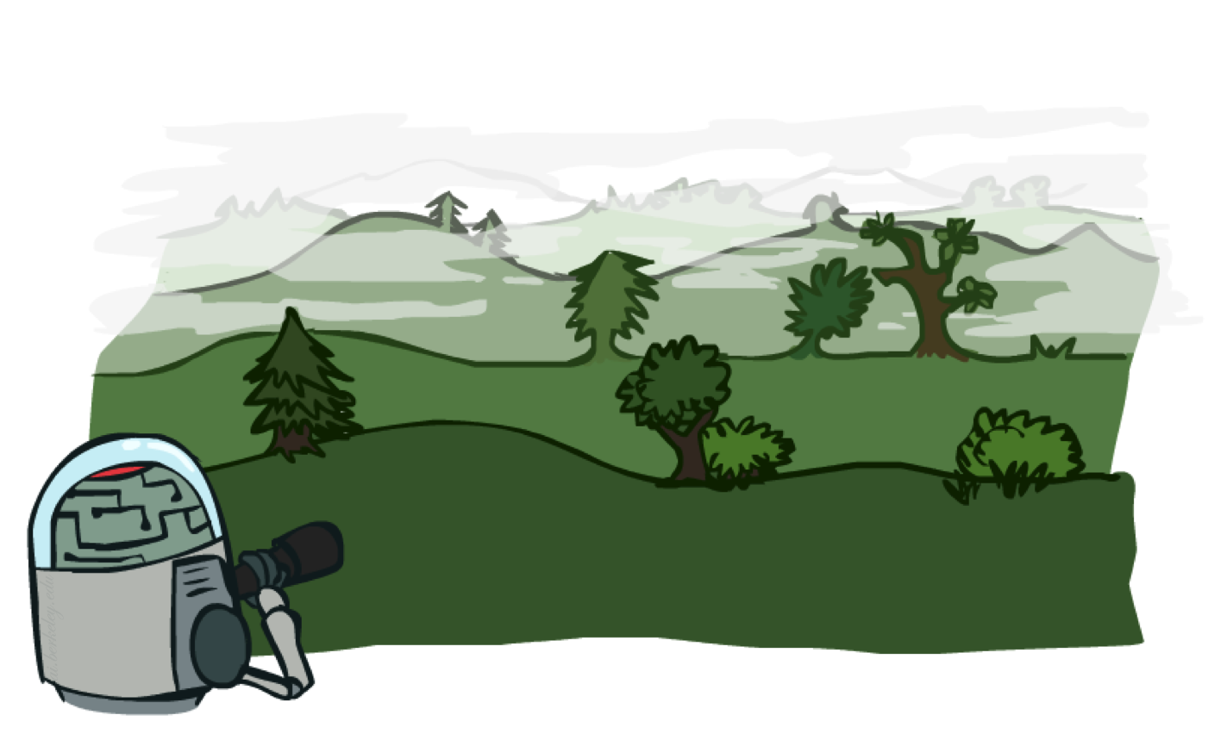
Search Problems

Slide 24

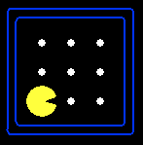





Search Problems
A search problem consists of:
  A state space
  A successor function
  (with actions, costs)
  A start state and a goal test
A solution is a sequence of actions (a plan) which transforms the start state to a goal state
“N”, 1.0
“E”, 1.0
Notes:
Often comes back on exams
Goal test – sometimes more than one state that satisfies having achieved the goal, for example, “eat all the dots”
Abstraction

Slide 25

Search Problems Are Models

Slide 26
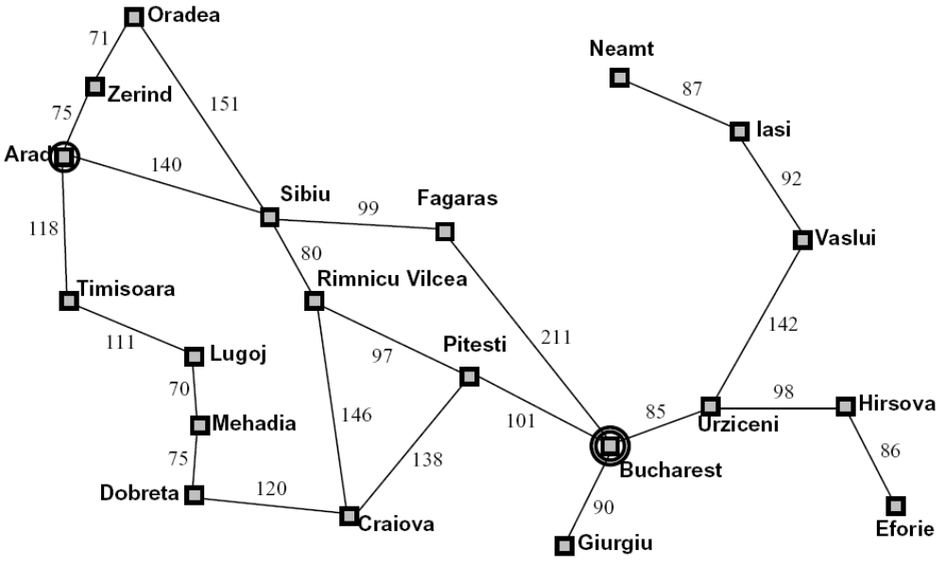
Example: Traveling in Romania
State space:
  Cities
Successor function:
  Roads: Go to adjacent city with cost = distance
Start state:
  Arad
Goal test:
  Is state == Bucharest?
Solution?

Slide 27
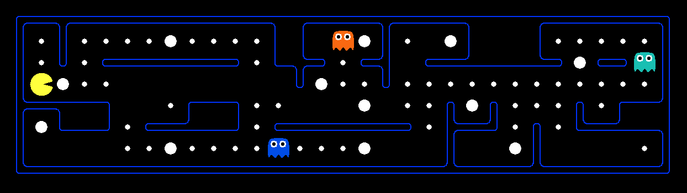
What’s in a State Space?
The world state includes every last detail of the environment
A search state keeps only the details needed for planning (abstraction)
Problem: Pathing
  States: (x,y) location
  Actions: NSEW
  Successor: update location only
  Goal test: is (x,y)=END
Problem: Eat-All-Dots
  States: {(x,y), dot booleans}
  Actions: NSEW
  Successor: update location and possibly a dot boolean
  Goal test: dots all false
Notes:
Wrong example for “eat-all-dots”: (x, y, dot count)

Slide 28
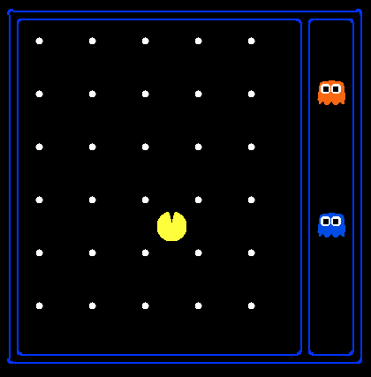
State Space Sizes?
World state:
  Agent positions: 120
  Food count: 30
  Ghost positions: 12
  Agent facing: NSEW
How many
  World states?
  120x(2³⁰)x(12²)x4
  States for pathing?
  120
  States for eat-all-dots?
  120x(2³⁰)
Notes:
90 * (2^30-1) + 30 * 2^29 = 145 billion
2^29 = 536 870 912

Slide 29
Quiz: Safe Passage
Problem: eat all dots while keeping the ghosts perma-scared
What does the state space have to specify?
  (agent position, dot booleans, power pellet booleans, remaining scared time)

Slide 30
Worked Example: Formulating a Search Problem
Two jugs (4 L and 3 L), a tap, and no markings. Measure exactly 2 L.
State space: (x, y) = litres in the 4 L and 3 L jugs
x ∈ {0..4}, y ∈ {0..3} → 20 possible states
Start state: (0, 0)
Goal test: x = 2
Actions (cost 1 each): Fill 4L, Fill 3L, Empty 4L, Empty 3L, Pour 4L→3L, Pour 3L→4L
Successor function: e.g. Pour 4L→3L moves min(x, 3 − y) litres
(4, 0) → (1, 3)
Solution: a sequence of actions from (0, 0) to a goal state
Pour 4L→3L
→
4L
3L
4L
3L
(4, 0)
(1, 3)
The search state keeps only what matters for planning: how much water is in each jug.

Slide 31
Water Jugs: Breadth-First Search Finds a Shortest Plan
Start
Fill 4L
Pour 4L→3L
Empty 3L
Pour 4L→3L
Fill 4L
Pour 4L→3L
→
→
→
→
→
→
4L
3L
4L
3L
4L
3L
4L
3L
4L
3L
4L
3L
4L
3L
(0, 0)
(4, 0)
(1, 3)
(1, 0)
(0, 1)
(4, 1)
(2, 3)
BFS explores states level by level: 1 state at depth 0, 2 at depth 1, 3 at depth 2, ... It reaches a goal at depth 6.
Because every action costs 1, the first goal BFS reaches uses the fewest actions. (Filling the 3 L jug first also takes 6 actions.)
Think: would DFS also find a 6-action plan? Would it always terminate without a closed set?

Slide 32
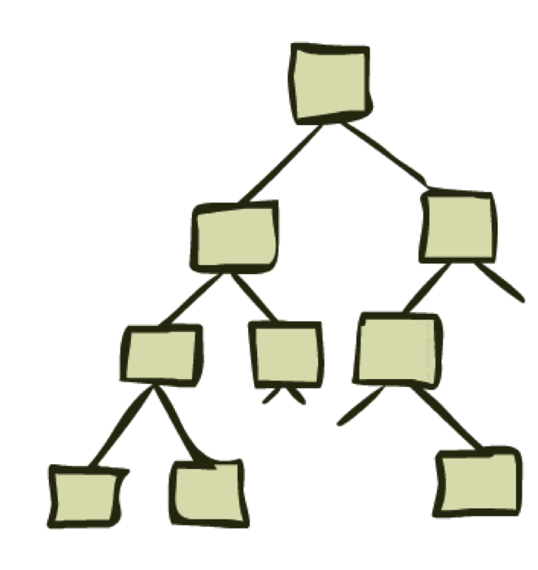
State Space Graphs and Search Trees

Slide 33
State Space Graphs
State space graph: A mathematical representation of a search problem
  Nodes are (abstracted) world configurations
  Arcs represent successors (action results)
  The goal test is a set of goal nodes (maybe only one)
In a state space graph, each state occurs only once!
We can rarely build this full graph in memory (it’s too big), but it’s a useful idea

Slide 34
State Space Graphs
State space graph: A mathematical representation of a search problem
  Nodes are (abstracted) world configurations
  Arcs represent successors (action results)
  The goal test is a set of goal nodes (maybe only one)
In a search graph, each state occurs only once!
We can rarely build this full graph in memory (it’s too big), but it’s a useful idea
a
G
b
c
e
d
f
S
h
p
q
r
Tiny search graph for a tiny search problem

Slide 35
Search Trees
This is now / start
“N”, 1.0
“E”, 1.0
Possible futures
A search tree:
  A “what if” tree of plans and their outcomes
  The start state is the root node
  Children correspond to successors
  Nodes show states, but correspond to PLANS that achieve those states
  For most problems, we can never actually build the whole tree
Notes:
Different plans that achieve the same state, will be different nodes in the tree.

Slide 36
State Space Graphs vs. Search Trees
State Space Graph
Each NODE in in the search tree is an entire PATH in the state space graph.
Search Tree
S
a
G
d
e
p
b
c
q
b
c
e
h
r
d
e
f
a
a
h
r
p
q
f
S
h
We construct both on demand – and we construct as little as possible.
p
q
f
q
c
G
p
q
r
q
c
G
a
a

Slide 37

Quiz: State Space Graphs vs. Search Trees
Consider this 4-state graph:
How big is its search tree (from S)?
a
S
G
b
Important: Lots of repeated structure in the search tree!

Slide 38
Tree Search

Slide 39
Search Example: Romania

Slide 40
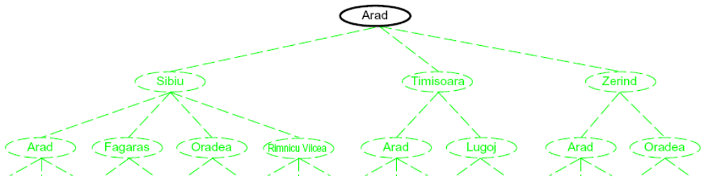
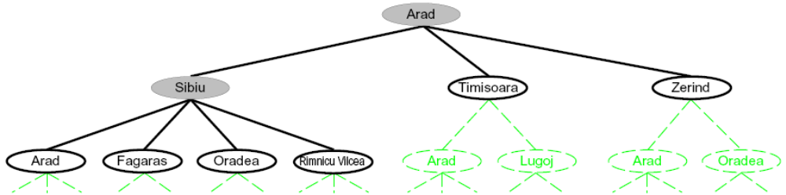
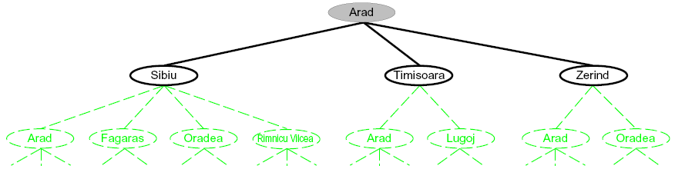
Searching with a Search Tree
Search:
  Expand out potential plans (tree nodes)
  Maintain a fringe of partial plans under consideration
  Try to expand as few tree nodes as possible

Slide 41
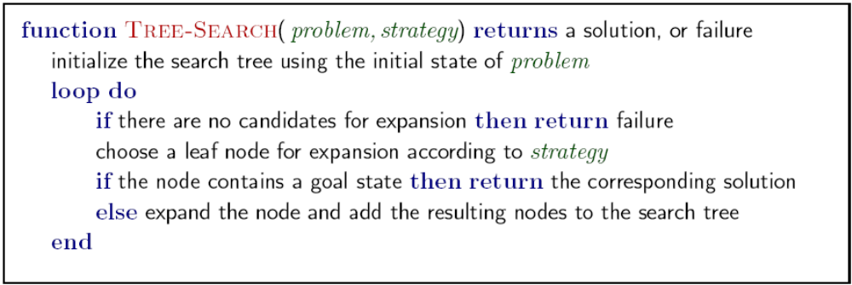
General Tree Search
Important ideas:
  Fringe
  Expansion
  Exploration strategy
Main question: which fringe nodes to explore?

Slide 42
Example: Tree Search
a
G
b
c
d
e
f
S
h
p
q
r
Notes:
Left: show tree
Right: fringe

Slide 43
Tree Search vs. Graph Search
Tree search can expand the same state many times: the search tree has lots of repeated structure, and can be infinite when the graph has cycles.
Graph search = tree search + a closed set: never expand a state twice.
When a popped node’s state is already closed, skip it.
All of today’s worked examples (and HW0) use graph search.
fringe ← [start]; closed ← {}
while fringe is not empty:
node ← fringe.pop()
if node.state in closed:
continue # skip
if is_goal(node.state):
return node.path
closed.add(node.state)
for child in successors(node):
if child.state not in closed:
fringe.push(child)
return failure
The fringe type is the only difference between DFS, BFS, and UCS.

Slide 44
Worked Example Graph
A
Find a path from S (start) to G (goal). Edge labels are step costs.
We will run DFS, BFS, and UCS on this same graph, one step at a time.
Rules for every trace:
• Graph search: never expand a state twice
• Goal test when a node is popped, not when it is added
• Ties are broken alphabetically
Try predicting each answer before we step through it!
G
2
4
2
S
C
5
3
5
1
B
4
D
Example from UC Berkeley CS 188, Fall 2026, Discussion 1

Slide 45
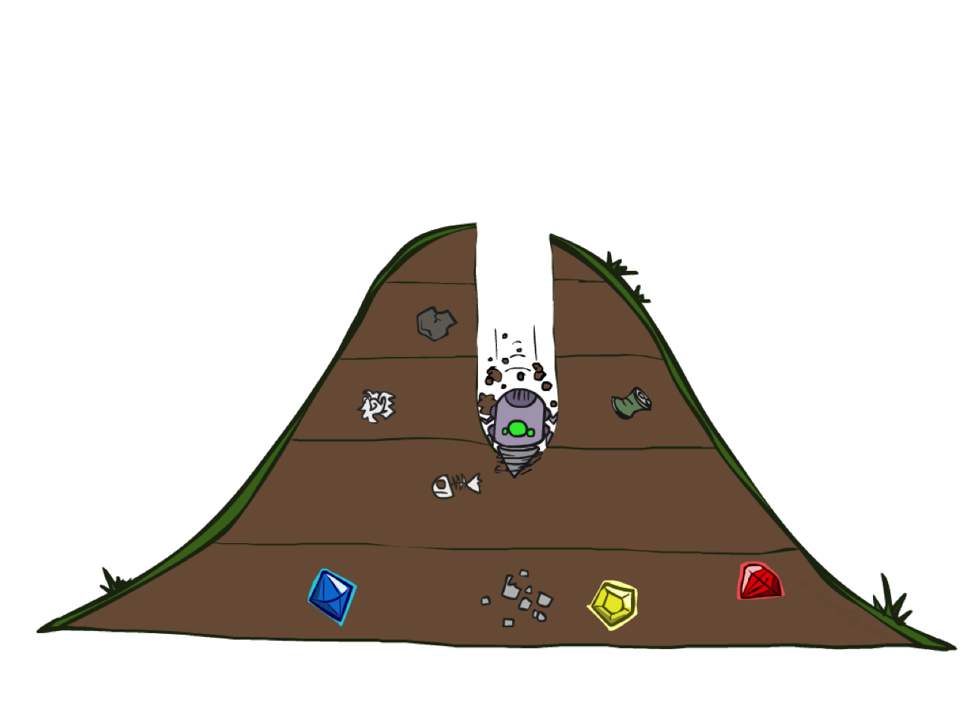
Depth-First Search

Slide 46
Depth-First Search
Strategy: expand a deepest node first
Implementation: Fringe is a LIFO stack
a
G
a
c
b
c
b
e
d
e
d
f
f
S
h
h
p
p
r
q
r
q
S
d
e
p
b
c
e
h
r
q
a
a
h
r
p
q
f
p
q
f
q
c
G
q
c
G
a
a

Slide 47
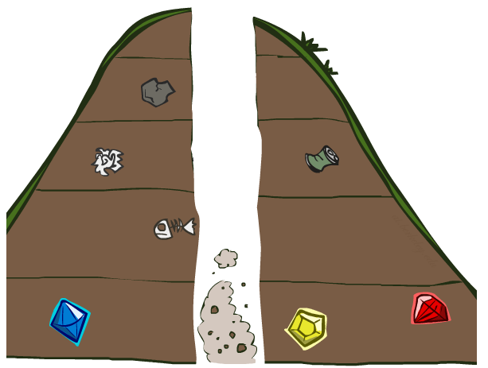
Search Algorithm Properties

Slide 48
Search Algorithm Properties
Complete: Guaranteed to find a solution if one exists?
Optimal: Guaranteed to find the least cost path?
Time complexity?
Space complexity?
Cartoon of search tree:
  b is the branching factor
  m is the maximum depth
  solutions at various depths
Number of nodes in entire tree?
  1 + b + b² + …. b^{m} = O(b^{m})
1 node
b
…
b nodes
b² nodes
m tiers
b^{m} nodes

Slide 49
Depth-First Search (DFS) Properties
What nodes DFS expand?
  Some left prefix of the tree.
  Could process the whole tree!
  If m is finite, takes time O(b^{m})
How much space does the fringe take?
  Only has siblings on path to root, so O(bm)
Is it complete?
  m could be infinite, so only if we prevent cycles (more later)
Is it optimal?
  No, it finds the “leftmost” solution, regardless of depth or cost
1 node
b
…
b nodes
b² nodes
m tiers
b^{m} nodes

Slide 50
DFS Worked Example (step 0 of 6)
A
Initial state
G
Fringe: Stack (LIFO): top first
2
4
top ▸
S
2
S
C
5
3
5
1
B
4
D
Expanded: (none)
Start: the fringe holds only the start state S. Nothing has been expanded yet.
Current
Expanded
On fringe
Not reached
DFS: expand the deepest node first · fringe = stack · graph search · ties alphabetical

Slide 51
DFS Worked Example (step 1 of 6)
A
Popped: S
G
Fringe: Stack (LIFO): top first
2
4
top ▸
S → A (new)
2
S
S → B (new)
C
5
S → D (new)
3
5
1
B
4
D
Expanded: S
Pop S. S is not the goal, so expand S. Add S → A, S → B, S → D. Pushed in reverse order so A ends on top.
Current
Expanded
On fringe
Not reached
DFS: expand the deepest node first · fringe = stack · graph search · ties alphabetical

Slide 52
DFS Worked Example (step 2 of 6)
A
Popped: S → A
G
Fringe: Stack (LIFO): top first
2
4
top ▸
S → A → C (new)
2
S
S → B
C
5
S → D
3
5
1
B
4
D
Expanded: S, A
Pop S → A. A is not the goal, so expand A. Add S → A → C. (S already expanded: not added.)
Current
Expanded
On fringe
Not reached
DFS: expand the deepest node first · fringe = stack · graph search · ties alphabetical

Slide 53
DFS Worked Example (step 3 of 6)
A
Popped: S → A → C
G
Fringe: Stack (LIFO): top first
2
4
top ▸
S → A → C → D (new)
2
S
S → A → C → G (new)
C
5
S → B
S → D
3
5
1
B
4
D
Expanded: S, A, C
Pop S → A → C. C is not the goal, so expand C. Add S → A → C → D, S → A → C → G. (A already expanded: not added.) Pushed in reverse order so D ends on top.
Current
Expanded
On fringe
Not reached
DFS: expand the deepest node first · fringe = stack · graph search · ties alphabetical

Slide 54
DFS Worked Example (step 4 of 6)
A
Popped: S → A → C → D
G
Fringe: Stack (LIFO): top first
2
4
top ▸
S → A → C → D → B (new)
2
S
S → A → C → D → G (new)
C
5
S → A → C → G
S → B
3
5
1
S → D
B
4
D
Expanded: S, A, C, D
Pop S → A → C → D. D is not the goal, so expand D. Add S → A → C → D → B, S → A → C → D → G. (C, S already expanded: not added.) Pushed in reverse order so B ends on top.
Current
Expanded
On fringe
Not reached
DFS: expand the deepest node first · fringe = stack · graph search · ties alphabetical

Slide 55
DFS Worked Example (step 5 of 6)
A
Popped: S → A → C → D → B
G
Fringe: Stack (LIFO): top first
2
4
top ▸
S → A → C → D → G
2
S
S → A → C → G
C
5
S → B
S → D
3
5
1
B
4
D
Expanded: S, A, C, D, B
Pop S → A → C → D → B. B is not the goal, so expand B. Every neighbor is already expanded, so nothing is added. (D, S already expanded: not added.)
Current
Expanded
On fringe
Not reached
DFS: expand the deepest node first · fringe = stack · graph search · ties alphabetical

Slide 56
DFS Worked Example (step 6 of 6)
A
Popped (goal!): S → A → C → D → G
G
Fringe: Stack (LIFO): top first
2
4
top ▸
S → A → C → G
2
S
S → B
C
5
S → D
3
5
1
B
4
D
Expanded: S, A, C, D, B, G
Pop S → A → C → D → G. G is the goal, so return this path. Total cost = 12.
Current
Expanded
On fringe
Not reached
DFS: expand the deepest node first · fringe = stack · graph search · ties alphabetical

Slide 57
DFS Result
A
Expansion order: S, A, C, D, B, G
Path returned: S → A → C → D → G
Cost: 2 + 4 + 1 + 5 = 12
Actions: 4
G
2
4
2
S
C
5
DFS dives deep along S → A → C → D before backing up.
It found a path quickly, but not the cheapest one. UCS will find a path of cost 8.
DFS returns the “leftmost” solution, regardless of depth or cost.
3
5
1
B
4
D
Returned path
Expanded

Slide 58
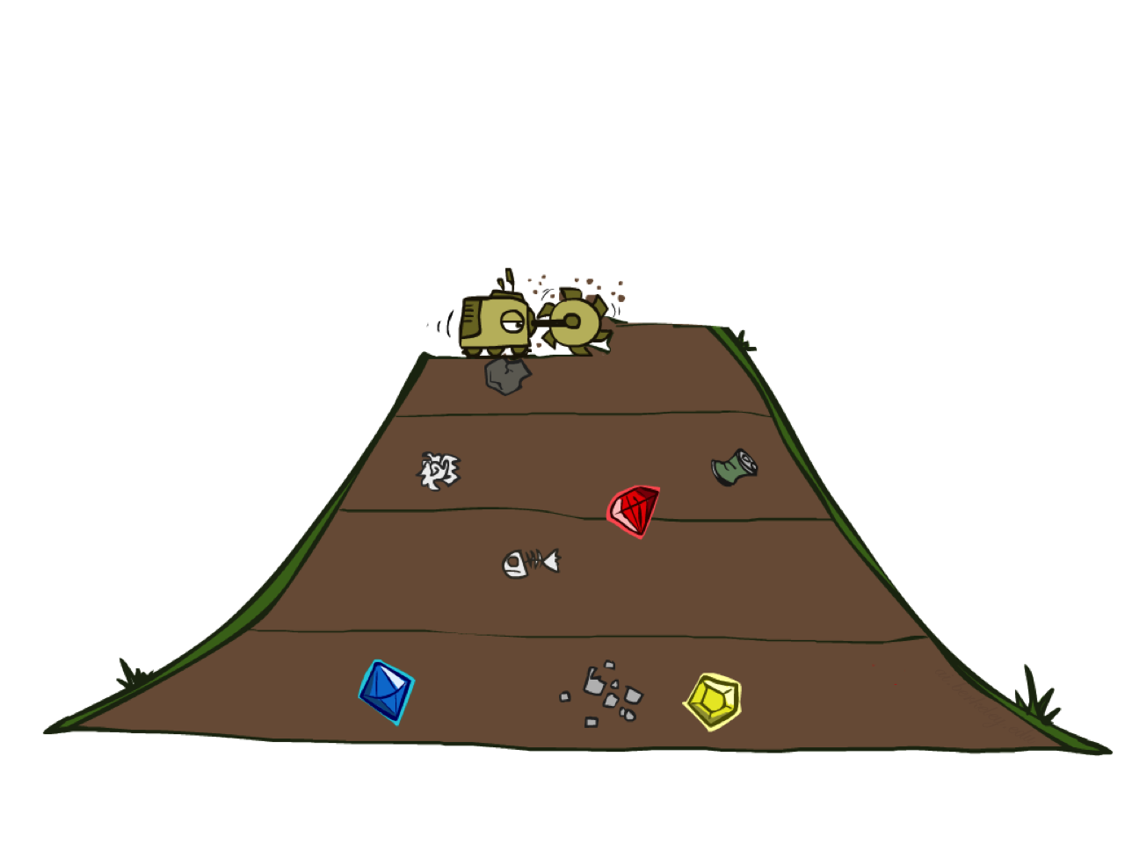
Breadth-First Search

Slide 59
Breadth-First Search
Strategy: expand a shallowest node first
Implementation: Fringe is a FIFO queue
a
G
b
c
d
e
f
S
h
p
q
r
S
d
e
p
Search
Tiers
b
c
e
h
r
q
a
a
h
r
p
q
f
p
q
f
q
c
G
q
c
G
a
a

Slide 60
Breadth-First Search (BFS) Properties
What nodes does BFS expand?
  Processes all nodes above shallowest solution
  Let depth of shallowest solution be s
  Search takes time O(b^{s})
How much space does the fringe take?
  Has roughly the last tier, so O(b^{s})
Is it complete?
  s must be finite if a solution exists, so yes!
Is it optimal?
  Only if costs are all 1 (more on costs later)
1 node
b
…
b nodes
s tiers
b² nodes
b^{s} nodes
b^{m} nodes

Slide 61
BFS Worked Example (step 1 of 8)
A
Popped: S
G
Fringe: Queue (FIFO): front first
2
4
front ▸
S → A (new)
2
S
S → B (new)
C
5
S → D (new)
3
5
1
B
4
D
Expanded: S
Pop S. S is not the goal, so expand S. Add S → A, S → B, S → D.
Current
Expanded
On fringe
Not reached
BFS: expand the shallowest node first · fringe = queue · graph search · ties alphabetical

Slide 62
BFS Worked Example (step 2 of 8)
A
Popped: S → A
G
Fringe: Queue (FIFO): front first
2
4
front ▸
S → B
2
S
S → D
C
5
S → A → C (new)
3
5
1
B
4
D
Expanded: S, A
Pop S → A. A is not the goal, so expand A. Add S → A → C. (S already expanded: not added.)
Current
Expanded
On fringe
Not reached
BFS: expand the shallowest node first · fringe = queue · graph search · ties alphabetical

Slide 63
BFS Worked Example (step 3 of 8)
A
Popped: S → B
G
Fringe: Queue (FIFO): front first
2
4
front ▸
S → D
2
S
S → A → C
C
5
S → B → D (new)
3
5
1
B
4
D
Expanded: S, A, B
Pop S → B. B is not the goal, so expand B. Add S → B → D. (S already expanded: not added.)
Current
Expanded
On fringe
Not reached
BFS: expand the shallowest node first · fringe = queue · graph search · ties alphabetical

Slide 64
BFS Worked Example (step 4 of 8)
A
Popped: S → D
G
Fringe: Queue (FIFO): front first
2
4
front ▸
S → A → C
2
S
S → B → D
C
5
S → D → C (new)
S → D → G (new)
3
5
1
B
4
D
Expanded: S, A, B, D
Pop S → D. D is not the goal, so expand D. Add S → D → C, S → D → G. (B, S already expanded: not added.)
Current
Expanded
On fringe
Not reached
BFS: expand the shallowest node first · fringe = queue · graph search · ties alphabetical

Slide 65
BFS Worked Example (step 5 of 8)
A
Popped: S → A → C
G
Fringe: Queue (FIFO): front first
2
4
front ▸
S → B → D
2
S
S → D → C
C
5
S → D → G
S → A → C → G (new)
3
5
1
B
4
D
Expanded: S, A, B, D, C
Pop S → A → C. C is not the goal, so expand C. Add S → A → C → G. (A, D already expanded: not added.)
Current
Expanded
On fringe
Not reached
BFS: expand the shallowest node first · fringe = queue · graph search · ties alphabetical

Slide 66
BFS Worked Example (step 6 of 8)
A
Popped (skip): S → B → D
G
Fringe: Queue (FIFO): front first
2
4
front ▸
S → D → C
2
S
S → D → G
C
5
S → A → C → G
3
5
1
B
4
D
Expanded: S, A, B, D, C
Pop S → B → D. D was already expanded, so graph search discards this entry.
Current
Expanded
On fringe
Not reached
BFS: expand the shallowest node first · fringe = queue · graph search · ties alphabetical

Slide 67
BFS Worked Example (step 7 of 8)
A
Popped (skip): S → D → C
G
Fringe: Queue (FIFO): front first
2
4
front ▸
S → D → G
2
S
S → A → C → G
C
5
3
5
1
B
4
D
Expanded: S, A, B, D, C
Pop S → D → C. C was already expanded, so graph search discards this entry.
Current
Expanded
On fringe
Not reached
BFS: expand the shallowest node first · fringe = queue · graph search · ties alphabetical

Slide 68
BFS Worked Example (step 8 of 8)
A
Popped (goal!): S → D → G
G
Fringe: Queue (FIFO): front first
2
4
front ▸
S → A → C → G
2
S
C
5
3
5
1
B
4
D
Expanded: S, A, B, D, C, G
Pop S → D → G. G is the goal, so return this path. Total cost = 10.
Current
Expanded
On fringe
Not reached
BFS: expand the shallowest node first · fringe = queue · graph search · ties alphabetical

Slide 69
BFS Result
A
Expansion order: S, A, B, D, C, G
Path returned: S → D → G
Cost: 5 + 5 = 10
Actions: 2
G
2
4
2
S
C
5
BFS returns the path with the fewest actions (2).
But it ignores edge costs: S → D → G costs 10, while S → A → C → G costs 8.
Two entries were skipped because their states were already expanded.
3
5
1
B
4
D
Returned path
Expanded

Slide 70
Quiz: DFS vs BFS

Slide 71
Quiz: DFS vs BFS
When will BFS outperform DFS?
When will DFS outperform BFS?
[Demo: dfs/bfs maze water (L2D6)]

Slide 72

Video of Demo Maze Water DFS/BFS (part 1)

Slide 73
Video of Demo Maze Water DFS/BFS (part 2)

Slide 74
Iterative Deepening
Idea: get DFS’s space advantage with BFS’s time / shallow-solution advantages
  Run a DFS with depth limit 1. If no solution…
  Run a DFS with depth limit 2. If no solution…
  Run a DFS with depth limit 3. …..
Isn’t that wastefully redundant?
  Generally most work happens in the lowest level searched, so not so bad!
b
…

Slide 75
Iterative Deepening: Worked Example
Depth limit | Nodes visited (in order) | Result
0 | S | no goal
1 | S, A, B, D | no goal
2 | S, A, C, B, D, D, B, C, G | found S → D → G
Each iteration runs a depth-limited DFS from scratch on the same graph (avoiding cycles along the current path).
IDS finds the shallowest goal, the same 2-action path as BFS, while storing only one path at a time like DFS.
Repeating the shallow levels is cheap: most of the work happens at the deepest level searched.

Slide 76
Cost-Sensitive Search
a
GOAL
2
2
b
c
3
2
1
8
2
e
d
f
3
9
8
2
START
h
1
4
2
p
4
r
15
q
BFS finds the shortest path in terms of number of actions.
It does not find the least-cost path. We will now cover
a similar algorithm which does find the least-cost path.

Slide 77
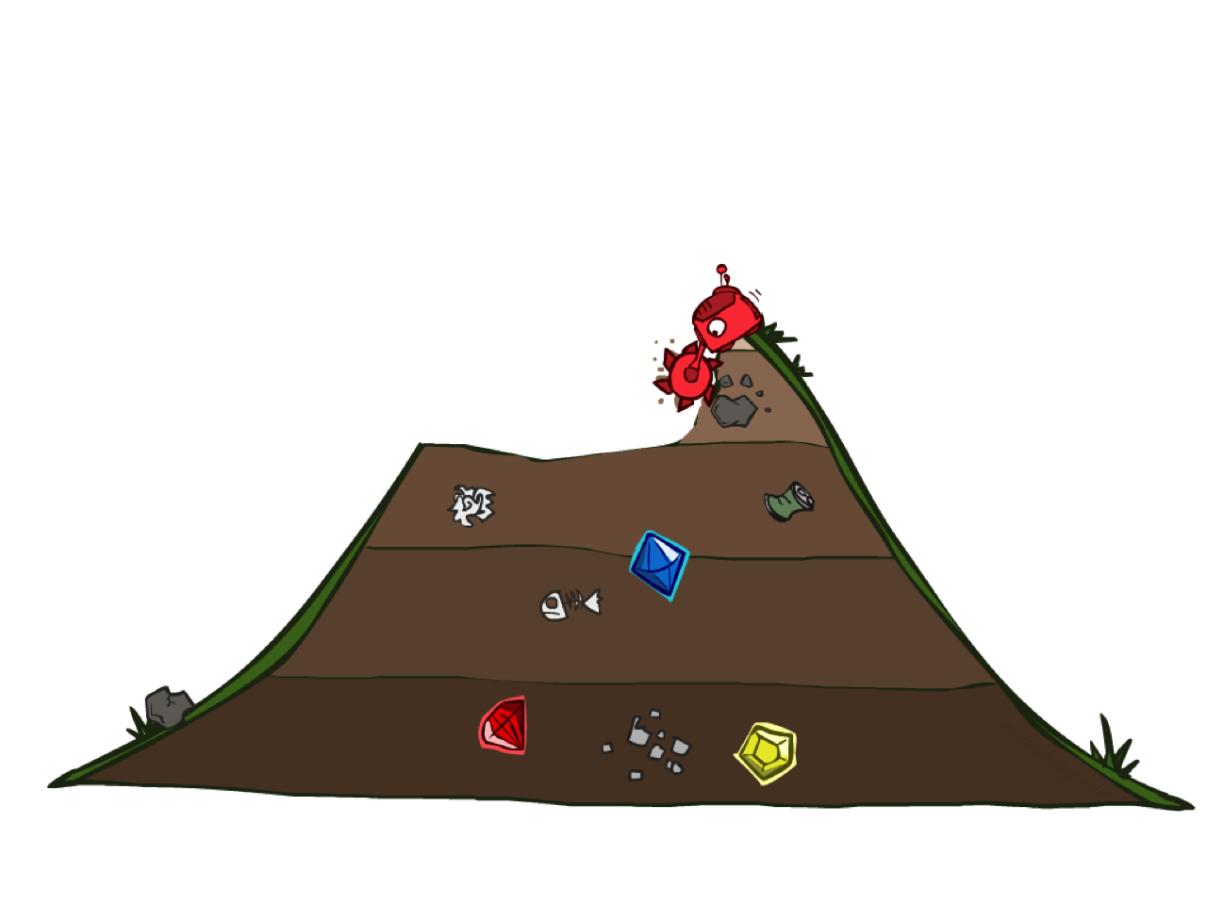
Uniform Cost Search

Slide 78
Uniform Cost Search
2
G
a
Strategy: expand a cheapest node first:
Fringe is a priority queue (priority: cumulative cost)
b
c
1
8
2
2
e
3
d
f
9
8
2
S
h
1
1
p
q
r
15
0
S
d
3
e
9
p
1
b
4
e
5
h
17
r
11
q
16
c
11
Cost contours
a
6
a
h
13
r
7
p
q
f
p
q
f
8
q
c
G
q
c
a
11
G
10
a

Slide 79
Uniform Cost Search (UCS) Properties
What nodes does UCS expand?
  Processes all nodes with cost less than cheapest solution!
  If that solution costs C* and arcs cost at least ε , then the “effective depth” is roughly C*/ε
  Takes time O(b^{C*/ε}) (exponential in effective depth)
How much space does the fringe take?
  Has roughly the last tier, so O(b^{C*/ε})
Is it complete?
  Assuming best solution has a finite cost and minimum arc cost is positive, yes!
Is it optimal?
  Yes! (Proof next lecture via A*)
b
c ≤ 1
…
C*/ε “tiers”
c ≤ 2
c ≤ 3

Slide 80
Uniform Cost Issues
Remember: UCS explores increasing cost contours
The good: UCS is complete and optimal!
The bad:
  Explores options in every “direction”
  No information about goal location
We’ll fix that soon!
…
c ≤ 1
c ≤ 2
c ≤ 3
Start
Goal
[Demo: empty grid UCS (L2D5)]
[Demo: maze with deep/shallow water DFS/BFS/UCS (L2D7)]

Slide 81
UCS Worked Example (step 1 of 8)
A
Popped: S (g = 0)
G
Fringe: Priority queue: cheapest first
2
4
next ▸
S → A g = 2 (new)
2
S
S → B g = 3 (new)
C
5
S → D g = 5 (new)
3
5
1
B
4
D
Expanded: S
Pop S (cost 0). S is not the goal, so expand S. Add S → A (2), S → B (3), S → D (5).
Current
Expanded
On fringe
Not reached
UCS: expand the cheapest node first · fringe = priority queue on path cost g(n) · ties alphabetical

Slide 82
UCS Worked Example (step 2 of 8)
A
Popped: S → A (g = 2)
G
Fringe: Priority queue: cheapest first
2
4
next ▸
S → B g = 3
2
S
S → D g = 5
C
5
S → A → C g = 6 (new)
3
5
1
B
4
D
Expanded: S, A
Pop S → A (cost 2). A is not the goal, so expand A. Add S → A → C (6). (S already expanded: not added.)
Current
Expanded
On fringe
Not reached
UCS: expand the cheapest node first · fringe = priority queue on path cost g(n) · ties alphabetical

Slide 83
UCS Worked Example (step 3 of 8)
A
Popped: S → B (g = 3)
G
Fringe: Priority queue: cheapest first
2
4
next ▸
S → D g = 5
2
S
S → A → C g = 6
C
5
S → B → D g = 7 (new)
3
5
1
B
4
D
Expanded: S, A, B
Pop S → B (cost 3). B is not the goal, so expand B. Add S → B → D (7). (S already expanded: not added.)
Current
Expanded
On fringe
Not reached
UCS: expand the cheapest node first · fringe = priority queue on path cost g(n) · ties alphabetical

Slide 84
UCS Worked Example (step 4 of 8)
A
Popped: S → D (g = 5)
G
Fringe: Priority queue: cheapest first
2
4
next ▸
S → A → C g = 6
2
S
S → D → C g = 6 (new)
C
5
S → B → D g = 7
S → D → G g = 10 (new)
3
5
1
B
4
D
Expanded: S, A, B, D
Pop S → D (cost 5). D is not the goal, so expand D. Add S → D → C (6), S → D → G (10). (B, S already expanded: not added.)
Current
Expanded
On fringe
Not reached
UCS: expand the cheapest node first · fringe = priority queue on path cost g(n) · ties alphabetical

Slide 85
UCS Worked Example (step 5 of 8)
A
Popped: S → A → C (g = 6)
G
Fringe: Priority queue: cheapest first
2
4
next ▸
S → D → C g = 6
2
S
S → B → D g = 7
C
5
S → A → C → G g = 8 (new)
S → D → G g = 10
3
5
1
B
4
D
Expanded: S, A, B, D, C
Pop S → A → C (cost 6). C is not the goal, so expand C. Add S → A → C → G (8). (A, D already expanded: not added.)
Current
Expanded
On fringe
Not reached
UCS: expand the cheapest node first · fringe = priority queue on path cost g(n) · ties alphabetical

Slide 86
UCS Worked Example (step 6 of 8)
A
Popped (skip): S → D → C (g = 6)
G
Fringe: Priority queue: cheapest first
2
4
next ▸
S → B → D g = 7
2
S
S → A → C → G g = 8
C
5
S → D → G g = 10
3
5
1
B
4
D
Expanded: S, A, B, D, C
Pop S → D → C (cost 6). C was already expanded, so graph search discards this entry.
Current
Expanded
On fringe
Not reached
UCS: expand the cheapest node first · fringe = priority queue on path cost g(n) · ties alphabetical

Slide 87
UCS Worked Example (step 7 of 8)
A
Popped (skip): S → B → D (g = 7)
G
Fringe: Priority queue: cheapest first
2
4
next ▸
S → A → C → G g = 8
2
S
S → D → G g = 10
C
5
3
5
1
B
4
D
Expanded: S, A, B, D, C
Pop S → B → D (cost 7). D was already expanded, so graph search discards this entry.
Current
Expanded
On fringe
Not reached
UCS: expand the cheapest node first · fringe = priority queue on path cost g(n) · ties alphabetical

Slide 88
UCS Worked Example (step 8 of 8)
A
Popped (goal!): S → A → C → G (g = 8)
G
Fringe: Priority queue: cheapest first
2
4
next ▸
S → D → G g = 10
2
S
C
5
3
5
1
B
4
D
Expanded: S, A, B, D, C, G
Pop S → A → C → G (cost 8). G is the goal, so return this path. Total cost = 8.
Current
Expanded
On fringe
Not reached
UCS: expand the cheapest node first · fringe = priority queue on path cost g(n) · ties alphabetical

Slide 89
UCS Result
A
Expansion order: S, A, B, D, C, G
Path returned: S → A → C → G
Cost: 2 + 4 + 2 = 8
Actions: 3
G
2
4
2
S
C
5
UCS returns the cheapest path (cost 8).
It expanded every state reachable for less than 8 before reaching G.
Notice S → D → G (cost 10) sat on the fringe, but a cheaper path reached G first.
3
5
1
B
4
D
Returned path
Expanded

Slide 90
Video of Demo Empty UCS

Slide 91
Video of Demo Maze with Deep/Shallow Water --- DFS, BFS, or UCS? (part 1)
Notes:
Let students guess which one of the three it is. (This is BFS.)

Slide 92
Video of Demo Maze with Deep/Shallow Water --- DFS, BFS, or UCS? (part 2)
Notes:
Let students guess which one of the three it is. (This is UCS.)

Slide 93
Video of Demo Maze with Deep/Shallow Water --- DFS, BFS, or UCS? (part 3)
Notes:
Let students guess which one of the three it is. (This is DFS.)

Slide 94
Same Graph, Three Strategies
Algorithm | Fringe | Expansion order | Path returned | Cost
DFS | Stack | S, A, C, D, B, G | S → A → C → D → G | 12
BFS | Queue | S, A, B, D, C, G | S → D → G | 10
UCS | Priority queue | S, A, B, D, C, G | S → A → C → G | 8
 | Complete? | Optimal? | Time | Space
DFS | Only if depth is finite | No | O(b^m) | O(bm)
BFS | Yes | Only if costs are equal | O(b^s) | O(b^s)
IDS | Yes | Only if costs are equal | O(b^s) | O(bs)
UCS | Yes* | Yes* | O(b^(C*/ε)) | O(b^(C*/ε))
b = branching factor, m = max depth, s = depth of shallowest goal, C* = optimal cost, ε = smallest step cost. * if every step cost ≥ ε > 0

Slide 95

The One Queue
All these search algorithms are the same except for fringe strategies
  Conceptually, all fringes are priority queues (i.e. collections of nodes with attached priorities)
  Practically, for DFS and BFS, you can avoid the log(n) overhead from an actual priority queue, by using stacks and queues
  Can even code one implementation that takes a variable queuing object

Slide 96
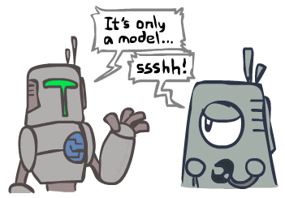
Search and Models
Search operates over models of the world
  The agent doesn’t actually try all the plans out in the real world!
  Planning is all “in simulation”
  Your search is only as good as your models…

Slide 97
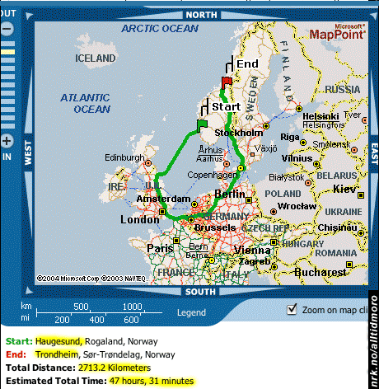
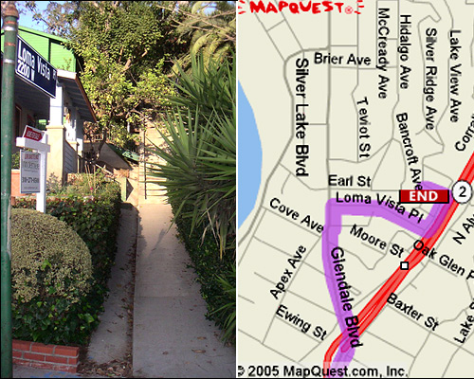
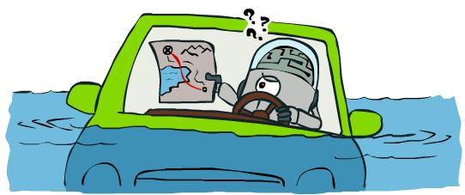
Search Gone Wrong?

Slide 98
Your Turn: Practice Problem
A
This graph is directed: follow the arrows.
For DFS, BFS, and UCS (graph search, ties alphabetical, goal test on pop):
1. In what order are states expanded?
2. Which path is returned, and what does it cost?
Work in pairs for 10 minutes, then we compare answers.
3
1
D
12
1
8
S
2
B
1
G
4
2
E
2
7
C

Slide 99
Practice Problem: Solution
A
DFS
Expanded: S, A, D, E, G
Path: S → A → D → E → G cost 7
BFS
Expanded: S, A, B, C, D, G
Path: S → A → G cost 13
UCS
Expanded: S, A, B, D, E, G
Path: S → B → D → E → G cost 6
Only UCS finds the cheapest path (green).
3
1
D
12
1
8
S
2
B
1
G
4
2
E
2
7
C

Slide 100
Homework 0: Search
Released today in the course repo: hw/hw0. Due Saturday, 21 November 2026, 11:59 PM Guyana time.
Covers Weeks 2 and 3: problem formulation, uninformed search, and informed search (A* and heuristics).
A. Pac-Man Search 25 pts
B. Written Problems 25 pts
Implement DFS, BFS, UCS, A*, and heuristics (autograded Q1–Q8). Q1–Q3 use today’s material.
Search theory, proofs about heuristics, and a hand trace on the Guyana road map.
C. Route Planning in Guyana 30 pts
D. Search vs. LLMs 15 pts
Model a real Guyanese road network as a search problem, then run experiments (autograded Q9–Q10).
Give the same problems to an LLM and compare its answers with A*.
Plus 5 pts for submission quality: Git history, PR description, and GenAI log. Start with Q1–Q3 now. Setting up Python and Git takes time.

Slide 101
Getting Started and Submitting HW0
Fork ChrisIsKing/MAI5100 and clone your fork. You need Python 3.10+ and Git
Copy the starter code into your own folder:
  hw/hw0/submissions/firstname_lastname/src and written.md
Check your setup: python autograder.py --no-graphics (0 points at first is expected)
Commit often with clear messages. Your Git history is graded
Open a pull request titled “HW0: Firstname Lastname” and fill in the PR template
  Autograder output, checklist, and reflection questions
Generative AI may be used as a collaborator, but log every use in written.md

Slide 102
Before Next Class (14 November)
Read Russell & Norvig Chapter 3.1–3.4; skim 3.5 for a preview
Set up HW0 and finish Part A, Q1–Q3: DFS, BFS, and UCS in Pac-Man
Redo today’s practice problem on your own
Next lecture: informed search. Can we use knowledge about where the goal is to search faster?
  Heuristics, greedy search, and A*

Slide 103
Acknowledgements
Slides adapted from UC Berkeley CS 188: Introduction to Artificial Intelligence (Dan Klein, Pieter Abbeel, and the CS 188 staff)
Worked example graph from CS 188 Fall 2026, Discussion 1
Homework 0 Part A is adapted from the CS 188 Pac-Man search project

