Slide 1

Notes:
This week, we will cover the following topics:
1. Intelligent Agents
- Agents and Environments
- Good Behavior: The Concept of Rationality
- The Nature of Environments
- The Structure of Agents
2. Solving Problems by Searching
- Problem-Solving Agents
- Example Problems
- Searching for Solutions
- Uniformed Search Strategies
- Informed Search Strategies

Slide 2


Slide 3


Slide 4
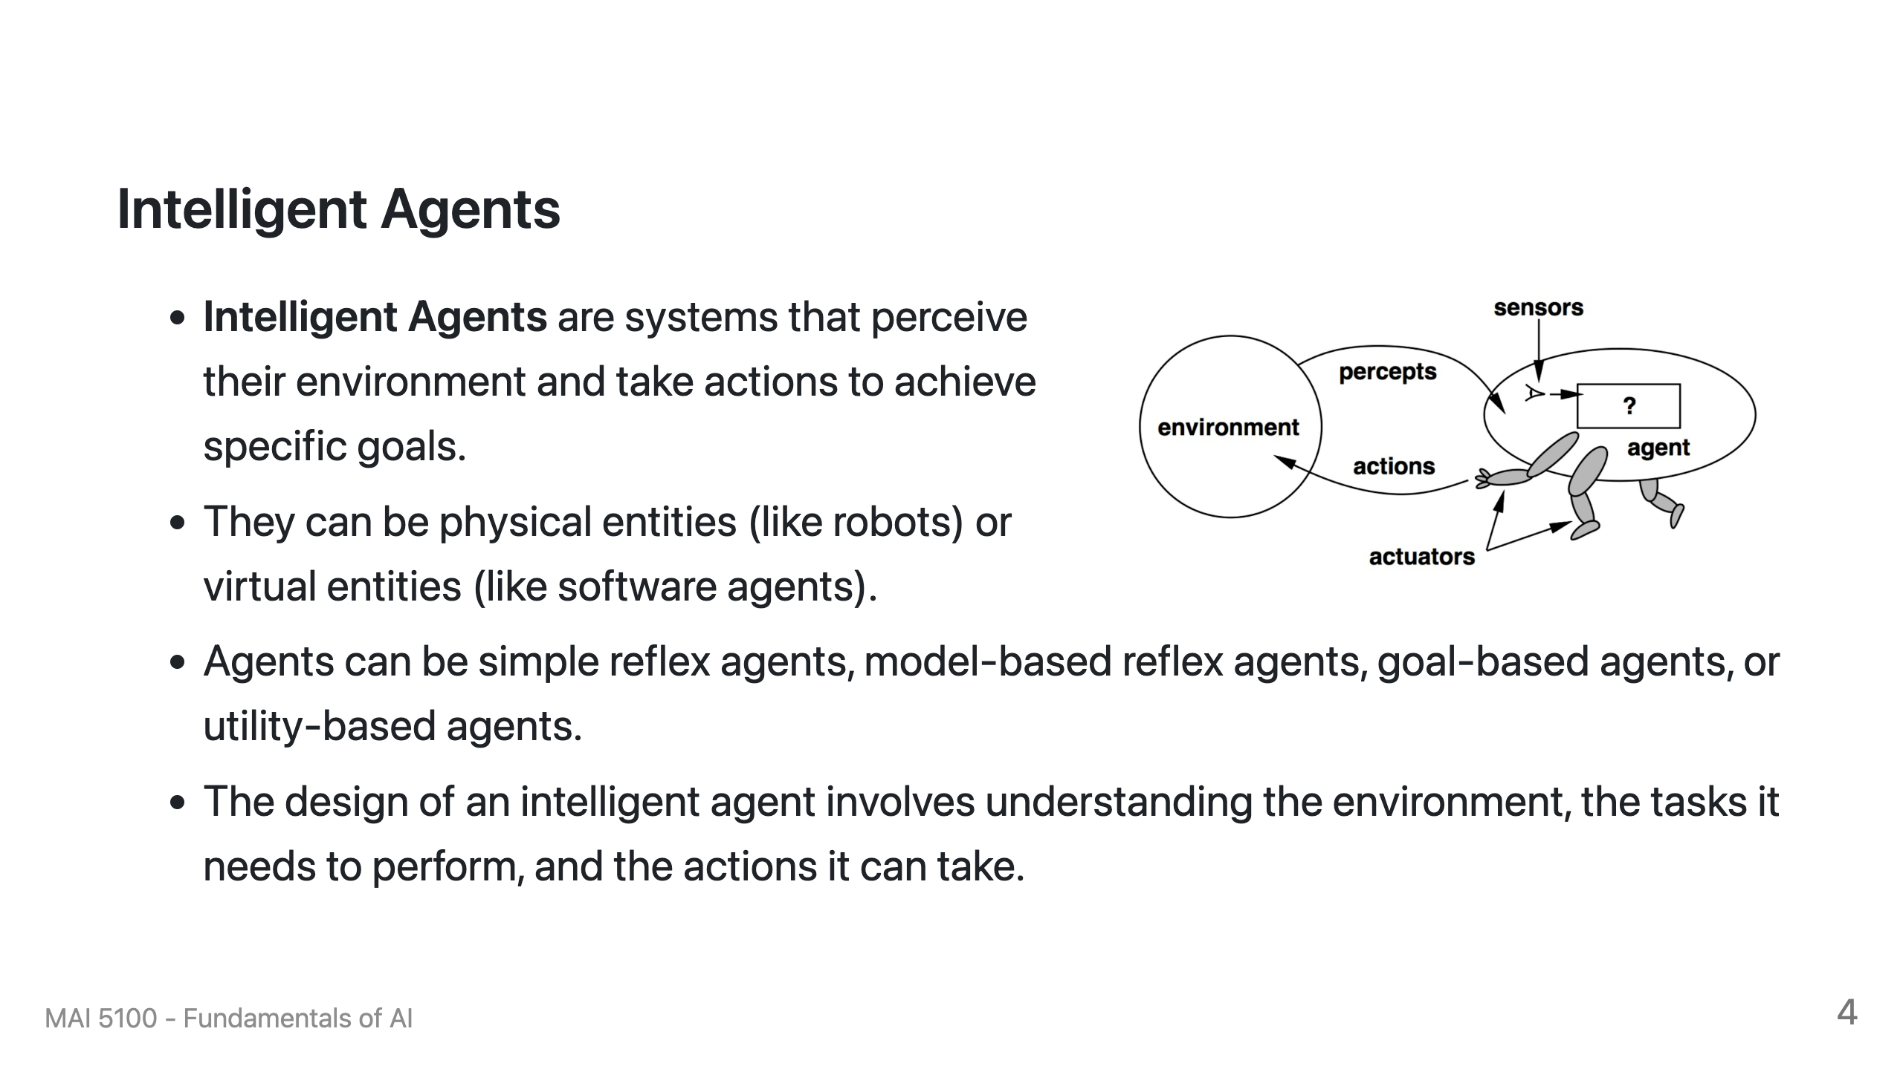

Slide 5
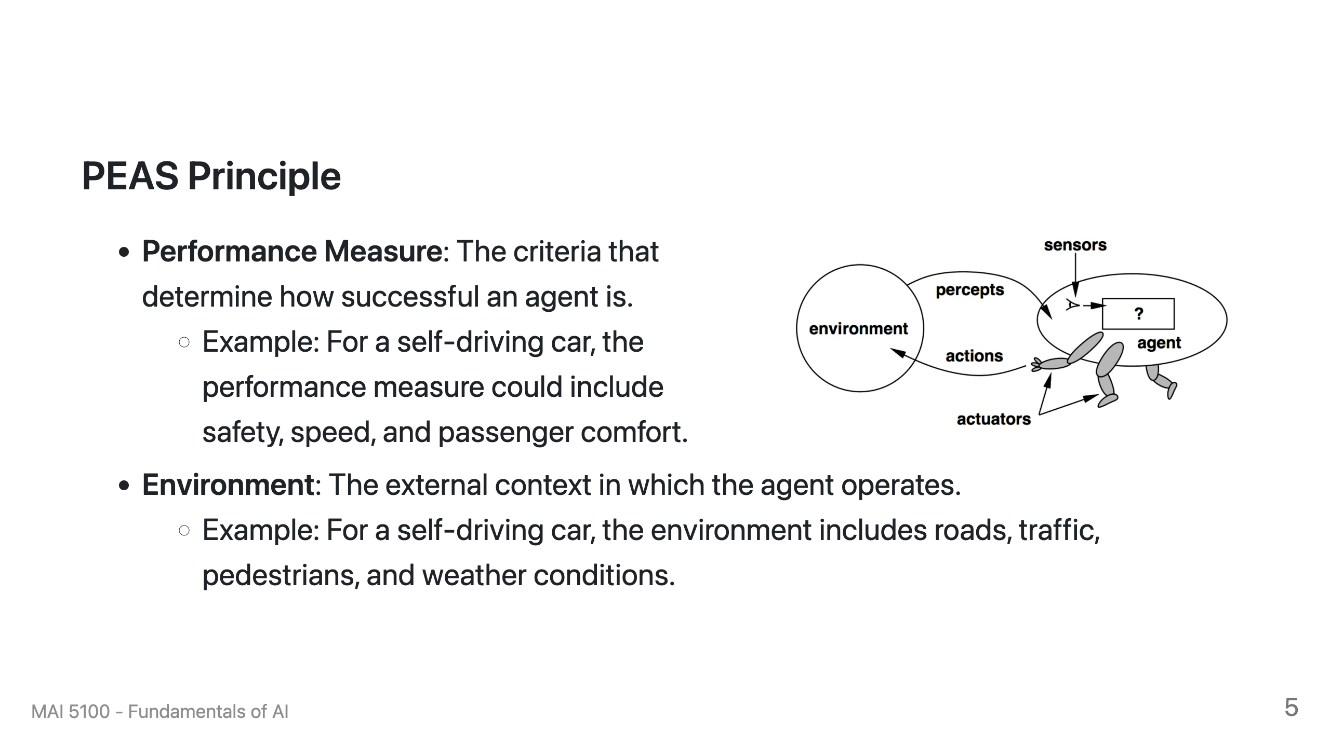

Slide 6
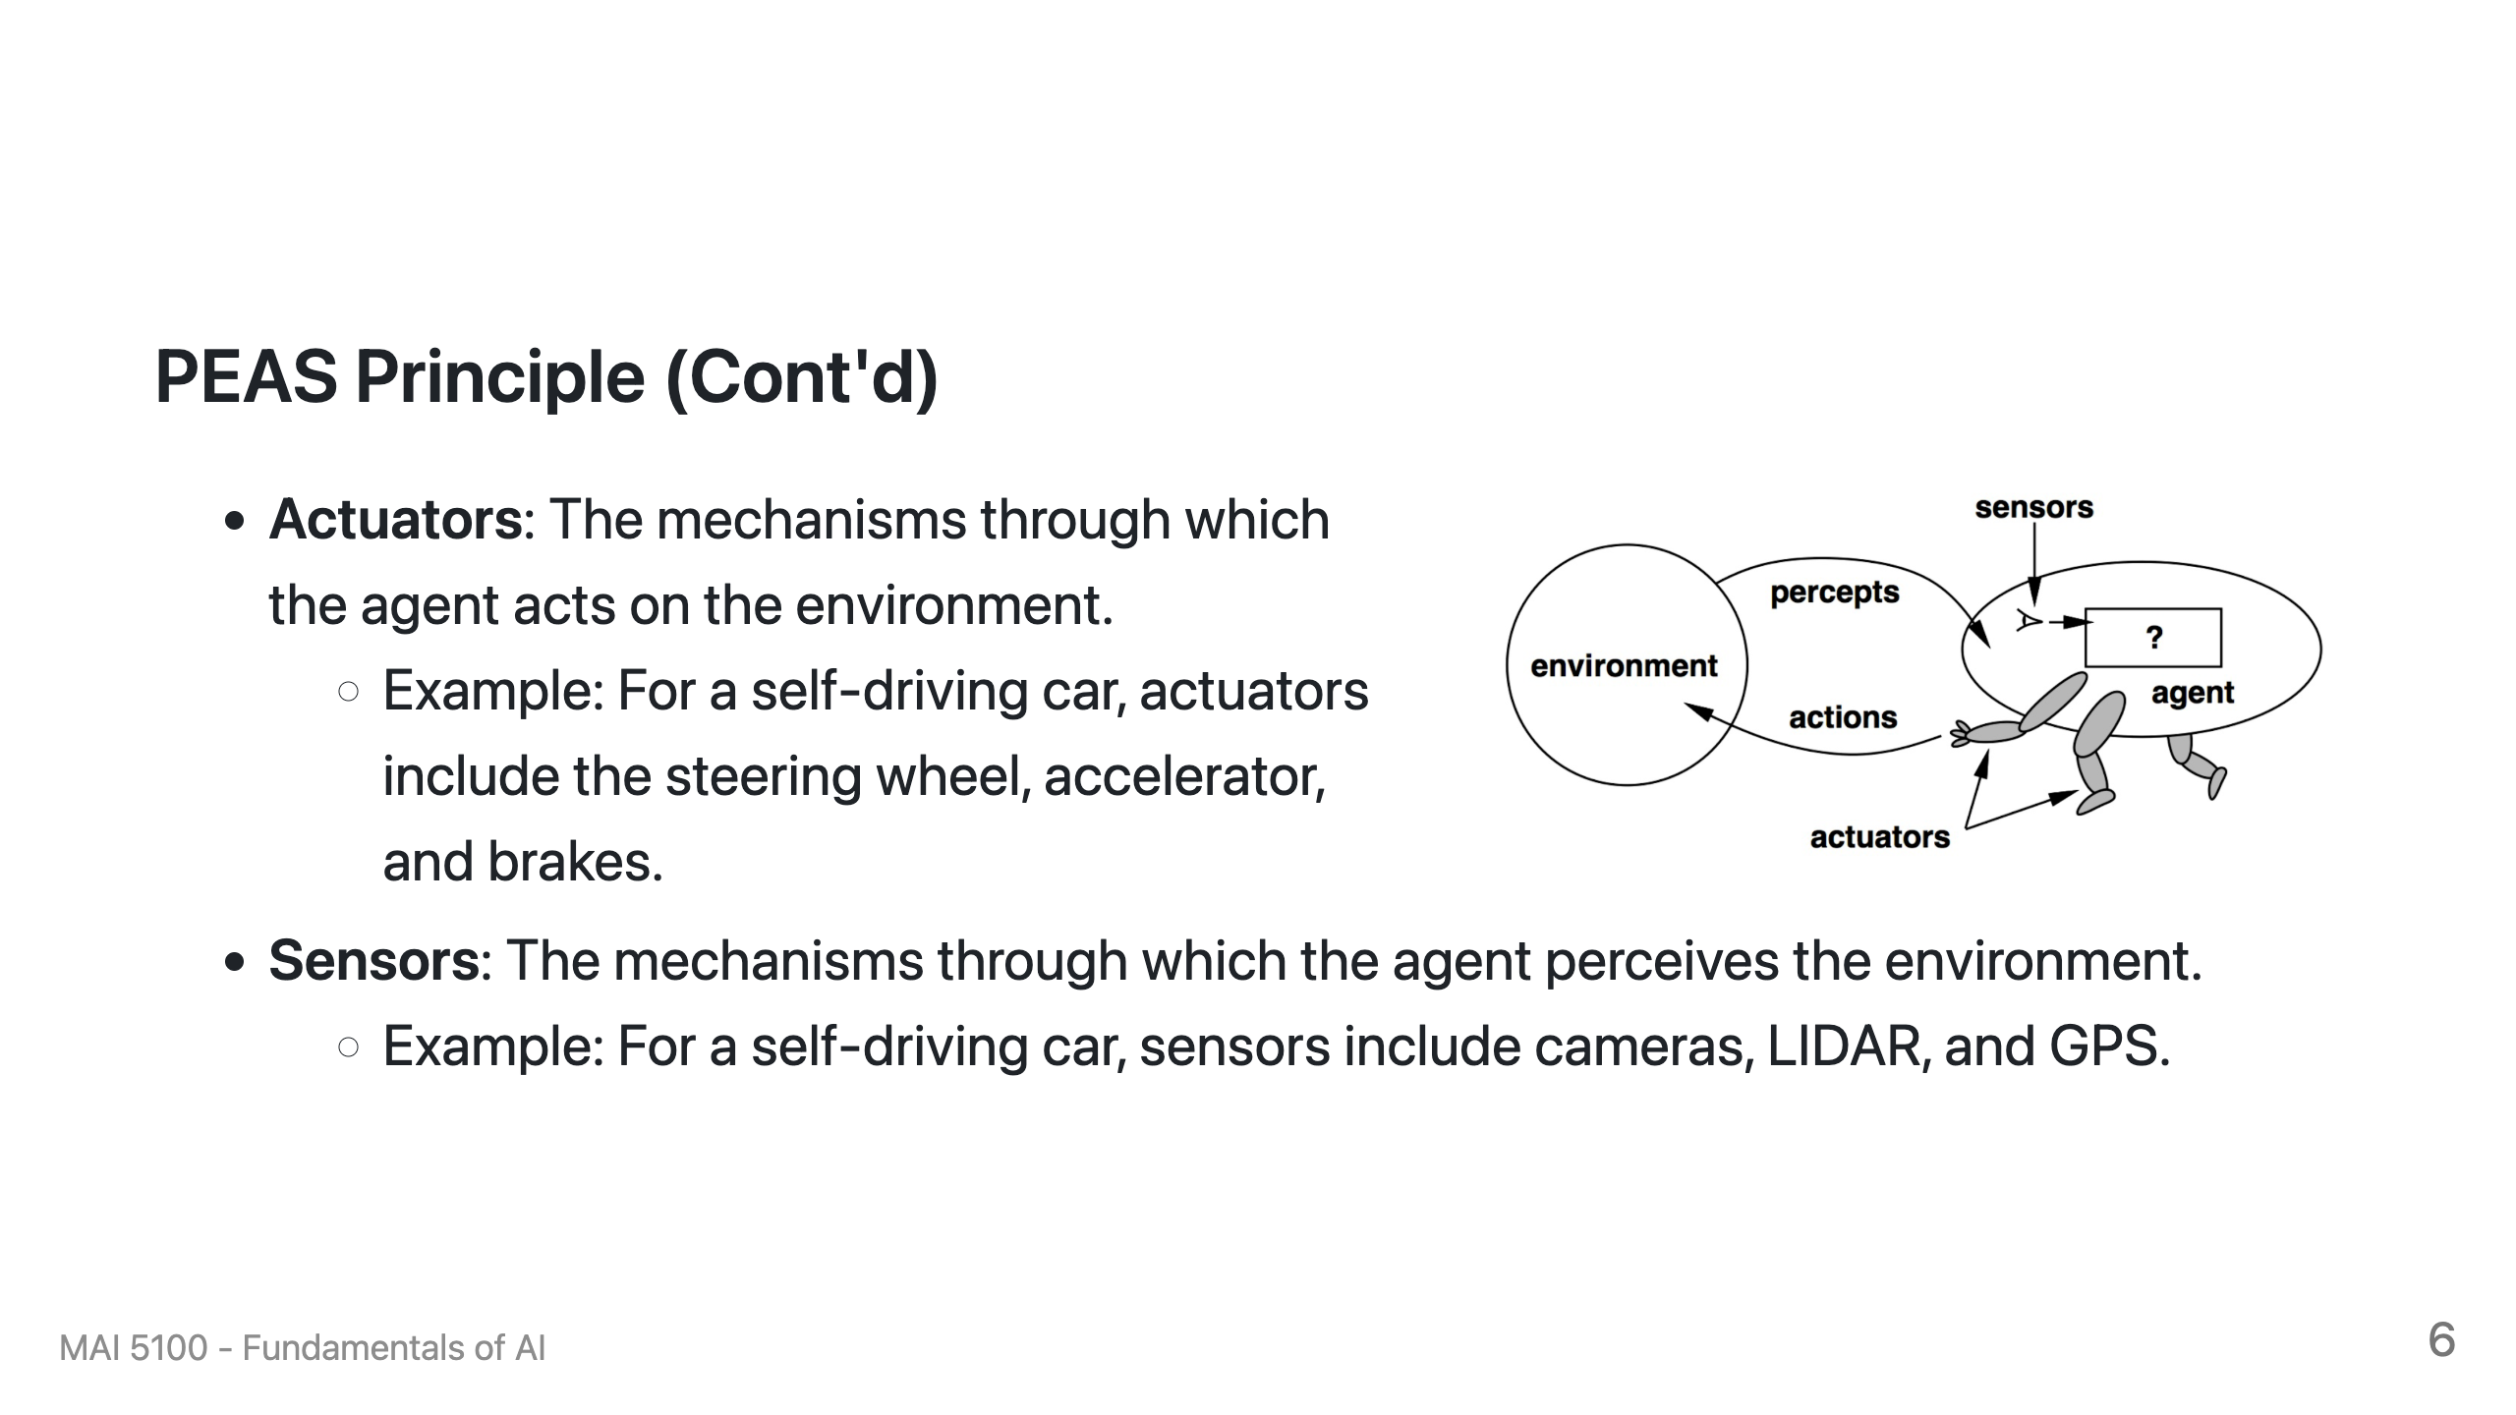

Slide 7
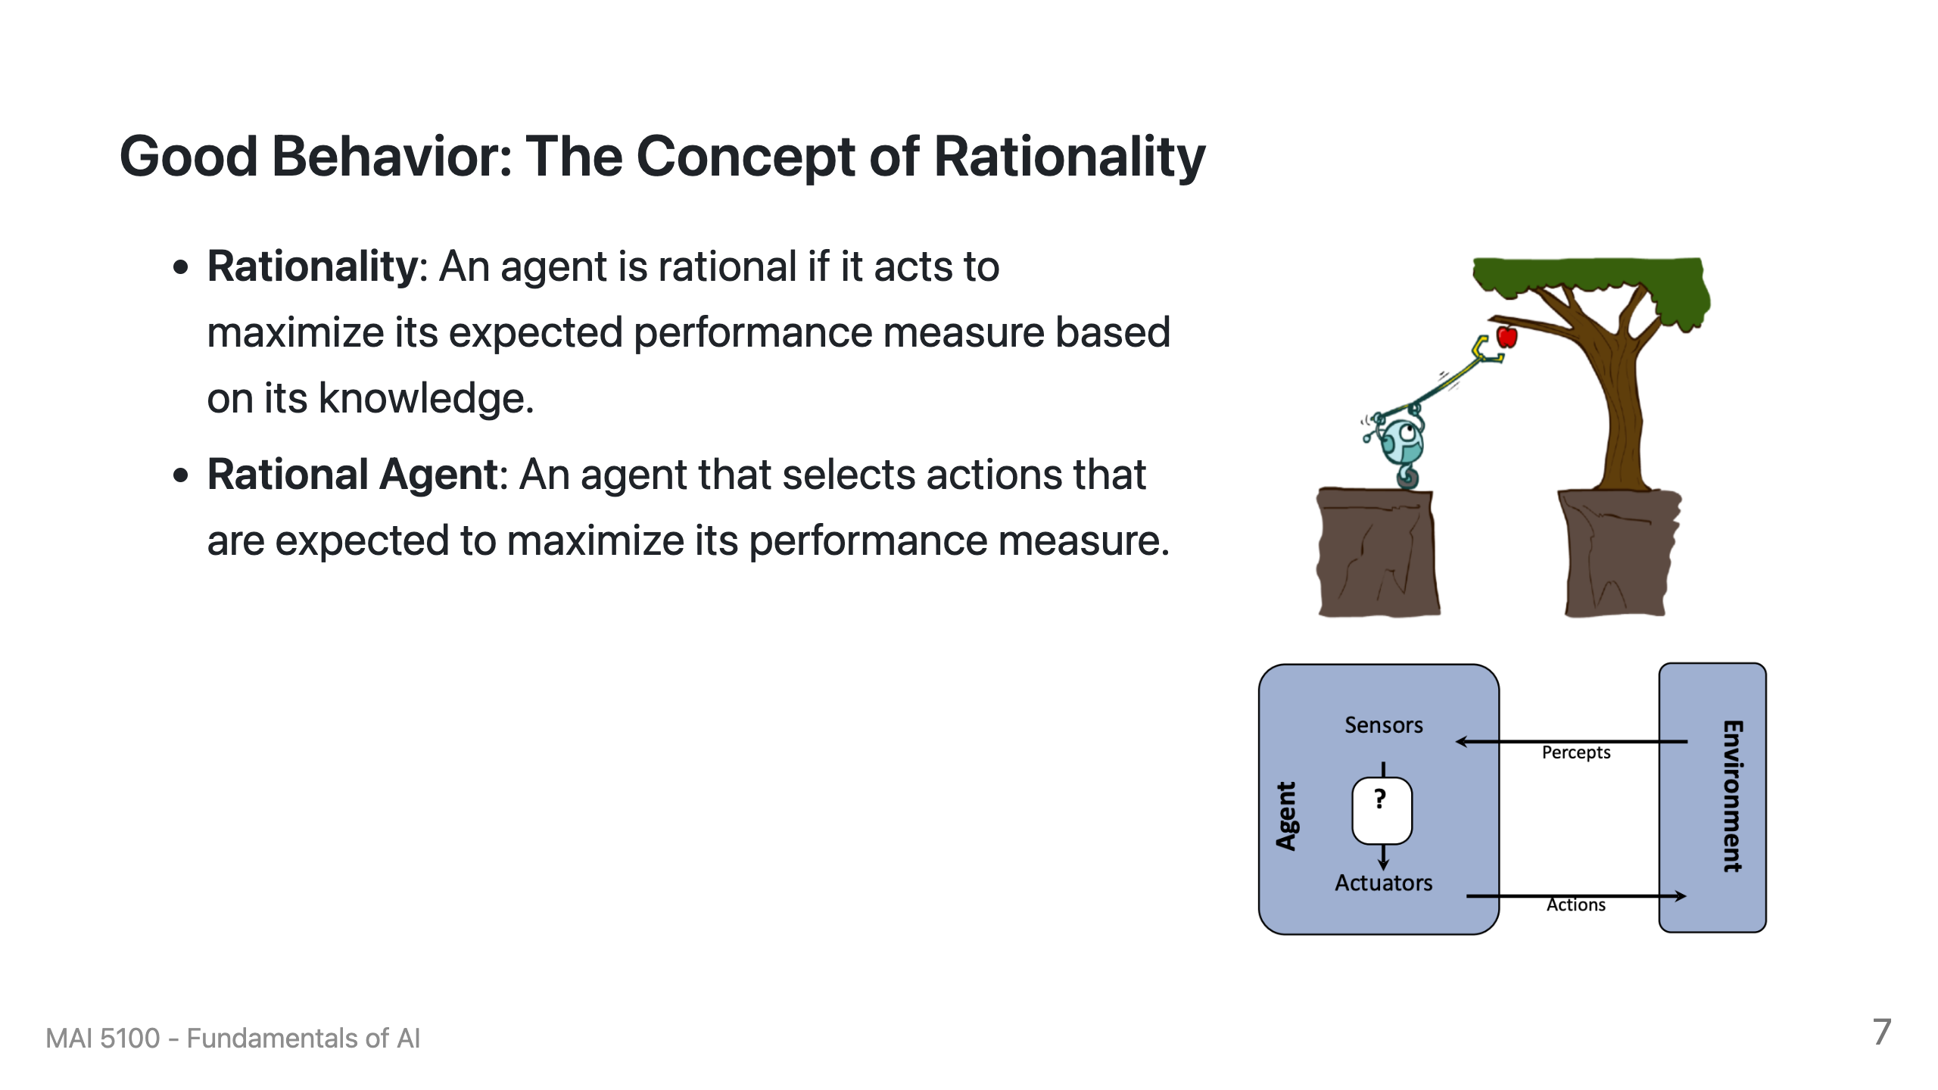

Slide 8
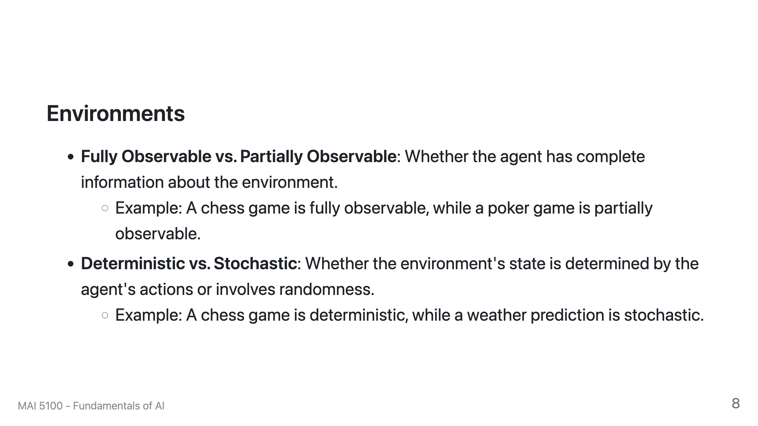

Slide 9
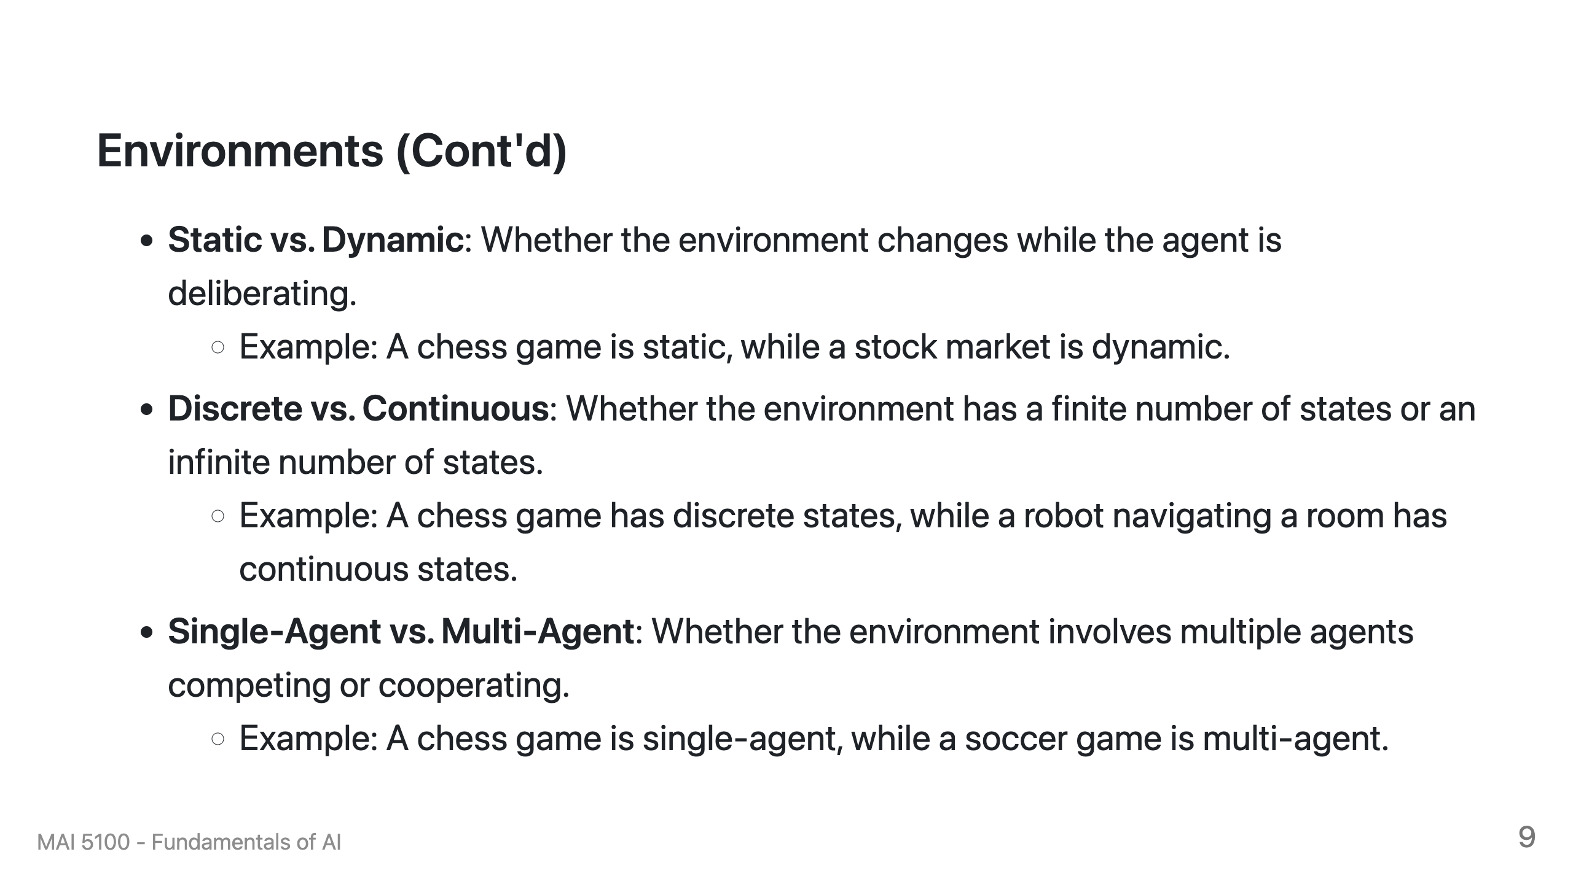

Slide 10
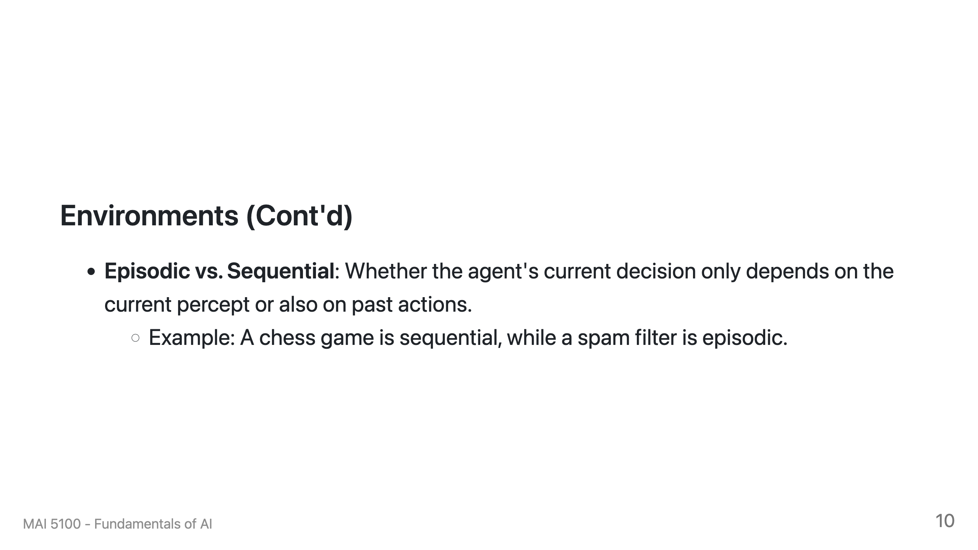

Slide 11
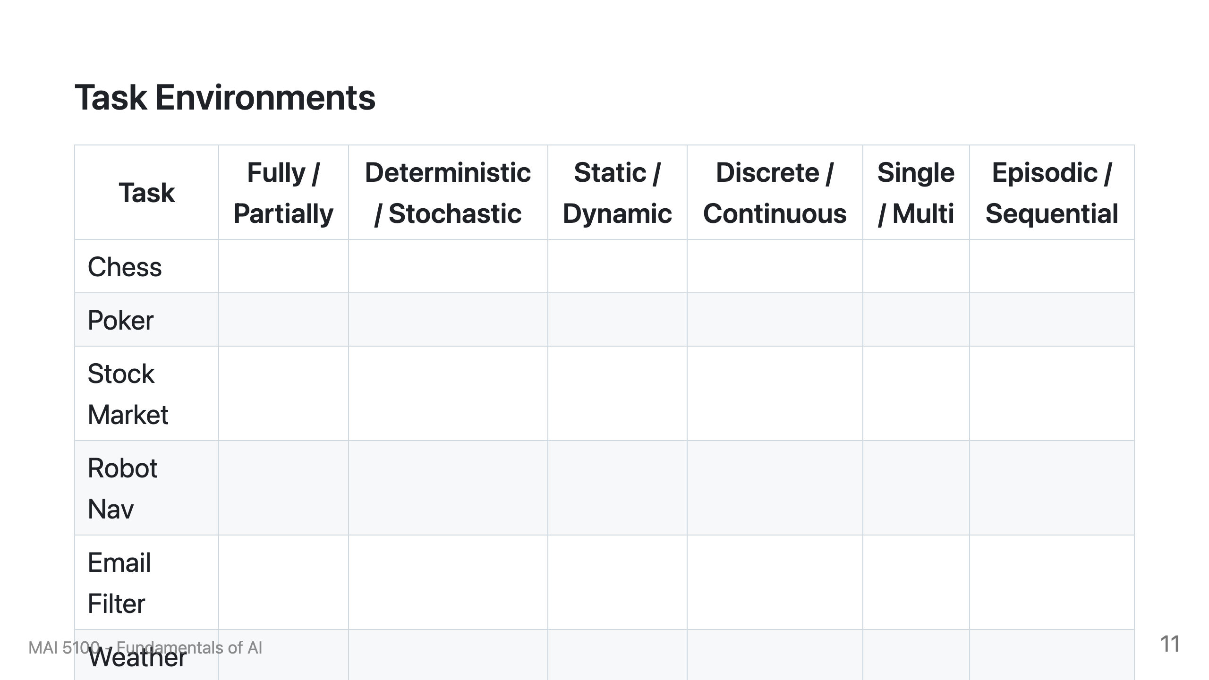

Slide 12
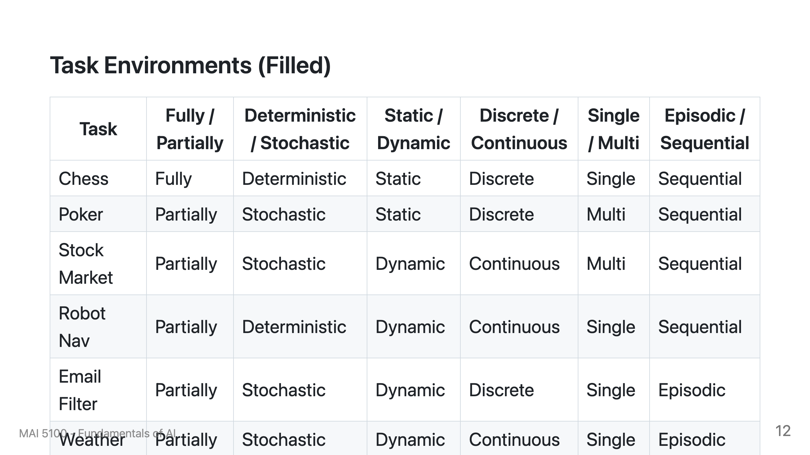

Slide 13
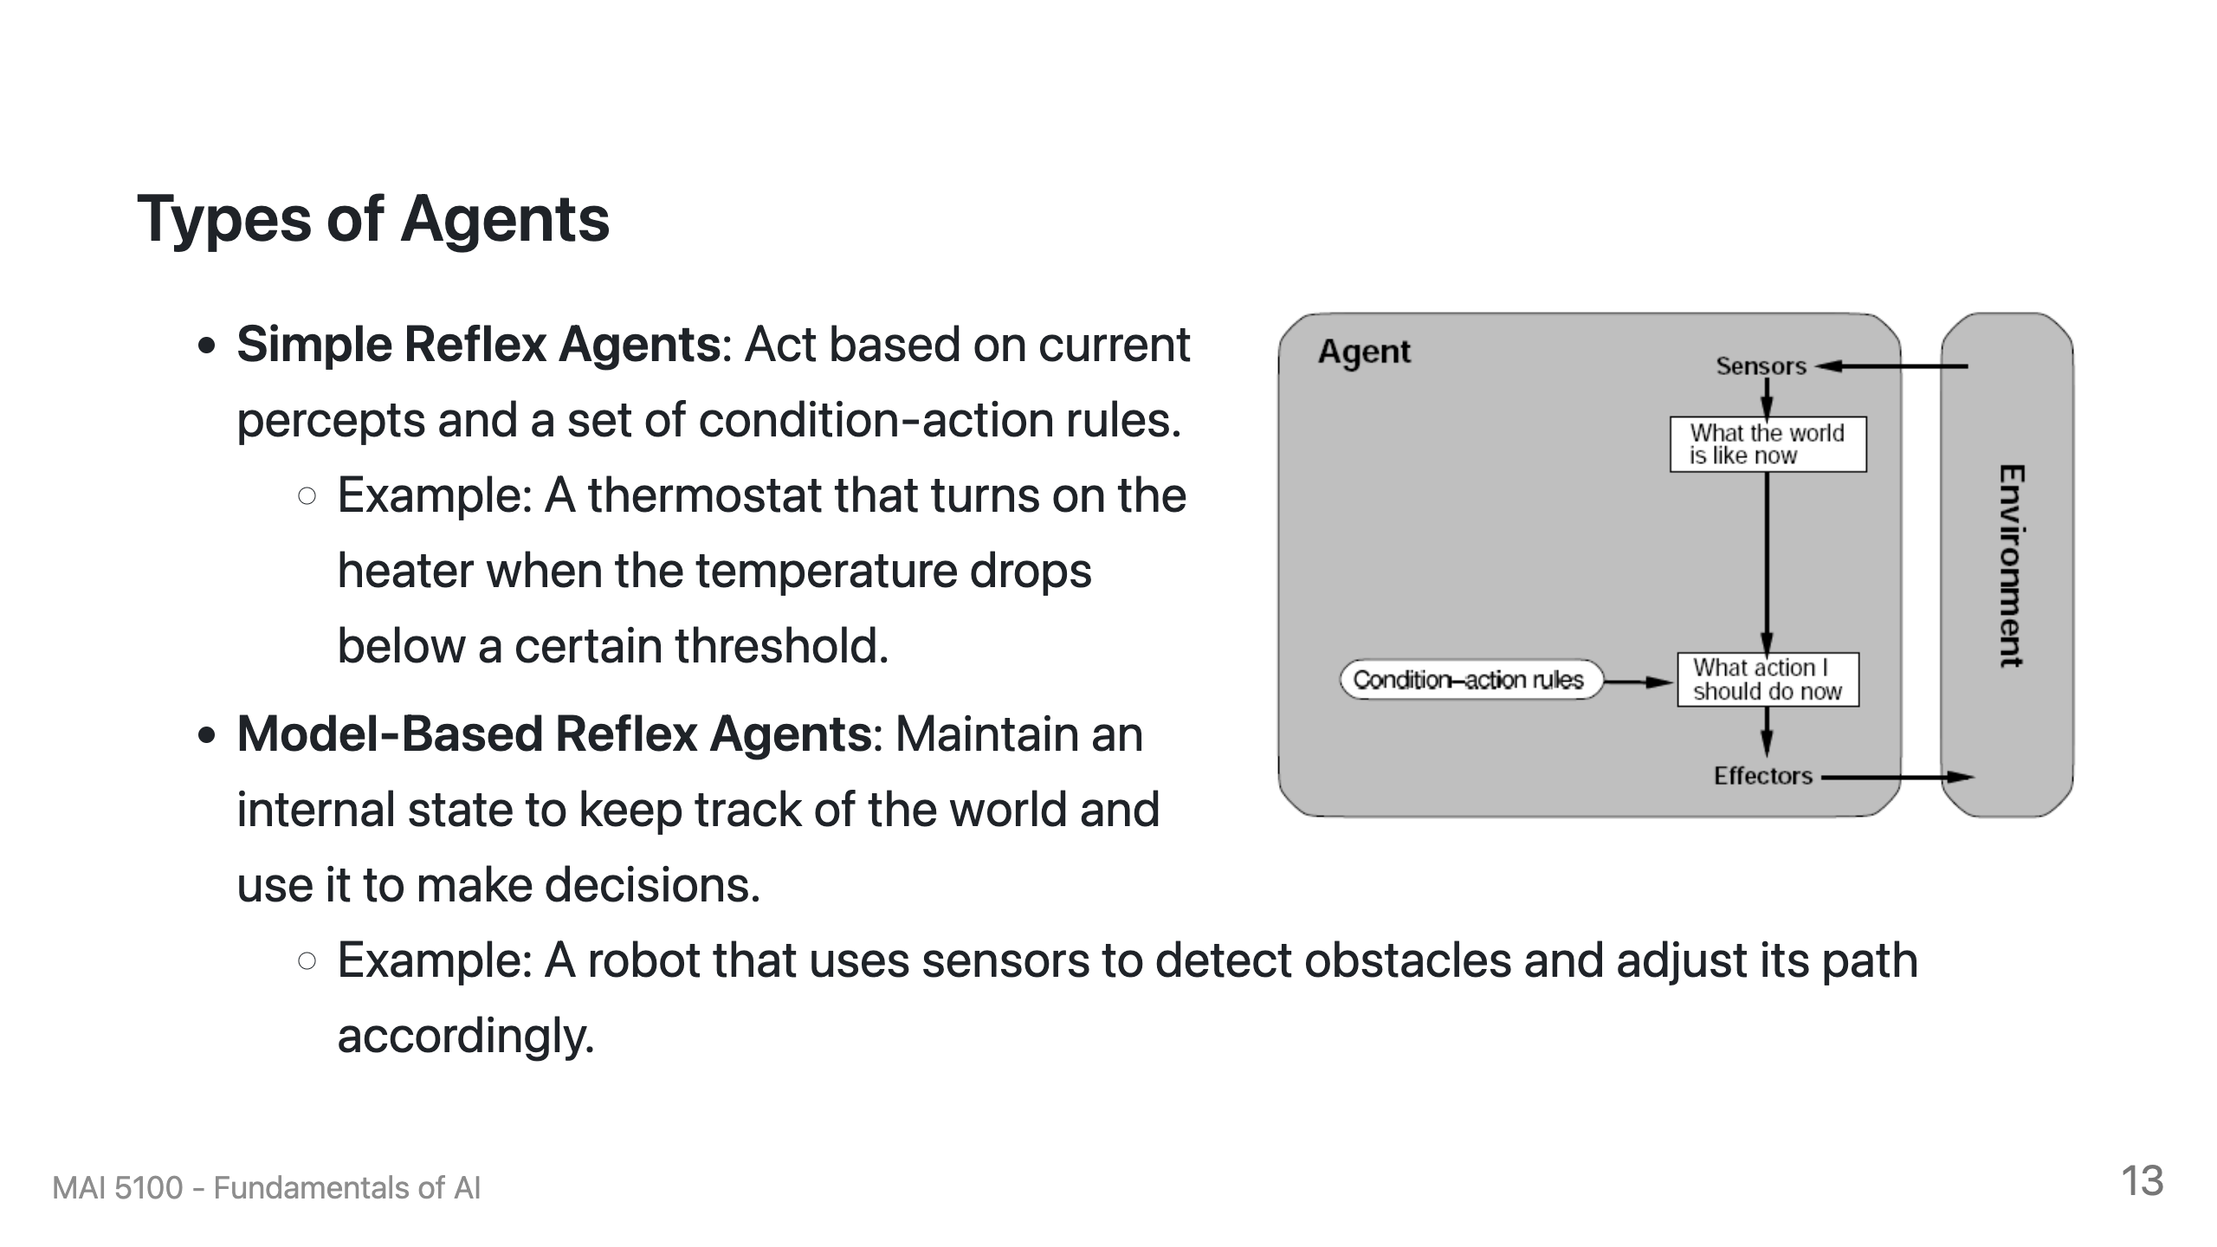

Slide 14
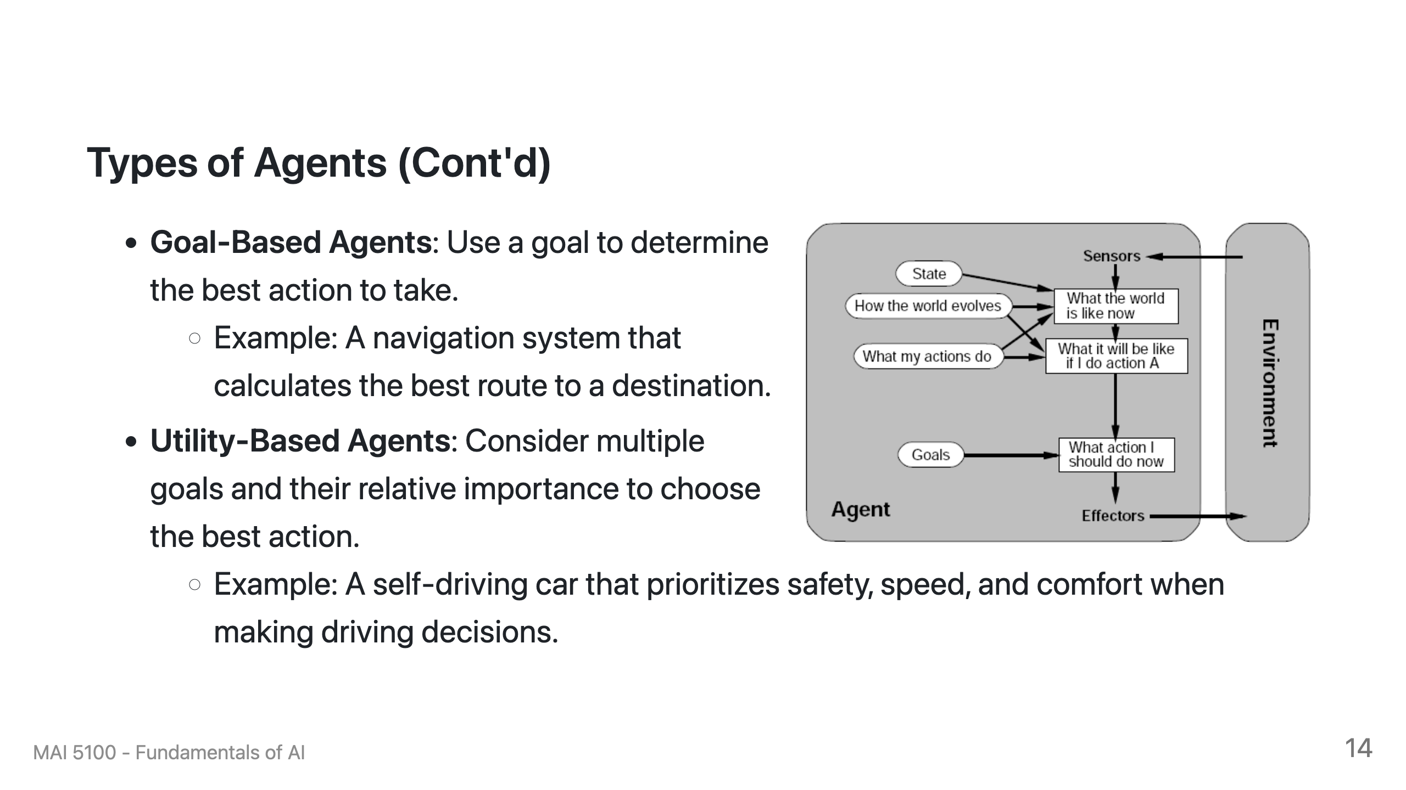

Slide 15
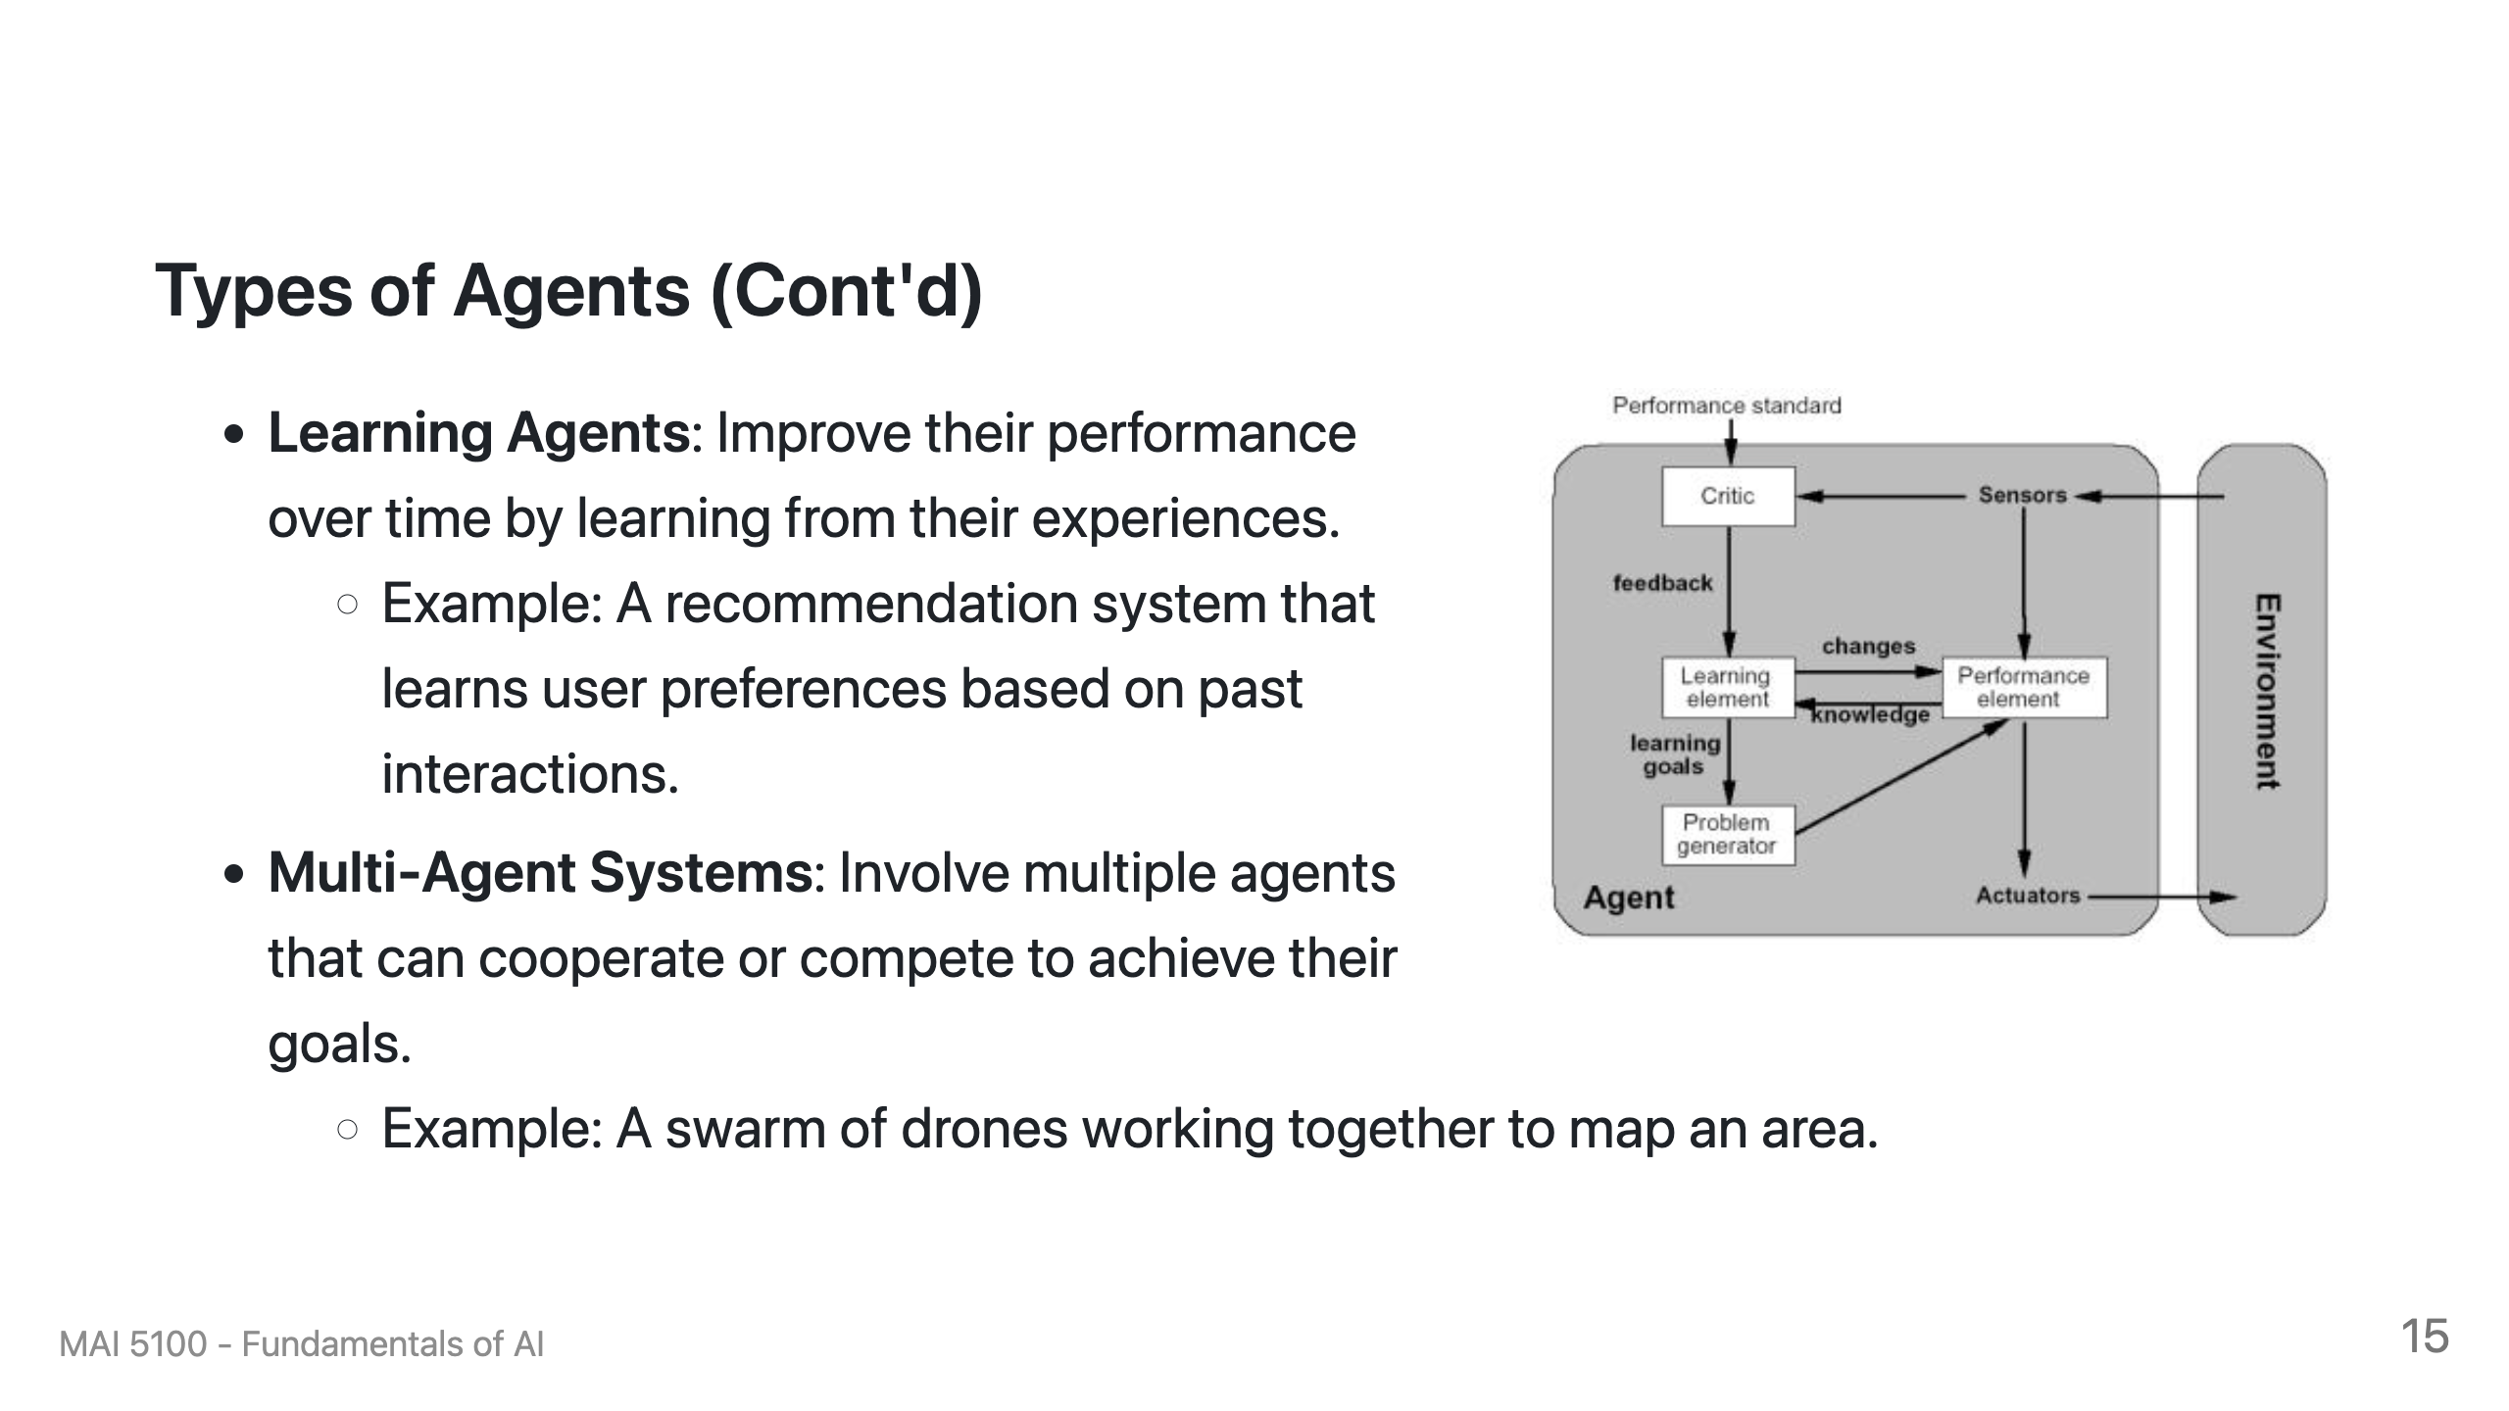

Slide 16
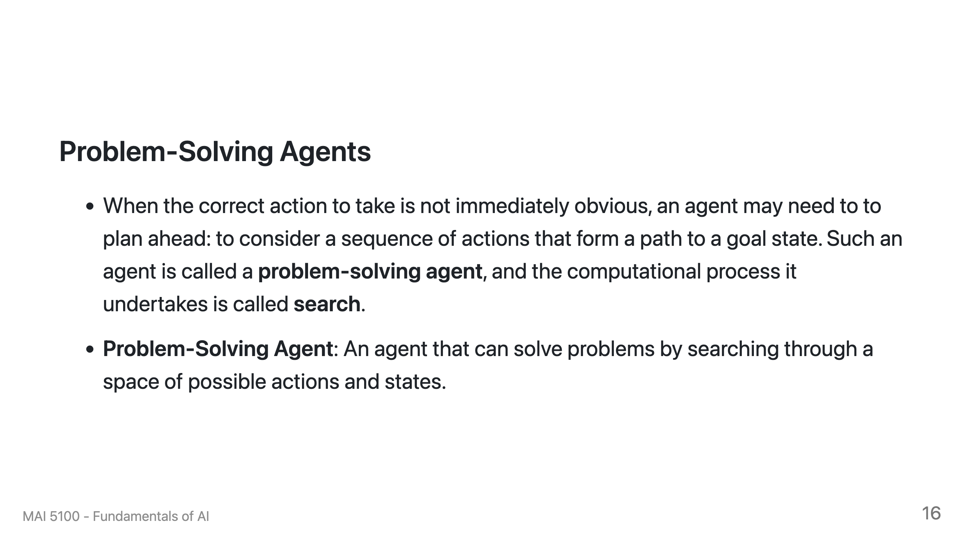

Slide 17
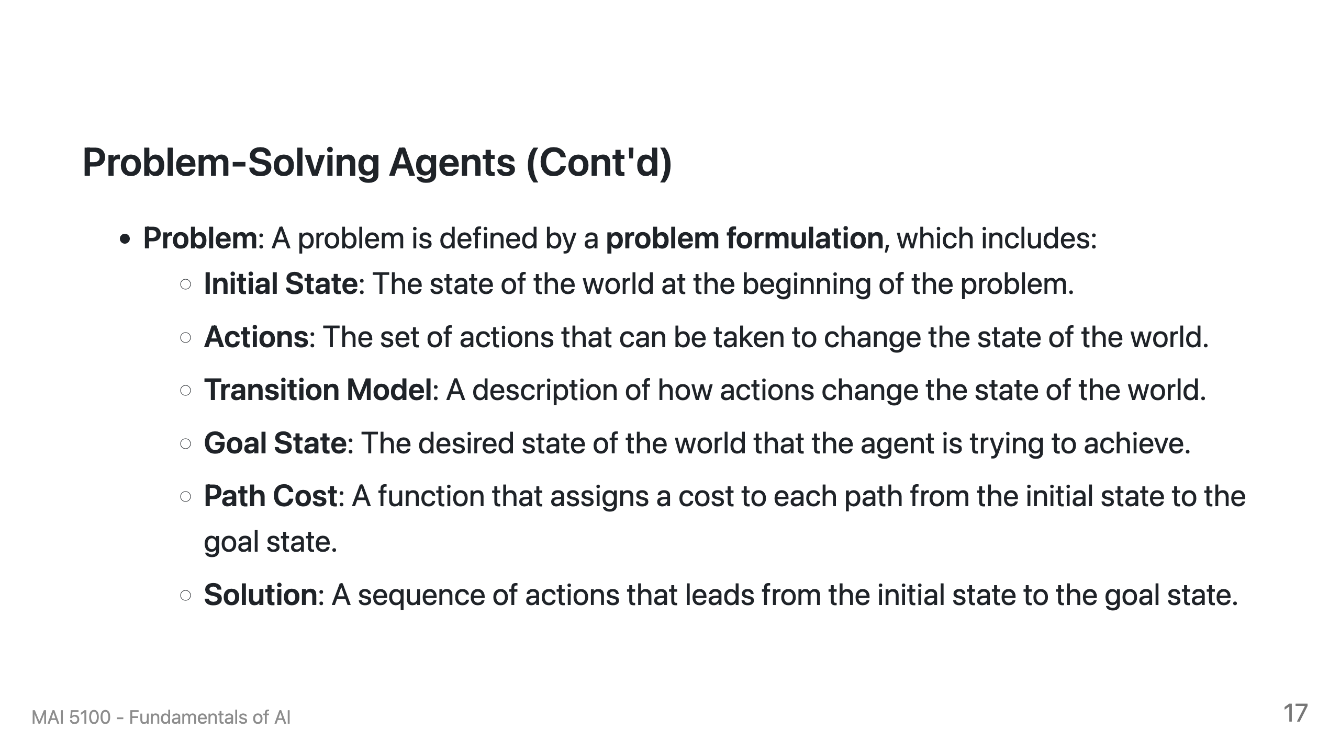

Slide 18


Slide 19
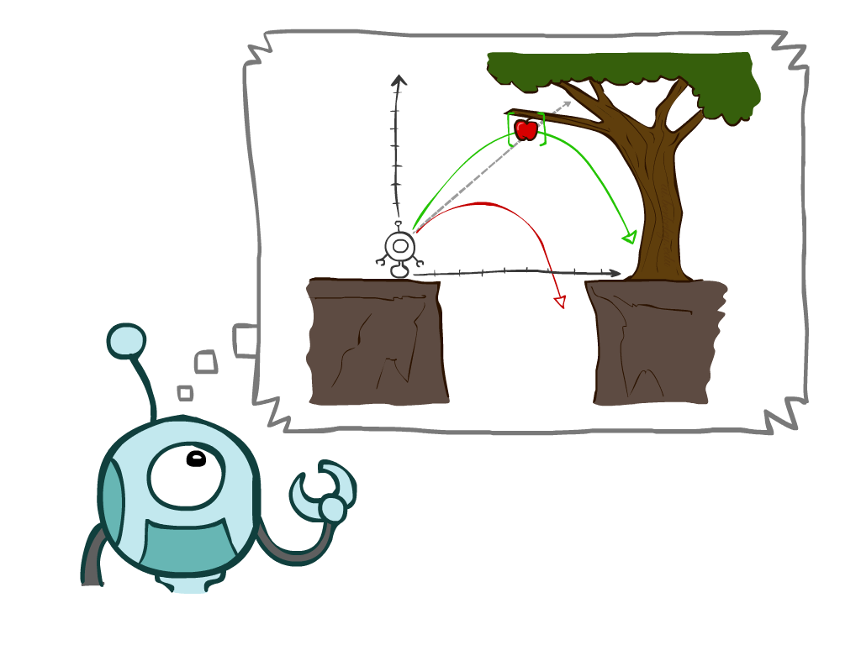
Today
Agents that Plan Ahead
Search Problems
Uninformed Search Methods
  Depth-First Search
  Breadth-First Search
  Uniform-Cost Search
Notes:
General theme in the class:
A goal we have in mind.
A mathematical abstraction to formalize this
Algorithms that operate on these abstractions

Slide 20
Agents that Plan

Slide 21

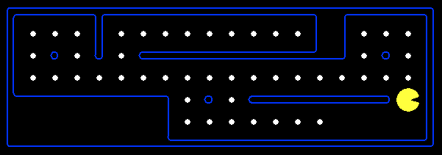
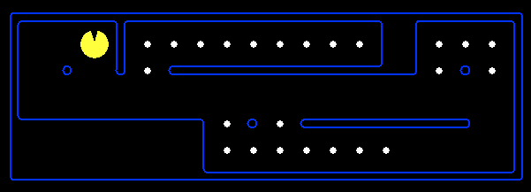
Reflex Agents
Reflex agents:
  Choose action based on current percept (and maybe memory)
  May have memory or a model of the world’s current state
  Do not consider the future consequences of their actions
  Consider how the world IS
Can a reflex agent be rational?
[Demo: reflex optimal (L2D1)]
[Demo: reflex optimal (L2D2)]
Notes:
Examples: blinking your eye (not using your entire thinking capabilities), vacuum cleaner moving towards nearest dirt

Slide 22
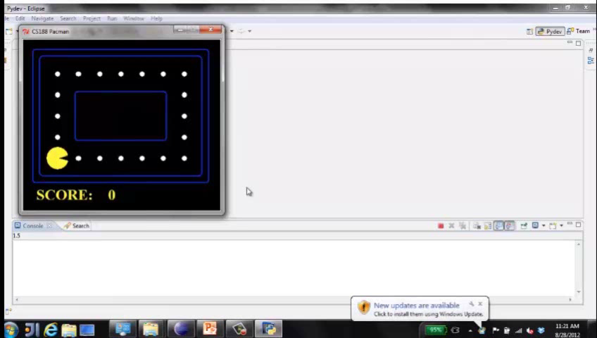
Video of Demo Reflex Optimal

Slide 23
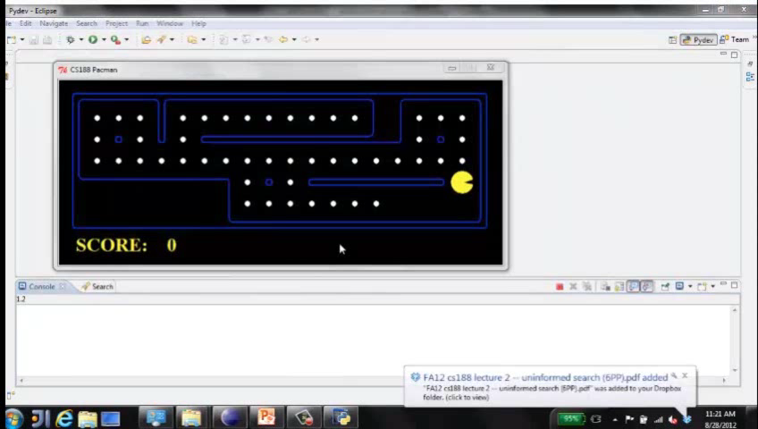
Video of Demo Reflex Odd

Slide 24
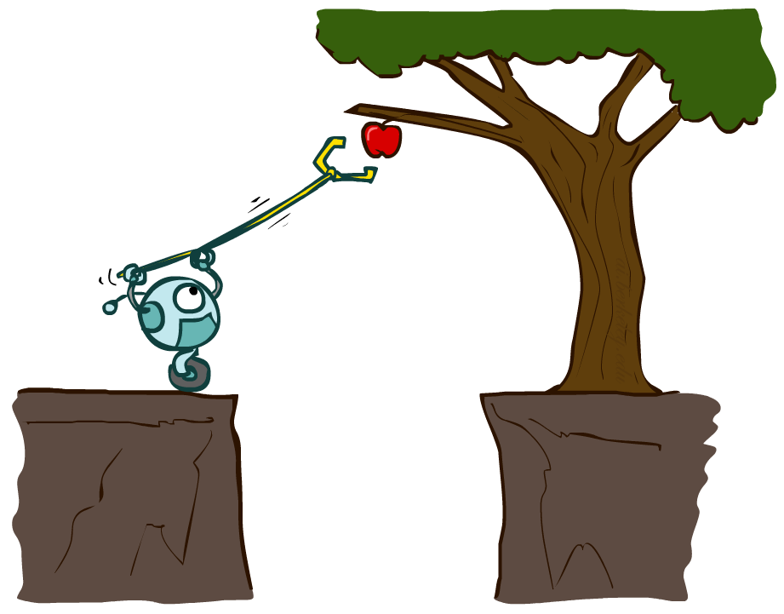
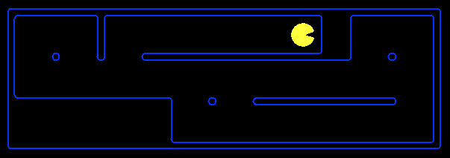
Planning Agents
Planning agents:
  Ask “what if”
  Decisions based on (hypothesized) consequences of actions
  Must have a model of how the world evolves in response to actions
  Must formulate a goal (test)
  Consider how the world WOULD BE
Optimal vs. complete planning
Planning vs. replanning
[Demo: replanning (L2D3)]
[Demo: mastermind (L2D4)]

Slide 25
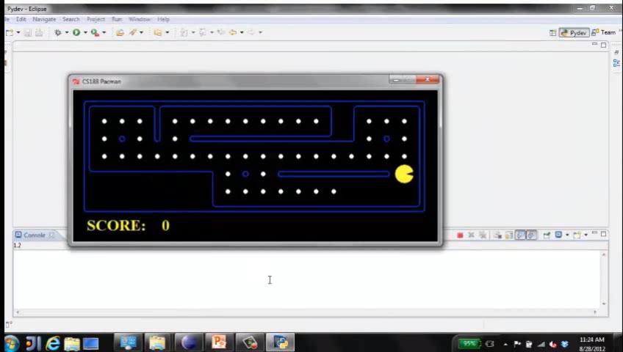
Video of Demo Replanning

Slide 26
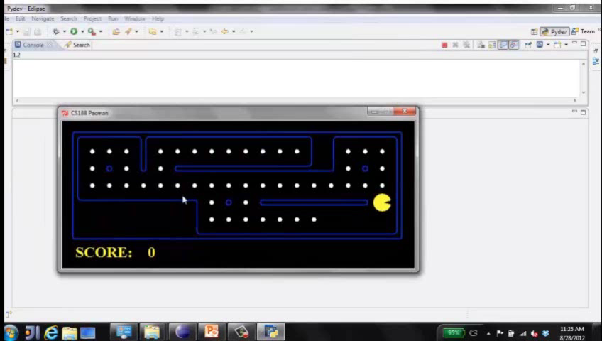
Video of Demo Mastermind

Slide 27

Search Problems

Slide 28

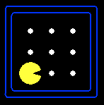





Search Problems
A search problem consists of:
  A state space
  A successor function
  (with actions, costs)
  A start state and a goal test
A solution is a sequence of actions (a plan) which transforms the start state to a goal state
“N”, 1.0
“E”, 1.0
Notes:
Often comes back on exams
Goal test – sometimes more than one state that satisfies having achieved the goal, for example, “eat all the dots”
Abstraction

Slide 29

Search Problems Are Models

Slide 30
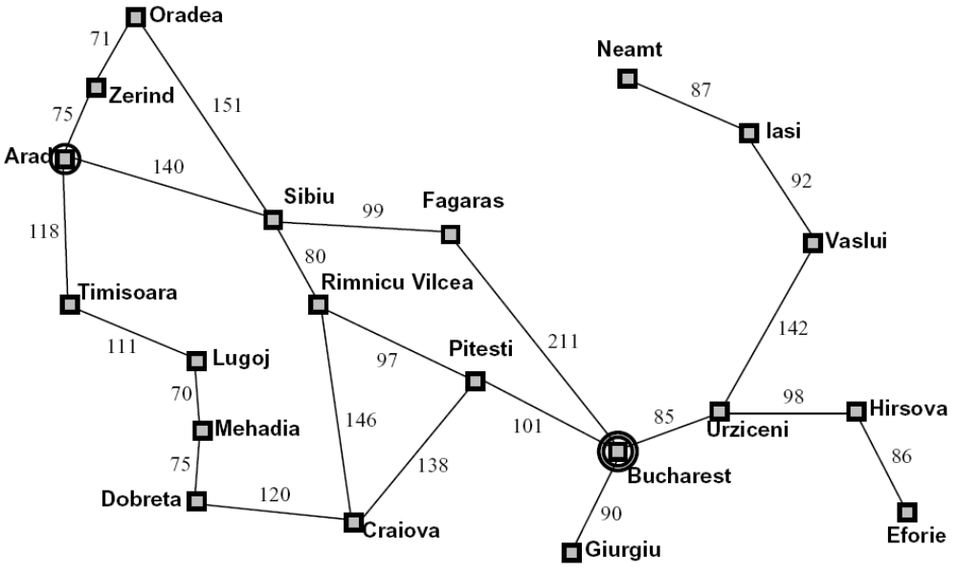
Example: Traveling in Romania
State space:
  Cities
Successor function:
  Roads: Go to adjacent city with cost = distance
Start state:
  Arad
Goal test:
  Is state == Bucharest?
Solution?

Slide 31
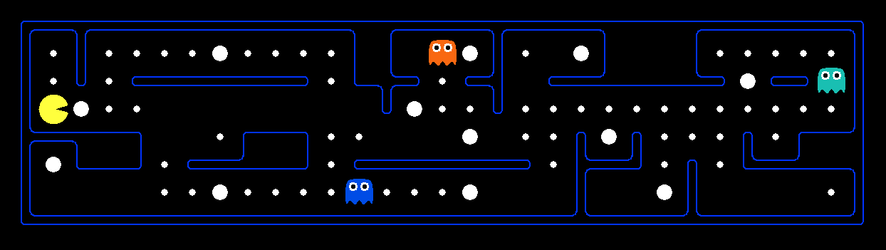
What’s in a State Space?
The world state includes every last detail of the environment
A search state keeps only the details needed for planning (abstraction)
Problem: Pathing
  States: (x,y) location
  Actions: NSEW
  Successor: update location only
  Goal test: is (x,y)=END
Problem: Eat-All-Dots
  States: {(x,y), dot booleans}
  Actions: NSEW
  Successor: update location and possibly a dot boolean
  Goal test: dots all false
Notes:
Wrong example for “eat-all-dots”: (x, y, dot count)

Slide 32
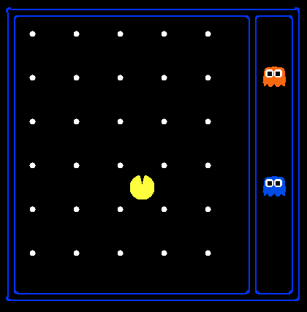
State Space Sizes?
World state:
  Agent positions: 120
  Food count: 30
  Ghost positions: 12
  Agent facing: NSEW
How many
  World states?
  120x(2³⁰)x(12²)x4
  States for pathing?
  120
  States for eat-all-dots?
  120x(2³⁰)
Notes:
90 * (2^30-1) + 30 * 2^29 = 145 billion
2^29 = 536 870 912

Slide 33
Quiz: Safe Passage
Problem: eat all dots while keeping the ghosts perma-scared
What does the state space have to specify?
  (agent position, dot booleans, power pellet booleans, remaining scared time)

Slide 34
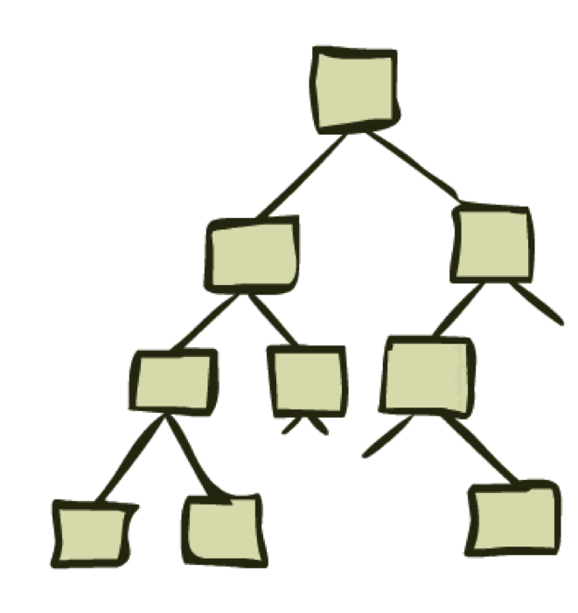
State Space Graphs and Search Trees

Slide 35
State Space Graphs
State space graph: A mathematical representation of a search problem
  Nodes are (abstracted) world configurations
  Arcs represent successors (action results)
  The goal test is a set of goal nodes (maybe only one)
In a state space graph, each state occurs only once!
We can rarely build this full graph in memory (it’s too big), but it’s a useful idea

Slide 36
State Space Graphs
State space graph: A mathematical representation of a search problem
  Nodes are (abstracted) world configurations
  Arcs represent successors (action results)
  The goal test is a set of goal nodes (maybe only one)
In a search graph, each state occurs only once!
We can rarely build this full graph in memory (it’s too big), but it’s a useful idea
a
G
b
c
e
d
f
S
h
p
q
r
Tiny search graph for a tiny search problem

Slide 37
Search Trees
This is now / start
“N”, 1.0
“E”, 1.0
Possible futures
A search tree:
  A “what if” tree of plans and their outcomes
  The start state is the root node
  Children correspond to successors
  Nodes show states, but correspond to PLANS that achieve those states
  For most problems, we can never actually build the whole tree
Notes:
Different plans that achieve the same state, will be different nodes in the tree.

Slide 38
State Space Graphs vs. Search Trees
State Space Graph
Each NODE in in the search tree is an entire PATH in the state space graph.
Search Tree
S
a
G
d
e
p
b
c
q
b
c
e
h
r
d
e
f
a
a
h
r
p
q
f
S
h
We construct both on demand – and we construct as little as possible.
p
q
f
q
c
G
p
q
r
q
c
G
a
a

Slide 39

Quiz: State Space Graphs vs. Search Trees
Consider this 4-state graph:
How big is its search tree (from S)?
a
S
G
b
Important: Lots of repeated structure in the search tree!

Slide 40
Tree Search

Slide 41
Search Example: Romania

Slide 42
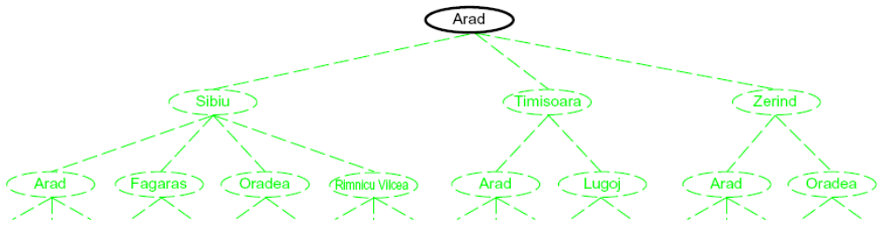
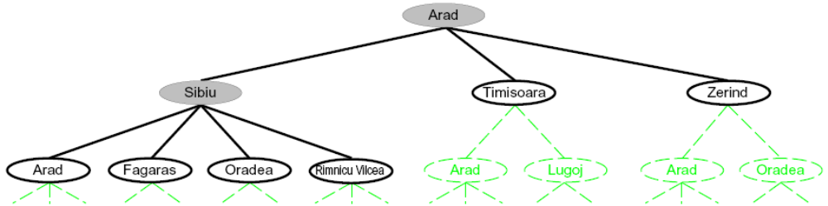
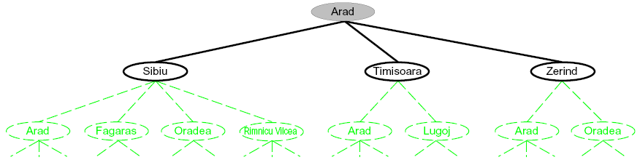
Searching with a Search Tree
Search:
  Expand out potential plans (tree nodes)
  Maintain a fringe of partial plans under consideration
  Try to expand as few tree nodes as possible

Slide 43
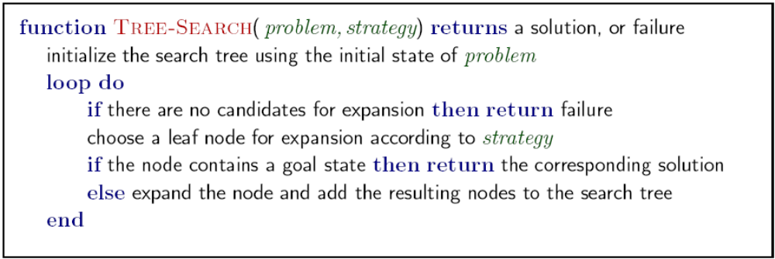
General Tree Search
Important ideas:
  Fringe
  Expansion
  Exploration strategy
Main question: which fringe nodes to explore?

Slide 44
Example: Tree Search
a
G
b
c
d
e
f
S
h
p
q
r
Notes:
Left: show tree
Right: fringe

Slide 45
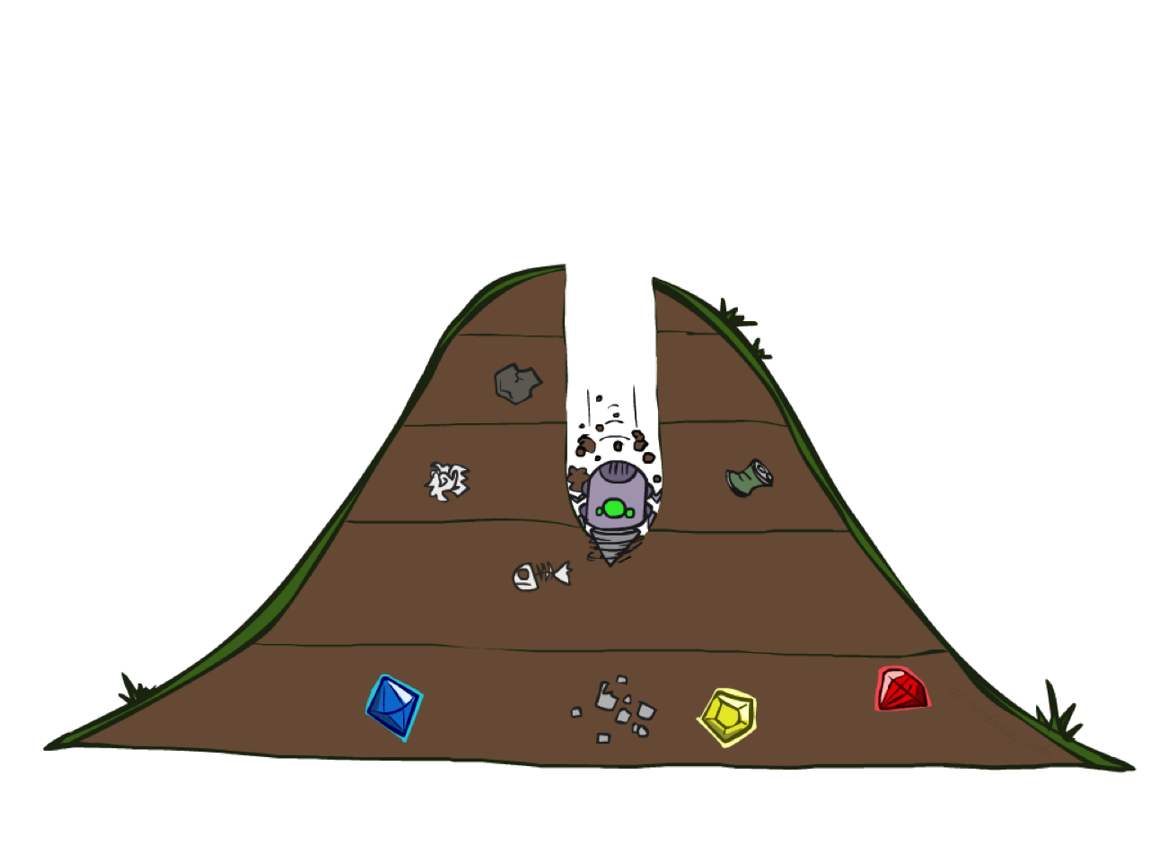
Depth-First Search

Slide 46
Depth-First Search
Strategy: expand a deepest node first
Implementation: Fringe is a LIFO stack
a
G
a
c
b
c
b
e
d
e
d
f
f
S
h
h
p
p
r
q
r
q
S
d
e
p
b
c
e
h
r
q
a
a
h
r
p
q
f
p
q
f
q
c
G
q
c
G
a
a

Slide 47
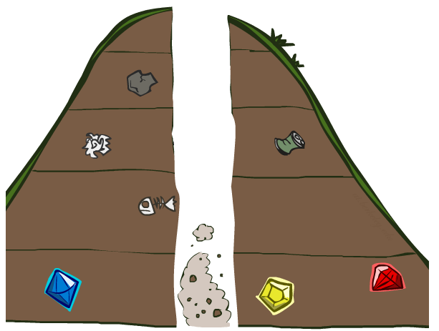
Search Algorithm Properties

Slide 48
Search Algorithm Properties
Complete: Guaranteed to find a solution if one exists?
Optimal: Guaranteed to find the least cost path?
Time complexity?
Space complexity?
Cartoon of search tree:
  b is the branching factor
  m is the maximum depth
  solutions at various depths
Number of nodes in entire tree?
  1 + b + b² + …. b^{m} = O(b^{m})
1 node
b
…
b nodes
b² nodes
m tiers
b^{m} nodes

Slide 49
Depth-First Search (DFS) Properties
What nodes DFS expand?
  Some left prefix of the tree.
  Could process the whole tree!
  If m is finite, takes time O(b^{m})
How much space does the fringe take?
  Only has siblings on path to root, so O(bm)
Is it complete?
  m could be infinite, so only if we prevent cycles (more later)
Is it optimal?
  No, it finds the “leftmost” solution, regardless of depth or cost
1 node
b
…
b nodes
b² nodes
m tiers
b^{m} nodes

Slide 50
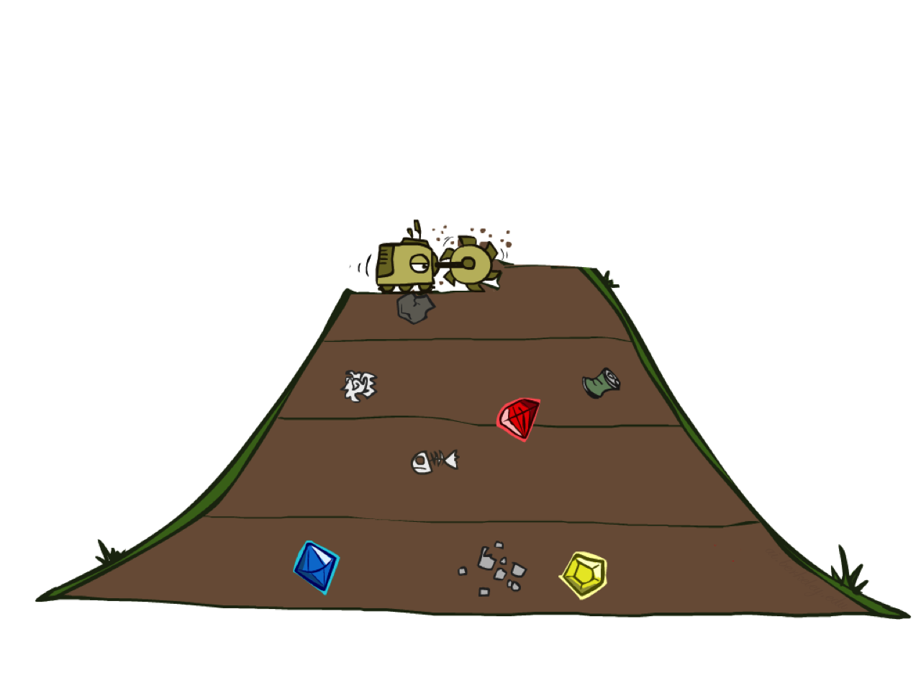
Breadth-First Search

Slide 51
Breadth-First Search
Strategy: expand a shallowest node first
Implementation: Fringe is a FIFO queue
a
G
b
c
d
e
f
S
h
p
q
r
S
d
e
p
Search
Tiers
b
c
e
h
r
q
a
a
h
r
p
q
f
p
q
f
q
c
G
q
c
G
a
a

Slide 52
Breadth-First Search (BFS) Properties
What nodes does BFS expand?
  Processes all nodes above shallowest solution
  Let depth of shallowest solution be s
  Search takes time O(b^{s})
How much space does the fringe take?
  Has roughly the last tier, so O(b^{s})
Is it complete?
  s must be finite if a solution exists, so yes!
Is it optimal?
  Only if costs are all 1 (more on costs later)
1 node
b
…
b nodes
s tiers
b² nodes
b^{s} nodes
b^{m} nodes

Slide 53
Quiz: DFS vs BFS

Slide 54
Quiz: DFS vs BFS
When will BFS outperform DFS?
When will DFS outperform BFS?
[Demo: dfs/bfs maze water (L2D6)]

Slide 55

Video of Demo Maze Water DFS/BFS (part 1)

Slide 56
Video of Demo Maze Water DFS/BFS (part 2)

Slide 57
Iterative Deepening
Idea: get DFS’s space advantage with BFS’s time / shallow-solution advantages
  Run a DFS with depth limit 1. If no solution…
  Run a DFS with depth limit 2. If no solution…
  Run a DFS with depth limit 3. …..
Isn’t that wastefully redundant?
  Generally most work happens in the lowest level searched, so not so bad!
b
…

Slide 58
Cost-Sensitive Search
a
GOAL
2
2
b
c
3
2
1
8
2
e
d
f
3
9
8
2
START
h
1
4
2
p
4
r
15
q
BFS finds the shortest path in terms of number of actions.
It does not find the least-cost path. We will now cover
a similar algorithm which does find the least-cost path.

Slide 59
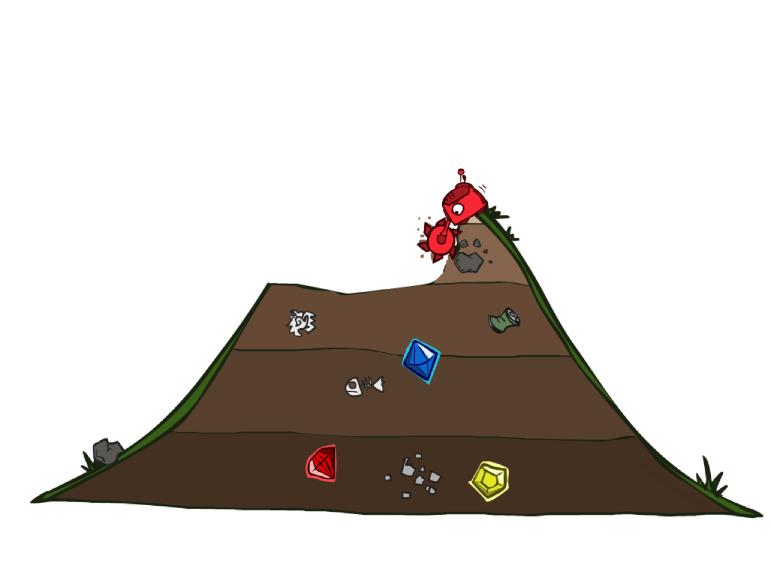
Uniform Cost Search

Slide 60
Uniform Cost Search
2
G
a
Strategy: expand a cheapest node first:
Fringe is a priority queue (priority: cumulative cost)
b
c
1
8
2
2
e
3
d
f
9
8
2
S
h
1
1
p
q
r
15
0
S
d
3
e
9
p
1
b
4
e
5
h
17
r
11
q
16
c
11
Cost contours
a
6
a
h
13
r
7
p
q
f
p
q
f
8
q
c
G
q
c
a
11
G
10
a

Slide 61
Uniform Cost Search (UCS) Properties
What nodes does UCS expand?
  Processes all nodes with cost less than cheapest solution!
  If that solution costs C* and arcs cost at least ε , then the “effective depth” is roughly C*/ε
  Takes time O(b^{C*/ε}) (exponential in effective depth)
How much space does the fringe take?
  Has roughly the last tier, so O(b^{C*/ε})
Is it complete?
  Assuming best solution has a finite cost and minimum arc cost is positive, yes!
Is it optimal?
  Yes! (Proof next lecture via A*)
b
c ≤ 1
…
C*/ε “tiers”
c ≤ 2
c ≤ 3

Slide 62
Uniform Cost Issues
Remember: UCS explores increasing cost contours
The good: UCS is complete and optimal!
The bad:
  Explores options in every “direction”
  No information about goal location
We’ll fix that soon!
…
c ≤ 1
c ≤ 2
c ≤ 3
Start
Goal
[Demo: empty grid UCS (L2D5)]
[Demo: maze with deep/shallow water DFS/BFS/UCS (L2D7)]

Slide 63
Video of Demo Empty UCS

Slide 64
Video of Demo Maze with Deep/Shallow Water --- DFS, BFS, or UCS? (part 1)
Notes:
Let students guess which one of the three it is. (This is BFS.)

Slide 65
Video of Demo Maze with Deep/Shallow Water --- DFS, BFS, or UCS? (part 2)
Notes:
Let students guess which one of the three it is. (This is UCS.)

Slide 66
Video of Demo Maze with Deep/Shallow Water --- DFS, BFS, or UCS? (part 3)
Notes:
Let students guess which one of the three it is. (This is DFS.)

Slide 67

The One Queue
All these search algorithms are the same except for fringe strategies
  Conceptually, all fringes are priority queues (i.e. collections of nodes with attached priorities)
  Practically, for DFS and BFS, you can avoid the log(n) overhead from an actual priority queue, by using stacks and queues
  Can even code one implementation that takes a variable queuing object

Slide 68
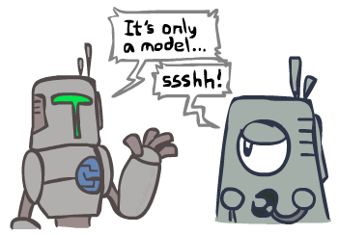
Search and Models
Search operates over models of the world
  The agent doesn’t actually try all the plans out in the real world!
  Planning is all “in simulation”
  Your search is only as good as your models…

Slide 69
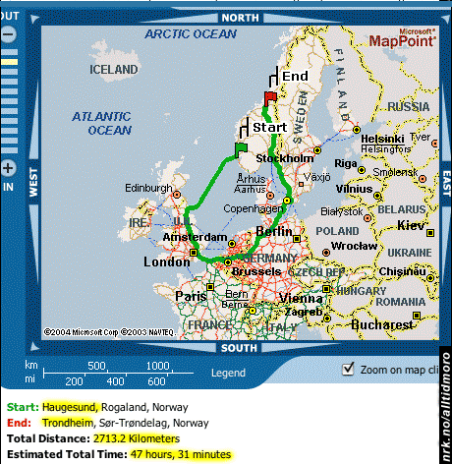
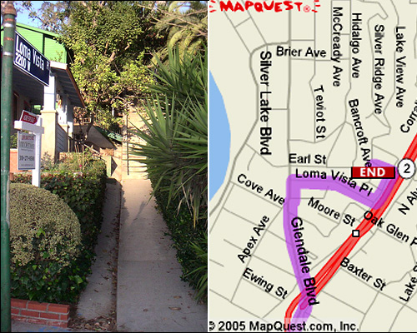

Search Gone Wrong?

Slide 70
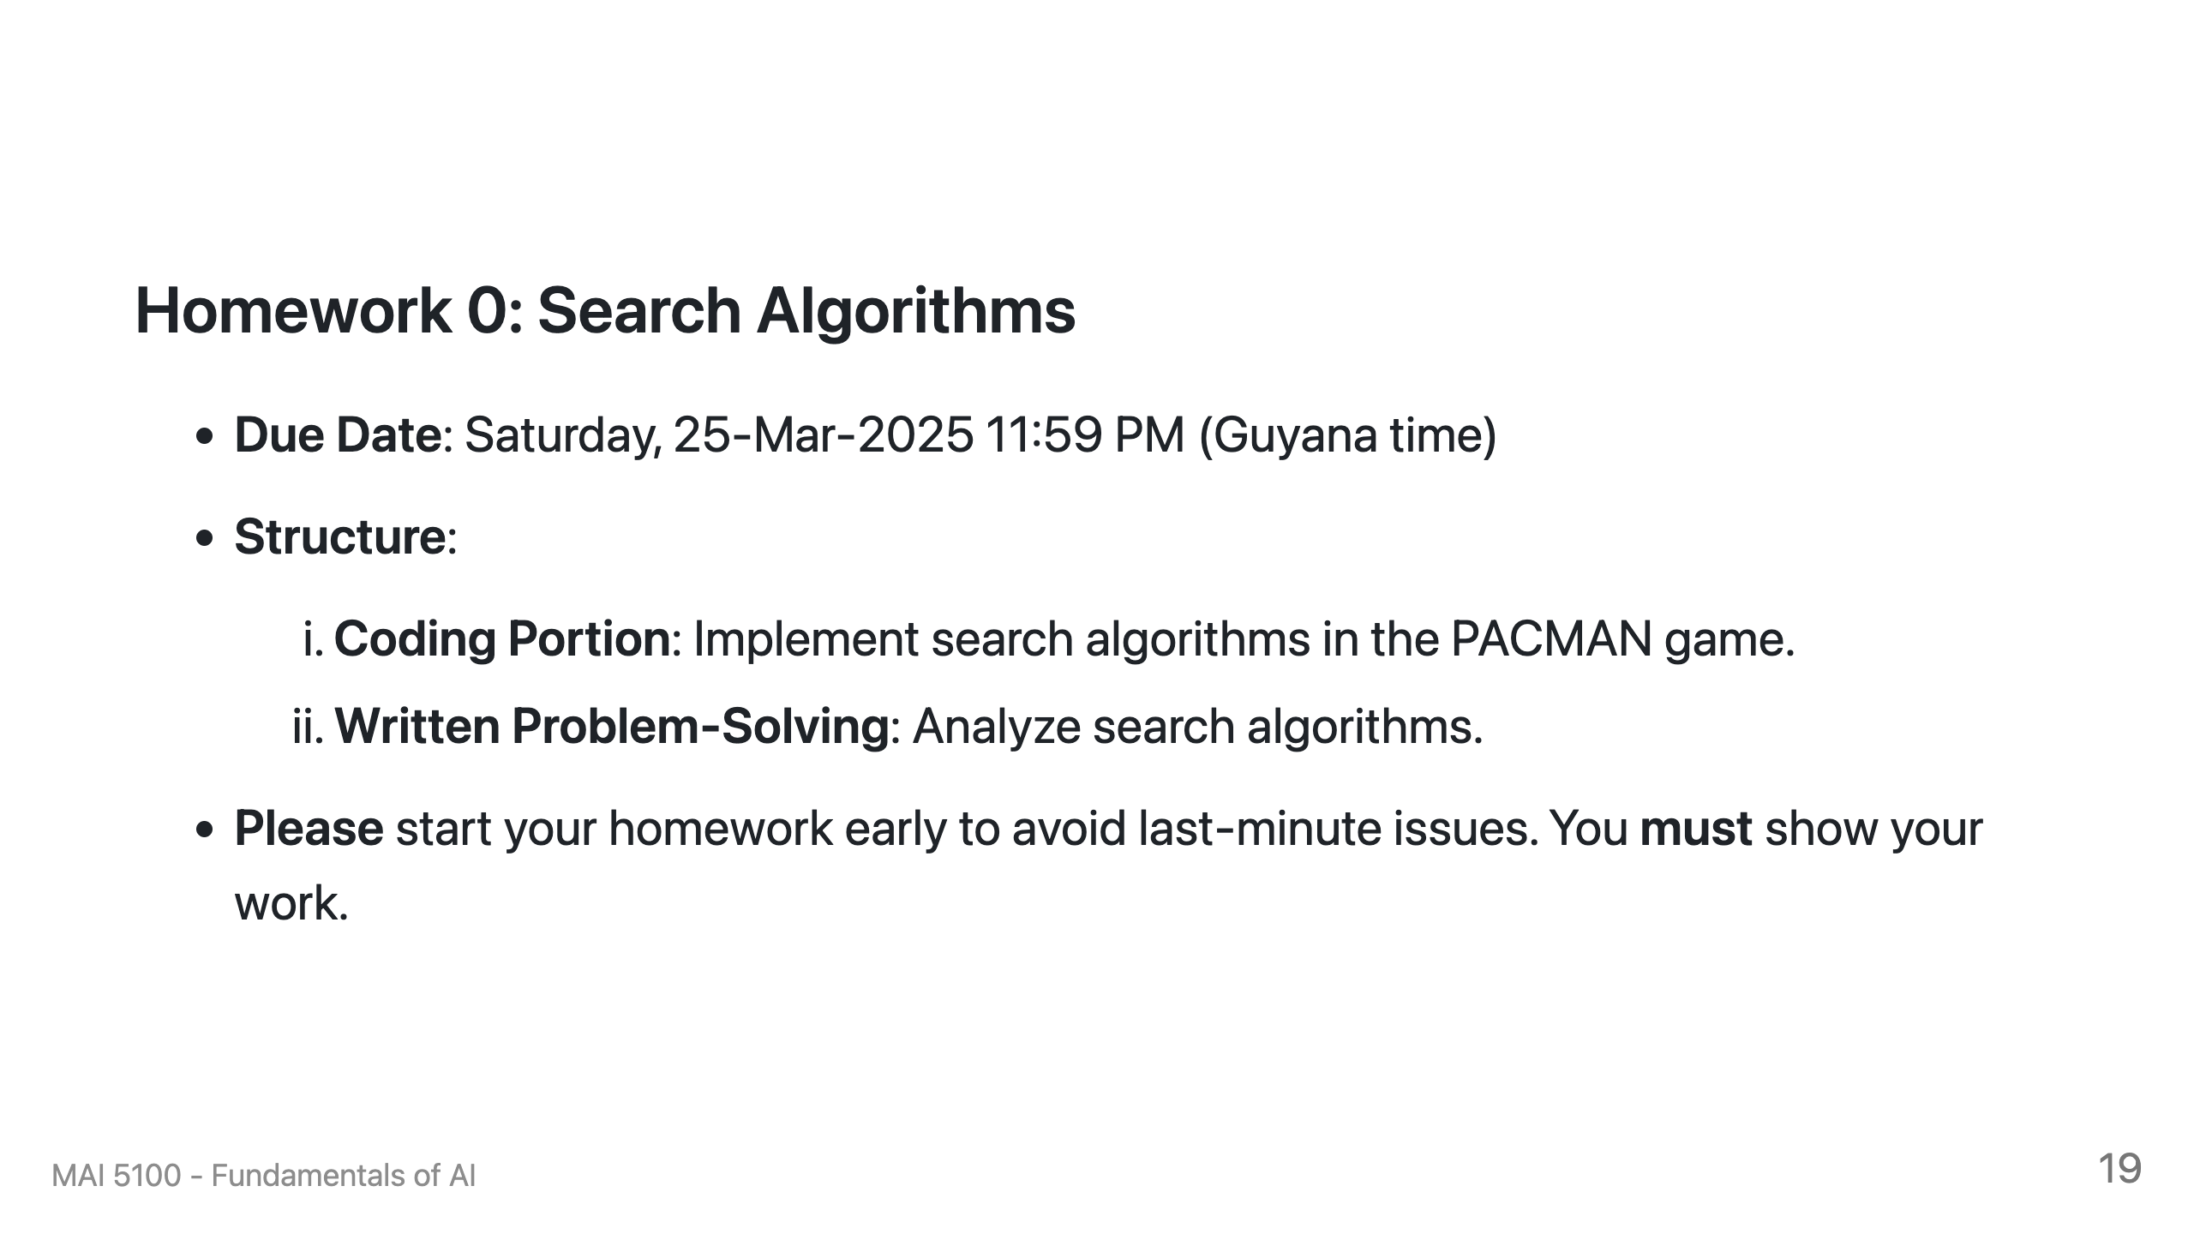

Slide 71
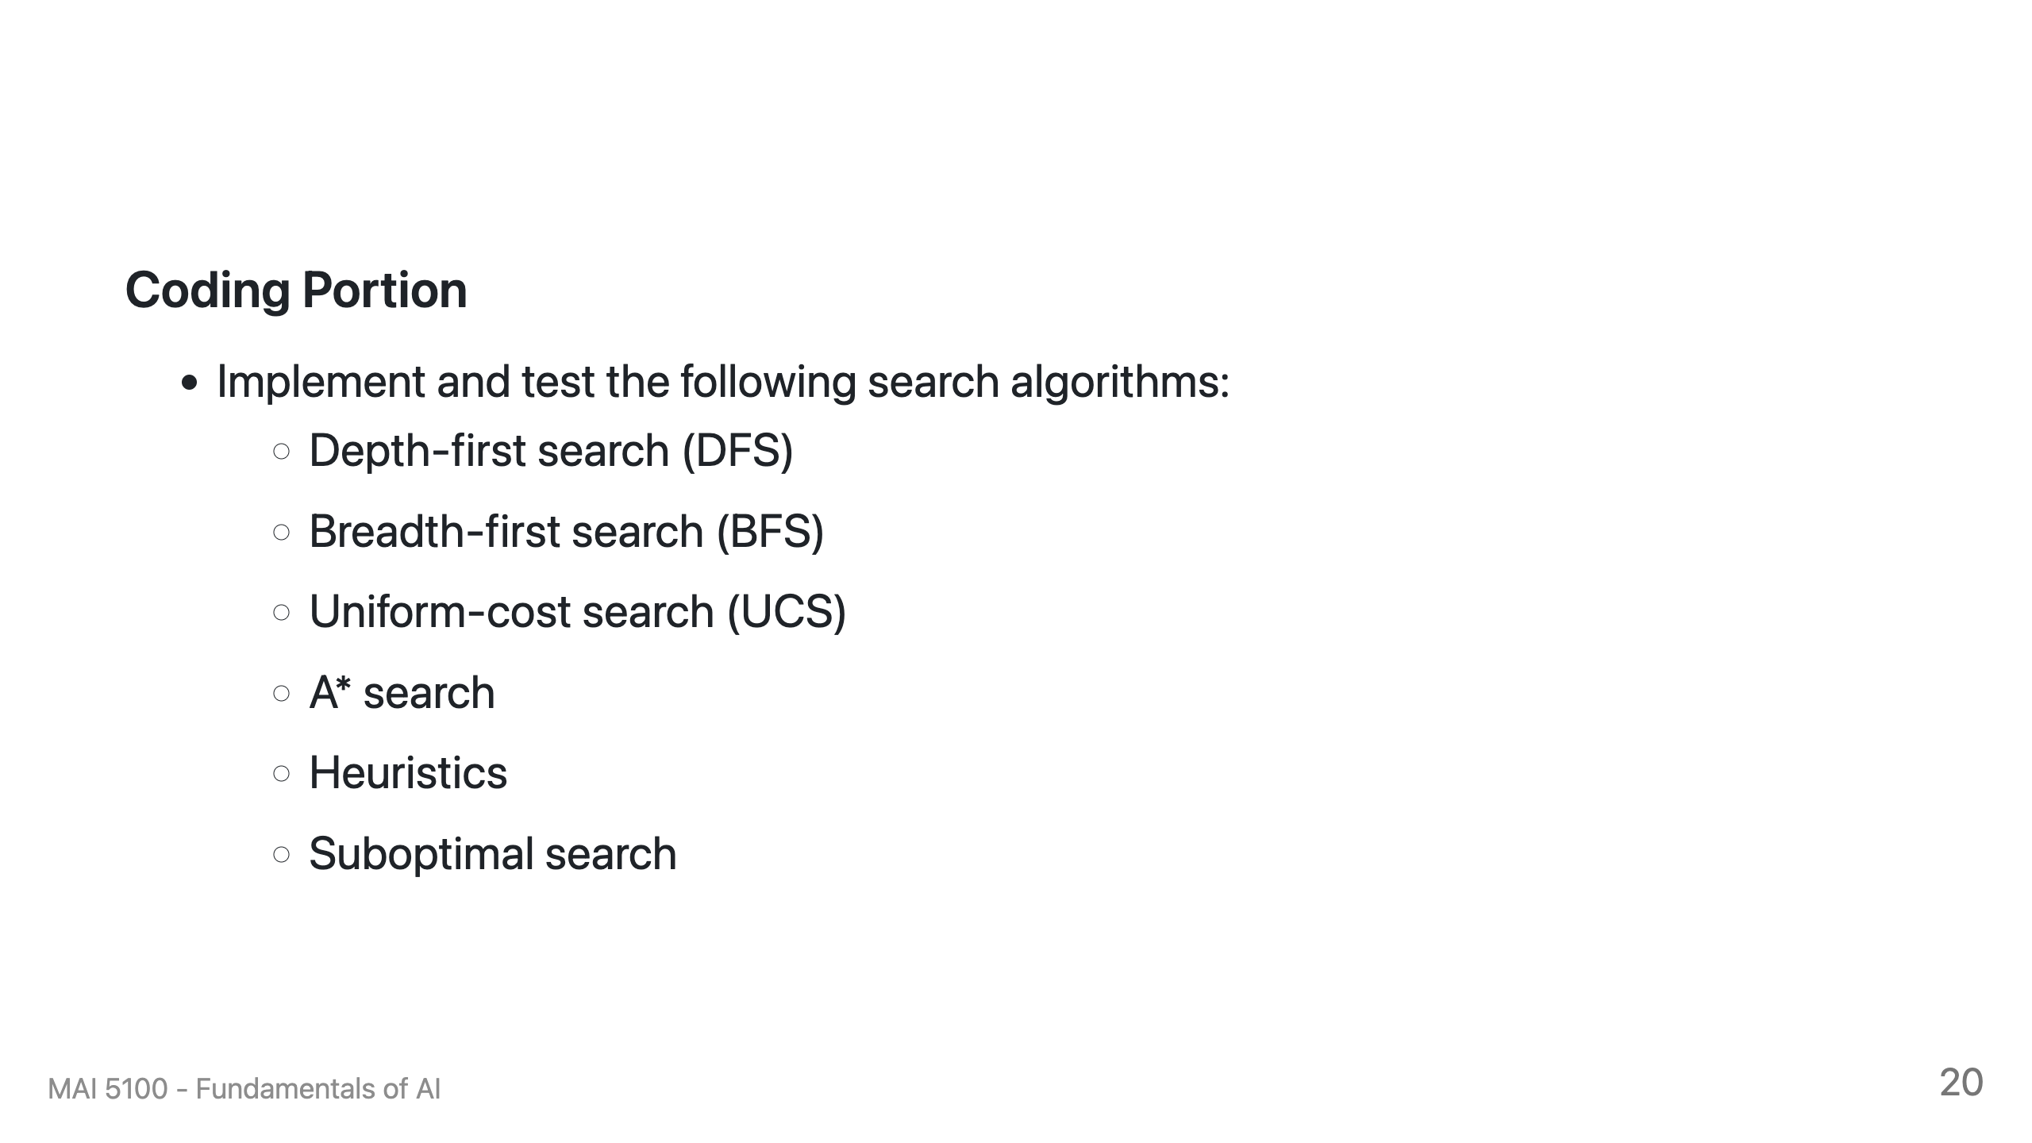

Slide 72


