Slide 1
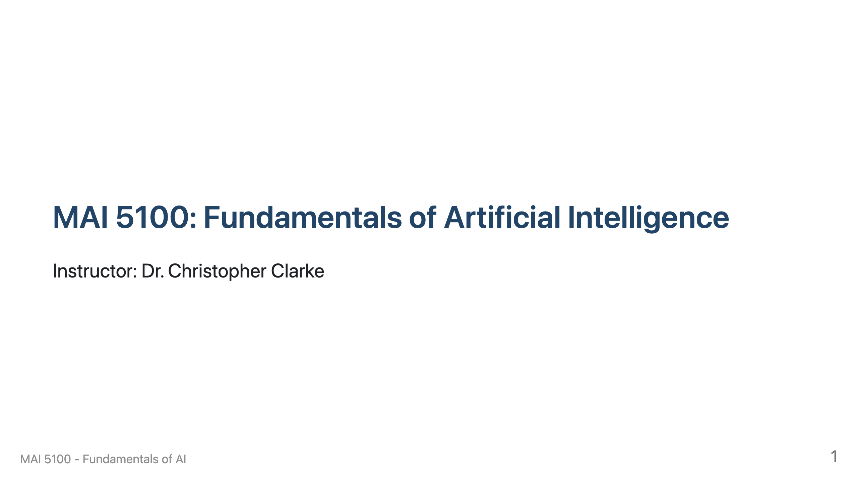

Slide 2
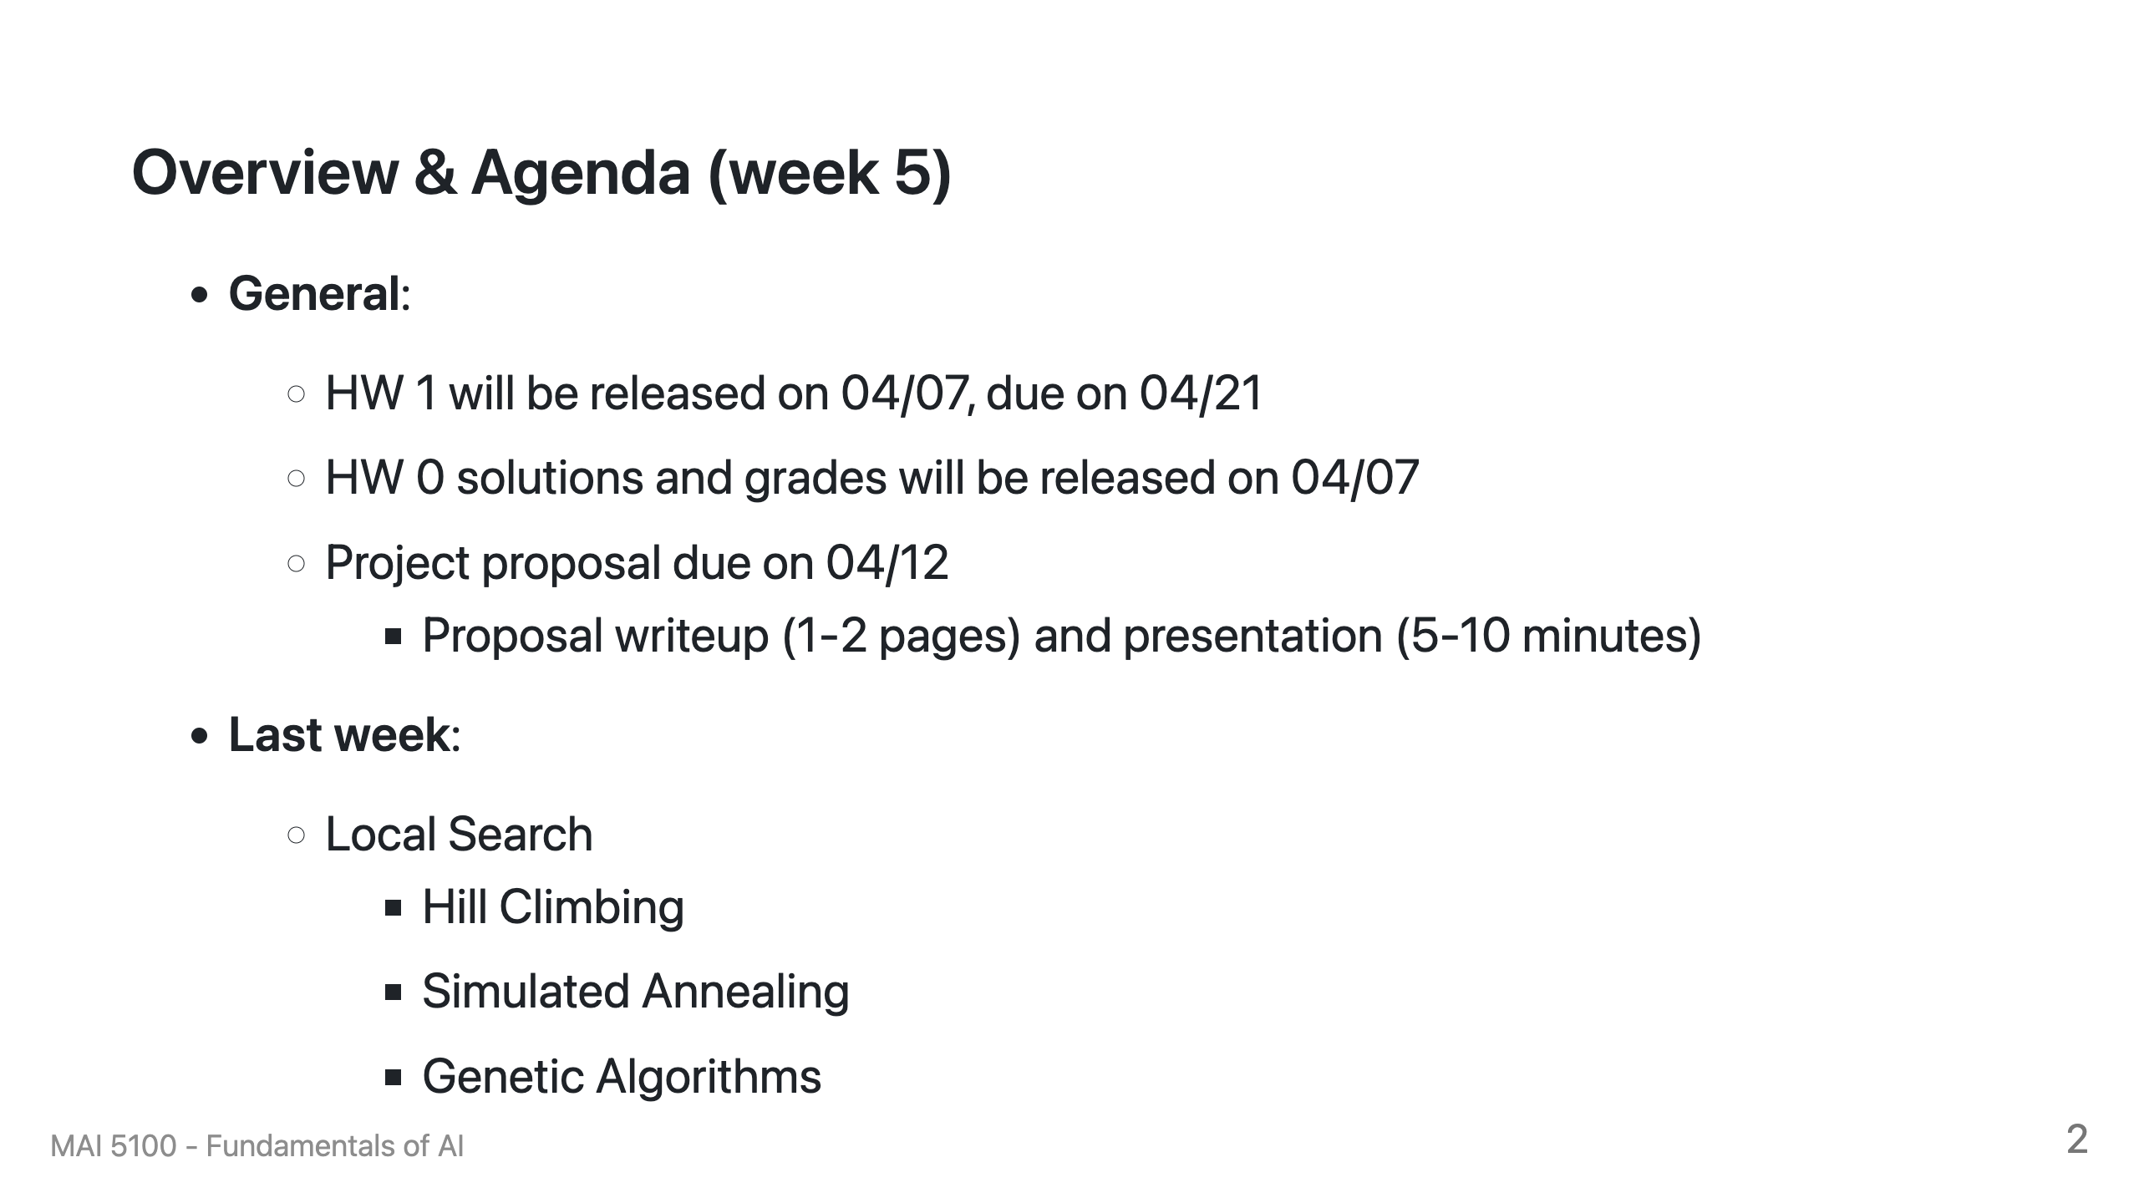

Slide 3
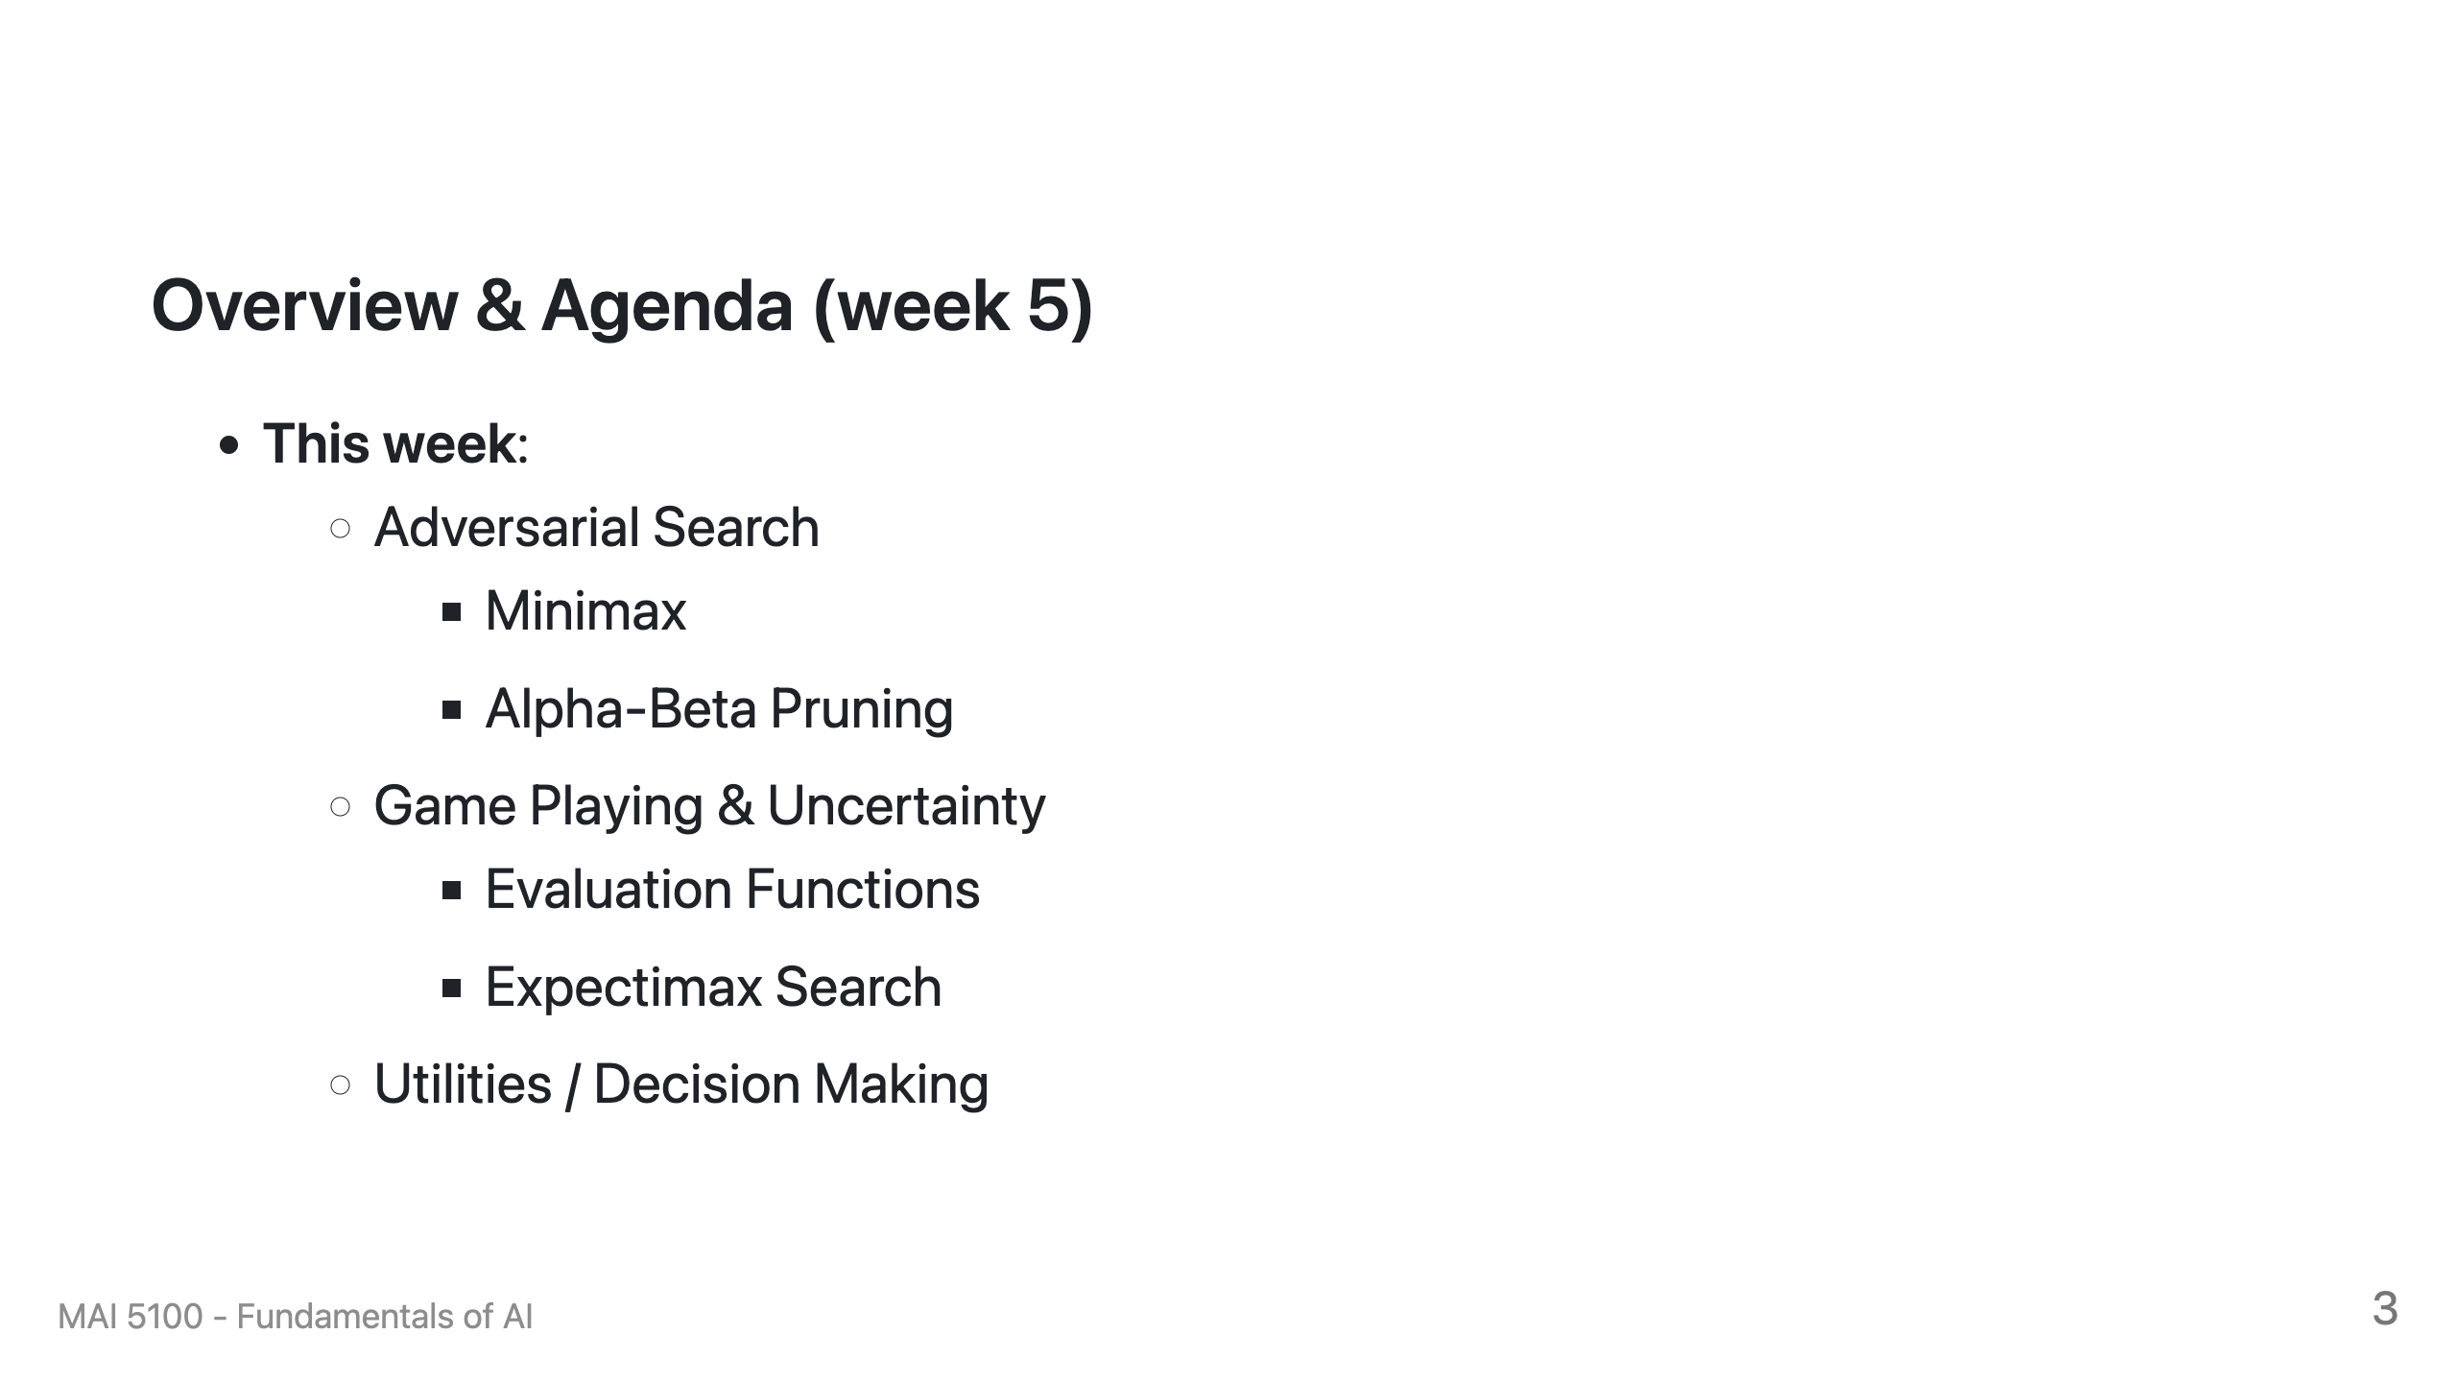

Slide 4
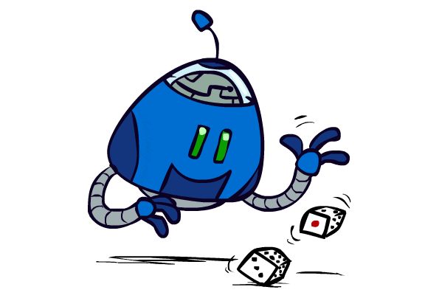
Uncertain Outcomes

Slide 5
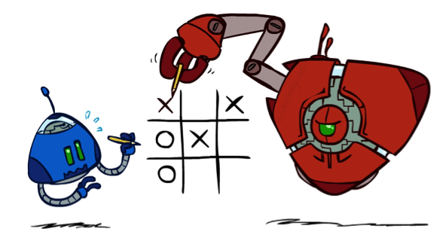

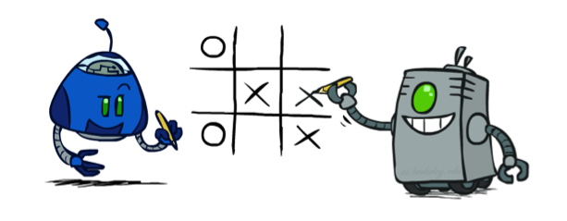
Worst-Case vs. Average Case
max
min
10
10
9
100
Idea: Uncertain outcomes controlled by chance, not an adversary!
Notes:
At least 10, or otherwise just rather dead; or just 100, or otherwise rather dead; that’s yet something different than minimax or expectimax

Slide 6
Expectimax Search
Why wouldn’t we know what the result of an action will be?
  Explicit randomness: rolling dice
  Unpredictable opponents: the ghosts respond randomly
  Actions can fail: when moving a robot, wheels might slip
Values should now reflect average-case (expectimax) outcomes, not worst-case (minimax) outcomes
Expectimax search: compute the average score under optimal play
  Max nodes as in minimax search
  Chance nodes are like min nodes but the outcome is uncertain
  Calculate their expected utilities
  I.e. take weighted average (expectation) of children
Later, we’ll learn how to formalize the underlying uncertain-result problems as Markov Decision Processes
max
chance
10
10
4
10
5
9
7
100
[Demo: min vs exp (L7D1,2)]

Slide 7

Video of Demo Minimax vs Expectimax (Min)

Slide 8
Video of Demo Minimax vs Expectimax (Exp)

Slide 9
Expectimax Pseudocode
def value(state):
  if the state is a terminal state: return the state’s utility
  if the next agent is MAX: return max-value(state)
  if the next agent is EXP: return exp-value(state)
def max-value(state):
  initialize v = -∞
  for each successor of state:
    v = max(v, value(successor))
  return v
def exp-value(state):
  initialize v = 0
  for each successor of state:
  p = probability(successor)
    v += p * value(successor)
  return v
Notes:
Pick an order for two reasons: sequential processor and pruning

Slide 10
Expectimax Pseudocode
def exp-value(state):
  initialize v = 0
  for each successor of state:
  p = probability(successor)
    v += p * value(successor)
  return v
1/2
1/6
1/3
5
8
7
24
-12
v = (1/2) (8) + (1/3) (24) + (1/6) (-12) = 10

Slide 11
Expectimax Example
3
12
9
2
4
6
15
6
0
Notes:
What is the value of the root?
8

Slide 12
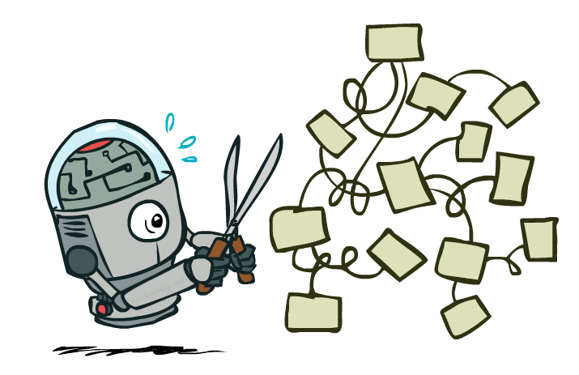
Expectimax Pruning?
3
12
9
2

Slide 13



Depth-Limited Expectimax
Estimate of true expectimax value (which would require a lot of work to compute)
400
300
…
…
492
362
…

Slide 14
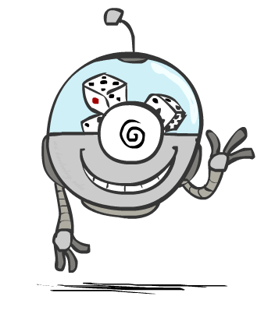
Probabilities

Slide 15
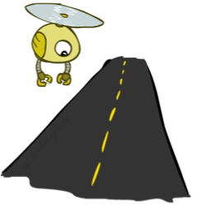
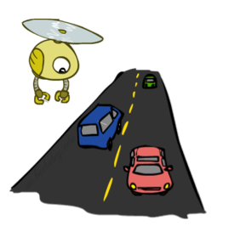
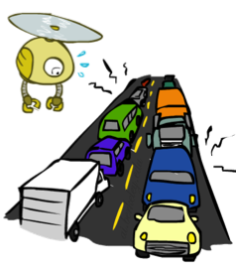
Reminder: Probabilities
A random variable represents an event whose outcome is unknown
A probability distribution is an assignment of weights to outcomes
Example: Traffic on freeway
  Random variable: T = whether there’s traffic
  Outcomes: T in {none, light, heavy}
  Distribution: P(T=none) = 0.25, P(T=light) = 0.50, P(T=heavy) = 0.25
Some laws of probability (more later):
  Probabilities are always non-negative
  Probabilities over all possible outcomes sum to one
As we get more evidence, probabilities may change:
  P(T=heavy) = 0.25, P(T=heavy | Hour=8am) = 0.60
  We’ll talk about methods for reasoning and updating probabilities later
0.25
0.50
0.25

Slide 16
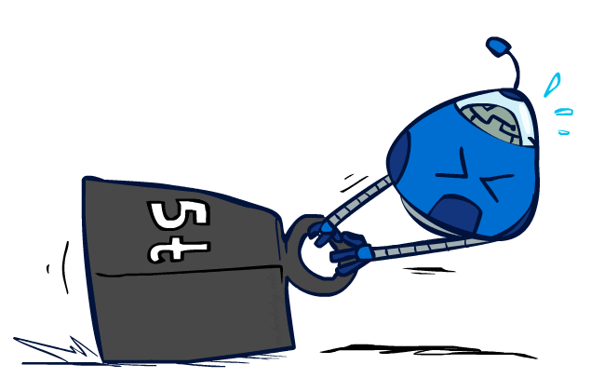
Reminder: Expectations
The expected value of a function of a random variable is the average, weighted by the probability distribution over outcomes
Example: How long to get to the airport?
Time:
20 min
30 min
60 min
+
+
35 min
x
x
x
Probability:
0.25
0.50
0.25

Slide 17

What Probabilities to Use?
In expectimax search, we have a probabilistic model of how the opponent (or environment) will behave in any state
  Model could be a simple uniform distribution (roll a die)
  Model could be sophisticated and require a great deal of computation
  We have a chance node for any outcome out of our control: opponent or environment
  The model might say that adversarial actions are likely!
For now, assume each chance node magically comes along with probabilities that specify the distribution over its outcomes
Having a probabilistic belief about another agent’s action does not mean that the agent is flipping any coins!

Slide 18
Quiz: Informed Probabilities
Let’s say you know that your opponent is actually running a depth 2 minimax, using the result 80% of the time, and moving randomly otherwise
Question: What tree search should you use?
Answer: Expectimax!
  To figure out EACH chance node’s probabilities, you have to run a simulation of your opponent
  This kind of thing gets very slow very quickly
  Even worse if you have to simulate your opponent simulating you…
  … except for minimax, which has the nice property that it all collapses into one game tree
0.1 0.9

Slide 19

Modeling Assumptions

Slide 20
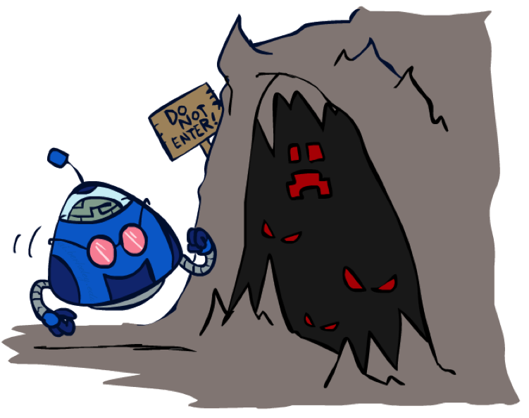
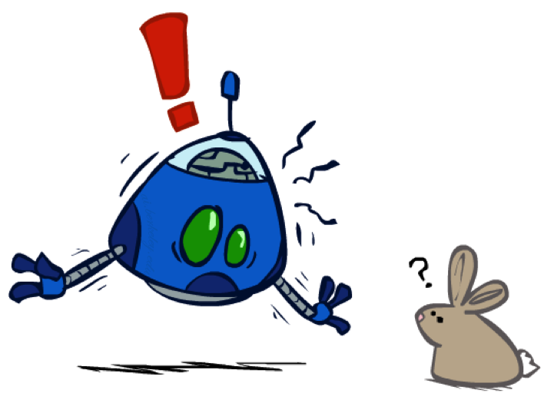
The Dangers of Optimism and Pessimism
Dangerous Optimism
Assuming chance when the world is adversarial
Dangerous Pessimism
Assuming the worst case when it’s not likely

Slide 21
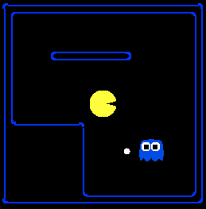
Assumptions vs. Reality
 | Adversarial Ghost | Random Ghost
Minimax Pacman | Won 5/5 Avg. Score: 483 | Won 5/5 Avg. Score: 493
Expectimax Pacman | Won 1/5 Avg. Score: -303 | Won 5/5 Avg. Score: 503
Results from playing 5 games
Pacman used depth 4 search with an eval function that avoids trouble
Ghost used depth 2 search with an eval function that seeks Pacman
[Demos: world assumptions (L7D3,4,5,6)]
Notes:
python pacman.py -g SmartGhost -l trapped2 -p ExpectimaxAgent -a depth=4,evalFn=better

Slide 22
Video of Demo World Assumptions
Random Ghost – Expectimax Pacman

Slide 23
Video of Demo World Assumptions
Adversarial Ghost – Minimax Pacman

Slide 24
Video of Demo World Assumptions
Adversarial Ghost – Expectimax Pacman

Slide 25
Video of Demo World Assumptions
Random Ghost – Minimax Pacman

Slide 26
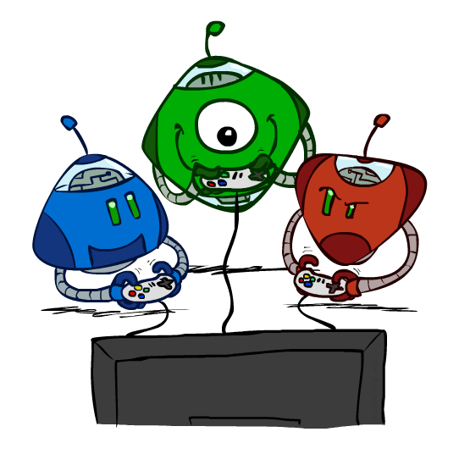
Other Game Types

Slide 27



Mixed Layer Types
E.g. Backgammon
Expectiminimax
  Environment is an extra “random agent” player that moves after each min/max agent
  Each node computes the appropriate combination of its children
Notes:
If it’s terminal or we reached our depth limit, return utility

Slide 28
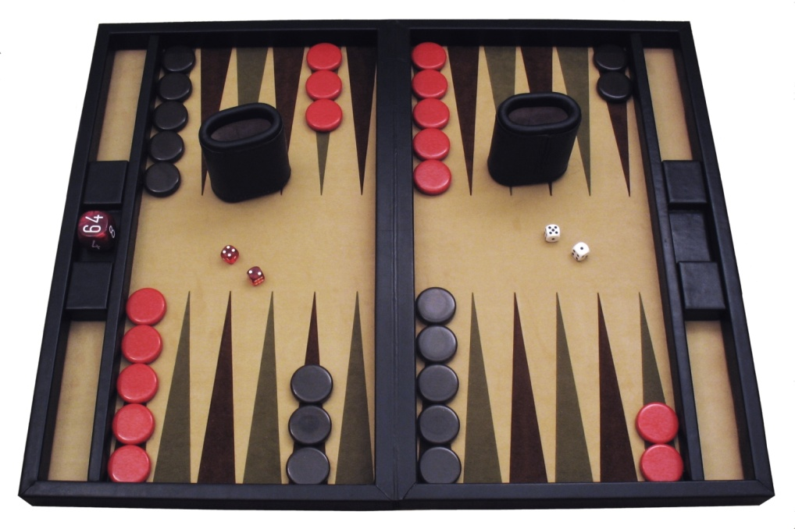
Example: Backgammon
Dice rolls increase b: 21 possible rolls with 2 dice
  Backgammon ≈ 20 legal moves
  Depth 2 = 20 x (21 x 20)³ = 1.2 x 10⁹
As depth increases, probability of reaching a given search node shrinks
  So usefulness of search is diminished
  So limiting depth is less damaging
  But pruning is trickier…
Historic AI: TDGammon uses depth-2 search + very good evaluation function + reinforcement learning:
world-champion level play
1st AI world champion in any game!
Image: Wikipedia

Slide 29
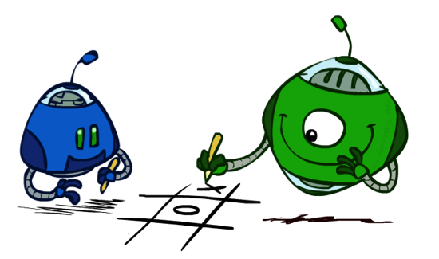
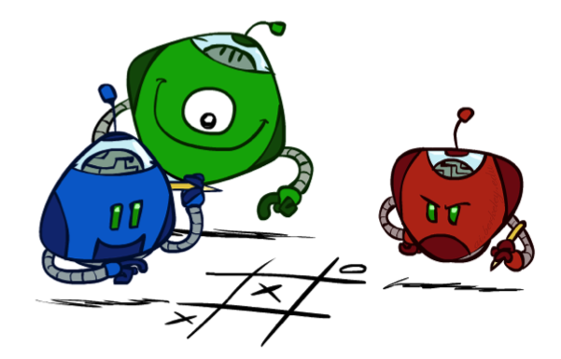
Multi-Agent Utilities
What if the game is not zero-sum, or has multiple players?
Generalization of minimax:
  Terminals have utility tuples
  Node values are also utility tuples
  Each player maximizes its own component
  Can give rise to cooperation and
  competition dynamically…
1,6,6
7,1,2
6,1,2
7,2,1
5,1,7
1,5,2
7,7,1
5,2,5

Slide 30
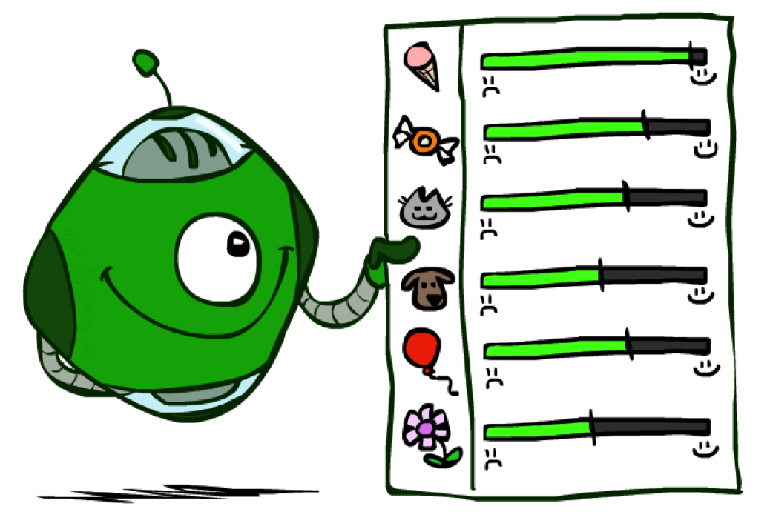
Utilities

Slide 31

Maximum Expected Utility
Why should we average utilities? Why not minimax?
Principle of maximum expected utility:
  A rational agent should chose the action that maximizes its expected utility, given its knowledge
Questions:
  Where do utilities come from?
  How do we know such utilities even exist?
  How do we know that averaging even makes sense?
  What if our behavior (preferences) can’t be described by utilities?

Slide 32
What Utilities to Use?
0
40
20
30
x²
0
1600
400
900
For worst-case minimax reasoning, terminal function scale doesn’t matter
  We just want better states to have higher evaluations (get the ordering right)
  We call this insensitivity to monotonic transformations
For average-case expectimax reasoning, we need magnitudes to be meaningful

Slide 33

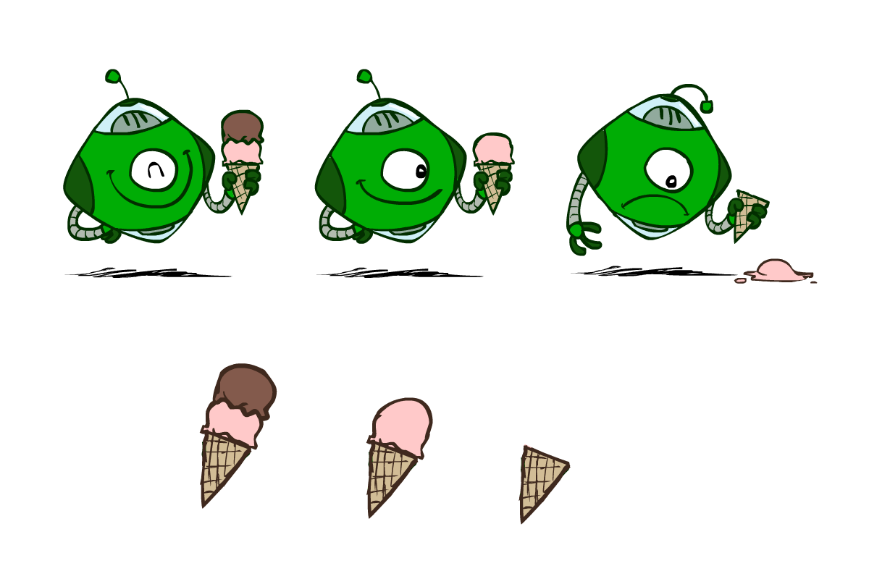
Utilities
Utilities are functions from outcomes (states of the world) to real numbers that describe an agent’s preferences
Where do utilities come from?
  In a game, may be simple (+1/-1)
  Utilities summarize the agent’s goals
  Theorem: any “rational” preferences can be summarized as a utility function
We hard-wire utilities and let behaviors emerge
  Why don’t we let agents pick utilities?
  Why don’t we prescribe behaviors?

Slide 34

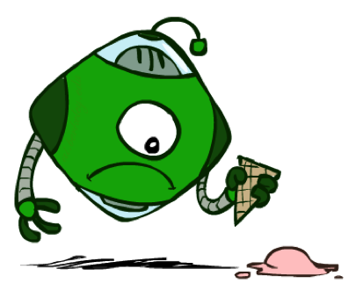
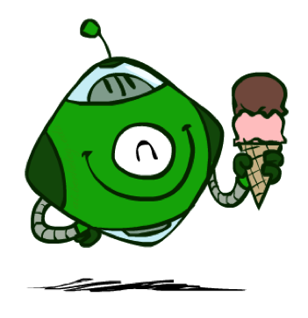
Utilities: Uncertain Outcomes
Getting ice cream
Get Single
Get Double
Oops
Whew!

Slide 35
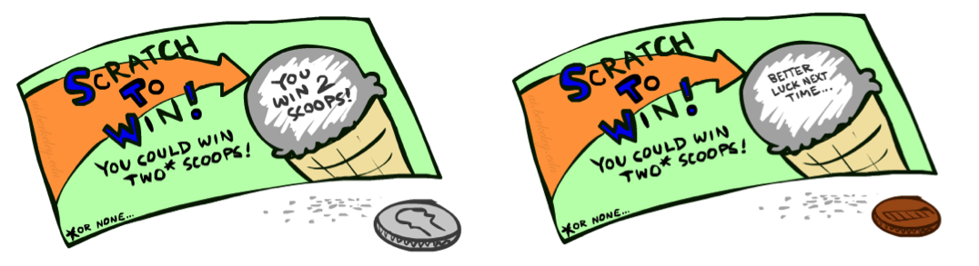
Preferences
A Prize
A Lottery
An agent must have preferences among:
  Prizes: A, B, etc.
  Lotteries: situations with uncertain prizes
Notation:
  Preference:
  Indifference:
A
p 1-p
A B

Slide 36
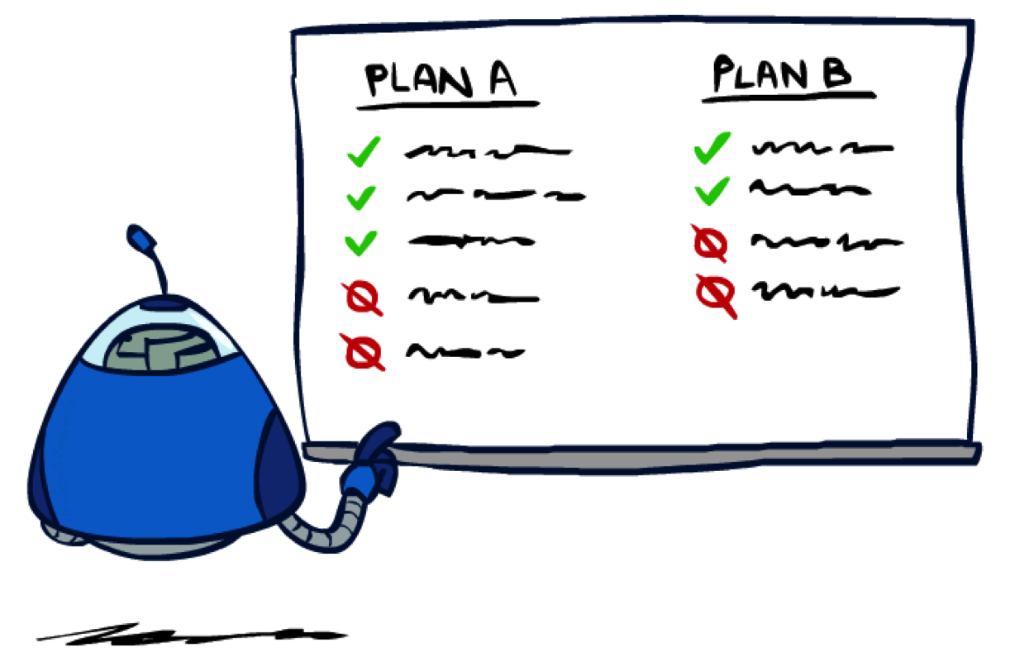
Rationality

Slide 37

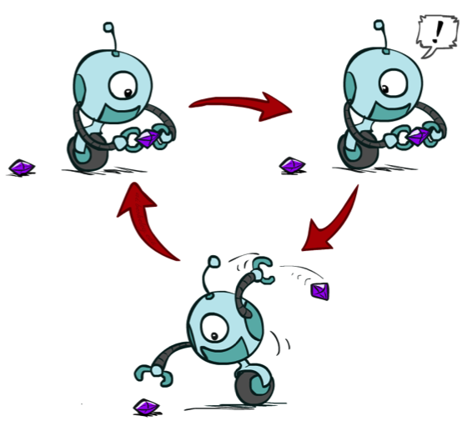
Rational Preferences
We want some constraints on preferences before we call them rational, such as:
For example: an agent with intransitive preferences can
be induced to give away all of its money
  If B > C, then an agent with C would pay (say) 1 cent to get B
  If A > B, then an agent with B would pay (say) 1 cent to get A
  If C > A, then an agent with A would pay (say) 1 cent to get C
Axiom of Transitivity:
Notes:
Apple, banana, carrot

Slide 38

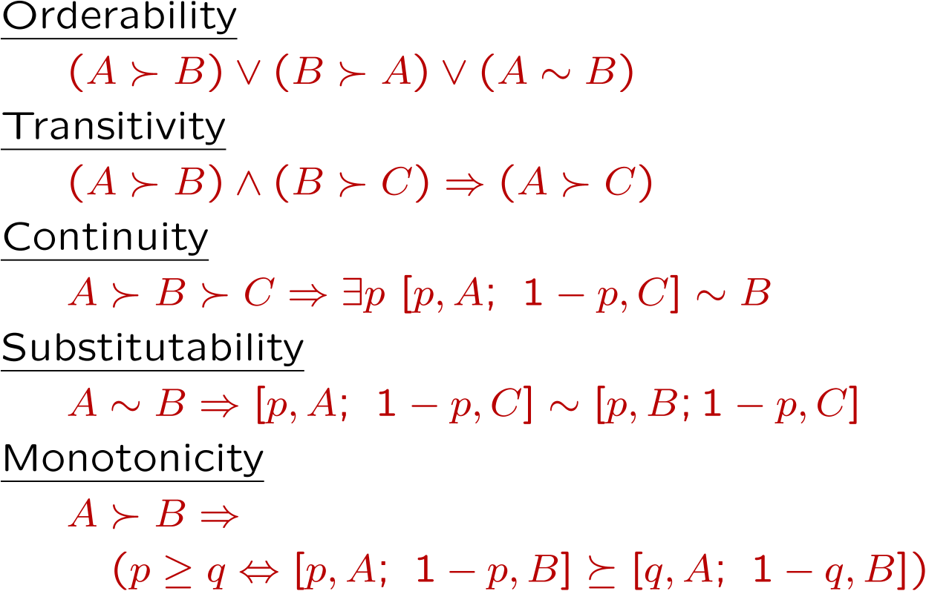
Rational Preferences
The Axioms of Rationality
Theorem: Rational preferences imply behavior describable as maximization of expected utility

Slide 39
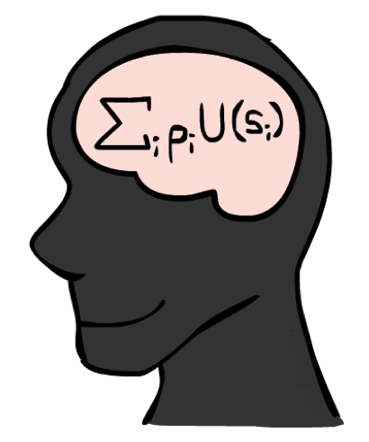
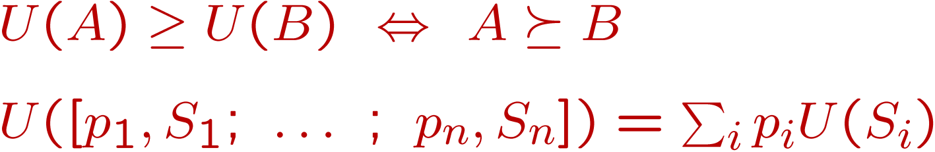
MEU Principle
Theorem [Ramsey, 1931; von Neumann & Morgenstern, 1944]
  Given any preferences satisfying these constraints, there exists a real-valued
  function U such that:
  I.e. values assigned by U preserve preferences of both prizes and lotteries!
Maximum expected utility (MEU) principle:
  Choose the action that maximizes expected utility
  Note: an agent can be entirely rational (consistent with MEU) without ever representing or manipulating utilities and probabilities
  E.g., a lookup table for perfect tic-tac-toe, a reflex vacuum cleaner

Slide 40
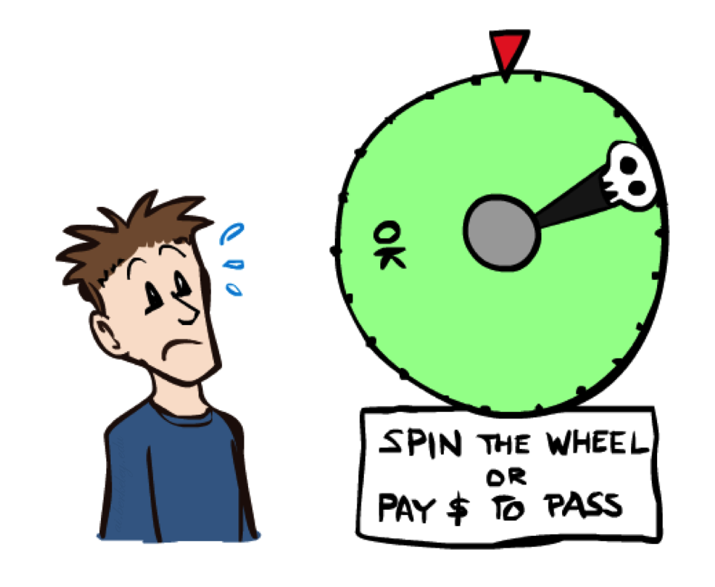
Human Utilities

Slide 41

Utility Scales
Normalized utilities: u₊ = 1.0, u₋ = 0.0
Micromorts: one-millionth chance of death, useful for paying to reduce product risks, etc.
QALYs: quality-adjusted life years, useful for medical decisions involving substantial risk
Note: behavior is invariant under positive linear transformation
With deterministic prizes only (no lottery choices), only ordinal utility can be determined, i.e., total order on prizes

Slide 42


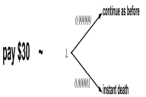
Human Utilities
Utilities map states to real numbers. Which numbers?
Standard approach to assessment (elicitation) of human utilities:
  Compare a prize A to a standard lottery L_{p} between
    “best possible prize” u₊ with probability p
    “worst possible catastrophe” u₋ with probability 1-p
  Adjust lottery probability p until indifference: A ~ L_{p}
  Resulting p is a utility in [0,1]
Pay $30
0.999999 0.000001
No change
Instant death

Slide 43
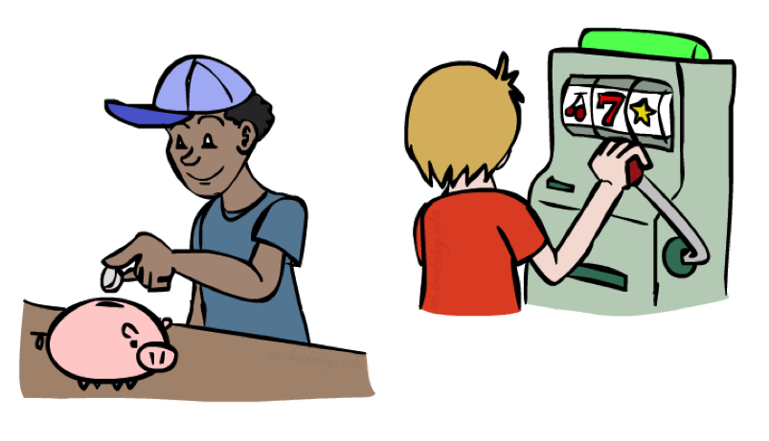
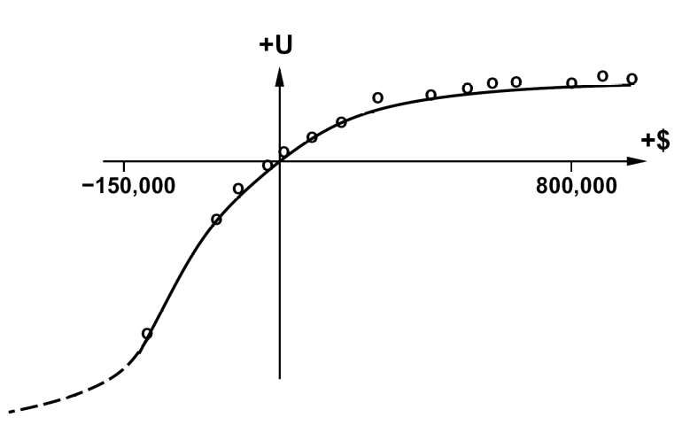
Money
Money does not behave as a utility function, but we can talk about the utility of having money (or being in debt)
Given a lottery L = [p, $X; (1-p), $Y]
  The expected monetary value EMV(L) is p*X + (1-p)*Y
  U(L) = p*U($X) + (1-p)*U($Y)
  Typically, U(L) < U( EMV(L) )
  In this sense, people are risk-averse
  When deep in debt, people are risk-prone
Notes:
Draw Jensen’s for utility curve

Slide 44
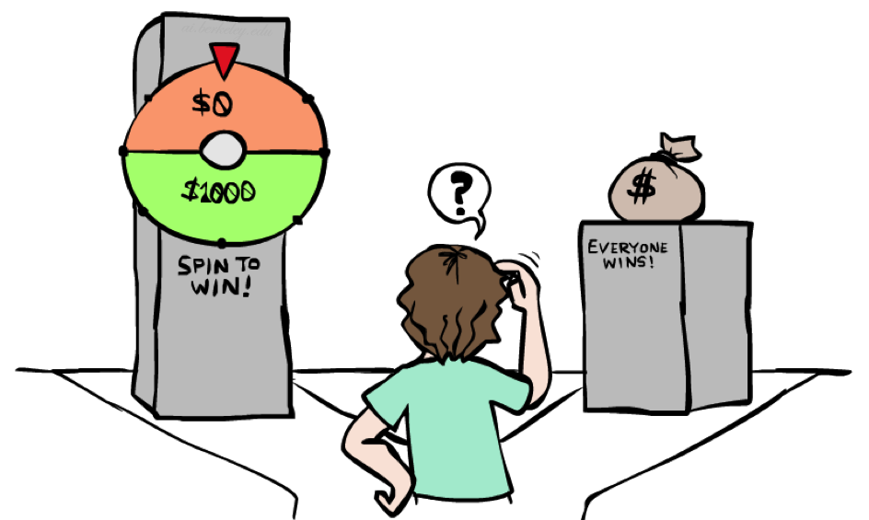
Example: Insurance
Consider the lottery [0.5, $1000; 0.5, $0]
  What is its expected monetary value? ($500)
  What is its certainty equivalent?
    Monetary value acceptable in lieu of lottery
    $400 for most people
  Difference of $100 is the insurance premium
    There’s an insurance industry because people will pay to reduce their risk
    If everyone were risk-neutral, no insurance needed!
  It’s win-win: you’d rather have the $400 and the insurance company would rather have the lottery (their utility curve is flat and they have many lotteries)

Slide 45

Example: Human Rationality?
Famous example of Allais (1953)
  A: [0.8, $4k; 0.2, $0]
  B: [1.0, $3k; 0.0, $0]
  C: [0.2, $4k; 0.8, $0]
  D: [0.25, $3k; 0.75, $0]
Most people prefer B > A, C > D
But if U($0) = 0, then
  B > A ⇒ U($3k) > 0.8 U($4k)
  C > D ⇒ 0.8 U($4k) > U($3k)

