Slide 1


Slide 2
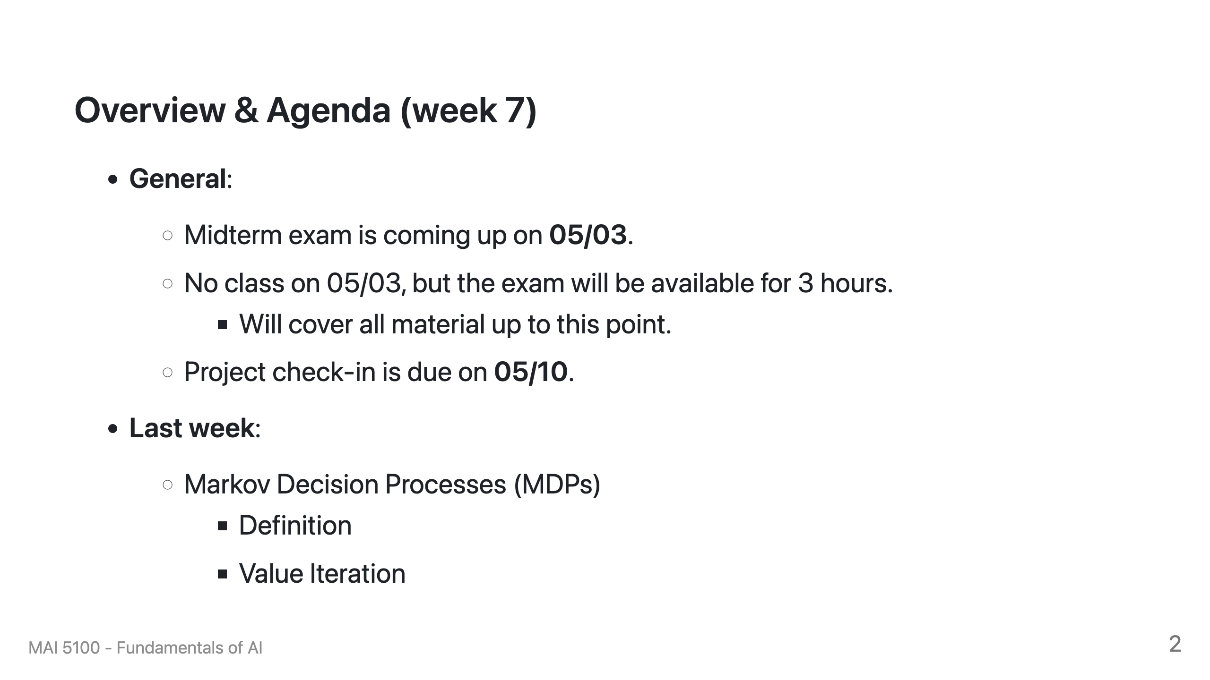

Slide 3
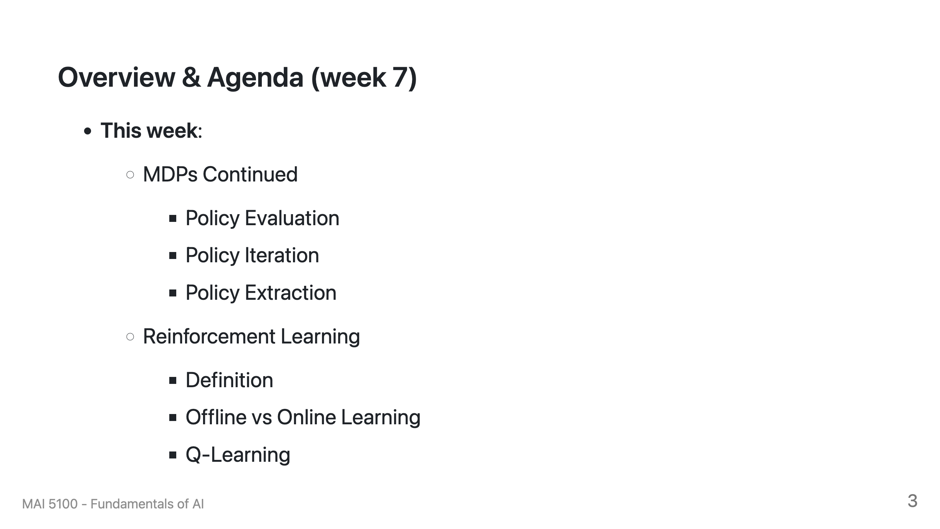

Slide 4
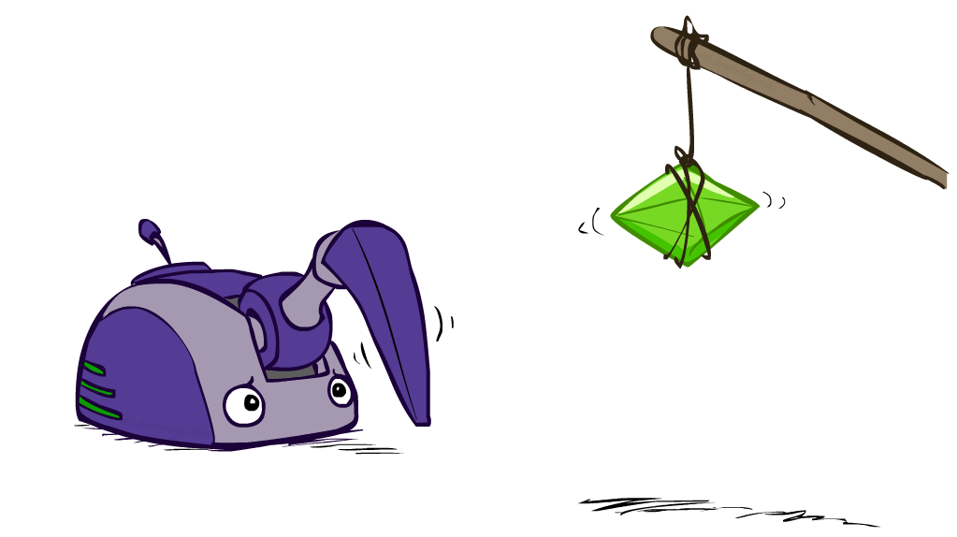
Reinforcement Learning

Slide 5
Reinforcement Learning
Agent
State: s
Reward: r
Actions: a
Environment
Basic idea:
  Receive feedback in the form of rewards
  Agent’s utility is defined by the reward function
  Must (learn to) act so as to maximize expected rewards
  All learning is based on observed samples of outcomes!
Notes:
Show robot-soccer learning to walk videos (UT Austin):
? Show snake robot:

Slide 6
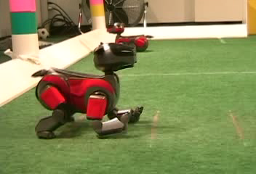

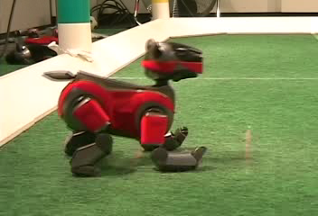
Example: Learning to Walk
Initial
A Learning Trial
After Learning [1K Trials]
[Kohl and Stone, ICRA 2004]

Slide 7

Example: Learning to Walk
Initial
[Kohl and Stone, ICRA 2004]
[Video: AIBO WALK – initial]

Slide 8

Example: Learning to Walk
Training
[Kohl and Stone, ICRA 2004]
[Video: AIBO WALK – training]

Slide 9

Example: Learning to Walk
Finished
[Kohl and Stone, ICRA 2004]
[Video: AIBO WALK – finished]

Slide 10
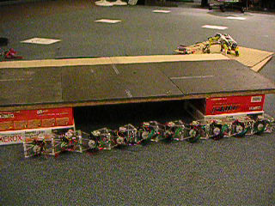
Example: Sidewinding
[Andrew Ng]
[Video: SNAKE – climbStep+sidewinding]

Slide 11

Example: Toddler Robot
[Tedrake, Zhang and Seung, 2005]
[Video: TODDLER – 40s]

Slide 12
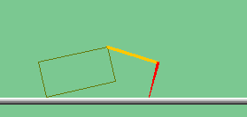
The Crawler!
[Demo: Crawler Bot (L10D1)] [You, in Project 3]
Notes:
At times no reward accumulated at all, just sitting still

Slide 13

Video of Demo Crawler Bot

Slide 14
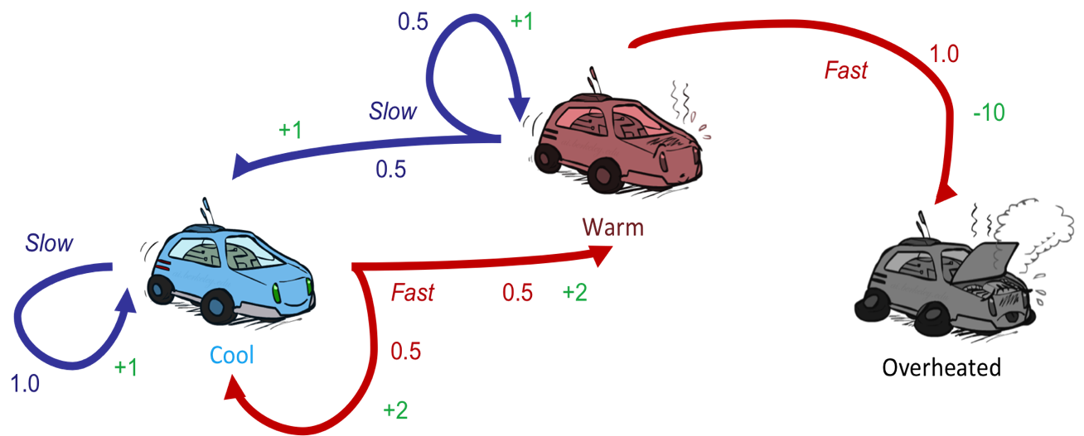
Reinforcement Learning
Still assume a Markov decision process (MDP):
  A set of states s ∈ S
  A set of actions (per state) A
  A model T(s,a,s’)
  A reward function R(s,a,s’)
Still looking for a policy π(s)
New twist: don’t know T or R
  I.e. we don’t know which states are good or what the actions do
  Must actually try actions and states out to learn

Slide 15
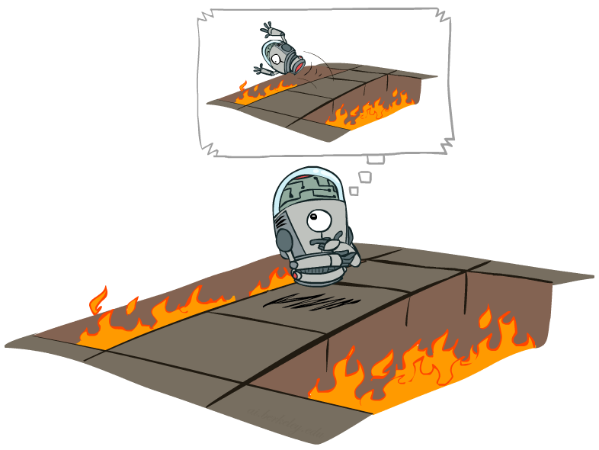
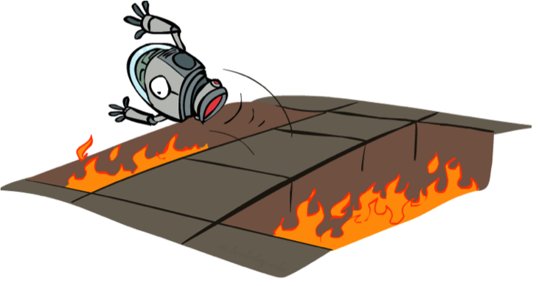
Offline (MDPs) vs. Online (RL)
Offline Solution
Online Learning

Slide 16

Model-Based Learning

Slide 17




Model-Based Learning
Model-Based Idea:
  Learn an approximate model based on experiences
  Solve for values as if the learned model were correct
Step 1: Learn empirical MDP model
  Count outcomes s’ for each s, a
  Normalize to give an estimate of
  Discover each when we experience (s, a, s’)
Step 2: Solve the learned MDP
  For example, use value iteration, as before

Slide 18
Example: Model-Based Learning
Input Policy π
Observed Episodes (Training)
Learned Model
Episode 1
Episode 2
T(s,a,s’).
T(B, east, C) = 1.00
T(C, east, D) = 0.75
T(C, east, A) = 0.25
…
R(s,a,s’).
R(B, east, C) = -1
R(C, east, D) = -1
R(D, exit, x) = +10
…
 | A
B | C | D
 | E
B, east, C, -1
C, east, D, -1
D, exit, x, +10
B, east, C, -1
C, east, D, -1
D, exit, x, +10
Episode 3
Episode 4
E, north, C, -1
C, east, D, -1
D, exit, x, +10
E, north, C, -1
C, east, A, -1
A, exit, x, -10
Assume: γ = 1

Slide 19
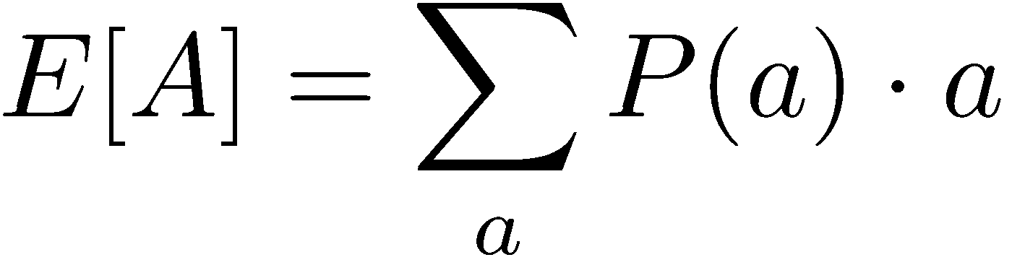
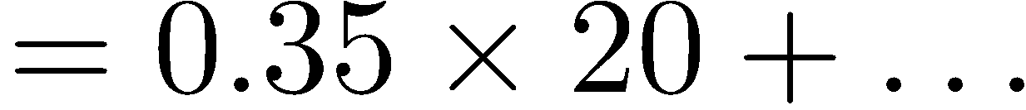
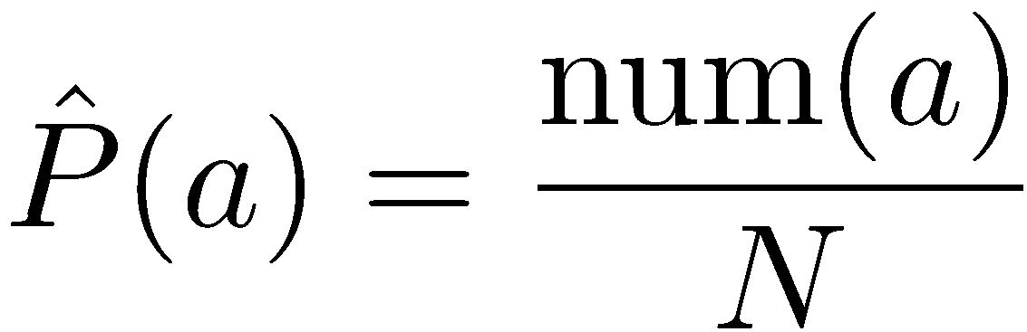
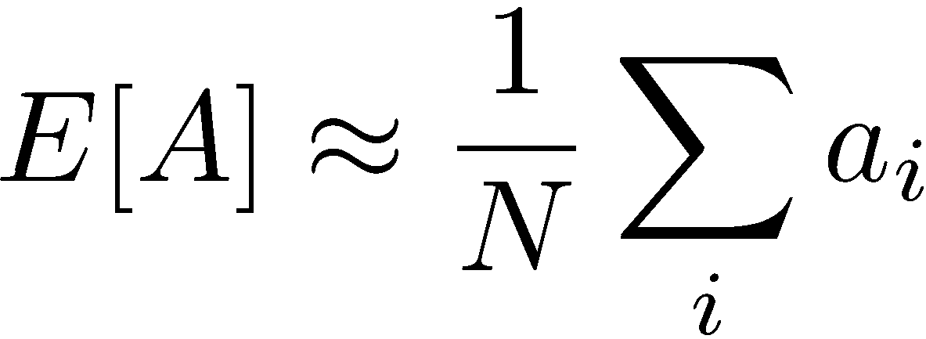
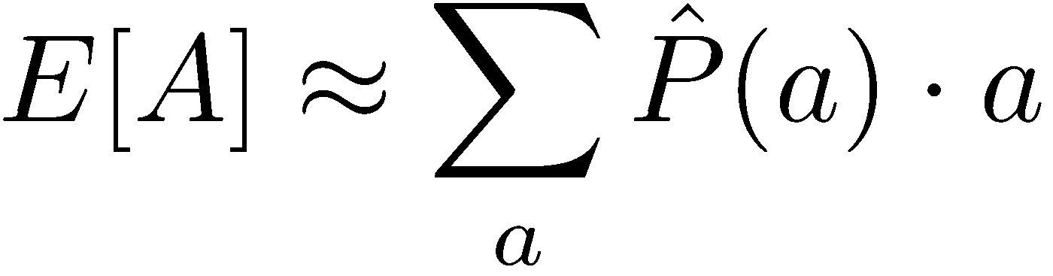
Example: Expected Age
Goal: Compute expected age of cs188 students
Known P(A)
Without P(A), instead collect samples [a₁, a₂, … a_{N}]
Unknown P(A): “Model Based”
Unknown P(A): “Model Free”
Why does this work? Because eventually you learn the right model.
Why does this work? Because samples appear with the right frequencies.

Slide 20
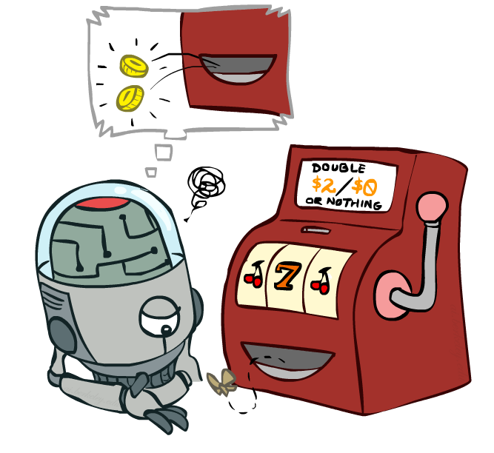
Model-Free Learning

Slide 21
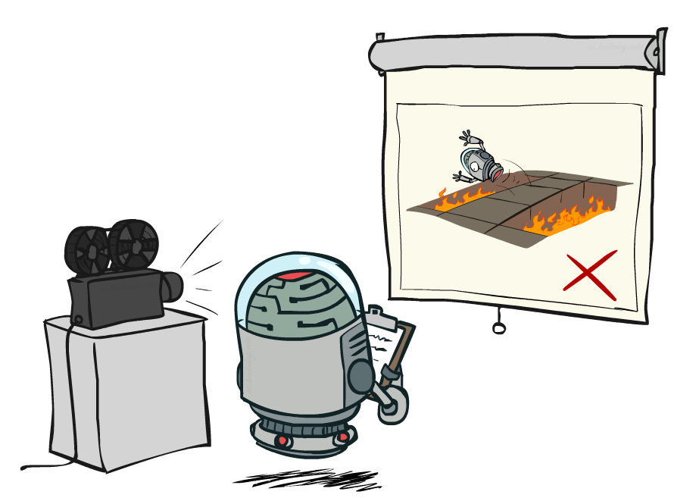
Passive Reinforcement Learning

Slide 22
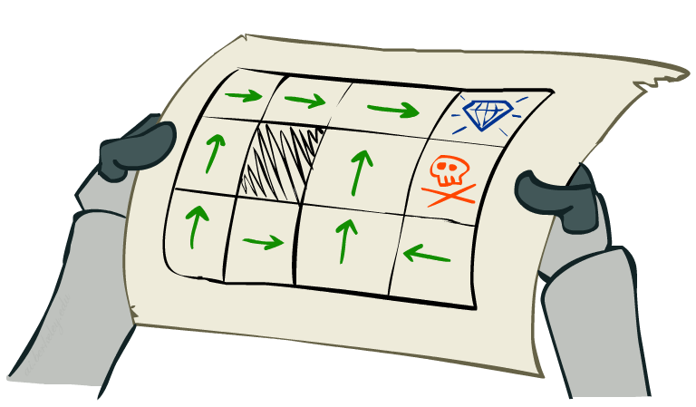
Passive Reinforcement Learning
Simplified task: policy evaluation
  Input: a fixed policy π(s)
  You don’t know the transitions T(s,a,s’)
  You don’t know the rewards R(s,a,s’)
  Goal: learn the state values
In this case:
  Learner is “along for the ride”
  No choice about what actions to take
  Just execute the policy and learn from experience
  This is NOT offline planning! You actually take actions in the world.

Slide 23
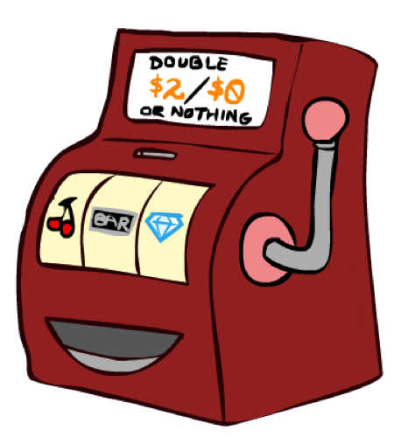
Direct Evaluation
Goal: Compute values for each state under π
Idea: Average together observed sample values
  Act according to π
  Every time you visit a state, write down what the sum of discounted rewards turned out to be
  Average those samples
This is called direct evaluation

Slide 24
Example: Direct Evaluation
Input Policy π
Observed Episodes (Training)
Output Values
Episode 1
Episode 2
 | A
B | C | D
 | E
 | A
B | C | D
 | E
B, east, C, -1
C, east, D, -1
D, exit, x, +10
B, east, C, -1
C, east, D, -1
D, exit, x, +10
-10
+8
+4
+10
Episode 3
Episode 4
-2
E, north, C, -1
C, east, D, -1
D, exit, x, +10
E, north, C, -1
C, east, A, -1
A, exit, x, -10
Assume: γ = 1

Slide 25
Problems with Direct Evaluation
What’s good about direct evaluation?
  It’s easy to understand
  It doesn’t require any knowledge of T, R
  It eventually computes the correct average values, using just sample transitions
What bad about it?
  It wastes information about state connections
  Each state must be learned separately
  So, it takes a long time to learn
Output Values
 | A
B | C | D
 | E
-10
+8
+4
+10
-2
If B and E both go to C under this policy, how can their values be different?

Slide 26

Why Not Use Policy Evaluation?
s
Simplified Bellman updates calculate V for a fixed policy:
  Each round, replace V with a one-step-look-ahead layer over V
  This approach fully exploited the connections between the states
  Unfortunately, we need T and R to do it!
Key question: how can we do this update to V without knowing T and R?
  In other words, how to we take a weighted average without knowing the weights?
π(s)
s, π(s)
s, π(s),s’
s’

Slide 27
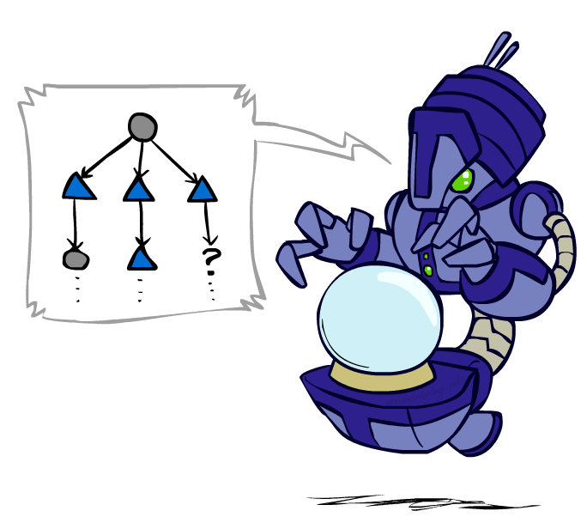
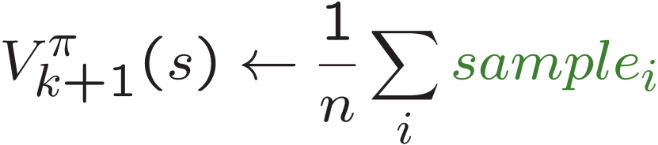
Sample-Based Policy Evaluation?
We want to improve our estimate of V by computing these averages:
Idea: Take samples of outcomes s’ (by doing the action!) and average
s
π(s)
s, π(s)
s, π(s),s’
s₁'
s₂'
s'
s₃'
Almost! But we can’t rewind time to get sample after sample from state s.
Notes:
- Hard to do in practice as we can’t rewind actions and start over

Slide 28
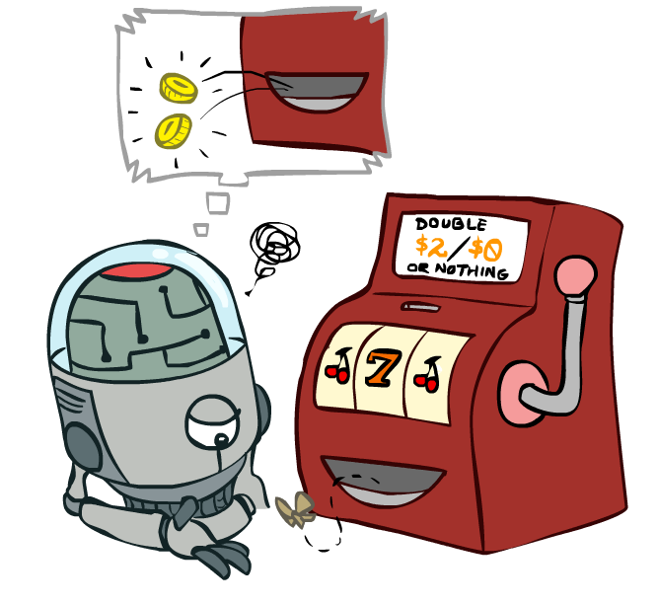
Temporal Difference Learning

Slide 29
Temporal Difference Learning
Big idea: learn from every experience!
  Update V(s) each time we experience a transition (s, a, s’, r)
  Likely outcomes s’ will contribute updates more often
Temporal difference learning of values
  Policy still fixed, still doing evaluation!
  Move values toward value of whatever successor occurs: running average
s
π(s)
s, π(s)
s’
Sample of V(s):
Update to V(s):
Same update:

Slide 30

Exponential Moving Average
Exponential moving average
  The running interpolation update:
  Makes recent samples more important:
  Forgets about the past (distant past values were wrong anyway)
Decreasing learning rate (alpha) can give converging averages

Slide 31
Example: Temporal Difference Learning
States
Observed Transitions
B, east, C, -2
C, east, D, -2
 | A
B | C | D
 | E
 | 0
0 | 0 | 8
 | 0
 | 0
-1 | 0 | 8
 | 0
 | 0
-1 | 3 | 8
 | 0
Assume: γ = 1, α = 1/2

Slide 32
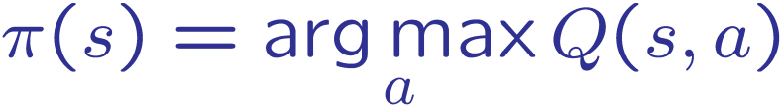
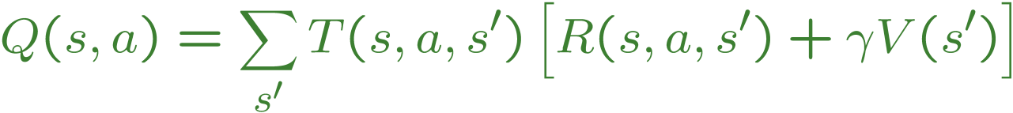
Problems with TD Value Learning
TD value leaning is a model-free way to do policy evaluation, mimicking Bellman updates with running sample averages
However, if we want to turn values into a (new) policy, we’re sunk:
Idea: learn Q-values, not values
Makes action selection model-free too!
s
a
s, a
s,a,s’
s’

Slide 33
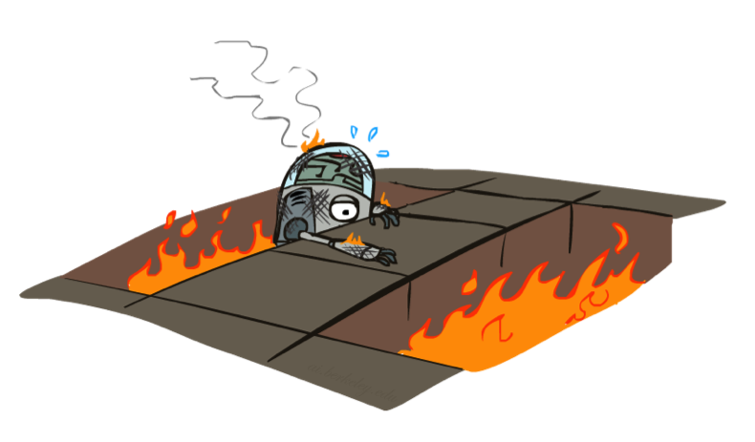
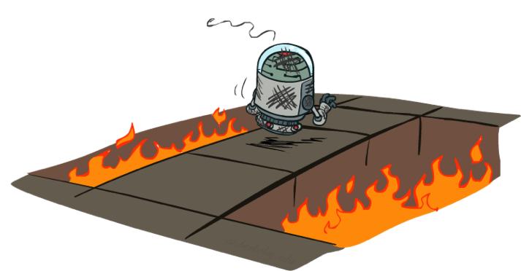
Active Reinforcement Learning

Slide 34
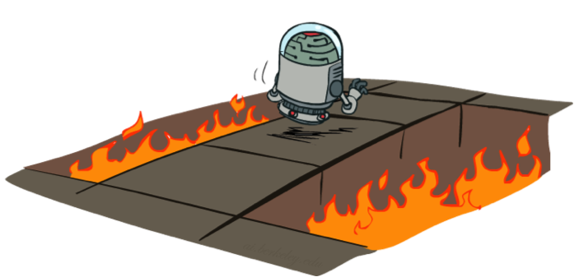
Active Reinforcement Learning
Full reinforcement learning: optimal policies (like value iteration)
  You don’t know the transitions T(s,a,s’)
  You don’t know the rewards R(s,a,s’)
  You choose the actions now
  Goal: learn the optimal policy / values
In this case:
  Learner makes choices!
  Fundamental tradeoff: exploration vs. exploitation
  This is NOT offline planning! You actually take actions in the world and find out what happens…

Slide 35
Detour: Q-Value Iteration
Value iteration: find successive (depth-limited) values
  Start with V₀(s) = 0, which we know is right
  Given V_{k}, calculate the depth k+1 values for all states:
But Q-values are more useful, so compute them instead
  Start with Q₀(s,a) = 0, which we know is right
  Given Q_{k}, calculate the depth k+1 q-values for all q-states:

Slide 36

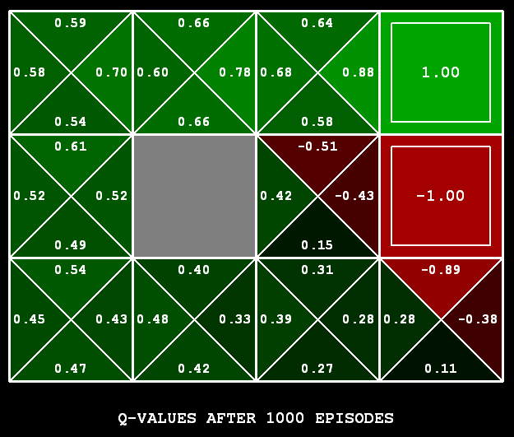
Q-Learning
Q-Learning: sample-based Q-value iteration
Learn Q(s,a) values as you go
  Receive a sample (s,a,s’,r)
  Consider your old estimate:
  Consider your new sample estimate:
  Incorporate the new estimate into a running average:
[Demo: Q-learning – gridworld (L10D2)]
[Demo: Q-learning – crawler (L10D3)]

Slide 37
Video of Demo Q-Learning -- Gridworld

Slide 38
Video of Demo Q-Learning -- Crawler

Slide 39

Q-Learning Properties
Amazing result: Q-learning converges to optimal policy -- even if you’re acting suboptimally!
This is called off-policy learning
Caveats:
  You have to explore enough
  You have to eventually make the learning rate
  small enough
  … but not decrease it too quickly
  Basically, in the limit, it doesn’t matter how you select actions (!)

