Slide 1
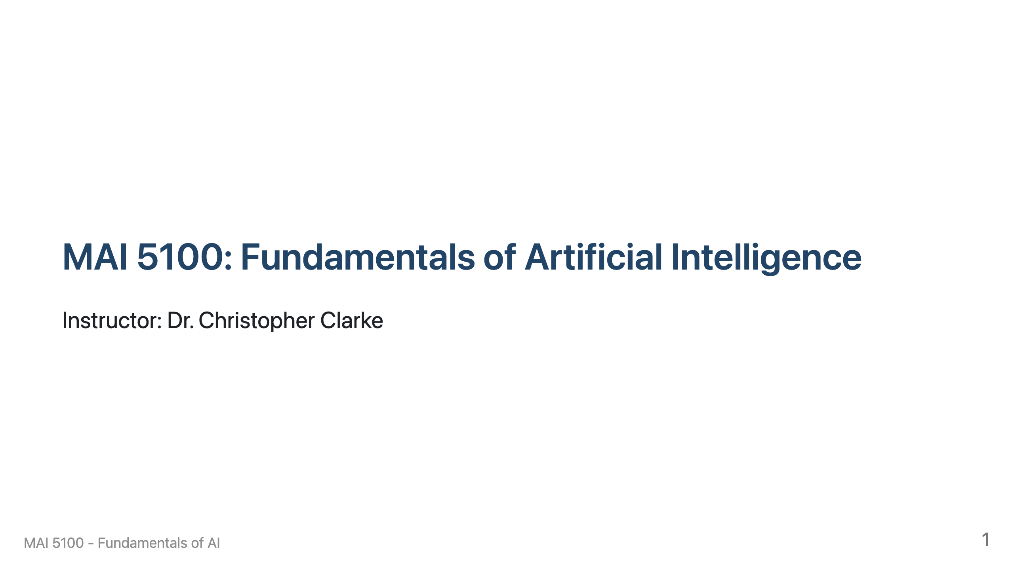

Slide 2
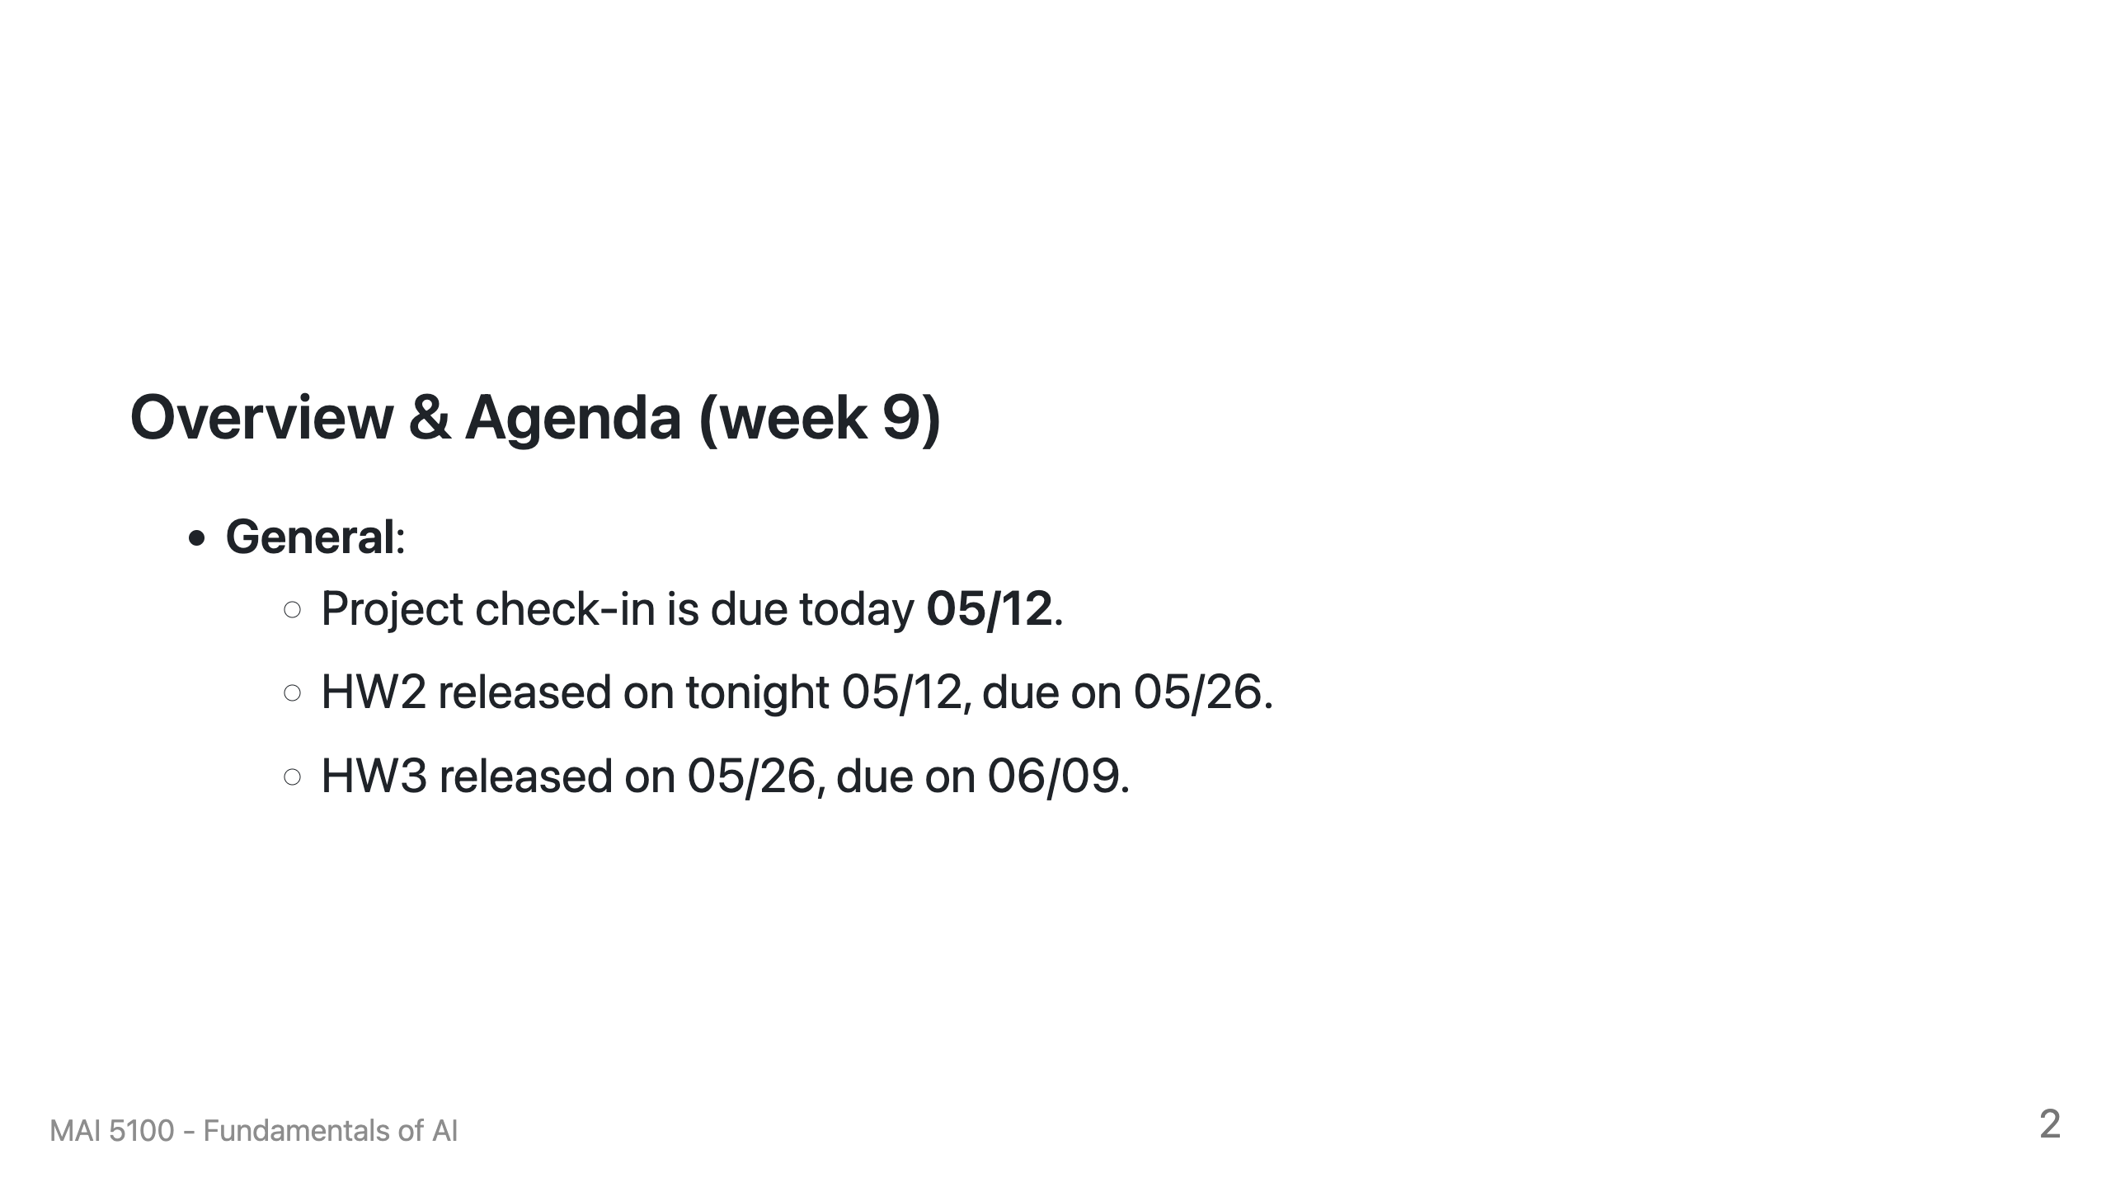

Slide 3
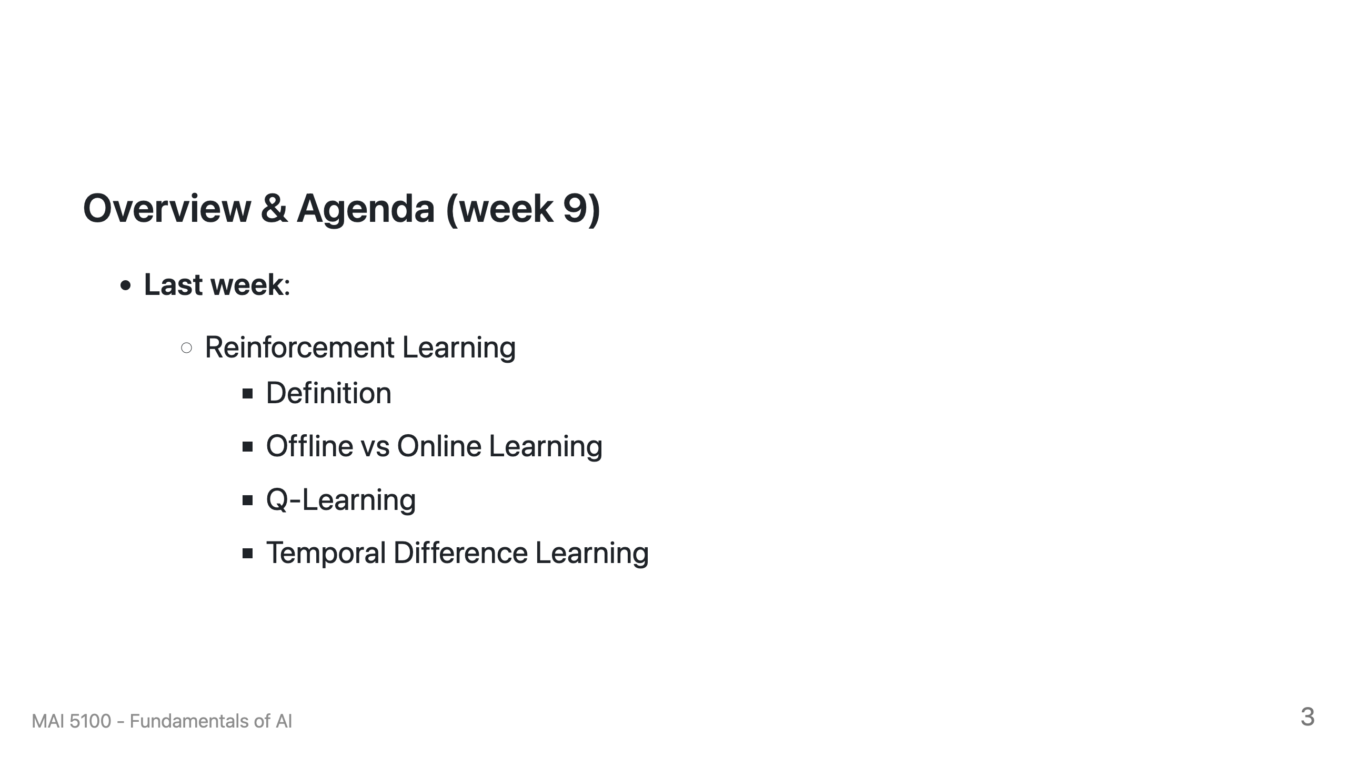

Slide 4
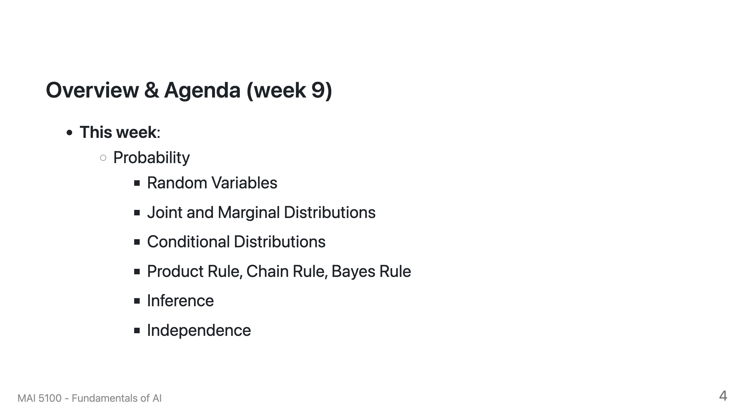

Slide 5
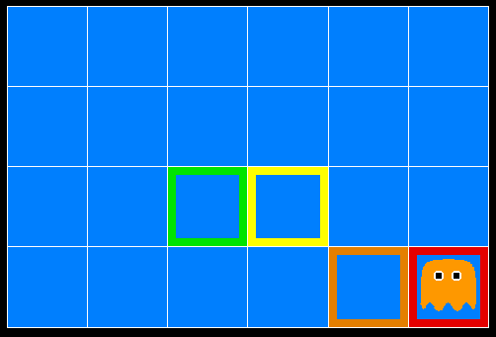
Inference in Ghostbusters
A ghost is in the grid somewhere
Sensor readings tell how close a square is to the ghost
  On the ghost: red
  1 or 2 away: orange
  3 or 4 away: yellow
  5+ away: green
Sensors are noisy, but we know P(Color | Distance)
P(red | 3) | P(orange | 3) | P(yellow | 3) | P(green | 3)
0.05 | 0.15 | 0.5 | 0.3
[Demo: Ghostbuster – no probability (L12D1) ]

Slide 6

Video of Demo Ghostbuster – No probability

Slide 7
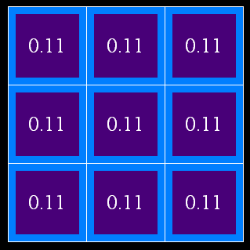
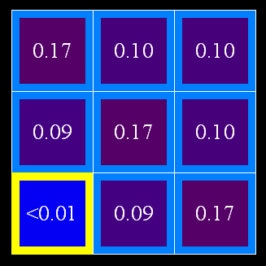
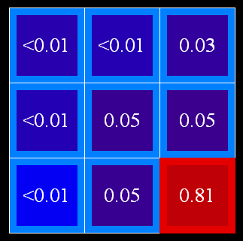
Uncertainty
General situation:
  Observed variables (evidence): Agent knows certain things about the state of the world (e.g., sensor readings or symptoms)
  Unobserved variables: Agent needs to reason about other aspects (e.g. where an object is or what disease is present)
  Model: Agent knows something about how the known variables relate to the unknown variables
Probabilistic reasoning gives us a framework for managing our beliefs and knowledge

Slide 8

Random Variables
A random variable is some aspect of the world about which we (may) have uncertainty
  R = Is it raining?
  T = Is it hot or cold?
  D = How long will it take to drive to work?
  L = Where is the ghost?
We denote random variables with capital letters
Like variables in a CSP, random variables have domains
  R in {true, false} (often write as {+r, -r})
  T in {hot, cold}
  D in [0, ∞)
  L in possible locations, maybe {(0,0), (0,1), …}

Slide 9
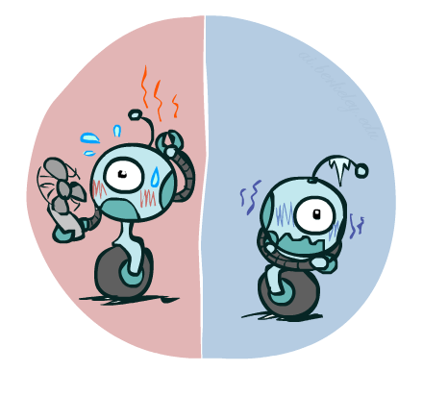

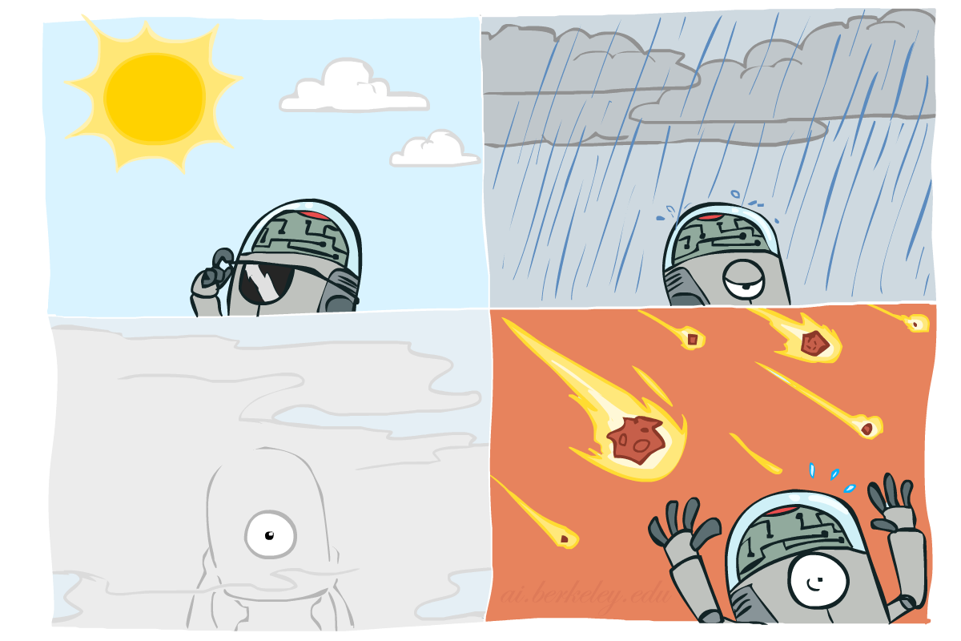

Probability Distributions
Associate a probability with each value
  Temperature:
  Weather:
W | P
sun | 0.6
rain | 0.1
fog | 0.3
meteor | 0.0
T | P
hot | 0.5
cold | 0.5

Slide 10


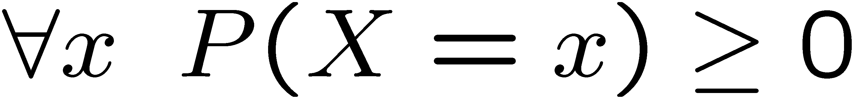
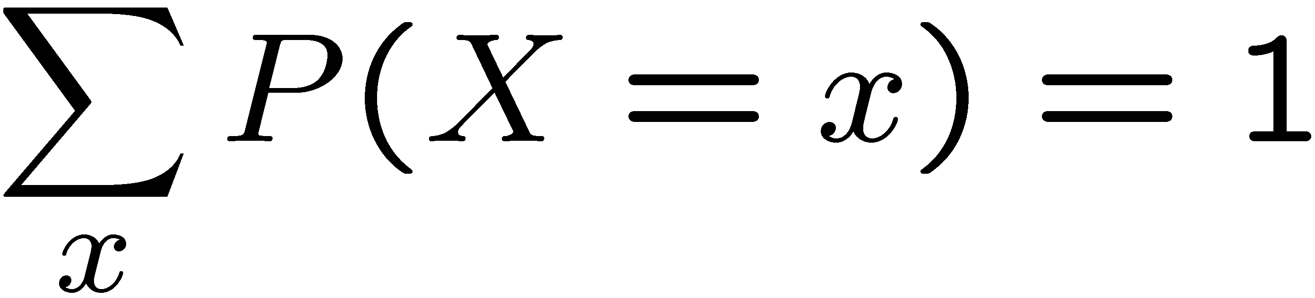
Probability Distributions
Unobserved random variables have distributions
A distribution is a TABLE of probabilities of values
A probability (lower case value) is a single number
Must have: and
Shorthand notation:
OK if all domain entries are unique
T | P
hot | 0.5
cold | 0.5
W | P
sun | 0.6
rain | 0.1
fog | 0.3
meteor | 0.0

Slide 11




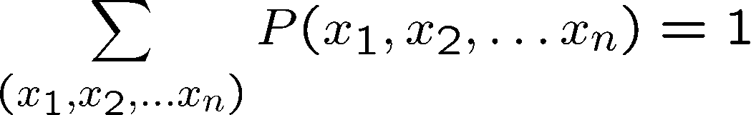
Joint Distributions
A joint distribution over a set of random variables:
specifies a real number for each assignment (or outcome):
  Must obey:
Size of distribution if n variables with domain sizes d?
  For all but the smallest distributions, impractical to write out!
T | W | P
hot | sun | 0.4
hot | rain | 0.1
cold | sun | 0.2
cold | rain | 0.3

Slide 12
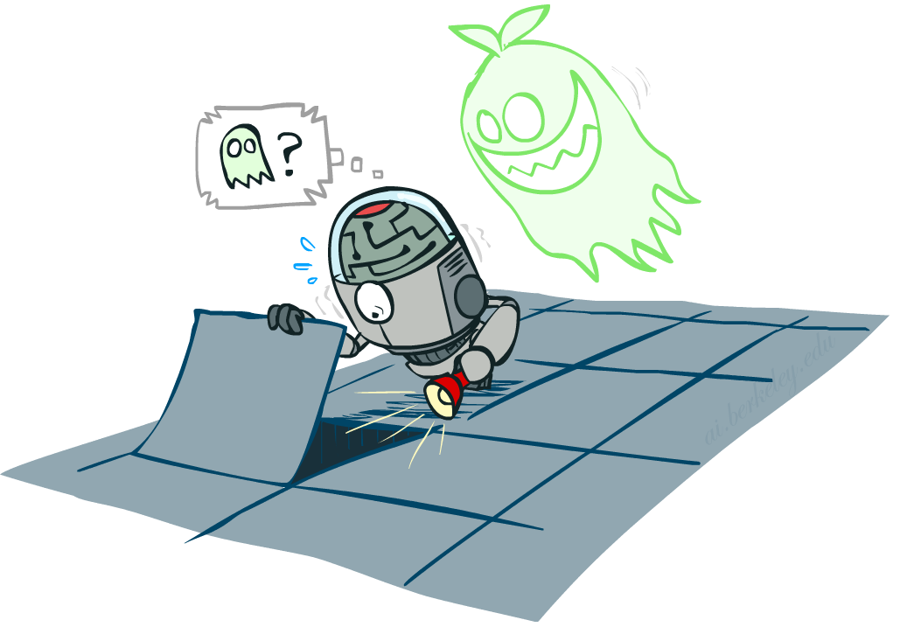

Probabilistic Models
Distribution over T,W
A probabilistic model is a joint distribution over a set of random variables
Probabilistic models:
  (Random) variables with domains
  Assignments are called outcomes
  Joint distributions: say whether assignments (outcomes) are likely
  Normalized: sum to 1.0
  Ideally: only certain variables directly interact
Constraint satisfaction problems:
  Variables with domains
  Constraints: state whether assignments are possible
  Ideally: only certain variables directly interact
T | W | P
hot | sun | 0.4
hot | rain | 0.1
cold | sun | 0.2
cold | rain | 0.3
Constraint over T,W
T | W | P
hot | sun | T
hot | rain | F
cold | sun | F
cold | rain | T

Slide 13
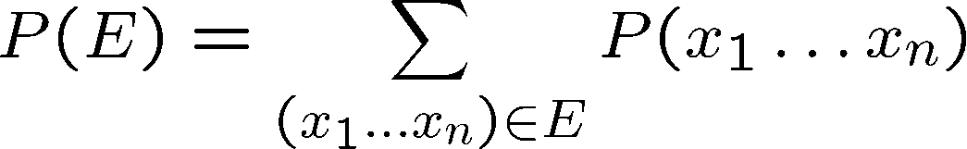
Events
An event is a set E of outcomes
From a joint distribution, we can calculate the probability of any event
  Probability that it’s hot AND sunny?
  Probability that it’s hot?
  Probability that it’s hot OR sunny?
Typically, the events we care about are partial assignments, like P(T=hot)
T | W | P
hot | sun | 0.4
hot | rain | 0.1
cold | sun | 0.2
cold | rain | 0.3

Slide 14
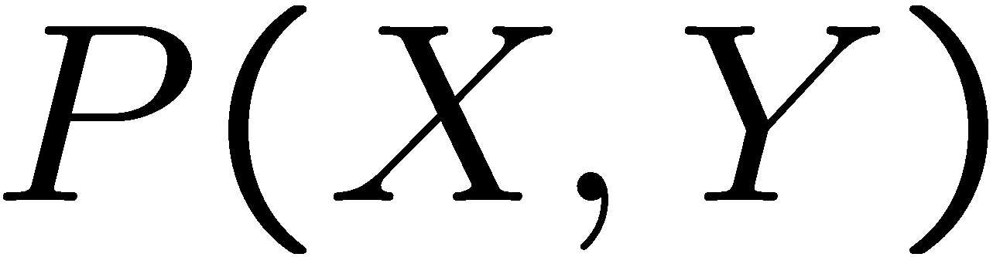
Quiz: Events
P(+x, +y) ?
P(+x) ?
P(-y OR +x) ?
X | Y | P
+x | +y | 0.2
+x | -y | 0.3
-x | +y | 0.4
-x | -y | 0.1

Slide 15
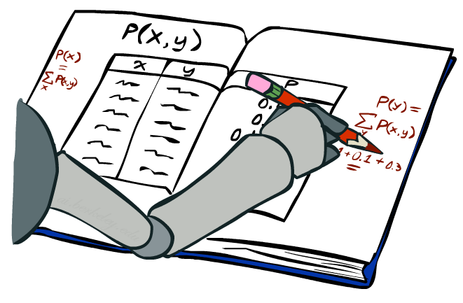
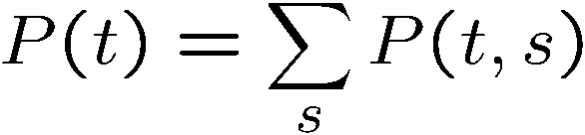
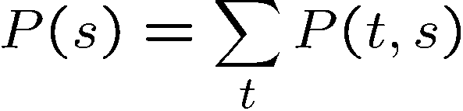
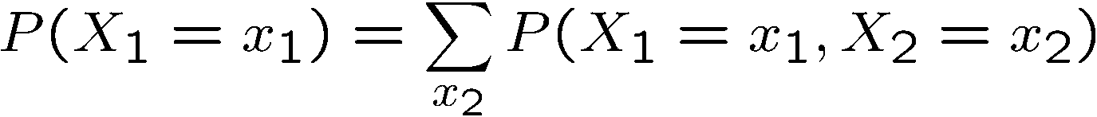
Marginal Distributions
Marginal distributions are sub-tables which eliminate variables
Marginalization (summing out): Combine collapsed rows by adding
T | P
hot | 0.5
cold | 0.5
T | W | P
hot | sun | 0.4
hot | rain | 0.1
cold | sun | 0.2
cold | rain | 0.3
W | P
sun | 0.6
rain | 0.4

Slide 16
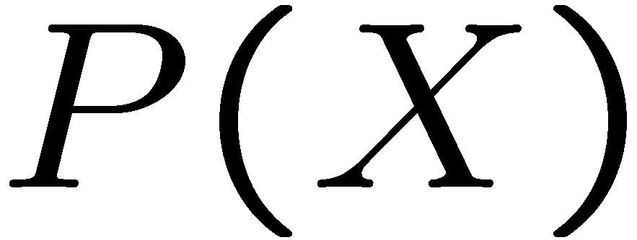
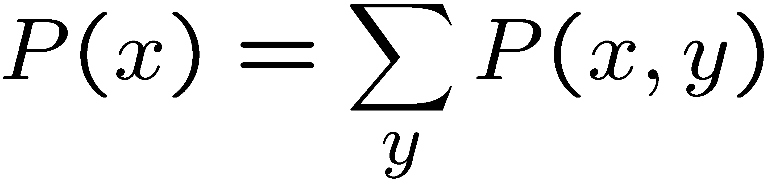
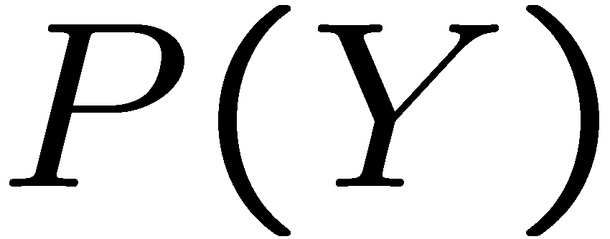
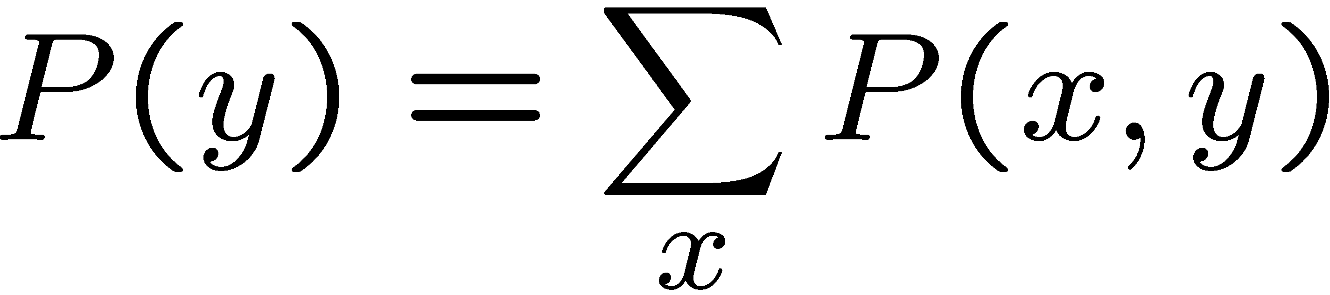
Quiz: Marginal Distributions
X | P
+x
-x
X | Y | P
+x | +y | 0.2
+x | -y | 0.3
-x | +y | 0.4
-x | -y | 0.1
Y | P
+y
-y

Slide 17
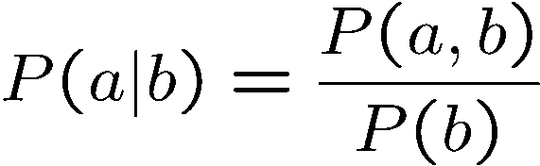
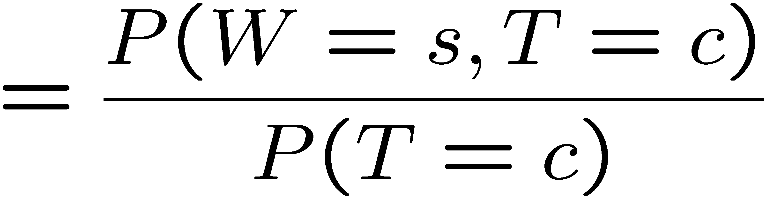
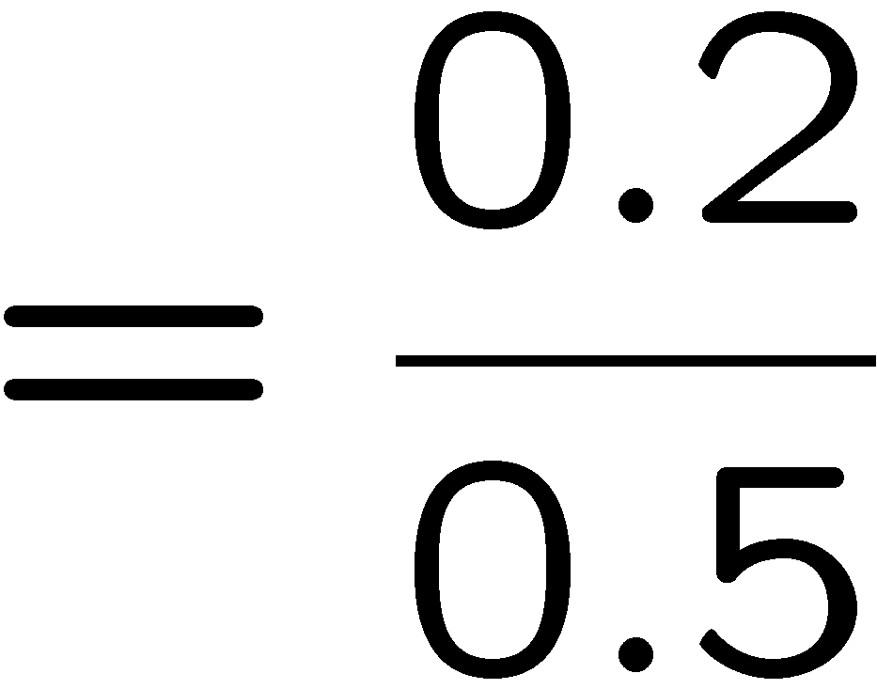



Conditional Probabilities
A simple relation between joint and conditional probabilities
  In fact, this is taken as the definition of a conditional probability
P(a,b)
P(a)
P(b)
T | W | P
hot | sun | 0.4
hot | rain | 0.1
cold | sun | 0.2
cold | rain | 0.3

Slide 18
Quiz: Conditional Probabilities
P(+x | +y) ?
P(-x | +y) ?
P(-y | +x) ?
X | Y | P
+x | +y | 0.2
+x | -y | 0.3
-x | +y | 0.4
-x | -y | 0.1

Slide 19



Conditional Distributions
Conditional distributions are probability distributions over some variables given fixed values of others
Conditional Distributions
Joint Distribution
W | P
sun | 0.8
rain | 0.2
T | W | P
hot | sun | 0.4
hot | rain | 0.1
cold | sun | 0.2
cold | rain | 0.3
W | P
sun | 0.4
rain | 0.6

Slide 20

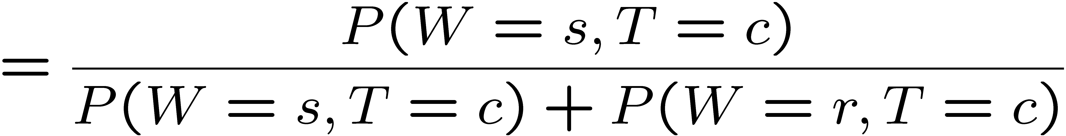
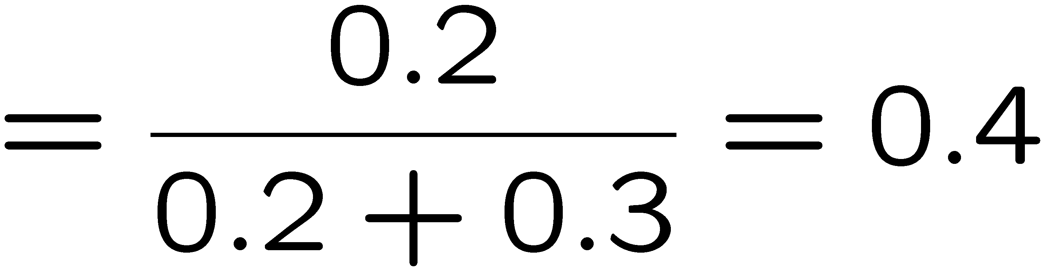
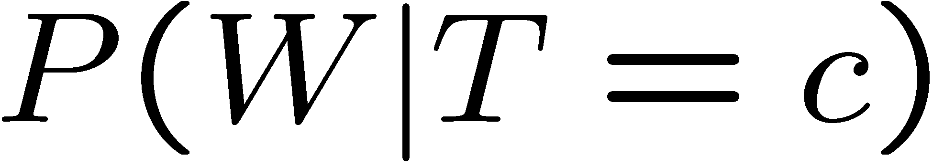
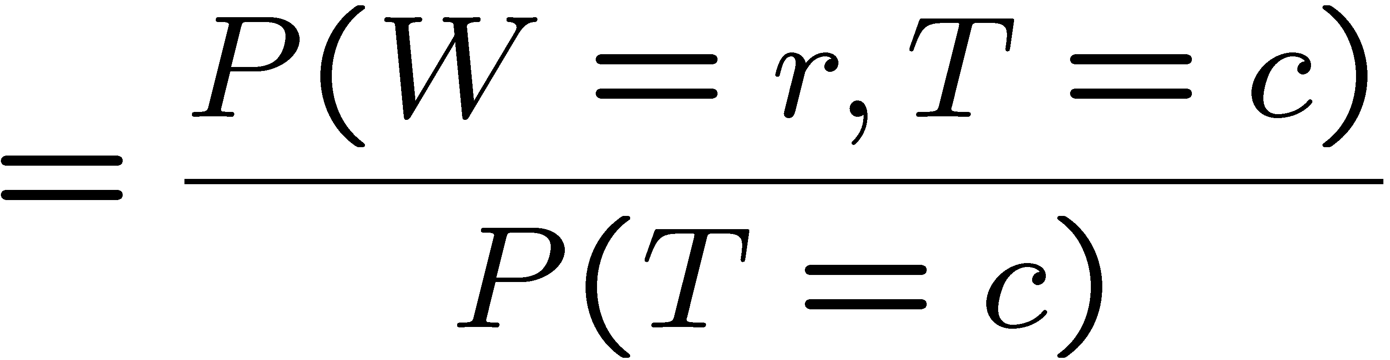

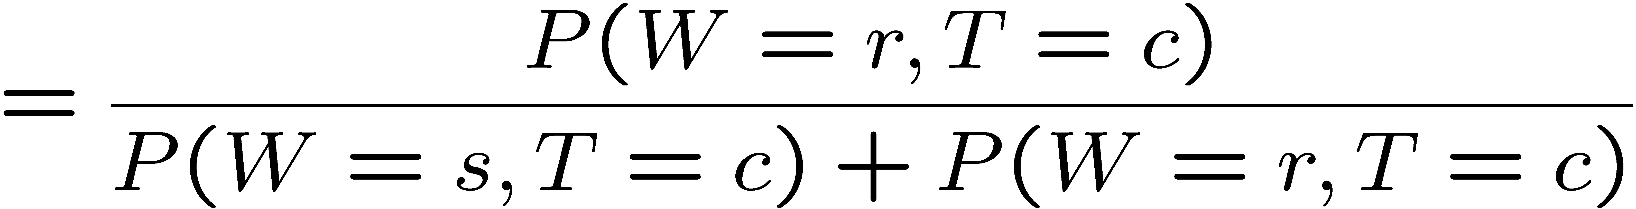
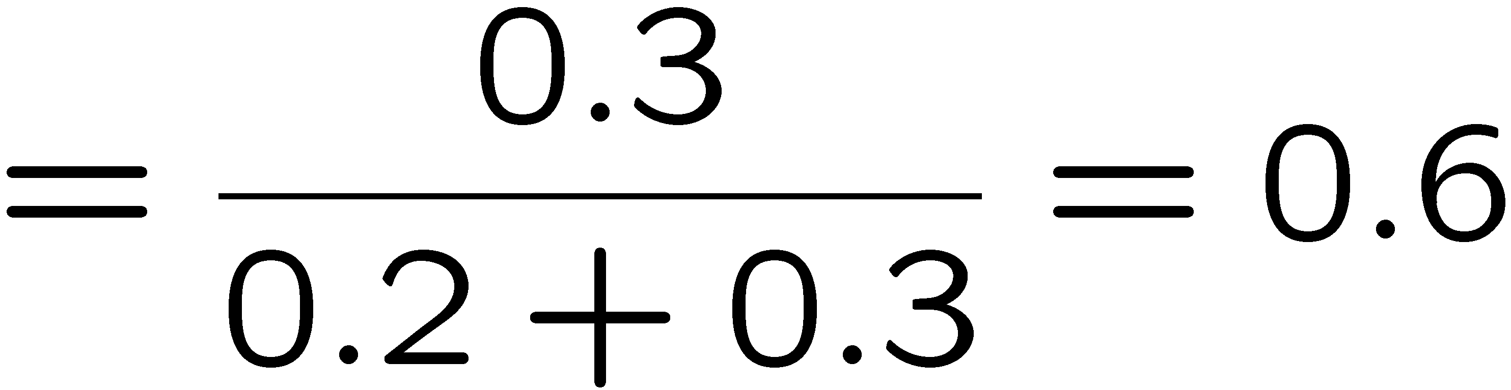
Normalization Trick
T | W | P
hot | sun | 0.4
hot | rain | 0.1
cold | sun | 0.2
cold | rain | 0.3
W | P
sun | 0.4
rain | 0.6

Slide 21
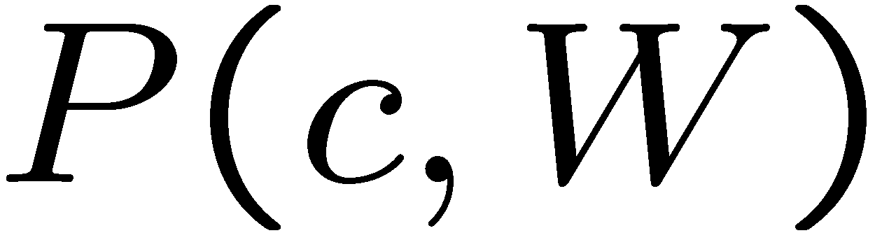
Normalization Trick
  SELECT the joint probabilities matching the evidence
  NORMALIZE the selection
  (make it sum to one)
T | W | P
hot | sun | 0.4
hot | rain | 0.1
cold | sun | 0.2
cold | rain | 0.3
T | W | P
cold | sun | 0.2
cold | rain | 0.3
W | P
sun | 0.4
rain | 0.6

Slide 22
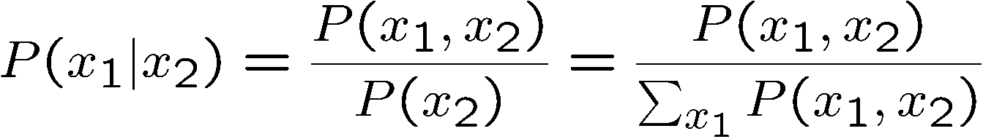
Normalization Trick
  SELECT the joint probabilities matching the evidence
  NORMALIZE the selection
  (make it sum to one)
T | W | P
hot | sun | 0.4
hot | rain | 0.1
cold | sun | 0.2
cold | rain | 0.3
T | W | P
cold | sun | 0.2
cold | rain | 0.3
W | P
sun | 0.4
rain | 0.6
Why does this work? Sum of selection is P(evidence)! (P(T=c), here)

Slide 23
Quiz: Normalization Trick
P(X | Y=-y) ?
  SELECT the joint probabilities matching the evidence
  NORMALIZE the selection
  (make it sum to one)
X | Y | P
+x | +y | 0.2
+x | -y | 0.3
-x | +y | 0.4
-x | -y | 0.1

Slide 24
To Normalize
(Dictionary) To bring or restore to a normal condition
Procedure:
  Step 1: Compute Z = sum over all entries
  Step 2: Divide every entry by Z
Example 1
All entries sum to ONE
Example 2
W | P
sun | 0.2
rain | 0.3
Normalize
W | P
sun | 0.4
rain | 0.6
T | W | P
hot | sun | 20
hot | rain | 5
cold | sun | 10
cold | rain | 15
T | W | P
hot | sun | 0.4
hot | rain | 0.1
cold | sun | 0.2
cold | rain | 0.3
Normalize
Z = 0.5
Z = 50

Slide 25


Normalization Trick
A trick to get a whole conditional distribution at once:
  Select the joint probabilities matching the evidence
  Normalize the selection (make it sum to one)
  Why does this work? Sum of selection is P(evidence)! (P(r), here)
T | W | P
hot | sun | 0.4
hot | rain | 0.1
cold | sun | 0.2
cold | rain | 0.3
T | R | P
hot | rain | 0.1
cold | rain | 0.3
T | P
hot | 0.25
cold | 0.75
Select
Normalize

Slide 26
Conditional Distributions
Conditional distributions are probability distributions over some variables given fixed values of others
Conditional Distributions
Joint Distribution
W | P
sun | 0.8
rain | 0.2
T | W | P
hot | sun | 0.4
hot | rain | 0.1
cold | sun | 0.2
cold | rain | 0.3
W | P
sun | 0.4
rain | 0.6

Slide 27
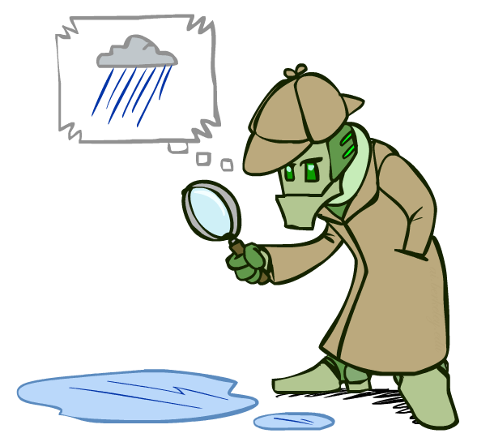
Probabilistic Inference
Probabilistic inference: compute a desired probability from other known probabilities (e.g. conditional from joint)
We generally compute conditional probabilities
  P(on time | no reported accidents) = 0.90
  These represent the agent’s beliefs given the evidence
Probabilities change with new evidence:
  P(on time | no accidents, 5 a.m.) = 0.95
  P(on time | no accidents, 5 a.m., raining) = 0.80
  Observing new evidence causes beliefs to be updated

Slide 28





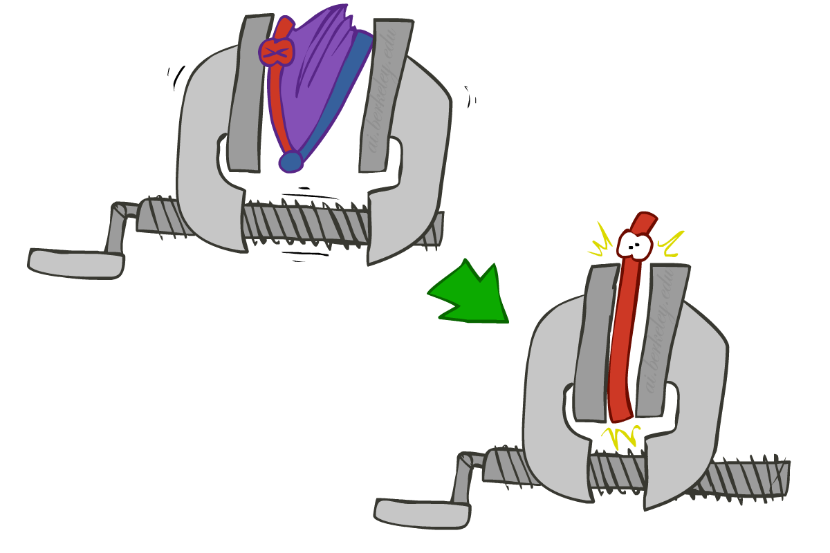
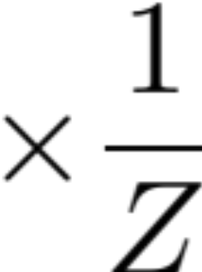
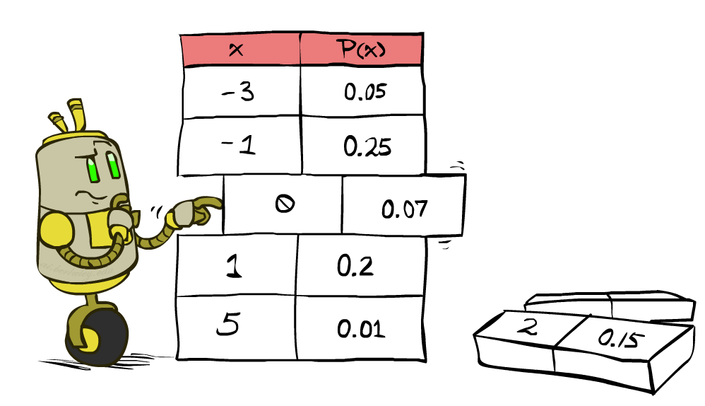


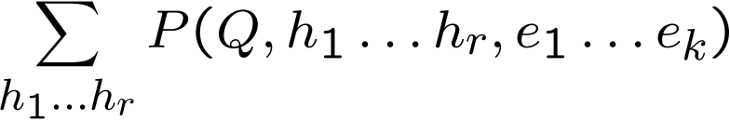
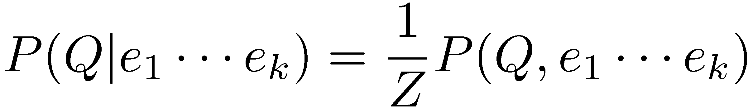
Inference by Enumeration
* Works fine with multiple query variables, too
General case:
  Evidence variables:
  Query* variable:
  Hidden variables:
We want:
All variables
Step 1: Select the entries consistent with the evidence
Step 2: Sum out H to get joint of Query and evidence
Step 3: Normalize

Slide 29
Inference by Enumeration
P(W)?
P(W | winter)?
P(W | winter, hot)?
S | T | W | P
summer | hot | sun | 0.30
summer | hot | rain | 0.05
summer | cold | sun | 0.10
summer | cold | rain | 0.05
winter | hot | sun | 0.10
winter | hot | rain | 0.05
winter | cold | sun | 0.15
winter | cold | rain | 0.20

Slide 30
Inference by Enumeration
Obvious problems:
  Worst-case time complexity O(d^{n})
  Space complexity O(d^{n}) to store the joint distribution

Slide 31
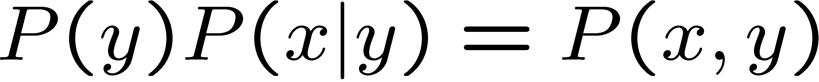
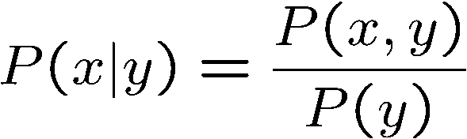
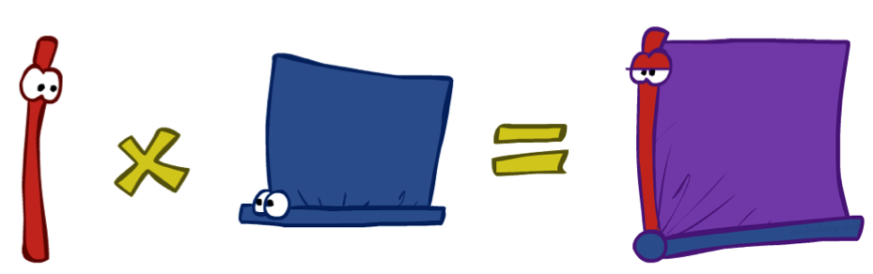
The Product Rule
Sometimes have conditional distributions but want the joint

Slide 32


The Product Rule
Example:
D | W | P
wet | sun | 0.1
dry | sun | 0.9
wet | rain | 0.7
dry | rain | 0.3
D | W | P
wet | sun | 0.08
dry | sun | 0.72
wet | rain | 0.14
dry | rain | 0.06
R | P
sun | 0.8
rain | 0.2

Slide 33
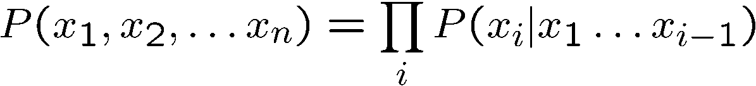
The Chain Rule
More generally, can always write any joint distribution as an incremental product of conditional distributions
Why is this always true?

Slide 34
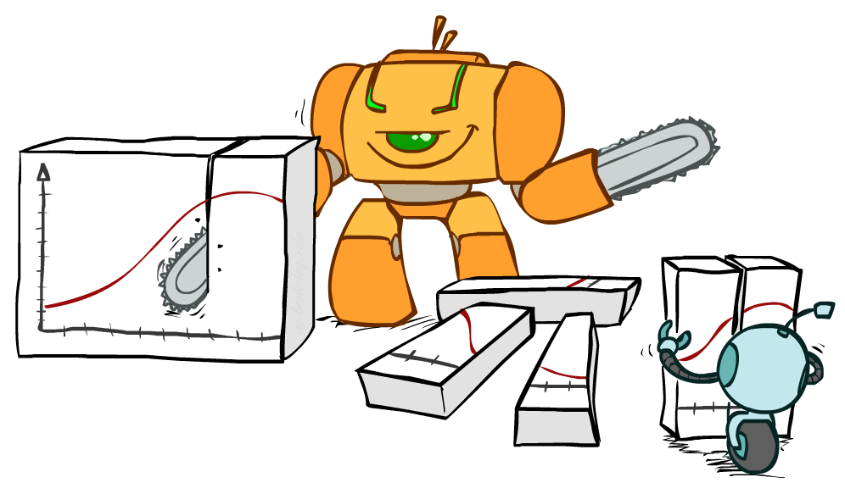
Bayes Rule

Slide 35


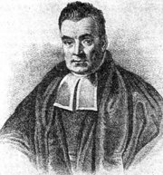
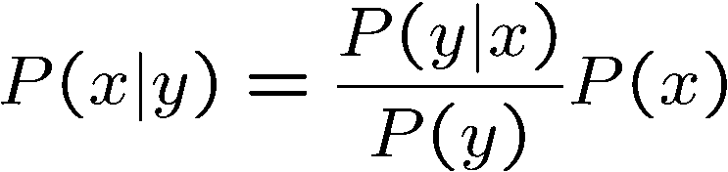
Bayes’ Rule
Two ways to factor a joint distribution over two variables:
Dividing, we get:
Why is this at all helpful?
  Lets us build one conditional from its reverse
  Often one conditional is tricky but the other one is simple
  Foundation of many systems we’ll see later (e.g. ASR, MT)
In the running for most important AI equation!
That’s my rule!

Slide 36
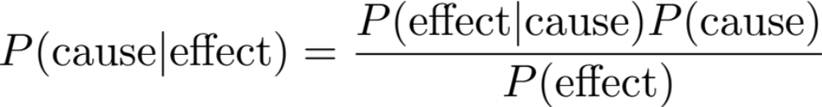



Inference with Bayes’ Rule
Example: Diagnostic probability from causal probability:
Example:
  M: meningitis, S: stiff neck
  Note: posterior probability of meningitis still very small
  Note: you should still get stiff necks checked out! Why?
Example
givens

Slide 37
Quiz: Bayes’ Rule
Given:
What is P(W | dry) ?
D | W | P
wet | sun | 0.1
dry | sun | 0.9
wet | rain | 0.7
dry | rain | 0.3
R | P
sun | 0.8
rain | 0.2

Slide 38

Ghostbusters, Revisited
Let’s say we have two distributions:
  Prior distribution over ghost location: P(G)
    Let’s say this is uniform
  Sensor reading model: P(R | G)
    Given: we know what our sensors do
    R = reading color measured at (1,1)
    E.g. P(R = yellow | G=(1,1)) = 0.1
We can calculate the posterior distribution P(G|r) over ghost locations given a reading using Bayes’ rule:
[Demo: Ghostbuster – with probability (L12D2) ]

Slide 39
Video of Demo Ghostbusters with Probability

Slide 40
Next Time: Markov Models

