Slide 1
MAI 5100
Fundamentals of Artificial Intelligence
Week 1: Introduction to AI
Dr. Christopher Clarke · University of Guyana

Slide 2
Today
• Welcome and introductions
• What is AI? Real-world impact, definitions, computational rationality, perspectives on intelligence
• A short history of AI and the patterns it reveals
• AI in Guyana and the Caribbean: opportunities, risks, and open questions
• This course: designing rational agents, course topics
• Logistics: schedule, assessment, submissions, generative AI policy
MAI 5100 · Fundamentals of AI
2

Slide 3

About Me
Dr. Christopher Clarke
• PhD & MS, Computer Science, U. of Michigan
• BSc, University of Guyana
• Engineering Lead, AI Core Engineering, Center for Advanced AI at Accenture
• Director, V75 Inc. and Nexus Hub Inc.
christopher.clarke@uog.edu.gy · csclarke.com
MAI 5100 · Fundamentals of AI
3

Slide 4
My Work
Current research and engineering focus
Large-scale LLM inference
Agentic systems
Human-AI interaction
Serving large models efficiently, reliably, and at scale
AI systems that plan, use tools, and take multi-step actions
How people work with, trust, and are affected by AI
Publications: Google Scholar
MAI 5100 · Fundamentals of AI
4

Slide 5
Your Turn
About 60 seconds each
• Your name and background
• Why are you interested in AI?
• Icebreaker: What AI tool did you use this week, and did it get something wrong?
MAI 5100 · Fundamentals of AI
5

Slide 6
Where Are You Starting From?
• How comfortable are you writing Python?
• Have you seen probability before (conditional probability, Bayes' rule)?
• Have you used Git and GitHub?
• Have you trained or fine-tuned a machine learning model?
MAI 5100 · Fundamentals of AI
6

Slide 7
What is AI?
From headlines to a working definition

Slide 8
What is AI?
“The science and engineering of making intelligent machines.”
John McCarthy, who coined the term “artificial intelligence” (1956)
Artificial Intelligence
Systems that perceive, reason, and act
Machine Learning
Learn patterns from data
A working definition
Building computer systems that perceive their environment, reason about it, learn from experience, and act to achieve goals, doing tasks that normally require human intelligence.
Deep Learning
Many-layered neural networks
• AI does not have to be human-like: a chess engine, a spam filter, and a chatbot are all AI
• AI is broader than ChatGPT: search, planning, reasoning, and learning are all part of it
Generative AI & LLMs
Create text, images, code
In this course we take the rational agent view: an agent perceives its environment and acts to maximize its expected performance.
MAI 5100 · Fundamentals of AI
8

Slide 9
AI Is Having Real-World Impact
Everyday tools
Economy & labor
Politics & law
Science
Text assistants, search, coding, translation
Investment, productivity, changing jobs
Regulation, elections, copyright, liability
Protein structure, materials, climate, conservation
Health
Education
Social life
Security
Diagnosis support, triage, people seeking health advice from chatbots
Tutoring, assessment, and how students learn
Companionship, content feeds, misinformation
Cyberattacks, surveillance, military systems
MAI 5100 · Fundamentals of AI
9

Slide 10


AI Impact: Everyday Tools
Image: Google
Image: Getty Images via TechCrunch
2B+ monthly users
20M+ users
Google reported that AI Overviews in Search had more than 2 billion monthly users (July 2025).
GitHub Copilot, an AI coding assistant, passed 20 million all-time users (July 2025).
Source: Alphabet Q2 2025 earnings remarks
Source: TechCrunch, Jul 30 2025
MAI 5100 · Fundamentals of AI
10

Slide 11
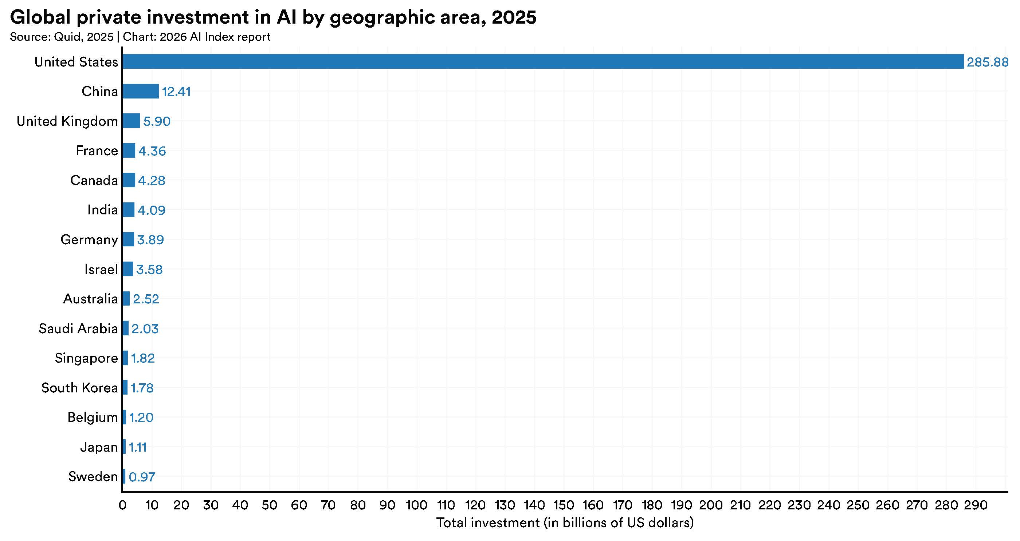

AI Impact: Economy & Labor
Chart: Stanford HAI, 2026 AI Index Report
Image: BalticServers.com / Wikimedia Commons, CC BY-SA 3.0
$344.7B
~2 hrs/week less email
Global private investment in AI in 2025, up 127.5% from 2024. The US accounted for the large majority.
In a randomized trial of 7,137 knowledge workers across 66 firms, workers who used Microsoft 365 Copilot spent about two fewer hours a week on email.
Source: Stanford HAI AI Index 2026
Source: NBER Working Paper 33795
MAI 5100 · Fundamentals of AI
11

Slide 12
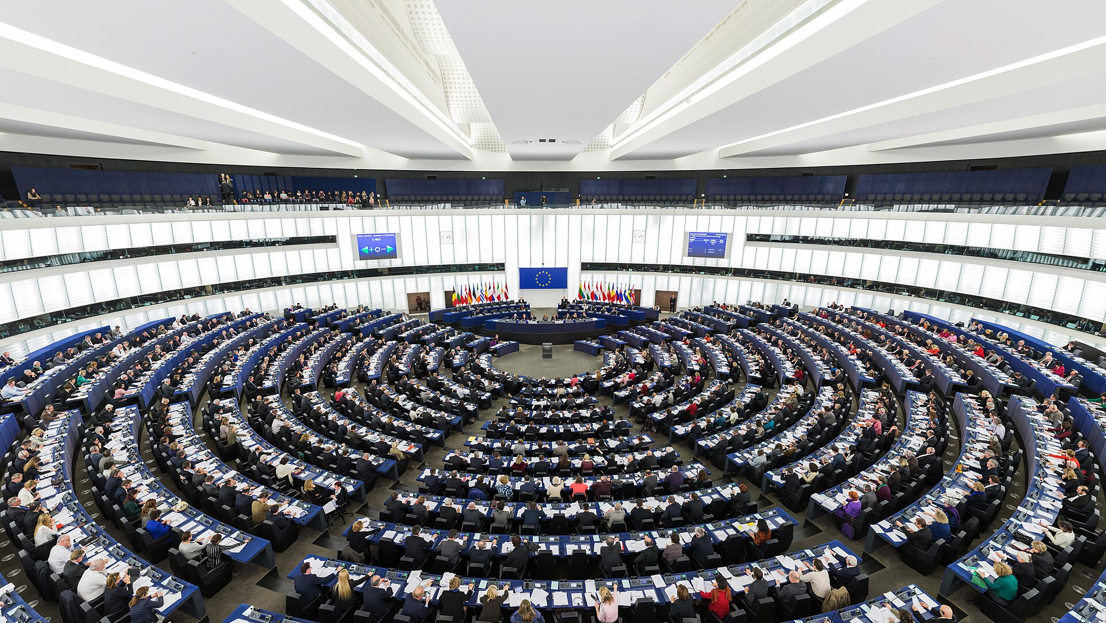

AI Impact: Politics & Law
Image: Diliff / Wikimedia Commons, CC BY-SA 3.0
Image: H. Zell / Wikimedia Commons, CC BY-SA 3.0
Aug 2, 2025
7M+ pirated books
EU AI Act obligations began applying to providers of general-purpose AI models, including transparency and copyright requirements.
A US judge ruled that training Claude on books was fair use, but that Anthropic's storage of millions of pirated books was not (June 2025).
Source: European Commission
Source: Reuters, Jun 24 2025
MAI 5100 · Fundamentals of AI
12

Slide 13
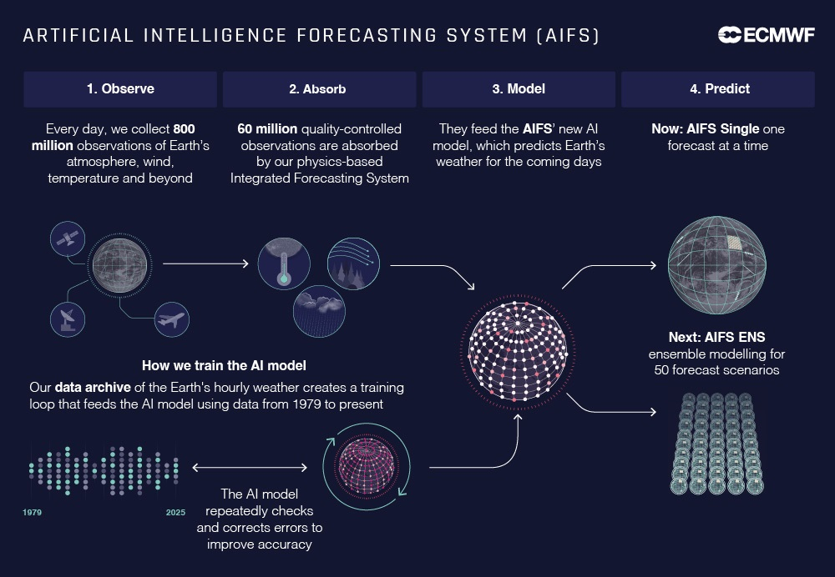
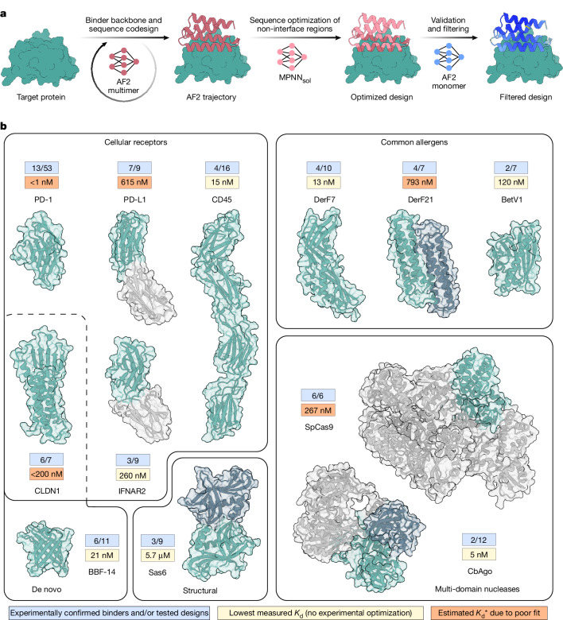
AI Impact: Science
Graphic: ECMWF
Figure: Pacesa et al., Nature (2025), CC BY
~1,000x less energy
46.3% success rate
The European weather centre's AI forecasting system (AIFS) became operational, cutting energy use per forecast by about 1,000 times (Feb 2025).
BindCraft used AI to design protein binders, averaging a 46.3% experimental success rate across 12 targets (Nature, 2025).
Source: ECMWF, Feb 25 2025
Source: Pacesa et al., Nature 2025
MAI 5100 · Fundamentals of AI
13

Slide 14


AI Impact: Health
Image: U.S. FDA
Image: National Cancer Institute / Wikimedia Commons, public domain
1,600+ devices
80.5% vs 73.8%
The US FDA has authorized more than 1,600 AI-enabled medical devices for marketing (as of Sept 2026). Authorization does not by itself prove clinical benefit.
Sensitivity of AI-supported mammography vs. standard double reading in the MASAI randomized trial of ~106,000 women in Sweden, with the same specificity.
Source: U.S. FDA
Source: Gommers et al., The Lancet, Jan 2026
MAI 5100 · Fundamentals of AI
14

Slide 15
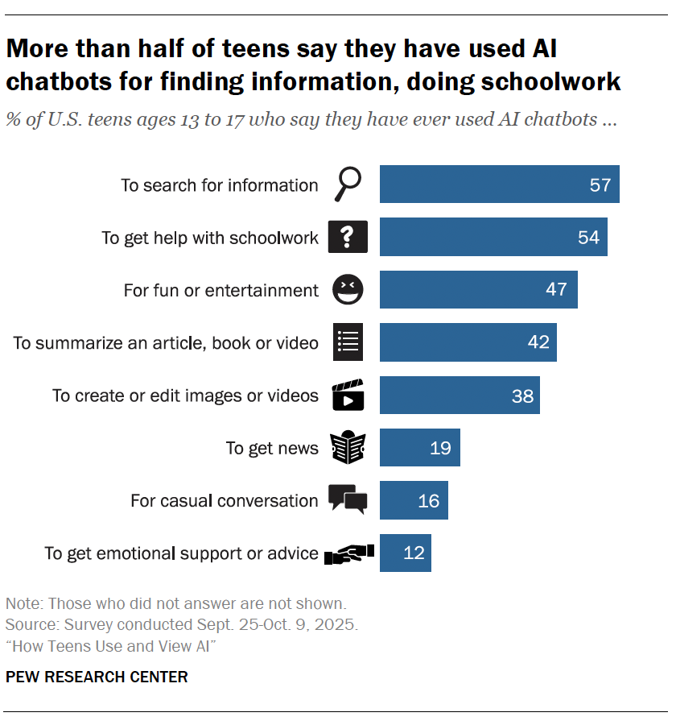

AI Impact: Education
Chart: Pew Research Center
Photo: World Bank
54% of US teens
+0.23 SD in English
More than half of US teens say they have used AI chatbots to help with schoolwork (Pew survey, Sept-Oct 2025).
A World Bank randomized trial of a six-week AI tutoring program in Edo State, Nigeria, found significant gains in English learning.
Source: Pew Research Center, Feb 24 2026
Source: World Bank, May 2025
MAI 5100 · Fundamentals of AI
15

Slide 16


AI Impact: Social Life
Image: Common Sense Media
Image: AI-generated with Midjourney (2023) / Wikimedia Commons, public domain
72% of US teens
5M views
have used an AI companion at least once; over half use them at least a few times a month (Common Sense Media, July 2025).
An AI-generated video falsely claimed to show missiles striking Tel Aviv. Synthetic media like this image of the Pope spread fast and fool many people.
Source: Common Sense Media, Jul 16 2025
Source: Reuters Fact Check, Mar 10 2026
MAI 5100 · Fundamentals of AI
16

Slide 17


AI Impact: Security
Image: Anthropic
Photo: ArmyInform / Wikimedia Commons, CC BY 4.0
~30 targets
Dozens of systems
Anthropic reported that a state-sponsored group used Claude Code to run a largely automated cyber-espionage campaign, succeeding in a small number of cases (Nov 2025).
Ukraine has rolled out dozens of AI-assisted drone guidance systems, some installed in thousands of drones, while requiring a human to make strike decisions.
Source: Anthropic, Nov 13 2025
Source: Reuters, Nov 29 2025
MAI 5100 · Fundamentals of AI
17

Slide 18
Discussion
Where did AI show up in your life this week?
Which of those uses would you call "intelligent"? Why?
What do they have in common?
MAI 5100 · Fundamentals of AI
18

Slide 19
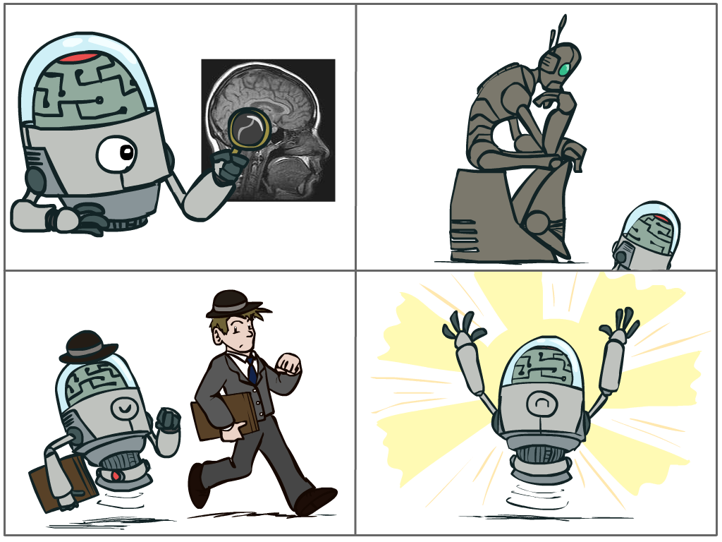
What Should We Build?
Should we make machines that...
• Think like people?
• Act like people?
• Think rationally?
• Act rationally?
"A computer would deserve to be called intelligent if it could deceive a human into believing that it was human." Alan Turing
MAI 5100 · Fundamentals of AI
19

Slide 20
Rational Decisions
• We use rational in a specific, technical sense:
– Rational = maximally achieving pre-defined goals
– Goals are expressed as the utility of outcomes
– The world is uncertain, so we use expected utility
• Being rational means acting to maximize your expected utility
A better title for this course might be: Computational Rationality
MAI 5100 · Fundamentals of AI
20

Slide 21
Perspectives on Intelligence
Skills-based
Embodiment (Rodney Brooks)
"A system is intelligent only if it can do X."
Play chess? Learn from experience? Use words properly? Never make mistakes?
Intelligence emerges from a body acting in the physical world, not from abstract reasoning alone.
Psychometric (Francois Chollet)
Human-compatible (Stuart Russell)
Measure abilities, not skills: how well a system handles tasks that neither it nor its developers saw before.
1. The machine's objective is to maximize human utility
2. It is initially uncertain about human preferences
3. It learns those preferences from human behavior
MAI 5100 · Fundamentals of AI
21

Slide 22
Is Generality Required?
"A human being should be able to change a diaper, plan an invasion, butcher a hog, conn a ship, design a building, write a sonnet, balance accounts, build a wall, set a bone, comfort the dying, take orders, give orders, cooperate, act alone, solve equations, analyze a new problem, pitch manure, program a computer, cook a tasty meal, fight efficiently, die gallantly. Specialization is for insects."
Robert A. Heinlein
Discuss: Should AI be general like this, or are narrow, reliable systems more useful?
MAI 5100 · Fundamentals of AI
22

Slide 23
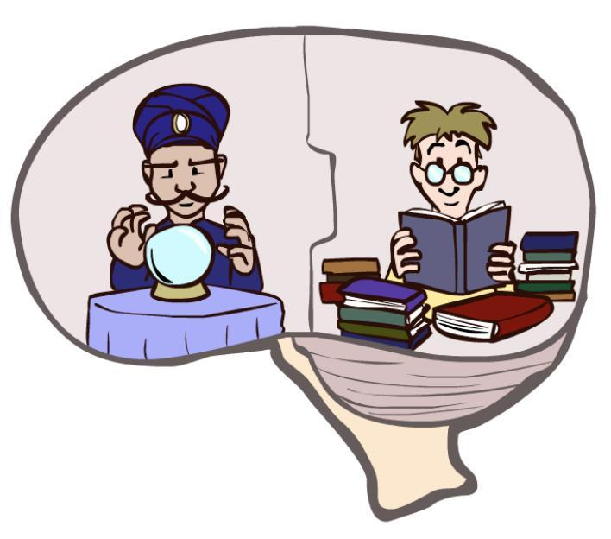
What About the Brain?
• Brains are very good at making rational decisions, but not perfect
• Brains are not modular like software, so they are hard to reverse engineer
• AI may already be better than brains at some tasks
• "Brains are to intelligence as wings are to flight"
• Scale is still different: roughly 100 trillion synapses in a human brain vs. an estimated ~1.8 trillion parameters in GPT-4
• The brain remains a great source of inspiration
MAI 5100 · Fundamentals of AI
Brain and model scale figures are approximate estimates.
23

Slide 24
A Short History of AI
Booms, winters, and rediscovery

Slide 25
1940s - 1980s: Foundations and First Booms
• 1943 McCulloch & Pitts: Boolean circuit model of the brain
• 1950 Turing, "Computing Machinery and Intelligence"
• 1956 Dartmouth workshop: the term "Artificial Intelligence" is adopted
• 1950s - 60s Logic-driven optimism: Samuel's checkers, Newell & Simon's Logic Theorist
• 1958 Rosenblatt shows how to train a perceptron; 1969 Minsky & Papert: perceptrons cannot learn XOR
• 1970s - 80s Knowledge-based systems and the expert systems industry boom
• 1986 Backpropagation makes multi-layer neural networks trainable
• Late 1980s Expert systems bust: the AI winter
MAI 5100 · Fundamentals of AI
25

Slide 26
1990 - 2017: Statistics, Data, and Deep Learning
• 1990s Resurgence of probability and a focus on uncertainty and agents
• 1992 TD-Gammon reaches human-level backgammon
• 1997 Deep Blue defeats Garry Kasparov at chess
• 2002 Roomba: AI in the home
• 2011 Watson wins Jeopardy!; Apple releases Siri
• 2012 AlexNet wins ImageNet: the deep learning era begins
• 2016 AlphaGo defeats Lee Sedol at Go
• 2017 The Transformer architecture is introduced
MAI 5100 · Fundamentals of AI
26

Slide 27
2017 - Today: Scale, Foundation Models, and Agents
• 2017 Libratus and DeepStack beat professionals at poker
• 2018 - 2020 AlphaFold predicts protein structure from amino acid sequences
• 2021 - 2022 Modern text-to-image generation
• 2022 ChatGPT is released; large language models go mainstream
• 2024 Nobel Prizes in Physics and Chemistry recognize AI advances
• 2025 AI systems reach gold-medal level at the International Mathematical Olympiad
• Today AI agents that use tools, write code, and take multi-step actions
MAI 5100 · Fundamentals of AI
27

Slide 28
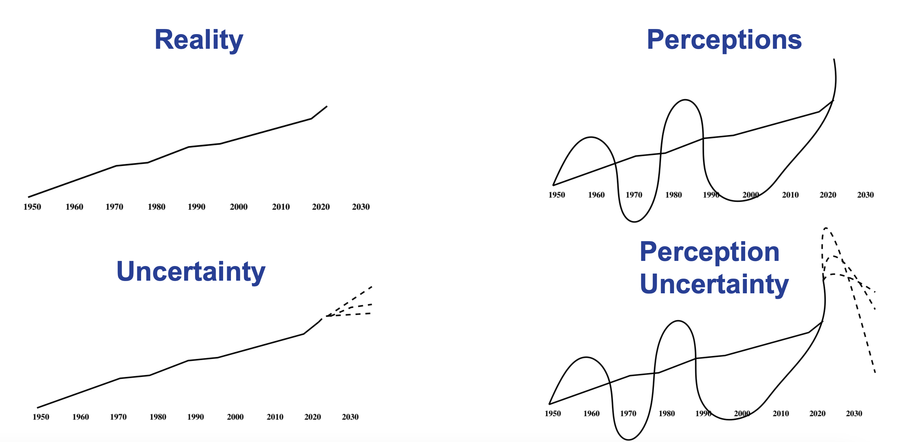
Patterns in AI History
• Overclaiming followed by disillusionment (AI winters)
• Simultaneous discovery or rediscovery of ideas
• Deeply interdisciplinary: math, statistics, control, neuroscience, psychology, economics, philosophy, linguistics
• Increasingly: law, medicine, education
• Where are we on the curve today?
MAI 5100 · Fundamentals of AI
28

Slide 29
AI in Guyana and the Caribbean
Opportunities, risks, and the questions we must answer ourselves

Slide 30
Why the Local Context Matters
• Most AI systems are built elsewhere, trained on data that rarely reflects Caribbean people, places, or language
• Small states face distinct constraints: compute cost, connectivity, data availability, talent retention
• Climate exposure, resource economies, and dispersed populations create problems worth solving locally
• Constraints can drive innovation: efficient models, offline-first tools, and solutions designed for local needs
MAI 5100 · Fundamentals of AI
30

Slide 31
Regional Momentum
• CTU ICT Week 2026 (Cayenne, French Guiana): Caribbean ICT ministers met under the theme "Advancing Resilience, Inclusion, Innovation and Cybersecurity in Caribbean Digital Development"
• Ministers endorsed the Final Report of the Caribbean AI Task Force and its seven policy pillars for regional AI governance and development
• Support for the Regional Digital Infrastructure Plan for the Caribbean, co-produced by the IDB and the World Bank, focused on international connectivity and data infrastructure
• Calls for resilient telecommunications: submarine cable diversity, early-warning systems, regional cooperation
• Trinidad and Tobago now has a Minister of Public Administration and Artificial Intelligence
MAI 5100 · Fundamentals of AI
Sources: CARICOM / CTU ICT Week 2026 Communique (caricom.org)
31

Slide 32
AI Is Already Here in Guyana
Education
Public services
The University of Guyana launched its Master in Artificial Intelligence in September 2024.
The Competition and Consumer Affairs Commission launched "Damion", a 24-hour WhatsApp AI agent for consumer protection questions (2024).
Business
Media
Local companies are deploying customer-facing AI agents, for example Silvie's Industrial Solutions' "Silvie AI" (2025).
AI4D 2023 Conference, held in Guyana, showcased practical AI applications for industry and development
Companies such as V75 Inc. have been building AI systems since 2016!
MAI 5100 · Fundamentals of AI
Sources: Stabroek News (Mar 2024, Sep 2024, May 2025, Sep 2025)
32

Slide 33
Opportunities
Agriculture
Health
Climate & disasters
Crop and pest monitoring, yield prediction, market information for farmers
Decision support where specialists are scarce, especially in hinterland regions
Flood and hurricane forecasting, early warning, coastal monitoring
Public services
Energy & resources
Education
Faster, more accessible government services in local languages
Optimization and monitoring across oil & gas, mining, and forestry
Personalized tutoring and support at scale
MAI 5100 · Fundamentals of AI
33

Slide 34


Opportunity: Agriculture
Image: CCRIF SPC
Photo: Nanditha Gogate, WELL Labs / Wikimedia Commons, CC BY-SA 4.0
Trinidad & Tobago
10,154 advisories
LetzFarm, an AI app from the Carbon Zero Institute and Abris, helps small farmers identify pests and diseases. CCRIF granted US$25,000 to expand access (2024).
India's National Pest Surveillance System analyses farmers' crop photos with AI, covering 61 crops and 400+ pests (as of March 2025).
Source: CCRIF SPC
Source: Govt. of India, PIB, Sep 2025
MAI 5100 · Fundamentals of AI
34

Slide 35
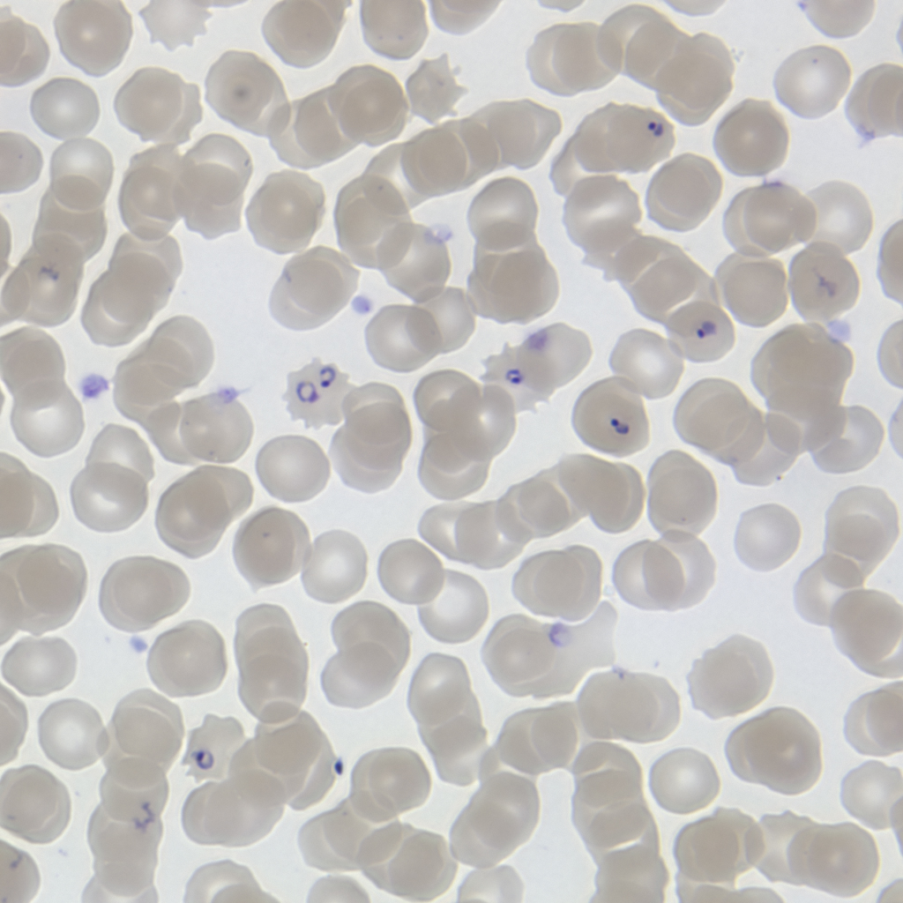
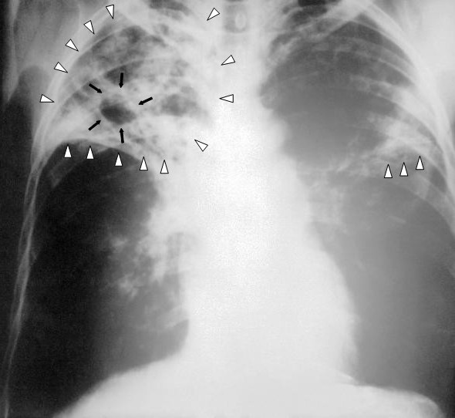
Opportunity: Health
Image: malaria parasites in blood, M. Zahniser / Wikimedia Commons, public domain
Image: Wikimedia Commons, public domain
Guyana: ~99% accurate
8 states
Guyana's Ministry of Health and Harvard University are developing an AI app that reads malaria slides. Early tests in Region Nine were about 99% accurate, per the Minister (2025).
India deployed DeepCXR, an AI tool that screens chest X-rays for tuberculosis, across eight states and union territories (2026).
Source: Ministry of Health Guyana, Mar 2025
Source: Govt. of India, PIB, Mar 2026
MAI 5100 · Fundamentals of AI
35

Slide 36
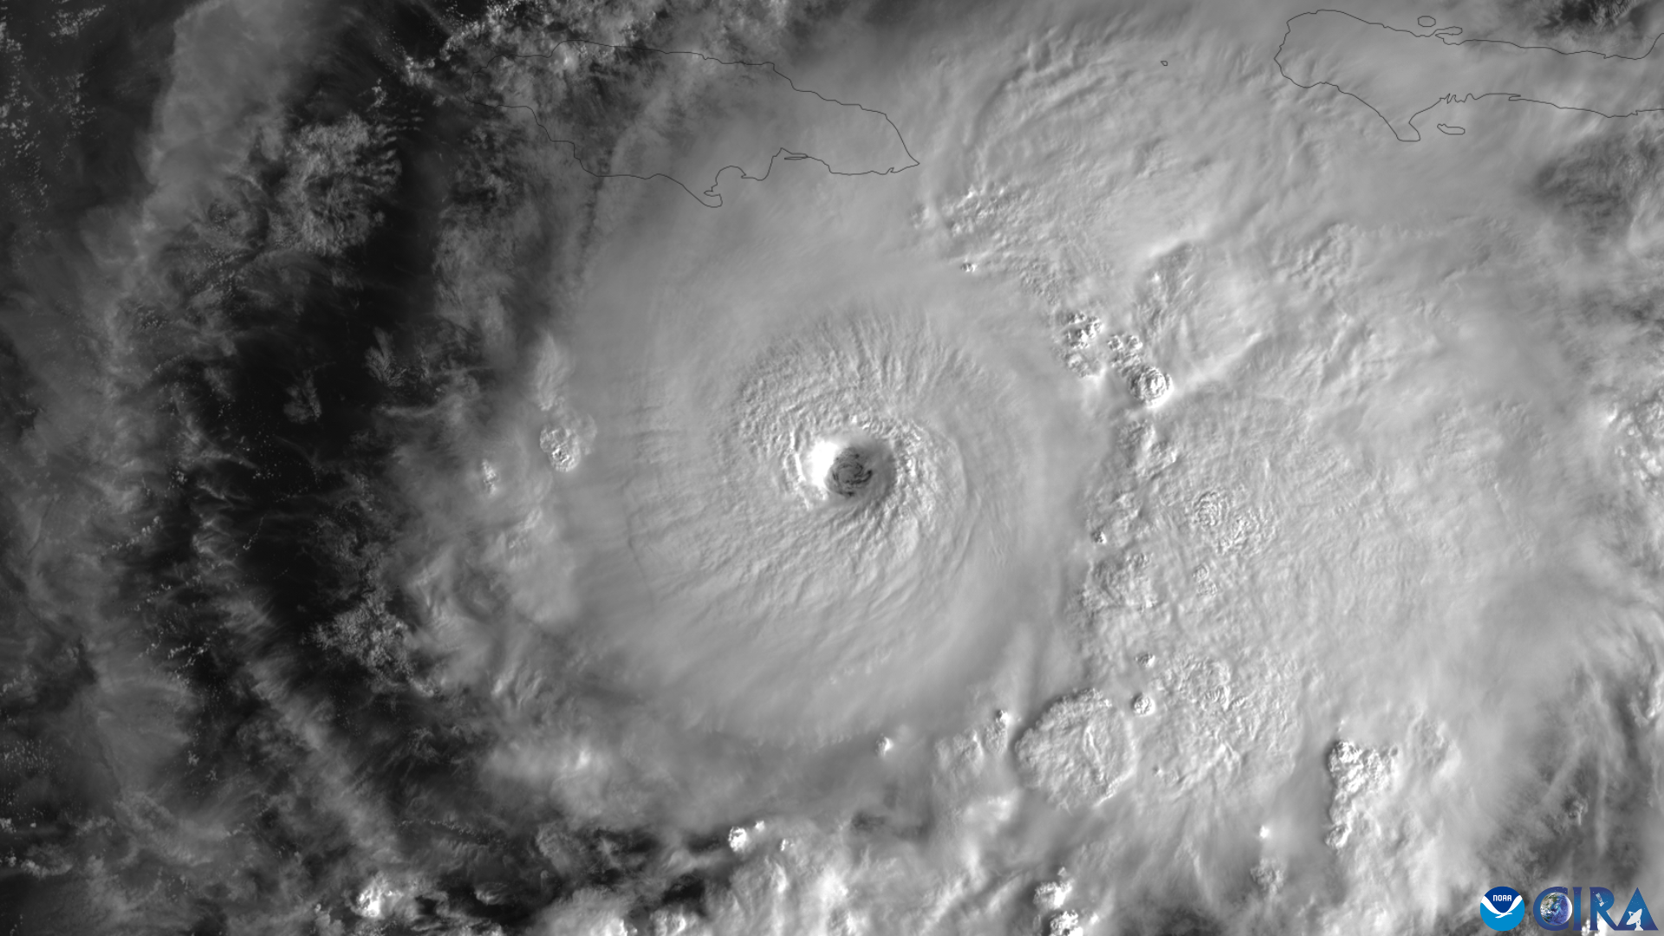
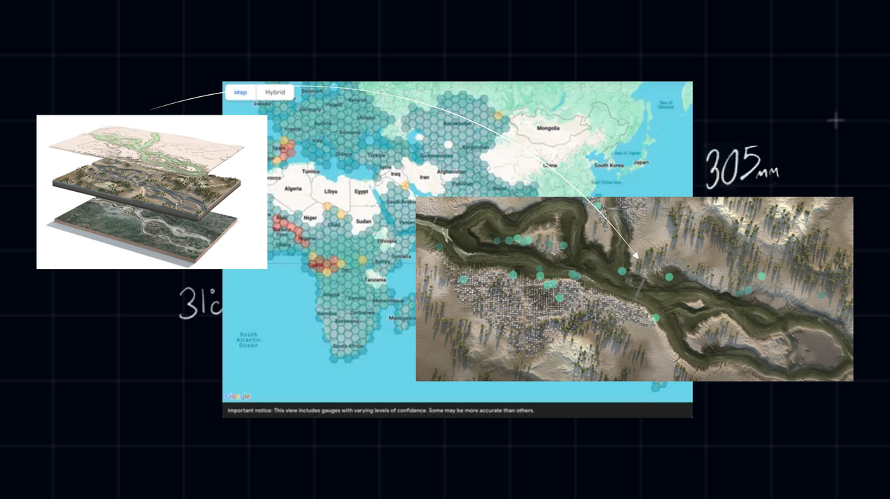
Opportunity: Climate & Disasters
Image: Hurricane Melissa, CSU/CIRA & NOAA / Wikimedia Commons, public domain
Image: Google
Jamaica: 32,500 displaced
Cash before the flood
After Hurricane Melissa, UNDP's AI-based model estimated that up to 32,500 people may have been displaced, and satellite analysis found 4.8M+ tonnes of debris (Nov 2025).
GiveDirectly used Google's AI Flood Hub forecasts to send cash to at-risk families before floods arrived, in Bangladesh and Nigeria (2025).
Source: UNDP Jamaica, Nov 2025
Source: Google, Feb 2025
MAI 5100 · Fundamentals of AI
36

Slide 37

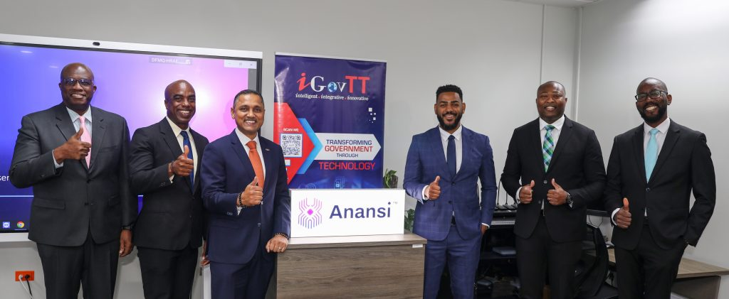
Opportunity: Public Services
Photo: iGovTT
Photo: Helar Lukats / Wikimedia Commons, CC BY-SA 4.0
Trinidad & Tobago: 7,000+ FAQs
Brazil: Chat GOV.BR
iGovTT launched Anansi, a 24/7 AI assistant that answers questions using FAQs from about 30 government agencies (Aug 2025).
Brazil's government answers students' questions about national exams and education programmes through an AI assistant on WhatsApp (2026).
Source: iGovTT, Aug 2025
Source: Govt. of Brazil, Jan 2026
MAI 5100 · Fundamentals of AI
37

Slide 38

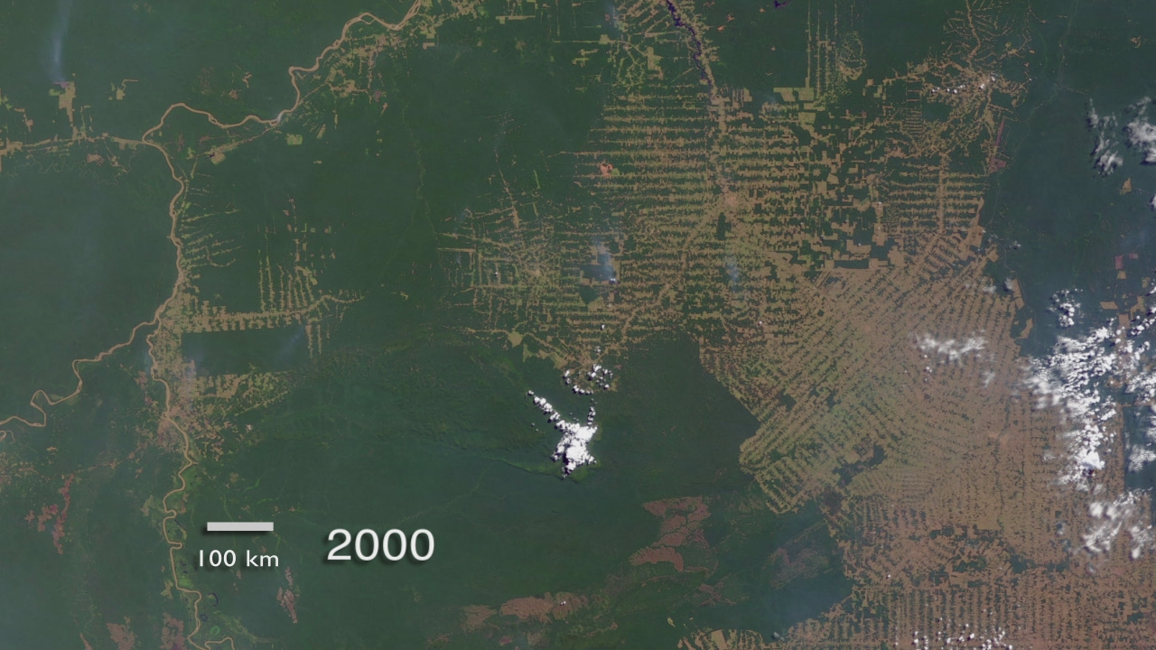
Opportunity: Energy & Resources
Image: Department of Public Information, Guyana
Image: NASA Goddard / Wikimedia Commons, public domain
Guyana at COP30
Brazil: 30 m maps
Guyana showcased plans to integrate AI-enabled biodiversity monitoring into its forest management and satellite-based forest monitoring systems (Nov 2025).
MapBiomas uses machine learning on satellite imagery to map land cover across Brazil every year, tracking forests, mining, and deforestation.
Source: DPI Guyana, Nov 2025
Source: MapBiomas, Aug 2025
MAI 5100 · Fundamentals of AI
38

Slide 39
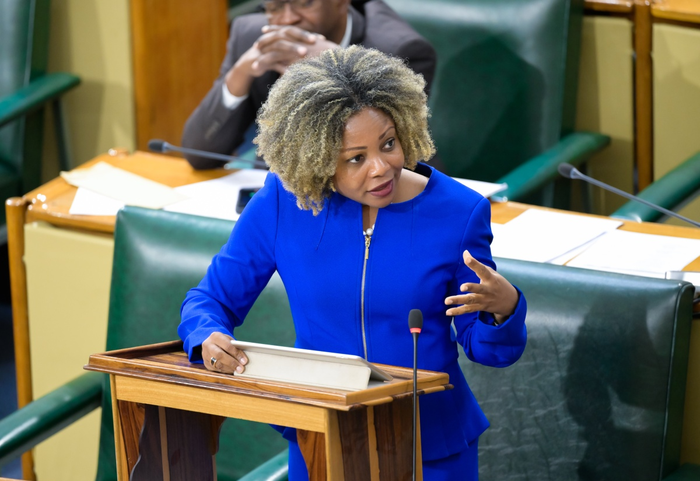
Opportunity: Education
Photo: Jamaica Information Service
Photo: World Bank
Jamaica: AI marking pilot
Nigeria: +0.23 SD
Jamaica's Ministry of Education is piloting AI paper marking in several schools, letting the Ministry see results in real time (Apr 2025).
Six weeks of after-school AI tutoring in Edo State significantly improved English learning in a World Bank randomized trial (2025).
Source: JIS, Apr 2025
Source: World Bank, May 2025
MAI 5100 · Fundamentals of AI
39

Slide 40
Risks and Challenges
Misinformation
Jobs
Data sovereignty
Deepfakes and synthetic media in elections and public discourse
Pressure on call centres, back-office, and clerical work
Who owns, stores, and profits from Caribbean data?
Bias
Cost & access
Talent
Models trained elsewhere may misread local people, names, and language
Compute, connectivity, and licensing are expensive for small states
Skilled graduates are often recruited abroad
MAI 5100 · Fundamentals of AI
40

Slide 41


Risk: Misinformation
Photo: Delegation of the EU in Guyana / Wikimedia Commons
Photo: Shixart1985 / Wikimedia Commons, CC BY 2.0
Guyana 2025 elections
US$6M fine
EU observers reported that "AI generated videos and fake Facebook pages were misleading" and AI voiceovers were used during Guyana's 2025 general elections.
The US FCC fined a political consultant for robocalls using an AI clone of President Biden's voice telling voters not to vote (2024).
Source: EU Election Observation Mission, Final Report
Source: US FCC, Sep 2024
MAI 5100 · Fundamentals of AI
41

Slide 42

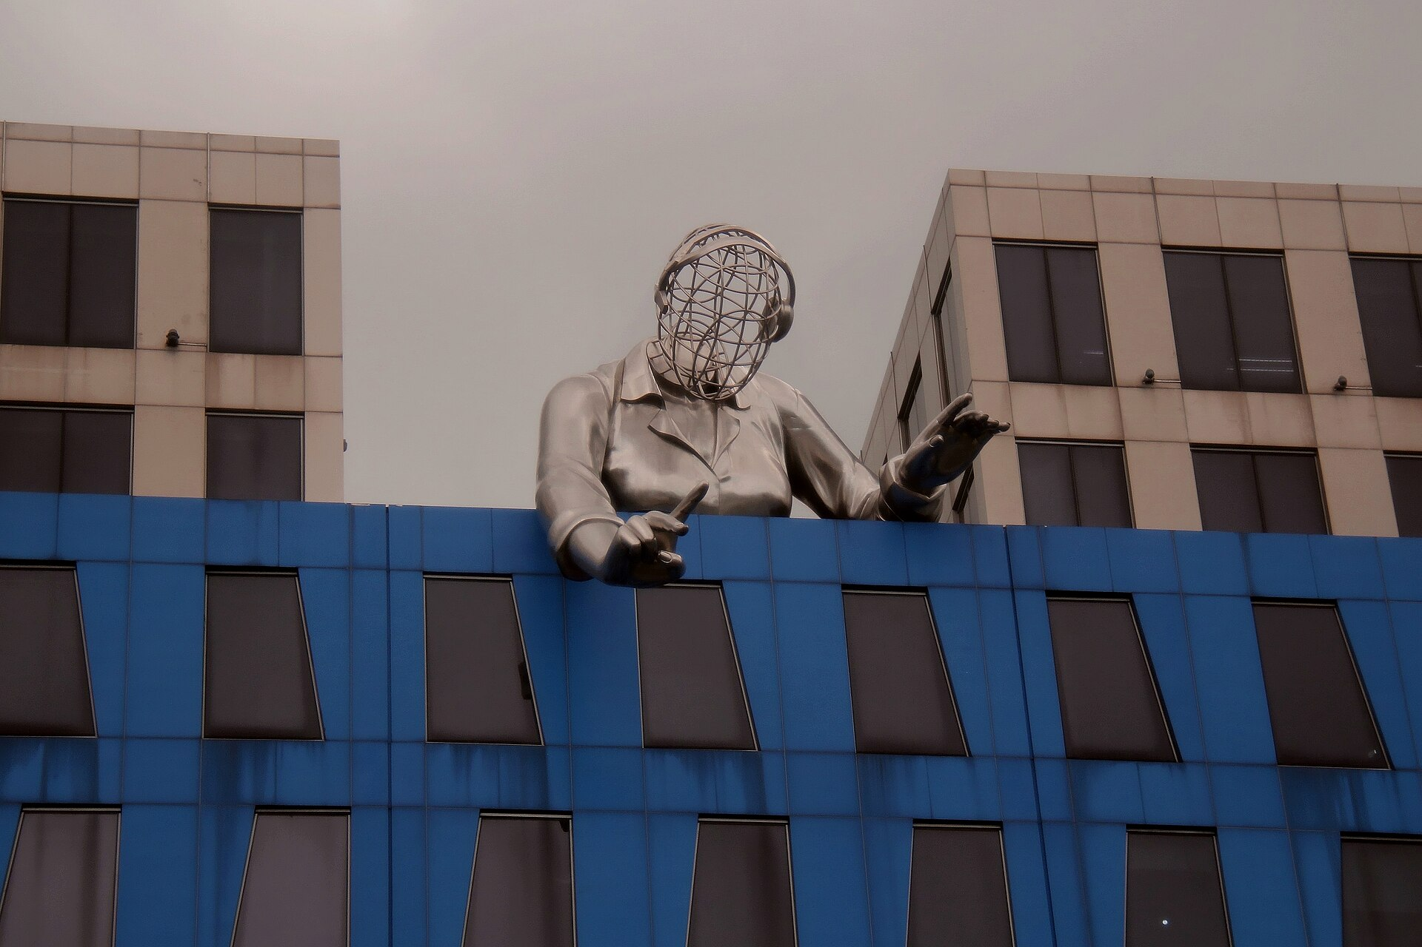
Risk: Jobs
Photo: Ministry of Industry, Investment and Commerce, Jamaica
Photo: TheNuggeteer / Wikimedia Commons, CC BY-SA 4.0
Jamaica: 50,000+ jobs
Philippines: 73%
Jamaica's BPO and digital services sector employs more than 50,000 people. The government says AI is already reshaping customer service and back-office work (2026).
of BPO workers are contact-centre clerks, a role the IMF rates as highly exposed to AI with low potential for AI to complement the worker (2025).
Source: MIIC Jamaica, Mar 2026
Source: IMF Working Paper 2025/043
MAI 5100 · Fundamentals of AI
42

Slide 43
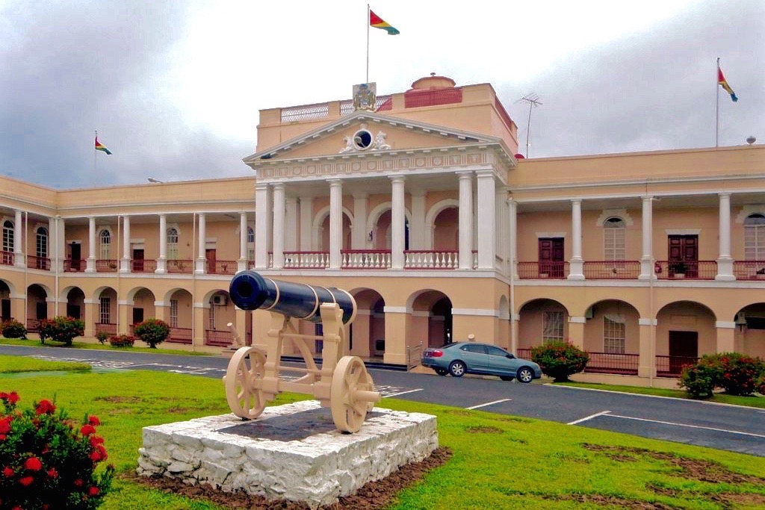
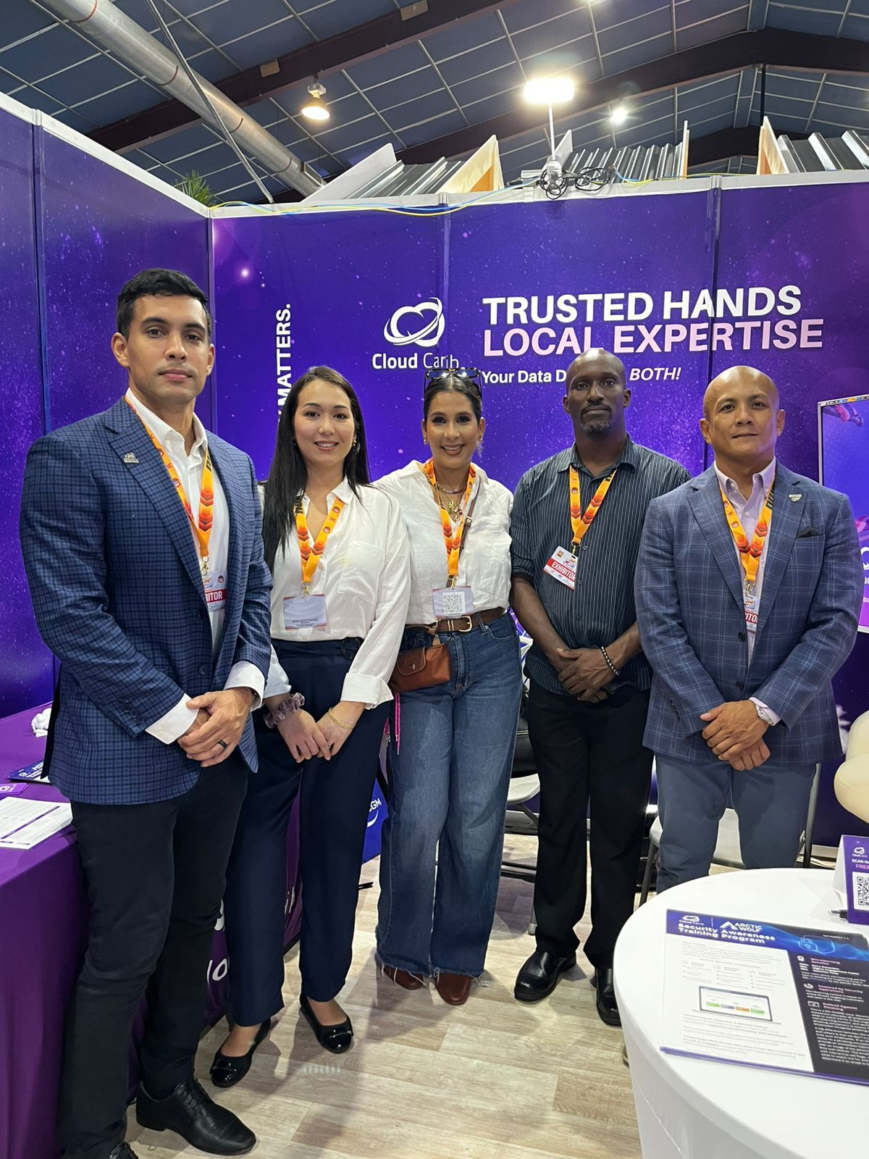
Risk: Data Sovereignty
Photo: David Stanley / Wikimedia Commons, CC BY 2.0
Photo: Cloud Carib
Guyana: Act No. 18 of 2023
US$7M+ investment
Guyana's Data Protection Act sets rules for how personal data is collected, processed, and transferred. AI systems that use Guyanese data must comply.
Cloud Carib announced sovereign data centre pods under development in Guyana, Curaçao, and Bermuda, so regional data can stay in the region (Mar 2026).
Source: Parliament of Guyana
Source: Cloud Carib, Mar 2026
MAI 5100 · Fundamentals of AI
43

Slide 44
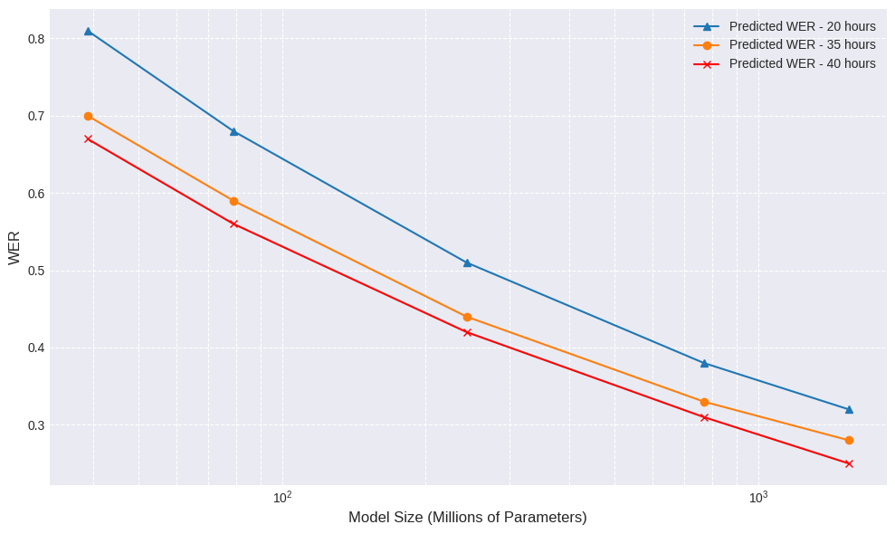
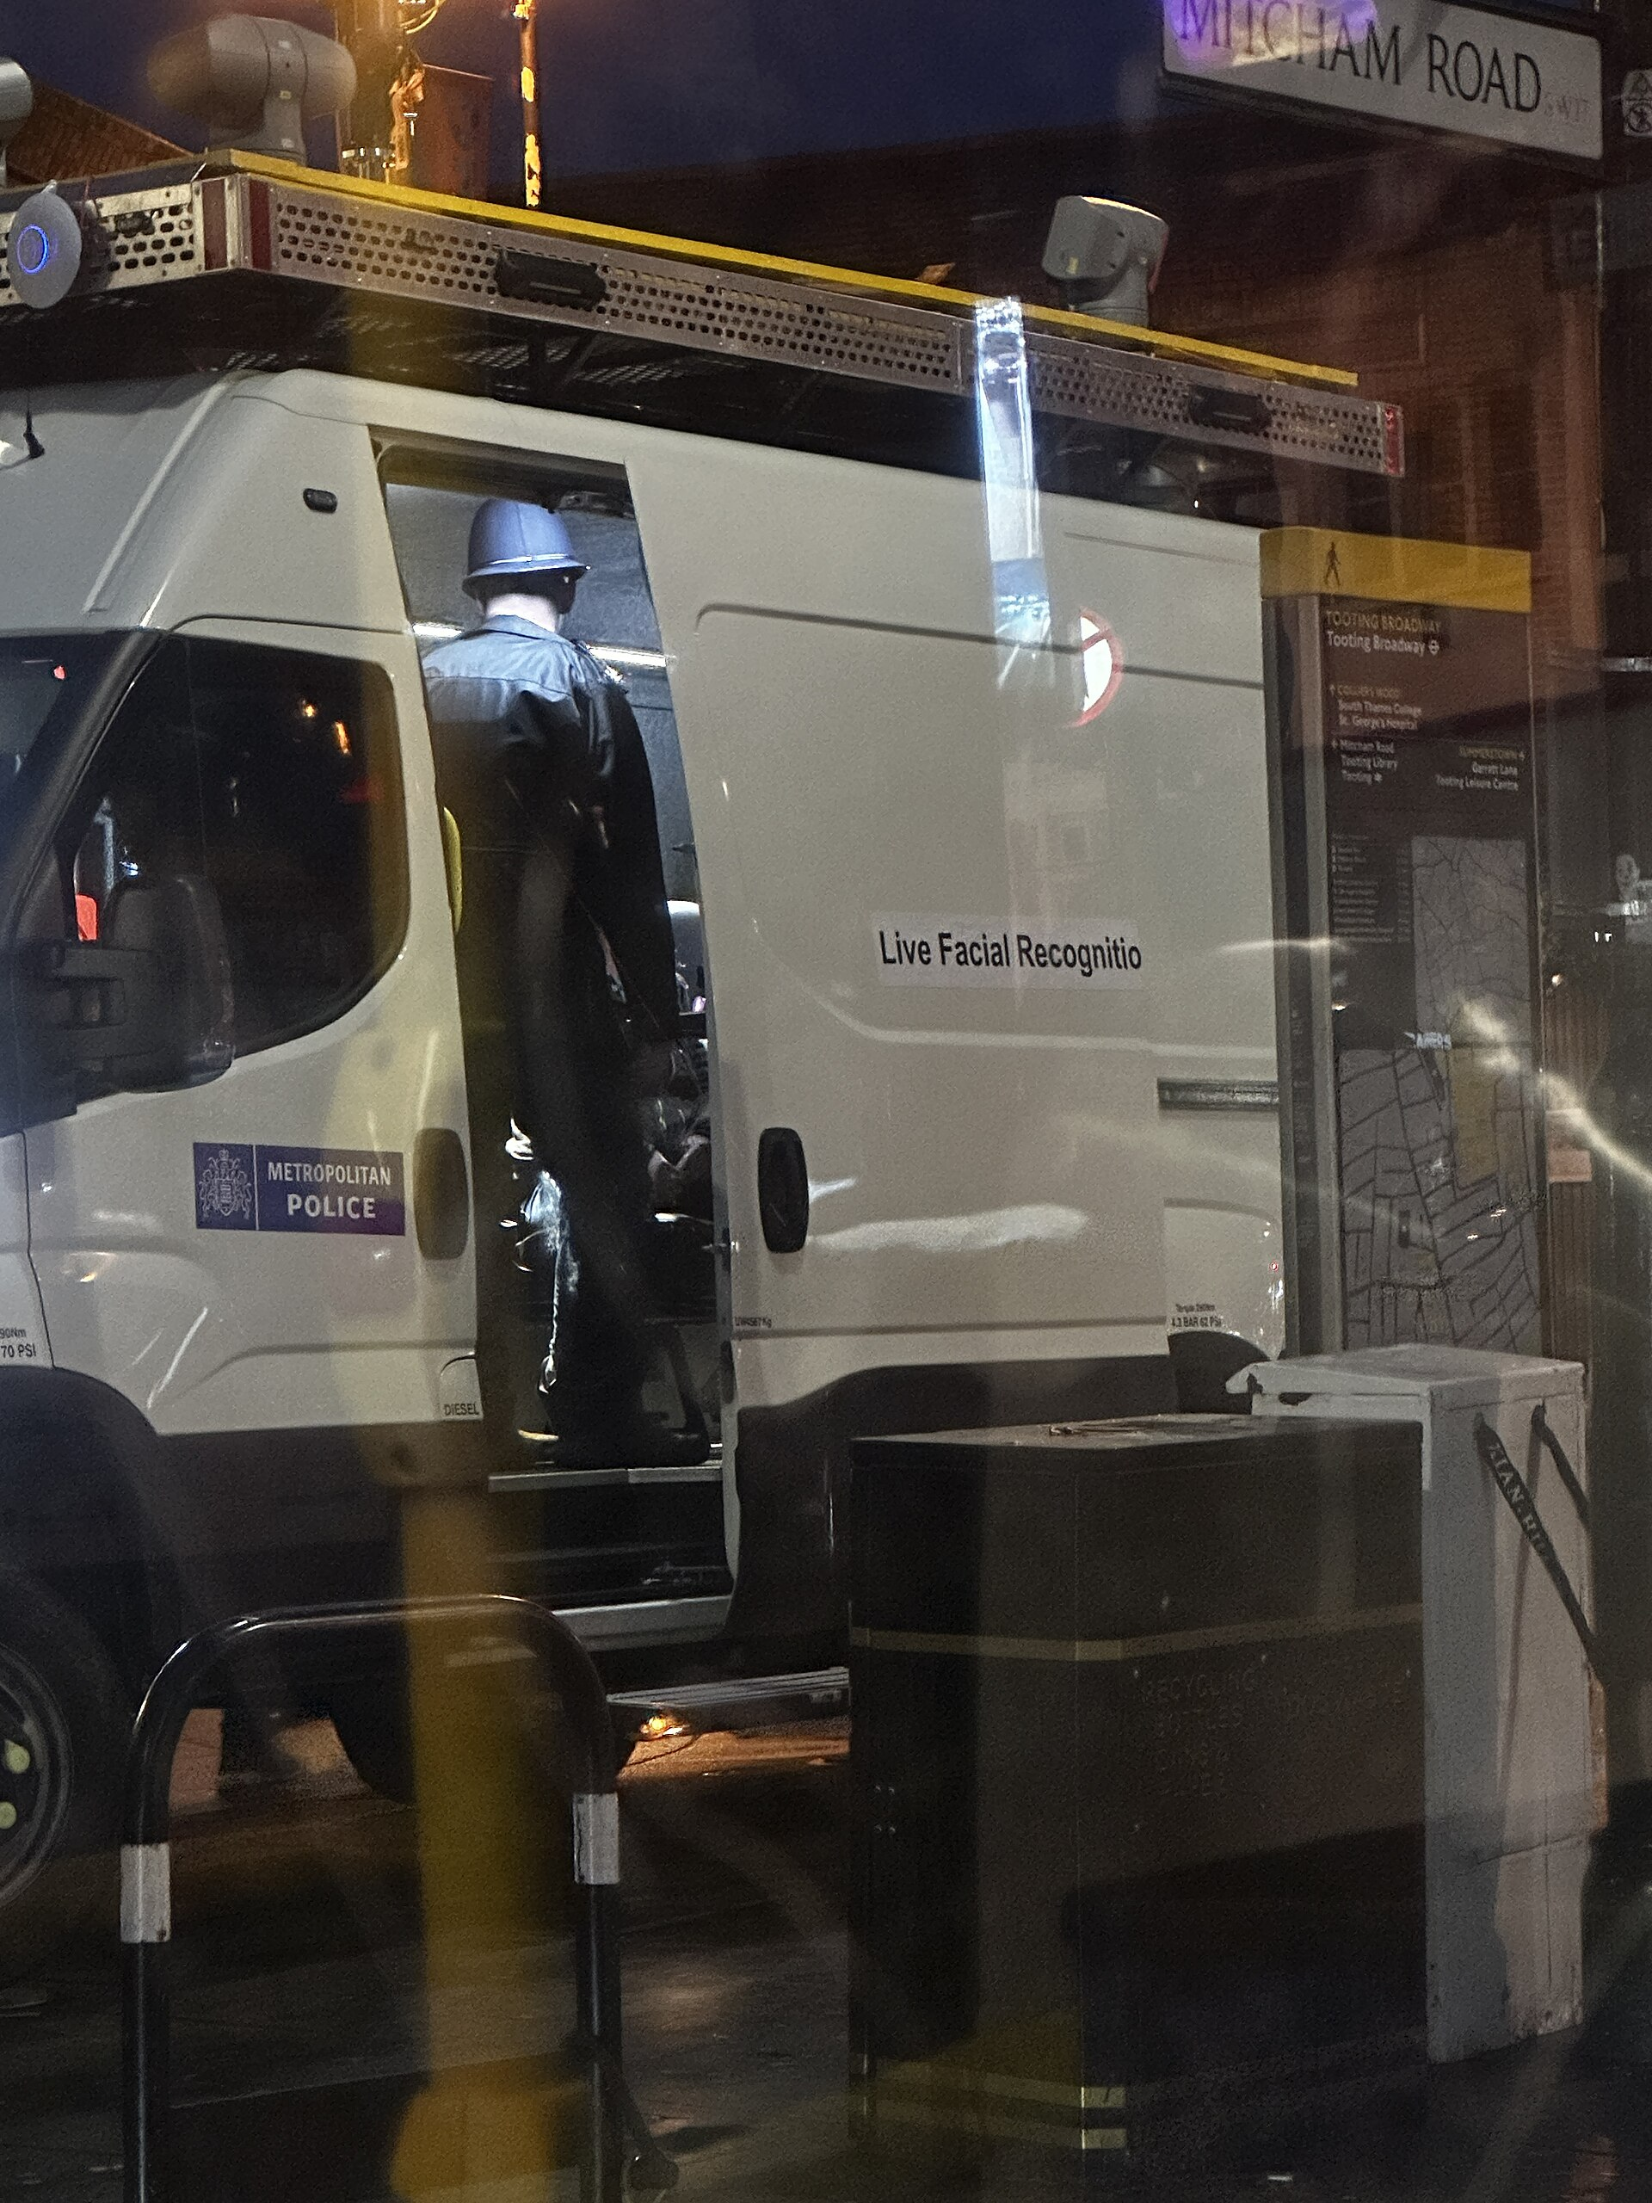
Risk: Bias
Chart: error falls with more Patois training data, from the paper (arXiv:2507.16834)
Photo: Secretlondon / Wikimedia Commons, CC BY-SA 4.0
89% vs 5% error
Wrongful arrest
OpenAI's Whisper Large speech model had a word error rate of 0.89 on Jamaican Patois music, compared with about 0.05 on standard English (2025).
Detroit police arrested Porcha Woodruff, eight months pregnant, after a faulty facial recognition match, the sixth known false accusation from the technology (2023).
Source: arXiv:2507.16834, Jul 2025
Source: ACLU, Aug 2023
MAI 5100 · Fundamentals of AI
44

Slide 45
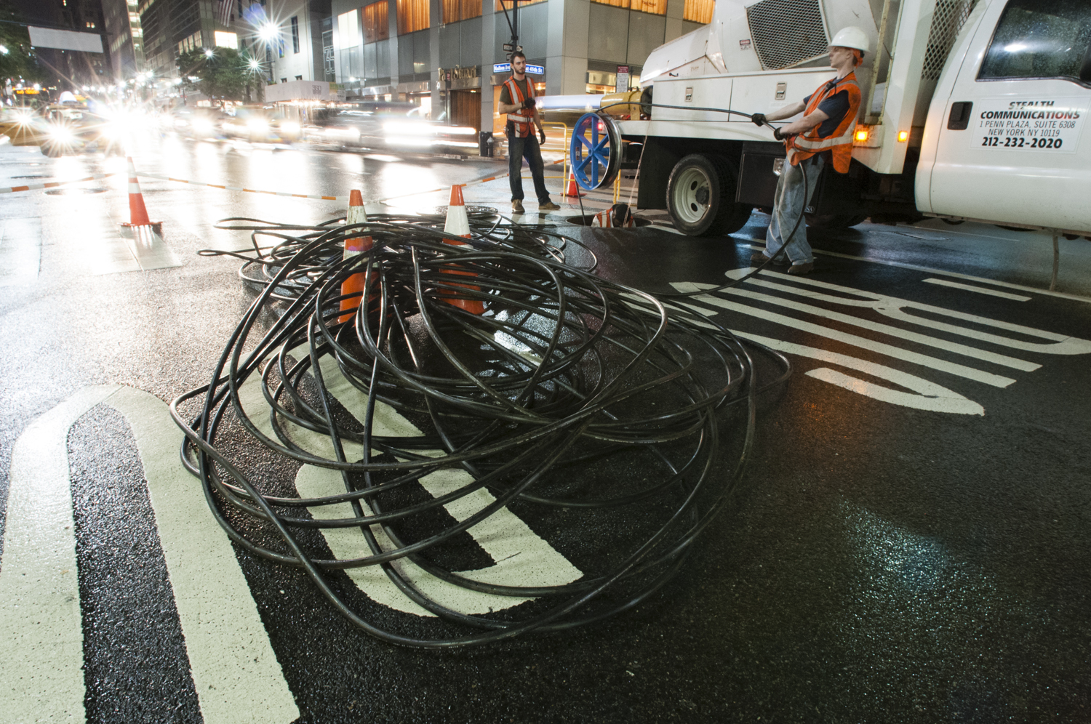
Risk: Cost & Access
Photo: Stealth Communications / Wikimedia Commons, CC BY-SA 3.0
Photo: BalticServers.com / Wikimedia Commons, CC BY-SA 3.0
~25% of income
77% vs <0.1%
For the poorest fifth of households in Jamaica, fixed broadband costs nearly 25% of monthly income, versus under 5% for the richest fifth (World Bank, 2023).
Share of global co-location data centre capacity in high-income vs. low-income countries (June 2025). Compute is concentrated in rich countries.
Source: World Bank, Oct 2023
Source: World Bank, Nov 2025
MAI 5100 · Fundamentals of AI
45

Slide 46

Risk: Talent
Discuss
What would it take to build and keep world-class AI talent in Guyana?
Remote work for global companies? Local startups? Research funding? Partnerships with the diaspora?
Photo: AusAID / DFAT, Wikimedia Commons, CC BY 2.0
Guyana 78.4% · Jamaica 89.9%
Estimated share of Guyana-born and Jamaica-born nurses who work in OECD countries rather than at home. The same pressures apply to AI and tech talent.
Source: OECD, Health at a Glance: LAC 2026
MAI 5100 · Fundamentals of AI
46

Slide 47
Breakout Discussion (15 minutes)
Pick one problem facing Guyana or the Caribbean.
• Is AI actually the right tool, or would a simpler solution work?
• What data would you need, and does it exist?
• What would a rational agent for this problem be trying to maximize?
• Who benefits, and who could be harmed?
• Be ready to share your answer in two minutes
MAI 5100 · Fundamentals of AI
47

Slide 48
MAI 5100
Designing rational agents

Slide 49
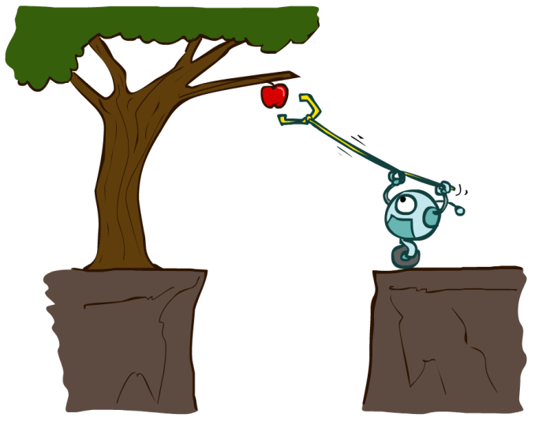
Designing Rational Agents
• An agent is an entity that perceives and acts
• A rational agent selects actions that maximize its expected utility
• The percepts, environment, and action space determine which techniques work
• This course covers:
– General AI techniques for a variety of problem types
– Recognizing when a problem can be solved with an existing technique
MAI 5100 · Fundamentals of AI
49

Slide 50
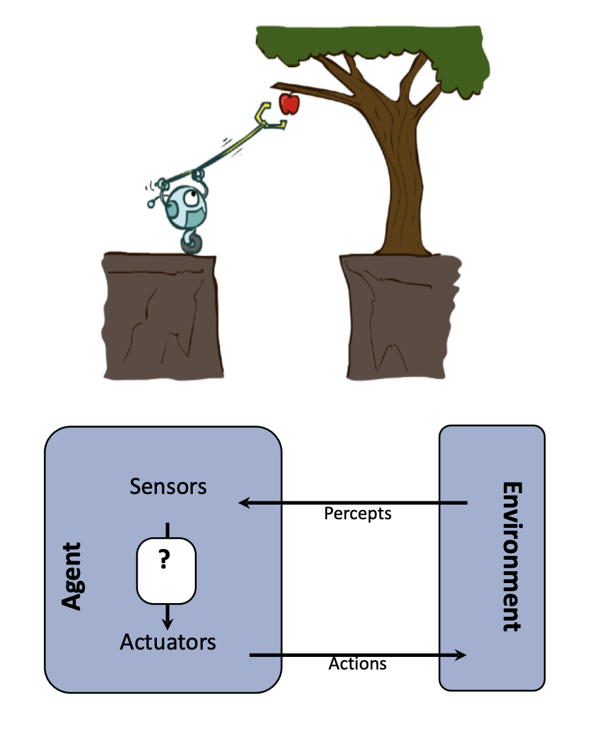
Agent and Environment
• Sensors receive percepts from the environment
• Actuators carry out actions in the environment
• The agent function maps what it has perceived so far to an action
• Our job: design that function well
MAI 5100 · Fundamentals of AI
50

Slide 51
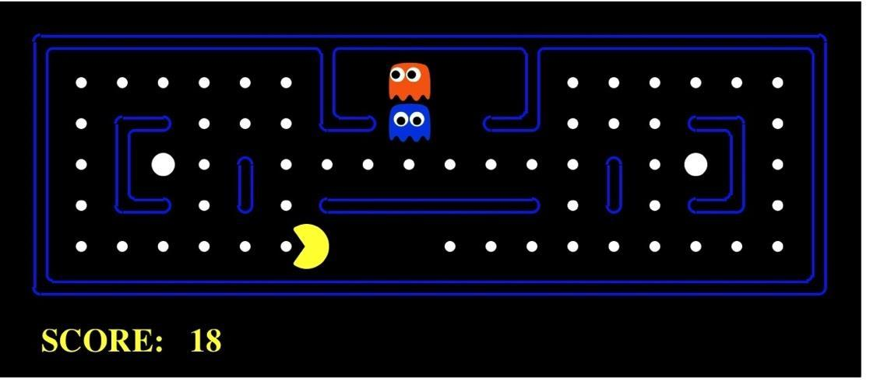
Pac-Man as an Agent
• Percepts: maze layout, food, ghosts, score
• Actions: North, South, East, West, Stop
• Goal: maximize score
• You will build Pac-Man agents throughout the course
Pac-Man is a registered trademark of Bandai Namco, used here for educational purposes.
MAI 5100 · Fundamentals of AI
51

Slide 52
Course Topics: Core Components of Rational Agents
Search & Planning
Probability & Inference
How can I use my model of the world to find a sequence of actions that achieves my goal?
How can I make sense of uncertainty?
Reinforcement Learning
Machine Learning
How can I learn a policy for any situation so that I maximize utility?
How can I learn a model of the world from data?
MAI 5100 · Fundamentals of AI
52

Slide 53
By the End of This Course You Will
• Build and understand the math behind rational, learning agents
• Select and apply the right AI method for a wide range of problems
• Recognize how these methods appear in modern AI systems, including LLMs and agents
• Be prepared to make informed decisions about how AI is used in society, here and abroad
This course is a foundation, not a survey of every modern technique. The principles you learn here underpin today's state-of-the-art systems.
MAI 5100 · Fundamentals of AI
53

Slide 54
Course Logistics

Slide 55
Schedule
Week | Date | Topic
1 | Oct 24 | Introduction to AI
2 | Oct 31 | Uninformed search
 | Nov 7 | No class
3 | Nov 14 | Informed search
4 | Nov 21 | Constraint satisfaction
5 | Nov 28 | Local & adversarial search
6 | Dec 5 | Expectimax, utilities, MDPs
7 | Dec 12 | MDPs and RL
8 | Dec 19 | Midterm / review
Week | Date | Topic
 | Dec 26 & Jan 2 | No class (holidays)
9 | Jan 9 | Probability
10 | Jan 16 | Bayes nets: representation
11 | Jan 23 | Bayes nets: inference
12 | Jan 30 | Markov models and HMMs
13 | Feb 6 | Decision networks; ML basics
14 | Feb 13 | ML: classification
15 | Feb 20 | Project presentations
Saturdays, 9:00 AM - 1:00 PM Guyana time on Zoom. The schedule may be adjusted; changes will be announced.
MAI 5100 · Fundamentals of AI
55

Slide 56
Assessment and Submissions
Component | Weight
Homeworks | 30%
Participation | 5%
Mid-term exam | 20%
Project | 40%
• Homeworks are Pac-Man based coding projects with an autograder, plus written problems
• Submit assignments as pull requests to the course GitHub repository
• Due by 11:59 PM Guyana time on the due date
• Course project: research-oriented or applied, completed in groups
• Plan for 10 - 15 hours per week outside of class
Grades: A 80-100 · B 70-79 · C 60-69 · F < 60
Readings: Russell & Norvig, Artificial Intelligence: A Modern Approach (4th ed.)
MAI 5100 · Fundamentals of AI
56

Slide 57
Generative AI Policy
• You may use generative AI as a collaborator, and you must acknowledge it
• You must understand everything you submit; we will check this on exams
• Submitting AI output you do not understand is an academic violation
• Goal: use AI to learn faster, not to skip the learning
"Having GPT-4 access while solving problems significantly improves performance... However, when access is subsequently taken away, students actually perform worse than those who never had access... unfettered access to GPT-4 can harm educational outcomes."
MAI 5100 · Fundamentals of AI
Bastani et al., Proceedings of the National Academy of Sciences, 2025
57

Slide 58
Before Next Week
• Read AIMA Chapter 1 (Introduction) and Chapter 2 (Intelligent Agents)
• Make sure you have Python 3 and Git installed, and a GitHub account
• Start thinking about project interests and potential teammates
Next week: Problem solving by search
MAI 5100 · Fundamentals of AI
58

Slide 59
Acknowledgements
• Portions of this lecture and course are adapted from UC Berkeley CS 188: Introduction to Artificial Intelligence
• Illustrations courtesy of the CS 188 course materials
MAI 5100 · Fundamentals of AI
59

