Slide 1



MICROSERVICES DEMO SERIES
REAL TIME
PROJECTS
REAL TIME
PROJECTS
Course Plan

Slide 2
MICROSERVICES DEMO SERIES
REAL TIME
PROJECTS
REAL TIME
PROJECTS
Online shopping portal
Understanding the architecture & technologies to apply

Slide 3







OVERVIEW
PRODUCT
NOTIFICATION
USER MANAGEMENT
FRAUD CHECK
CLIENTS
CART
PAYMENT GATEWAY
ORDER

Slide 4
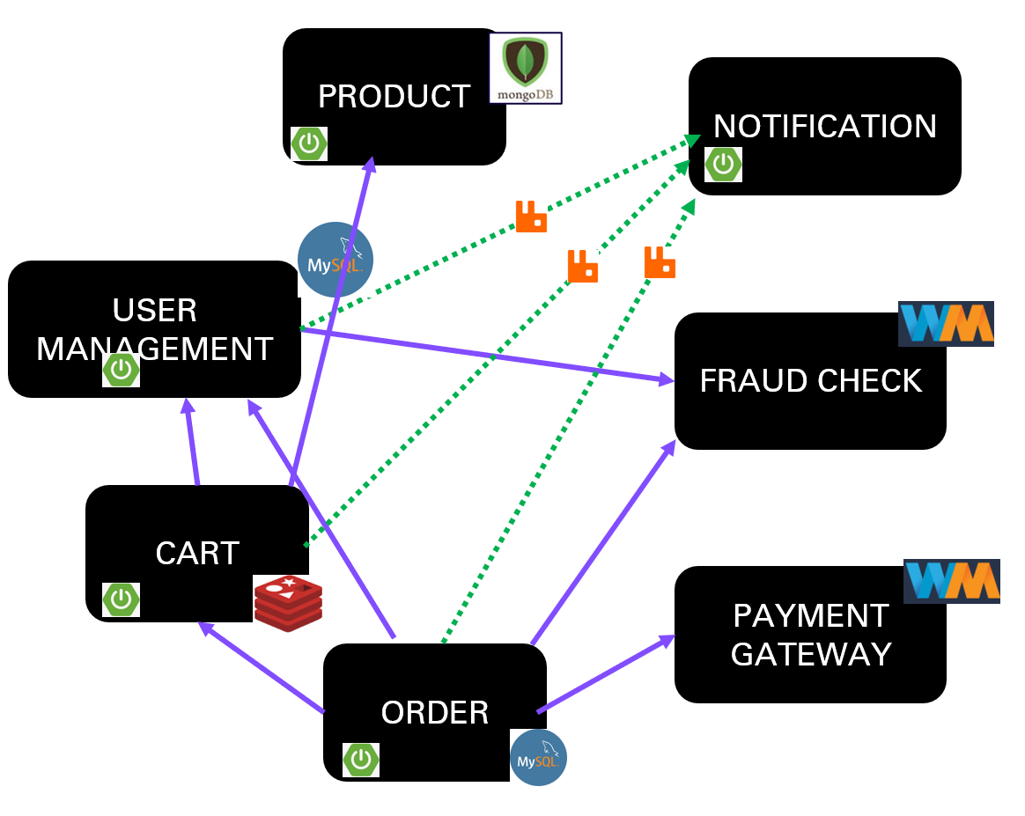
LETS MAKE LIFE OF CLIENTS EASY
LETS MAKE LIFE OF CLIENTS EASY
Centralized config management
A
P
I
G
A
T
E
W
A
Y
CLIENTS
SERVICE REGISTRY & DISCOVERY
LOAD BALANCER

Slide 5

INDIVIDUAL SERVICES STRUCTURE
CREATE
CREATE
ACTUATOR
ACTUATOR
READ
ORDER
SERVICE
READ
CART
SERVICE
CIRCUIT BREAKER
UPDATE
UPDATE
DELETE
DELETE

Slide 6

DATA ARCHIVAL AND PROCESSING
Data Storage/Archival

Slide 7
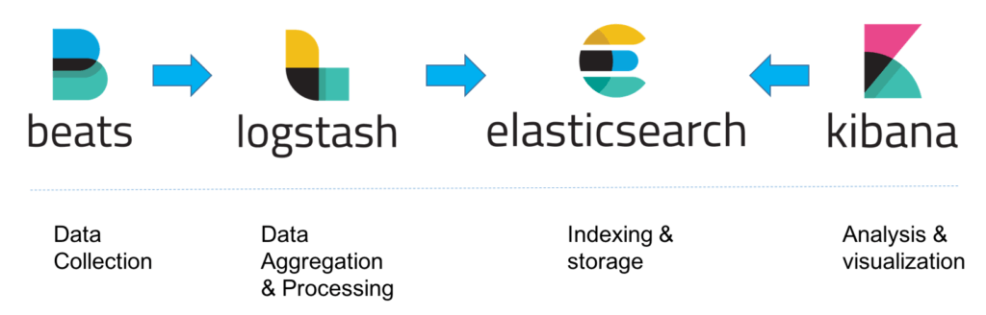
LOG MONITORING – ELK stack

Slide 8



DEPLOYMENT

Slide 9

WRITING CLIENT – FRONT END

Slide 10
THANKS FOR YOUR TIME
https://github.com/greenlearner01/microservices-projects-store/tree/master/Online-Shopping-Portal

Slide 11

MICROSERVICES DEMO SERIES
Product
micro-service
Let's speed up the coding with Lombok & Codota

Slide 12
MICROSERVICES DEMO SERIES
Product
Micro service
REST API data Validation

Slide 13
Product
Microservice
Create
Read
allProducts
productById
productsByCategory
Update
Delete

Slide 14
MICROSERVICES DEMO SERIES
Product
Micro service
Custom exception handling

Slide 15
Topics to be covered
Add business logic to add further validation scenario
Custom exception handler

Slide 16
MICROSERVICES DEMO SERIES
Product
Micro service
Code improvement
&
Hot Code Swapping

Slide 17
Topics to be covered
Hot code swapping to avoid restart on every time code changes
Adding Id of the product autmatically

Slide 18
MICROSERVICES DEMO SERIES
REAL TIME
PROJECTS
REAL TIME
PROJECTS
REAL TIME
PROJECTS
REAL TIME
PROJECTS
Product
Micro service
How to Make things configurable

Slide 19
Topics to be covered
Configure valid currencies
Validate the currency while adding data into the system
Add new currency in the service without changing the code

Slide 20
MICROSERVICES DEMO SERIES
REAL TIME
PROJECTS
REAL TIME
PROJECTS
Product
Micro service
understanding Profiles

Slide 21
Topics to be covered
Add profiles
So that we can jump between dev/test/prod environments
Best practices with profiles
2 ways for profiles
Single file
Multiple profile specific files

Slide 22
MICROSERVICES DEMO SERIES
REAL TIME
PROJECTS
REAL TIME
PROJECTS
Product
Micro service
One place logging with filters
PART 3 OF 3

Slide 23
Topics to be covered
All the request response data to be logged for debugging purposes
Validate and mask the data before logging
Filtering requests to be logged
Logs configuration
Different log levels – TRACE, DEBUG, INFO, WARN, ERROR, FATAL, or OFF
Externalizing logs to external file
Size of the log file
Log file not to be deleted when application restarted
New file created when threshold size is reached

Slide 24
MICROSERVICES DEMO SERIES
REAL TIME
PROJECTS
REAL TIME
PROJECTS
Product
Micro service
Actuator for service monitoring

Slide 25

MICROSERVICES DEMO SERIES
REAL TIME
PROJECTS
REAL TIME
PROJECTS
notification when service status changes
Product Micro service(as client)
Spring boot admin server

Slide 26
MICROSERVICES DEMO SERIES
REAL TIME
PROJECTS
REAL TIME
PROJECTS
Hazelcast for clustering & data persistence
Product Micro service(as client)
Spring boot admin server

Slide 27

Open Source Storage and Computing at In-Memory Speeds
To store your data in RAM, spread and replicate it across a cluster of machines
And performing data-local computation.
Replication gives us resilience to failures of cluster nodes.
©Green Learner - https://youtube.com/greenlearner

Slide 28
2 approaches of data persistence for SBA server
Multiple instances of SBA server with inbuilt Hazelcast dependency
Maintain Hazelcast cluster separately and connect it with SBA server
©Green Learner - https://youtube.com/greenlearner

Slide 29
MICROSERVICES DEMO SERIES
REAL TIME
PROJECTS
REAL TIME
PROJECTS
UI Customization
Product Micro service(as client)
Spring boot admin server

Slide 30
MICROSERVICES DEMO SERIES
REAL TIME
PROJECTS
REAL TIME
PROJECTS
Product Micro service(as client)
Spring boot admin server
Review | Summary

Slide 31
Server Setup
Services registration with SBA
Server
Security
Analysis on what we can do with SBA like changing log levels
Data Persistence
Clients
Notification
UI Customization

Slide 32
MICROSERVICES DEMO SERIES
REAL TIME
PROJECTS
REAL TIME
PROJECTS
REAL TIME
PROJECTS
REAL TIME
PROJECTS
Product
Micro service
Integrating circuit breaker: analysis

Slide 33
Product Microservice

Slide 34
MICROSERVICES DEMO SERIES
REAL TIME
PROJECTS
REAL TIME
PROJECTS
REAL TIME
PROJECTS
REAL TIME
PROJECTS
Product
Micro service
Swagger documentation- customization

