Slide 1



MICROSERVICES DEMO SERIES
Course Plan

Slide 2
MICROSERVICES DEMO SERIES
Online shopping portal
Understanding the architecture & technologies to apply

Slide 3







OVERVIEW
PRODUCT
NOTIFICATION
USER MANAGEMENT
FRAUD CHECK
CLIENTS
CART
PAYMENT GATEWAY
ORDER

Slide 4
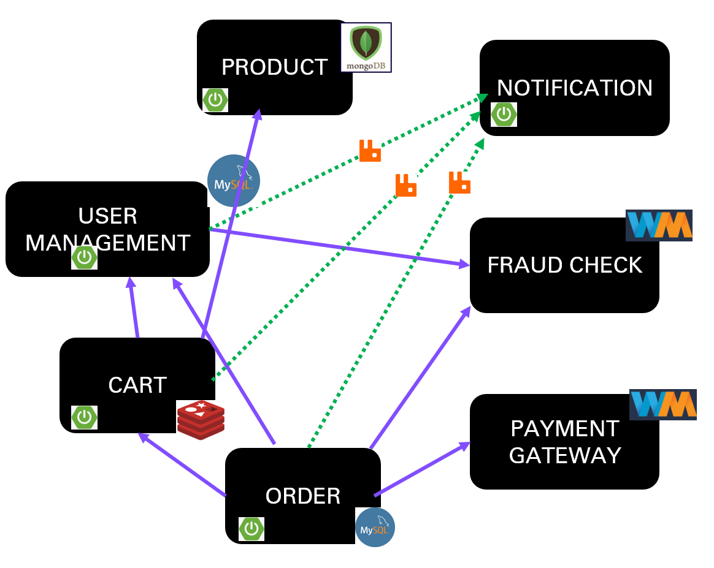
LETS MAKE LIFE OF CLIENTS EASY
LETS MAKE LIFE OF CLIENTS EASY
Centralized config management
A
P
I
G
A
T
E
W
A
Y
CLIENTS
SERVICE REGISTRY & DISCOVERY
LOAD BALANCER

Slide 5

INDIVIDUAL SERVICES STRUCTURE
CREATE
CREATE
ACTUATOR
ACTUATOR
READ
ORDER
SERVICE
READ
CART
SERVICE
CIRCUIT BREAKER
UPDATE
UPDATE
DELETE
DELETE

Slide 6

DATA ARCHIVAL AND PROCESSING
Data Storage/Archival

Slide 7
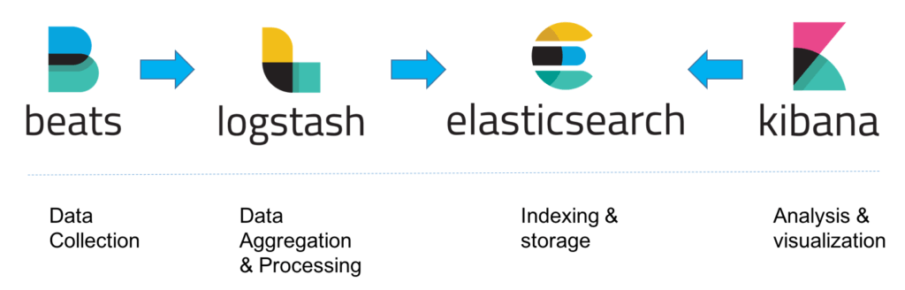
LOG MONITORING – ELK stack

Slide 8



DEPLOYMENT

Slide 9

WRITING CLIENT – FRONT END

Slide 10
THANKS FOR YOUR TIME
https://github.com/greenlearner01/microservices-projects-store/tree/master/Online-Shopping-Portal

Slide 11

MICROSERVICES DEMO SERIES
Product
micro-service
Writing endpoints

Slide 12
Product
Microservice
Create
Read
allProducts
productById
productsByCategory
Update
Delete

Slide 14
Product
Microservice
Create
Read
allProducts
productById
productsByCategory
Update
Delete

