Slide 1
AGILE!

Slide 2
Product Owner
Engaging with Stakeholders
Ordering the backlog
Descending order of importance
Uncover Risks

Slide 3
Scrum Master
Guides on the side
Bounce ideas off of
Assign tickets to those best able to complete them
Ensure good knowledge transfer
Ensure tickets are completed if work interruptions(such as vacations or emergencies) occur.

Slide 4
Developer
Develop software
Desk Testing
Ensure code matches style guide
Ensure code is well documented and uniform

Slide 5
Tester
Test software features
Travel all paths, if possible. Not just the happy path.
Check inputs
Check outputs

Slide 6
Phases of the Agile Process
Concept
Inception
Iteration
Testing
Release
Maintenance
Retirement

Slide 7
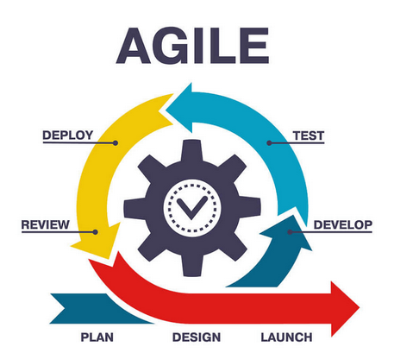
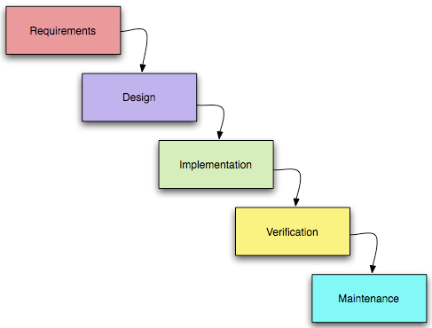
Agile versus Waterfall

Slide 8
Waterfall Process
The process would have been different with the Waterfall method. In short it would have been a lot more rigid, completely stories one at a time. Assign, Develop, Test in house. Repeat. Only when all requirements are completed is it given to the stakeholders for testing. It’s not a good model.

Slide 9
Works Cited
C. Jabbour personal communication, 06/21/2025
C. Jabbour personal communication, 06/21/2025
C. Jabbour personal communication, 06/21/2025
RST Software. (n.d.). The 7 phases of Agile software development life cycle: Agile SDLC explained. Retrieved June 21, 2025, from https://www.rst.software/blog/7-phases-of-agile-sdlc kms-healthcare.com+6rst.software+6

