Slide 1
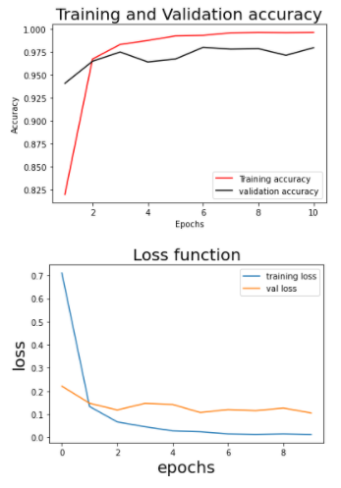
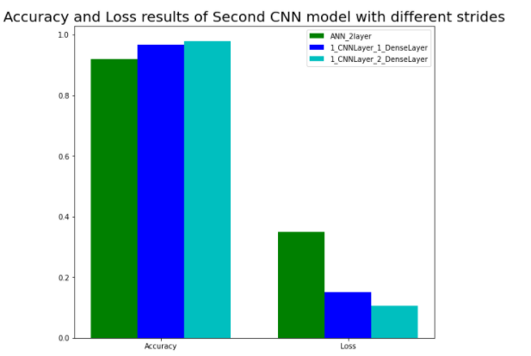
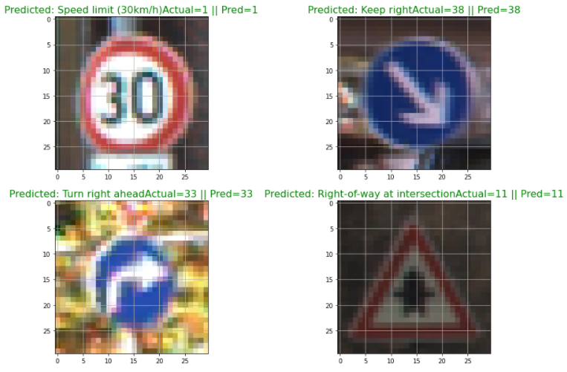
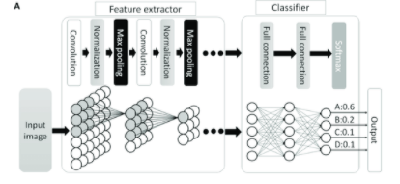
Gurpreet Singh , Chris Kurian
Application of Machine Learning in Mechatronic Systems, Simon Fraser University
Introduction
For the large and real-life dataset of road traffic signs, how accurate of a model can we create by using a combination of convolutional layers and fully connected Dense layers. To reduce the computational requirements of the system, the optimum settings for each two layered network is found.
Results
Conclusions
The results show that an artificial neural network with only two layers can achieve a prediction accuracy of up to 91.93%. Using a Convolutional Layer can increase the accuracy up to 98.10% accuracy. The effectiveness of both network architecture is shown as surprisingly high for only two layers.
Materials and methods
Using Keras API, and Python libraries, several convolutional and artificial neural networks are created and compared in performance for validation accuracy. The most effective model is then displayed for the user to see various images in the test set and the model prediction compared to the real value.
Literature cited
Wang Xue; Liao Feijia; Xu Wenxia; Guo Kun; Li Guodong Based on K-Means Clustering and CNN Algorithm Research in Hail Cloud Determination
Acknowledgments
Accuracy metrics (keras.io)
Python Project on Traffic Signs Recognition with 95% Accuracy using CNN & Keras - DataFlair (data-flair.training)
GTSRB - German Traffic Sign Recognition Benchmark | Kaggle

