Slide 1
Blockchain Casino
A number guessing game that utilizes the Ethereum blockchain.
+
Developed by: Christian Lahaine, Chris Ansburg, and Will Damron
Notes:
Please read the notes on slide 121 to know the tips of how to enable or disable the glassy looks by using the Selection Pane for some mock up.

Slide 2
Idea Process
Blockchain and games
1
We wanted to utilize blockchain in our new project. Tarek inspired us to create a smart contract to hold bets, while tying it in with our project 2.
2
Guessing Game
We thought a number guessing game would be easier to implement and could still utilize smart contracts to ensure secure transaction environment.
3
Smart Contracts
Permission less and trustworthy forms of transactions to guarantee legitimacy of fair outcomes.
4
Ganache and Web3
Web3 allows us to call smart contracts written on remix ide in python. Ganache creates a local blockchain for development purposes.

Slide 3
Game Description
Random Number Generator in Python
01
Pick a number 1 through 100.
Enter ETH Wallet Address
02
Withdraw 1 ETH from your account to the smart contract.
Winner Winner Chicken Dinner!
03
The person whose guess is closest to the generated number wins.
Winner Takes All!
04
Smart contract deposits full amount of ETH to your digital wallet.

Slide 4
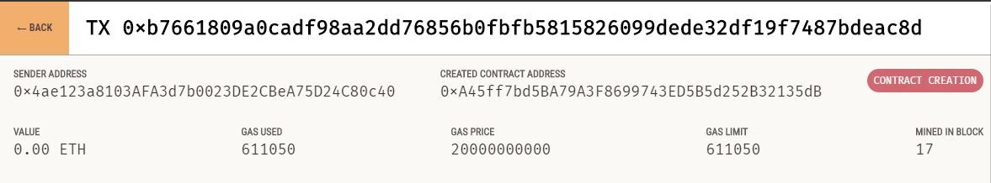
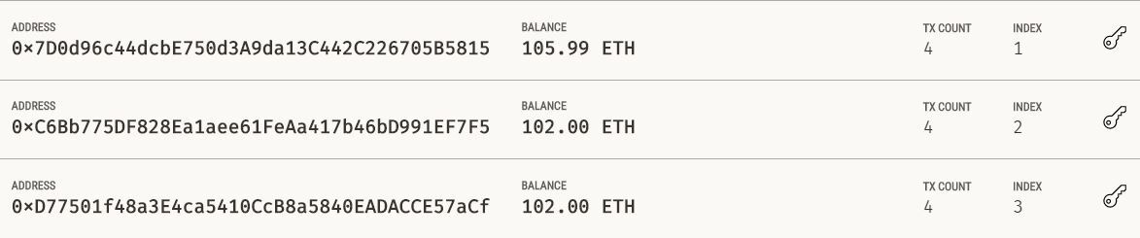
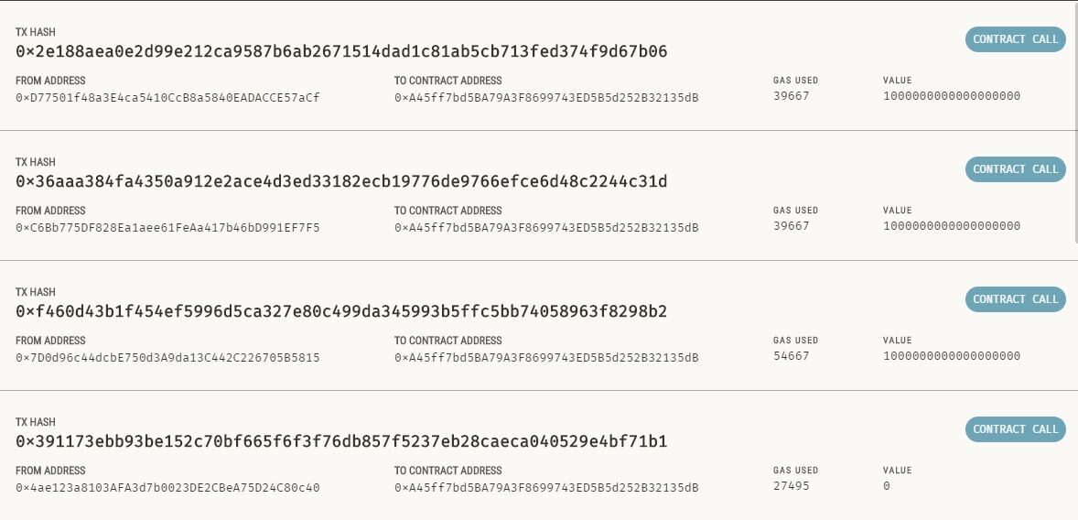
Demonstration
This is the contract creation on the blockchain
These are the beginning amounts of each players wallets.
This is the smart contract and the withdrawals of ETH from each players address.

Slide 5
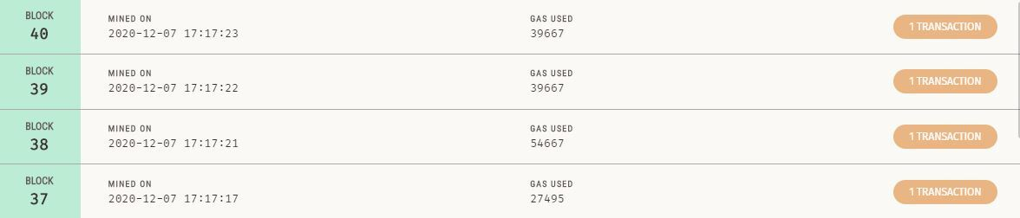
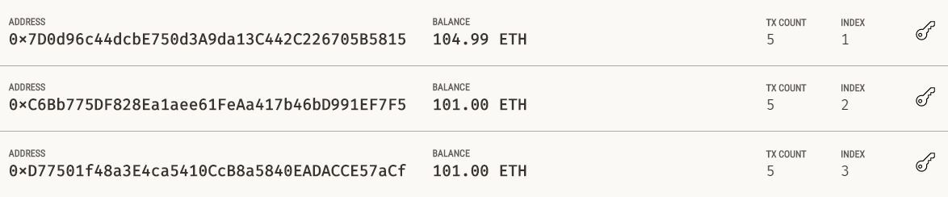
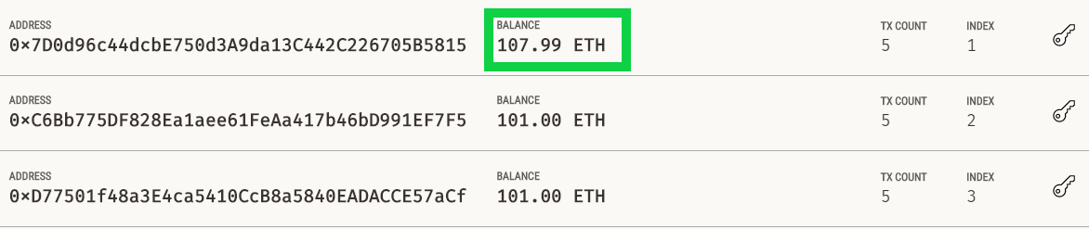
Demonstration
These are mined blocks that coincide with the smart contracts and withdrawals
These are the amounts after withdrawals
These are the balances after the winnings are deposited.

Slide 6
Challenges
Web3
Solidity
Streamlit
Documentation
Foreign Language
Chris
Lack of documentation made it difficult to implement.
Integrating a newly learned language on a shortened project schedule.
Obviously, he had trouble since you are seeing this on a PowerPoint.

Slide 7
Future Possibilities
Expand to other games
Generate Revenue
We can use the same smart contracts for sports betting.
Could add feature where house wins pot.
Marketing
Sell Idea to Ajit
Partnerships and sponsorships through corporate and affiliate marketing.
We know you want to buy this

