Slide 1
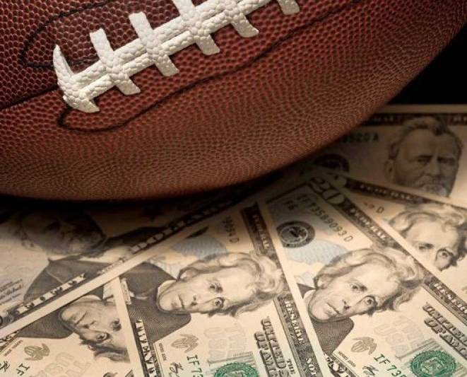
NFL – Prediction Model
Prepared by:
Christian Lahaine
William Damron
Chris Ansburg
Notes:
Please read the notes on slide 121 to know the tips of how to enable or disable the glassy looks by using the Selection Pane for some mock up.

Slide 2
Why Sports Betting?
Global Market
Accessibility
Happy Customer
Poised to grow 144.4bn during 2020-2024
Legalization of sports betting that is offered online
Increased commercialization of sporting events will drive demand

Slide 3
Project Overview
Our Goal:
Our Data Process:
The goal of our project was to create a machine learning model to predict the outcomes of the 2019 playoffs and Super Bowl.
We intend to later use it for a gambling strategy
Many gambling sites offer relatively low prices for high pay outs. Thus, our model does not have to be 100% accurate each time.
We used pd.read_html to scrape data from footballdb.com.
We originally tried to web scrape using Beautiful Soup, but switched directions due to time constraints.
32%
23%
14%
We used team offense, defense, passing, rushing, downs, games, and outcomes from the 2012-2019 seasons.

Slide 4
Project Map
Analysis
There were many statistics available for each team. We initially brought in many statistics we believed would be beneficial to our model.
Model Training
We trained our model on the 2012 to 2019 regular and post seasons, excluding 2019 post season.
Model Techniques
We focused on Linear Regression, Random Forest, AdaBoost Regressor, and Gradient Boosting Regressor.
Data Prep
We reduced our data sample to display the specific factors that influenced the outcome of each game.
Predictive Model(s)
We were open minded about which model would be the most successful.

Slide 5

Our Dataset
The specific data we used to fill our model with was a difficult choice, but we
narrowed it down to 51 columns of data.
+
In a perfect world, we would have been able to include all the data points we
found.
+
We removed data such as games, week, and attempts. We did not believe these
would be key indicators to influence a game
+
We believe these indicators would work best with our chosen models.
+
Finding data was also difficult, we initially looked for readily available
Datasets. Quickly we realized that the data we were looking for would
have costed more money than we were wiling to spend. Thus, we scraped
the web using HTML scraping.
Notes:
Please read the notes on slide 121 to know the tips of how to enable or disable the glassy looks by using the Selection Pane for some mock up.

Slide 6
Data Challenges
Week or Year
A major issue we encountered was whether to include yearly data, or weekly data for each team.
Data Availability
We found lots of data, however it was not always from the same source and was typically not arranged in the same order as previous data we found.
The data we did find was not in a csv file, which required time to scrape and then format.
Joining the Data
Another issue that took up a lot of time was joining the data.
Rams/Chargers
Over the course of our time frame, two teams had changed locations. This required us to update the data accordingly.

Slide 7
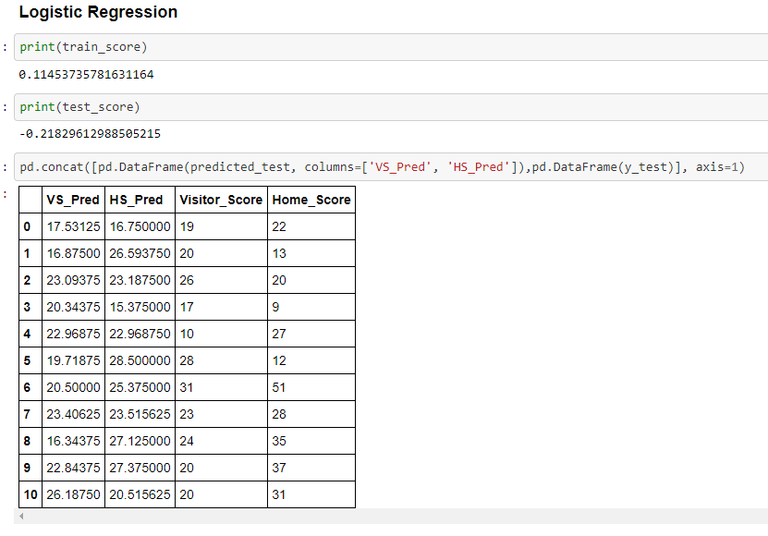
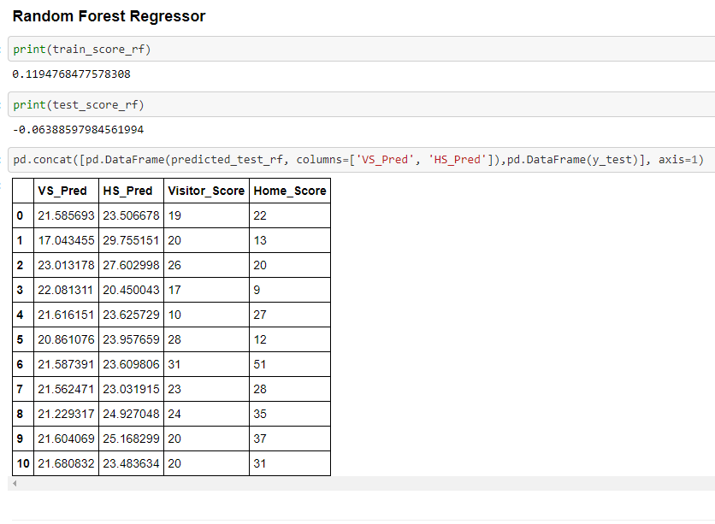
ML Models
Logistic Regression
Random Forest Regressor
Our first attempt at ML provided a win ratio of (.45).
We found Logistical Regression would be worse than flipping a coin.
Our second attempt was more successful with a win ratio of (.73).
This model was much better than flipping a coin.

Slide 8
Model Results
Random Forest
01
We realized that Random Forest was the best model to reach our goal due to the higher accuracy on the test data.
Other Models Tested
02
The other models we used did not result in an accurate score that was better than flipping a coin.
Satisfactory?
03
We were satisfied with our second results due to the average win ratio of Vegas lines is .64 - .69.

Slide 9
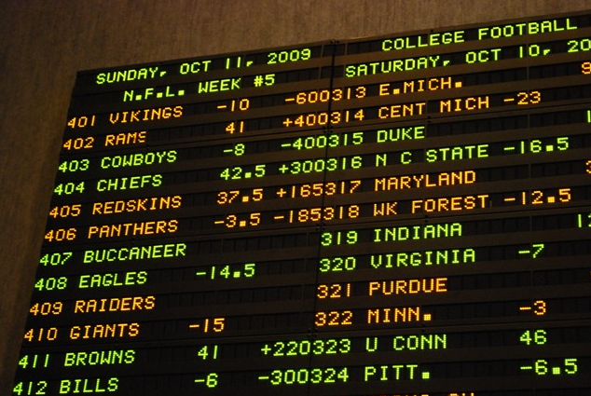
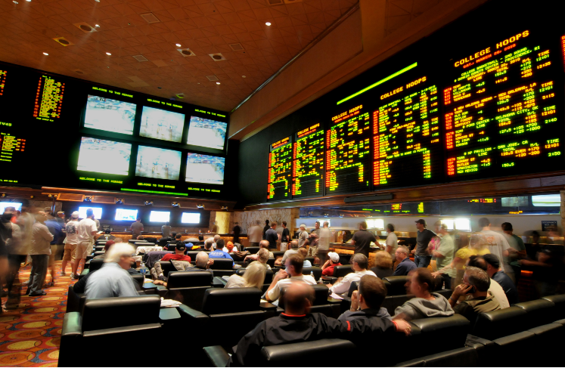
Going Forward…
-
We intend to continue working on this project after this project/class is completed.
We believe it has large potential to benefit us regarding picking teams for gambling purposes.
-
This was a project that included subject matter that was very interesting to us and without time constraints, we believe we can perfect and achieve our desired goal.
-
We plan to bring in our 51 new features to make the model more robust.
We are going to switch our model from batch to online, so it updates and gives predictions weekly.
We are using a parlay strategy where it bets on each matchup of each week.
Our model will give us the top 50 unique parlays for each week.
-
-
-

