Slide 2
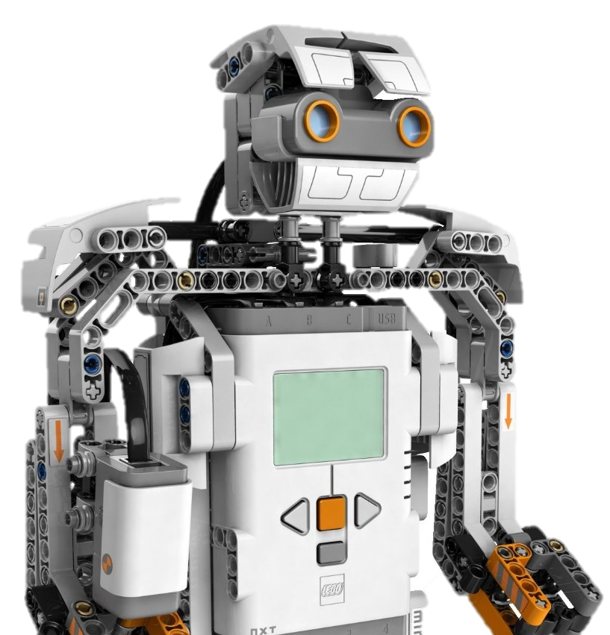
Robot Programming Exercise 3
Joseph Groocock | Matthias Casula | Chris Lane

Slide 3

Our Approach
We came up with ideas for all parts of the exercise:
Comprehensive & Inclusive solutions
Outlines of potential issues we may encounter with code or the robot
Fixes or ways to avoid issues

Slide 4
[Part 1] Task A: Proportional Feedback
The ideas:
Use of an Ultrasonic Distance Sensor
The accuracy isn’t paramount.
Inconsistencies can be accounted for in code.
This was our initial pseudo-code generated by our initial impressions of the exercise:
MV = 1 while (PV > SP) {
//Reading from sensor getPV()
//Likely PV – SP error = SP – PV
MV = MV + (0.1 * error) pilot.setSpeed(MV) } pilot.stop()

Slide 5
[Part 1] Task A: Proportional Feedback
Process Variable [PV] is the raw sensor value; the distance from the object.
Set point [SP] is the target distance for the robot to be from the object.
Manipulated Variable [MV] is the speed set to the robot which is proportionally changed depending on the distance to the object.
MV = 1 while (PV > SP) {
//Reading from sensor getPV()
//Likely PV – SP error = SP – PV
MV = MV + (0.1 * error) pilot.setSpeed(MV) } pilot.stop()

Slide 6
[Part 1] Task A: Proportional Feedback
ADD PROBLEMS WITH EX3P1A HERE

Slide 7
[Part 1] Task B: Line Following
We had several possible solution ideas, not limited to the following:
Using a Light Sensor both on the front and back
This idea was quickly abolished due to realising we cannot tell which side the line has fallen off therefore making correction very difficult.
Using a camera to detect the curve of the line in conjunction with two Light Sensors to detect junctions
This seemed like the most accurate and reliable solution but was pushed aside as it sounded too complicated to implement and maintain.
Using two Light Sensors a line-width apart
In the end we chose this as our plan of action as it seemed to strike a good balance between reliability and simplicity.
We learned very quickly that it was not the case and proved to be very troublesome.
In hindsight, using the camera line tracking would probably have been more reliable.

Slide 8
[Part 1] Task B: Line Following
One major issue we had when designing the algorithm to navigate lines was working out how much to turn.
On sharp turns the robot didn’t turn enough
On wide turns the robot would overshoot or yo-yo
Our solution to this was to significantly reduce the speed of the robot allowing it extra time to turn and respond and correct itself without significant oversteer or understeer.

Slide 9

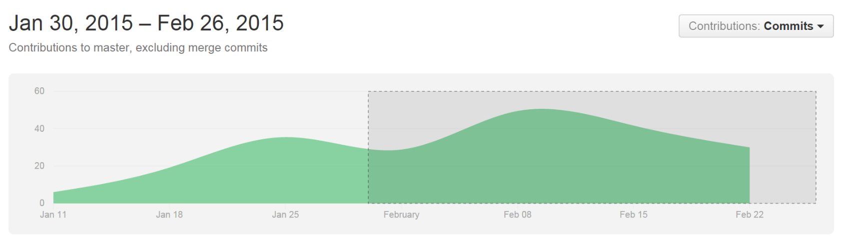
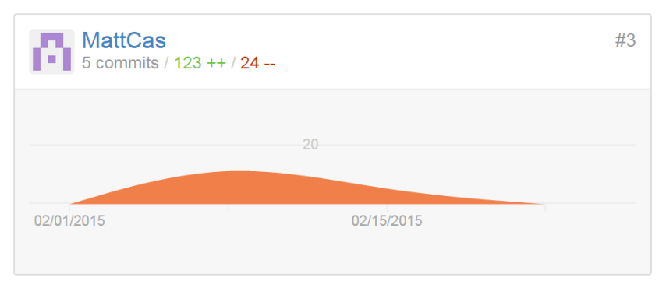
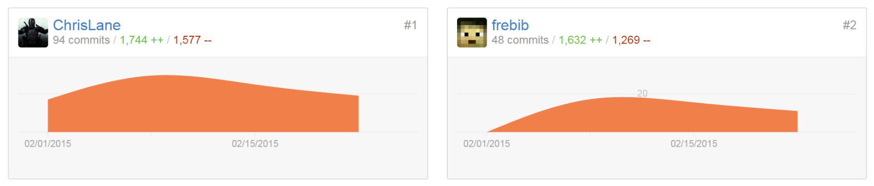
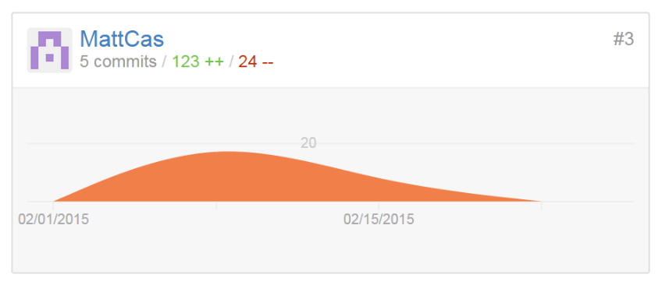
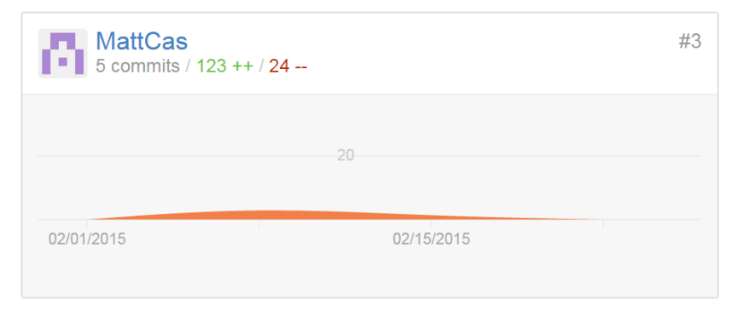
GitHub Repo Statistics for Exercise 3

