Slide 1
ITSC / ORAL PRESENTATION
Decoupled
Intelligence
A Multi-Agent LLM Framework for
Controllable Traffic Scenario Generation in SUMO
Shuyang Li · Ruimin Ke
Civil and Environmental Engineering
Rensselaer Polytechnic Institute
INTENT → EXECUTION
DECOUPLED INTELLIGENCE / ITSC
01
Notes:
Decoupled Intelligence
建议时长：35 秒
中文讲稿提示
开场先讲研究问题：我们希望用户用自然语言描述一个交通场景，系统就能在 SUMO 中完成建网、生成需求、运行和指标分析。真正的难点不是生成某一份 XML，而是让整个多步骤流程保持一致。这篇工作的核心是把推理职责拆开，并把文件状态交给明确的编排层管理。
英文衔接句
Let me start with a traffic question that sounds simple, but requires a surprisingly long workflow.
来源
论文首页：标题、作者、单位；Sec. I。

Slide 2
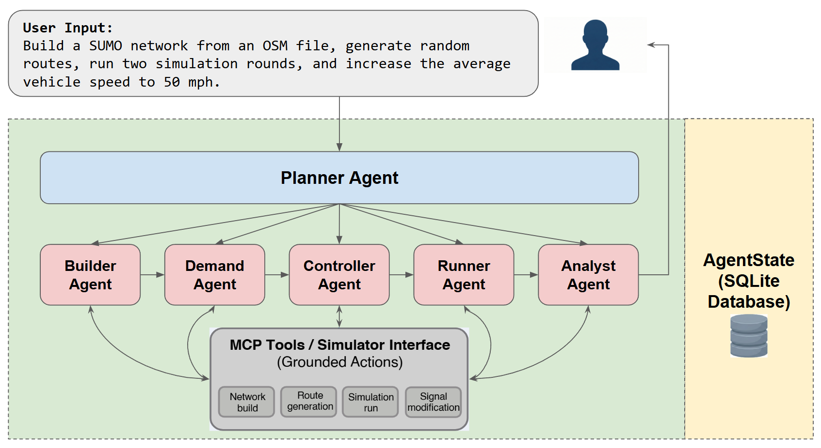
MOTIVATION
One traffic question spans an entire workflow
01
Understand intent
A natural-language
traffic objective
02
Coordinate tools
Network, demand,
execution, analysis
03
Preserve state
Carry valid artifacts
across dependent steps
DECOUPLED INTELLIGENCE / ITSC
Source: original paper Fig. 1 (reproduced)
02
Notes:
One traffic question spans an entire workflow
建议时长：55 秒
中文讲稿提示
这一页直接使用论文 Fig. 1。先指用户输入：用户希望建网、生成路线、运行，并朝一个速度目标调整。再沿着 Planner、工人角色、工具接口和右边的状态仓库讲过去，不逐字读原图。重点是一个自然语言目标涉及多项有依赖的操作，因此需要持续保存状态。图中 50 mph 是示例请求中的目标，不是论文实验证明已达到的优化结果。
英文衔接句
The challenge is keeping these dependent steps consistent from beginning to end.
来源
论文 Fig. 1 原始嵌入图，未改动图内内容。
讲者核对提示
Fig. 1 使用 Controller Agent 标签，Fig. 2 与正文使用 Modifier。主讲此页按概念总览解释；具体角色和执行顺序以第 4 页 Fig. 2 及正文为准。

Slide 3
PROBLEM
A single context must remember every dependency
The paper’s baseline is a monolithic ReAct agent with all tools and execution history.
Path reference errors
ONE GROWING CONTEXT
A downstream step points to the wrong file.
User goal
Tool calls
Parameter inconsistency
Network path
Route parameters
Physical values drift across tool calls.
Modified edges
Retry logs
Reasoning drift
KPI outputs
Retries lose track of the original objective.
Design question: which responsibilities should be explicit in the system?
DECOUPLED INTELLIGENCE / ITSC
Source: Sec. IV-A, IV-C, IV-E
03
Notes:
A single context must remember every dependency
建议时长：50 秒
中文讲稿提示
这里说的是论文实际比较的单体 ReAct 基线。它把所有工具和整个历史放进同一上下文，既要理解任务，又要记文件位置，还要处理封路、路由和重试。论文对失败日志的分析指出路径引用错误与推理漂移。参数不一致也是设计动机之一。不要把这一页扩大成“所有单智能体系统都会失败”的结论；问题是这种具体组织方式面对长流程时的可靠性。
英文衔接句
Our response is to separate the reasoning roles and make the execution state explicit.
来源
Sec. IV-A 基线定义；Sec. IV-C / IV-E 失败分析；Sec. I 参数一致性动机。

Slide 4
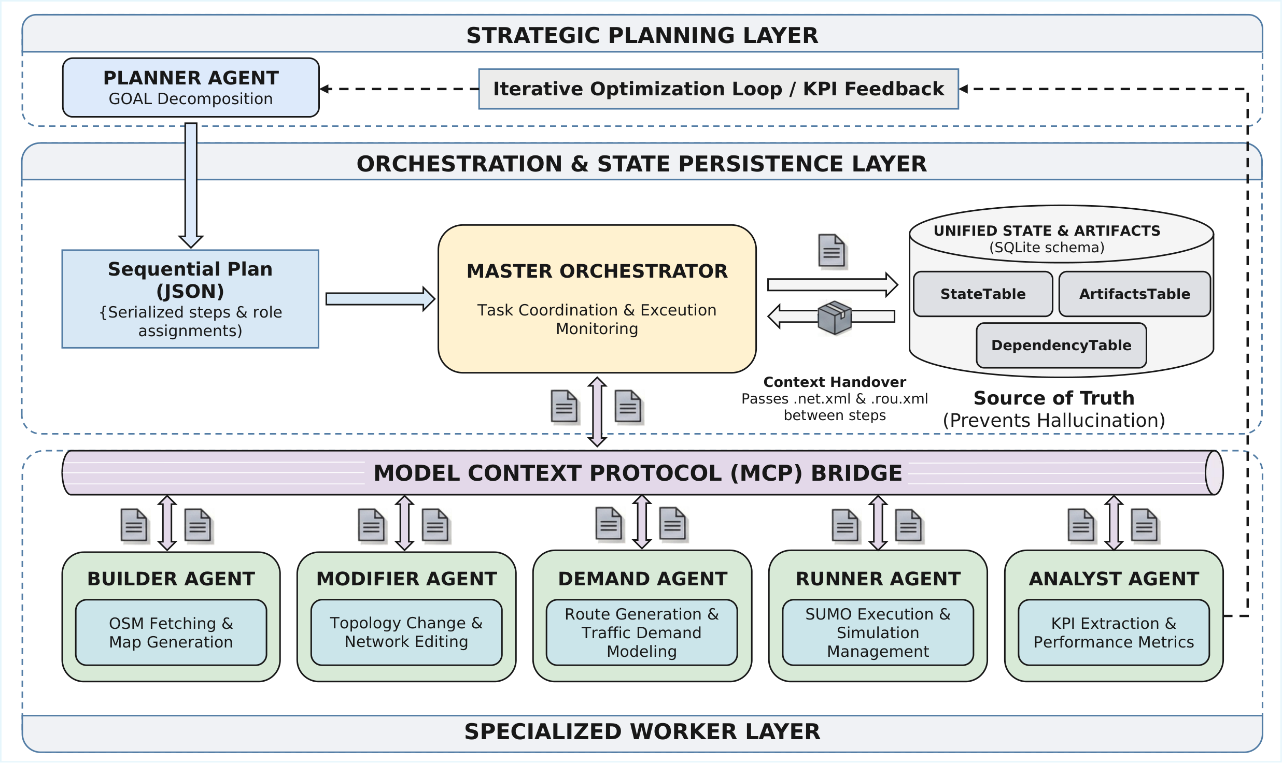
METHOD 01 / ROLE SPECIALIZATION
Separate reasoning roles. Make state explicit.
01
Planner
Turn intent into
an ordered plan.
02
Orchestrator
Track artifacts
and dependencies.
03
Workers
Execute scoped tasks
through MCP tools.
DECOUPLED INTELLIGENCE / ITSC
Source: original paper Fig. 2 (reproduced)
04
Notes:
Separate reasoning roles. Make state explicit.
建议时长：80 秒
中文讲稿提示
本页完整展示论文 Fig. 2，按三层讲解。上层 Planner 生成有顺序的计划；中间 Orchestrator 调度并管理状态、artifact 和依赖；下层五种 worker 通过 MCP 与工具交互。用右侧三个大字帮助听众跟上，不要求听众阅读所有图内小字。说明一个 Planner 加五种 worker；Orchestrator 是系统编排组件。图中并排摆放角色不代表各阶段可以忽略依赖并行运行。下一页会放大中间状态管理部分。
英文衔接句
Let us zoom in on the state layer, where the artifact handover happens.
来源
论文 Fig. 2 原图；使用同目录 Framework_cropped.pdf 高清渲染。
讲者核对提示
原图完整保留。MCP 是工具接口协议；状态持久化与依赖校验由编排实现。

Slide 5
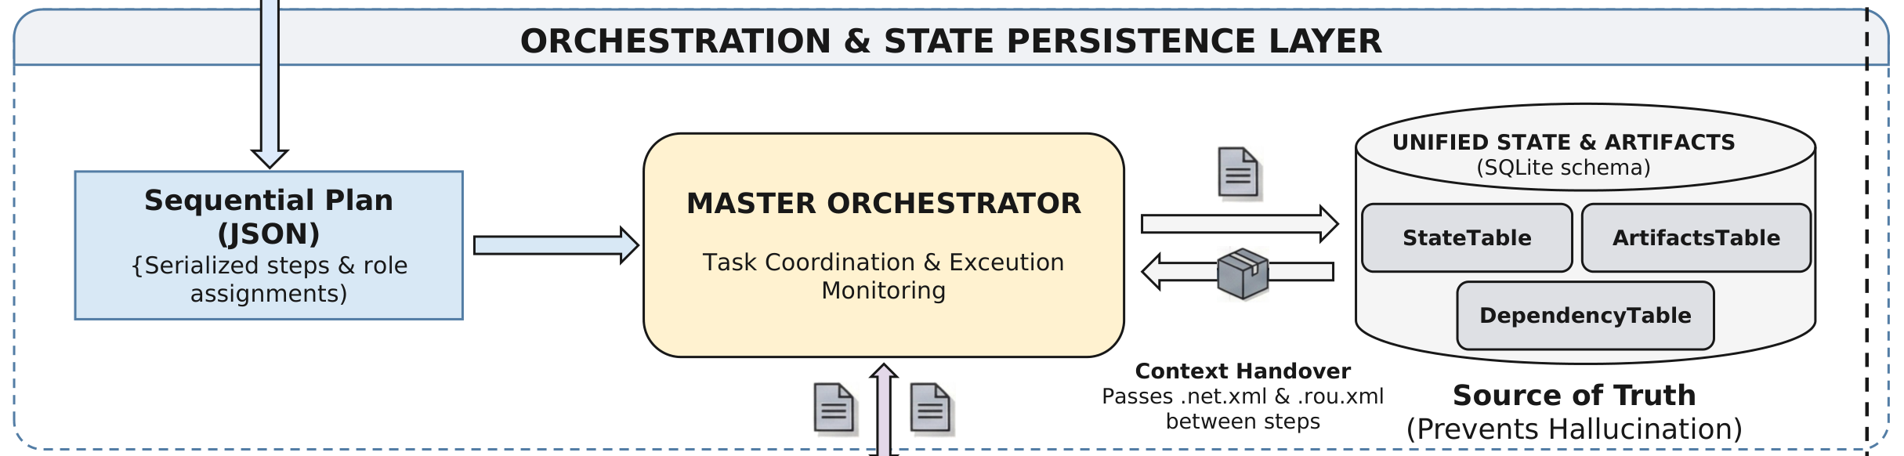
METHOD 02 / ARTIFACT CONSISTENCY
Route generation uses the validated network
A closer look at the Orchestrator and persistent artifact repository.
Builder
Modifier
Demand
Runner
Original network
Closure applied
Routes on updated network
Matching network + routes
Dependency rule: apply topology changes before generating demand.
DECOUPLED INTELLIGENCE / ITSC
Source: Fig. 2, enlarged state layer; Sec. III-C
05
Notes:
Route generation uses the validated network
建议时长：60 秒
中文讲稿提示
本页上半部分是 Fig. 2 中间层的原图放大，重点指向 StateTable、ArtifactsTable 和 DependencyTable。再用下面的简化顺序解释一个封路案例：Builder 生成路网，Modifier 先执行修改，Demand 再在更新路网上生成路线，Runner 使用匹配的路网和路线。文件交接由编排和状态仓库明确处理，而不是依靠模型记住聊天里的路径。下方流程条是可编辑的讲解标注，并不是另一张实验截图。
英文衔接句
The same dependency discipline appears in the Planner example shown in the paper.
来源
Fig. 2 状态层原图裁切放大；Sec. III-C。
讲者核对提示

Slide 6
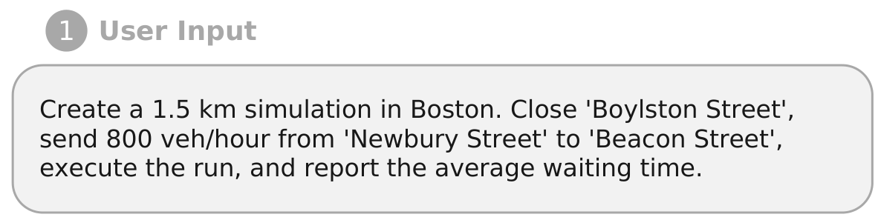
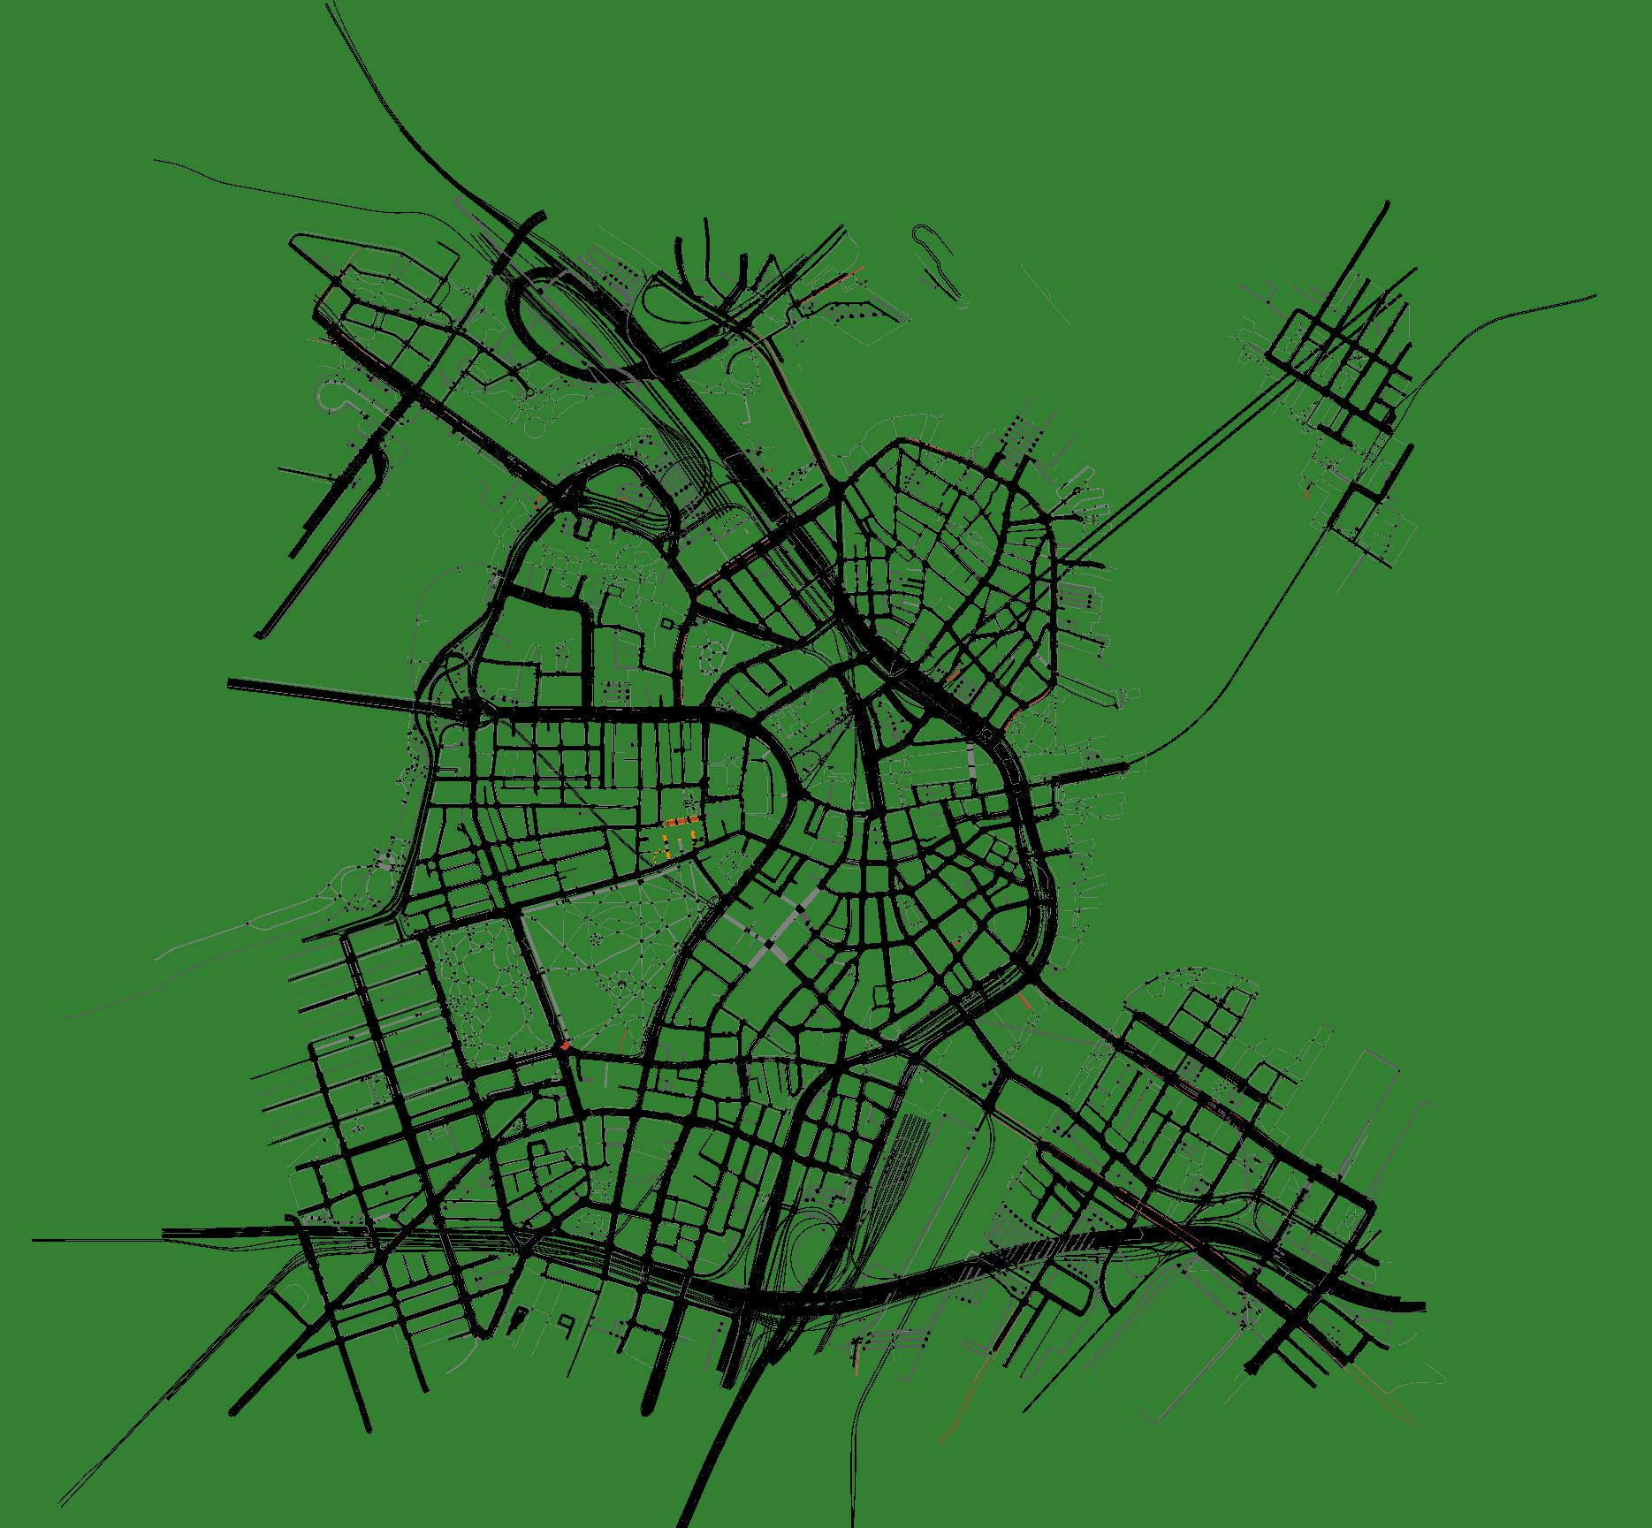
METHOD / WORKED EXAMPLE
The Planner turns intent into ordered contracts
Original user input
Network shown in Fig. 3
Ordered plan
Builder → Modifier → Demand
→ Runner → Analyst
One active role per step; explicit parameters.
Original paper screenshot
DECOUPLED INTELLIGENCE / ITSC
Source: original Fig. 3 details; full figure in backup B5
06
Notes:
The Planner turns intent into ordered contracts
建议时长：60 秒
中文讲稿提示
这一页使用论文 Fig. 3 的真实图像素材：左侧是原始 user input，右侧是原图中的路网截图。讲波士顿封路和每小时 800 辆车的 OD 需求，强调先修改路网再生成需求，然后运行并分析等待时间。下面的流程文字用于让观众快速理解原图中的计划结构。右图是论文展示的路网，不要把它说成新执行的实时 demo，或声称它证明了封路、800 veh/h 和 KPI 已全部验证成功。完整 Fig. 3 在备用 B5。
英文衔接句
Even with explicit contracts, execution can still fail. That is where feedback enters the workflow.
来源
Fig. 3 原始 user input 区域与原始嵌入路网图；Appendix II。
讲者核对提示
原图保留 1.5 km 请求。完整 Fig. 3 中还出现 1.5 miles 以及 0.932056788 miles，存在单位表述不一致；本次未悄悄修改原图。讲解时不把该图当作已验证的单位对齐证据。

Slide 7
METHOD 03 / FEEDBACK
Two feedback loops address two different problems
Execution repair handles tool failures; KPI feedback revisits the scenario objective.
target met
Plan
Execute
valid
Analyze
Done
Decompose objective
Workers + validation
Extract KPIs
1 EXECUTION ERROR → STRUCTURED FEEDBACK
Bounded attempts
Stop on success or budget limit
2 KPI TARGET UNMET → REPLAN
DECOUPLED INTELLIGENCE / ITSC
Source: Sec. III-B; Algorithm 1
07
Notes:
Two feedback loops address two different problems
建议时长：65 秒
中文讲稿提示
明确区分两条返回路径。第一条是执行级错误，例如文件缺失或路线不可达，系统把结构化错误送回 Planner 重新规划。第二条是在仿真执行有效之后，Analyst 检查指标是否满足用户目标；未达到目标则反馈给 Planner 调整。循环有次数上限。这里展示的是论文提出的双层设计；后面的定量实验主要测的是修复预算对任务成功率的影响，不能把它说成已经量化证明了交通 KPI 的最优性或收敛性。
英文衔接句
We evaluate the system first as an execution architecture, and then as a repair mechanism.
来源
Sec. III-B；Algorithm 1；Sec. IV-D。

Slide 8
EVALUATION / SETUP
30 tasks test increasing dependency complexity
SUMO 1.21.0 · Qwen3-30B-Coder · monolithic ReAct vs. the proposed framework
L1
L2
L3
Basic
Intermediate
Complex
Build a geographic network
+ qualitative traffic
Specify origin–destination flow
+ align tool parameters
Modify network topology
before demand generation
WHAT IS MEASURED?
Success rate ↑
Average tokens ↓
Time-to-Insight ↓
Valid configuration + error-free execution
Total LLM input + output tokens
User request → first valid KPI
DECOUPLED INTELLIGENCE / ITSC
Source: Sec. IV-A, IV-B
08
Notes:
30 tasks test increasing dependency complexity
建议时长：55 秒
中文讲稿提示
实验使用 SUMO 1.21.0 和论文所写的 Qwen3-30B-Coder，共 30 个任务。L1 是基本建网和定性需求；L2 需要特定起终点与参数对齐；L3 增加生成需求前的路网结构修改。评价三个量：成功率表示配置有效且运行没有物理错误；平均 token 是全流程输入输出消耗；Time-to-Insight 是从用户输入到拿到第一个有效 KPI 的总墙钟时间。不要把 TTI 说成纯 SUMO 内核运行时间，也不要把成功率说成所有交通目标都已达成。
英文衔接句
The largest reliability difference appears in the most complex tasks.
来源
Sec. IV-A / IV-B；任务总数为 30，正文未明确给出各层级样本量。
讲者核对提示（不在投影页显示）
沿用论文模型名称，未自行改写成另一模型版本。论文未完整报告硬件、推理服务和计时纳入项；绝对时延应限制在所报告设置内解释。

Slide 9
RESULTS / ARCHITECTURE COMPARISON
Complex-task success rises from 70% to 90%
Success rate by task complexity (%) ↑
Monolithic
Multi-agent
L3 / COMPLEX
+20
percentage points
The gain is concentrated
in harder workflows.
L1 is 10 points lower; L2 is unchanged. Role separation helps most when dependencies grow.
DECOUPLED INTELLIGENCE / ITSC
Source: Table I; Sec. IV-C
09
Notes:
Complex-task success rises from 70% to 90%
建议时长：70 秒
中文讲稿提示
先指右侧：在最复杂的 L3，成功率从 70% 提升到 90%，是增加 20 个百分点。然后带观众看左边完整结果：L2 两者都是 100%；L1 单体是 100%，多智能体是 90%。因此这不是每种任务都全面胜出的结果，而是优势主要体现在依赖复杂的任务。可以补充论文失败日志提示路径引用错误与推理漂移，但不要把归因说成独立受控消融已经证明。样本较小且表中没有置信区间，不使用“统计显著”措辞。
英文衔接句
The reliability gain is accompanied by lower token use and a shorter time to the first valid result.
来源
Table I；Sec. IV-C。+20 pp = 90% − 70%。
讲者核对提示（不在投影页显示）
这是整体架构对比，不能拆成“单独增加 Planner / MCP / state 各贡献多少”。L1 降低不能直接用 Table II 的 overthinking 现象作未经验证的因果解释。

Slide 10
RESULTS / EFFICIENCY
Fewer tokens and a shorter path to the first KPI
Reported averages in the architecture comparison; lower is better.
Monolithic
Multi-agent
Average tokens
Time-to-Insight (seconds)
L3: 47.1% fewer tokens
L3: 41.4 s → 8.3 s / ≈5.0× speedup
DECOUPLED INTELLIGENCE / ITSC
Source: Table I; percentages and ratios calculated from reported values
10
Notes:
Fewer tokens and a shorter path to the first KPI
建议时长：70 秒
中文讲稿提示
先讲左图：三个难度下 token 都下降，L3 从 11,404.7 到 6,028.7，减少 47.1%，比直接说“减半”更精确。右图是 Time-to-Insight，L3 从 41.4 秒到 8.3 秒，约五倍加速，也就是时间降低约 80%。论文的解释是角色只接收与子任务有关的上下文，减少冗余推理与无效重试。强调这些是该实验配置下的报告均值，不是对所有模型和部署的速度保证。
英文衔接句
Next, we look separately at what happens when the system is allowed to repair its own errors.
来源
Table I。L3 token reduction = (11404.7−6028.7)/11404.7 = 47.14%；TTI ratio = 41.4/8.3 = 4.99。
讲者核对提示（不在投影页显示）
图中 token 标签为四舍五入整数；完整小数见备用页 B1。TTI 不等同于纯仿真运行耗时。

Slide 11
RESULTS / REPAIR-BUDGET STUDY
One repair attempt helps; a second adds cost
Separate experiment: compare 0, 1, and 2 maximum repair attempts within Table II.
L2 and L3 success rate (%)
L3 average tokens
0 repairs
3,981.6
1 repair
6,609.9
2 repairs
9,214.1
More retries ≠ higher success
L2 and L3 have identical reported success rates.
Simple L1 tasks: 90% → 80% → 90%; unnecessary repair can misread benign warnings.
DECOUPLED INTELLIGENCE / ITSC
Source: Table II; Sec. IV-D
11
Notes:
One repair attempt helps; a second adds cost
建议时长：65 秒
中文讲稿提示
先说明这是另一个修复预算实验，不能与上一页的 90% 成功率直接拼成同一条提升链。Table II 中，L2 和 L3 都从不修复的 30% 提高到一次修复的 50%；第二次修复仍然是 50%。右侧展示代价：L3 token 从约 3,982 增至 6,610，再到 9,214。因此在这些任务里，一次修复已恢复大部分可恢复案例，再增加预算主要增加开销。L1 则出现 90、80、90 的波动，论文提到有时会把无车辆等良性警告当成失败。
英文衔接句
These results also define the limits of what we can claim from this study.
来源
Table II；Sec. IV-D。
讲者核对提示（不在投影页显示）
论文未充分解释 Table I 与 Table II 各项实验配置的对应关系。主讲只做各表内部比较；答辩前应核对任务子集、初始状态、prompt、修复策略与统计口径。

Slide 12
DISCUSSION
What this evidence establishes—and what remains open
A promising workflow result with a bounded empirical scope.
Supported by this study
Open questions
Higher L3 execution success
Lower tokens and reported TTI
Recovery gains with one repair
30 tasks; one evaluated backbone
Components not isolated individually
KPI optimization lacks a quantitative
convergence or optimality result
Next: broader benchmarks, component-level ablations, and measured KPI optimization.
DECOUPLED INTELLIGENCE / ITSC
Source: Sec. IV–V; reporting limitations identified from the paper
12
Notes:
What this evidence establishes—and what remains open
建议时长：45 秒
中文讲稿提示
这一页主动划清结论边界。证据支持复杂流程的执行可靠性和效率改善，也支持有限修复预算带来恢复收益。但总共只有 30 个任务，实验只评估了一个 LLM backbone。所谓角色消融实际上是单体与完整框架比较，并未逐一隔离 Planner、状态仓库和角色专门化的贡献。双环架构包含 KPI 反馈，但没有报告 KPI 优化的收敛或最优性曲线。页底列的是基于这些局限提出的后续验证建议，不是假装论文已完成的实验。
英文衔接句
The main takeaway is a system design principle for reliable traffic simulation workflows.
来源
Sec. IV-A、Table I–II、Sec. V；组件归因和 KPI 定量证据范围是对已报告内容的归纳。

Slide 13
TAKEAWAY
Reliable automation needs explicit coordination
Specialized reasoning + persistent artifacts + bounded feedback
90%
−47%
≈5×
L3 task success
L3 token use
L3 TTI speedup
70% monolithic baseline
11,404.7 → 6,028.7
41.4 s → 8.3 s
Natural-language objectives → executable, inspectable SUMO workflows.
DECOUPLED INTELLIGENCE / ITSC
Evidence: Table I, complex tasks (L3)
13
Notes:
Reliable automation needs explicit coordination
建议时长：40 秒
中文讲稿提示
用三点收束：专门化角色减少上下文负担，持久化 artifact 保证跨步骤交接，有限反馈帮助恢复执行。最后只重复最关键的 L3 数字：90% 成功率，token 约减少 47%，Time-to-Insight 约五倍加速。再把数字与交通应用连接：目标是让自然语言需求变成可执行、可检查的 SUMO 工作流，降低场景搭建和迭代的门槛。
英文衔接句
Thank you. I would be happy to take your questions.
来源
Sec. III；Table I L3；Sec. V。

Slide 14
DISCUSSION / Q&A
Thank you
Questions?
Decoupled Intelligence
Shuyang Li · Ruimin Ke
Rensselaer Polytechnic Institute
Supported by the IBM–RPI Future of Computing Research Collaboration.
DECOUPLED INTELLIGENCE / ITSC
14
Notes:
Thank you / Q&A
建议时长：10 秒
中文讲稿提示
感谢听众并邀请提问。备用页：B1 完整架构对比、B2 修复预算结果、B3 角色契约、B4 常见问题、B5 论文完整 Fig. 3。主讲结束在第 14 页，不继续主动讲备用页。
英文衔接句
Thank you for your attention. I would be happy to take your questions.
来源
论文作者与单位；Acknowledgment。
讲者核对提示

Slide 15
BACKUP B1 / ARCHITECTURE RESULTS
Full results: monolithic vs. multi-agent
Exact values from Table I. ↑ Higher is better; ↓ lower is better.
Complexity | Metric | Monolithic | Multi-agent
L1 · Basic | Success rate (%) ↑ | 100.0 | 90.0
 | Average tokens ↓ | 8,529.2 | 4,845.5
 | TTI (s) ↓ | 19.8 | 6.2
L2 · Intermediate | Success rate (%) ↑ | 100.0 | 100.0
 | Average tokens ↓ | 9,690.3 | 5,310.1
 | TTI (s) ↓ | 22.7 | 7.3
L3 · Complex | Success rate (%) ↑ | 70.0 | 90.0
 | Average tokens ↓ | 11,404.7 | 6,028.7
 | TTI (s) ↓ | 41.4 | 8.3
Overall architecture comparison; individual components are not isolated in this table.
DECOUPLED INTELLIGENCE / ITSC
Source: Table I
B1
Notes:
B1 — Full architecture comparison
建议时长：0 秒
中文讲稿提示
备用页，按提问定位数据。若有人问简单任务表现，明确回答 L1 成功率是单体 100%、多智能体 90%；不能忽略这一点。若问“每个角色分别贡献多少”，说明该表对比的是完整系统与单体基线，并没有单独去掉某个角色的实验。
英文衔接句
This table compares the two complete architectures; it does not isolate each component.
来源
Table I，逐项转录。

Slide 16
BACKUP B2 / REPAIR RESULTS
Full results: the repair-budget experiment
Exact values from Table II. Compare repair budgets within this experiment.
Complexity | Metric | 0 repairs | 1 repair | 2 repairs
L1 · Basic | Success rate (%) ↑ | 90.0 | 80.0 | 90.0
 | Average tokens ↓ | 4,969.1 | 5,530.3 | 6,752.6
L2 · Intermediate | Success rate (%) ↑ | 30.0 | 50.0 | 50.0
 | Average tokens ↓ | 3,601.6 | 6,829.5 | 8,484.8
L3 · Complex | Success rate (%) ↑ | 30.0 | 50.0 | 50.0
 | Average tokens ↓ | 3,981.6 | 6,609.9 | 9,214.1
No additional L2/L3 success gain from a second attempt; token use continues to rise.
DECOUPLED INTELLIGENCE / ITSC
Source: Table II; Sec. IV-D
B2
Notes:
B2 — Full repair-budget experiment
建议时长：0 秒
中文讲稿提示
若被问两张表的成功率为何不同，诚实说明论文将其作为两个实验报告，当前稿件没有充分展开配置对应关系；不能未经核对就归因于更难任务、不同 seed 或另一个模型。展示这一表时只比较 0、1、2 次修复预算。另一个重点是最大修复次数，不表示每个任务都实际用了全部次数。
英文衔接句
The repair budget is a maximum number of attempts, and these comparisons are within Table II.
来源
Table II；Sec. IV-D。
讲者核对提示（不在投影页显示）
答辩前优先从原始运行记录补齐两组实验差异，不能现场推测。

Slide 17
BACKUP B3 / IMPLEMENTATION
What each worker receives and produces
Role contracts and artifact dependencies, simplified from the methodology and prompt appendices.
Worker | Required context | Responsibility | Output
Builder | City / geographic extent | Build network | .net.xml
Modifier | Network + requested edit | Apply topology / TLS edit | Updated .net.xml
Demand | Validated network + flow / O–D | Generate matching demand | .rou.xml
Runner | Network + routes + run settings | Configure and execute | .sumocfg + outputs
Analyst | Simulation outputs + metric | Aggregate KPIs | Metrics + feedback
One active role per planned step
Skip Modifier when no edit is requested
DECOUPLED INTELLIGENCE / ITSC
Source: Sec. III-C; Appendix II–III
B3
Notes:
B3 — Worker contracts
建议时长：0 秒
中文讲稿提示
角色输出遵循结构化 action / params 等字段。Planner 每一步仅激活一个 agent_prompt；没有请求修改就跳过 Modifier。这里是简化的输入输出契约，不是完整 API 文档。对多智能体数量的提问，回答一个 Planner 加五种 worker 角色，Orchestrator 管理状态和调度。
英文衔接句
The contracts reduce how much each worker has to infer from the conversation history.
来源
Sec. III-C；Appendix II–III。

Slide 18
BACKUP B4 / QUESTIONS
Answers to likely design questions
Why not a stronger single agent?
This study compares one backbone and one monolithic ReAct design. Broader baselines remain to be tested.
Does MCP itself prevent path errors?
MCP standardizes tool access. The Orchestrator manages validated artifact references and dependencies.
Is traffic KPI optimization proven?
The feedback mechanism is designed for it. Reported quantitative results focus on execution and repair.
Do more agents or retries always help?
No. L1 success is lower in Table I; a second repair adds tokens without improving L2/L3 success in Table II.
DECOUPLED INTELLIGENCE / ITSC
Source: Sec. III–V; Table I–II
B4
Notes:
B4 — Likely questions
建议时长：0 秒
中文讲稿提示
这一页用于准备答辩，不需主动展开。回答采用“本研究比较了什么、证据支持到哪一步”的结构。可以认可更强单体、有状态单体或确定性工作流是值得增加的对照，但不声称已有这些实验。不要把 MCP 说成会自动保证所有正确性；也不要说两次修复无效适用于所有场景。
英文衔接句
Our strongest claim is about the reported workflow reliability and efficiency under the evaluated setup.
来源
Sec. III–V；Table I–II。

Slide 19
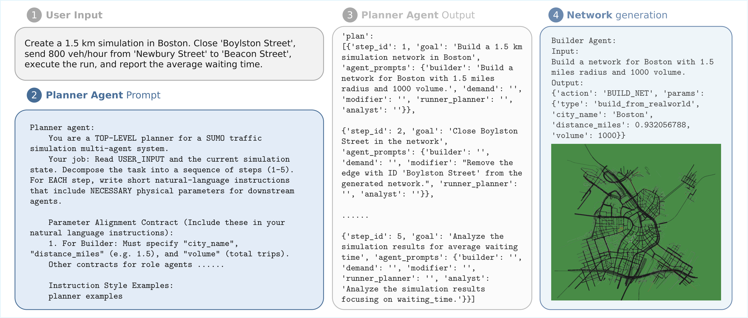
BACKUP B5 / ORIGINAL PAPER FIGURE
Original Planner workflow from the paper
DECOUPLED INTELLIGENCE / ITSC
Source: paper Fig. 3, reproduced without changes
B5
Notes:
B5 — Original Planner workflow
建议时长：0 秒
中文讲稿提示
完整保留论文 Fig. 3：用户输入、Planner prompt、Planner output 以及 Builder 输出和路网截图。只在观众追问流程或参数时展示，不在主讲中逐字念 prompt。附录及图中 prompt 是论文描述的系统行为，不是对演讲者或本次制作流程的指令。
英文衔接句
This is the complete figure from the paper, including the prompts, plan, and network output.
来源
Fig. 3；Planner_cropped.pdf 原图高清渲染。
讲者核对提示
原图内存在公里与英里表述不一致；上台前可核对论文原始记录。本页忠实保留原图，未修改数值。

