Slide 1
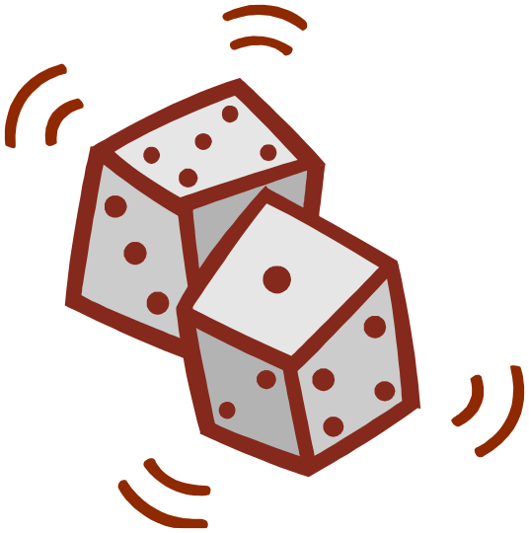
Kinetic Monte Carlo
Simulations And Applications
Kristen A. Fichthorn
The Pennsylvania State University
University Park, PA USA

Slide 2
Kinetic Monte Carlo: A Coarse-Grained,
Atomistic, Lattice-Based Technique for
Condensed-Matter Dynamics
∞
Length (m)
Continuum Equations
10⁻⁶
10⁻⁸
kMC
MD
10⁻¹¹
∞
10⁻¹⁵ 10⁻¹² 10⁻⁹ 10⁻⁶
Time (s)

Slide 3
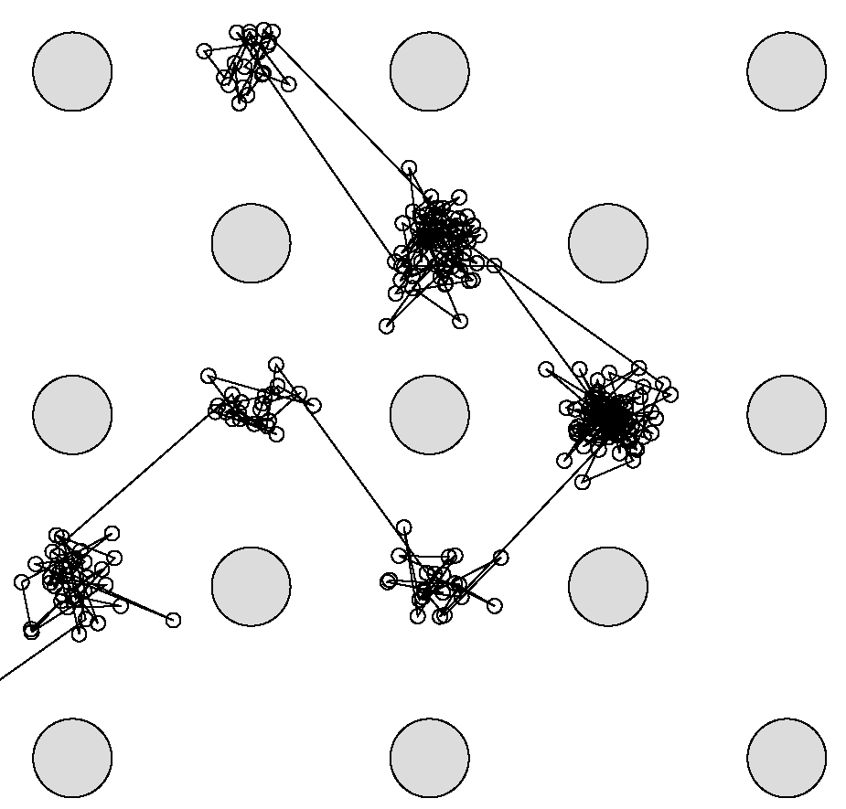
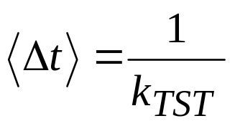
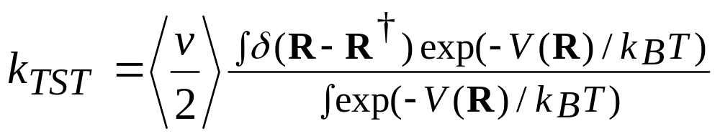
Kinetic Monte Carlo: Coarse-Graining MD
Rotate
MD of Co on Cu(001):
The Whole Trajectory
kMC: Coarse-Grained
Hops
Rare Events:

Slide 4
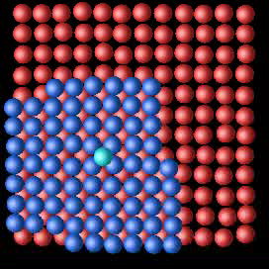
Rare Events: Passage of a Dynamical
System from one Minimum to Another
Diffusion of Atoms on Solid
Surfaces – e.g., the growth
of Co on Cu
Protein Folding, Catalysis at
Solid Surfaces, etc…..

Slide 5
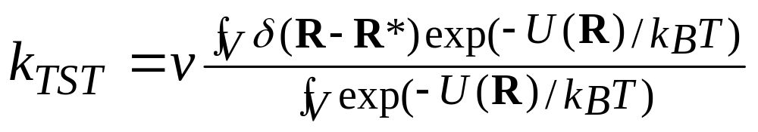
Transition-State Theory (TST)
How Fast Does It Happen?
V - volume of the state
R* - transition-state dividing surface
U(R) – potential energy
ν - thermal velocity

Slide 6
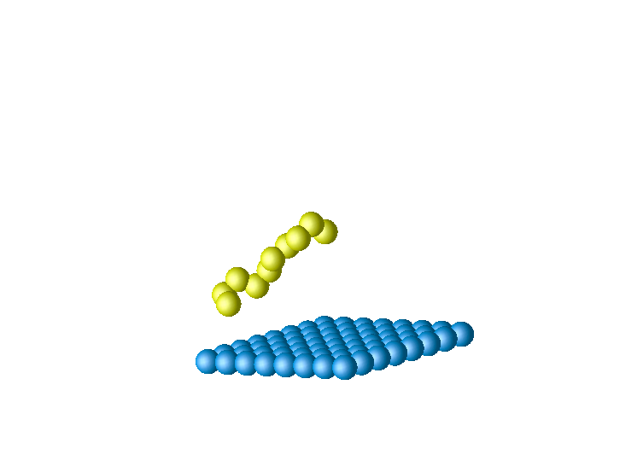
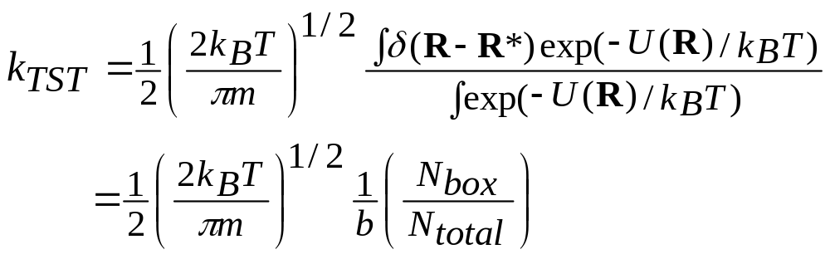
TST Rates for Thermal Desorption:
Transition State
b
Track trajectories of
molecules as they leave
the surface for the gas
h
K. A. Fichthorn and R. A. Miron, Phys. Rev. Lett. 89, 196103 (2002).

Slide 7
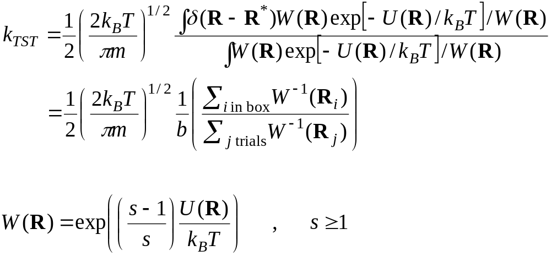
Rate Constants for Thermal Desorption:
The Umbrella Sampling Trick
Scale High-Temperature Results to Low Temperatures
G. Torrie and J. Valleau, Chem. Phys. Lett. 28, 578 (1974).
E. Grimmelmann, J. Tully, and E. Helfand, J. Chem. Phys. 74, 5300 (1981).

Slide 8
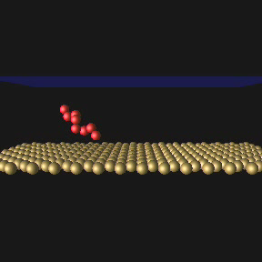
Thermal Desorption
A Sample Molecular Dynamics Trajectory

Slide 9
What is the Transition State?
The Potential-Energy Surface
Alkane-Surface Interaction
U(R)
*
R

Slide 10
H
H
Transition States
H
H
H
H
H
H
H
H
H
H
H
H
H
H
H
H
†
†
†
†
H
H
H
H
H
H
Minima
H
H
H
H
H
H
H
H
H
H
H
H
H
H
H
H
H
H
Rotational Transitions in Ethane

Slide 11
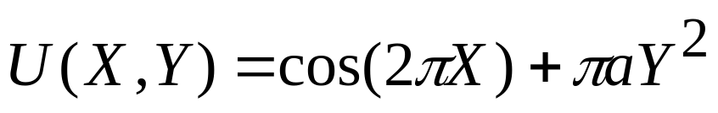
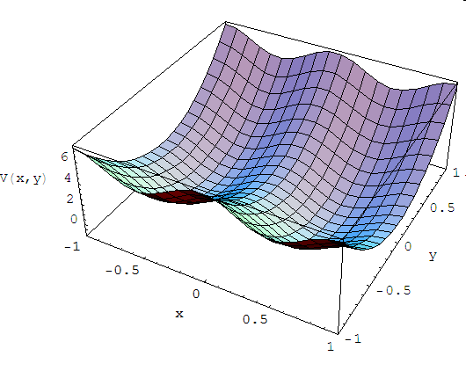
What is the Transition State?
A 2D Potential-Energy Surface
Minimum
Saddle Point – the Transition State

Slide 12
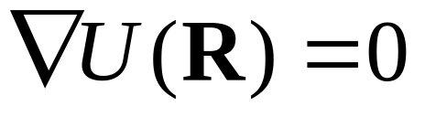

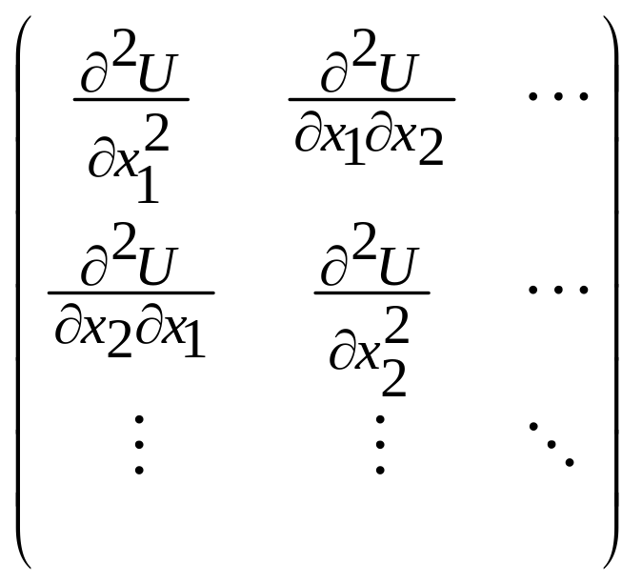
What is the Transition State?
Critical Points on the Potential Surface
Minima, Maxima, Saddle Points:
The Hessian Matrix:
3Nx3N for N atoms
Positive Eigenvalues at Minima
One Negative Eigenvalue at
the Transition State
The Barrier:
E₀ = U(saddle) – U(minimum)

Slide 13
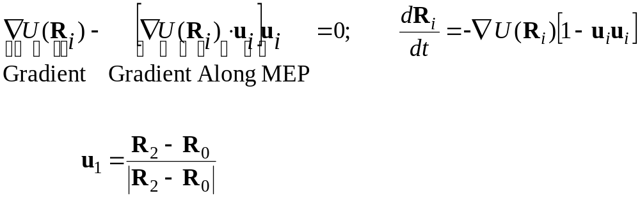
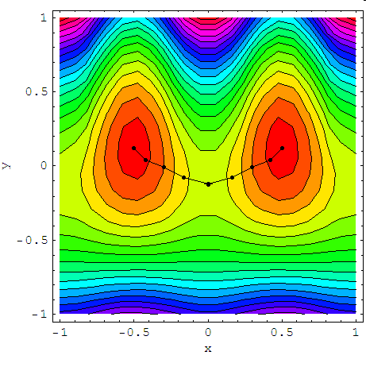
The Minimum-Energy Path
(AKA The Reaction Coordinate)
u₀
R₀
R₂
R₁
R₃
u_{i} = unit vector pointing
along the path at i

Slide 14
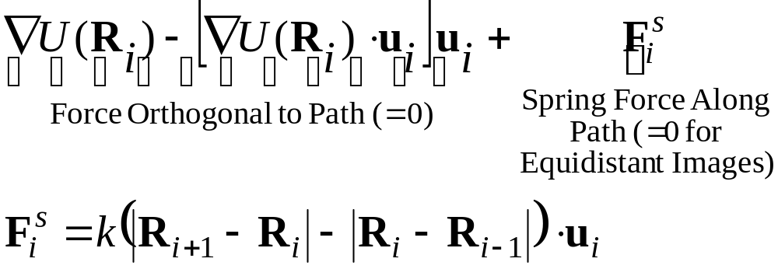
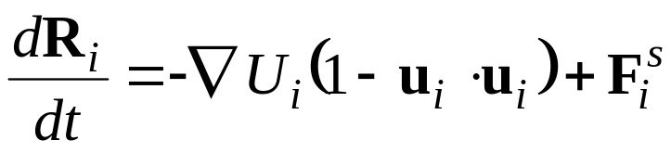
The Nudged Elastic Band Method
Springs Keep Images
Distributed On the Path
H. Jónsson, G. Mills, K. W. Jacobsen, in
`Classical and Quantum Dynamics in
Condensed Phase Simulations', ed.
B. J. Berne, G. Ciccotti and D. F. Coker
(World Scientific, 1998)

Slide 15
The Harmonic Approximation: Good for
Motion in and on Solids

Slide 16
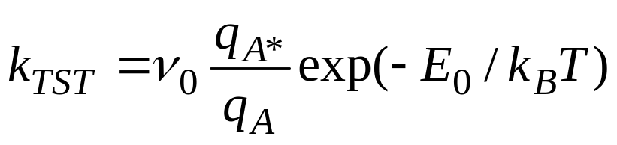
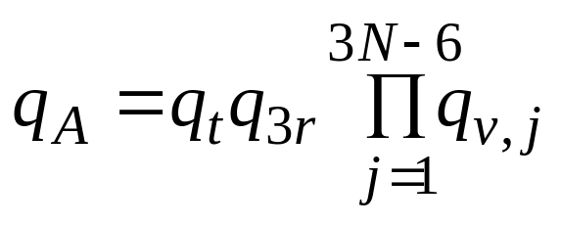
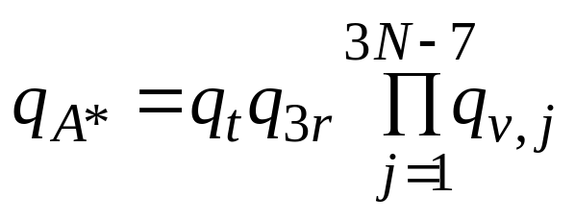
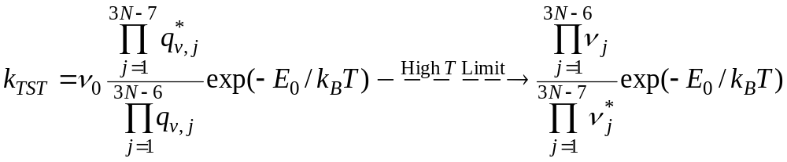
A Case of Special Interest: The Harmonic
Approximation
A – 3N d.o.f.
3 translation
3 rotation
3N-6 vibration
A* - 3N d.o.f. – 1 for motion over the saddle
3 translation
3 rotation
3N-7 vibration

Slide 17
Kinetic Monte Carlo: Coarse-Graining MD
Rotate
MD of Co on Cu(001):
The Whole Trajectory
kMC: Coarse-Grained
Hops
Rare Events:

Slide 18
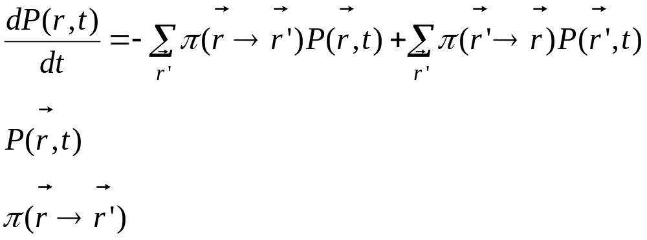





Kinetic Monte Carlo as an Accurate
Solution to the Master Equation
: Probability to be at State at Time t
: Transition Probability per Unit Time
from to

Slide 19
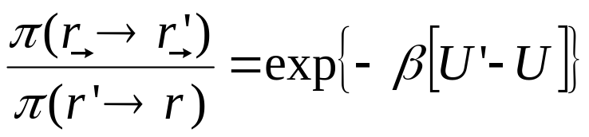
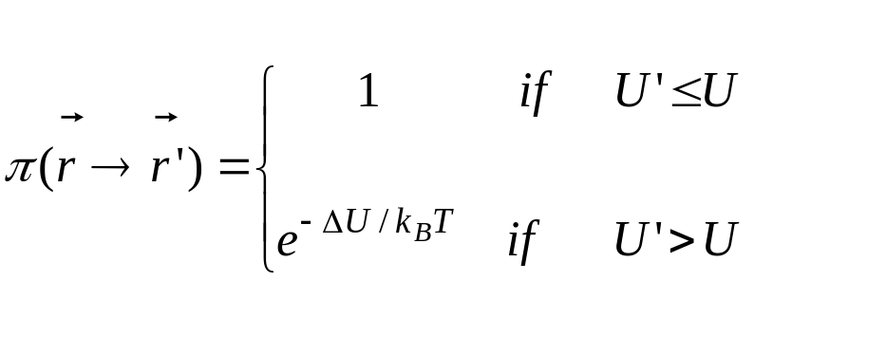
KMC Transition Probabilities and
Detailed Balance
U *
b
U_{i→f}
Energy
Metropolis MC Satisfies
Detailed Balance,
But Not Kinetics
U_{i}
U_{f}
π(i→f) = ν₀ exp( − U ^{b}_{i→ f} / k_{B}T )
TST Satisfies Detailed
Balance and Kinetics

Slide 20
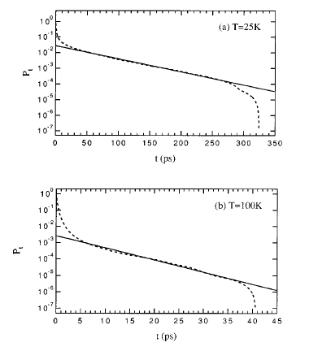
KMC Simulates a Poisson Process
δ
Events Can Happen Any
Time with an Equal
Probability per Unit Time r
1
2
3
…
t = nδ
How Long Must We Wait?
P
(
n
)
=
(
1
−
δ
r
)
n
δ
r
P
(
n
)
δ
→
0
−
rt
⎯
⎯
⎯
→
W
(
t
)
=
re
δ
t
=
1
/
r
Adsorbate Hopping is
A Poisson Process
J. Raut and K. Fichthorn,
J. Chem. Phys. 103, 8694 (1995).

Slide 21
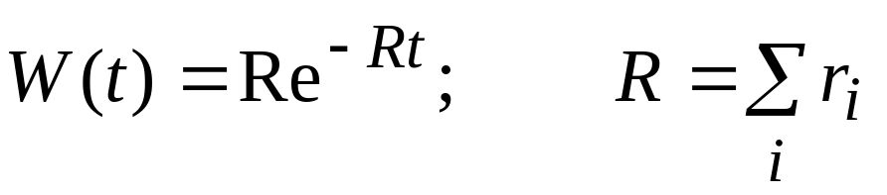
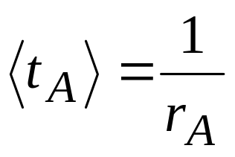
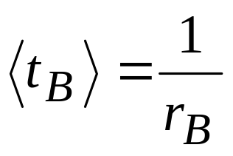
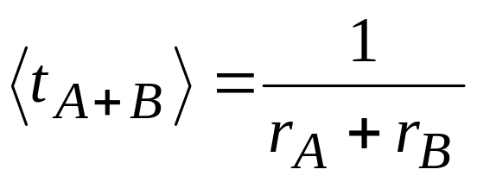
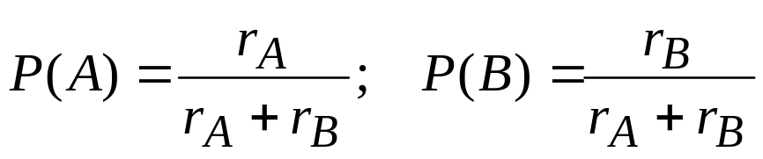
Multiple Independent Poisson Processes:
One Big Poisson Process
A
t_{0,A}
t_{1,A}
…
+
B
t_{0,B}
t_{1,B}
…
=
t₀
t₁
…

Slide 22
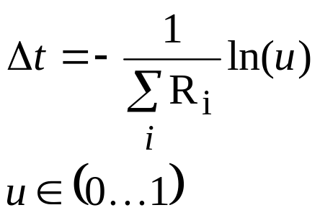
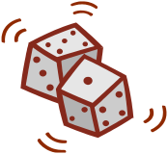
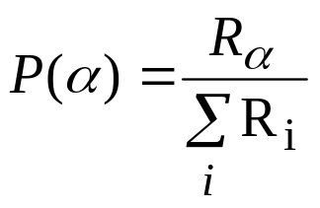
A Generic kMC Algorithm
Finished
?
Initialize Lattice
Yes
No
Identify All Processes
and Rates R_{i}
Do Process α, Increment Time
Choose a Process α
0
α
−
1
α
1
∑
P
(
i
)
∑
P
(
i
)
i
=
1
i
=
1
*Binary Tree Search
*N-Fold Way [A. Bortz, M. Kalos, and J.
Lebowitz, J. Comp. Phys. 17, 10 (1975)]

Slide 23
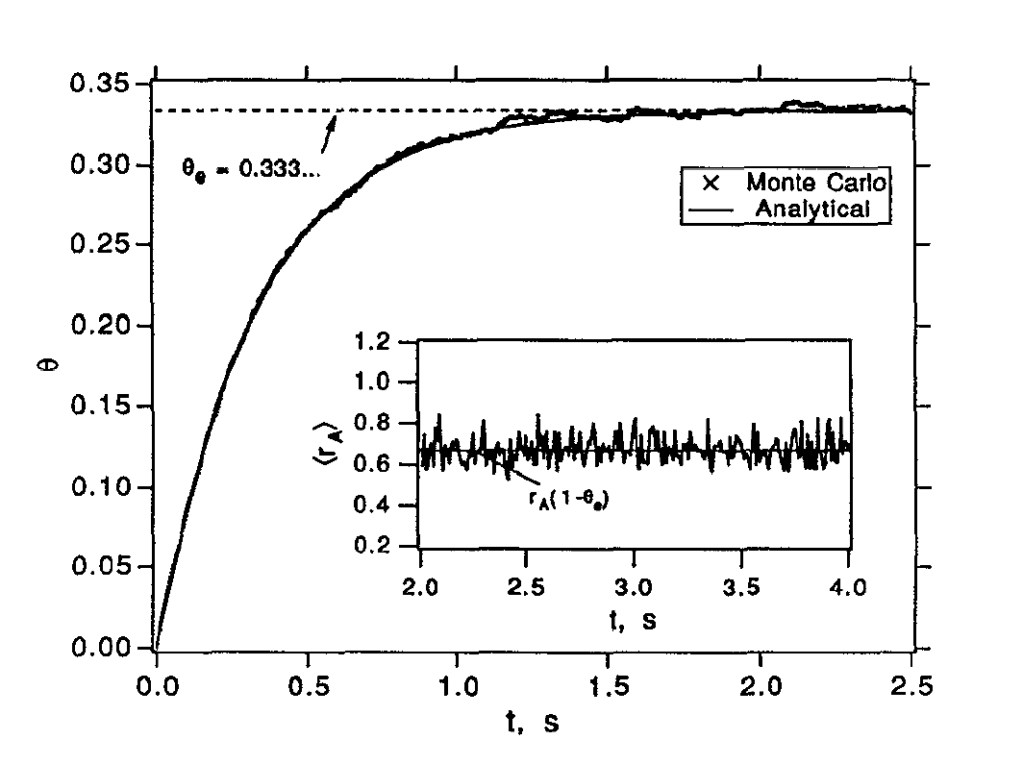
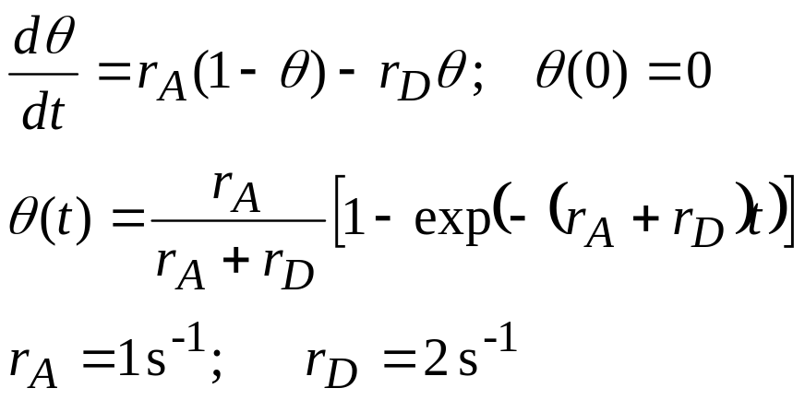
Application of kMC to Langmuir
Adsorption / Desorption
r_{A}
r_{D}
K. Fichthorn and W.H. Weinberg,
J. Chem. Phys. 95, 1090 (1991).

Slide 24
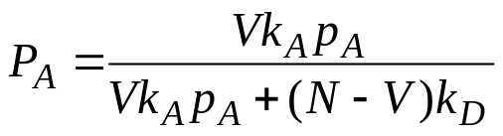
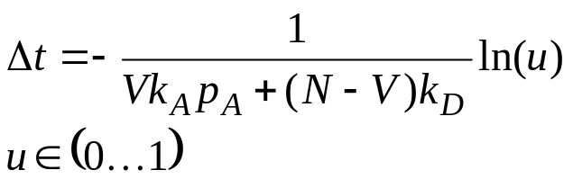

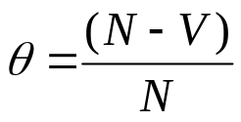
kMC of Langmuir Adsorption / Desorption
Initialize Lattice,
N Sites
Finished
?
Yes
No
Count of Vacant
Sites, V
Choose Adsorption with
Find a Site, Do Process, Increment Time
Choose Desorption with
0
P_{A}
P_{D}
1

Slide 25
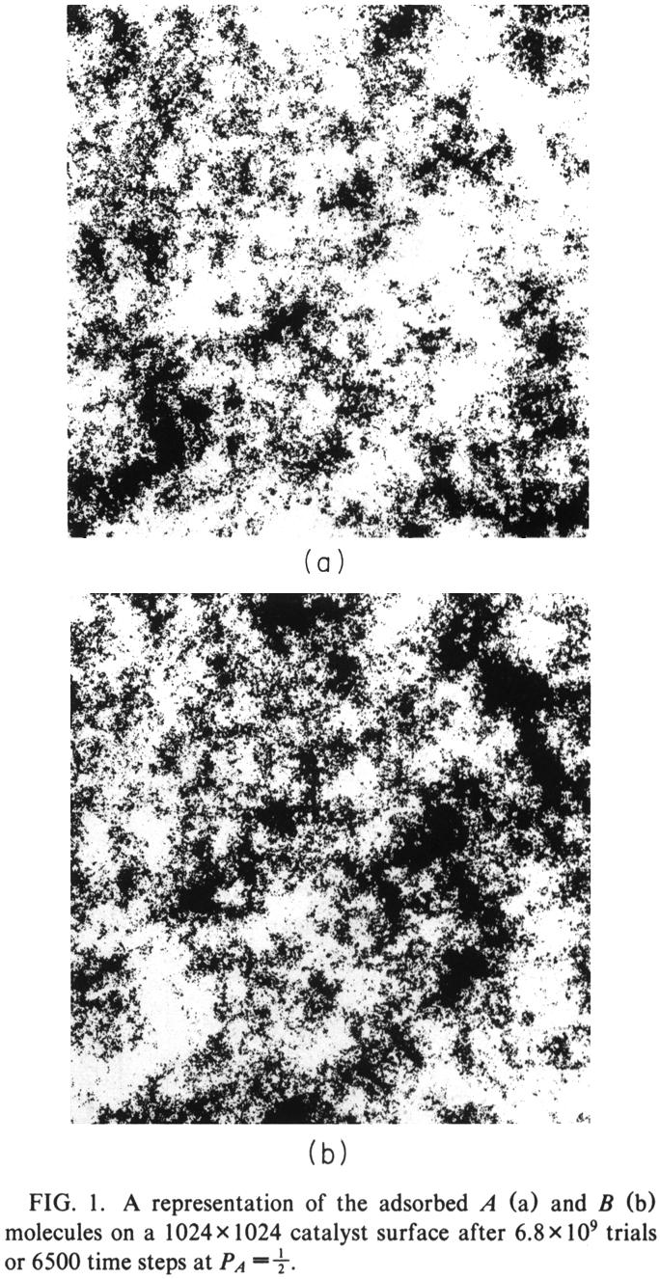
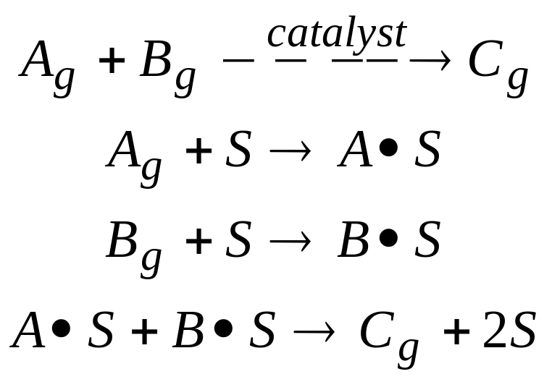
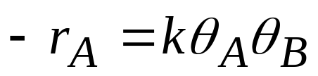
kMC Model of Langmuir-
Hinshelwood Reaction
The Mean-Field Approximation Isn’t Always Accurate……
R. Ziff and K. Fichthorn, PRB 34, 2038 (1986).

Slide 26
KMC Simulations of Thin-Film Epitaxy
Deposition
Edge Diffusion
Aggregation
Nucleation
Terrace Diffusion

Slide 27
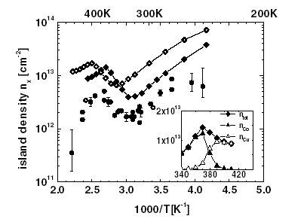
An ab-initio kMC Study of the Growth of
Co on Cu(001)
Spin-Polarized, FP-LAPW DFT
For Energy Barriers
Hopping / Exchange
of Co & Cu Adatoms
Experiment
Cu Hopping Away
from Exchanged Co
Co Grows on Top of Cu
Co Trapped at Exchanged Co
Co Hopping Away
from Exchanged Co
Co, Cu Escape from Exchanged Co
R. Pentcheva, K. Fichthorn, M. Scheffler,
et al., PRL 90, 076101 (2003).

Slide 28
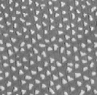
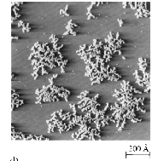
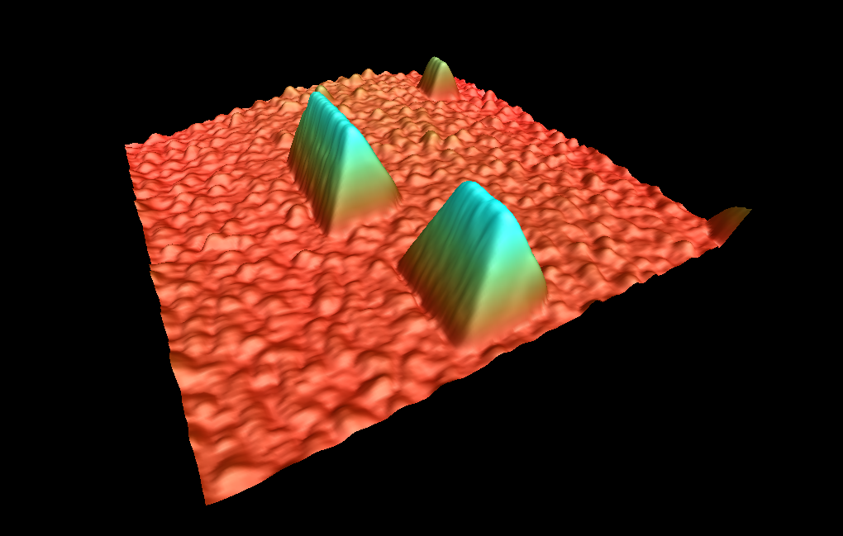
Nanostructured Surfaces
from First Principles
Non-Equilibrium Kinetics + Interactions =
Ag/ 2 ML Ag / Pt(111)
H. Brune et al., Nature
394, 451 (1998).
Ag / Pt(111)
H. Brune et al., Nature
369, 469 (1994).
Al / Al(110)
F. Bautier de Mongeot et al.,
PRL 91, 016102 (2003).
….And More!!!

Slide 29
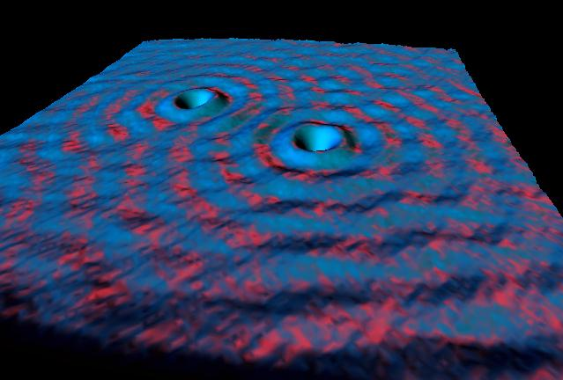
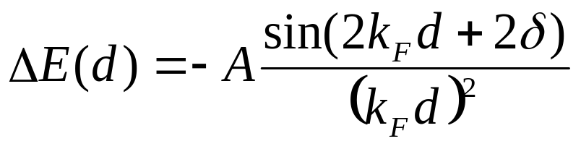

Substrate-Mediated Interactions
Electronic Interaction:
d > λ_{F} / 2
K. Lau and W. Kohn, Surf. Sci. 75, 69 (1978); P. Hyldgaard and M. Persson, J. Phys. Cond. Matter 12, L13 (2000).
Charge-Density Waves on Cu(111)
M. Crommie, et al., Nature 363, 524 (1993).
Elastic Interaction:
K. Lau and W. Kohn, Surf. Sci. 65, 607 (1977).

Slide 30
Influence of Substrate-Mediated Interactions
On Morphology of Thin-Film Epitaxy
“Electronic” Pair Interaction: Strained Ag(111)
Energy , meV
14
50
15
13
13
15
40
11
8
9
7
9
8
11
12
12
30
14
9
5
4
5
9
14
20
10
6
3
3
6
10
9
4
1
1
4
9
10
12
6
2
2
6
12
11
5
1
1
5
0
15
8
3
11
15
3
8
-50
9
4
1
1
4
9
-100
13
7
3
2
3
7
13
14
9
5
4
5
9
14
-200
13
8
6
6
8
13
15
11
9
9
11
K. A. Fichthorn and M. Scheffler,
Phys. Rev. Lett. 84, 5371 (2000).
12
10
12
15
14

Slide 31
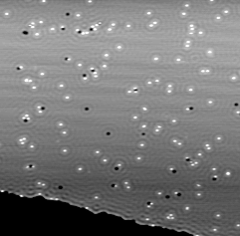
Diffusion and Lateral Interactions for Co/Ag(111)
Experimental STM images at T=15K.
60 x 60 nm
STM obtained from K. Kern. Max-Planck-Institute for Solid State Research Stuttgart, Germany.

Slide 32
Island Barriers: Step-wise Changes at
Critical Sizes
Energy, meV
(a)
(b)
(c)
130
100
60
(d)
(e)
(f)
30
0
-250
K. Fichthorn, M. Merrick, and M. Scheffler,
PRB 68, 041404 (2003).

Slide 33
Interactions to Kinetics:
Transition-State Theory
E *
1
2
E^{b}_{i→f} = E₀^{b} + (E_{f} − E_{i} )
D_{i→f} = ν₀ exp( − E_{i→f} /kT )
b
E_{i→f}
Energy
E_{i}
* Values from DFT
E_{f}
More than 10¹⁴ Rates are Included!

Slide 34
Effect of Repulsive Ring on Island Density
T = 50 K
F=0.1 ML/s
θ=0.07 ML
DFT-kMC
Nearest-Neighbor Attraction
Also seen by A. Bogicevic et al., Phys. Rev. Lett. 85, 1910 (2000).

Slide 35
Potential Energy Map: θ = 0.024
Energy, meV
400
200
100
50
15
-15
-50
-100
-200
-400
T = 50 K
F = 0.1 ML/s
• Ring Strength Grows with Island Size
• Interactions Depend on Island Shape

Slide 36
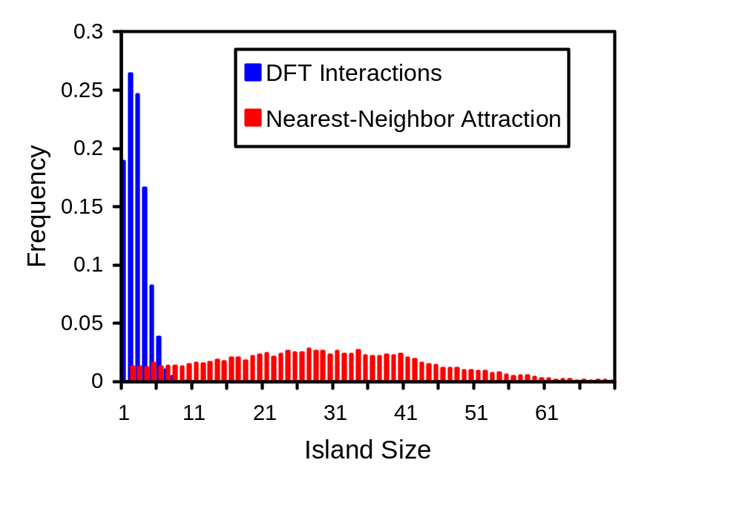
Sharp Island-Size Distributions
K. A. Fichthorn, M. L. Merrick, and M. Scheffler,
Phys. Rev. B 68, 041404(R) (2003).

Slide 37




Pitfalls of kMC Coarse-Graining
Identifying All Events
Assumption of a Lattice, TST
K. Fichthorn and R. Miron, PRL 89,
196103 (2002).
J. Hamilton, M. Sorenson, and A. Voter,
PRB 61, 5125 (2000).
Also see:
R. A. Miron and K. A. Fichthorn,
J. Chem. Phys. 115, 8742 (2001).

Slide 38


Pitfalls of kMC
Short-Time Motion Slows Things Down
Calculating Every Rate
W. Luo, J. Sofo, M. Scheffler,
and K. Fichthorn (in prep)
K. Fichthorn and M. Scheffler,
PRL 84, 5371 (2000).
R. A. Miron and K. Fichthorn

Slide 39

The Future of kMC*…
More Extensive Ab Initio kMC
kMC with On-the-Fly Rates
Better Handling of Multiple Time Scales
Parallel kMC……

Slide 40
Conclusions
kMC is a coarse-grained technique for
condensed-matter dynamics
kMC simulates a Poisson Process
kMC can be coupled with ab initio rate processes
There are pit-falls
kMC will improve by:
on-the-fly rates
parallel implementation
optimizing performance for stiff systems

Slide 41
Parallel Kinetic Monte-Carlo
Simulation of Thin-Film Growth
Michael Merrick and Kristen Fichthorn
Department of Chemical Engineering
The Pennsylvania State University
University Park, PA USA
Funding: NSF DGE-9987589 and NSF ECC-0085604.

Slide 42
Why Parallel kMC?
Arrays of Nanostructures
Dynamics of Stepped Surfaces
………
Reactor Studies
∞
Length (m)
Continuum Equations
10⁻⁶
kMC
10⁻⁸
MD
10⁻¹¹
∞
10⁻¹⁵ 10⁻¹² 10⁻⁹ 10⁻⁶
Time (s)

Slide 43
Serial kMC Simulates A Poisson Process
Finished
?
Initialize Lattice
Yes
No
Identify All Processes
and Rates R_{i}
Do Process α, Increment Time
Choose a Process α
0
α
−
1
α
1
∑
P
(
i
)
∑
P
(
i
)
i
=
1
i
=
1
**N-Fold Way Algorithm
[A. Bortz, M. Kalos, and J. Lebowitz,
J. Comp. Phys. 17, 10 (1975)]

Slide 44
Parallel kMC Domain
Decomposition
D₁
D₂
D₁
D₂
D₃
D₄
D₃
D₄
t=0
…
Each Domain has an
Independent Time Line
Superpose Time Lines to
Create the System Time
Line (Poisson Process)
t

Slide 45
Parallel kMC Domain
Decomposition
D₁
D₁
D₂
D₂
D₃
D₃
D₄
D₁
D₂
D₃
D₄
D₄
t=0
Skin
…
t
Neighboring Domains
Interact via the Skin

Slide 46
Parallel kMC Domain
Decomposition
D₁
D₂
D₁
D₂
D₃
D₄
D₃
D₄
t=0
Skin
…
t
Skin Event
Skin Events Can Change
History!

Slide 47
Parallel kMC Domain
Decomposition
D₁
D₂
D₁
D₂
D₃
D₄
D₃
D₄
t=0
Skin
…
Least
Advanced
Time
Time Lines are
Re-Synchronized
After a Skin Event
Or After a Fixed
Number of Steps
t
Skin Event
Remove These Events
To Re-Synchronize

Slide 48
Parallel kMC Domain
Decomposition
D₁
D₂
D₁
D₂
D₃
D₄
D₃
D₄
t=0
These
Events
Are Fixed
Skin
…
L.A.T.
t
After Re-Synchronizing,
Time Lines Proceed
Independently Again
These Events Are
Tentative

Slide 49
KMC Simulations of Ag/Ag(111) Epitaxy
Deposition, F
Edge Diffusion
F =0.1 and 0.01 ML/s
T=35 and 75K
D₀ = 8.2 x10¹¹ s⁻¹
E = 87 meV
ε_{NN} = -200 meV
Aggregation
Nucleation
~ 20 different rates
Terrace Diffusion, D=D₀exp(-E/k_{B}T)
K. Fichthorn and M. Scheffler, Phys. Rev. Lett. 84, 6371 (2000).
C. Ratsch and M. Scheffler, Phys. Rev. B 58, 13163 (1998).

Slide 50

Island Density N_{x}
0.048
0.046
0.044
0.042
Island Density (ML)
0.04
0.038
0.036
T=35K, F=0.1 ML/s
Parallel (4 Nodes)
Serial Simulation
0.0016
0.0014
0.0012
Island Density (ML)
0.001
Serial and Parallel Agree
0.0008
0.0006
T=75K, F=0.01 ML/s

Slide 51
Simulation Times
10000000
Different
Simulation
Times
Serial Times:
1000000
T=35K,
F=0.1 ML/s
100000
F/D~.5
10000
T=75K
F=0.01 ML/s
Time (sec)
F/D~8.5x10⁻⁹
1000
Parallel Times:
4 nodes.
100
10
F/D~.5
F/D~8.5x10⁻⁹
1
10000
100000
1000000
10000000
Comparable
Parallel Speed-Up
Number of Lattice Sites

Slide 52


Parallel Efficiencies
* Serial Time Extrapolated
Super Parallel
Efficiencies
> 100%
Reduced Skin/Domain Ratio
Less Overhead

