Slide 1
To add
Atomistic NEGF simulation by Yee Sin
Assumptions
Equations used for this model
Literature review (for MRAM/MgO)
What is the contribution/novelty?
Potentially add TEM data from GF

Slide 2
Atomistic simulations with Yee Sin

Slide 3
Assumptions

Slide 4
Equations used for the model

Slide 5
Literature Review

Slide 6
Contribution/Novelty

Slide 7
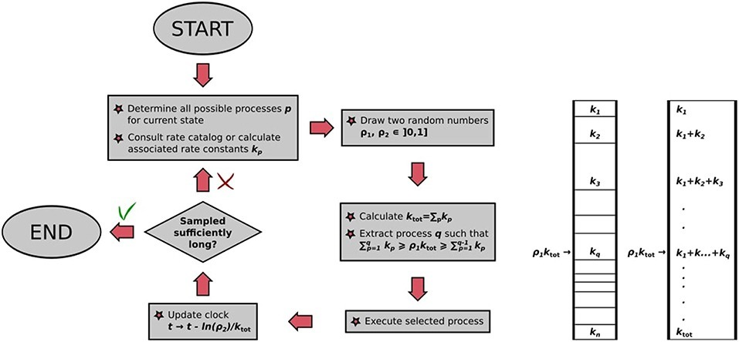
Kinetic Monte Carlos Algorithm
M. Andersen et al. Front. Chem. 2019 A Practical Guide to Surface Kinetic Monte Carlo Simulations

Slide 8
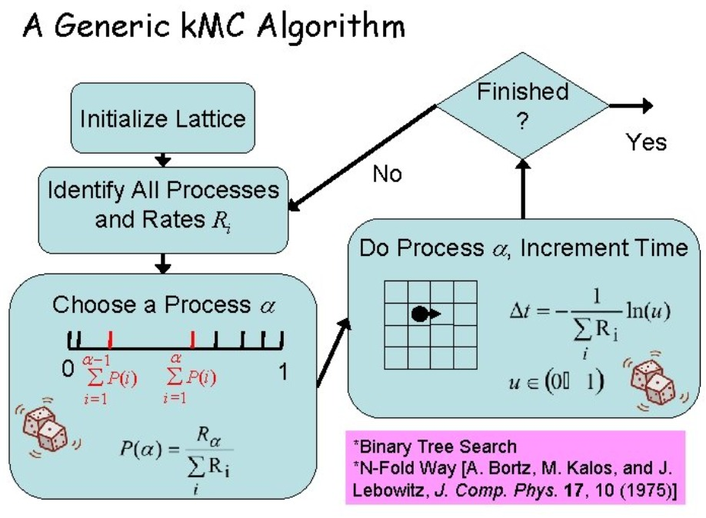
Kristen A. Fichtorn Kinetic Monte Carlo Simulations and Applications

Slide 9
31 Jan 2022 Agenda
Issue 0: Review of simulated sanity check
Issue 1: How best to define the increase in k due to neighboring defects?
Issue 2: How to account for the asymmetric pulsing of BIP?
Issue 3: How to model diffusion model?

Slide 10
Issue 0
Review of simulated sanity check

Slide 11
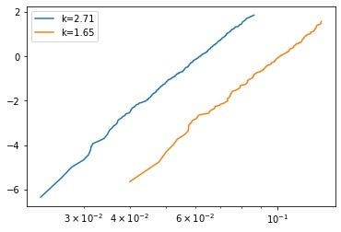
Kinetic Monte Carlos simulation
k_{B}
Bulk cell Intrinsic rate
200 devices per plot
50 x 50 x 5 (X Y Z) size grid

Slide 12
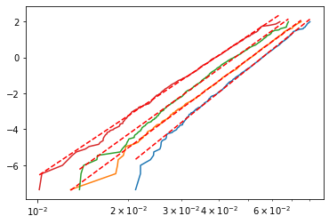
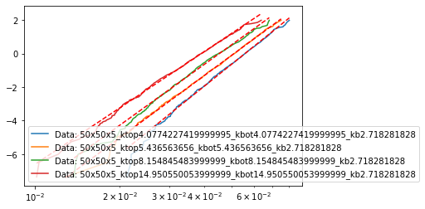
k_{I}
k_{B}
Interface cell Intrinsic rate
Bulk cell Intrinsic rate
k_{I} = n*k_{B}
Where n=1, 1.5, 2, 2.5, 3…
n=1.5
n=2
n=3
n=5.5
1100 devices per plot
50 x 50 x 5 (X Y Z) size grid

Slide 13
k_{I}
k_{B}
Interface cell Intrinsic rate
Bulk cell Intrinsic rate
k_{I} = n*k_{B}
Where n=1, 1.5, 2, 2.5, 3…
n=1.5
n=2
n=3
n=5.5
1100 devices per plot
50 x 50 x 5 (X Y Z) size grid

Slide 14
k_{I}
k_{B}
Interface cell Intrinsic rate
Bulk cell Intrinsic rate
Surface roughness modeling
k_{I} = n*k_{B}
Where n=1, 1.5, 2, 2.5, 3…
n=1.5
n=2
n=3
n=5.5
1100 devices per plot
50 x 50 x 5 (X Y Z) size grid

Slide 18
Issue 1
How best to define the increase in k due to neighboring defects?

Slide 19
Proposed Solution
k_{I}
Interface cell Intrinsic rate
k_{B}
Bulk cell Intrinsic rate

Slide 20
Proposed Solution
k_{I}+α₁
k_{I}+α₁
k_{B}+α₁
k_{B}+α₁
k_{B}+α₁
Defect
α_{count} = function(count of neighboring defects)
Where function is tbc:
Polynomial
Log
Power
Exponential
Look up table (from Yee Sin’s DFT)

Slide 21
Proposed Solution
k_{I}+α₂
k_{I}+α₂
k_{B}+α₂
k_{B}+α₂
Defect
k_{B}+α₁
k_{B}+α₁
k_{B}+α₁
α_{count} = function(count of neighboring defects)
Where function is tbc:
Polynomial [A*count^2+B*count+C]
Log [A*log(B*count+C)]
Power [A(count+C)^B]
Exponential [A*(exp(B*count+C))]
Look up table (from Yee Sin’s DFT)

Slide 22
Issue 2
How to account for the asymmetric pulsing of bipolar pulsing (BIP)?

Slide 23
Context
BIP pulsing is a repeated two step process.
Up (AP) → Down (P) → Up (AP) → Down (P) → …
Resistance for Up and Down are not the same. Ie. the k for defects are different.

Slide 24
Proposed Solution
Process step no. = 1, 3, 5…
Process step no. = 2, 4, 6…
Bulk rate 1
Bulk rate 2
Interface rate 1
Interface rate 2

Slide 25
Proposed Solution
Process step no. = 1, 3, 5…
Process step no. = 2, 4, 6…
Bulk rate 1
Bulk rate 2
Interface rate 1
Interface rate 2

Slide 26
Problems
Physically inaccurate. BIP timestep is different from defect generation timestep. Ie. in one Up pulse, more than one defect can be generated.

Slide 27
k_{I_Top}
Interface cell Intrinsic rate
k_{I} = n*k_{B}
Where n=1, 1.5, 2, 2.5, 3…
k_{I_bottom}
k_{B}
Bulk cell Intrinsic rate

Slide 28
Issue 3
How to model diffusion model?

Slide 29
Proposed Solution
Defect generation
k_{I}
k_{I}
k_{I}
k_{I}
k_{I}
k_{B}
k_{I}
k_{I}
k_{I}
k_{d}
k_{d}
k_{d}
k_{B}
k_{B}
k_{B}
k_{B}
k_{B}
k_{B}
k_{B}
k_{B}
k_{B}
k_{B}
k_{B}
k_{B}
k_{B}
k_{B}
k_{B}
k_{B}
k_{B}
k_{B}
k_{B}
k_{B}
k_{B}
k_{B}
k_{B}
k_{B}
k_{B}
k_{B}
k_{B}
k_{B}
k_{B}
k_{B}
0
0
0
0
0
0
0
0
0
0

Slide 30
Proposed Solution
Defect activation
k_{B}
k_{I}
k_{I}
k_{I}
k_{I}
k_{I}
k_{I}
k_{I}
k_{I}
k_{d}
k_{B}
k_{B}
k_{B}
k_{B}
k_{B}
k_{B}
k_{B}+α
k_{B}+α
k_{B}
k_{d}
k_{d}
k_{d}
k_{d}
k_{d}
k_{B}
k_{B}
k_{B}
k_{B}
k_{B}
k_{B}
k_{B}+α
k_{B}+α
k_{B}+α
k_{B}
k_{B}
k_{B}
k_{B}
k_{B}
k_{B}
k_{B}
k_{B}
k_{B}
k_{B}
k_{B}
0
0
0
0
0
0
0
0
0
0

Slide 31
Proposed Solution
Defect diffusion for unipolar
k_{B}
k_{I}
k_{I}
k_{I}
k_{I}
k_{I}
k_{I}
k_{I}
k_{I}
k_{I}
k_{B}
k_{B}+α
k_{B}+α
k_{B}
k_{B}
k_{B}+α
k_{B}+α
k_{B}+α
k_{B}
k_{d}
k_{d}
k_{d}
k_{d}
k_{d}
k_{B}
k_{B}
k_{B}
k_{B}
k_{B}
k_{B}
k_{B}+α
k_{B}+α
k_{B}
k_{d}
k_{d}
k_{d}
k_{d}
k_{d}
k_{B}
k_{B}
k_{B}
k_{B}
k_{B}
k_{B}
k_{B}+α
k_{B}+α
k_{B}+α
k_{B}
0
0
0
0
0
0
0
0
0
0

Slide 32
Proposed Solution
Defect diffusion for bipolar
k_{B}
k_{I}
k_{I}
k_{I}
k_{I}
k_{I}
k_{I}
k_{I}
k_{I}
k_{I}
k_{B}
k_{B}+α
k_{B}+α
k_{B}
k_{B}
k_{B}+α
k_{B}+α
k_{B}+α
k_{B}
k_{d}
k_{d}
k_{d}
k_{d}
k_{d}
k_{d}
k_{d}
k_{d}
k_{B}
k_{B}
k_{B}
k_{B}
k_{B}
k_{B}
k_{B}+α
k_{B}+α
k_{B}
k_{d}
k_{d}
k_{d}
k_{d}
k_{d}
k_{d}
k_{d}
k_{B}
k_{B}
k_{B}
k_{B}
k_{B}
k_{B}
k_{B}+α
k_{B}+α
k_{B}+α
k_{B}
0
0
0
0
0
0
0
0
0
0

Slide 33
Proposed Solution 1
Defect damage
k_{I}
k_{I}
k_{I}
k_{I}
k_{I}
k_{I}
k_{I}
k_{I}
k_{I}
k_{I}
k_{B}
k_{B}+α
k_{B}+α
k_{B}
k_{B}+α
k_{B}+α
k_{B}+α
k_{B}
k_{d}
k_{d}
k_{d}
k_{d}
k_{d}
k_{d}
k_{d}
k_{d}
k_{d}
k_{B}
k_{B}+α
k_{B}+α
k_{B}+α
k_{B}
k_{B}+α
k_{B}+α
k_{B}+α
k_{B}
k_{d}
k_{d}
k_{d}
k_{d}
k_{d}
k_{B}
k_{B}
k_{B}
k_{B}
k_{B}
k_{B}+α
k_{B}+α
k_{B}+α
k_{B}
k_{B}
0
0
0
0
0
0
0
0
0
0

Slide 34
Proposed Solution
Defect termination
k_{I}
k_{I}
k_{I}
k_{I}
k_{I}
k_{I}
k_{I}
k_{I}
k_{I}
k_{I}
k_{B}
k_{B}
k_{B}
k_{B}
k_{B}
k_{B}
k_{B}
k_{B}
k_{B}
k_{B}
k_{B}
k_{B}+α
k_{B}+α
k_{B}+α
k_{B}
k_{B}
k_{B}
k_{B}
k_{B}
k_{B}
k_{B}
k_{B}+α
k_{B}+α
k_{B}
k_{B}
k_{B}
k_{B}
k_{B}
k_{B}
k_{d}
k_{d}
k_{d}
k_{d}
k_{d}
0
0
0
0
0
0
0
0
0
0

Slide 35
Proposed Solution
Asymmetry
k_{I}
k_{I}
k_{I}
k_{I}
k_{I}
0
0
0
0
0
Interface
rate 1
k_{I}
k_{I}
Interface
rate 2
k_{B}
k_{B}+α
k_{B}+α
k_{B}+α
k_{B}
k_{B}
k_{B}+α
k_{B}+α
k_{B}+α
k_{B}
k_{d}
k_{B}
k_{B}
k_{d}
k_{d}
Bulk rate 1
Bulk rate 2
k_{B}
k_{B}+α
k_{d}
k_{d}
k_{B}+α
k_{B}
k_{B}
k_{B}+α
k_{d}
k_{B}+α
k_{B}
k_{d}
k_{d}
k_{d}
k_{B}+α
k_{B}+α
k_{B}
k_{B}+α
k_{d}
k_{B}+α
k_{B}+α
k_{B}
k_{B}
k_{B}+α
k_{B}+α
k_{B}+α
k_{B}
α 1
α 2
k_{d}
k_{d}
0
0
0
0
0
k_{I}
k_{I}
k_{I}
k_{I}
k_{I}
Diffusion
rate 1
Diffusion
rate 2

Slide 36
Proposed Solution 2
Defect damage that results in an non-mobile defect (purple)
k_{I}
k_{I}
k_{I}
k_{I}
k_{I}
k_{I}
k_{I}
k_{I}
k_{I}
k_{I}
k_{B}
k_{B}+α
k_{B}+α
k_{B}
k_{B}+α
k_{B}+α
k_{B}+α
k_{B}
k_{d}
k_{d}
k_{d}
k_{d}
k_{d}
k_{d}
k_{d}
k_{d}
k_{d}
k_{B}
k_{B}+α
k_{B}+α
k_{B}+α
k_{B}
k_{B}+α
k_{B}+α
k_{B}+α
k_{B}
k_{B}
k_{B}
k_{B}
k_{B}
k_{B}
k_{B}+α
k_{B}+α
k_{B}+α
k_{B}
k_{B}
0
0
0
0
0
0
0
0
0
0

