Slide 1
Legacy Code Survival

Slide 2
Code which is outside our control.

Slide 3
Time and Money
Comprehend
Refactor
Replace

Slide 4
We have met the enemy!
And they are us!

Slide 5

How to Survive
Know your enemy (Analysis)
Plan the attack (Design)
Check the plan (Testing)
Multiple Cycles

Slide 6
Gear Up
UML
Design Patterns
SOLID

Slide 7
Unified Modeling Language
Use Cases
Activity Diagrams
Class Diagrams
Object Diagrams
Sequence Diagrams
Communication Diagrams
Timing Diagrams
Component Diagrams

Slide 8

Analyze
Notes:
Understand the relationship between pieces of code.
Disposable: Doesn't have to be a lengthy process. Back of napkin will work. It will all change once you take action.

Slide 9
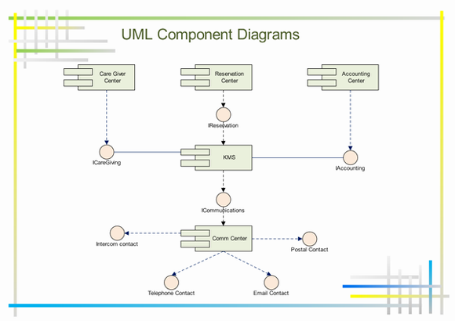
Plan
Notes:
Component Diagram can help us visualize the future code but what will it look like?

Slide 10


Design Patterns
MVC
Factory
Singleton
Adapter
Notes:
Your code has nice straight edges and clear goals. And then we have legacy code with its protrusions, curves and holes.
Use the adapter pattern to match them up.

Slide 11

Surround and Isolate
Notes:
Wrap the legacy code with an adapter which has the nice straight lines and 90 degree corners that match your code.

Slide 12
SOLID
Single Responsibility
Open/Closed
Liskov substitution
Interface segregation
Dependency Inversion

Slide 13
Dependency Inversion
Breaking down the problem is the problem
Change how you we think
Think top down
Notes:
Breaking down the problem into its smallest components and building our way back up can lead us away from Dependency Inversion.

Slide 14


Dependency Inversion
Notes:
Right we have dependency and dependency to an interface defined from the childs point of view.
To the left we have dependency on an interface that is defined by what the parent needs to know.

Slide 15
Legacy Code
Static class dependency
Business Logic
Class Dependency
Static class dependency
Business Logic
Interface dependency
Static class dependency
Class dependency
Static class dependency

Slide 16


Slide 17
0.00

Slide 18
Resource
Dia – Open Source diagram editor with UML support.
Practical Object Oriented Design in Ruby (poodr.com)
http://martinfowler.com/articles/dipInTheWild.html#InversionComparedToWhat

