Slide 1
ClipButler
Christopher Maxel, Shane Wozniak, Joseph van der Harst, Caleb Anthony

Slide 2
Overview of Presentation
Introduction to Project
Practical Uses
PREFS
BUFFER
Conclusion

Slide 3
Introduction

Slide 4
Project Evergreen Requirements
Application that stores strings accessible in other applications
The application is intended to:
Allow for ease of access when transfering string between apps
Be comprised of two primary interfaces: BUFFER and PREFS
Display a notification while running
Run on Android mobile devices

Slide 5

Then ClipButler was Born...
Implements all required features outlined in our SRS
Built by an awesome team utilizing agile methods
Contains aesthetic icons and logos
Has an elegant, yet simple, user interface

Slide 6
Primary Development Locations
HQ

Slide 7
ClipButler Uses

Slide 8
Best Uses of ClipButler
Built for users with multiple years experience with smart devices
Designed by Elephant’s national team to assist phone users in transferring strings
Works across applications
Practical Uses Include:
Copying multiple addresses to send to clients
Saving progress when working on large bodies of text

Slide 9


BUFFER

Slide 10
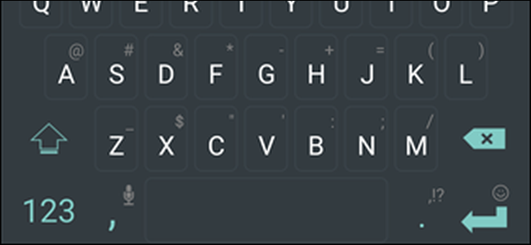
BUFFER
Accessed in three clicks via Trip-p-ple Click
Duplicate Copy Protection
Dark Mode
Scrollable list of recent copies

Slide 11
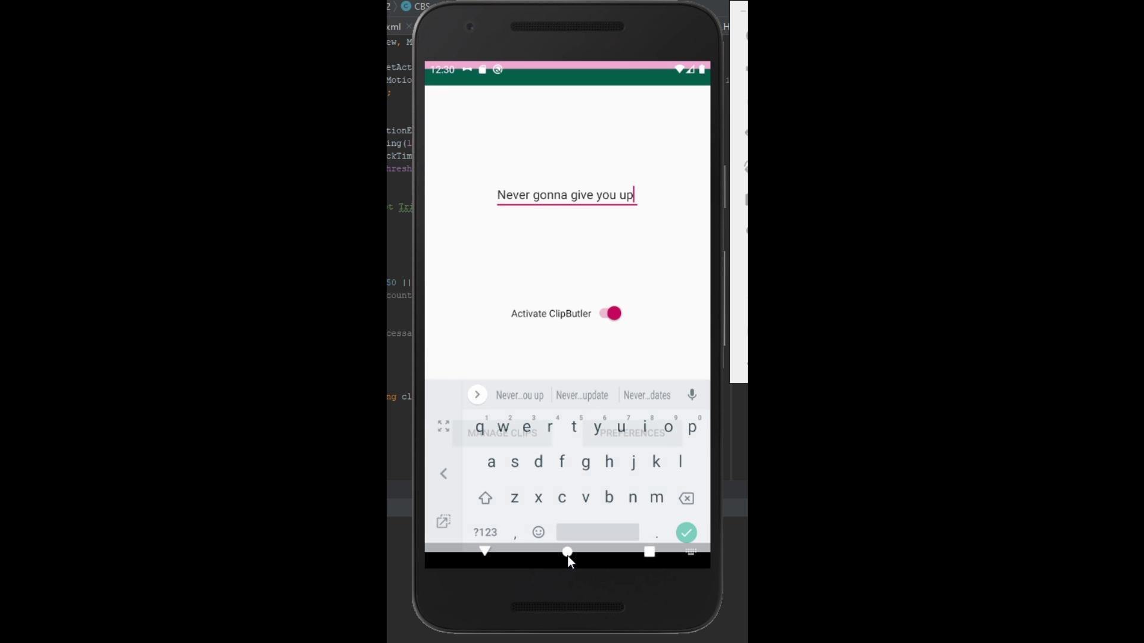
BUFFER Video Demonstration

Slide 12
BUFFER - Backend
Data Structure - glorified “queue”
FIFO List
Data Persistence

Slide 13

PREFS

Slide 14
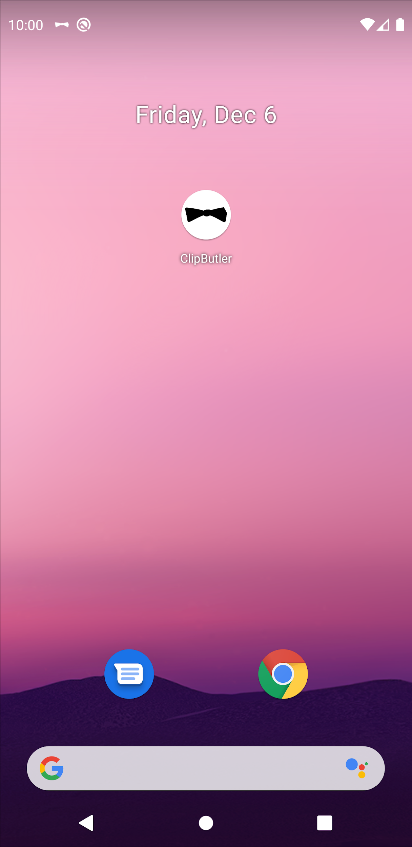
PREFS
App launcher is shown in the dashboard when installed
ClipButler is displayed below the app launcher
Multiple pages (Home, Preferences, Manage Clips)

Slide 15
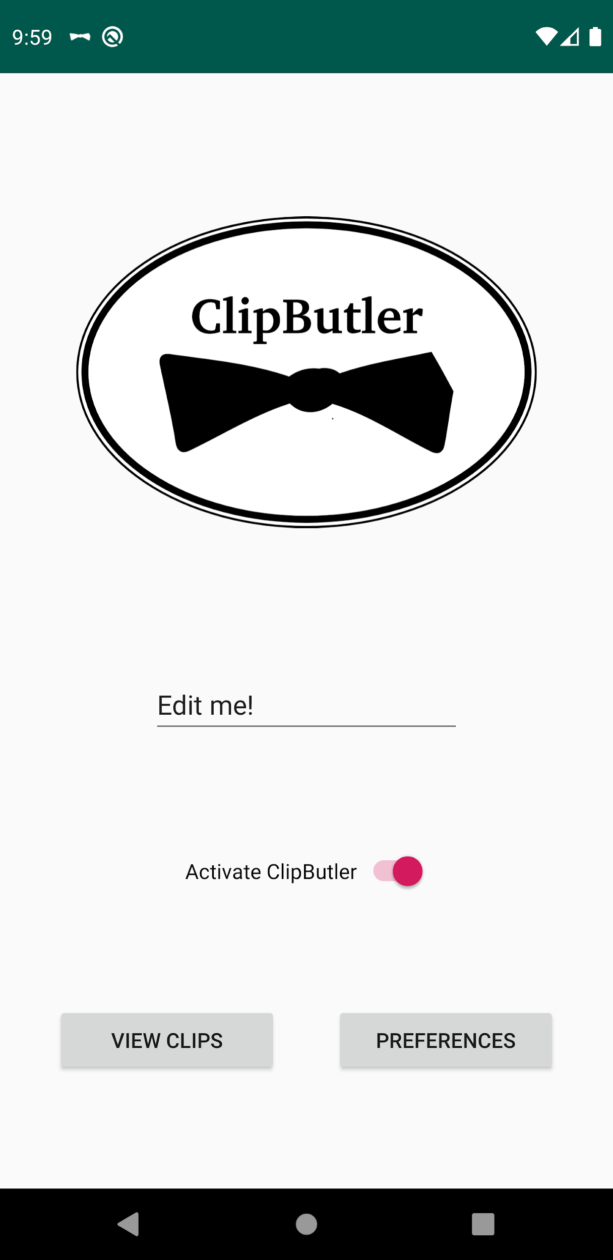
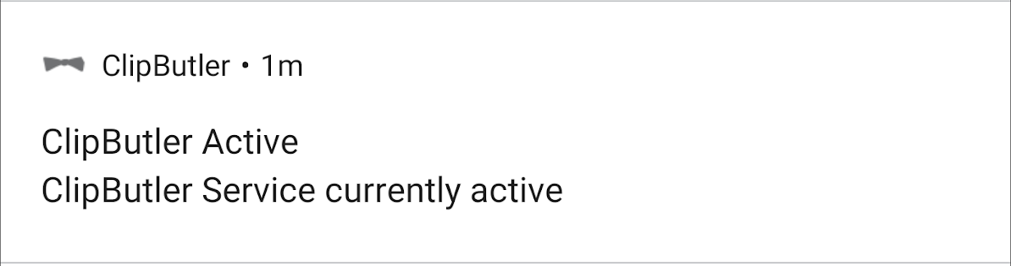
PREFS - Home Page
ClipButler’s logo is on display here
Welcome messages and news are posted here
Buttons exist for navigation
ClipButler Active Notification

Slide 16
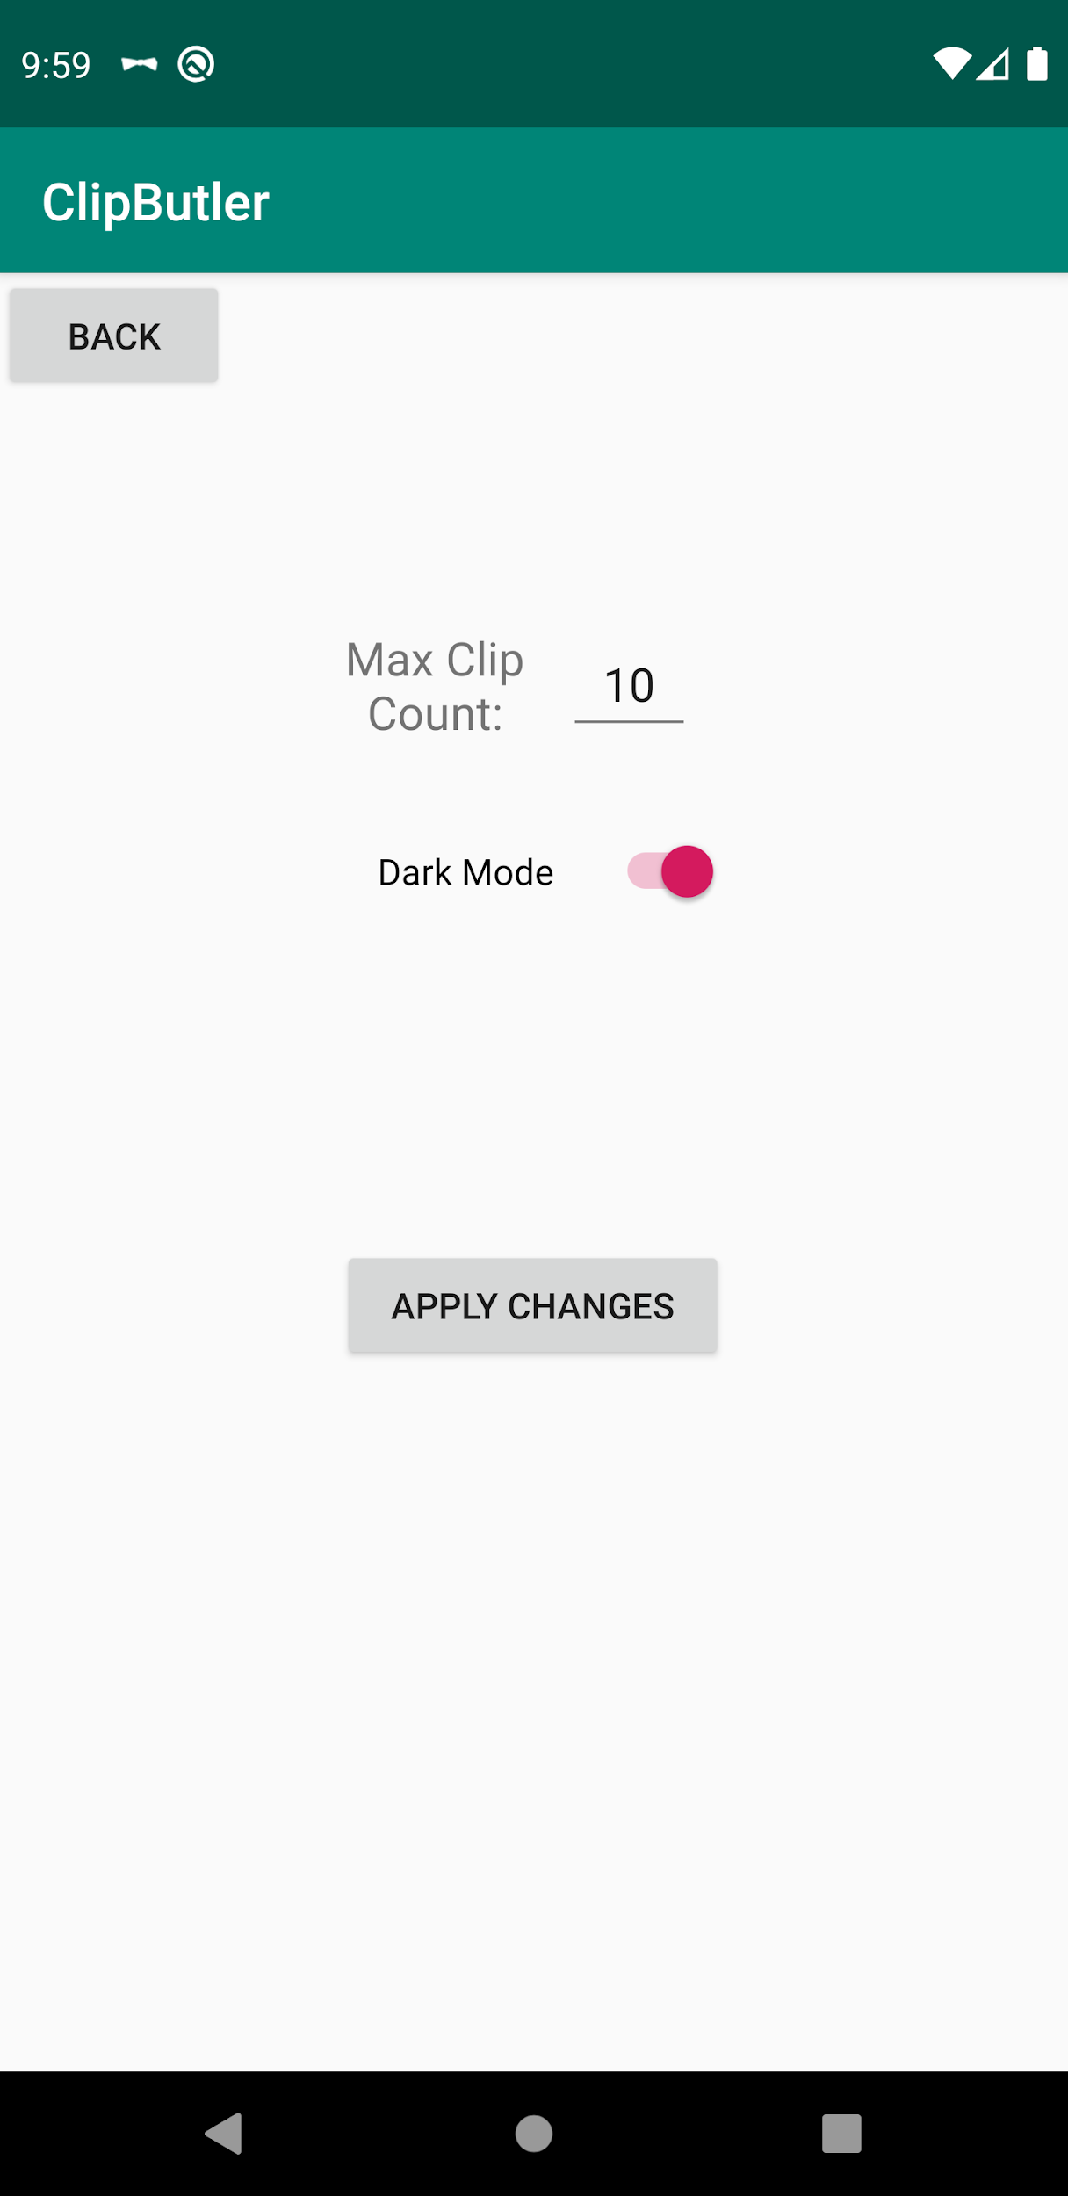
PREFS - Preferences
Update the max clips stored and displayed
Activate and deactivate dark mode

Slide 17
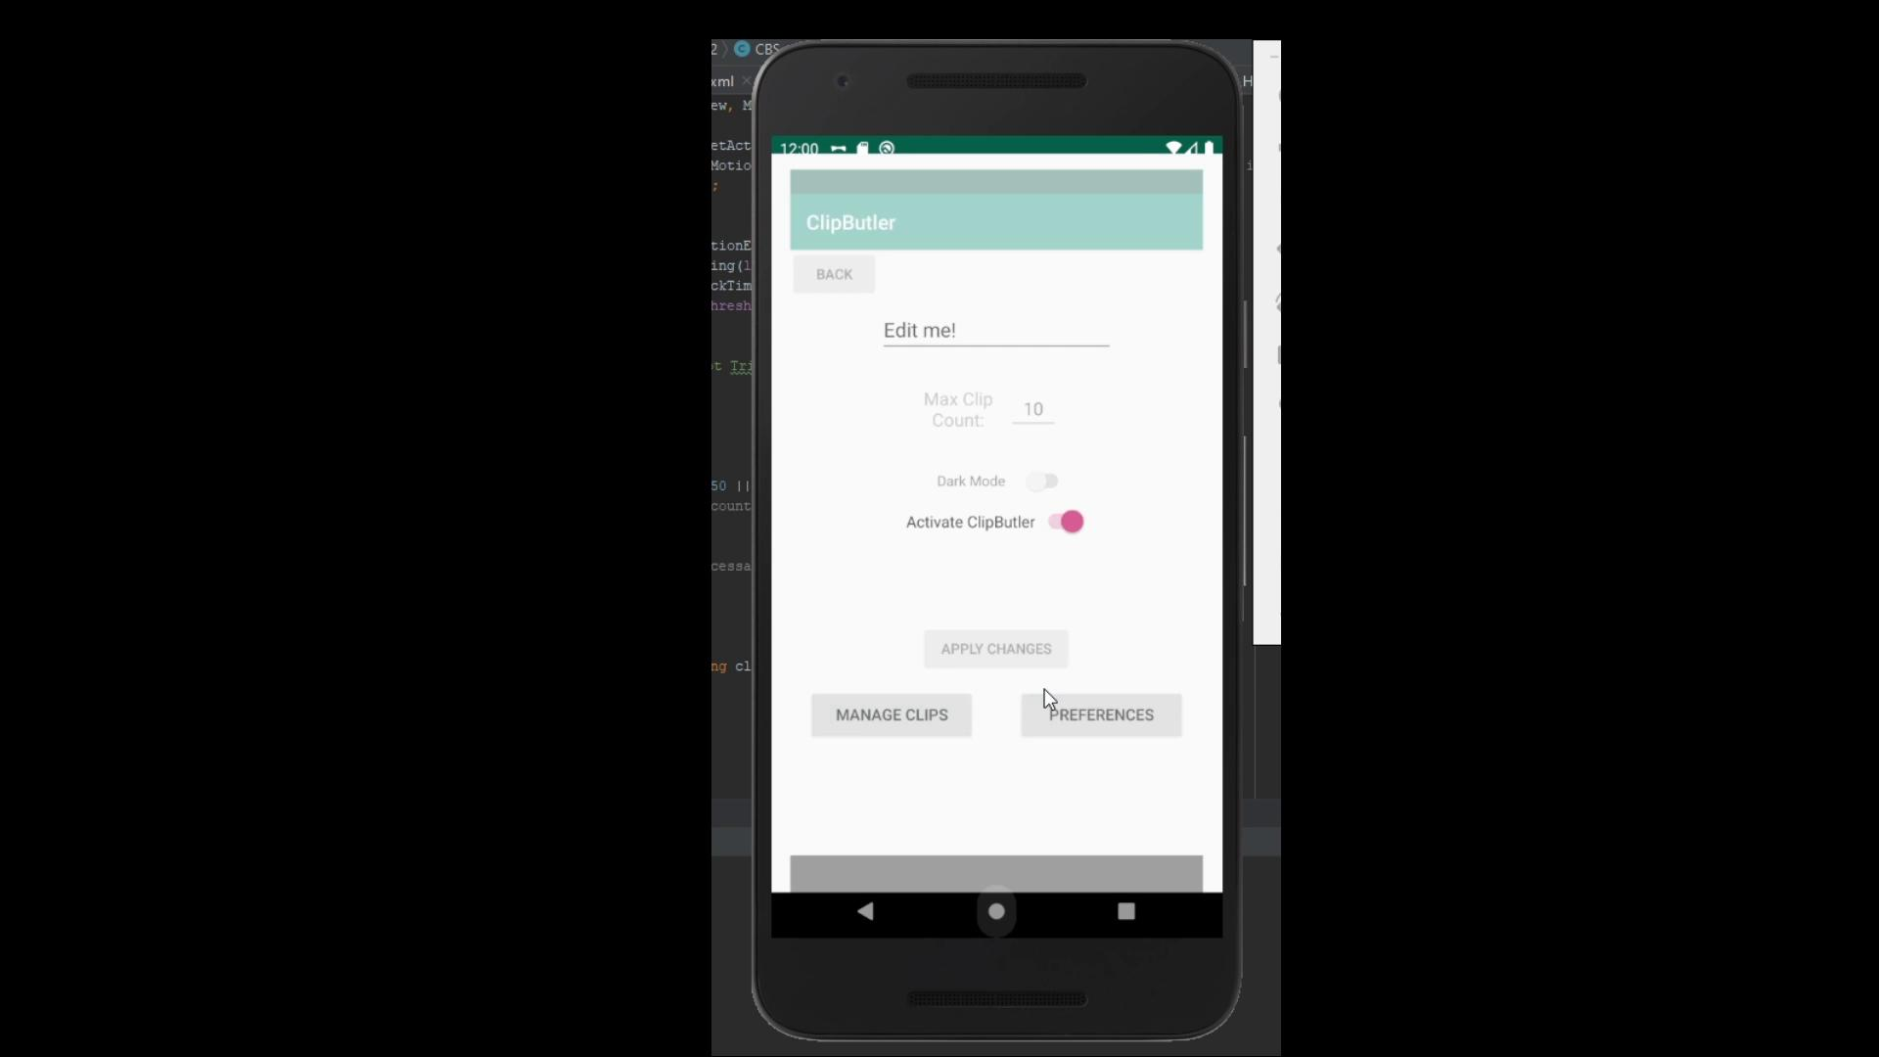
PREFS Video Demonstration

Slide 18
Conclusion

Slide 19

Elephant’s Software Development Process
BUFFER
PREFS
Connect
Features

Slide 20
Future Steps
PREFS
View, Edit, and delete strings in PREFS View Clips page
PREFS dark mode
BUFFER
BUFFER pop up animation

Slide 21
Project Takeaways
Teamwork is key to good software engineering
Communication is required for a successful flow
Merging in git should be done frequently to avoid conflicts
Android has a learning curve
Structure is more important than (almost) everything
Working with a customer as great as Dr. Stanley can still be hell

Slide 22
End of Presentation

Slide 23
Requirements
Prepare a 15 minute presentation
Describe project requirements
Describe next steps (if development were to continue)
Describe lessons learned
Describe progress and give thorough demo of current status
No hand-waving - show actual working software
Prepare what you are going to say during demo, don’t just wing it
Every group member must have a significant part in the presentation
Note: this isn’t an exhaustive list. Please prepare the presentation as if you are delivering it to an actual client. You are trying to make your customer happy! Be professional!

Slide 24
Sample Logos to Choose From

Slide 25
SlidesCarnival icons are editable shapes.
This means that you can:
Resize them without losing quality.
Change line color, width and style.
Isn’t that nice? :)
Examples:

