Slide 1

Unifying language modeling capabilities for flexible interaction
Deryle Lonsdale & Rebecca Madsen
lonz@byu.edu, rmadsen@byu.net

Slide 2
Language modeling capabilities
Soar cognitive modeling system
  Goal-directed, operator-based production system with machine learning
Natural-language components
  Incremental comprehension modeling
    Incoming words → X-bar syntax → LCS semantics
  Incremental generation modeling
    LCS semantics → X-bar syntax → outgoing words
  Opportunistic discourse modeling
    Recipes: flexible plan recognition/formulation
Speech input/output
  Sphinx recognizer, Festival TTS

Slide 3
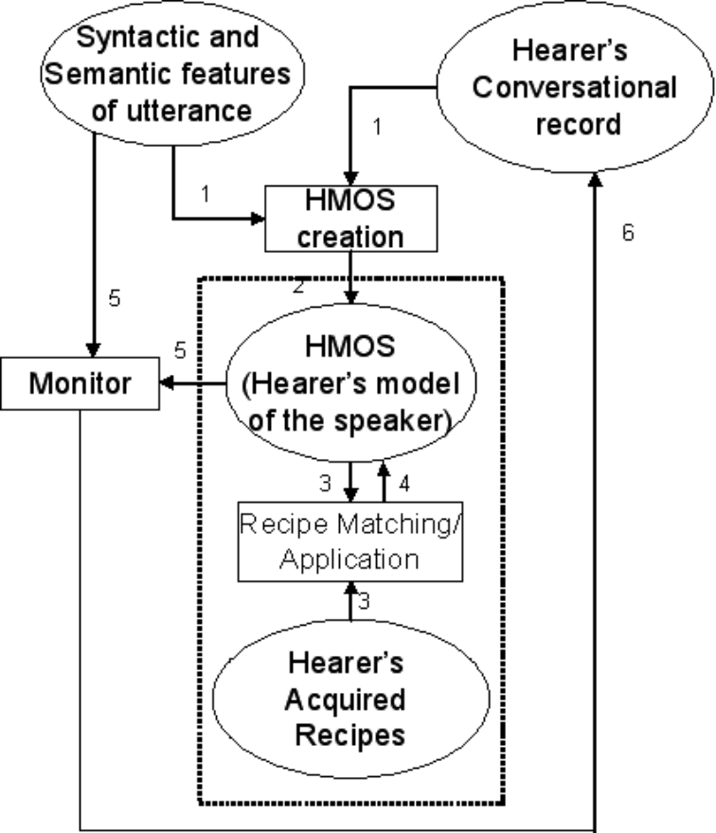
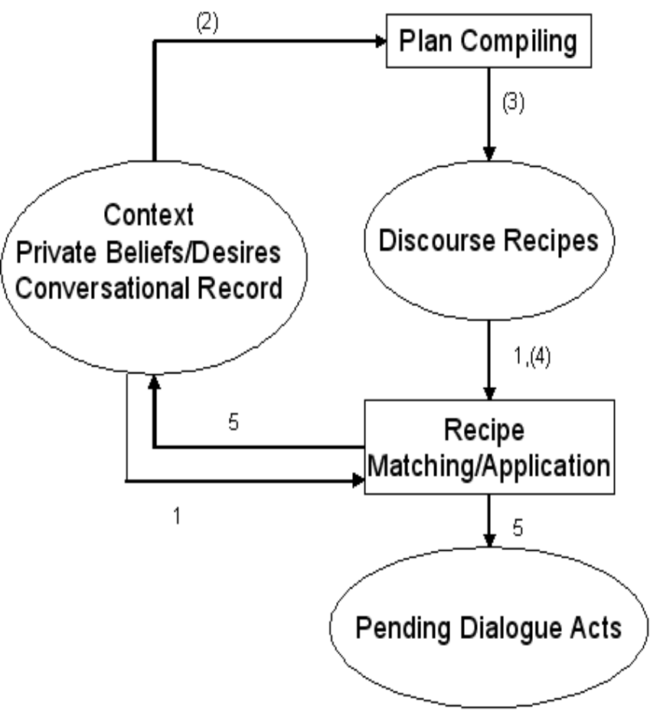
Dialogue plan recognition/formulation

Slide 4
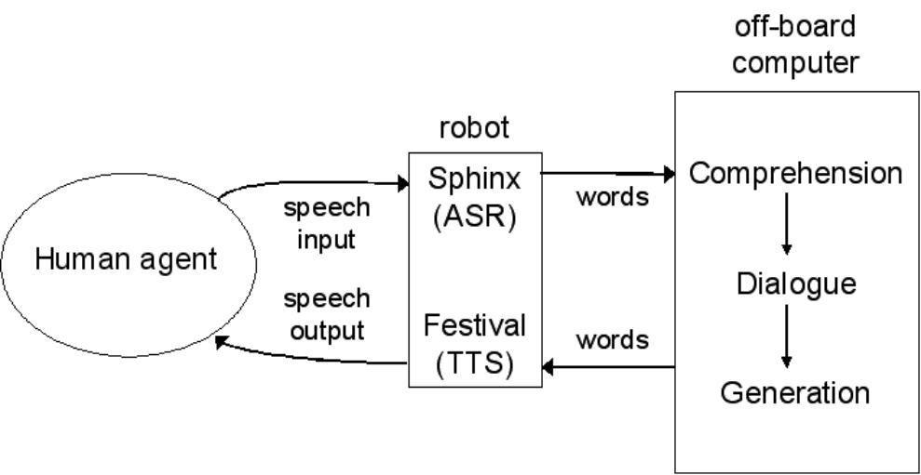
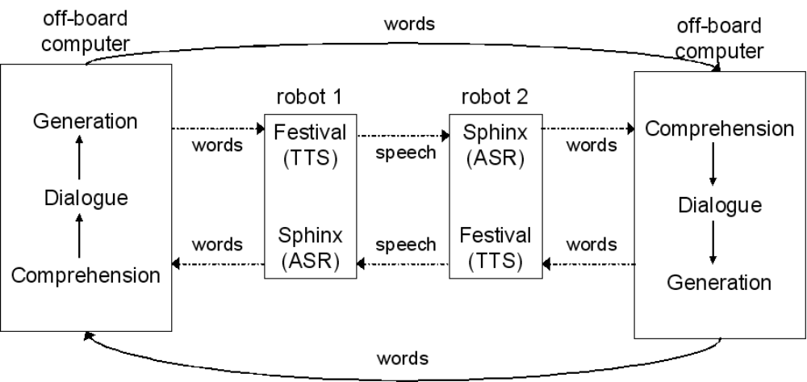
Scenarios: HCI, agent←→agent

