Slide 1

Bike Path Detective
The City Ride Anomaly Hunter → turning messy mobility data into better city decisions
DRAGOMIR TIMEEA-ELENA
DRĂGHICI DENIS-DANIEL
MICEA CHRISTIAN-ANDREI

Slide 2

The Problem
Teleporting Bikes
Bikes appearing to cross town instantly, which are impossible ride records
Negative Durations
Rides with negative or zero minute durations are errors in the data
Double Bookings
One bike starting a second ride before finishing the first
Data Anomalies
Many other data irregularities and suspicious behavior

Slide 3


Who Feels the Pain?
End User: City Mobility Operations Analyst
Works for a public bike-sharing program. Needs to make real decisions about bikes, stations, and routes, but spends hours manually fixing spreadsheets instead.
Questions they need to answer
Which stations are busiest? Which routes are popular? Are any bikes producing impossible records? Which records should be excluded from reports?

Slide 4
How Bad Does It Hurt?
Estimates based on multiple reruns of our data generator - probabilities can easily be tuned
~10%
~55%
Records That Need Cleaning
Invalid Records
Estimated share of ride records with formatting issues, duplicates, or inconsistencies
Estimated share with missing fields, impossible durations, invalid timestamps or other unfixable issues
10
10K
Known Stations
Ride Records
City network stations → easily adjustable and modifiable
Dataset size → all requiring validation, cleaning, and anomaly detection

Slide 5







Our Technical Solution
Read
Validate
Clean
CSV input via Python's built-in csv module
Apply business rules to each record and label them accordingly
Normalize fixable formatting issues
Analyze
Detect
Report
Provide report with valuable statistics based on cleaned data
Flag anomalies and suspicious patterns
Readable output for the operations analyst
Constraint: Python 3.13 builtins + standard library only. No Pandas. No NumPy. No third-party packages.

Slide 6
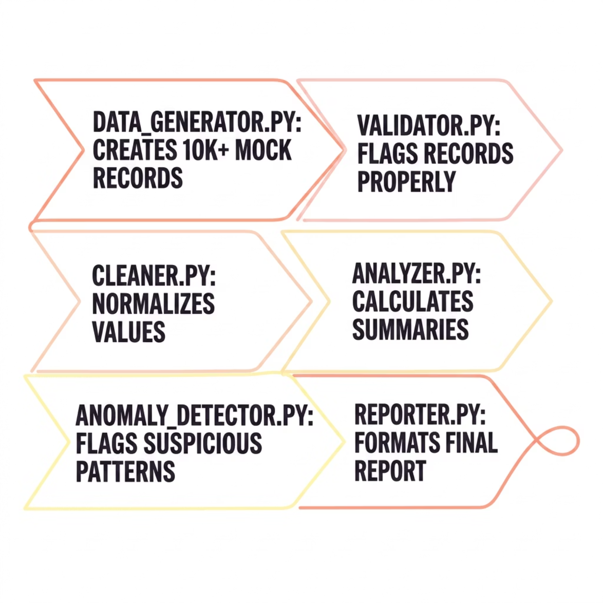
Solution Architecture
Modular Design
Each module has a single responsibility. main.py orchestrates the full pipeline. Unit tests in tests/ protect business logic.
Data separated into clean, needs-cleaning, suspicious and beyond-repair groups
Mock generator produces 10,000+ records with controlled chaos
Report written to reports/… text files and/or terminal

Slide 7

Validation & Cleaning Rules
What We Clean
What We Flag
Trim whitespace, normalize casing
Bike IDs → uppercase (bike-042 → BIKE-042)
Station names → title case
User types → lowercase
Datetime formats unified
Distance strings ("3.4 km" → 3.4)
Missing required fields
Duplicate ride IDs
Unknown user types
Unknown stations
Negative or zero durations
End time before start time
Bikes with overlapping rides
Duration mismatches vs. timestamps
Rule of thumb: Clean formatting problems. Report reality problems.

Slide 8


Anomaly Detection: 5+ Rules
1
2
3
Bike Overlapping
Station and Route Spikes
Duration ≠ Timestamps
One bike in two rides at the same time
Station and Route usage > x1.3 average → event or data problem?
Recorded duration differs from timestamp calculation within threshold
4
5
Unknown Stations
Zero Duration Rides
Unknown stations in the records could mean typos, data entry errors or system issues
Rides with duration = 0 that start and stop at the same station are OK, the rest are not

Slide 9





Technical Challenges We Faced
Separation of responsabilities
Generating realistic, varied data
Testing when working with 10K+ records
Repeated code with slight alterations

Slide 10

From Messy Records to Better Decisions
Identify
Locate
Unreliable ride records and impossible usage patterns
Overloaded stations and bikes with sync issues
Decide
Exclude bad data, act on real patterns with confidence

