Slide 1
Consumer Complaint Analysis
Chris Michael | Galvanize Data Science Immersive
Seattle Cohort 4

Slide 2
Introduction
Mechanical Engineering (BSME)/Electrophysicist (MSEE)
Lead Landing Gear Analyst – 787, 777X
I love telling a story with data but needed better tools!

Slide 3
Objective
Can the resolution of a consumer complaint be predicted based on information contained in text data?

Slide 4





Data
Data from the Consumer Financial Protection Bureau (CFPB)
Using only closed cases with text narrative
Data is unbalanced (80% “No Relief”, 20% “Relief Provided”)
Addressed using weighting of “Yes”

Slide 5
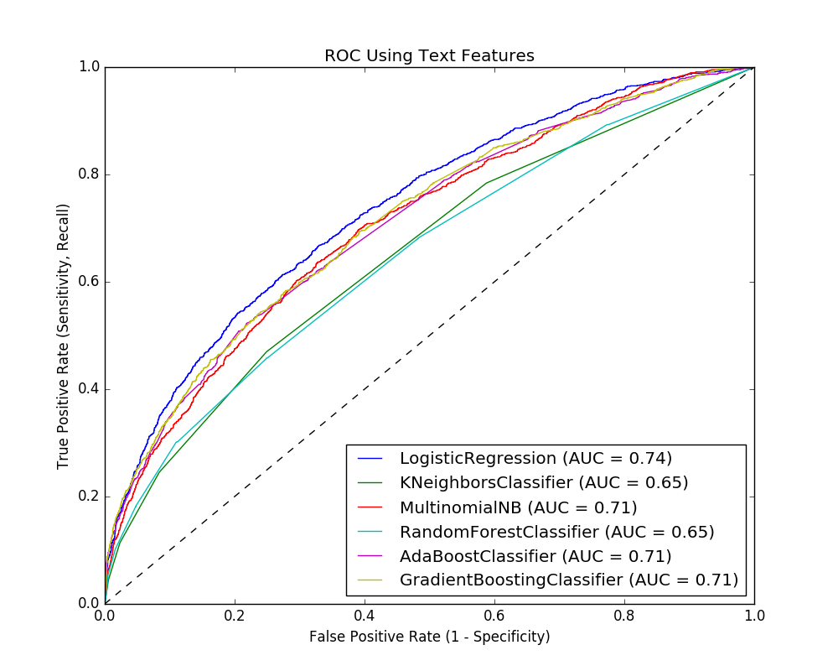
Modeling/Results
Model | Accuracy | Precision | Recall | F1 | AUC
Using Non-Text Features
Logistic Regression | 53.0
Using Text Features
Logistic Regression | 82.2 | 65.0 | 21.3 | 32.1 | 76.1
KNeighbors | 37.5 | 21.0 | 78.4 | 33.2 | 55.8
Multinomial Naïve Bayes | 81.5 | 65.7 | 13.5 | 22.4 | 74.3
Random Forest | 81.1 | 59.0 | 14.3 | 23.0 | 68.3
AdaBoost | 82.0 | 65.2 | 18.9 | 29.3 | 73.3
Gradient Boosting | 82.1 | 77.8 | 13.4 | 22.9 | 73.7
NOTE – Table shows data from full data set, ROC Plot shows data from 20000 sample dataset

Slide 6
Next Steps
Complaint prediction provides insight to:
Manage costs
Position resources
Modeling with Word2Vec
Explore complaint processing time
Explore product-specific

Slide 7
Chris Michael
GitHub: https://github.com/ChrisMichael11/Consumer_Complaint_Project
LinkedIn: https://www.linkedin.com/in/christophermmichael
Email: christopher.m.michael@gmail.com

