Slide 1
Consumer Complaint Analysis
Chris Michael | Galvanize Data Science Immersive
Seattle Cohort 4
Notes:
Hi I’m Chris Michael, and this is my capstone project: Consumer Complaint Analysis

Slide 2
Introduction
Mechanical Engineering (BSME)/Electrophysicist (MSEE)
Lead Landing Gear Analyst – 787, 777X
I love telling a story with data but needed better tools!
Notes:
Before we get into the project, a little about my background:
I’ve spent 11 years as a mechanical and electrical engineer at Boeing. During that time I designed landing gear actuation systems, worked on phased array antennas, and built hydraulic and kinematic models of landing gear systems.
My favorite part of my job was always taking a huge mess of data from some problem that we couldn’t answer and being able to put together a story that explain what happened using data. Since I only really had access to Excel at work I started looking for ways to use better tools with more power and ended up here at Galvanize.

Slide 3
Objective
Predict the result of closure for a complaint submitted to the Consumer Financial Protection Bureau (CFPB)
Notes:
The objective of this project is predict the result of a complaint submitted to the Consumer Financial Protection Bureau.
This type of information can be very important to a business. It can provide them with:
Positioning resources to provide the best customer service
Manage costs
Exploit opportunities to save/make money

Slide 4




Data
Data from the Consumer Financial Protection Bureau (CFPB)
Using only closed cases with text narrative
Data is imbalanced (80% “No Relief”, 20% “Relief Provided”)
Notes:
The data set I used came from the Consumer Financial Protection Bureau, which was created in 2008 to provide consumers an additional outlet to document complaints that were not being addressed by a company.
The data set contains ~590K entries, but only 84K have text responses from the consumer. I focused on the text data for this analysis to see if NLP can be used to extract more information from the data.
The data comes from the CPFB API in a pretty clean format. To prepare the data for modeling, I just need to clean up some missing values, create dummy variables for some categorical variables and create my labels.
To create the labels, there were 5 “closure cases” to deal with. I chose to combine these 5 cases in to a 1 or 0 classification (1 = relief provided, 0 = no relief or closed). The data is imbalanced with ~80% of the labels being “0” and 20% being “1”.
I vectorized each consumer complaint and tried different forms of stemming, but did not see an increase in model performance with stemming. I tried multiple numbers of features during the vectorization process and settled on 5000 features.

Slide 5
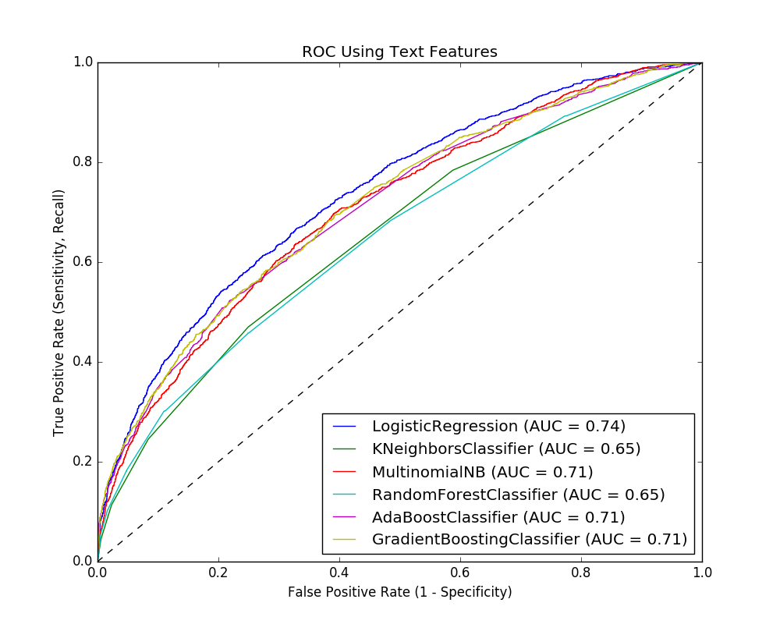
Modeling/Results
Model | Accuracy | Precision | Recall | F1 | AUC
Using Non-Text Features
Logistic Regression | 53.0
Using Text Features
Logistic Regression | 82.2 | 65.0 | 21.3 | 32.1 | 76.1
KNeighbors | 37.5 | 21.0 | 78.4 | 33.2 | 55.8
Multinomial Naïve Bayes | 81.5 | 65.7 | 13.5 | 22.4 | 74.3
Random Forest | 81.1 | 59.0 | 14.3 | 23.0 | 68.3
AdaBoost | 82.0 | 65.2 | 18.9 | 29.3 | 73.3
Gradient Boosting | 82.1 | 77.8 | 13.4 | 22.9 | 73.7
NOTE – Table shows data from full data set, ROC Plot shows data from 20000 sample dataset
Notes:
Before running any NLP on the data, I ran a logistic regression on the 84000 entries using the “non-text features”, i.e. anything but the text. This gave me an accuracy of ~53%. I also performed this test over the full data set and obtained the same result.
After running 6 different models on my vectorized text data, Logistic Regression produced the best results, with the highest accuracy and largest AUC. This is expected as Logistic Regression is a great for binary classification. Logistic Regression has a higher recall rate than Gradient Boosting and a higher F1 score, which is why it was chosen over Gradient Boosting.

Slide 6
Next Steps
Complaint prediction provides insight to:
Modeling with Word2Vec
Predict complaint processing time
Predict results for specific product
Add additional text features in data set to NLP
Notes:
Next steps - knowing the outcome of a complaint can help a business manage costs and position resources to provide a better customer expereince. Knowing what specific areas of the business are costing money/time, a business could also optimize or exploit those areas their benefit.
Additionally, I would like to to perform language processing with Word2Vec. Word2Vec is a 2 layer neural network that has been shown to work very well at pulling context from text, and would hopefully pull more insight from the text.

Slide 7
Chris Michael
GitHub: https://github.com/ChrisMichael11/Consumer_Complaint_Project
LinkedIn: https://www.linkedin.com/in/christophermmichael
Email: christopher.m.michael@gmail.com

