Slide 1
Consumer Complaint Analysis
Chris Michael | Galvanize Data Science Immersive
Seattle Cohort 4

Slide 2
Overview
Introduction
Objective
Data / Data Pipeline
Modeling
Results
Recommendations/Next Steps

Slide 3
Introduction
About me:
Mechanical Engineering (BSME)/Electrophysicist (MSEE)
Lead Landing Gear Analyst – 787, 777X

Slide 4

Objective
Can the result of complaint resolution be predicted?
Closed / Untimely response [3.5%]
Closed with explanation [76.4%]
Closed with non-monetary/monetary relief [20.1%]

Slide 5





Data / Data Pipeline
Data from the Consumer Financial Protection Bureau (CPFB)
Data converted from categorical descriptions to numerical values for use in models
Text was cleaned and modified for processing
Data is 80% “No”, 20% “Yes”
NEED TO ADDRESS CLASS IMBALANCE

Slide 6
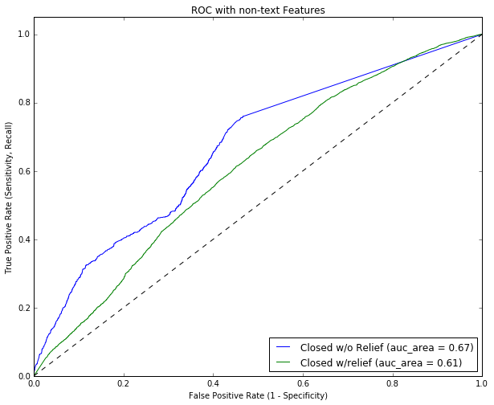
Modeling
A baseline model using non-text features was run to check
MODEL: Logistic Regression
Multiple NLP approaches were preformed:
MODEL: TFIDF – Multiple classifiers
MODEL: Word2Vec

Slide 7
Results
A baseline model using non-text features was run to check
Best Model: SAY SOMETHING COOL
Multiple NLP approaches were preformed:
TF-IDF: SAY SOMETHING COOLER!!!
Word2Vec: SAY SOMETHING COOLER!!!

Slide 8
Recommendations/Next Steps
Using the predictive power of the model, a company could address the situations where they provide some sort of relief (monetary or other) and determine the most economic was to do so
NEXT STEPS:
Look into time ranges, specific products
Does some product drive a company to provide ”relief”
Does the time taken to process a complaint drive the result of providing “relief”

Slide 9
Project Info/Contact Info
Chris Michael
Project – Consumer Complaint Analysis
https://github.com/ChrisMichael11/Consumer_Complaint_Project
LinkedIn:
https://www.linkedin.com/in/christophermmichael
Email:
christopher.m.michael@gmail.com

Slide 10
References
Figure on Slide 4 - Cross Industry Standard Process for Data Mining. (2016, March 29). In Wikipedia, The Free Encyclopedia. Retrieved 15:56, August 2, 2016, from https://en.wikipedia.org/w/index.php?title=Cross_Industry_Standard_Process_for_Data_Mining&oldid=712521431
https://www.kaggle.com/c/word2vec-nlp-tutorial/details/part-2-word-vectors
https://pypi.python.org/pypi/pyzipcode (used in EDA)

