Slide 1
Consumer Complaint Analysis
Chris Michael | Galvanize Data Science Immersive
Seattle Cohort 4

Slide 2
Overview
Introduction
Objective
Data / Data Pipeline
Modeling
Results
Recommendations/Next Steps

Slide 3
Introduction
About me:
Mechanical Engineering (BSME)/Electrophysicist (MSEE)
Lead Landing Gear Analyst – 787, 777X

Slide 4

Objective
Can the result of complaint resolution be predicted?
Closed / Untimely response [3.5%]
Closed with explanation [76.4%]
Closed with non-monetary/monetary relief [20.1%]
For analysis I am using two groupings “Relief provided” and “Relief not provided”
CPFB started in 2008 to “hold companies accountable to the consumer”

Slide 5





Data / Data Pipeline
Data from the Consumer Financial Protection Bureau (CFPB)
CPFB started in 2008
Data converted from categorical descriptions to numerical values for use in models
Text was cleaned and modified for processing
Data is 80% “Relief no provided”, 20% “Relief provided”
Addressed using weighting of “Yes” Class and also creating a balanced set of randomly selected “Yes” and “No” results

Slide 6
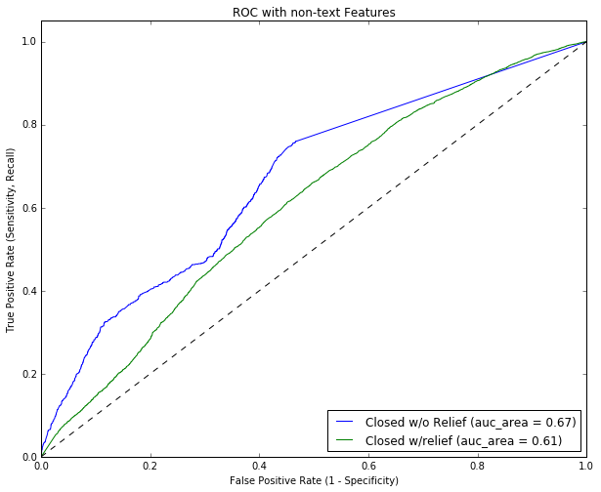
Modeling/Results
A baseline model using non-text features was run to check
MODEL: Logistic Regression 53.0%
Multiple NLP approaches were preformed:
MODEL– TFIDF
Logistic Regression 80.3%
KNearestNeighbors 78.0%
Multinomial Naïve Bayes 80.9%
Random Forest 80.1%
MODEL: Word2Vec XX.X%

Slide 7
Results
A baseline model using non-text features was run to check
Best Model: A random forest produced ~53% accuracy using non-text features
Multiple NLP approaches were preformed:
TF-IDF: Using TFIDF, ~80% accuracy was obtained
Word2Vec: SAY SOMETHING COOLER ONCE YOU MAKE IT WORK!!!

Slide 8
Recommendations/Next Steps
Predicting the outcome of a complaint can give businesses insight to how to better manage costs or position resources to manage complaints.
NEXT STEPS:
Look into time ranges, specific products
Does some product drive a company to provide ”relief”
Does the time taken to process a complaint drive the result of providing “relief”

Slide 9
Project Info/Contact Info
Chris Michael
Project – Consumer Complaint Analysis
https://github.com/ChrisMichael11/Consumer_Complaint_Project
LinkedIn:
https://www.linkedin.com/in/christophermmichael
Email:
christopher.m.michael@gmail.com

Slide 10
References
Figure on Slide 4 - Cross Industry Standard Process for Data Mining. (2016, March 29). In Wikipedia, The Free Encyclopedia. Retrieved 15:56, August 2, 2016, from https://en.wikipedia.org/w/index.php?title=Cross_Industry_Standard_Process_for_Data_Mining&oldid=712521431
https://www.kaggle.com/c/word2vec-nlp-tutorial/details/part-2-word-vectors
https://pypi.python.org/pypi/pyzipcode (used in EDA)

