Slide 1
Consumer Complaint Analysis
Chris Michael | Galvanize Data Science Immersive
Seattle Cohort 4

Slide 2
Overview
Introduction
Objective
Data / Data Pipeline
Modeling
Results
Recommendations

Slide 3
Introduction
About me:
Mechanical Engineering (BSME)/Electrophysicist (MSEE)
Lead Landing Gear Analyst – 787, 777X

Slide 4

Objective
Can Machine Learning be used to predict the result of a complaint levied against a company?

Slide 5


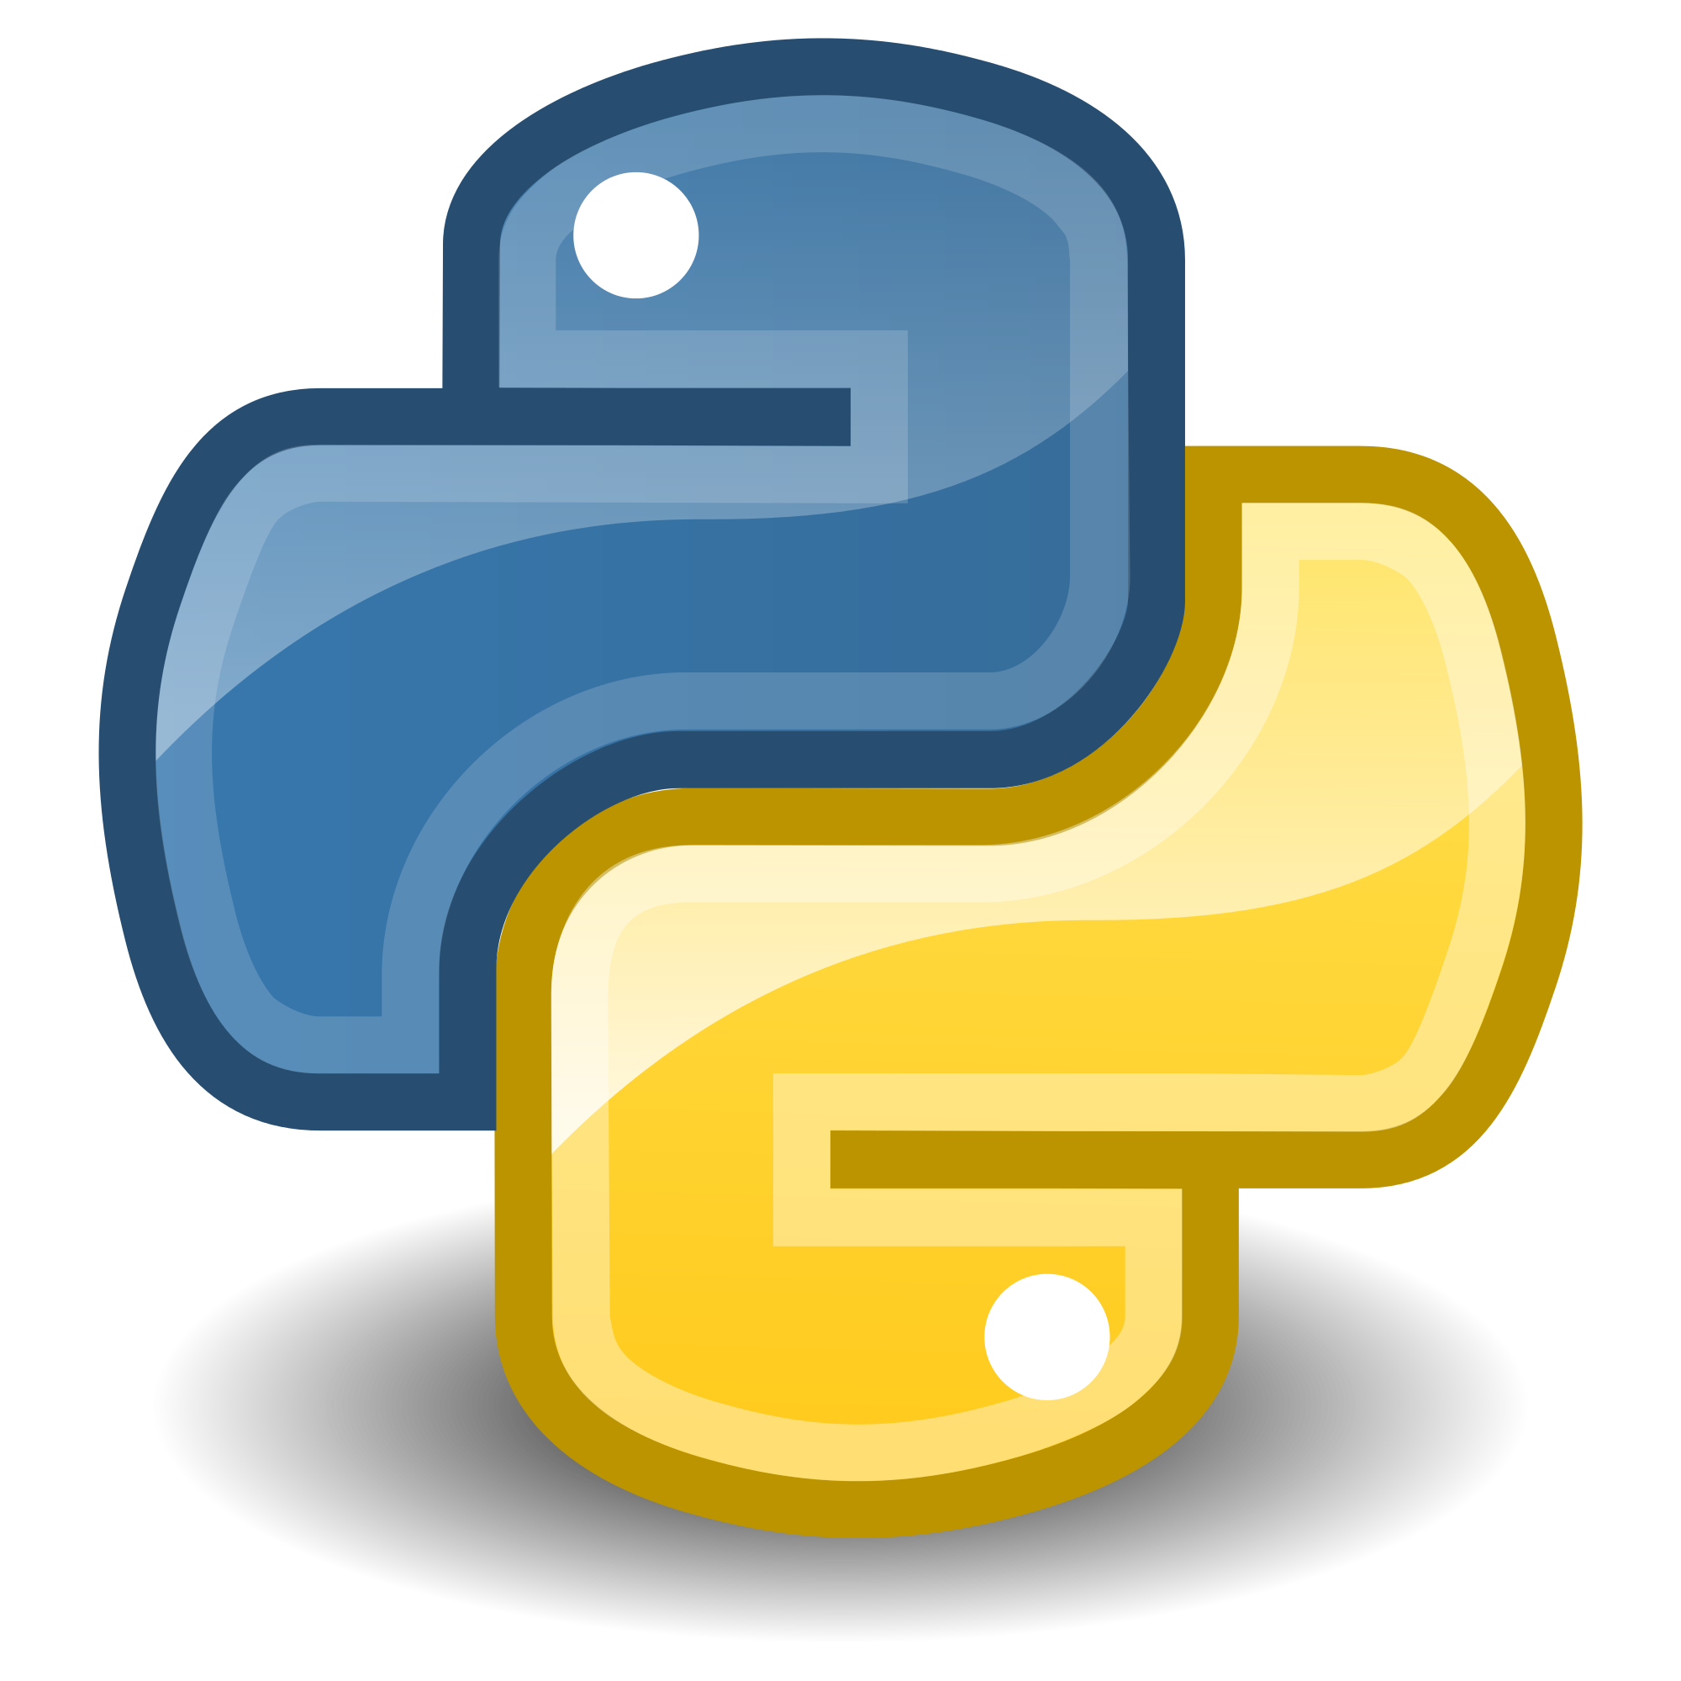


Data / Data Pipeline
Data from the Consumer Financial Protection Bureau (CPFB) was very clean.
Data converted from categorical descriptions to numerical values for use in models
Text was cleaned and modified for processing
Data is 80% “No”, 20% “Yes”

Slide 6
Modeling
A baseline model using non-text features was run to check
MODEL:
Multiple NLP approaches were preformed:
MODEL:
MODEL:

Slide 7
Results
A baseline model using non-text features was run to check
Best Model: SOMETHING NOT AS COOL
Multiple NLP approaches were preformed:
TF-IDF: SOMETHING COOLER!!!
Word2Vec: SOMETHING COOLER!!!

Slide 8
Recommendations/Next Steps
Using the predictive power of the model, a company could address the situations where they provide some sort of releif (monetary or other) and determine the most economic was to do so
NEXT STEPS:
Look into time ranges, specific products
Does some product drive a company to provide ”relief”
Does the time taken to process a complaint drive the result of providing “relief”

Slide 9
Project/Contact Info
Chris Michael
Project – Consumer Complaint Analysis
https://github.com/ChrisMichael11/Consumer_Complaint_Project
LinkedIn:
https://www.linkedin.com/in/christophermmichael
Email:
Christopher.m.michael@gmail.com

Slide 10
Refrences
REFRENCES
Cross Industry Standard Process for Data Mining. (2016, March 29). InWikipedia, The Free Encyclopedia. Retrieved 15:56, August 2, 2016, from https://en.wikipedia.org/w/index.php?title=Cross_Industry_Standard_Process_for_Data_Mining&oldid=712521431
https://www.kaggle.com/c/word2vec-nlp-tutorial/details/part-2-word-vectors
https://pypi.python.org/pypi/pyzipcode

