Slide 1
Led Data Transmission
Experimental Setup
470Ohm
Device under
test
e.g.
Attiny13
PC
PB4
USB
Arduino Uno
Light
Receiver
Circuit
Arduino
Pin12
Arduino
Pin13
Test-Led

Slide 2
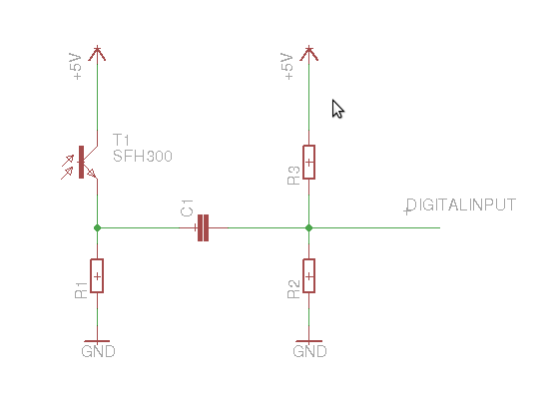
Light Receiver Circuit

