Slide 1
Hs
108
277.15
Headspring
Headspring
We believe there’s a better way

Slide 2
TPL
DataFLow Library
Message-based async networks

Slide 3



What we’ll cover
A brief history
CCR Overview
TPL and DataFlow
Library Overview
Async City
The Simcity knock-off
The CCR’s role in Microsoft’s robotics initiative and what problems Microsoft was trying to solve with the CCR.
How the CCR translated into the TPL and C# 5.0, and what these new features bring to your daily dev adventures
Walkthrough a complex asynchronous network that resembles the supply and demand of a city

Slide 4
What is the CCR?
The CCR helps manage asynchronous operations, deal with concurrency, exploit parallel hardware and deal with partial failure.
Originally developed Advanced Strategies group for Microsoft Robotics
Based on a message-passing architecture through Ports
Introduced coordination primitives called Arbiters
Introduced a “work stealing” thread pool
Notes:
- CCR was a little strange: everything about it told you that it was a separate thing, but for the longest time, it was only available through Robotic Studio
-

Slide 5
Why is the CCR?
YEah Robots, but really to solve a pattern problem
Async was always easy
Coordination was always possible
Patterns only existed in the wild
The CCR made coordination patterns first-class citizens

Slide 6
CCR coordination primitives
http://msdn.microsoft.com/en-us/library/bb648749.aspx

Slide 7
Iterators
An amazing little state machine
The compiler translates iterator methods into an IEnumerator class
What code to execute next is managed by the nested class
Iterators are, in effect, little state machines
They are very good at what they do
I love them a whole bunch
Seriously guys,
A lot

Slide 8
ITERATORS
Iterator methods interleave program control into the calling method
CALLER
CALLEE
CALLER
CALLEE
CALLER
CONTINUATION!

Slide 9
ITERATORS
public IEnumerator<Candy> GetMeCandies() {
var candy1 = MakeCandy1();
yield return candy1;
var candy2 = MakeCandy2();
yield return candy2;
}
RETURN TO CALLER
CONTINUATION!

Slide 10
CCR coordination primitives
http://msdn.microsoft.com/en-us/library/bb648749.aspx

Slide 11
ITERATORS
CCR scheduler pulls tasks from iterator
CCR scheduler pushes tasks to worker thread
WORKER
ITERATOR
CCR SCHEDULER
WORKER
WORKER
“Work stealing” thread pool

Slide 12
C# 5.0: async & await
moving iterator-based coordination to the language level
public async Task GetMeCandies() {
var candy1 = await MakeCandy1();
var candy2 = await MakeCandy2();
}
RETURN TO CALLER
CONTINUATION!

Slide 13
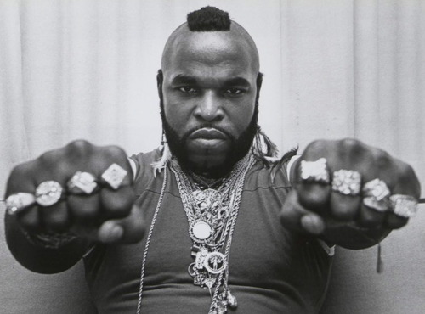
Now, tell me about TPL Dataflow, fool!

Slide 14
Tpl dataflow
From the ccr to tpl dataflow
CCR provided tools to build a network (Ports and Arbiters), but networks were accidental
TPL Dataflow was designed to build async networks from the start
CCR needed a “refresh” in the C# 5.0 landscape

Slide 15
TPL Dataflow blocks
Source blocks
Source
Grouping
Data
Data
Data
Data
Data

Slide 16
TPL Dataflow blocks
Target blocks
Target
Data

Slide 17
TPL Dataflow blocks
Propagator blocks
Propagator
Data
Data

Slide 18
TPL Dataflow pipelines
To make a pipeline, link a source block to a series of propagator or grouping blocks, and finally, to a target block
Source
Source
Grouping
Propagator
Propagator
Propagator
Target
Source

Slide 19
TPL Dataflow networks
To make a network, connect a source block to a series of propagator or grouping blocks and finally, to a target block
Propagator
Target
Target
Source
Propagator
Propagator
Propagator
Target
Grouping

Slide 20
Tpl dataflow blocks
http://msdn.microsoft.com/en-us/library/hh228603.aspx

Slide 21
Async city
Rules of the game
Entity |  | Consumes | Produces
 | Business |    |  
 | Home |   |   
 | Trash incinerator | 
 | Water Tower |  | 
 | Electric company | 
 | Sewage treatment | 
The network should be able to detect waste if producers are over-producing
Consumers periodically consume resources, and can become starved if not served by a producer

Slide 22
_{w}
_{w}








_{w}

 + 
₁

₂

₃


_{w}


_{w}
₁
₂
₃
_{w}

