Slide 1

Bootstrap and ng-bootstrap
Изготвила: Румяна Крумова, F89285

Slide 2
Bootstrap is a free and open source front end web development framework primarily used for creating websites and web apps.
Creators - Mark Otto, Jacob Thornton

Slide 3
Why Bootstrap?

Slide 4

Open source and customizable

Slide 5
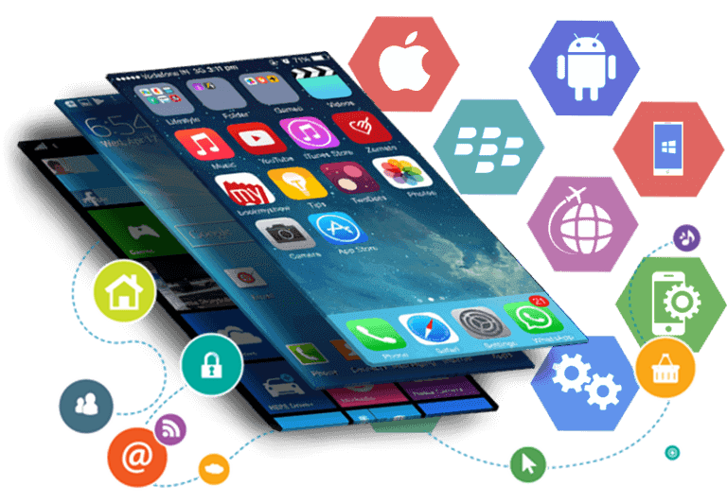
It’s mobile first

Slide 6

Saves lot of time

Slide 7

Fast

Slide 8
Material vs Bootstrap

Slide 9
Philosophy and Purpose
Material design
Bootstrap
Мore oriented towards the way that a website or application will look.
Mainly focused on easily creating responsive websites and web applications, which are functional and of high quality when it comes to user experience.

Slide 10
Design Process and Components
Material design
Bootstrap
Material Design comes with numerous components that provide a base design, which then can be worked on by the developers themselves.
Bootstrap is an open-source framework, also referred to as a UI library, which can use Grunt to create and run its designing processes.

Slide 11
Browser Compatibility and Frameworks
Material design
bootstrap
Material Design supports both of the frameworks of Angular Material and React Material User Interface. It also uses the SASS preprocessor.
Bootstrap supports the frameworks of React Bootstrap and Angular UI Bootstrap. It can use the SASS and LESS languages for building websites.

Slide 12
Documentation and Support
Material design
bootstrap
Material Design is built around the BEM (Block, Element, Modifier methodology) and its components are created by a combination of classes, that make them easy to use, but can affect the HTML in some cases.
Bootstrap is the best in this regard, in our opinion. Its code documentation is impeccable and the large online community that provides help are two of its greatest features.

Slide 13
NG-BOOTSTRAP
The angular way

Slide 14

Angular + Bootstrap

