Slide 1
COMP 353 Databases
Final Project

Slide 2
Contributors
Alexander Vissa
Christopher Mukherjee
Karim Kaidbey
Cheng Cheng

Slide 3
Part 1: DIAGRAM
Relational Diagram showing connections between all sections of the Starline hospital database
Color-coded for easy interpretation

Slide 4
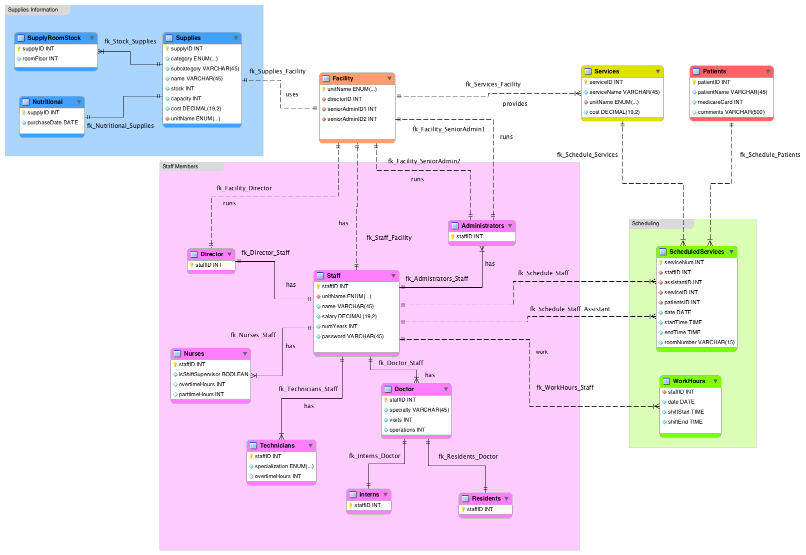

Slide 5
Part 2: WEBSITE
Fully integrated PHP website with SQL queries
Connects to server and displays information using views for increased security
Login with varied access levels
Editing of database table data allowed with proper permission

Slide 6
Thank you!

