Slide 1
Foundations for a Common Workflow to Contribute to HFOSS
Darci Burdge
Stoney Jackson

Slide 2





Acknowledgement and Licensing
Acknowledgement
This material is based on work supported by the National Science Foundation under Grant Nos. DUE-1225708, DUE-1225738, DUE-1225688, DUE-1525039, DUE-1524898, and DUE-1524877. Any opinions, findings and conclusions or recommendations expressed in this material are those of the author(s) and do not necessarily reflect the views of the National Science Foundation (NSF).
Copyright and Licensing
This work is copyrighted by the authors
This work is licensed under a Creative Commons Attribution-ShareAlike 4.0 International License http://creativecommons.org/licenses/by-sa/4.0/

Slide 3
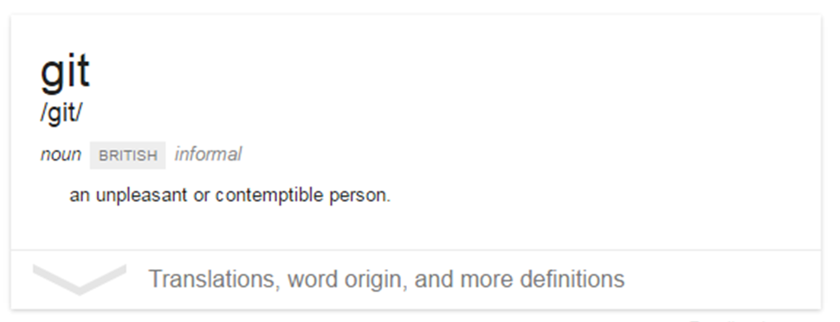
What is Git?

Slide 4
What is Git?
Git is a version control system
It allows you to keep track of changes to a set of files over time
You can also revert back to the previous state of a file

Slide 5
Resources
http://foss2serve.org
https://github.com/StoneyJackson/git-ccscne-2016

