Slide 1
Knowledge Graph Embedding Based Question Answering
Xiao Huang, Jingyuan Zhang, Dingcheng Li, Ping Li
Cognitive Computing Lab (CCL), Baidu Research, USA

Slide 2
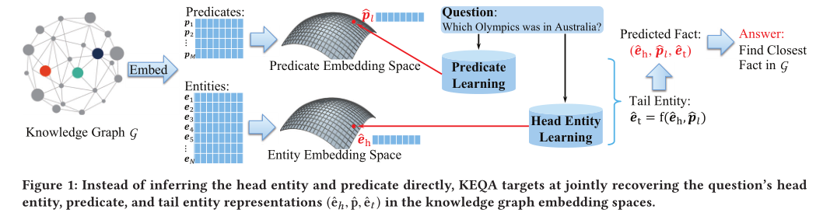
主要思想：
To answer a simple question, instead of inferring its head entity and predicate directly, KEQA targets at
jointly recovering the question’s head entity, predicate, and tail entity representations in the KG embedding spaces.

Slide 3
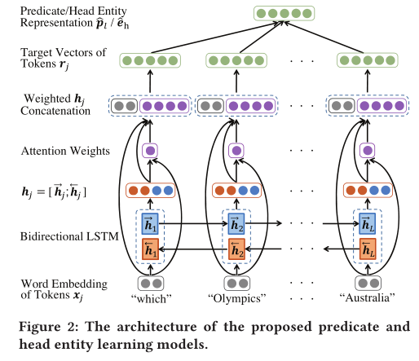


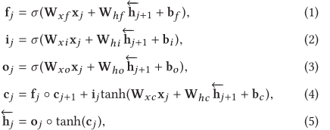
Predicate and Head Entity Learning Models
Notes:
这里要去说明一下为什么关系匹配和实体消歧的效果会比较差

Slide 4
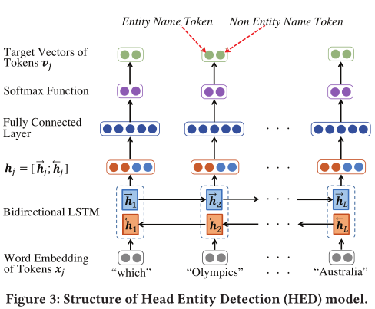
Head Entity Detection Model

Slide 5

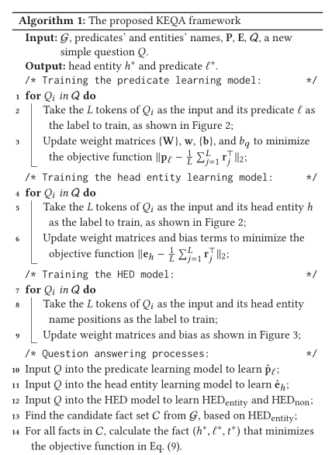
Joint Distance Metric

Slide 6
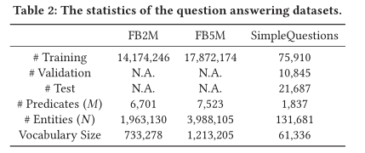
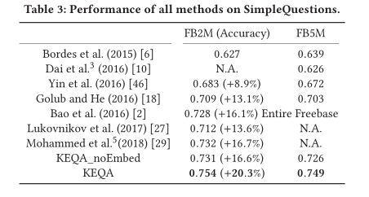
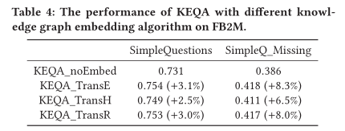

Slide 7
Simple Question Answering by Attentive Convolutional Neural Network
Wenpeng Yin ∗ , Mo Yu † , Bing Xiang, Bowen Zhou † , Hinrich Schütze ∗Cognitive Computing Lab
∗ Center for Information and Language Processing，LMU Munich, Germany
IBM Watson Yorktown Heights, NY, USA

Slide 8
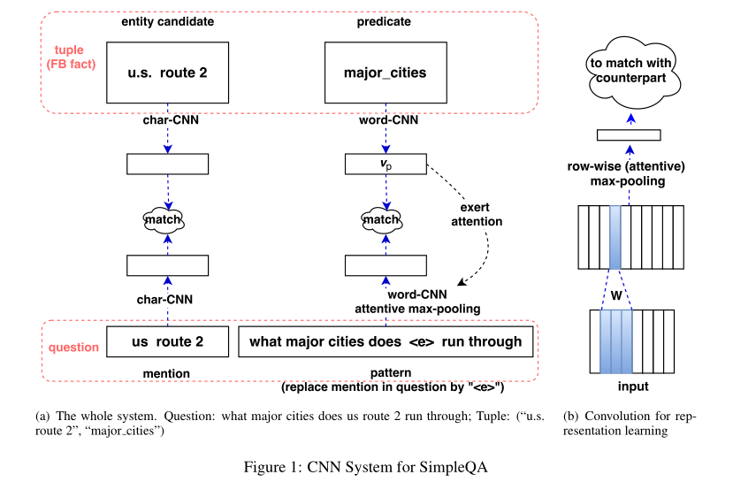

Slide 9
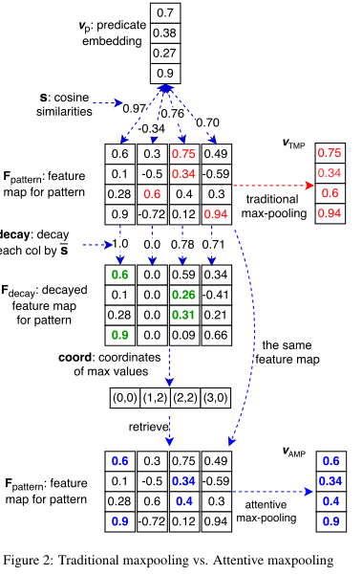
Notes:
到黑板举个例子

Slide 10
