Slide 1
RippleNet: Propagating User Preferences on the Knowledge Graph for Recommender Systems
CIKM’18
Shanghai Jiao Tong University Microsoft Research Asia The Hong Kong Polytechnic University

Slide 2
Background:
To address the sparsity and cold start problem of collaborative filtering(CF);
take the knowledge graph as the source of side information;
knowledge graph (KG) : nodes- entities ; edges - relations
Applications: question answering, word embedding , text classification…RS KG can benefit RS from three aspects:
introduces semantic relatedness among items, improve the precision of RS
contains relations with various types, extend a user’s interests reasonably, increase the diversity of RS
connects a user’s historical records and the recommended ones, bring explainability to RS

Slide 3
Related works: KG-aware recommendations: 1.embedding-based methods :
pre-process a KG with knowledge graph embedding (KGE) ,and then
incorporates the learned entity embeddings into a recommendation framework.
Drawback:
the adopted KGEs are more suitable for in-graph applications such as link prediction than for RS
2. path-based methods
explore the various patterns of connections among items in KG for recommendations.
Drawback:
1)rely heavily on manually designed meta-paths, which is hard to optimize in practice;
2)it is impossible to design hand-crafted meta-paths in certain scenarios.
Notes:
where entities and relations are not within one domain.

Slide 4

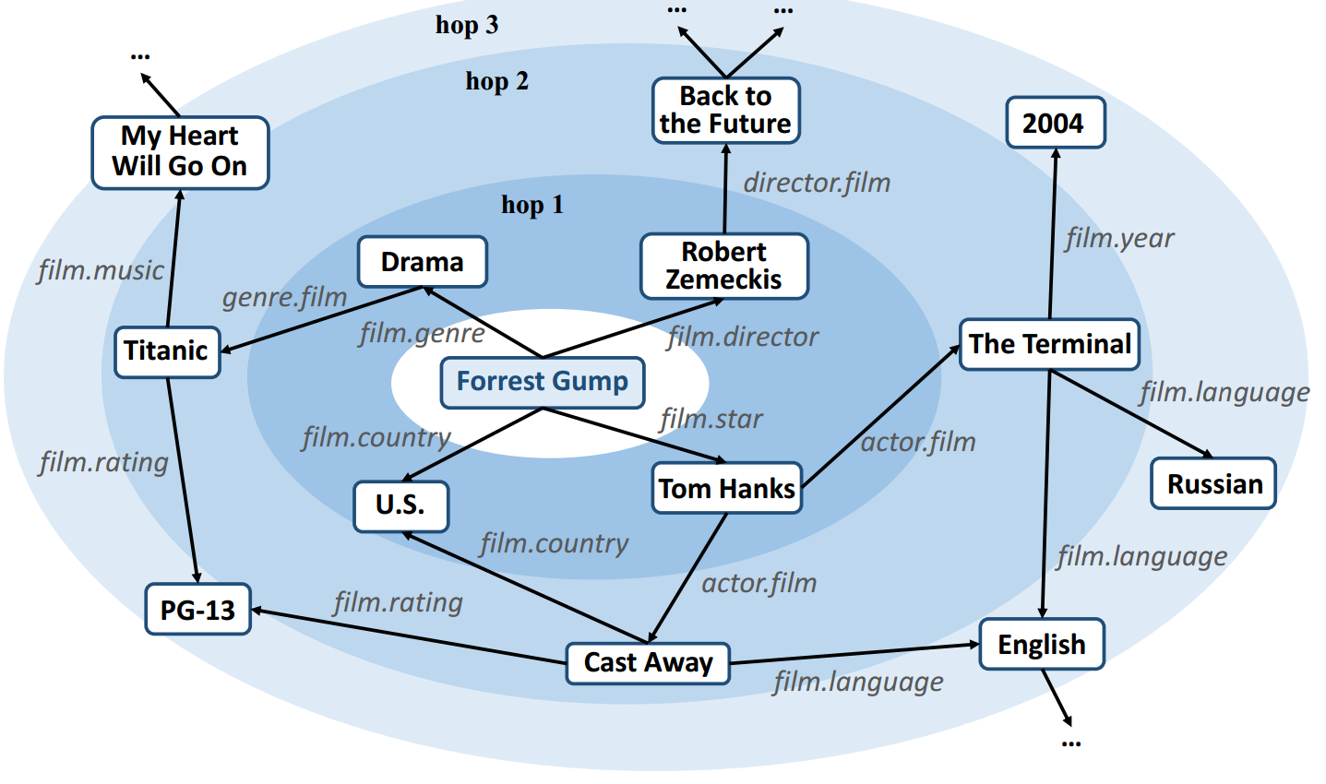

Inspiration:
preference propagation
VS
actual ripples propagating on the water
1. a user’s potential interest in entities propagates along the links in KG layer by layer, from near to distant ;
2.strength of a user’s potential preferences in ripple sets weakens with the increase of the hop number k
3.multiple "ripples" superpose to form a resultant preference distribution of the user over the knowledge graph
Notes:
activated by his historical preferences

Slide 5
RippleNet
designed for click-through rate (CTR) prediction:
Given interaction matrix ,knowledge graph G,
to predict whether a user has interest in an item with which he has had no interaction before.
contributions :
first work to combine embedding-based and path-based methods in KG-aware recommendation
Idea: preference propagation automatically discovers users’ hierarchical potential interests by iteratively propagating users’ preferences in the KG.
Achieves substantial gains in movie, book and news RS, over several state-of-the-art baselines
Notes:
, which takes a user-item pair as input and outputs the probability of the user engaging (e.g., clicking, browsing) the item.
*incorporates the KGE methods into recommendation naturally by preference propagation;
*automatically discover possible paths from an item in a user’s history to a candidate item

Slide 6
Symbols
U = {u1,u2, ...} sets of users
V = {v1,v2, ...} sets of items
the user-item interaction matrix Y = {y_{uv} |u ∈ U,v ∈ V}
knowledge graph G
entity-relation-entity triples (h,r, t). h ∈ E, r ∈ R, and t ∈ E: the head, relation, and tail of a knowledge triple, respectively
E and R : the set of entities and relations in the KG
Θ :the model parameters

Slide 7
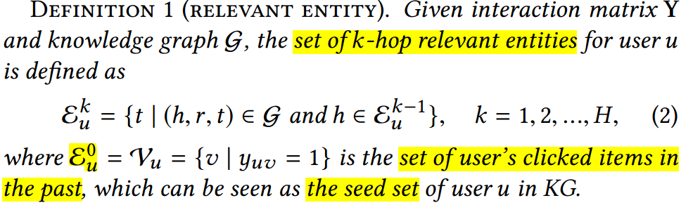
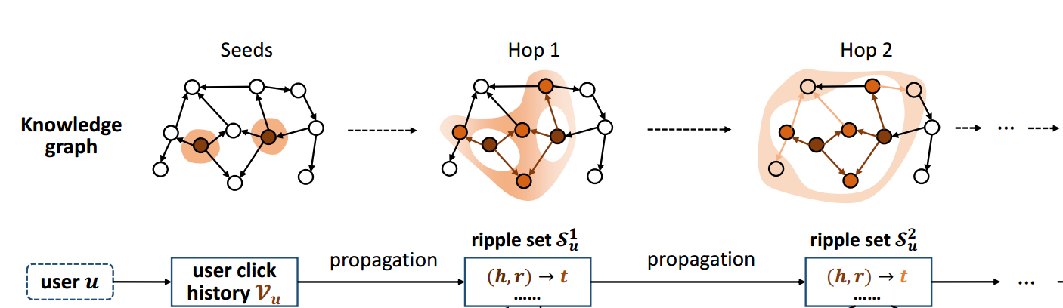
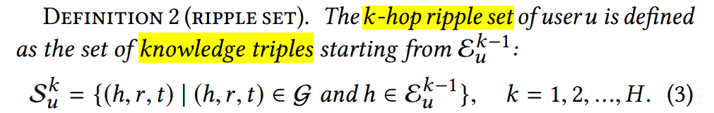
Definition

Slide 8
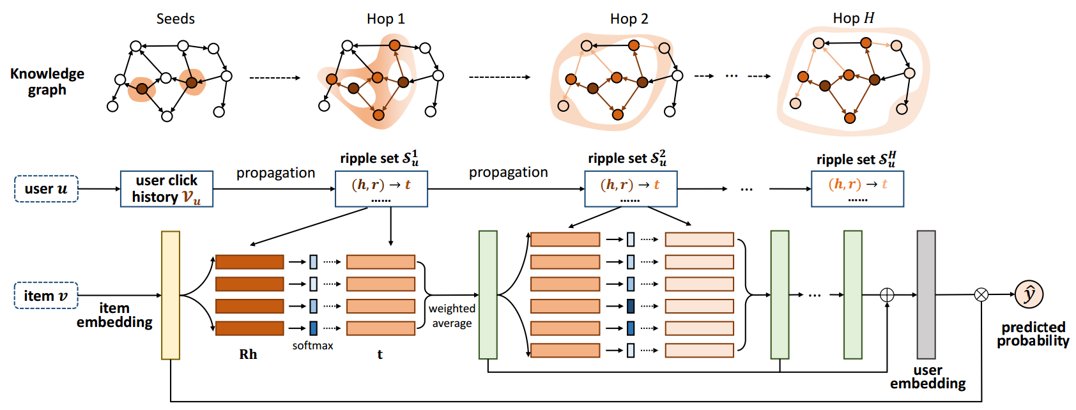


The overall framework of the RippleNet
each triple (hi, ri, ti) in S_{u}¹ is assigned a relevance probability:
o_{u}¹ : the 1-order response of user u ’s click history Vu with respect to item v:
(4)+(5):preference propagation ;
replacing v with o_{u}¹ in Eq. (4) , repeat the procedure iteratively…;
Notes:
*Item embedding based on the application scenario *take the embedding matrix Ri into consideration when calculating the relevance of item v and entity hi :
item-entity pair may have diﬀerent similarities when measured by diﬀerent relations
*similar to item-based CF methods in which a user is represented by his related items , to reduce the size of parameters
*interests are transferred from his history set Vu to the set of his 1-hop relevant entities Eu1 along the links, is called preference propagation

Slide 9


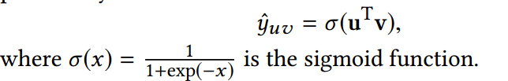
The overall framework of the RippleNet
The embedding of user u with respect to item v :
output the predicted clicking probability:
Notes:
*last hop ouH contains all the information from previous hops theoretically necessary to incorporate ok u of small hops k in calculating user embedding since they may be diluted in oH u

Slide 10
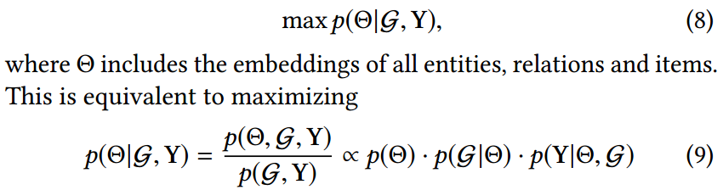

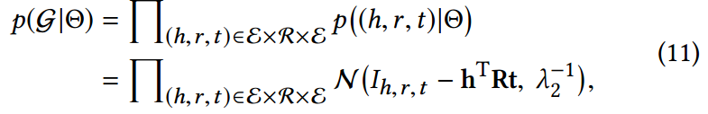

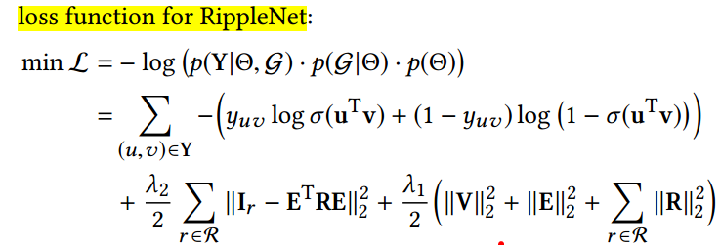
Learning Algorithm
Notes:
Frst term measures the cross-entropy loss between ground truth of interactions Y and predicted value by RippleNet,
the second term measures the squared error between the ground truth of the KG Ir and the reconstructed indicator matrix ETRE,
and the third term is the regularizer for preventing over-ftting.
G,Y是可观测变量，一般都假设为θ分布。所以模型根据G,Y求θ后验分布
分母，边缘分布，可观测，固定
每一个关系对生成的概率：尽可能乘积为1 差值标准正态分布

Slide 11
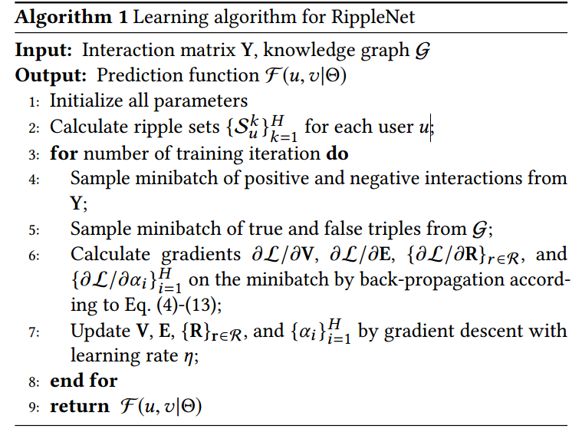
Learning Algorithm

Slide 12
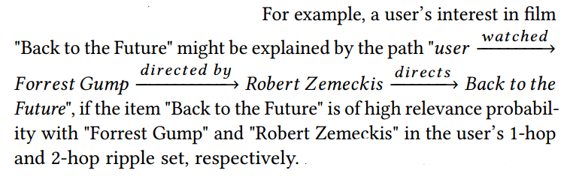
concern about ripple sets: too large size with the increase of hop number k
Solutions:
specific scenarios: limit relations to scenario-related categories
number of maximal hop H is usually not too large in practice
sample a fixed-size set of neighbors
Explainability
Ripple Superposition an entity could be reached by multiple paths starting from a user’s click history.
These parallel paths greatly increase a user’s interests in overlapped entities.
Notes:
*Automatically tracking the paths from a user’s history to an item with high relevance probability in the KG, reveal why a user might like a particular item
*an entity could be reached by multiple paths in the KG starting from a user’s click history. For example, "Saving Private Ryan" is connected to a user who has watched "The Terminal", "Jurassic Park" and "Braveheart“ through actor "Tom Hanks", director "Steven Spielberg" and genre "War", respectively. These parallel paths greatly increase a user’s interests in overlapped entities. We refer to the case as ripple superposition .

Slide 13
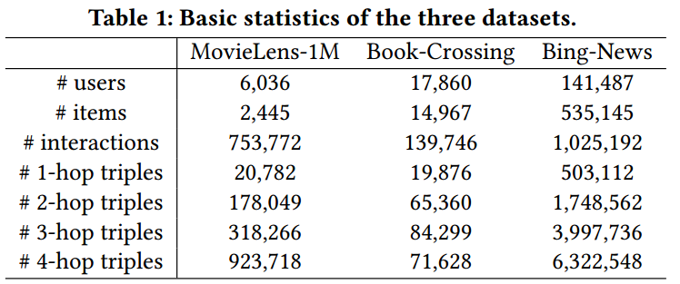
EXPERIMENTS
Dataset:MovieLens-1M⁶ , Book-Crossing , Bing-News
how to construct KG for each dataset :Using Microsoft Satori
Select a subset of triples from the whole KG whose relation name contains "movie" or "book";
collect IDs of all valid movies/books by matching their names with tail of triples (head, flim.flim.name, tail) or (head, book.book.title, tail)
match the IDs with the head and tail of all KG triples from the sub-KG , select all well-matched triples, and extend the set of entities iteratively up to four hops
Notes:
Each piece of news has a title and a snippet. For simplicity, items with no matched or multiple matched entities are excluded.
找到所有的关系对，跟主题相关的；
从关系对中找到相关的 item，也就是关系名是flm.flm.name的…
找到跟item相关的所有关系对，并基于此扩展item/实体

Slide 14
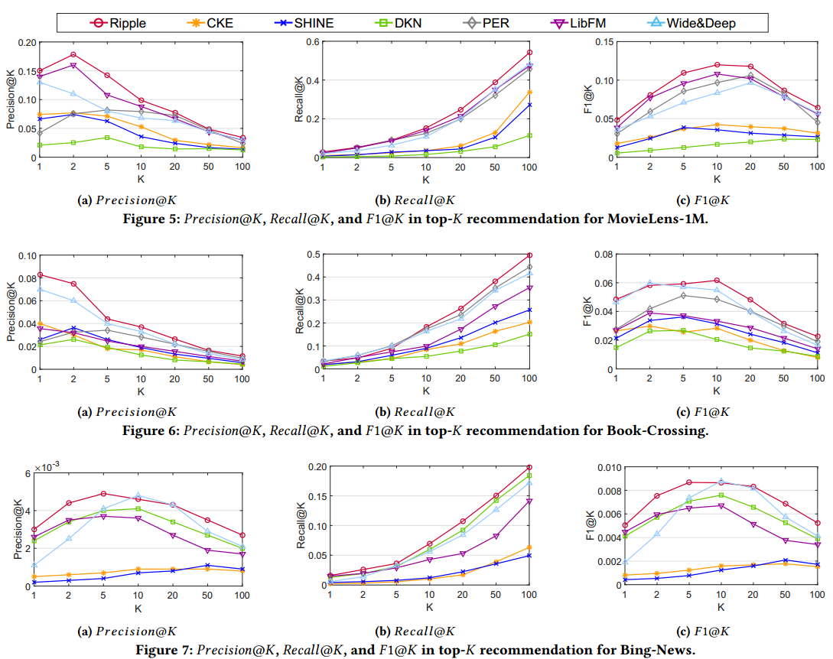
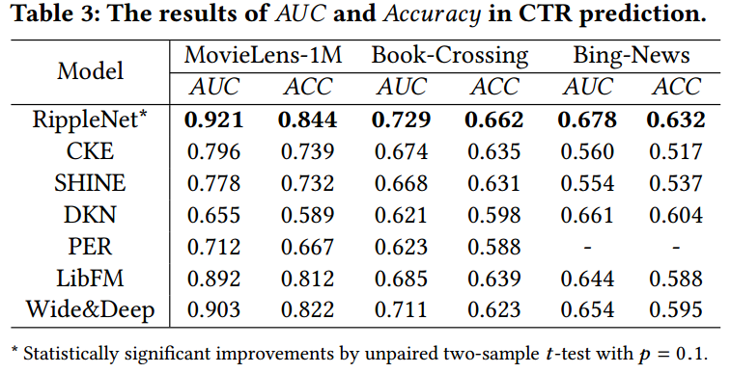
Results:
In click-through rate (CTR) prediction: In top-K recommendation:
Notes:
CKE:CF + structural knowledge module
SHINE autoencoders for user-item interaction and item profile
DKN entity embedding +word embedding as multiple channels, combines them together in CNN
PER treats the KG as HIN and extracts meta-path based features to represent the connectivity between users and items.
LibFM: feature-based factorization input:concatenate user ID, item ID, and the corresponding averaged entity embeddings Wide&Deep : combining a (wide) linear channel with a (deep) nonlinear channel

Slide 15
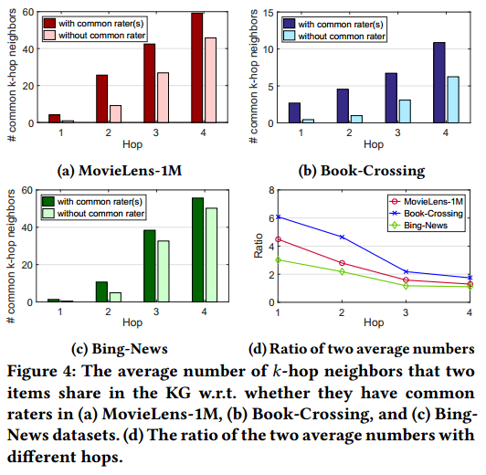
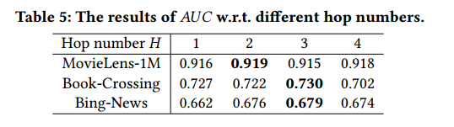
Empirical Study about hop-k
trade-oﬀ between the positive signals from long-distance dependency and negative
signals from noises
Notes:
find a moderate hop number in RippleNet to explore users’ potential interests as far as possible while avoiding introducing too much noise.
too small of an H can hardly explore inter-entity relatedness and dependency of long distance

Slide 16
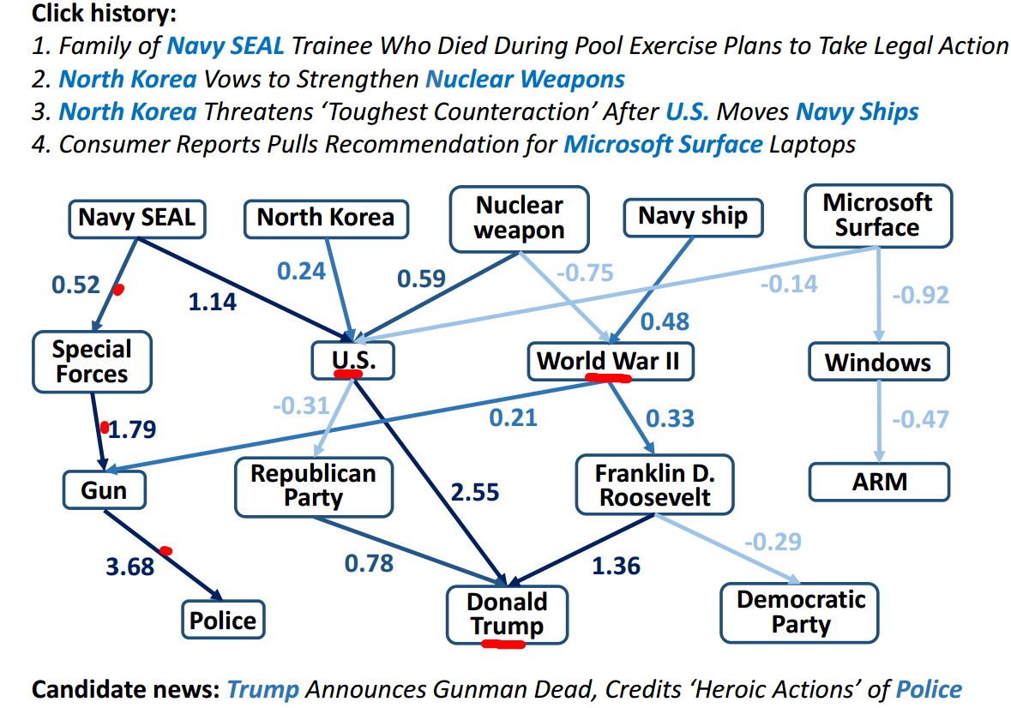
Case Study
RippleNet associates the candidate news with the user’s relevant entities with diﬀerent strengths
several entities in the KG receive more intensive attention from the user’s history, resulting from the ripple superposition

