Slide 1
Graph Neural Networks: A Review of Methods and Applications
Jie Zhou∗, Ganqu Cui∗, Zhengyan Zhang∗, Cheng Yang, Zhiyuan Liu,
Tsinghua University
Notes:
系统地介绍了原型和不足，各种变体…，对应用GNN的系统做了分类，最后提出了未来发展中的问题
精力有限，只讲模型部分

Slide 2
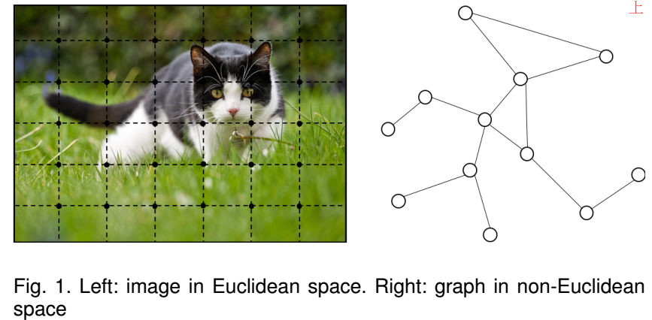
Background
graph data (rich relation information among elements)
used as denotation of a large number of systems across various areas： social science (social network); natural science (physical systems and protein-protein interaction networks), knowledge graphs…
analyzing graphs with ML have been receiving more and more attention
graph analysis
As a unique non-Euclidean data structure for ML, graph analysis focuses on node classification, link prediction and clustering..
Notes:
图是一种模拟一组对象（节点）及其关系（边）的数据结构。
近年来，由于图形的强大表现力，即图形可以用作包括社会科学、自然科学在内的各种领域的大量系统的表示，用机器学习分析图形的研究越来越受到关注。
图结构的数据比较特殊，是非欧式… 解释图 regular Euclidean data like image (2D grid) and text (1D sequence)
针对图数据的分析进行的工作有：

Slide 3
GNN(Graph Neural Networks):
convincing performance and high interpretability, GNN has been a widely applied graph analysis method recently.
connectionist models that capture the dependence of graphs via message passing between the nodes of graphs.
GNN retain a state that can represent information from its neighborhood with an arbitrary depth.
Notes:
GNN作为在图域上运行的基于深度学习的方法，由于…，广泛应用到了图分析中
介绍GNN时，提到了两个特点：
连接模型，通过图形节点之间的消息传递，捕获节点间的依赖性。
GNN保留一个状态，可以获取和利用来自任意深度的邻域的信息（很多步的邻居的信息）

Slide 4
fundamental motivations
1.CNNs：only operate on regular Euclidean data（ instances of graphs）
keys : local connection, shared weights and multilayer.
These keys are of great importance to graph domain:
graphs : the typical locally connected structure.
shared weights reduce the computational cost.
multi-layer structure : deal with hierarchical patterns, which captures features of various sizes.
Find generalization of CNNs to graphs ?
hard to define localized convolutional filters and pooling operators
hinders the transformation of CNN from Euclidean to non-Euclidean domain.
Notes:
CNN: extract multi-scale localized spatial features and compose them to construct highly expressive representations, 和传统谱理论的方法相比
多层结构的使用，多层结构是处理分层模式的关键，它捕获各种大小的特征。Eg: 某个子图的embedding
很难定义局部卷积filters和池化算子，这阻碍了CNN从欧几里德域到非欧几里德域的转换。*

Slide 5
fundamental motivations
2.graph embedding
represent graph nodes, edges or subgraphs in low-dimensional vectors
Following the idea of representation learning and word embedding
Examples:
DeepWalk: treats nodes as words and the generated random walks on graphs as sentences, and then applies SkipGram model on them
node2vec ,LINE ,and SDNE and so on.
Drawback:
computationally expensive and non-optimal for large graphs.
Notes:
另一个动机来自图嵌入，它学习图形节点，边或子图的低维向量表示。受表征学习和word embedding成功应用的影响。
DeepWalk将节点视为单词，将在图上生成的随机路径作为句子处理，然后再使用SkipGram模型。
然而，对于大图，这些方法在计算复杂度高并且不是最佳的。
GNN旨在解决这些问题。

Slide 6
why GNN are worth investigating(GNN VS CNN…)
1.order of nodes:
There isn’t a natural order of nodes in the graph;
CNNs and RNNs: stack the feature of nodes by a specific order;
GNNs: propagate on each node respectively
2. How to deal with the edge(the information of dependency between two nodes):
standard NN: regarded dependency information as the feature of nodes.
GNNs: do propagation guided by the graph （edge)
3. About reasoning
reasoning is a very important research topic for high-level AI;
standard NN: cannot learn the reasoning graph from large experimental data;
GNNs: generate the graph from non-structural data,
a powerful neural model for further high-level AI.
Notes:
1.图中没有自然的节点顺序;CNN等按特定顺序堆叠节点的特征; GNN在每个节点上…顺序无关
2.GNN把边作为一种实体，通过边进行传播，通过近邻节点状态的加权和来更新节点的隐藏状态。
3.推理是人的高级功能，也是高级AI的目标；人脑的推理过程可看做从日常经验中提取出一个抽象图的过程;
GNN可以成为为高级AI提供支持的神经模型（发现多个图中的相似的模式，学习到规律….）

Slide 7
Models(original &variants)
1. original graph neural networks and limitations
2. variants operate on graphs with different types,
and utilize different propagation functions
Notes:
在不同类型图上的变体
和不同的传播函数的变体

Slide 8

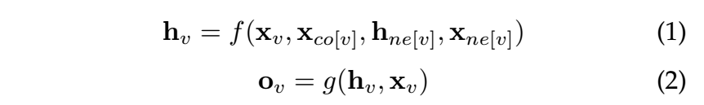


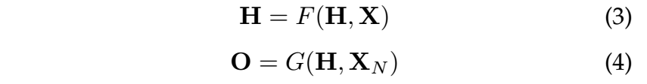
original GNN:
each node is defined by its features and the related nodes
target： learn a state embedding:
（1）中参数：节点v的特征,节点v对应的边的特征, 节点v的近邻点的特征，自身状态, f: local transition function, shared among all nodes
g:local output function, describes how the output is produced
全局/向量形式：
把H,O,X，X_{N} 分别表示所有状态，所有输出，所有特征，何有节点特征堆叠形成的向量，
Notes:
对每个节点的处理分为两个环节：
参数介绍一遍，再为什么叫传播状态：contains the information of neighborhood;
输出：used to produce an output(标签，其他作用；loss
F,全局转移函数，G，全局输出函数，分别是整个图上所有节点的f，g的堆叠形式

Slide 9
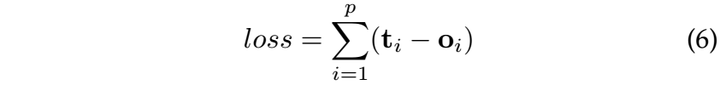
Model learning
The value of H is the fixed point of Eq. 3.
Banach’s fixed point theorem,
How to learn the parameters of f and g:
Loss:
p : number of supervised nodes ; ti the target information for the supervision
gradient-descent strategy
Notes:
使用经典迭代方案来计算状态：
for any initial value H(0) 公式5的速度是求方程3的解的指数级倍
当我们确定GNN的框架时，接下来的问题是如何学习参数.f和g中描述的计算可以被解释为前馈神经网络，也是我们要学习的参数（学到了W，状态自然得到））
迭代状态初始值，计算H的不动点；根据loss计算对参数的梯度，梯度下降。

Slide 10
Limitations
inefficient to update the hidden states of nodes iteratively for the fixed point.
uses the same parameters in the iteration; while most popular NN use different parameters in different layers,
(hierarchical feature extraction)
the update of node hidden states is a sequential process
which can benefit from the RNN kernel like GRU ans LSTM
some informative features on the edges which cannot be modelled
Notes:
基于不动点原理，迭代地更新节点的隐藏状态是低效的。
GNN在迭代中使用相同的参数，而大多数流行的神经网络在不同的层中使用不同的参数，这些参数可以用作分层的特征提取方法。
此外，节点隐藏状态的更新是一个顺序过程，所以可以受益于RNN内核，如GRU和LSTM。
边也有一些信息特征，然而在原始GNN中无法对边建模。此外，如何学习边的隐藏状态也是一个重要问题。

Slide 11

variants operating on different graph types
original GNN, the input graph consists of nodes with label information and undirected edges, the simplest graph format
Directed Graphs bring more information than undirected edges eg: the edge starts from the head entity(parent) and ends at the tail entity
ADGPM uses two kinds of weight matrix to incorporate more precise structural information
H^{t-1}’
M. Kampffmeyer, Y. Chen, X. Liang, H. Wang, Y. Zhang, and E. P. Xing. Rethinking knowledge graph propagation for zero-shot learning. arXiv preprint arXiv:1805.11724, 2018.
Notes:
original GNN, 节点有标签信息，无向图，最简单形式
在知识图中，边从头部实体开始并在尾部实体处结束，头部实体是尾部实体的父类，这表明我们应该以不同的方式处理来自父类和子类的信息传播过程。
两种邻接矩阵合起来相当于总的，关键在于两个参数矩阵，更有效对不同边建模

Slide 12
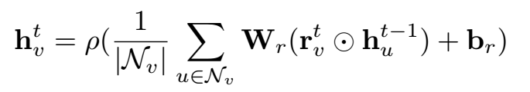
variants operating on different graph types
Graphs with Edge Information
each edge also has its information like the weight or the type of the edge
convert the graph to a bipartite graph:
the original edges ->nodes; one original edge ->two new edges
The encoder of G2S uses the following aggregation function for neighbors:
Wr and br : propagation parameters for different types of edges (relations)
D. Beck, G. Haffari, and T. Cohn. Graph-to-sequence learning using gated graph neural networks. In Proceedings of the 56th Annual Meeting of the Association for Computational Linguistics (Volume 1: Long Papers), pages 273–283. Association for Computational Linguistics, 2018
Notes:
which means there are two new edges between the edge node and begin/end nodes.
边节点的状态或者特征？中介点 再传播到点v

Slide 13


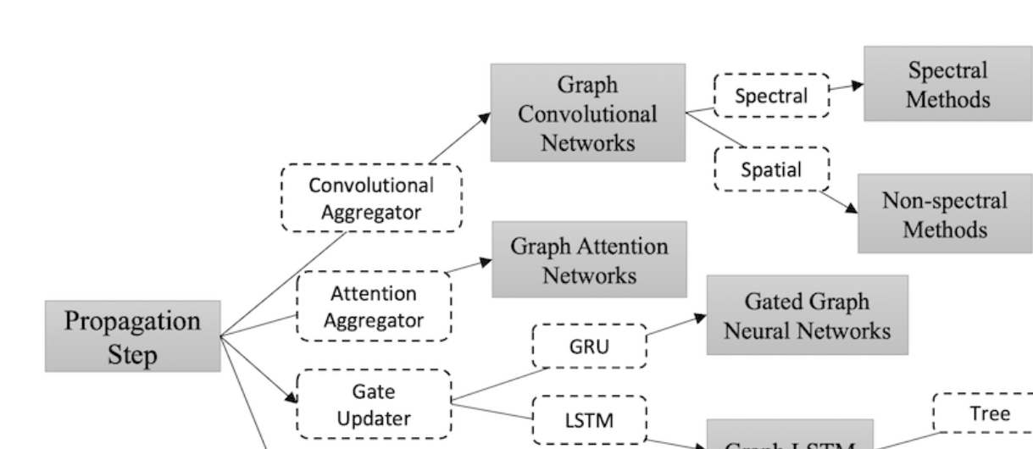
Variants with different propagation Types
Propagation : aggregators+ updaters
1）different aggregators to gather information from each node’s neighbors
2）Specific updaters to update nodes’ hidden states
Convolution： generalizing convolutions to the graph domain； categorized as spectral approaches and non-spectral approaches.
Notes:
传播过程就是更新自身的embedding的过程：分为两步：从近邻收集信息，更新自身的状态

Slide 14
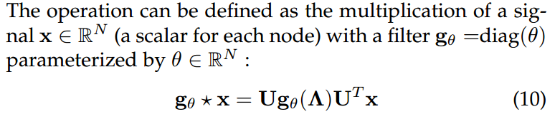
Spectral approaches
work with a spectral representation of the graphs
convolution operation is defined in the Fourier domain by computing the eigendecomposition of the graph Laplacian.
U is the matrix of eigenvectors of the normalized graph Laplacian L
D :degree matrix ;A : adjacency matrix of the graph Λ :a diagonal matrix of its eigenvalues
Drawback:a model trained on a specific structure could not be directly applied to a graph with a different structure. J. Bruna, W. Zaremba, A. Szlam, and Y. Lecun. Spectral networks and locally connected networks on graphs. international conferenceon learning representations, 2014.
Notes:
这类方法基于对图的谱方法表示。
卷积操作主要借助于拉普拉斯矩阵的奇异值分解。
X信号向量；g（）
the learned filters depend on the Laplacian eigenbasis, which depends on the graph structure 依赖于特定的图结构

Slide 15



Non-spectral approaches
operating on spatially close neighbors
major challenge：
defining the convolution operation with different sized neighborhoods and maintaining the local in-variance of CNNs.
Duvenaud uses different weight matrices for nodes with different degrees：
is the weight matrix for nodes with degree Nv at Layer L drawback：cannot be applied to large-scale graphs with more node degrees.
D. K. Duvenaud, D. Maclaurin, J. Aguileraiparraguirre, R. Gomezbombarelli, T. D. Hirzel, A. Aspuruguzik, and R. P. Adams. Convolutional networks on graphs for learning molecular fingerprints. neural information processing systems, pages 2224–2232, 2015.
Notes:
难点是定义具有不同大小的邻域的卷积运算，并维持CNN的局部不一致。
对不同度数的节点使用不同的权重矩阵

Slide 16


Non-spectral approaches
Atwood proposed the diffusion-convolutional neural networks (DCNNs)
Use Transition matrices to define the neighborhood for nodes
X :N × F tensor of input features (F is the number of features)
P is the degree-normalized transition matrix from the adjacency matrix A P∗ :N×K×N tensor; contains the power series {P; P2, ..., Pk} of matrix P
H (which is N × K × F ) :the diffusion representations of each node J. Atwood and D. Towsley. Diffusion-convolutional neural networks. In D. D. Lee, M. Sugiyama, U. V. Luxburg, I. Guyon, and R. Garnett, editors, Advances in Neural Information Processing Systems 29, pages 1993–2001. Curran Associates, Inc., 2016.
Notes:
X是n个节点的特征矩阵；P是度数规范化之后的邻接矩阵，P2是P的乘积运算，理解为从某个节点出发后的二跳连接矩阵
每个实体在图上每跳一次之后，都有一个F维的特征，最终形成K*F的扩散卷积表示；在经过一个K*F的权重矩阵和非线性关系，形成最终的扩散表示

Slide 17
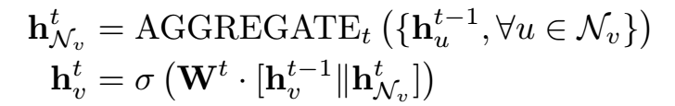
Non-spectral approaches
GraphSAGE：a general inductive framework
generates embeddings by sampling and aggregating features from a node’s local neighborhood.
not utilize the full set of neighbors, but a fixed-size set of neighbors by uniformly sampling.
suggests several aggregator functions：Mean ；Pooling … Pooling :Each neighbor’s hidden state ->a full connected layer ->a max-pooling operation
W. L. Hamilton, Z. Ying, and J. Leskovec. Inductive representation learning on large graphs. neural information processing systems, pages 1024–1034, 2017.
Notes:
通过从节点的邻域中对特征进行采样和聚合来生成自己的embedding。
不使用所有邻居整合信息，而是通过均匀采样来使用固定大小的邻居
Each neighbor’s hidden state is fed through a full connected layer and then a max-pooling operation is applied to the set of the node’s neighbors.

Slide 18
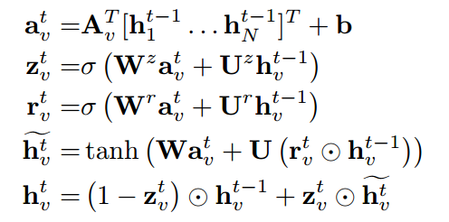
Gated Graph Neural Networks(GGNN)
use the gate mechanism like GRU or LSTM in the propagation
improve the long-term propagation of information across the graph structure.
basic recurrence of the propagation model:
Av is the connection of node v with its neighbors;
a gathers the neighborhood information of node v;
z and r are the update and reset gates
GRU-like update functions incorporate information from the other nodes and from the previous timestep
Y. Li, D. Tarlow, M. Brockschmidt, and R. S. Zemel. Gated graph sequence neural networks. arXiv: Learning, 2016.
Notes:
在传播步骤中使用门递归单位（GRU），展开固定步数T的递归，并使用反向传播来计算梯度。
1.第一步整合，近邻信息。
后面几部更新。
2.Reset和更新门由近邻状态和上个状态决定。
3.记忆单元：由近邻状态和reset门，上个状态决定（Reset,相关门 决定记忆单元跟前一个状态的相关度；
4.下个状态由上个状态，更新门和记忆单元决定
可以把从近邻收集的信息当作是GRU中的外部输入，节点状态还是状态

Slide 19
Variants with other propagation Types
LSTMs are also used in a similar way as GRU through the propagation process
Graph Attention Networks：computes the hidden states of each node by attending over its neighbors, following a self-attention strategy.
…
Notes:
使用LSTM的跟GRU类似
除此之外，还有将self-attention融合到模型中的改进
由于时间关系，不在一一说明。
除此之外，也抽象出几个框架，介绍了模型应用，不在说明。

Slide 20
谢谢大家 欢迎批评指正

