Slide 1
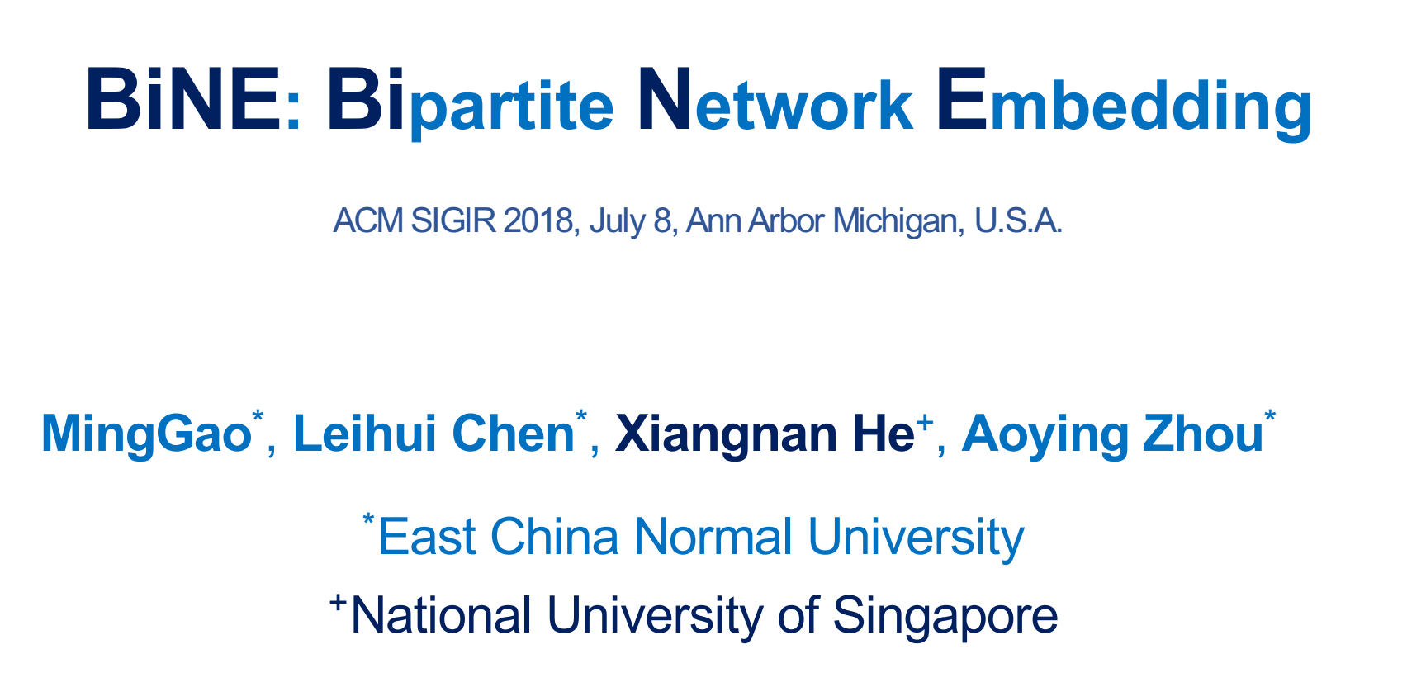

Slide 2
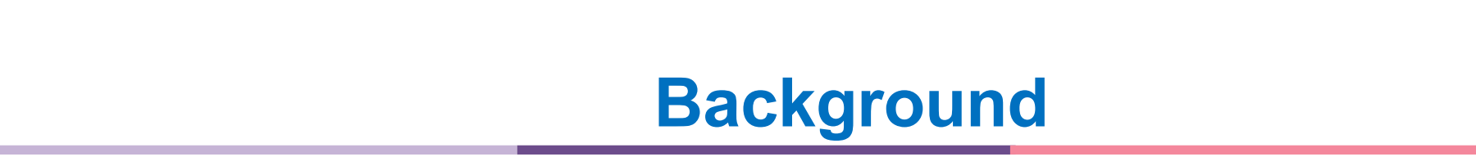
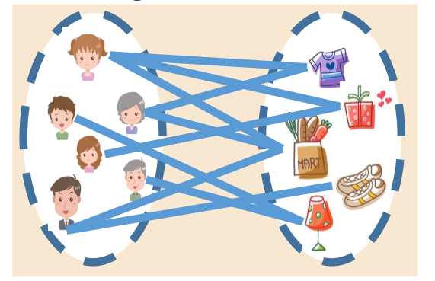
Network
A ubiquitous data structure to model the relationships between entities.
Bipartite Network:
Two types of vertexes;
Only observed edges between the two types of vertexes.
Network embedding
Crucial to obtain the representations for vertices.
Helpful to many applications, such as vertex labeling, link prediction, recommendation, and clustering, etc.
Notes:
只有在不同类型的两个点之间才存在边。比如一个用户购买商品的推荐系统中….
分析图的重要技术：

Slide 3
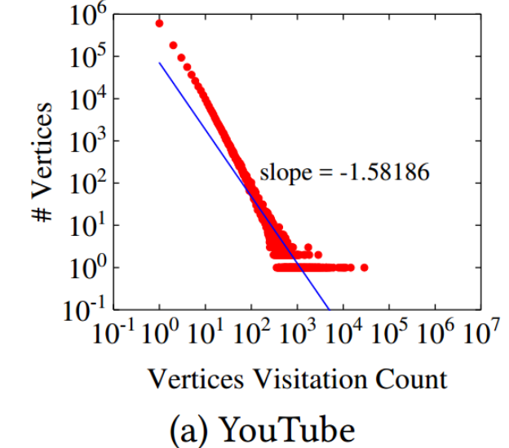
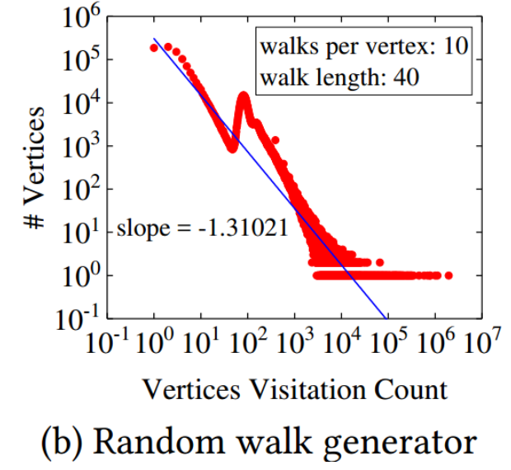
Homogeneous network embedding: (vertices are of the same type)
Similar to DeepWalk: random walks +word embedding
suboptimal for bipartite networks due to :
Ignore type information of vertices:
*implicit relations between vertices of the same type: important but ignored.
Ignore key characteristic of bipartite network :power-law distribution of vertex degrees
*the random walk generator is not optimal.
Heterogeneous network embedding:
MetaPath2vec++ treats explicit and implicit relations as contributing equally
Notes:
0.图上随机游走，点序列构成的corpus，然后使用skipgram model计算embedding。
1.二部图中两种类型的点。虽然只有不同类型的点之间存在可观测的边，
但是同种节点之间的隐含关系（unobserved but transitive links 可传递的边）也重要：eg在推荐系统中，购买相同项目的用户可能有近似的兴趣，这种关系对于推荐很重要。但是传统只考虑显式边，未考虑隐式关联。
2. youtube数据集中点的频率分布：典型的幂次分布;使用deepwalk的策略生成的语料库中，点的频率分布明显不是…
原因分析：随机游走的生成器对二部图非最优： 每个点出发的路径相同，长度相同
3.也有人把用于heterogeneous networks异构网络embedding的方法（metapath2vec++）直接用于二部图
但没有区分显式关系和隐式关系，但是实际系统中，二者的重要性明显不同.

Slide 4
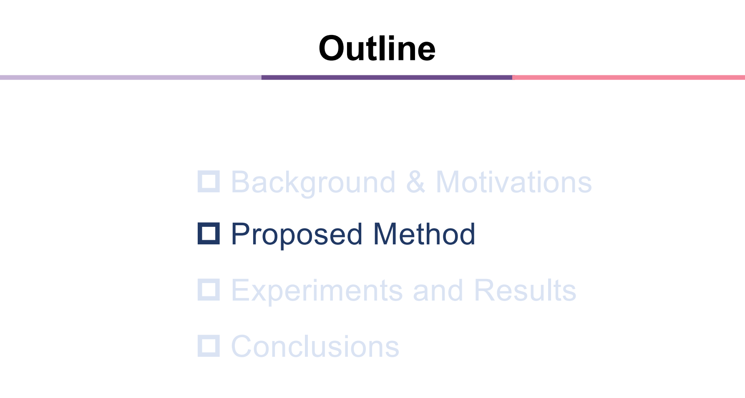

Slide 5
Two Characteristics of BiNE：
Model both the explicit and implicit relations simultaneously .
explicit : to reconstruct the network by focusing on observed links.
Implicit: to capture the high-order correlations in the network.
A biased and self-adaptive random walk generator.
number of walks starting from each vertex based on its importance.
allow a walk to be stopped in a probabilistic way.
Notes:
1.具体的，对每种关系分别设计一个目标函数；
因为两种目标函数共享一个embedding，相互影响。这种联合优化方式，取得更好地效果。
2.为了让生成的embedding尽可能地维持二部图的原始特征，提出了一个….
从每个节点出发的路径数取决于节点重要性，
依据概率决定路径长度，受自然语言中句子长度不同的启发。

Slide 6
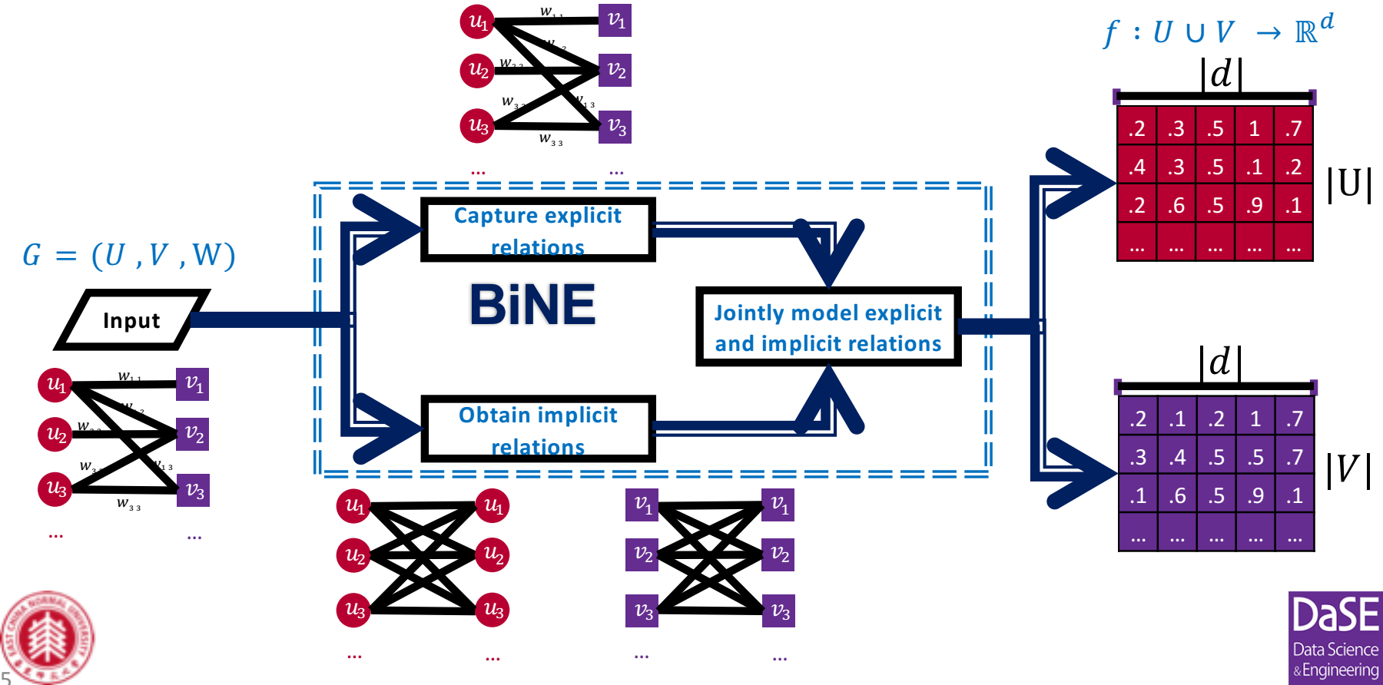

Slide 7
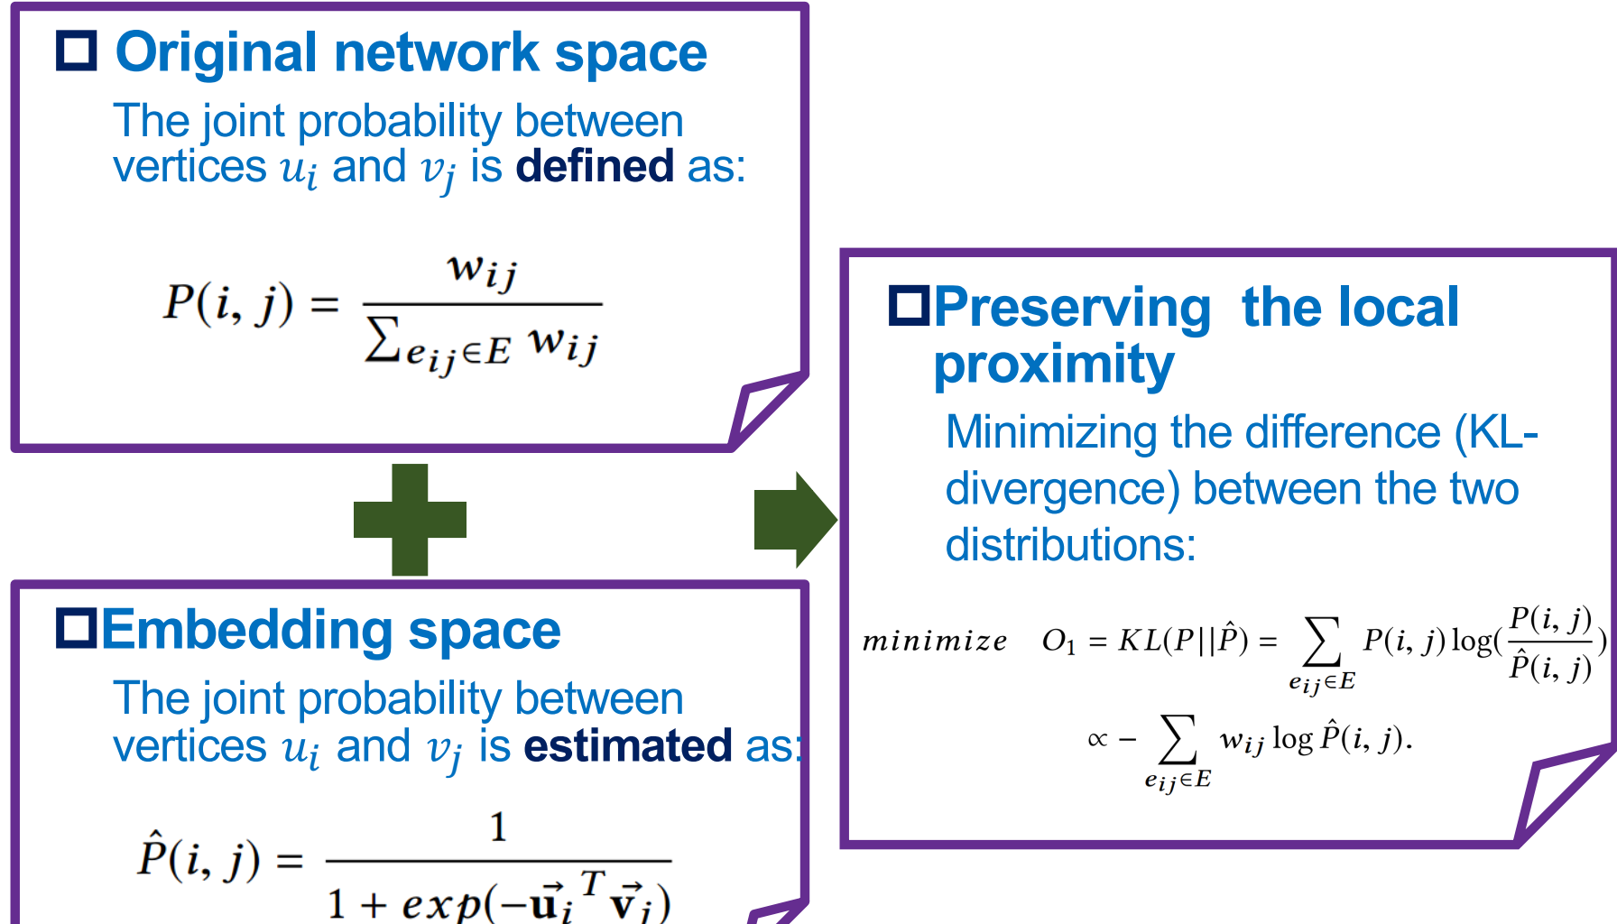
Notes:
1.在图里，衡量两个相连的点的local proximity 可以用权重：边权重/所有权重和
2.评估点在向量空间的local proximity 局部近似性：沿用word2vec的内积处理+sigmoid型的处理
3.一个好的embedding，应该保留原图的局部相似度。所以目标函数就是减小分布的差距，使得原图中联系紧密的两个点在映射空间中也比较近似。

Slide 8
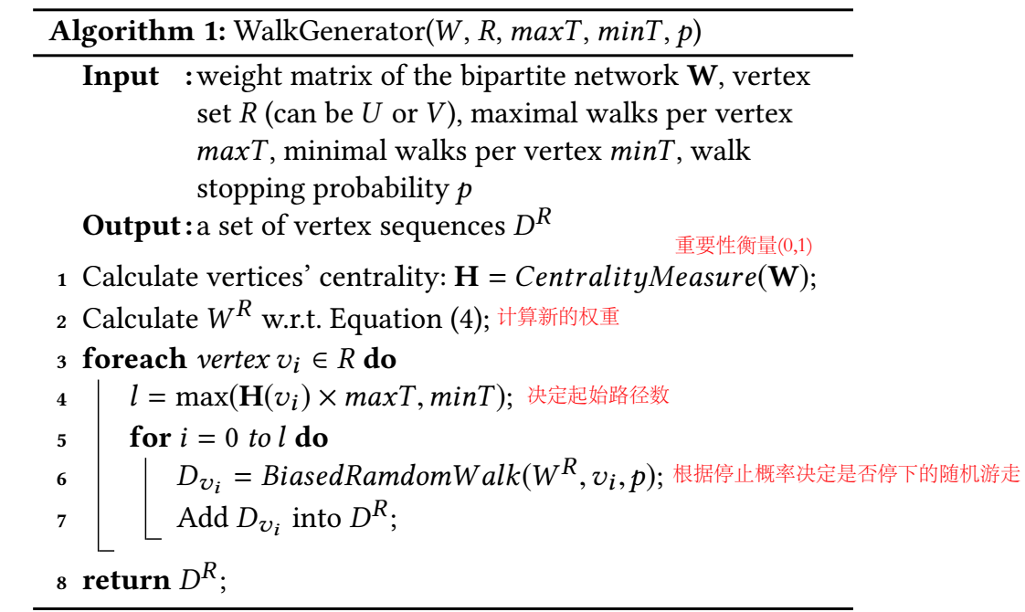
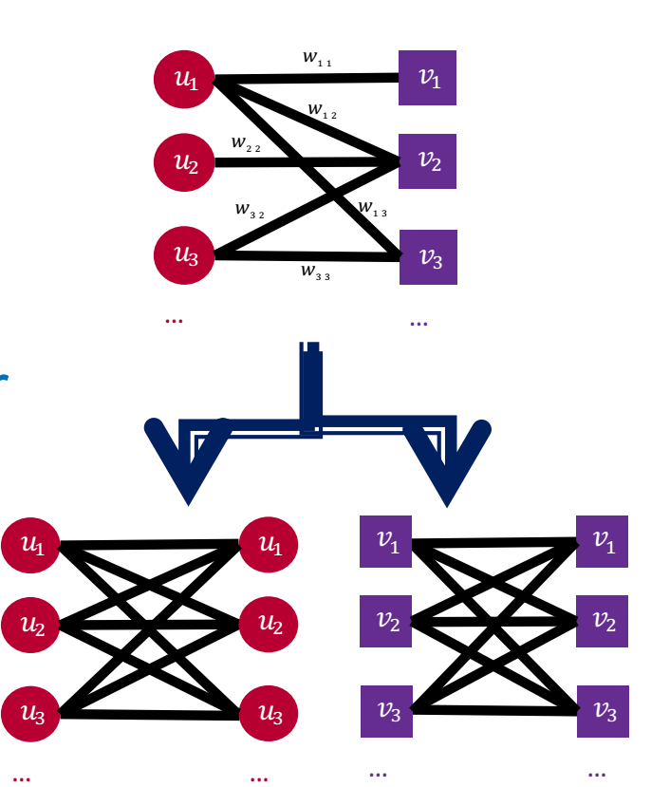
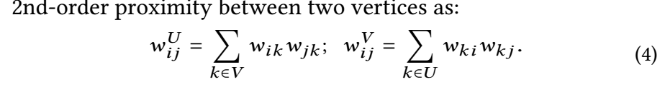
Constructing Corpus of Vertex Sequences
Construct U-U and V-V networks：
random walks on two homogeneous networks that contain the 2nd-order proximity between vertices of the same type.
Run Self-adaptive random walker：
Number of walks starting from a vertex depends on its centrality score；
Length of a vertex sequence is controlled by a stop probability；
Notes:
总的来说，还是两步走….
没有直接在二部图上游走，而是首先构造两个由相同类型的点构成的图，再随机游走。
两个点之间没有边，这里作者认为二者之间存在着2-order的近似性，所以计算了它们的近似性作为边的权重：2-order边的权重是通过某一个中间节点相连的两个显式边的权重乘积和。

Slide 9
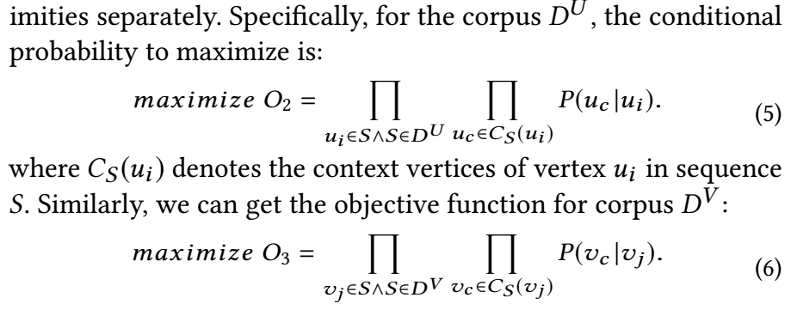
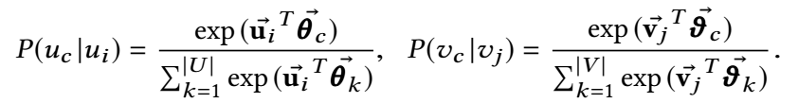
Implicit Relation Modeling：Skipgram model
Assumption: vertices frequently co-occurred in the same context of a sequence should be assigned to similar embeddings.
基于embedding，计算corpus中点和近邻点共现的概率，最大化：
Optimizing O2/O3 is non-trivial：softmax function, time-costing
Notes:
在生成的两个corpus上运用skipgram model 学习节点的embedding。
基本假设：序列上下文中共现比较多的点的embedding近似 LDA等模型….
先确定序列中的一个点，然后确定它上下文中其他点出现的概率：Ui的上下文中，Uc出现的概率。
最大化O2 O3让具有相似context的节点的embedding相似，达到了目标。
softmax需要遍历所有节点:非平凡-负采样,降低复杂度。

Slide 10
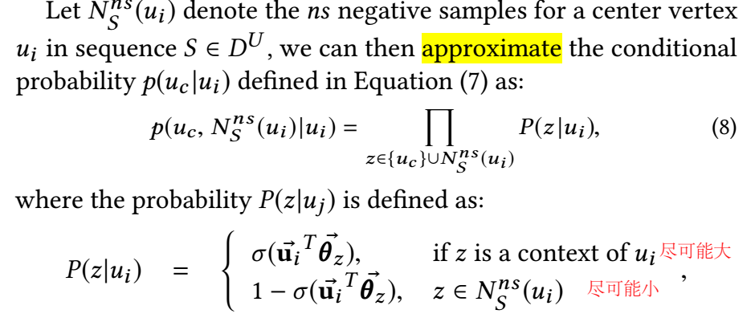
Negative Sampling
Object：For a center vertex ui , high-quality negatives ：dissimilar from ui .
locality sensitive hashing (LSH): guarantees that dissimilar vertices are located in diﬀerent buckets in a probabilistic way
Notes:
把节点按照拓扑结构分块：随机选择一些不包含中心点的桶/块
只关注上下文和负样本，而不是全部点
语义：一个点和上下文点的相似度尽可能大，和负样本的相似度尽可能小

Slide 11


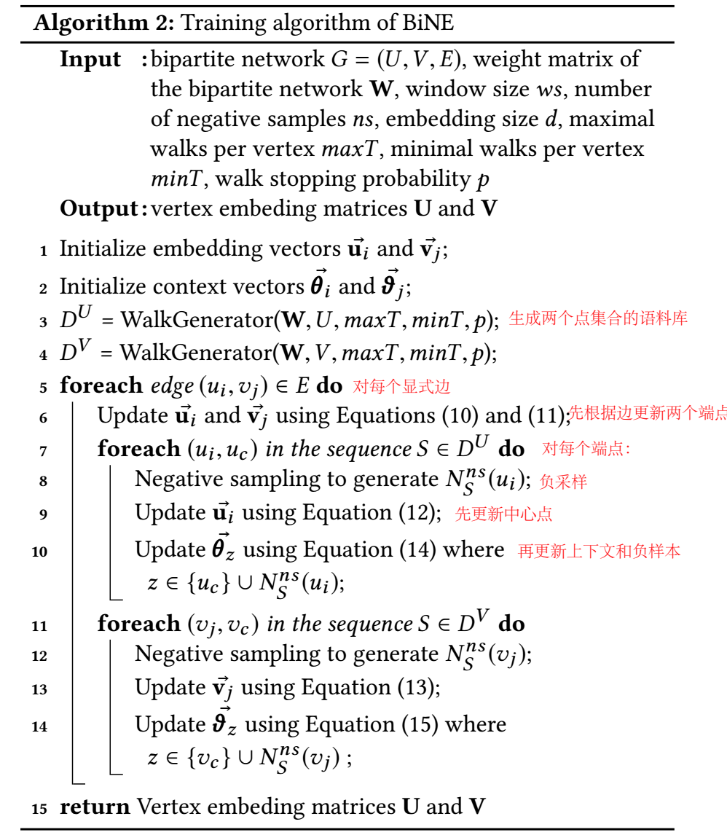

Notes:
α, β and γ are hyper-parameters to be specifed to combine diﬀerent components
三个部分需要的训练样本不同！！！一个对边，一个对点.
上下文的正样本和负样本也要更新

Slide 12
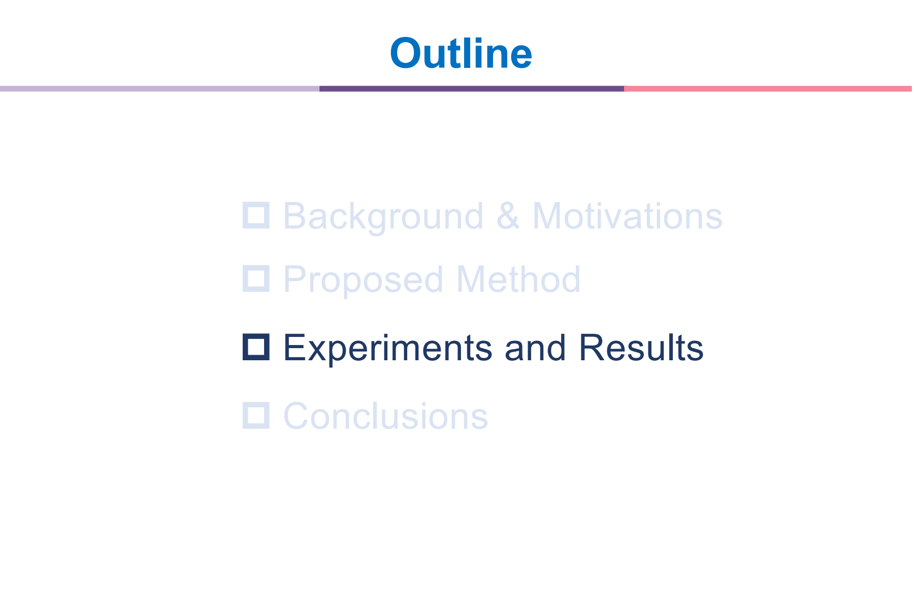

Slide 13
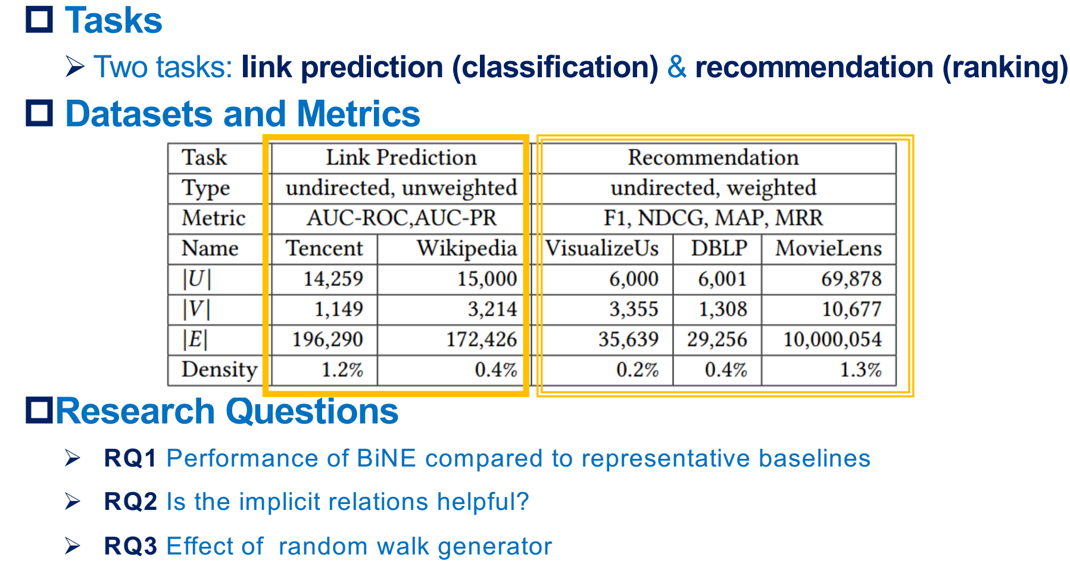
Notes:
area under the ROC curve (AUC-ROC) and Precison-Recall curve (AUC-PR)
Wikipedia :the edit relationship between authors and pages
Tencent dataset records the watching behaviors of users on movies in QQlive
DBLP dataset contains the publish network of authors on venues
VisualizeUS:contains the picture tagging network between pictures and tags, where the edge weight denotes the number of times a tag has been tagged on an image.

Slide 14
Network embedding methods：
homogeneous network embedding ：DeepWalk，LINE，Node2vec
heterogeneous networks ：Metapath2vec++
Link Prediction methods
JC (Jaccard coefficient)
AA (Adamic/Adar)
Katz (Katz index)
PA (Preferential attachment)
Recommendation methods
BPR [Rendle et al UAI 2009]
RankALS [Takács et al Recsys 2012]
FISMauc [Kabbur et al KDD 2013]

Slide 15
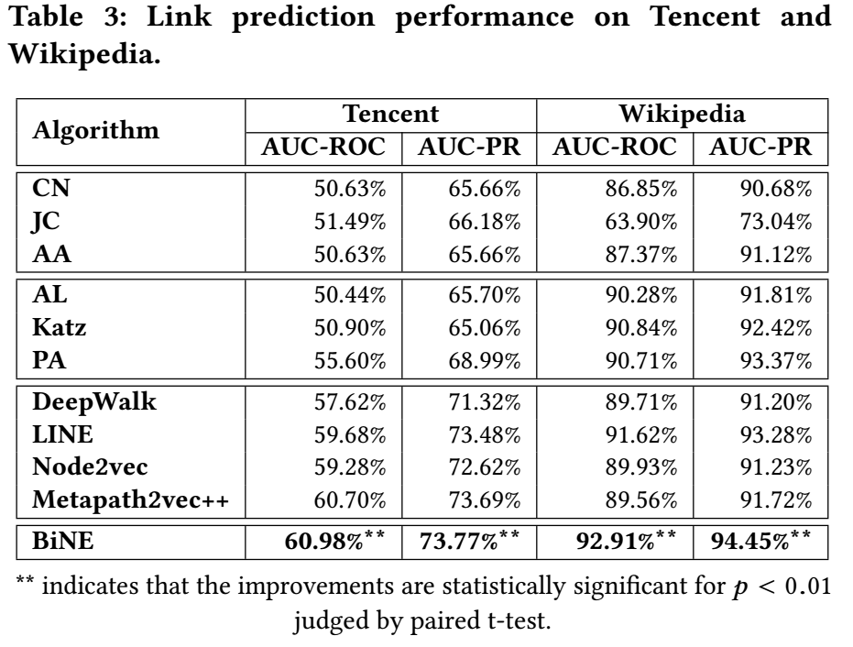
Observations:
1. Data-dependent supervised manner is more advantageous.
2. Positive effect of modeling both explicit and implicit relations into the embedding process.
3. Effectiveness of modeling the explicit and implicit relations in different ways.
Notes:
1. 基于神经网络的方法比传统的基于指标的方法好很多：数据驱动
2.Metapath2vec++ and BiNE are signifcantly better than other neural network-based methods. 同时考虑显式和隐式
3.相比于Metapath2vec++ ，BiNE更优

Slide 16
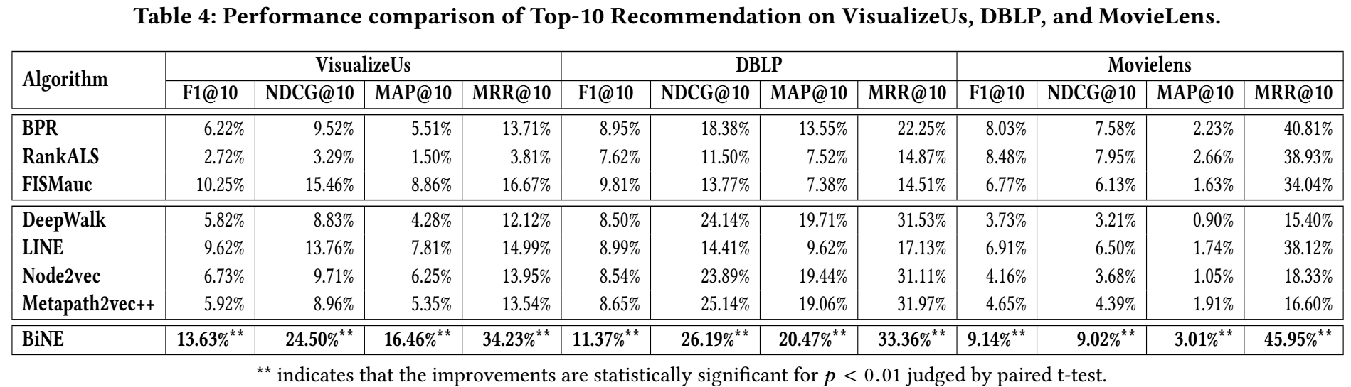
Observations: 1. Importance of focusing on the higher-order proximities among vertices 2. Jointly training is superior to separately training + post-processing
Notes:
2.相比于line：
Line：考虑1/2 order，但忽略更高层；
分别学习到1-order和2-order的embedding，再整合，没有联合训练

Slide 17
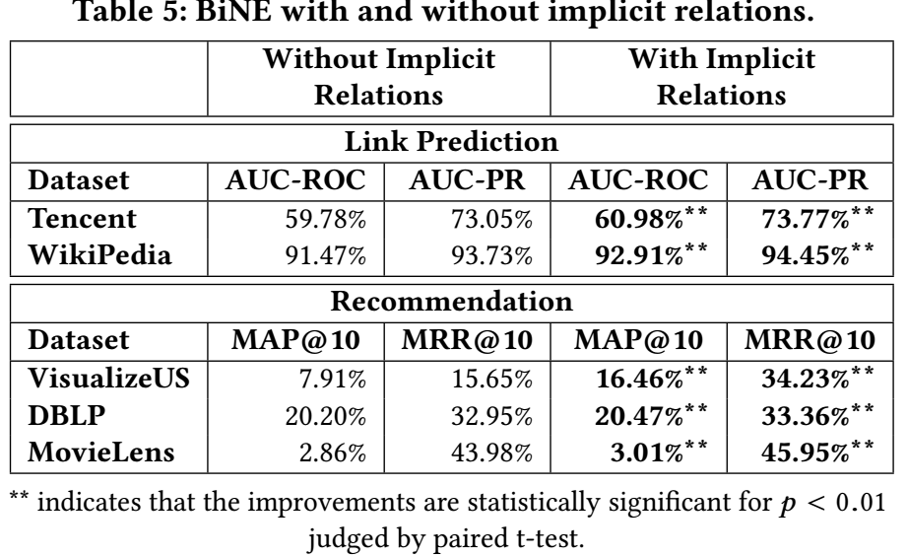
Observation: Modeling high-order implicit relations is effective to complement with explicit relation modeling.
Notes:
compare BiNE with its variant that removes the modeling of implicit relations.

Slide 18
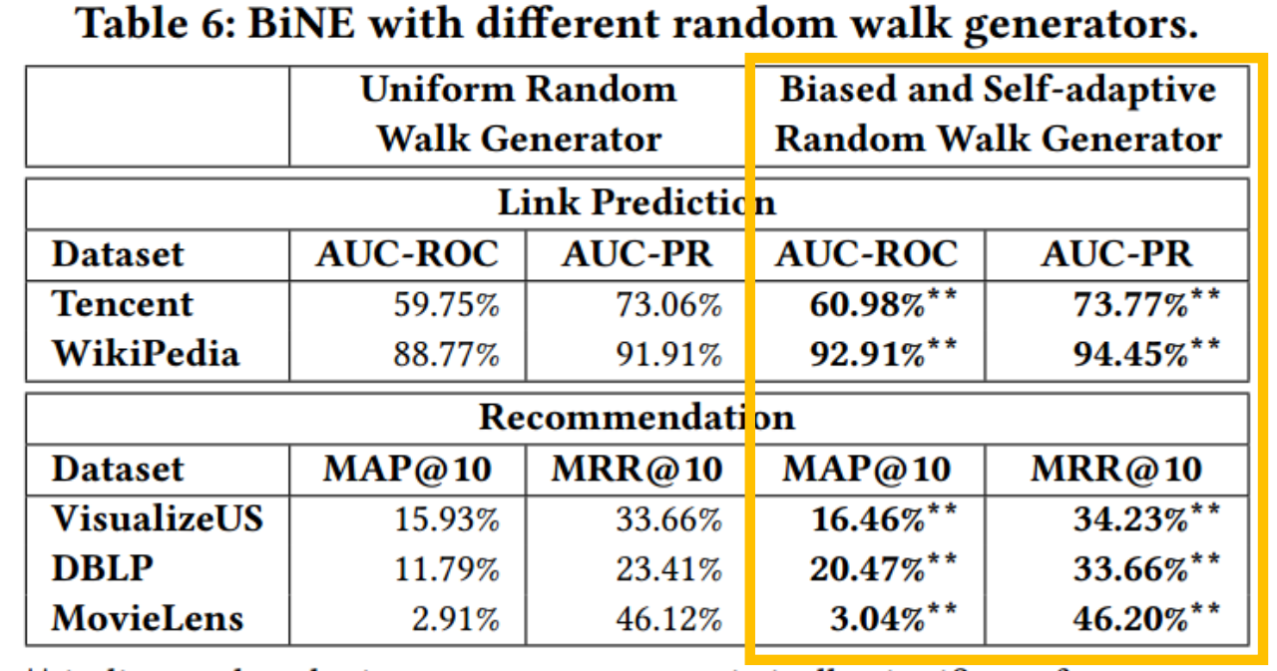
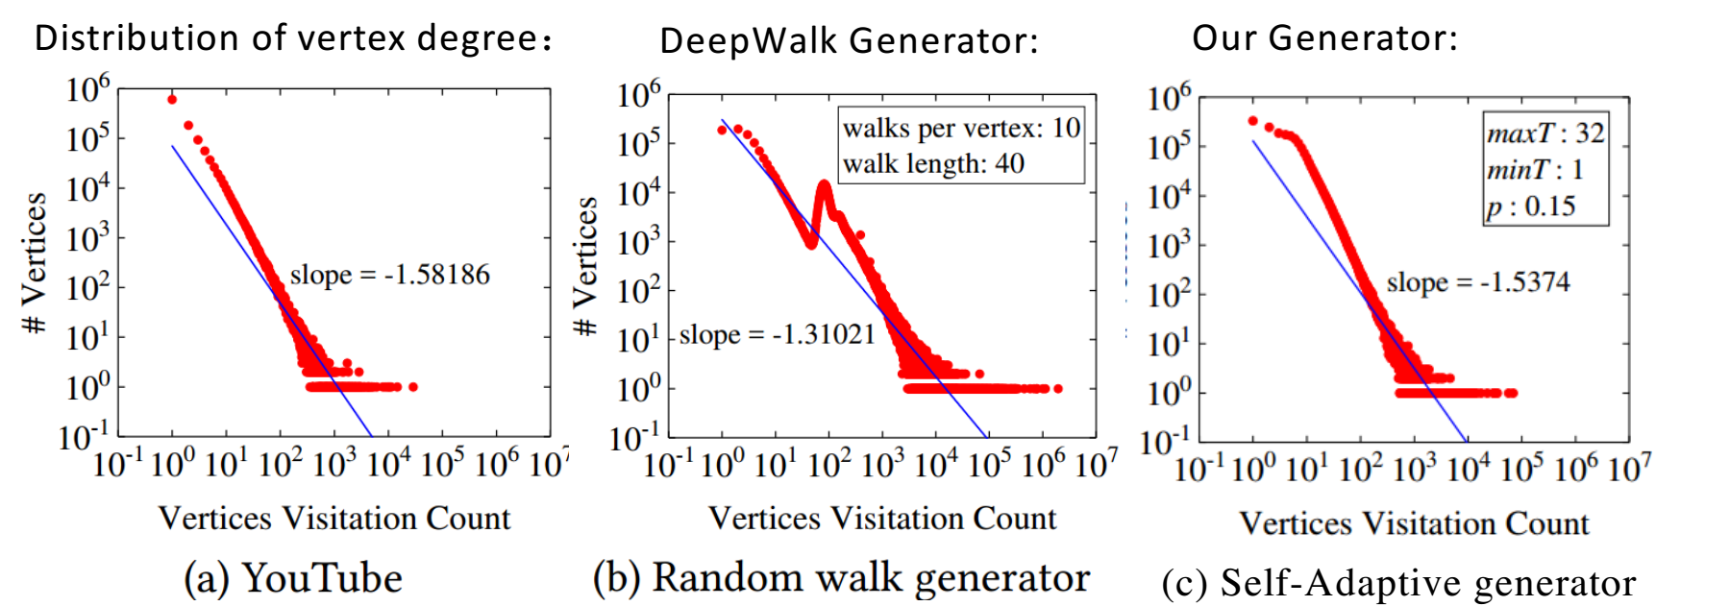
Observation: The biased and self-adaptive random walk generator contributes to learning better vertex embeddings.
Notes:
统计原始数据的分布特征，基于数据得到语料之后再统计，发现分布特征近似

Slide 19
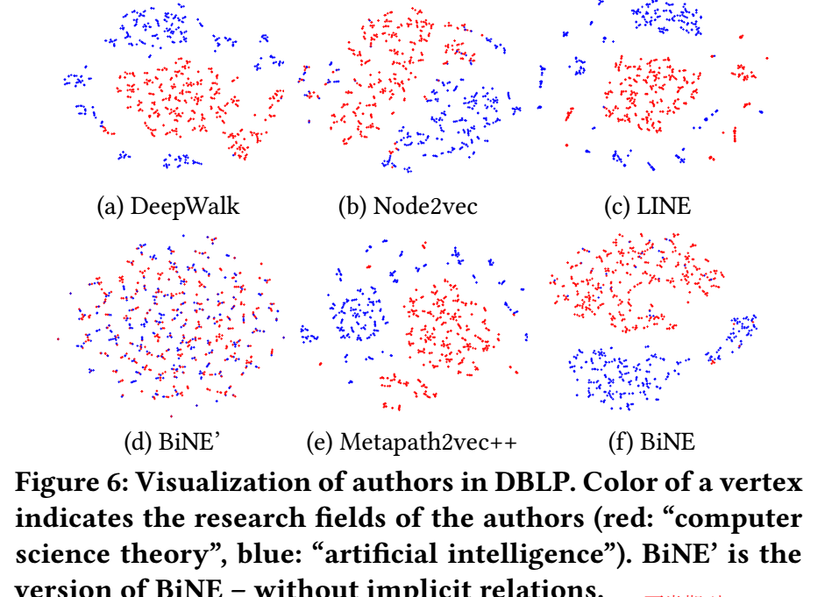
Dataset： A subset of DBLP：
736 researchers and 6 journals from two research fields: computer science theory , AI；
A link will be formed if the researcher published at least 5 papers in the journal.
Embedding + t-SNE tool
Notes:
A good embedding algorithm should provide a meaningful visualization that layout a network.
A subset of DBLP dataset, It consists of 736 researchers and 6 international journals from two diﬀerent research felds: computer science theory , artifcial intelligence
utilize the t-SNE tool [41] to map the embedding vectors of authors into 2D space.
it also generates an obvious gap between two research fields.

Slide 20
Conclusions
Propose a dedicated approach for embedding bipartite networks
Jointly model both the explicit relations and higher-order implicit relations
Extensive experiments on several tasks of link prediction, recommendation, and visualization

