Slide 1
Inductive Representation Learning on Large Graphs
William L. Hamilton
wleif@stanford.edu
Rex Ying
rexying@stanford.edu
Jure Leskovec
jure@cs.stanford.edu

Slide 2
01
Introduction
02
The Details of GraphSAGE
CONTENTS
03
Experiments & Results
04
Conclusion & Appendix

Slide 3
Introduction
Background
Low-dimensional vector embeddings of nodes in large graphs have proved extremely useful as feature inputs for a wide variety of prediction and graph analysis tasks.
The basic idea behind node embedding approaches is to use dimensionality reduction techniques to distill the high-dimensional information about a node’s graph neighborhood into a dense vector embedding.
These node embeddings can then be fed to downstream machine learning systems and aid in tasks such as node classification, clustering, and link prediction.
a single fixed graph → high -throughput, production machine learning systems
Notes:
1）在大网络中节点的低维向量嵌入是很重要的特征输入2）一般的节点嵌入方法是使用降维技术3）降维得到的结果可以用作机器学习系统进行分类、聚类、链路预测等任务
一般的方法是针对单一的固定网络，本文的方法是针对高通量的机器学习系统

Slide 4
Introduction
Transductive Learning vs. Inductive Learning
Transductive Learning：从彼个例到此个例，有点像英美法系，实际案例直接结合过往的判例进行判决，关注具体实践。
Inductive Learning：从多个个例归纳出普遍性，再演绎到个例，有点像大陆法系，先对过往的判例归纳总结出法律条文，再应用到实际案例进行判决。从有限的实际样本中，企图归纳出普遍真理，倾向形而上，往往会不由自主地成为教条。
Transductive和Inductive的区别在于我们想要预测的样本，是不是我们在训练的时候已经见（用）过的。通常transductive比inductive的效果要好，因为inductive需要完成从训练到测试的推广。
Notes:
直推式学习和归纳式学习

Slide 5
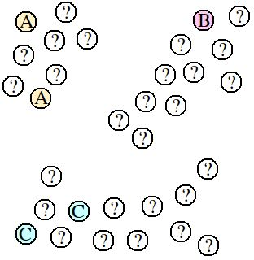
Introduction
Transductive Learning vs. Inductive Learning
Transductive learning直接以某种算法观察出数据的分布，这里呈现三个cluster，就根据cluster判定，不会建立一个预测的模型，如果一个新的数据加进来，就必须重新算一遍整个算法，新加的数据也会导致旧的已预测问号的结果改变。
Inductive learning就是只根据现有的ABC，用比如kNN距离算法来预测，在来一个新的数据的时候，还是只根据kNN来预测。
Notes:
对于高通量的图，如YouTube等网络不适用于transductive learning。
Inductive learning是通过现象总结一个规律，然后对新的数据使用这条规律。这个规律可能不对，所以这种方法有更大的挑战

Slide 6
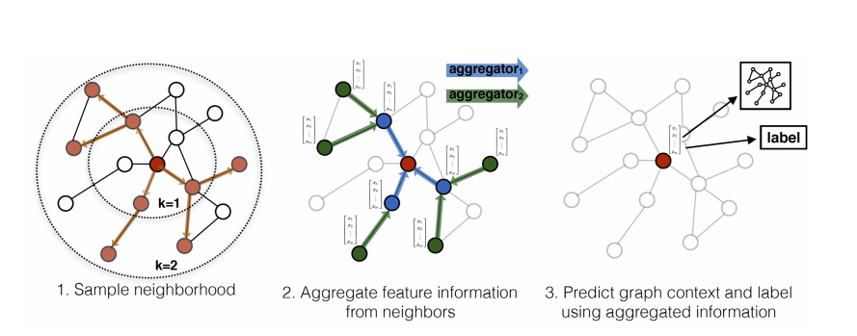
The Details of GraphSAGE
Visual illustration of the GraphSAGE
GraphSAGE (SAmple and aggreGatE) :
Input : node features (e.g., text attributes, node profile information, node degrees)
Instead of training a distinct embedding vector for each node, we train a set of aggregator functions that learn to aggregate feature information from a node’s local neighborhood

Slide 7
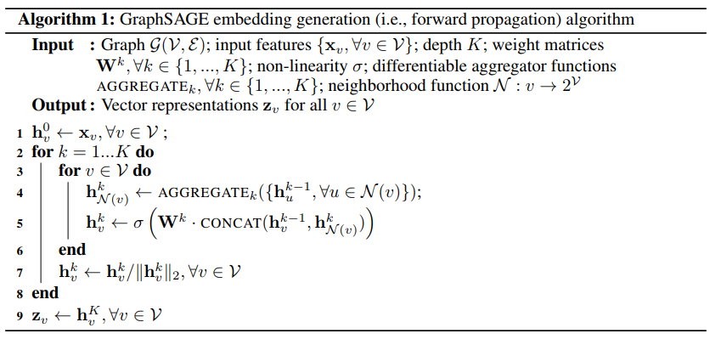
The Details of GraphSAGE
Algorithm of GraphSAGE
① 固定模型参数 → 学习如何生成嵌入（forward propagation）
② 学习如何训练模型
（back propagation ）
无mini-batch版本

Slide 8
The Details of GraphSAGE
Aggregator Architectures
Mean aggregator :
LSTM aggregator :
not inherently symmetry
Pooling aggregator :
Notes:
平均聚集函数：在元素级别进行平均，而且比一般的方法多了一个concat操作，可以看做是在层级关系上的（不同搜索深度的） “skip-connection”
Lstm聚集函数：将节点邻居随机排列作为lstm的输入
池化聚集函数：在max之前可以是任意深度的多层感知机，多层感知机可以被看做是一系列函数的集合，用来计算邻居节点的特征。

Slide 9
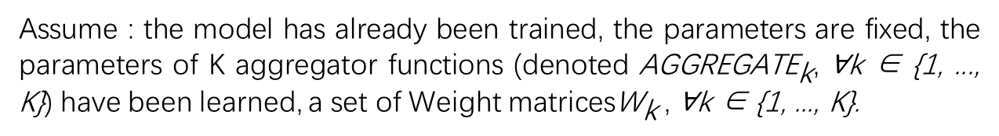
The Details of GraphSAGE
Embedding generation (forward propagation) algorithm
Assume : the model has already been trained, the parameters are fixed, the parameters of K aggregator functions (denoted ${\text{AGGREGATE}}_{\text{k}}$, ∀k ∈ {1, ..., K}) have been learned, a set of Weight matrices${\text{W}}_{\text{k}}$ , ∀k ∈ {1, ..., K}.

Slide 10
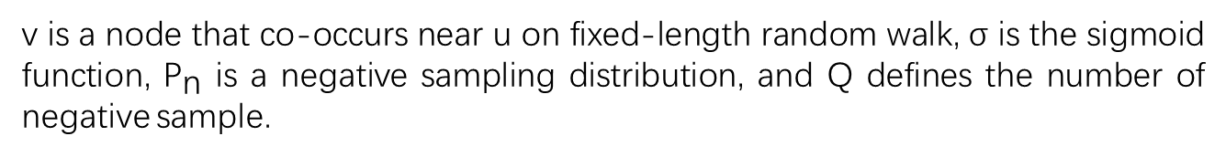
The Details of GraphSAGE
Learning the parameter of GraphSAGE
v is a node that co-occurs near u on fixed-length random walk, σ is the sigmoid function, ${\text{P}}_{\text{n}}$ is a negative sampling distribution, and Q defines the number of negative sample.
Notes:
损失函数：强调相邻的节点的嵌入是相近的，之前的嵌入方法一般是将节点独立的嵌入结果作为损失函数的一部分，而本论文是将节点的局部邻居作为特征组成损失函数

Slide 11
Experiments
Tasks & Datasets
Tasks :
classifying academic papers into different subjects using the Web of Science citation dataset
classifying Reddit posts as belonging to different communities
classifying protein functions across various biological protein-protein interaction (PPI) graph
Datasets :
Citation : An undirected citation graph dataset derived from the Thomson Reuters Web of Science Core Collection.
Reddit : Reddit is a large online discussion forum where users post and comment on content in different topical communities.
PPI : Classify protein roles—in terms of their cellular functions from gene ontology—in various protein-protein interaction (PPI) graphs, with each graph corresponding to a different human tissue.
Notes:
PPI每个图对应不同的人类组织

Slide 12
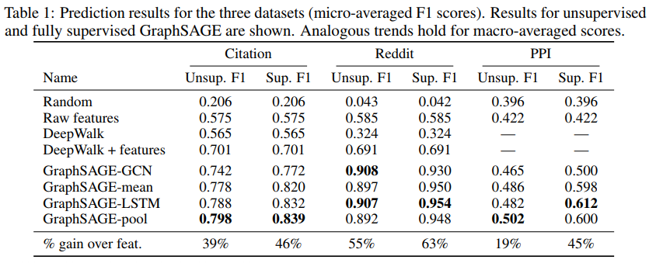
Experiments
Results
Notes:
Baseline：a random classifer, a logistic regression feature-based classifier (that ignores graph structure), the DeepWalk algorithm [28] as a representative factorization-based approach, and a concatenation of the raw features and DeepWalk embedding
GraphSAGE-ＧＣＮ是之前半监督学习ＧＣＮ的一种变体

Slide 13
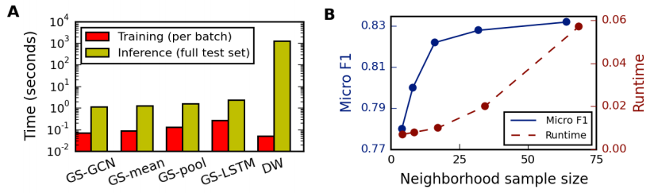
Experiments
Runtime & Neighborhood sample size

Slide 14
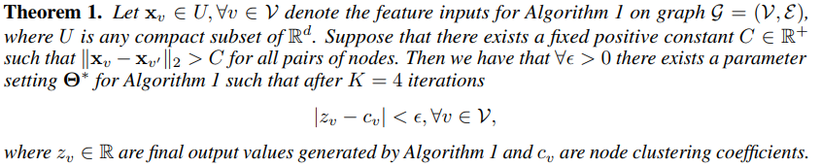
Theoretical analysis
how GraphSAGE can learn about graph structure, even though it is inherently based on features.
whether GraphSAGE can learn to predict the clustering coefficient of a node

Slide 15
THANKS FOR WATCHING
黄金筱 2019.2.23

