Slide 1
Assessing the Scalability of Biologically-Motivated Deep Learning Algorithms and Architectures

Slide 2
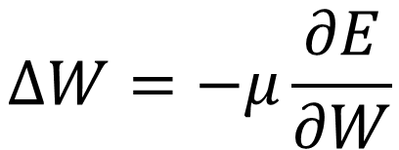
The solution in artificial networks: backprop
$$∆W=−μ\frac{∂E}{∂W}$$
- 反向传播机制不像大脑
- 科学家们寻找了不少“生物学上更合理”、也就是更像大脑工作机制的替代品

Slide 3
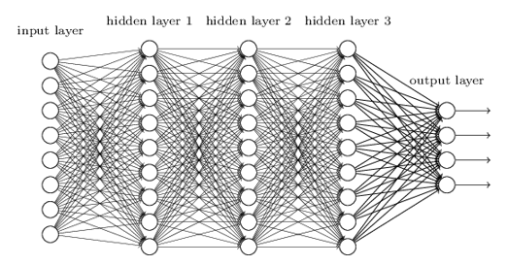



Why isn’t backprop “biologically plausible” ?
链式法则
$$f_{i+1}=f\left(f_{i}∗w_{i+1}+b_{i+1}\right)$$
$$∆w_{2}=\frac{∂Loss}{∂w_{2}}=\frac{∂Loss}{∂f_{4}}∙\frac{∂f_{4}}{∂f_{3}}∙\frac{∂f_{3}}{∂f_{2}}∙\frac{∂f_{2}}{∂w_{2}}$$
$$\frac{∂f_{2}}{∂w_{2}}=\frac{∂f}{∂\left(f_{1}∗w_{2}\right)}∙f_{1}$$

Slide 4

(1) Error term (2) Transpose of downstream weights (3) Derivative of activation function (4) separate forward and backward passes
Why isn’t backprop “biologically plausible” ?
$$∆W_{0}∝e ∙W_{1}^{T}∙σ^{′}\left(u\right) ∙x$$

Slide 5
- No weight transport (weight transposes) - No weight tying (convolution kernels) - No feedback of signed errors - Use continuous signals - Violate Dale’s Law - Use separate forward/backward passes and local activations derivatives
Constraints on learning rules
Notes:
The principle basically states that a neuron performs the same chemical action at all of its synaptic connections to other cells, regardless of the identity of the target cell.
无论目标细胞的身份如何，神经元在与其他细胞的所有突触连接处都执行相同的化学作用。

Slide 6
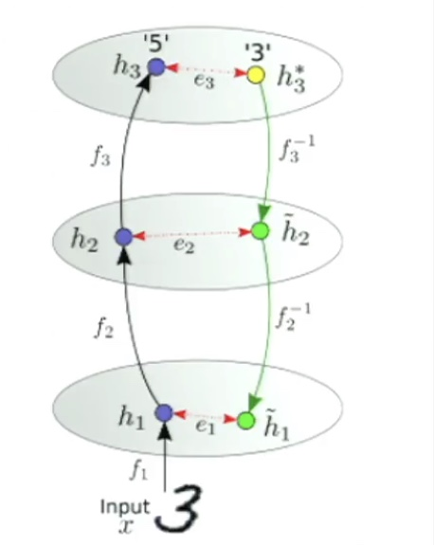
(1) Assume perfect backward inverse functions (2) Send activity targets rather than errors (3) Compute per-layer errors locally (4) use a simple delta rule to compute forward weight updates
目标传播 Target propagation

Slide 7
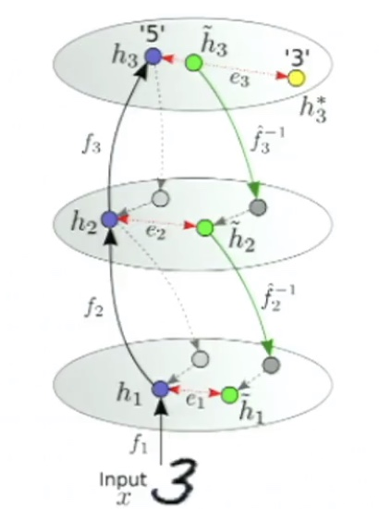
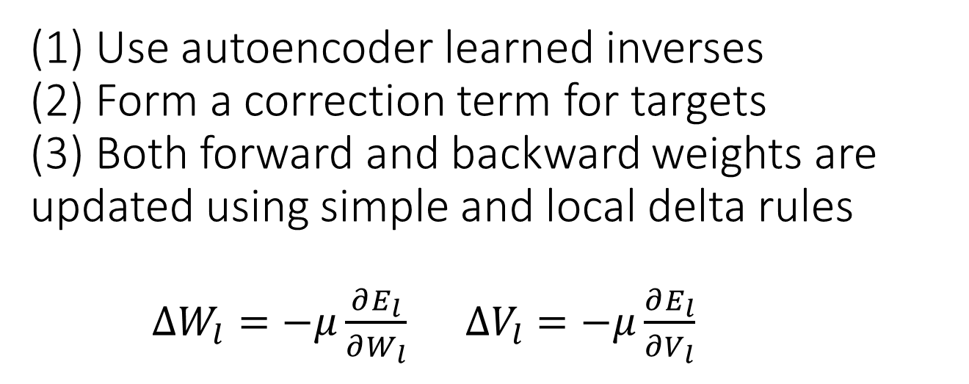
(1) Use autoencoder learned inverses (2) Form a correction term for targets (3) Both forward and backward weights are updated using simple and local delta rules $∆W_{l}=−μ\frac{∂E_{l}}{∂W_{l}}$ $∆V_{l}=−μ\frac{∂E_{l}}{∂V_{l}}$
目标差传播 Difference target propagation

Slide 8
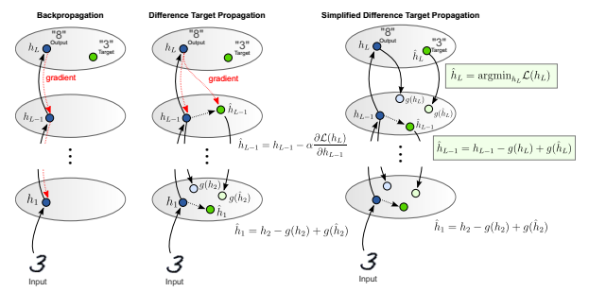
Gradient free DTP variants
(1) Use learned inverse to form targets for penultimate layer
(2) Augment output layer with random features computes from penultimate layer activities
Notes:
The second term is the error in the reconstruction, which provides a stabilizing linear correction for imprecise inverse functions
第二个术语是重构中的误差，它为不精确的反函数提供了稳定的线性校正。

Slide 9
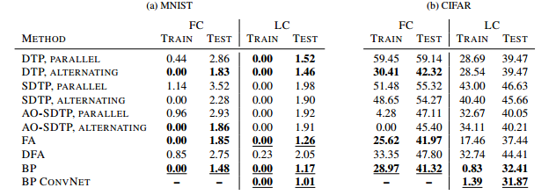
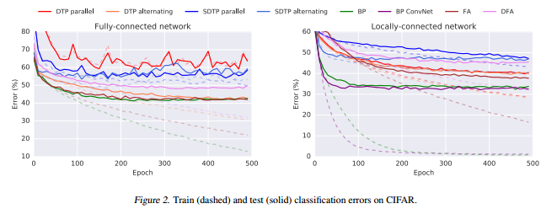
Results
用BP训练的CNN，拥有共享权重，大大减少了自由参数，让模型的学习能力更容易向复杂任务中推广。
Notes:
CNN在生物学意义上，有一个“不太可取”的特性，就是权重共享。 因为，每个神经元的权值，都需要非常精确地传递开来，这个操作在自然界里太不现实。

Slide 10
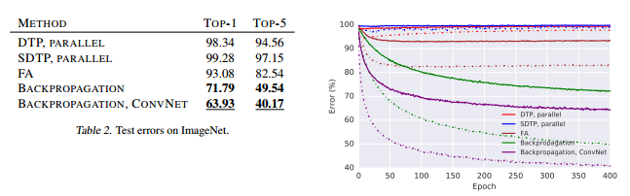
Results
反向传播的表现依然优于其他选手，且以卷积网络的版本为最优。
也就是说，即便无法像人类一样轻取复杂问题，反向传播依然离这个目标更近，加上共享权重就更近。

Slide 11
