Slide 1
Grad-CAM++: Improved Visual Explanations for Deep Convolutional Networks
Aditya Chattopadhyay, Anirban Sarkar, Member, IEEE, Prantik Howlader,
and Vineeth N Balasubramanian, Member, IEEE

Slide 2
Work
Grad-CAM++
Provide better visual explanations of CNN model predictions
Better object localization as well as explaining occurrences of multiple object instances in a single image

Slide 3
Weaknesses of Grad-CAM
performance drops when localizing multiple occurrences of the same class
do not capture the entire object in completeness

Slide 4
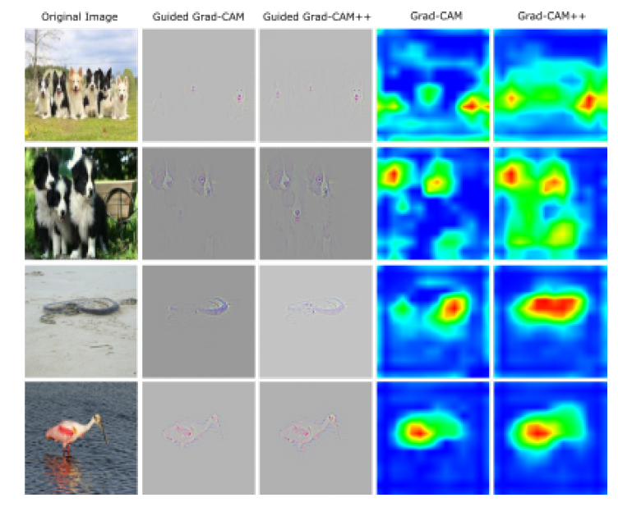

Slide 5


CAM(Class Activation Mapping)
In CAM, the authors demonstrate that a CNN with a Global Average Pooling (GAP) layer shows localization capabilities despite not being explicitly trained to do so
Each spatial location (i; j) in the class-specific saliency map L is then calculated as:
Notes:
GAP取代全连接层
In a CNN with GAP,
特定的C类最后的分数 Yc
can be
written as a linear combination of its global average pooled
last convolutional layer feature maps A

Slide 6
CAM
CAM estimates these weights by training a linear classifier for each class c using the activation maps of the last convolutional layer generated for a given image. This however limits its explainability prowess to CNNs with a GAP penultimate layer, and requires retraining of multiple linear classifiers (one for each class), after training of the initial mode
Notes:
CAM利用为给定图像生成的最后一个卷积层的激活映射，为每个c类训练一个线性分类器来估计这些权重。然而，这将其解释能力限制在具有间隙倒数第二层的CNNs上，并且需要在初始模式训练之后对多个线性分类器(每个类一个)进行再训练

Slide 7

Grad-CAM
Z is a constant (number of pixels in the activation map)
Notes:
Grad-CAM was built to address these issues

Slide 8
Grad-CAM
Grad-CAM can thus work with any deep CNN where the final Y is a differentiable function of the activation maps A, without any retraining or architectural modification
Notes:
因此，grade - cam可以与任何深度CNN一起工作，其中最终的Y是激活映射a的可微函数，无需任何再训练或架构修改

Slide 9
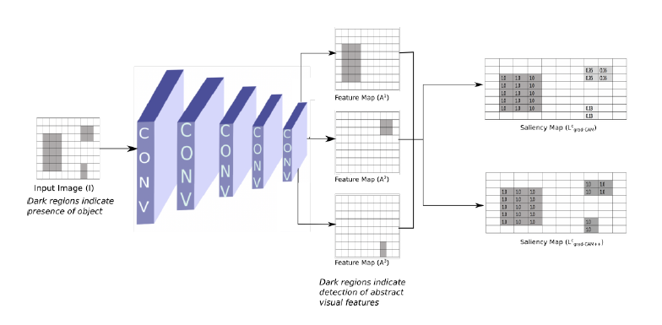
Grad-CAM++
Notes:
Akij = 1 if a visual pattern is detected else 0.

Slide 10
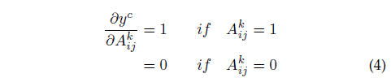
Grad-CAM++
The derivative is expected to be high for feature map pixels that contribute to the presence of the object.

Slide 11
Grad-CAM++
Plugging in values from Eqn 4 into Eqn 3
we obtain the following feature map weights in the case of Grad-CAM
Notes:
带到（2） 计算显著图

Slide 12
Grad-CAM++
Hence, if there were multiple occurrences of an object with slightly different orientations or views (or parts of an object that excite different feature maps), different feature maps may be activated with differing spatial footprints, and the feature maps with lesser footprints fade away in the final saliency map
Notes:
因此，如果一个对象的多个位置或视图稍有不同(或者对象的某些部分激发了不同的feature map)，那么不同的feature map可能会被不同的空间脚印激活，而脚印较小的feature map会在最终的显著性map中消失

Slide 13


Grad-CAM++
This problem can be fixed by taking a weighted average of the pixel-wise gradients
The idea behind considering only the positive gradients
in Eqn 5 is similar to works such as Deconvolution and Guided Backpropogation .
Notes:
这个问题可以通过加权平均像素梯
这里阿尔法是c类和卷积特征映射A的像素梯度加权系数
W捕捉到特定激活图Ak的重要程度，我们更喜欢用正梯度来表示增加输出神经元激活的视觉特征，而不是抑制输出神经元的激活

Slide 14

Grad-CAM++
Combining Eqn 1 and Eqn 5, we get:
Notes:
计算系数

Slide 15


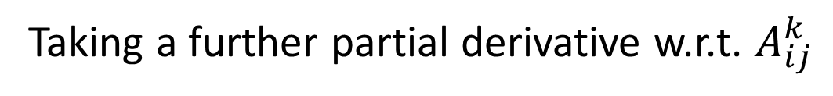
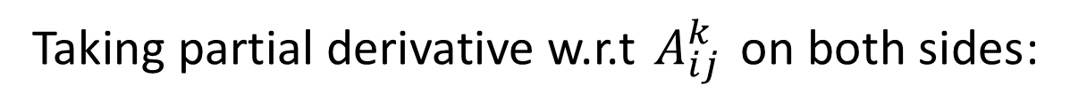
Grad-CAM++
Taking partial derivative w.r.t $A_{ij}^{k}$on both sides:
we drop the relu in our derivation as it only functions as a threshold for allowing the gradients to flow back
Taking a further partial derivative w.r.t. $A_{ij}^{k}$
Notes:
我们在推导过程中去掉relu，因为它只作为允许梯度回流的阈值

Slide 16


Grad-CAM++
Rearranging terms, we get:
Substituting Eqn 10 in Eqn 5, we get the following Grad-CAM++ weights:

Slide 17
Grad-CAM++
In principle, the class score Y can be any prediction; the only constraint being that Y must be a smooth function. For this reason, unlike Grad-CAM (which takes the penultimate layer representation as their class score Y), we pass the penultimate layer scores through an exponential function, as the exponential function is infinitely differentiable
Notes:
原则上，类得分Y可以是任何预测;唯一的限制是Y必须是一个光滑函数。由于这个原因，不像grade - cam(以倒数第二层表示为它们的class score Y)，我们通过一个指数函数传递倒数第二层的分数，因为指数函数是无限可微的
The time overhead for calculating higher-order derivatives remains of the same order as Grad-CAM, as only the diagonal terms are used (no cross higher-order derivatives). If we pass the penultimate layer scores through an exponential function and the last layer has only linear or ReLU activation functions, the calculation of higher-order derivatives becomes trivial.
计算高阶导数的时间开销仍然与梯度凸轮相同，因为只使用对角项(没有交叉的高阶导数)。如果我们通过指数函数传递倒数第二层的分数，而最后一层只有线性或ReLU激活函数，那么高阶导数的计算就变得微不足道。

Slide 18
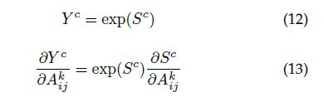

Grad-CAM++
Let S be the penultimate layer scores for class c.
Notes:
S对于A的偏导可以用tf pytorch算

Slide 19
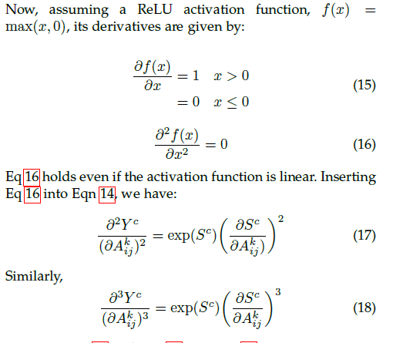
Grad-CAM++
Notes:
Relu输出后就是S
17 18 带到10

Slide 20

Grad-CAM++
With a single backward pass on the computational graph, all the gradient weights (as defined in Eqn 5) can be computed
Notes:
其他平滑函数 softmax 论文也提到了

Slide 21
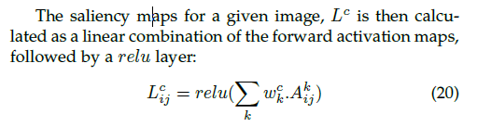
Grad-CAM++

Slide 22
Grad-CAM++
For all experiments, we used an off-the-shelf VGG-16 model from the Caffe Model Zoo , to be consistent with earlier work that used the same model
Notes:
ALEXNET RESNET 附录

Slide 23
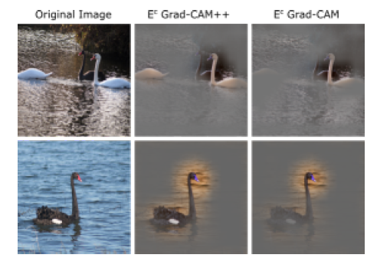
Grad-CAM++
Notes:
LoI

Slide 24
Grad-CAM++
(I) Average Drop
A good explanation map for a class should highlight the regions that are most relevant for decision-making
(ii) Increase in Confidence
Providing only the explanation map region as input (instead of the full image) rather increases the confidence in the prediction
(iii) Win
Measures the number of times in the given set of images, the fall in the model’s confidence for an explanation map
Notes:
我们注意到，当提供完整图像作为输入时设置与仅提供解释映射作为输入时设置之间的置信度变化
如果模型以完整图像作为输入预测(正确)类标签，置信度为0.8，且仅显示解释图时模型对类的置信度下降到0.4，则模型置信度下降%为50%。

Slide 25
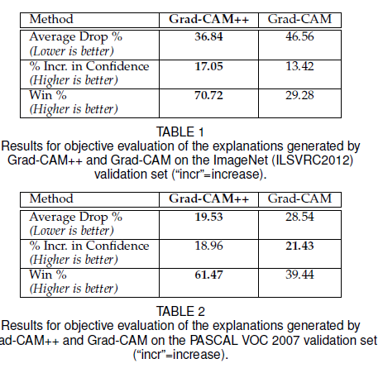
Grad-CAM++

Slide 26
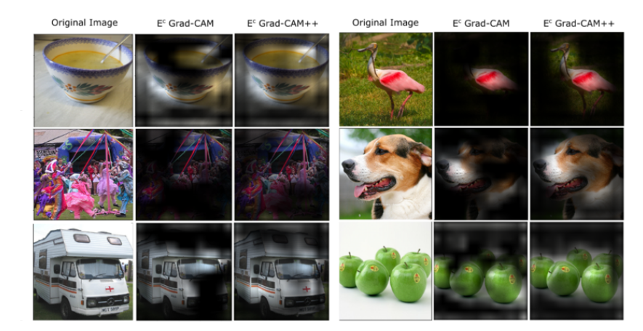
Grad-CAM++
Grad-CAM++ achieved a score of 109.69 as compared to 56.08 of Grad-CAM. The remaining 84.23 was labeled as ”same” by the subjects
Notes:
人力鉴定

Slide 27

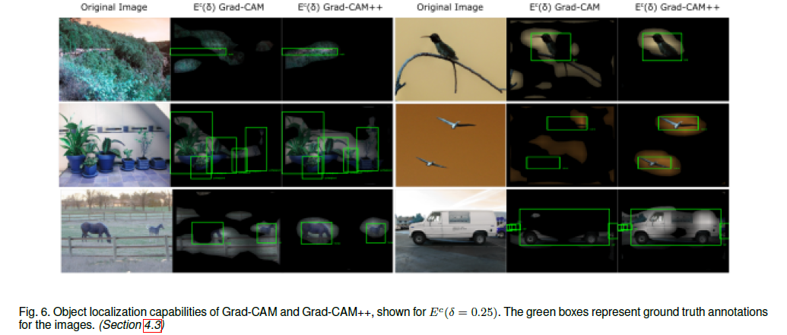
Grad-CAM++
Object Localization
Dataset:Pascal VOC 2012
Notes:
bounding box annotations

Slide 28
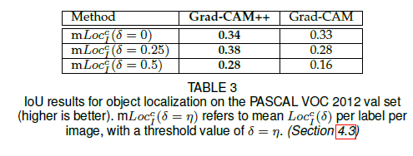
Grad-CAM++
Notes:
是个阈值 大于多少的时候像素算是激活的能够算在框框里面

Slide 29
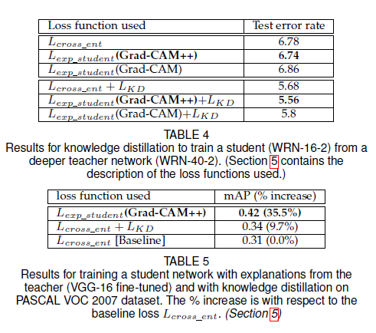
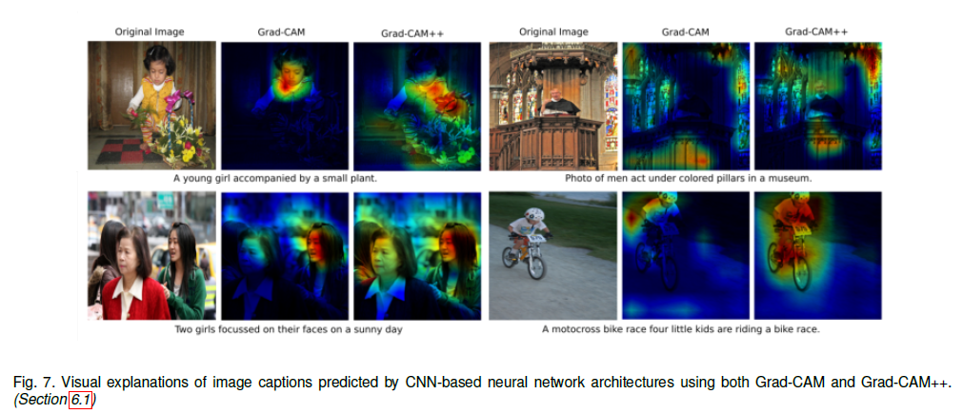
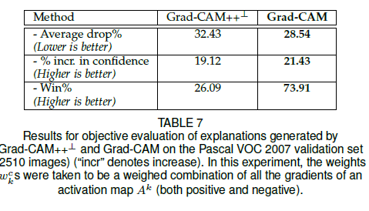
Grad-CAM++
Notes:
知识蒸馏 3d动作识别

Slide 30
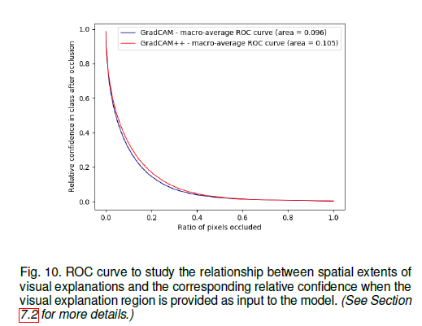
Grad-CAM++
Does Grad-CAM++ do well because of larger maps?
Notes:
我们绘制ROC曲线来测量被遮挡地图的空间面积与被遮挡后类的相对置信度之间的权衡关系

Slide 31
Thanks

