Slide 1
MICCAI 2019

Slide 2
Oral Session
Computer Aided Diagnosis, Detection and Classification
Industry Session
Reconstruction and Synthesis
Registration and Segmentation
Doctoral Symposium
Computer Assisted Interventions
MIC meets CAI (Medical Image Computing and Computer Assisted Intervention)

Slide 3
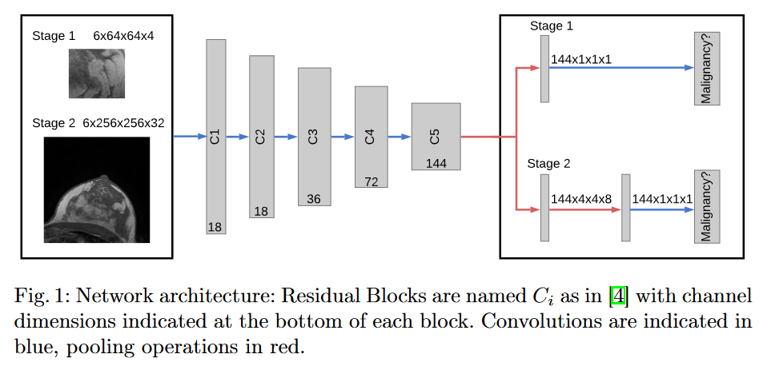
除了刷精度之外？
模型未必很复杂
Multi Scale Curriculum CNN for Context-Aware Breast MRI Malignancy Classification
一些不同寻常的方向
Detecting Cannabis-Associated Cognitive Impairment using Resting-state fNIRS
LSTM Network for Prediction of Hemorrhagic Transformation in Acute Stroke
AR
多种工作的结合
Hand Pose Estimation for Pediatric Bone Age Assessment
开源代码，开源工具
新的生成图像的技术

Slide 4
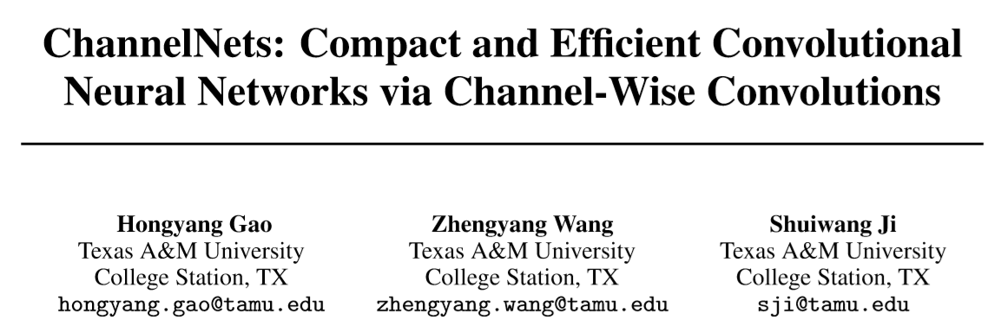

Slide 5
normal convolutions
K x K x m x n
m
m
n
K x K x m x n x F x F

Slide 6
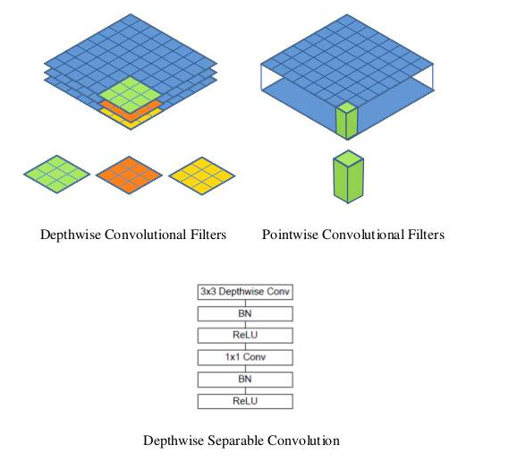
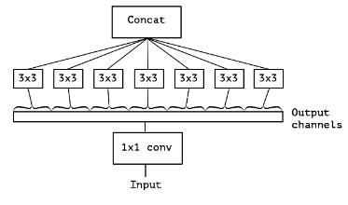
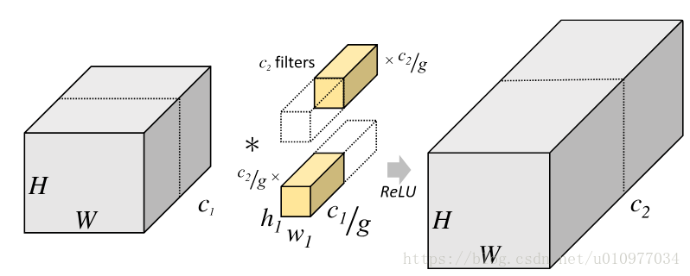
Group Conv & Depth-wise Conv

Slide 7
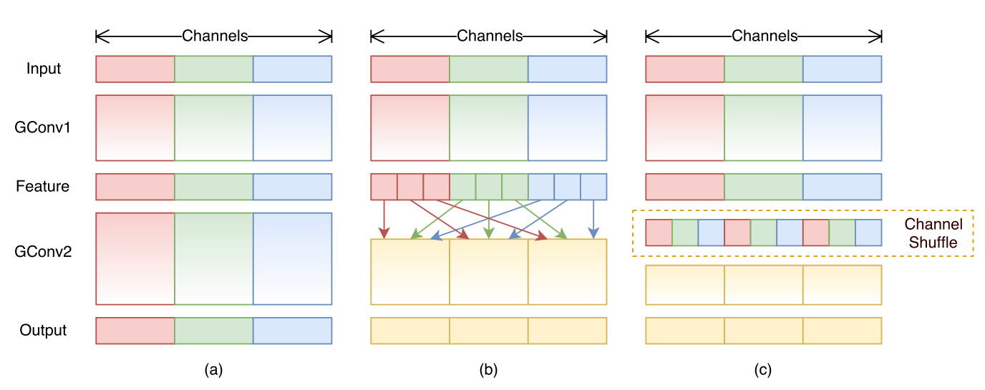
Group Conv + Channel Shuffle

Slide 8
we propose channel-wise convolutions, which are used to replace dense connections among feature maps with sparse ones.
To apply channel-wise convolutions in model compression, we develop group channel-wise convolutions, depth-wise separable channel-wise convolutions, and the convolutional classification layer. They are used to compress different parts of CNNs, leading to our ChannelNets.

Slide 9
standard convolutions
K x K x m x n
m
m
n
K x K x m x n x F x F
共n个

Slide 10
channel-wise convolutions
d
m
n
在后面的Depth-wise channel-wise convolutions详解

Slide 11
group channel-wise convolutions
Output的每个group包含n/g个channel
d
m
n
总共g组
Given n input feature maps that are divided into g groups, this operation performs g independent channel-wise convolutions. Each channel-wise convolution uses a stride of g and outputs n/g feature maps with appropriate padding. Note that, in order to ensure all n input channels are involved in the computation of any output group of channels, the kernel size of channel-wise convolutions needs to satisfy d >= g.

Slide 12
Depth-wise channel-wise convolutions
d
m
n
the depth-wise separable channel-wise convolution replaces the 1x1 convolution in the depth-wise separable convolution with the channel-wise convolution. The connections among channels are changed directly from a dense pattern to a sparse one.

Slide 13
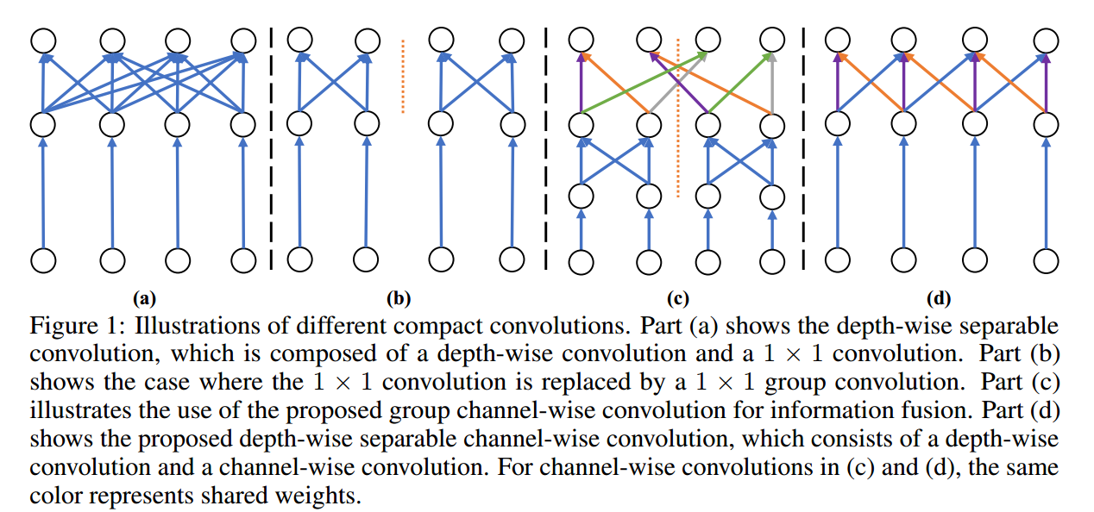

Slide 14
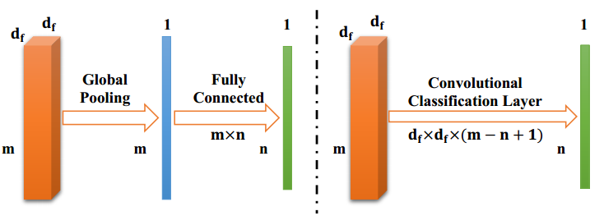
Convolutional Classification Layer
While the convolutional classification layer dramatically reduces the number of parameters, there is a concern that it may cause a signification loss in performance. In the fully-connected classification layer, each prediction is based on the entire feature vector by taking all features into consideration. In contrast, in the convolutional classification layer, the prediction of each class uses only (m - n + 1) features. However, our experiments show that the weight matrix of the fully-connected classification layer is very sparse, indicating that only a small number of features contribute to the prediction of a class. Meanwhile, our ChannelNets with the convolutional classification layer achieve much better results than other models with similar amounts of parameters.

Slide 15
ChannelNets
ChannelNet-v1
+ group channel-wise convolutions
ChannelNet-v2
+ depth-wise separable channel-wise convolutions
ChannelNet-v3
+ convolutional classification layer

Slide 16
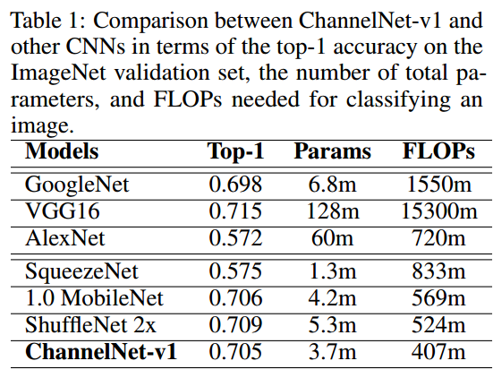
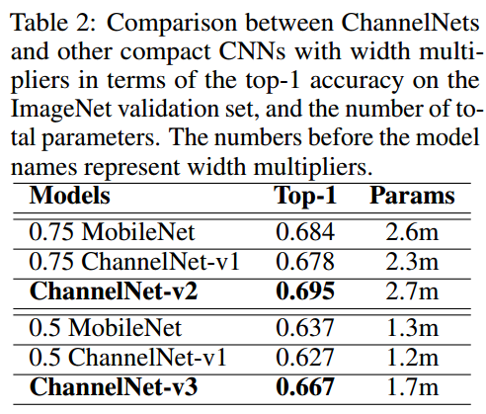
Experimental Studies

Slide 17
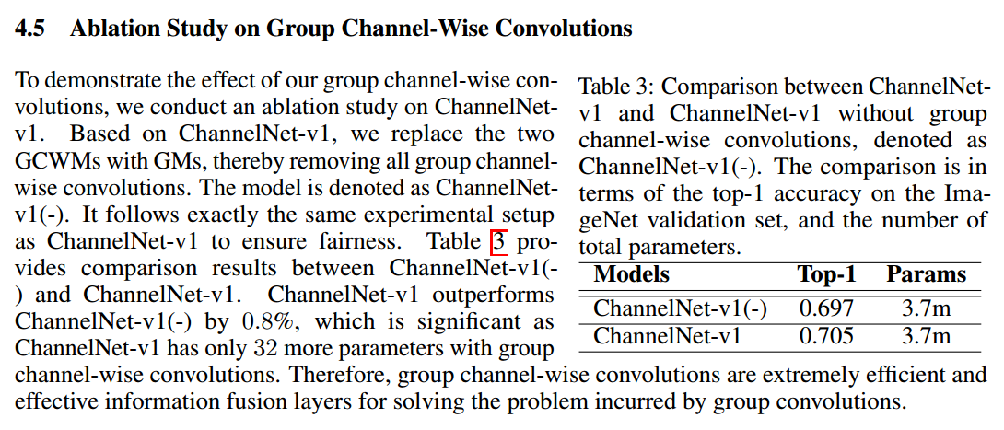

Slide 18
