Slide 1
CAN: Revisiting Feature Co-Action for Click-Through Rate Prediction
Alibaba Group Beijing, China 周国睿…
Notes:
阿里CTR建模领域最新的工作CAN，11月。CAN已经在双十一前全面在阿里定向广告落地，在线效果提升非常显著。
兴趣建模做的很好：
DIN,DIEN,全生命周期的Search-based User Interest Modeling with Lifelong Sequential Behavior Data for Click-Through Rate Prediction.

Slide 2
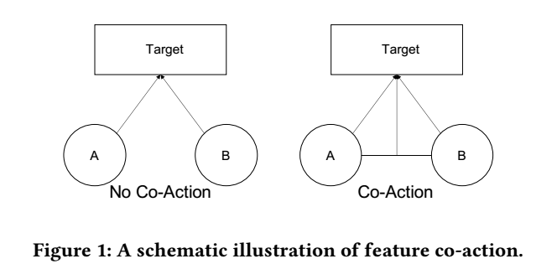
Background
Baseline：independent feature + non-linear interactions from raw feature
独立特征输入到LR,DNN等模型中；
DNN自动学习特征之间的交互
Co-action：
the collective eﬀects of features toward final prediction
E.g.: the co-action of “bathing suit” and “goggle”
explains how a set of features correlates with the optimization target
Notes:
特征CA现象：共同 泳镜 泳衣
特征CA可以针对多个特征，但一般两个。

Slide 3
Related work
Aggregation based methods(DIN,DIEN,MIND, MIMN…)
aggregate the historical behavior sequence of user to obtain discriminative representation
utilize the feature co-action to model the weight of each user action in historical behavior
Problem: only used for information aggregation but not information augmentation!
combinatorial embedding methods(PNN, DCN, FM…)
Models the feature co-action by explicitly combining feature embeddings
Problem:
the embeddings take the responsibility of both representation learning and co-action modeling,
They may conﬂict with each other thus bound the performance.

Slide 4
The importance of feature co-action modeling
Why important:
capture the co-action
augment the input
reduce the difficulty for the model to learning
Existing methods underestimate the importance of co-action：
Experiments: Cartesian product model is better than state-of-the-art methods!
Cartesian product model:
fed the co-occurrence feature to a model
most direct method to do co-action modeling
defects: huge parameter quantity, no information sharing between two combinations that contains same feature
Speculation: existing methods has poor expressiveness and the cannot learn the embedding balancing representation and co-action modeling.
Notes:
在输入中加入特征CA的部分，增强输入；可以减小对模型同时处理 表示学习 和对CA建模的难度。
笛卡尔积是对CA的最直观建模，但是有缺点：参数空间大，没有特征共用。但是效果还是比已有的方法好。

Slide 5
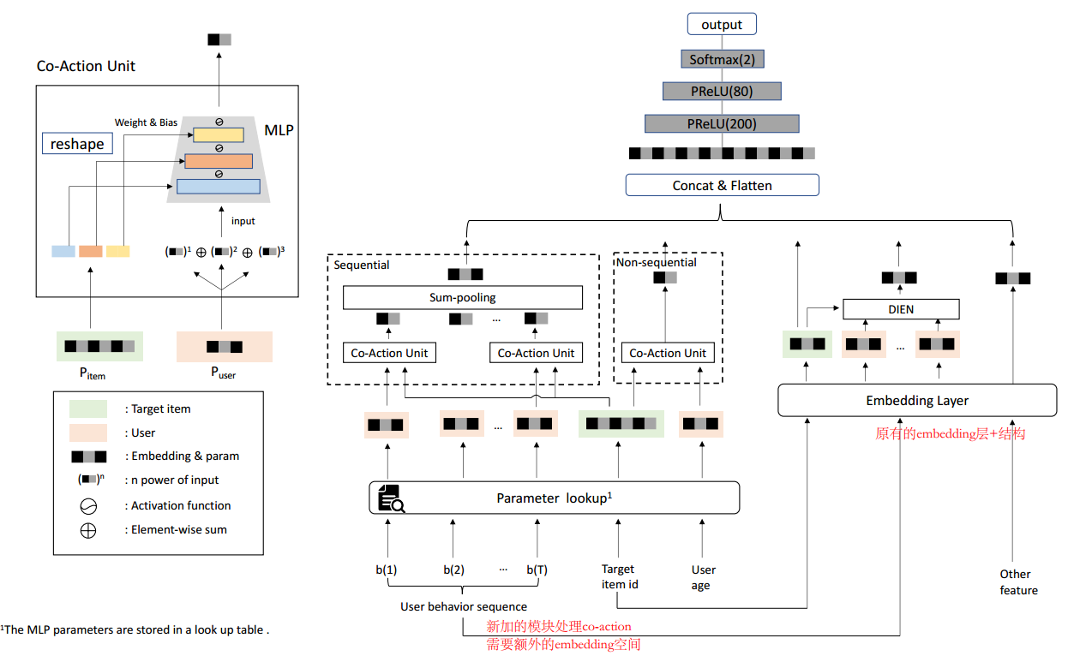
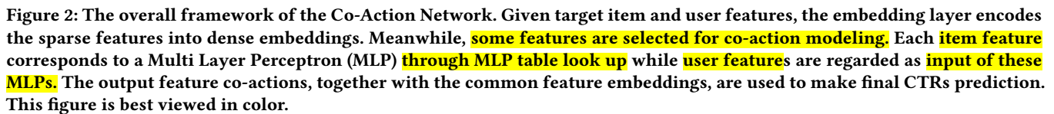
CO-ACTION NETWORK
Notes:
原始的网络结构保留，使用额外的参数和插件结构来对CA建模。
一部分特征Xuser和Xitem被用于CA建模。

Slide 6
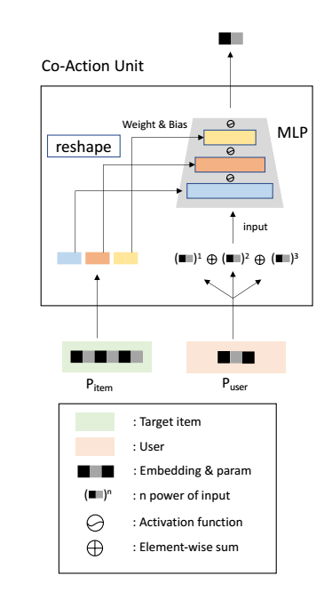
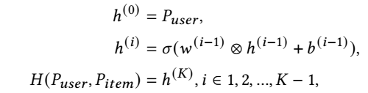
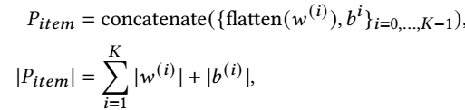
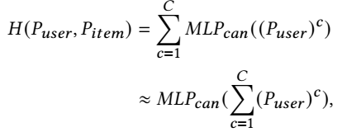
Co-Action Unit
CA unit优点：
provides more capacity to guarantee the update of two field features and avoid couple gradients.
less scale of the learnable parameters： cartesian product O(N²D) -> CA unit O(NT)
has better generalization to new feature combinations
Multi-order Enhancement: estimate feature interaction over high orders.
Notes:
Unit：两个特征做co-action：首先进行嵌入，然后使用一个MLP操作：user的feature的embedding当做是输入，item的feature的embedding当做MLP的参数。（各个层中的权重和偏差）。《user的特征维度小于item的》 候选item的个数远远少于用户行为历史中的item的个数，所以选择候选item的embedding作为MLP的参数。
使用DNN，动态的参数和输入，组合两个组件特征，保证两个域的特征的更新，缓解梯度耦合问题。（怎么两个域？输入的怎么更新？）
组合的两个特征，每个都有N个值，embedding长度是D。T是CA单元中参数的个数，远远小于ND.
新组合：只要要组合的两个特征的embedding都有，就可以使用该unit建模。
尽管DNN可以隐式的学习高阶特征组合，但是这个过程可能很长，学习起来比较困难。所以对输入进行多项式处理，低阶和高阶输入，加速学习。

Slide 7
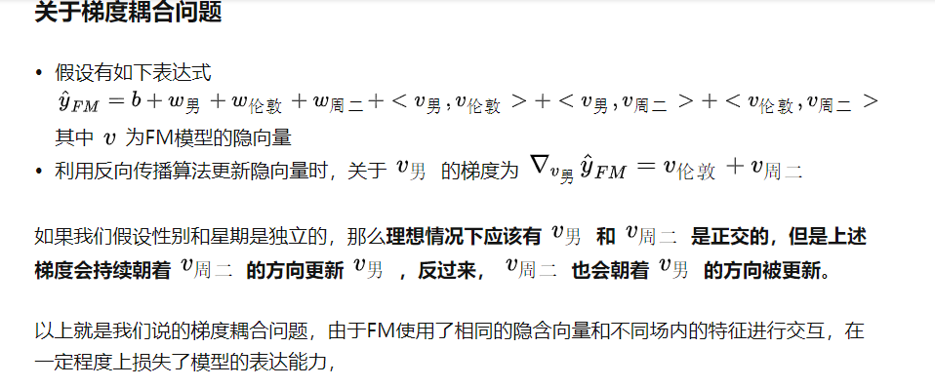
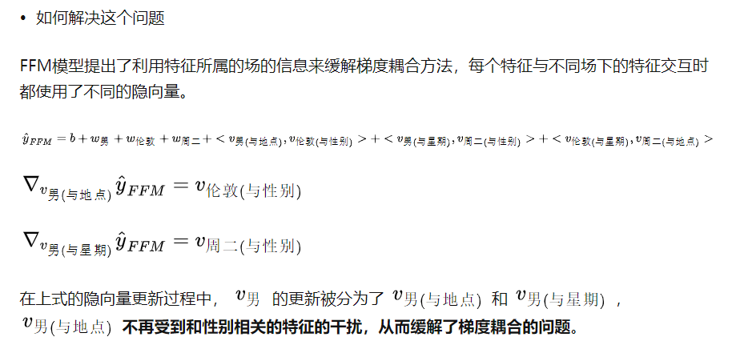

Slide 8
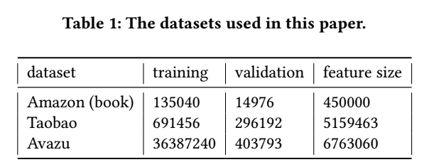
Experimental Settings
Dataset
Amazon dataset(Books subset)：product reviews and metadata from Amazon.
Taobao dataset: user behaviors including click, purchase, adding item to shopping cart and item favoring, just take the click behaviors
Avazu dataset: 24 data fields, which is suitable to verify the eﬀect of sequence /
non-sequence to feature co-action modeling
Notes:
亚马逊，用户没有评价过的作为负例，构建点击和未点击序列
淘宝：只选取了用户点击序列
以上两个，对CA建模时，选取的是用户历史序列和候选item的组合。而Avazu 很多离散，可以验证不同特征组合的效果。

Slide 9
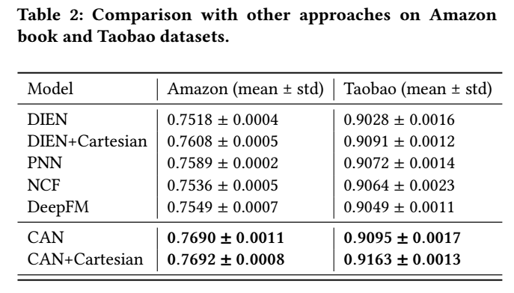
Experimental Settings
Results
Comparing to the base model DIEN, the CAN improve the AUC by 1.7% and 2.1%
DIEN < PNN <DIEN+ Cartesian <CAN<CAN+ Cartesian
Notes:
基于聚合的方法DIEN; 基于组合的方法：PNN, deepfm
DIEN < PNN <DIEN+笛卡尔<CAN<CAN+笛卡尔
（DIEN效果这么差？比PNN和NCF都差？）

Slide 10
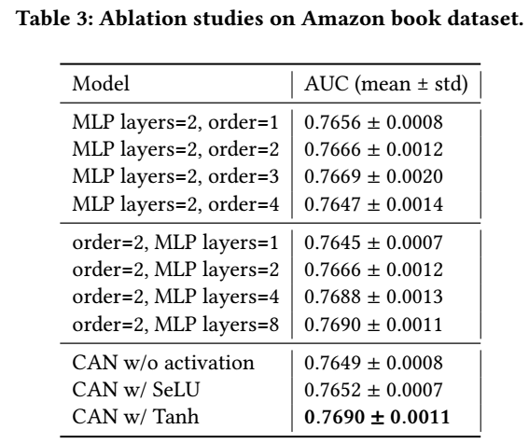
Experimental Settings
Ablation Study
Multi orders：2 or 3 power terms is proper in practical applications
MLP depth： when the number of layers exceed 4, there is no obvious AUC gain
Activation functions：Tanh plays a role of normalizer to avoid numerical issues in high orders.
Notes:
在一阶的基础上，加2阶，三阶等
MLP太深时，没有足够的实例去训练它
？

Slide 11
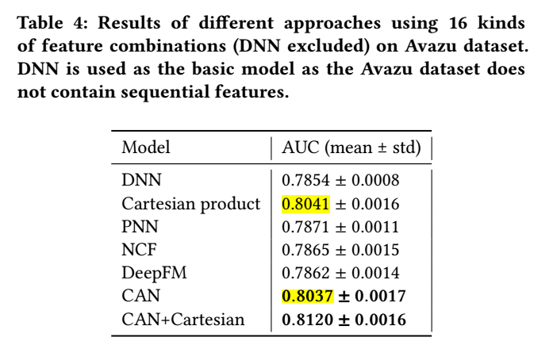
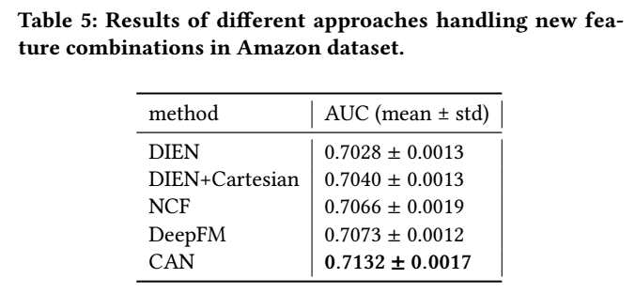
Experimental Settings
Model Universality and Generalization
Universality：
CAN is designed mainly for real industrial data which contain a lot of behavior sequences
CAN is still capable for non-sequential input
Generalization：
A new test set whose feature combinations are brand new for a well trained model
only require the feature combination to be zero shot rather than all features
Notes:
通用性：
数据集由24个特征域，使用其中16个去组合。
DNN没有使用特征组合，而是直接使用全部的特征？
逼近了笛卡尔，但是参数量明显较小。
泛化性：测试集中的样本的特征组合在训练集中没有出现过。特征组合，而不是单一特征没有出现。
笛卡尔积没法使用。
CAN最好，适合大量新特征出现的工业场景。

Slide 12
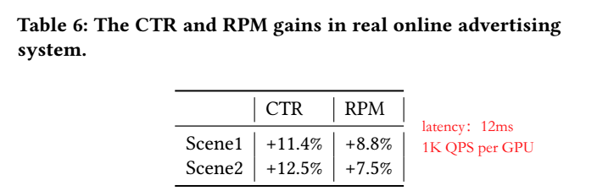
Experimental Settings
Results on Industrial Data
Online Serving and Challenges.
Cartesian product model：
the model size is expanding at an extremely fast rate even using IDs frequency filtering；
unacceptable number of embedding look up operations as well as system response latency
CAN:
select 21 features including 6 ad features and 15 user feature to generate feature combinations
the user features are mostly behavior sequences with length of more than 100
Solution
Sequence cut-oﬀ：user behavior sequences：200->50 QPS +20% AUC -0.1%
Combination reduction：
the combinations with ad feature and user feature of the same type can better model the feature co-occurrence, “item_id” and “item_click_history” ; “category_id” and “category_click_history”
number of combinations: 90>48 QPS +30%
Computational kernel optimization:
rewritte the internal calculation logic of the BLAS (Basic Linear Algebra Subprograms) : QPS +60%
make a kernel fusion between matrix multiplication and sum-pooling : QPS +47%
Notes:
CAN问题：
1.1.额外的embedding空间带给系统压力 1.2.特征CA的运算开销随着特征个数线性增加
2额外的内存访问会造成响应延迟
1.[Batch_size × K × dim_in × dim_out] × [batch_size × K × seq_len × dim_in] The dim_in and dim_out are not commonly used shape so that such matrix multiplication are not well optimized by the BLAS
2.矩阵运算之后要在序列长度的维度上做sum-pooling，所以矩阵运算的结果要先写入GPU的内存中，然后再加。把这种操作整合，减少内存读写。

Slide 13
启发：
兴趣建模与特征交互
学术界的特征交互（FM->FFM->deepFm->DCN->xDeepFM）还能走下去？
电商等工业领域关注兴趣建模
兴趣建模+特征交互？
特征交互：笛卡尔积与哈达玛积
参数空间
信息共享
模型落地
Qps&时延
指标提升 VS 成本
参考资料：
想为特征交互走一条新的路
FLEN: 一种时空高效的利用场信息缓解梯度耦合的大规模CTR预测模型

