Slide 1
DU-Net: Convolutional Network for the Detection of Arterial Calcifications in Mammograms Manal AlGhamdi, Member, IEEE, Mohamed Abdel-Mottaleb, Fellow, IEEE, Fernando Collado-Mesa Oct. 2020

Slide 2
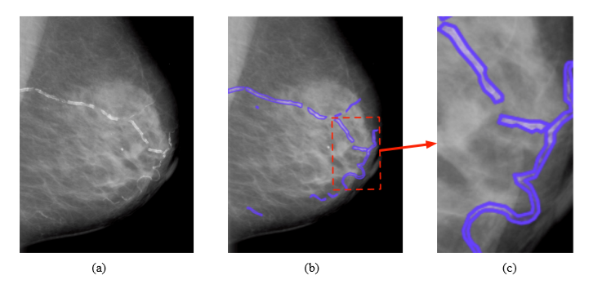
Two contributions:
Proposed a network combing DenseNet with Unet as DU-Net for BACs segmentation
Using Dense Block to replace the downsampling and layers in Unet (short-skip connection).
Concatenation → Summation in Unet between encoder-block and decoder-block at the same-level feature maps(long-skip connection).
2. Create a BACs ground-truth dataset annotated from Digital Database for Screening Mammography for breast disease detection.
Total 3400 images. 413 contains with BACs, and 413 selected randomly with No-BACs.
Three experts A(10 years experience), B and C(3 years).

Slide 3
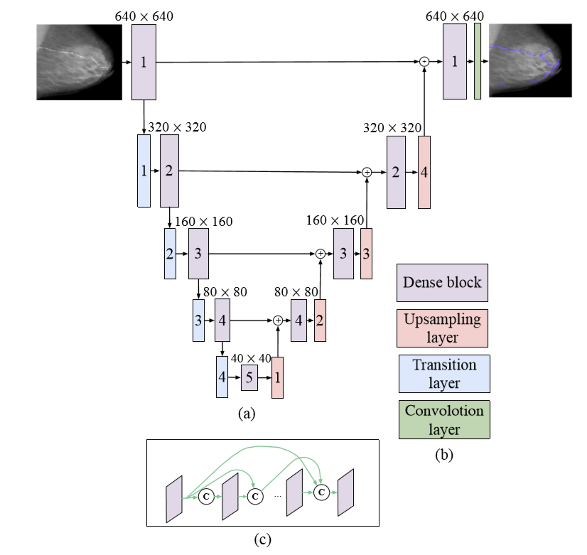
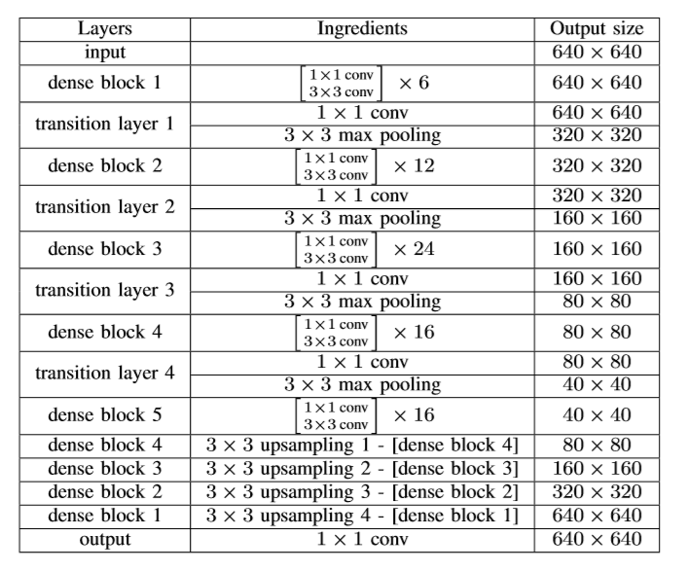
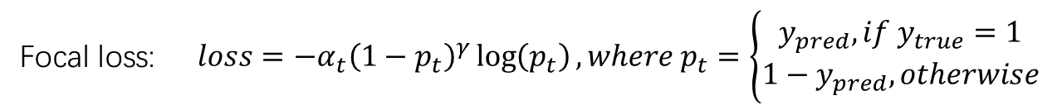
Network architecture:
Focal loss: $loss=−α_{t}{\left(1−p_{t}\right)}^{γ}\log\left(p_{t}\right),where p_{t}=\left\{\begin{aligned}y_{pred}, if{ y}_{true}=1 \\ 1−y_{pred}, otherwise\end{aligned}\right.$

Slide 4
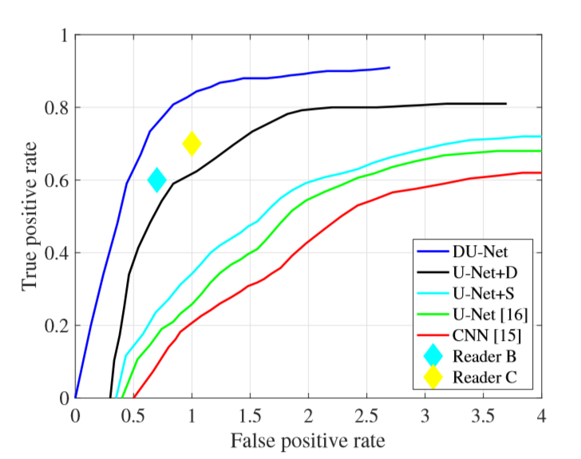
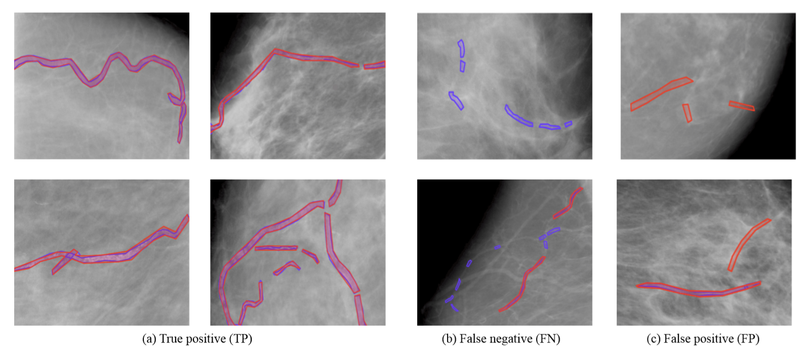
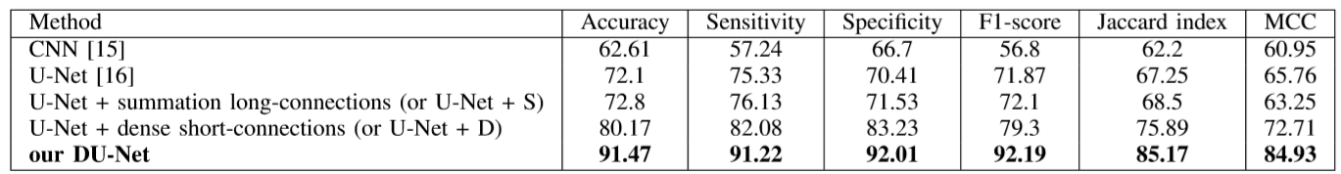
Experiment（High momentum 0.9）:
U-net: Origin model with long skip concatenation
U-net+S: Origin model with long skip summation
U-net+D: Origin model

Slide 5
Benefit：
Benefit：
1. Summation got better performance than concatenation, significantly reduce the computational load.

