Slide 1
Using React and Office UI Fabric React Components
Using React and Office UI Fabric React Components

Slide 2

Using React and Office UI Fabric React Components
Office UI Fabric
Fabric React
Adding Fabric React to SPFx Projects

Slide 3
What is the Office UI Fabric?
Built by Microsoft
All about styling instead of JavaScript
Integrates with other frameworks
Language support

Slide 4
Open Source
The Office UI Fabric project is developed and maintained by Microsoft in order to...
Help the development community build Office Add-ins and Office 365 web apps that integrate seamlessly with Office
Provide a point of reference for the evolving Office 365 design language that anyone can reference
Enable the community to contribute to better experiences for everyone who builds for Office

Slide 5
Monitor Releases and Contribute
Microsoft releases changes to the design language, components, and other assets frequently, and will make these updates available to the community.
If features are deprecated MS notes that in the change log, and the feature will be removed from the next major release.
Change Log
https://github.com/OfficeDev/Office-UI-Fabric/releases
Contribute In the GitHub Repository
https://github.com/OfficeDev/Office-UI-Fabric

Slide 6

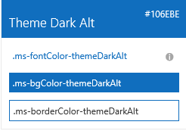

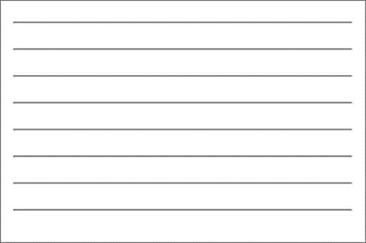

Fabric Core styling
Fonts and typography
Segoe font family + type ramp, official Office 365 iconography
Color
Official Office 365 color palette
Branded assets
Product symbols + product filetype symbols
Animations
Official Office 365 selection of easings and animations
Responsive grid
Tailored to Office 365 silhouettes
Notes:
When I talk about what we make available to developers, there are two broad categories: core and components
Core is the basic, fundamental elements of our design language that devs (MS devs included) can use to integrate apps, web parts, and custom solutions into Office/Office 365 and (of course) SP experiences

Slide 7
Styles
Office UI Fabric provides styles to allow you to implement the following things in your applications:
Typography
Color
Icons
Animations
Responsive Grid
Localization

Slide 8
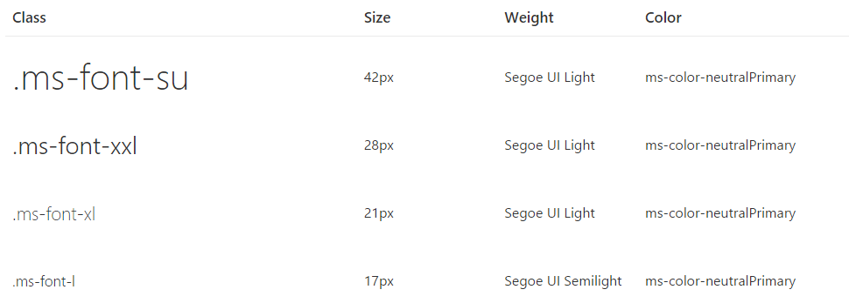
Typography
Base font classes
Fabric includes 10 base font classes that represent the type ramp for the Office Design Language. Each base class sets a default size, weight, and color.

Slide 9
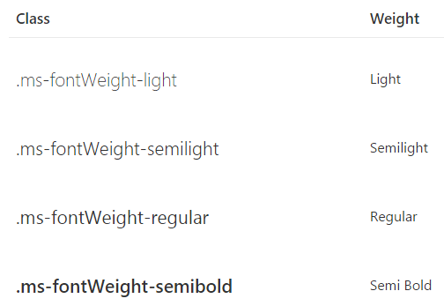
Typography
Helper font classes
Use one of several helper font classes to change the text weight

Slide 10
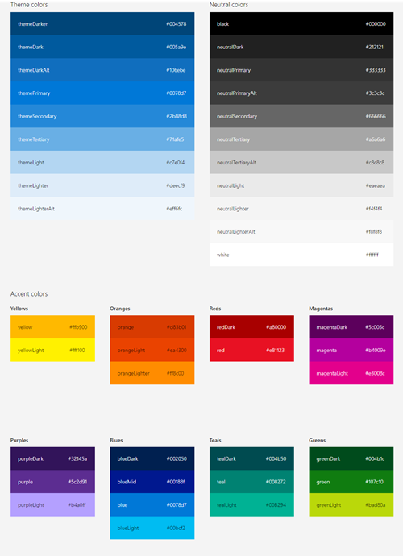
Color
Includes 9 theme colors and 11 neutral colors
Each has helper classes for text, border, background, and hover states
These color classes act as hooks into the Office 365 suite-wide theming system
When the theming system is enabled and your app or Add-in is consuming the suite navigation, these classes pick up the user's chosen theme

Slide 11
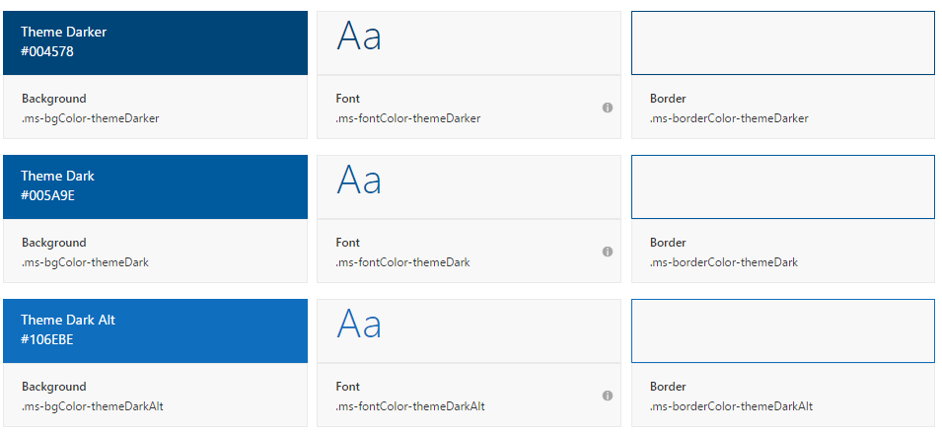
Color
Theme colors
Use theme colors in wayfinding, navigation, and key interactions like primary actions and current or selected indicators

Slide 12
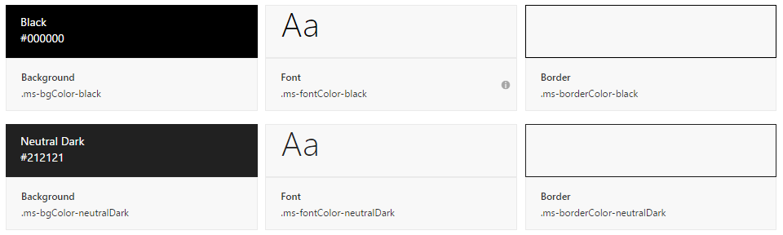
Color
Neutral Colors
Neutral colors include black, gray, and white. Use darker shades of gray for primary content, such as text and titles
Use black sparingly for high-impact strings (labels, names) and hover states
Use lighter shades of gray for supporting graphic elements and page areas

Slide 13
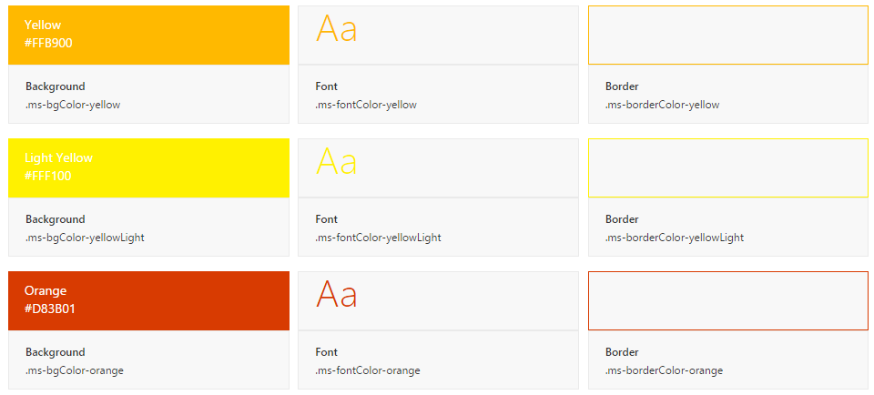
Color
Accent Colors
Fabric also includes accent colors from the Microsoft color palette

Slide 14
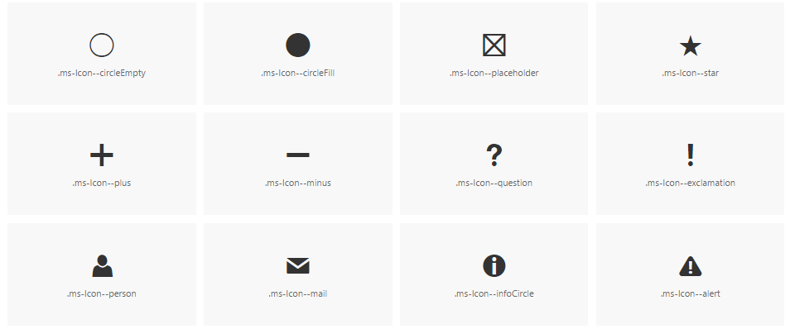
Icons
Fabric uses a custom font for its iconography
Font contains glyphs that you can scale, color, and style in any way
You can even flip them for right-to-left localization

Slide 15
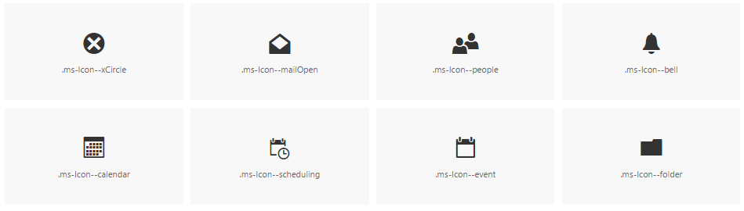
Icons
To use the icons, combine the base ms-Icon class with a modifier class for the specific icon.
<i class="ms-Icon ms-Icon--mail" aria-hidden="true"></i>
Note the aria-hidden attribute, which prevents screen readers from reading the icon. In cases where meaning is conveyed only through the icon, such as an icon-only navigation bar, be sure to apply an aria-label to the button for accessibility.

Slide 16

Side panel animations
When choosing a motion for side panels, consider the origin of the triggering element
Use the motion to create a link between the action and the resulting UI
For example, if the triggering element is on the right side of the interface, consider having the panel move in from the right

Slide 17

Dialog animations
When choosing a motion for dialogs, consider the origin and tone of the content
For a warning or error dialog, a quick fade in might be appropriate
If the dialog appears when a user chooses an item to get more information, a scale-up might be appropriate

Slide 18
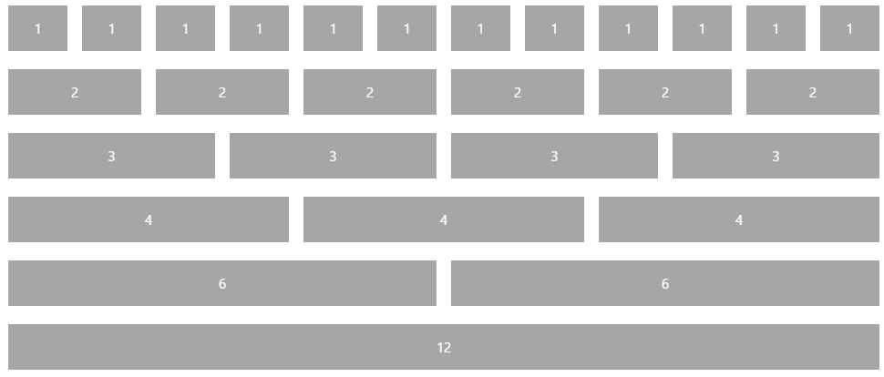
Responsive Grid
Fabric comes with a mobile-first, 12-column, responsive grid that you can use to create flexible layouts for a variety of screen sizes and device types

Slide 19
Localization
Right-to-left support
Fabric comes with an alternate CSS file for pages written in right-to-left (RTL) languages, such as Arabic and Hebrew
This reverses the order of columns in the responsive grid, making it easy to create an RTL layout without writing additional templates
Future versions of Fabric will also reverse some icons and provide additional helper utilities

Slide 20
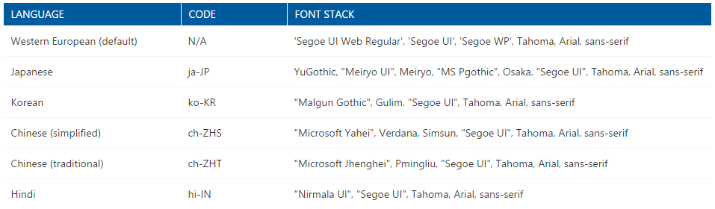
Localization
Language-optimized fonts
By default, Fabric presents all text using the Western European character set of Segoe UI
For languages with other characters, Fabric will either serve a version of Segoe UI with a different character set or use a system font
Fabric supports many language codes, which utilize different font stacks

Slide 21
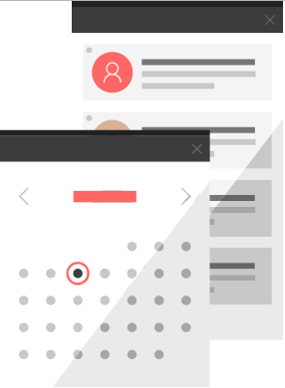
Fabric React: Office UI Fabric Components
Fabric's components make up the building blocks of your UI and are meant to be consumed as CSS applied to your markup
All JavaScript is presentational to explain behavior
Download the components from the GitHub repository
https://github.com/OfficeDev/Office-UI-Fabric

Slide 22
The Code
Office UI Fabric
https://developer.microsoft.com/fabric
Get Started
https://developer.microsoft.com/fabric#/get-started
OpenSource GitHub Repository
https://github.com/OfficeDev/office-ui-fabric-react

Slide 23
Adding Fabric React to SPFx Projects
SharePoint Framework projects include a special NPM package of Office UI Fabric Core for SharePoint
Fabric React already includes the Office UI Fabric CSS so… remove the duplicate
npm uninstall @microsoft/sp-office-ui-fabric-core --save
Update included web part’s reference to Office UI Fabric CSS
Remove old reference to the Office UI Fabric Core CSS
Change the first line in the web part’s SCSS from:
@import '~@microsoft/sp-office-ui-fabric-core/dist/sass/SPFabricCore.scss’;
…and replace it with the following:
@import '~office-ui-fabric-react/dist/sass/_References.scss';

Slide 24
Using Fabric React Controls
Don’t import the entire Fabric React library; only import the control:
import { List } from 'office-ui-fabric-react/lib/List’;
Leverage the control within your React control:
public render(): React.ReactElement<IColorListProps> {
return (
<div>
<List items={ this.props.colors }
onRenderCell={ this._onRenderListCell } />
</div>
);
}

Slide 25
Demo Leveraging Fabric React in SPFx Projects

Slide 26

Summary
Office UI Fabric
Fabric React
Adding Fabric React to SPFx Projects

Slide 27
Reading further
SharePoint Framework
https://docs.microsoft.com/en-us/sharepoint/dev/spfx/sharepoint-framework-overview
Office UI Fabric
https://developer.microsoft.com/fabric

Slide 28
Thank you.

