Slide 1
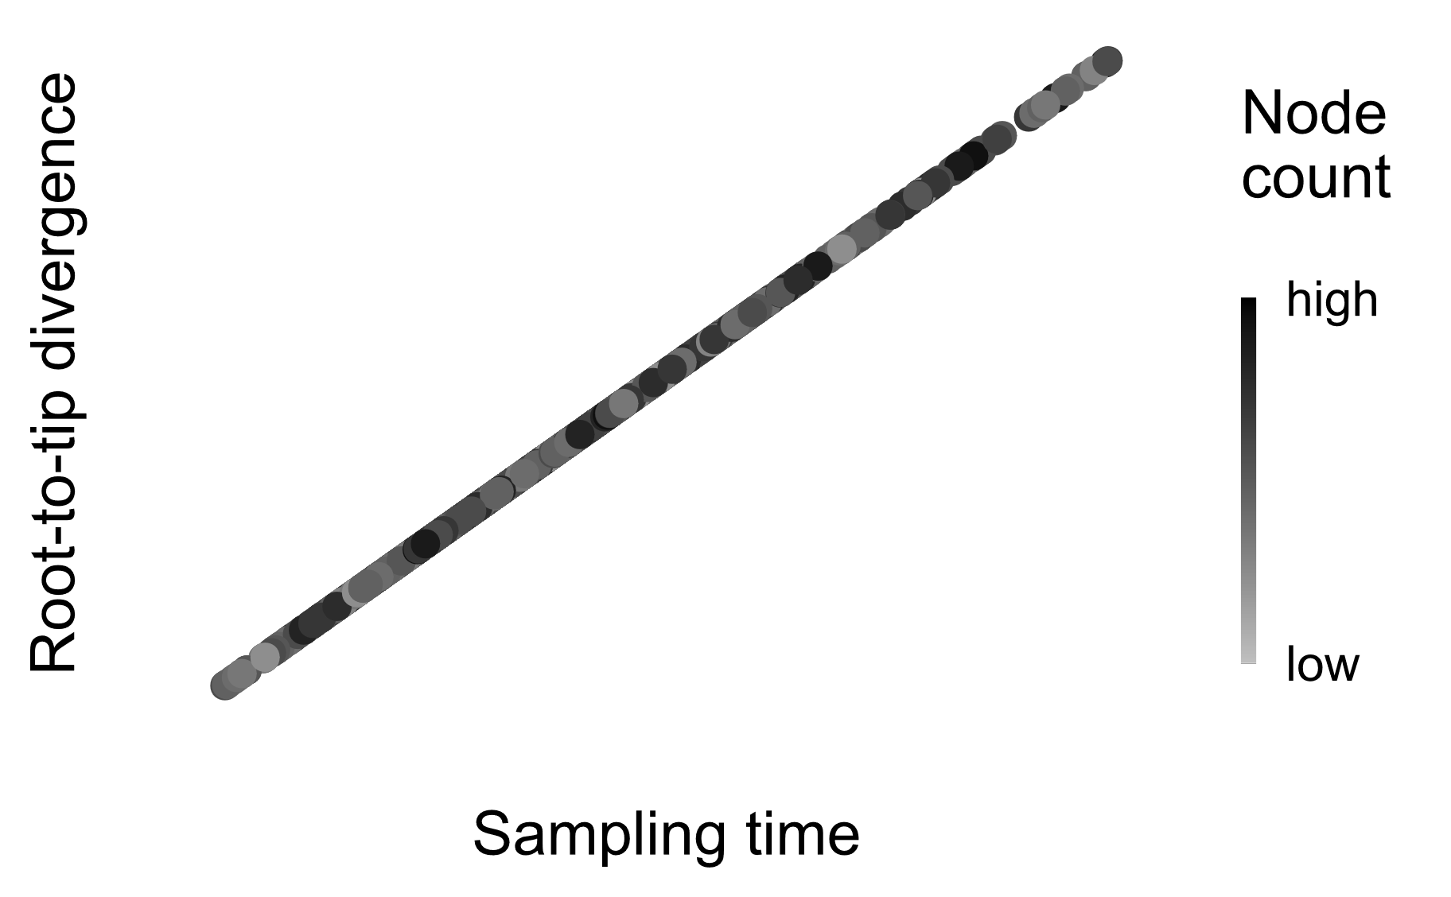
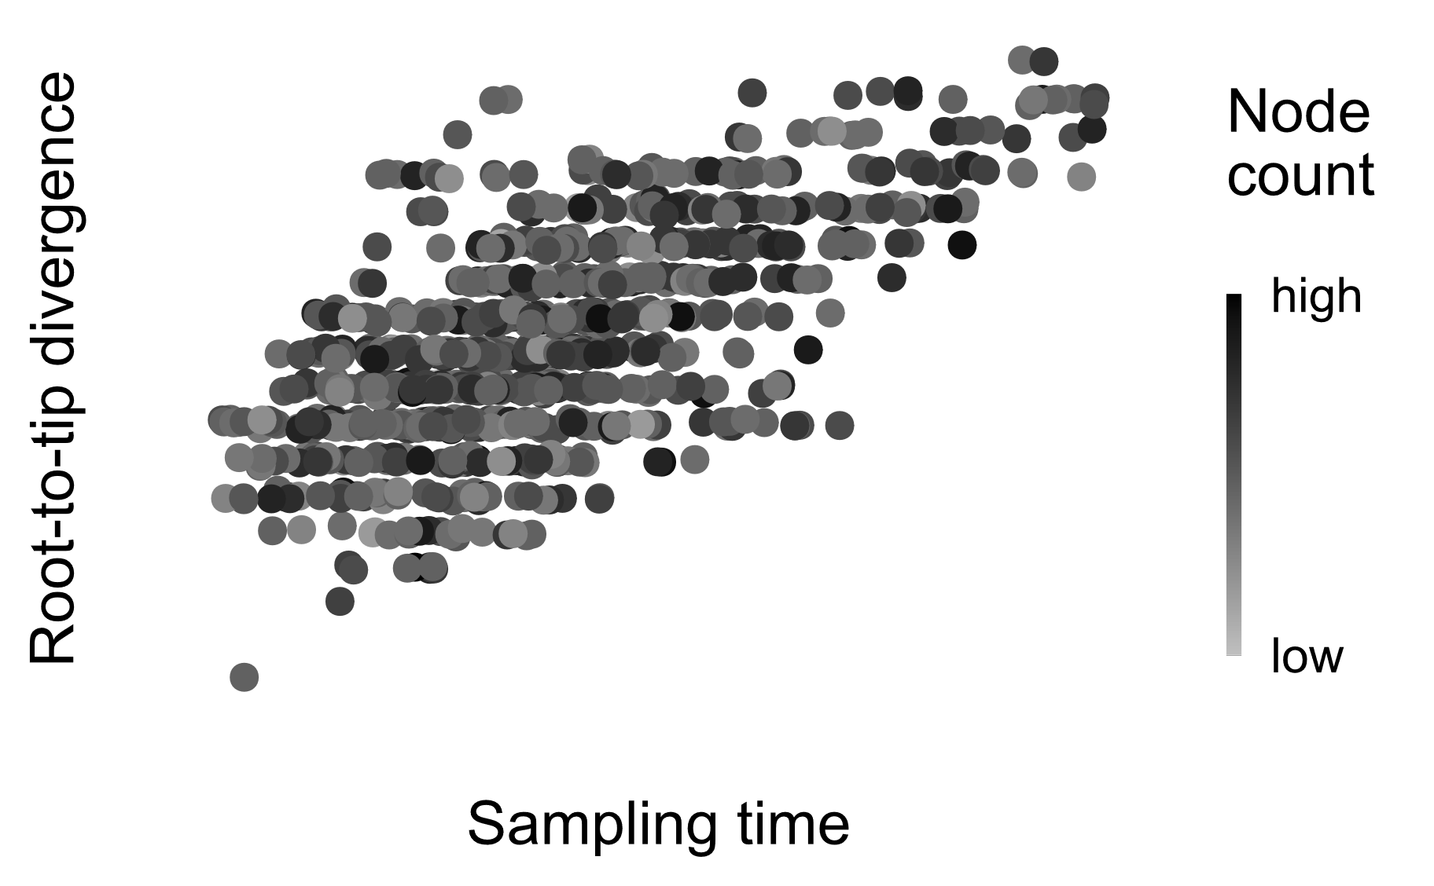
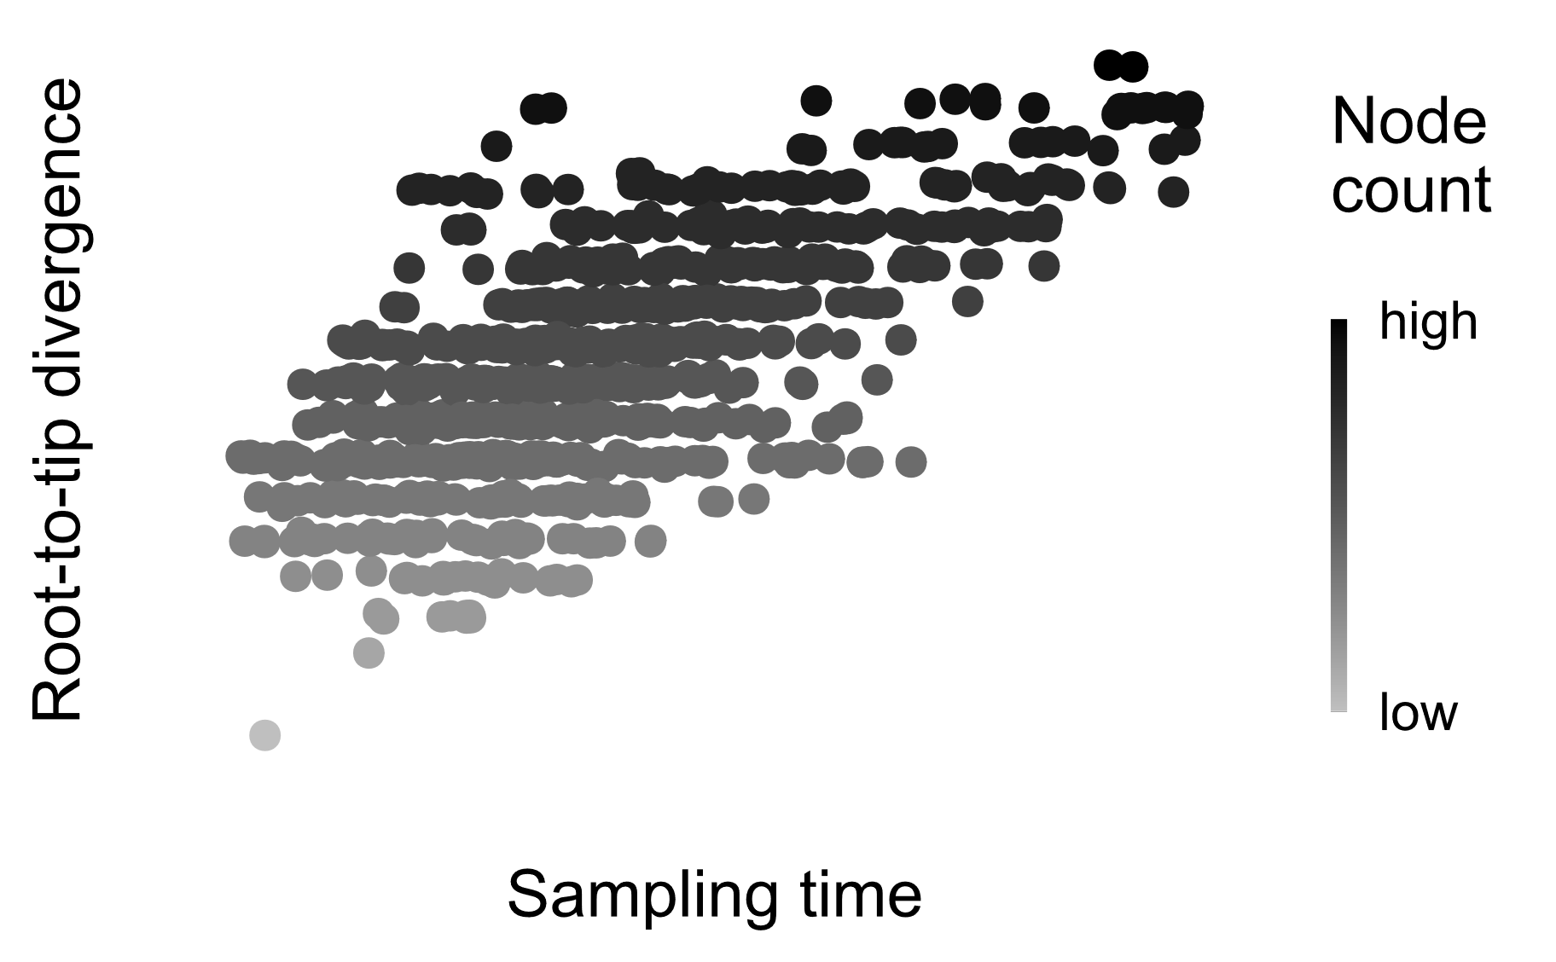
Gradual evolution (strict clock)
Mutation
Time
Gradual evolution (relaxed clock)
Mutation
Time
Punctuated evolution
Mutation
Time

