Slide 1
CA$ha
Birkenstocks and Socks
Peggy Anderson
Jonathan Baxter
Chris Penner

Slide 2
What is ca$ha
A fast and easy budgeting application for desktops and mobile devices

Slide 3
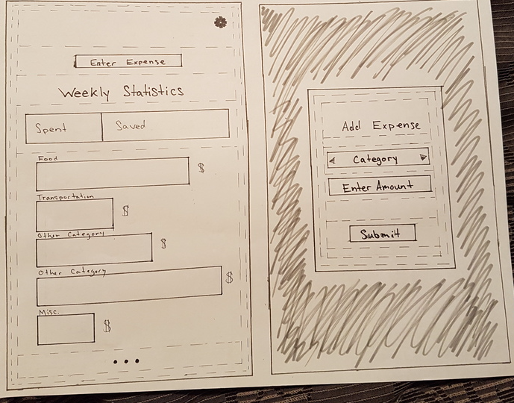
Low-fidelity Prototype
Paper Prototype
Results
Positioning of buttons
More labels
Missed some Functionality
Notes:
Each did 10 by 10
Different low-fidelity prototypes for mobile and desktop
Cognitive walkthrough to evaluate
Results: inputs looked like buttons, flow wasn’t as easy as thought, no cancel button

Slide 4
Objective of Medium-Fidelity Prototype
Implemented using HTML, CSS and JavaScript
Allowed us to automate the “Wizard of Oz approach”

Slide 5
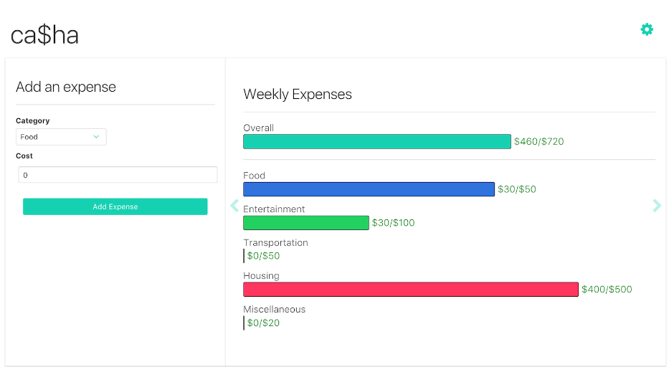
Medium-Fidelity Prototype

Slide 6
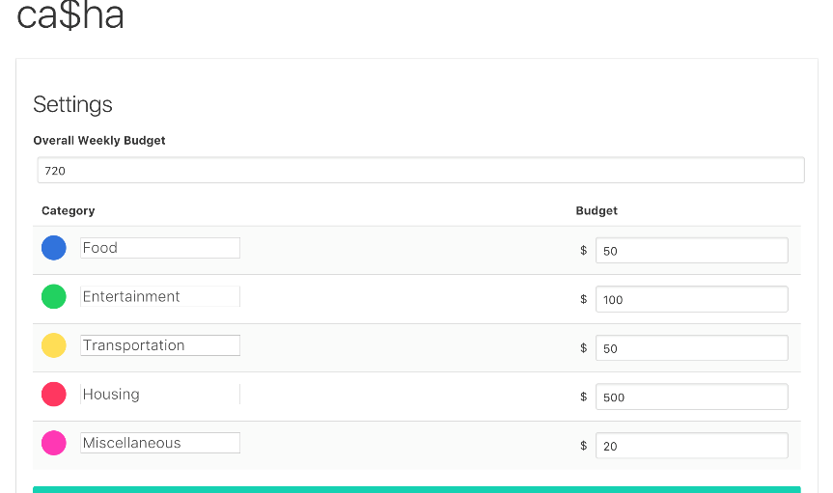
Medium-Fidelity Prototype

Slide 7
Evaluation
Used interviews to conduct our evaluation
Interviews were semi-structured
Mix of closed and open-ended questions
Notes:
To test out the app we wanted:
-people who weren’t experienced with technology
-someone in computer science, preferably working for a while
-someone who studied budgeting
Wanted the interviews to feel like a conversation

Slide 8
Results of Evaluation
Easy to add expenses
Easy to view spending
More in depth data
More customization

Slide 9
Final recommendations
Valid approach with some minor tweaks

Slide 10
Questions?
Try it out! bit.do/cmpt481

